Slide 1
18-447
Computer Architecture
Lecture 7: Pipelining
Prof. Onur Mutlu
Carnegie Mellon University
Spring 2015, 1/30/2015

Slide 2
Agenda for Today & Next Few Lectures
Single-cycle Microarchitectures
Multi-cycle and Microprogrammed Microarchitectures
Pipelining
Issues in Pipelining: Control & Data Dependence Handling, State Maintenance and Recovery, …
Out-of-Order Execution
Issues in OoO Execution: Load-Store Handling, …

Slide 3
Recap of Last Lecture
Multi-cycle and Microprogrammed Microarchitectures
  Benefits vs. Design Principles
  When to Generate Control Signals
  Microprogrammed Control: uInstruction, uSequencer, Control Store
  LC-3b State Machine, Datapath, Control Structure
  An Exercise in Microprogramming
  Variable Latency Memory, Alignment, Memory Mapped I/O, …
Microprogramming
  Power of abstraction (for the HW designer)
  Advantages of uProgrammed Control
  Update of Machine Behavior

Slide 4
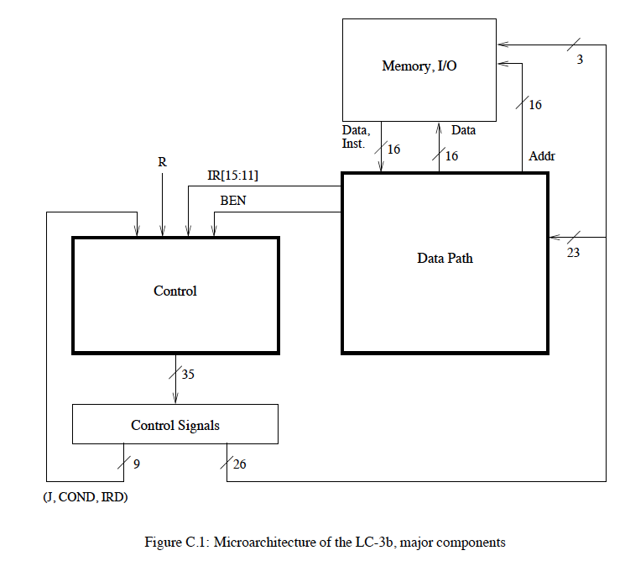
Review: A Simple LC-3b Control and Datapath

Slide 5
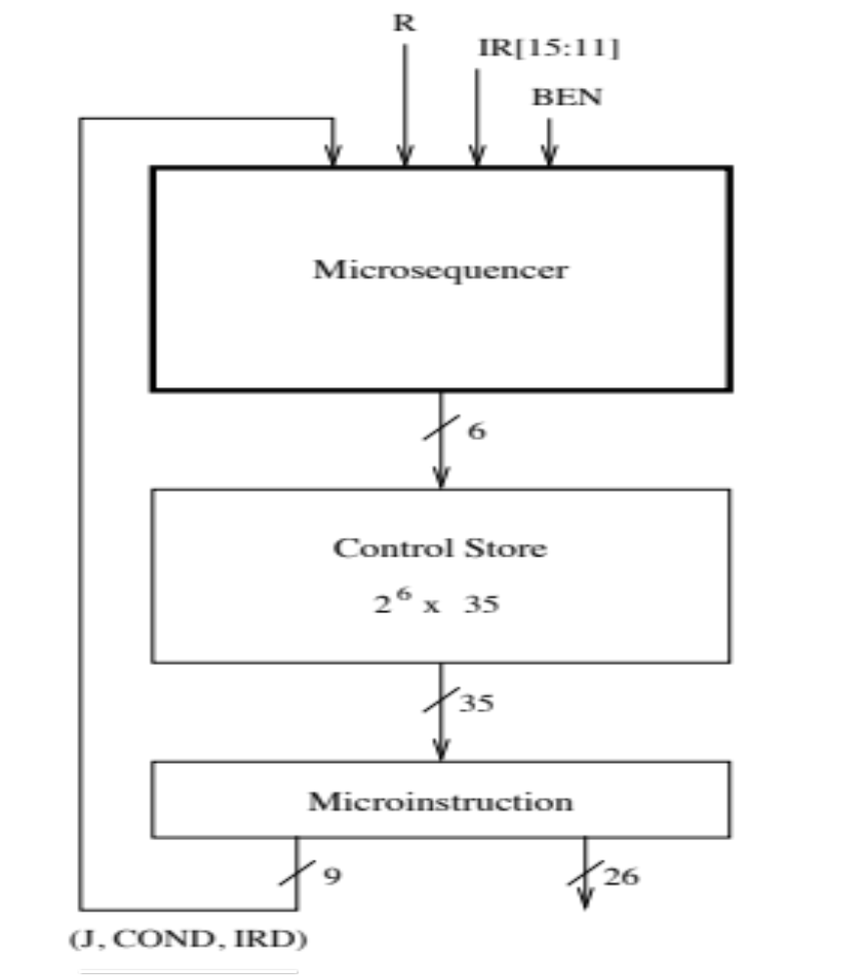
Simple Design
of the Control Structure

Slide 6
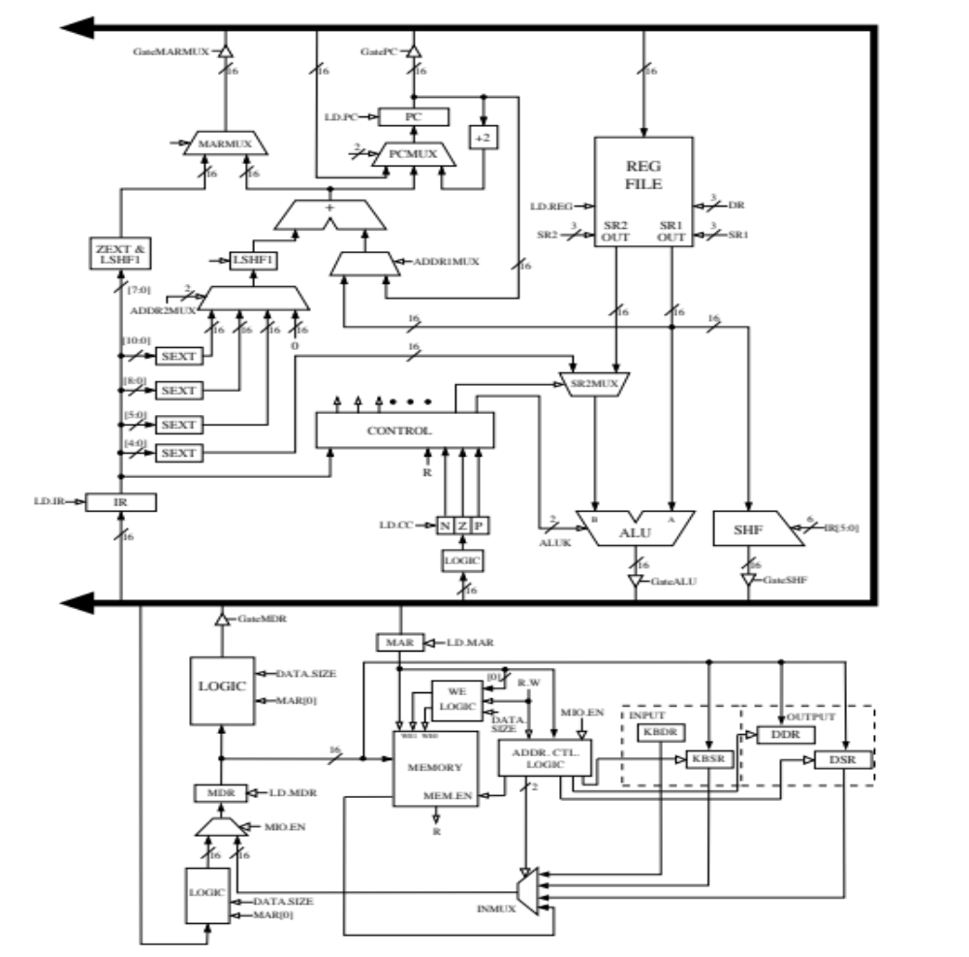
A Simple Datapath
Can Become
Very Powerful

Slide 7
Review: The Power of Abstraction
The concept of a control store of microinstructions enables the hardware designer with a new abstraction: microprogramming
The designer can translate any desired operation to a sequence of microinstructions
All the designer needs to provide is
  The sequence of microinstructions needed to implement the desired operation
  The ability for the control logic to correctly sequence through the microinstructions
  Any additional datapath elements and control signals needed (no need if the operation can be “translated” into existing control signals)

Slide 8
Review: Advantages of Microprogrammed Control
Allows a very simple design to do powerful computation by controlling the datapath (using a sequencer)
  High-level ISA translated into microcode (sequence of u-instructions)
  Microcode (u-code) enables a minimal datapath to emulate an ISA
  Microinstructions can be thought of as a user-invisible ISA (u-ISA)
Enables easy extensibility of the ISA
  Can support a new instruction by changing the microcode
  Can support complex instructions as a sequence of simple microinstructions
Enables update of machine behavior
  A buggy implementation of an instruction can be fixed by changing the microcode in the field

Slide 9
Wrap Up Microprogrammed Control
Horizontal vs. Vertical Microcode
Nanocode vs. Microcode vs. Millicode
Microprogrammed MIPS: An Example

Slide 10
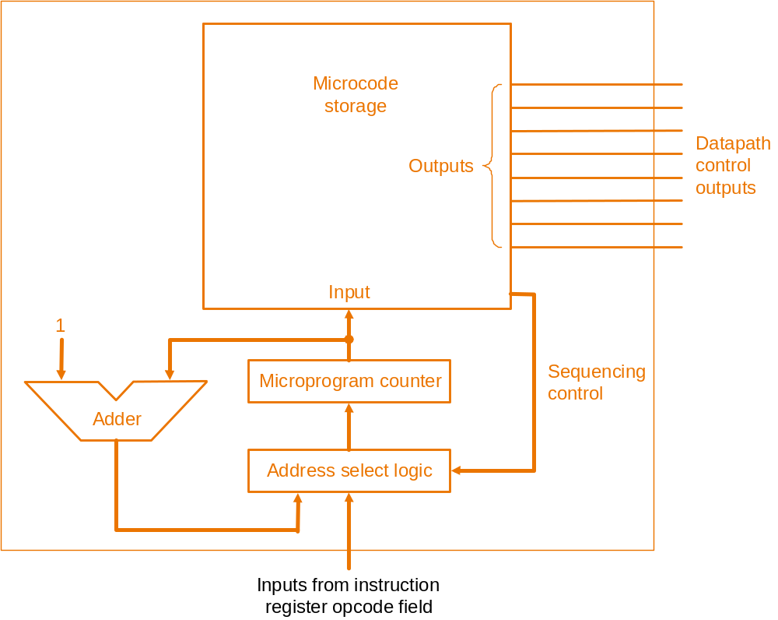
Horizontal Microcode
A single control store provides the control signals
ALUSrcA
IorD
IRWrite
PCWrite
PCWriteCond
….
k-bit control signal output
MIPS design
From
P&H, Appendix D
n-bit μPC input
[Based on original figure from P&H CO&D, COPYRIGHT 2004 Elsevier. ALL RIGHTS RESERVED.]
Control Store: 2^{n}× k bit (not including sequencing)

Slide 11
Vertical Microcode
Two-level control store: the first specifies abstract operations
1-bit signal means do this RT
(or combination of RTs)
“PC ⇐ PC+4”
“PC ⇐ ALUOut”
“PC ⇐ PC[ 31:28 ],IR[ 25:0 ],2’b00”
“IR ⇐ MEM[ PC ]”
“A ← RF[ IR[ 25:21 ] ]”
“B ← RF[ IR[ 20:16 ] ]”
………….
n-bit μPC input
…….
m-bit input
ROM
k-bit control signal output
[Based on original figure from P&H CO&D, COPYRIGHT 2004 Elsevier. ALL RIGHTS RESERVED.]
ALUSrcA
IorD
IRWrite
PCWrite
PCWriteCond
….
If done right (i.e., m<<n, and m<<k), two ROMs together
(2^{n}×m+2^{m}×k bit) should be smaller than horizontal microcode ROM (2^{n}×k bit)

Slide 12
Nanocode and Millicode
Nanocode: a level below traditional microcode
  microprogrammed control for sub-systems (e.g., a complicated floating-point module) that acts as a slave in a microcontrolled datapath
Millicode: a level above traditional microcode
  ISA-level subroutines that can be called by the microcontroller to handle complicated operations and system functions
  E.g., Heller and Farrell, “Millicode in an IBM zSeries processor,” IBM JR&D, May/Jul 2004.
In both cases, we avoid complicating the main u-controller
You can think of these as “microcode” at different levels of abstraction

Slide 13

Nanocode Concept Illustrated
a “μcoded” processor implementation
ROM
processor
datapath
μPC
We refer to this
as “nanocode”
when a μcoded
subsystem is embedded
in a μcoded system
a “μcoded” FPU implementation
ROM
arithmetic
datapath
μPC

Slide 14
Microcoded Multi-Cycle MIPS Design
Any ISA can be implemented with a microprogrammed microarchitecture
P&H, Appendix D: Microprogrammed MIPS design
We will not cover this in class
However, you can do an extra credit assignment for Lab 2

Slide 15
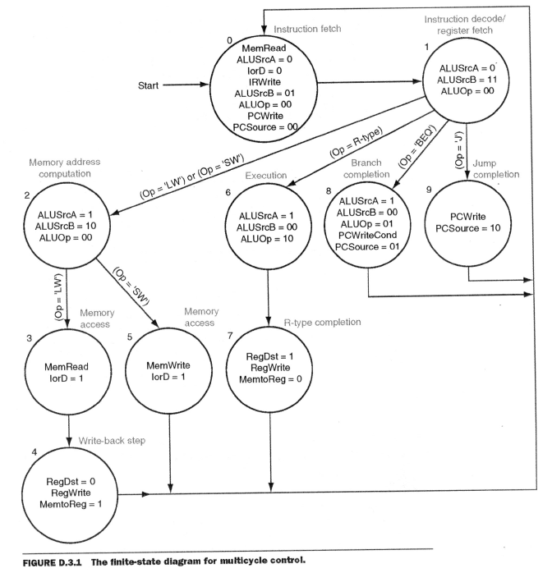
Microcoded Multi-Cycle MIPS Design
[Based on original figure from P&H CO&D, COPYRIGHT 2004 Elsevier. ALL RIGHTS RESERVED.]

Slide 16
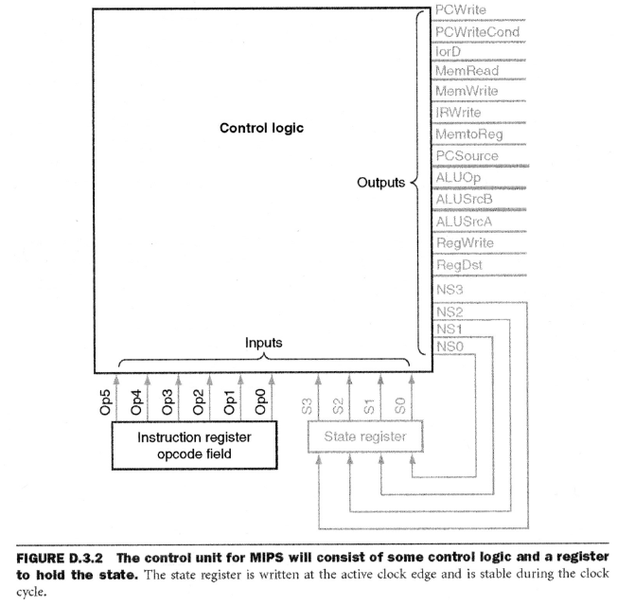
Control Logic for MIPS FSM
[Based on original figure from P&H CO&D, COPYRIGHT 2004 Elsevier. ALL RIGHTS RESERVED.]

Slide 17
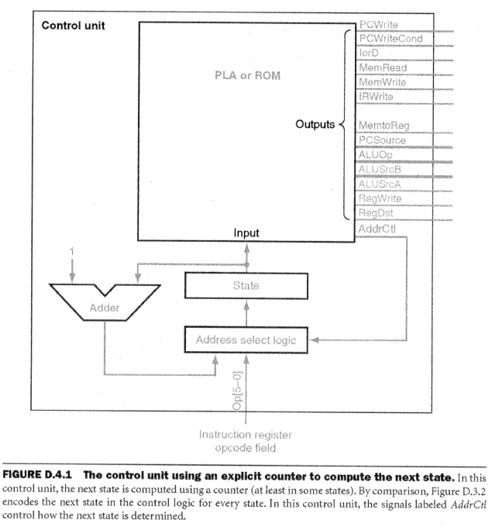
Microprogrammed Control for MIPS FSM
[Based on original figure from P&H CO&D, COPYRIGHT 2004 Elsevier. ALL RIGHTS RESERVED.]

Slide 18
Multi-Cycle vs. Single-Cycle uArch
Advantages
Disadvantages
You should be very familiar with this right now

Slide 19
Microprogrammed vs. Hardwired Control
Advantages
Disadvantages
You should be very familiar with this right now

Slide 20
Can We Do Better?
What limitations do you see with the multi-cycle design?
Limited concurrency
  Some hardware resources are idle during different phases of instruction processing cycle
  “Fetch” logic is idle when an instruction is being “decoded” or “executed”
  Most of the datapath is idle when a memory access is happening

Slide 21
Can We Use the Idle Hardware to Improve Concurrency?
Goal: More concurrency → Higher instruction throughput (i.e., more “work” completed in one cycle)
Idea: When an instruction is using some resources in its processing phase, process other instructions on idle resources not needed by that instruction
  E.g., when an instruction is being decoded, fetch the next instruction
  E.g., when an instruction is being executed, decode another instruction
  E.g., when an instruction is accessing data memory (ld/st), execute the next instruction
  E.g., when an instruction is writing its result into the register file, access data memory for the next instruction

Slide 22
Pipelining

Slide 23
Pipelining: Basic Idea
More systematically:
  Pipeline the execution of multiple instructions
  Analogy: “Assembly line processing” of instructions
Idea:
  Divide the instruction processing cycle into distinct “stages” of processing
  Ensure there are enough hardware resources to process one instruction in each stage
  Process a different instruction in each stage
    Instructions consecutive in program order are processed in consecutive stages
Benefit: Increases instruction processing throughput (1/CPI)
Downside: Start thinking about this…

Slide 24
Example: Execution of Four Independent ADDs
Multi-cycle: 4 cycles per instruction
Pipelined: 4 cycles per 4 instructions (steady state)
F
D
E
W
F
D
E
W
F
D
E
W
F
D
E
W
Time
F
D
E
W
F
D
E
W
Is life always this beautiful?
F
D
E
W
F
D
E
W
Time

Slide 25
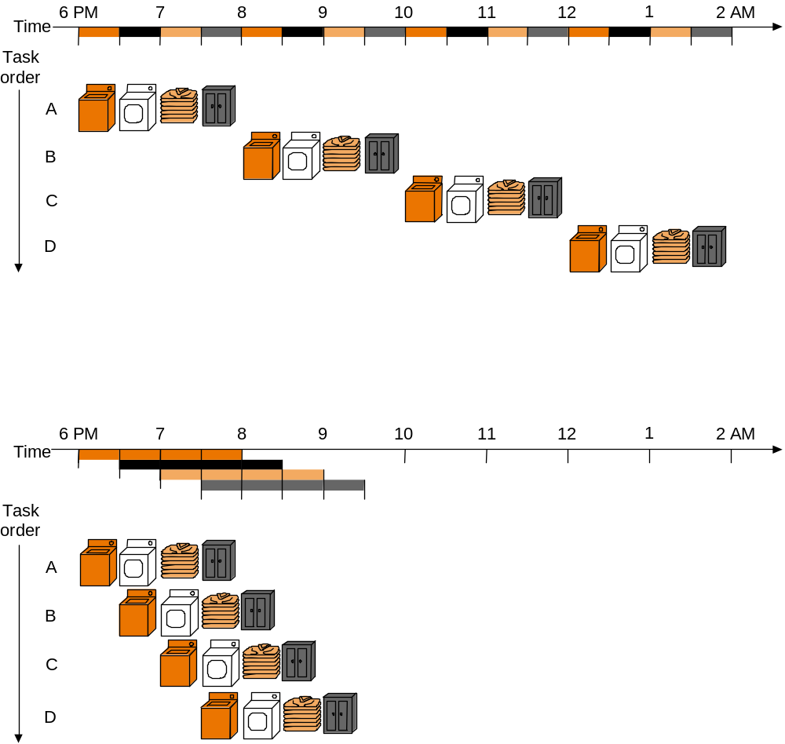
The Laundry Analogy
“place one dirty load of clothes in the washer”
“when the washer is finished, place the wet load in the dryer”
“when the dryer is finished, take out the dry load and fold”
“when folding is finished, ask your roommate (??) to put the clothes away”
- steps to do a load are sequentially dependent
- no dependence between different loads
- different steps do not share resources
Based on original figure from [P&H CO&D, COPYRIGHT 2004 Elsevier. ALL RIGHTS RESERVED.]

Slide 26
Pipelining Multiple Loads of Laundry
- 4 loads of laundry in parallel
- no additional resources
- throughput increased by 4
- latency per load is the same
Based on original figure from [P&H CO&D, COPYRIGHT 2004 Elsevier. ALL RIGHTS RESERVED.]

Slide 27




Pipelining Multiple Loads of Laundry: In Practice
the slowest step decides throughput
Based on original figure from [P&H CO&D, COPYRIGHT 2004 Elsevier. ALL RIGHTS RESERVED.]

Slide 28
Pipelining Multiple Loads of Laundry: In Practice
A
B
A
B
throughput restored (2 loads per hour) using 2 dryers
Based on original figure from [P&H CO&D, COPYRIGHT 2004 Elsevier. ALL RIGHTS RESERVED.]

Slide 29
An Ideal Pipeline
Goal: Increase throughput with little increase in cost (hardware cost, in case of instruction processing)
Repetition of identical operations
  The same operation is repeated on a large number of different inputs (e.g., all laundry loads go through the same steps)
Repetition of independent operations
  No dependencies between repeated operations
Uniformly partitionable suboperations
  Processing can be evenly divided into uniform-latency suboperations (that do not share resources)
Fitting examples: automobile assembly line, doing laundry
  What about the instruction processing “cycle”?

Slide 30
Ideal Pipelining
combinational logic (F,D,E,M,W)
T psec
BW=~(1/T)
T/2 ps (F,D,E)
T/2 ps (M,W)
BW=~(2/T)
T/3
ps (F,D)
T/3
ps (E,M)
T/3
ps (M,W)
BW=~(3/T)

Slide 31
More Realistic Pipeline: Throughput
Nonpipelined version with delay T
BW = 1/(T+S) where S = latch delay
k-stage pipelined version
BW_{k-stage} = 1 / (T/k +S )
BW_{max} = 1 / (1 gate delay + S )
T ps
Latch delay reduces throughput
(switching overhead b/w stages)
T/k
ps
T/k
ps

Slide 32
More Realistic Pipeline: Cost
Nonpipelined version with combinational cost G
Cost = G+L where L = latch cost
k-stage pipelined version
Cost_{k-stage} = G + Lk
G gates
Latches increase hardware cost
G/k
G/k

Slide 33
Pipelining Instruction Processing

Slide 34
Remember: The Instruction Processing Cycle
  Fetch
  Decode
  Evaluate Address
  Fetch Operands
  Execute
  Store Result
  1. Instruction fetch (IF)
  2. Instruction decode and
  register operand fetch (ID/RF)
  3. Execute/Evaluate memory address (EX/AG)
  4. Memory operand fetch (MEM)
  5. Store/writeback result (WB)

Slide 35
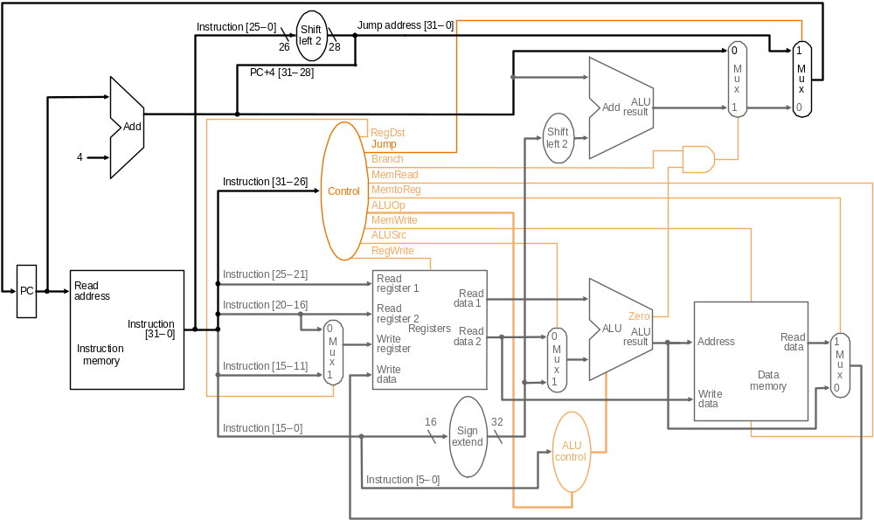
Remember the Single-Cycle Uarch
PCSrc₁=Jump
PCSrc₂=Br Taken
bcond
ALU operation
T
BW=~(1/T)
Based on original figure from [P&H CO&D, COPYRIGHT 2004 Elsevier. ALL RIGHTS RESERVED.]

Slide 36
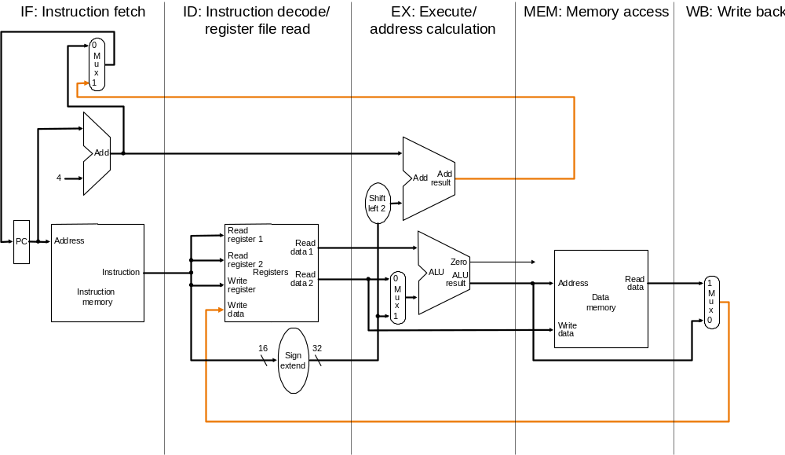
Dividing Into Stages
200ps
100ps
200ps
200ps
100ps
ignore
for now
RF
write
Is this the correct partitioning?
Why not 4 or 6 stages? Why not different boundaries?
Based on original figure from [P&H CO&D, COPYRIGHT 2004 Elsevier. ALL RIGHTS RESERVED.]

Slide 37
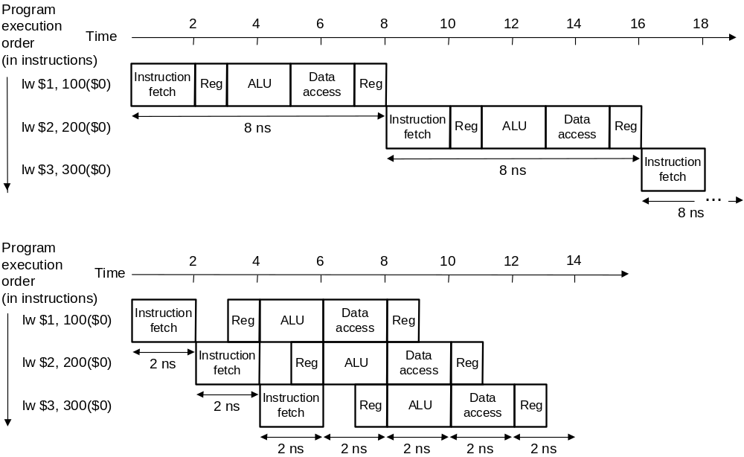
Instruction Pipeline Throughput
200 400 600 800 1000 1200 1400 1600 1800
800ps
800ps
800ps
200 400 600 800 1000 1200 1400
200ps
200ps
200ps
200ps
200ps
200ps
200ps
5-stage speedup is 4, not 5 as predicted by the ideal model. Why?

Slide 38
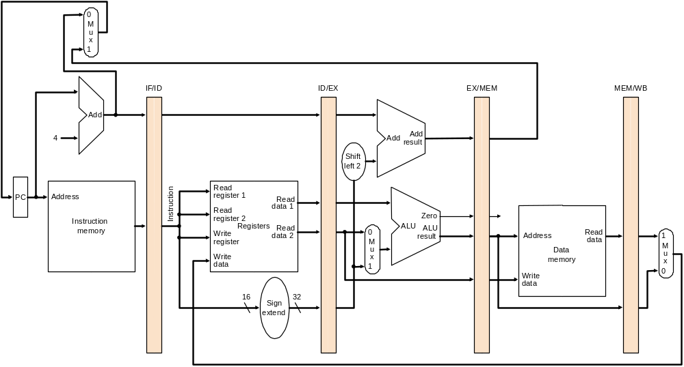
Enabling Pipelined Processing: Pipeline Registers
No resource is used by more than 1 stage!
PC_{D}+4
PC_{E}+4
nPC_{M}
PC_{F}
A_{E}
IR_{D}
Aout_{M}
B_{E}
MDR_{W}
B_{M}
Imm_{E}
Aout_{W}
T/k
ps
T
T/k
ps
Based on original figure from [P&H CO&D, COPYRIGHT 2004 Elsevier. ALL RIGHTS RESERVED.]

Slide 39
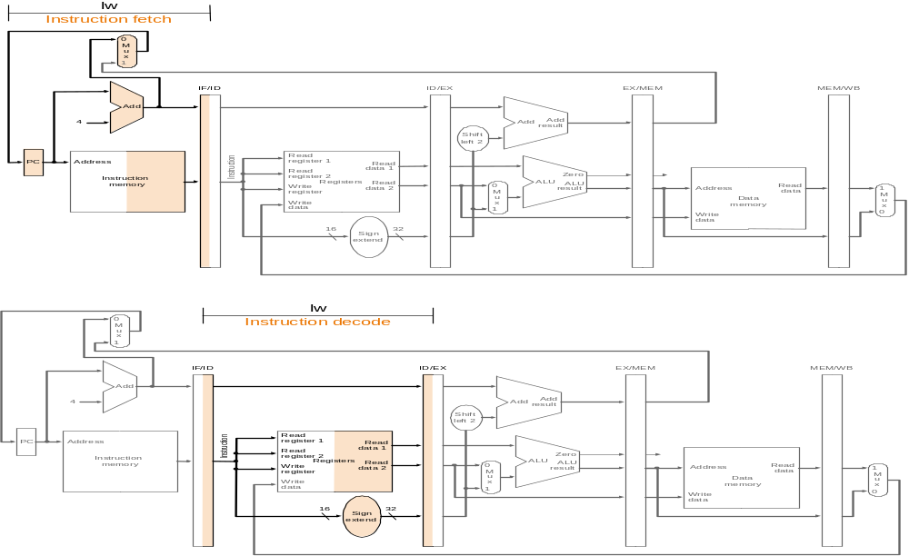
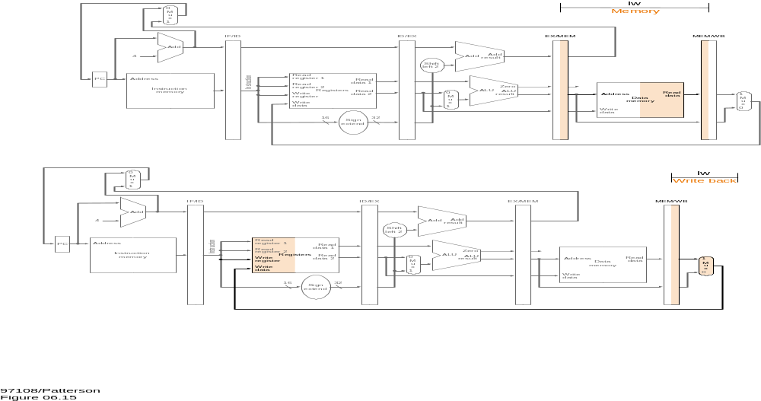
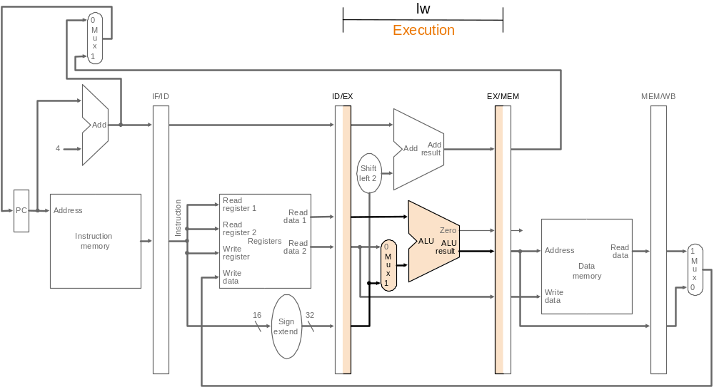
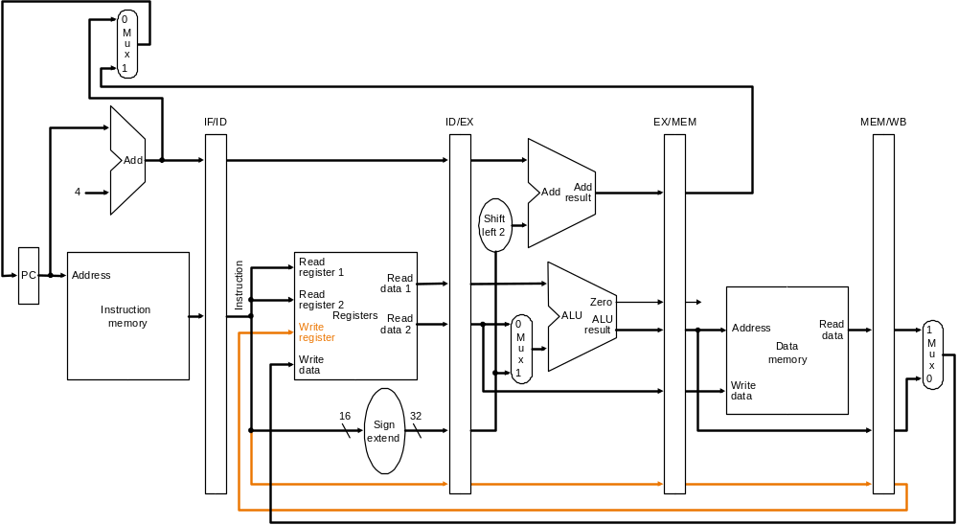
Pipelined Operation Example
All instruction classes must follow the same path
and timing through the pipeline stages.
Any performance impact?
Based on original figure from [P&H CO&D, COPYRIGHT 2004 Elsevier. ALL RIGHTS RESERVED.]

Slide 40
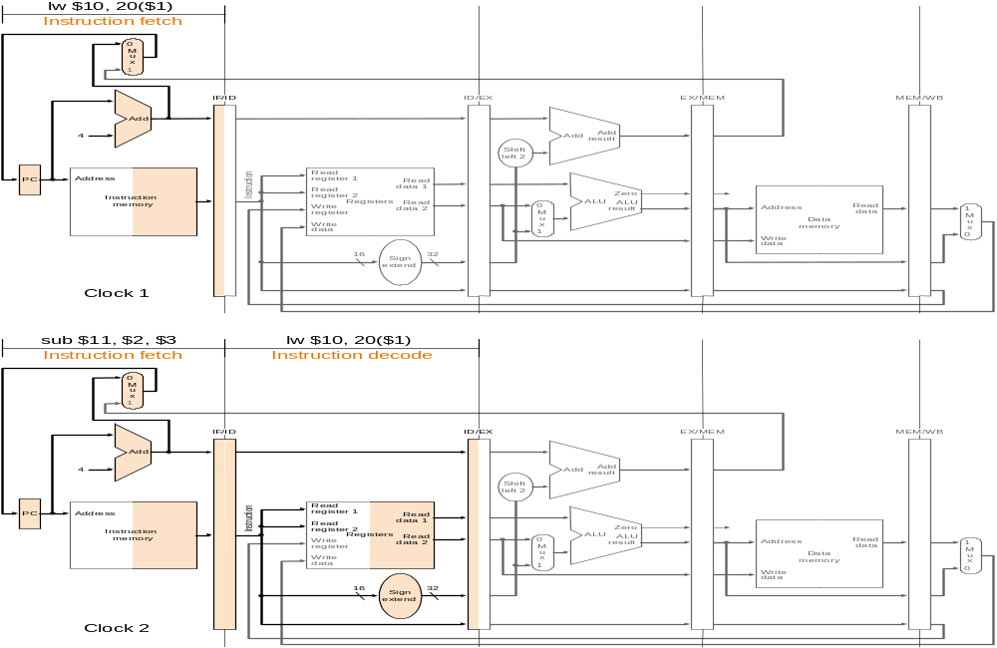
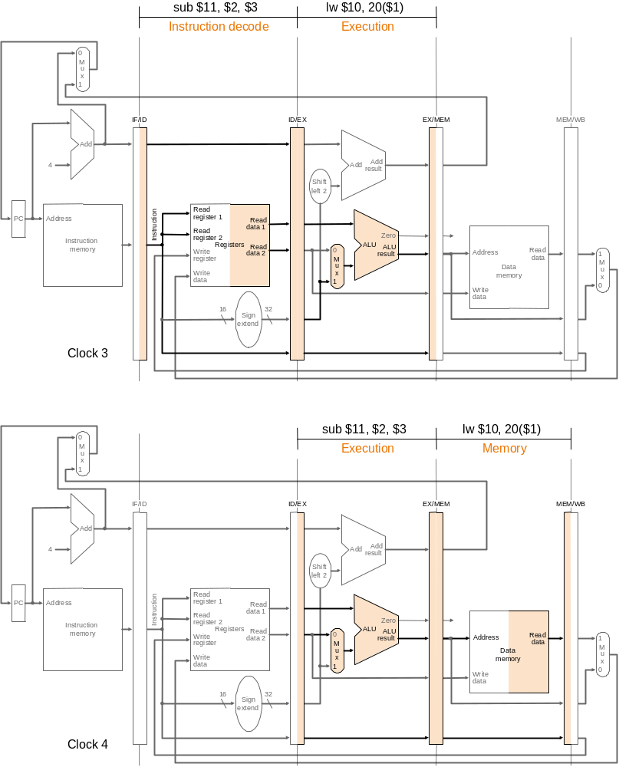
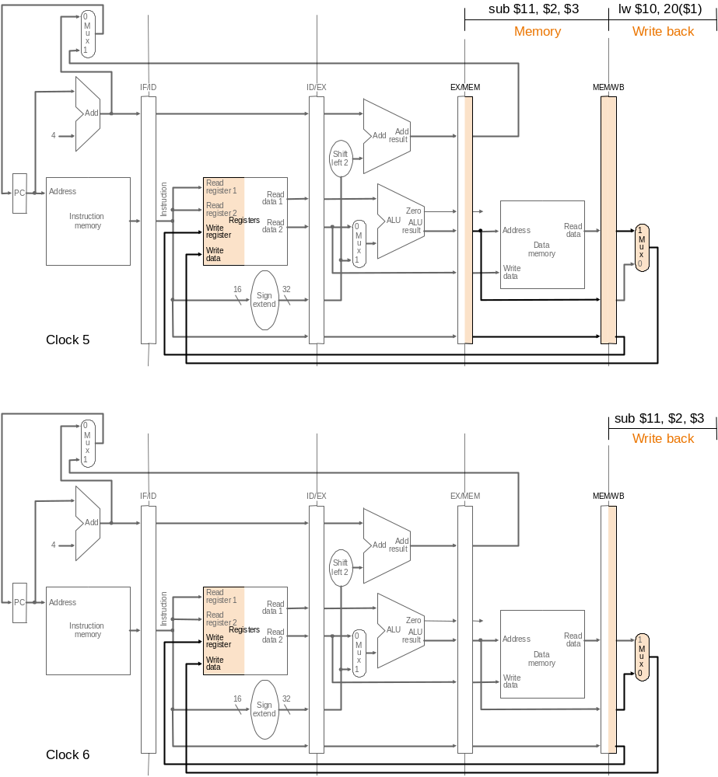
Pipelined Operation Example
Is life always this beautiful?
Based on original figure from [P&H CO&D, COPYRIGHT 2004 Elsevier. ALL RIGHTS RESERVED.]

Slide 41
Illustrating Pipeline Operation: Operation View
t₀
t₁
t₂
t₃
t₄
t₅
Inst₀
IF
ID
EX
MEM
WB
Inst₁
IF
ID
EX
MEM
WB
Inst₂
IF
ID
EX
MEM
WB
Inst₃
IF
ID
EX
MEM
WB
Inst₄
IF
ID
EX
MEM
IF
ID
EX
IF
ID
steady state
(full pipeline)
IF

Slide 42
Illustrating Pipeline Operation: Resource View
 | t₀ | t₁ | t₂ | t₃ | t₄ | t₅ | t₆ | t₇ | t₈ | t₉ | t₁₀
IF
ID
EX
MEM
WB
I₀
I₁
I₂
I₃
I₄
I₅
I₆
I₇
I₈
I₉
I₁₀
I₀
I₁
I₂
I₃
I₄
I₅
I₆
I₇
I₈
I₉
I₀
I₁
I₂
I₃
I₄
I₅
I₆
I₇
I₈
I₀
I₁
I₂
I₃
I₄
I₅
I₆
I₇
I₀
I₁
I₂
I₃
I₄
I₅
I₆

Slide 43
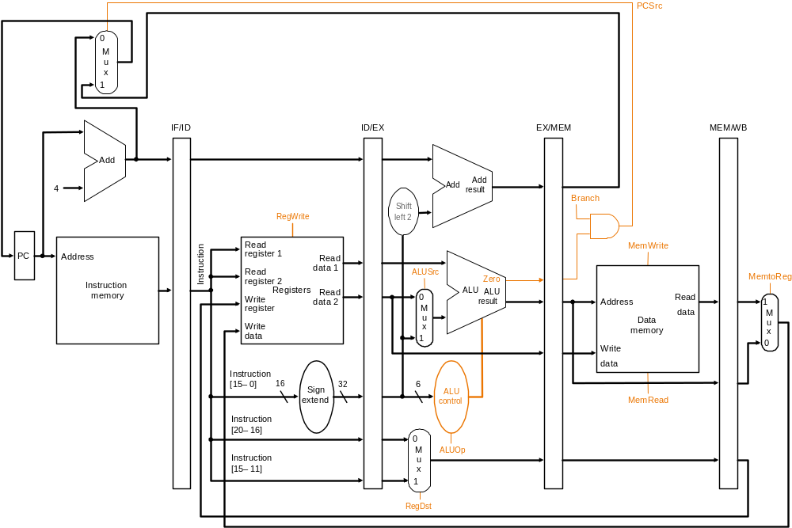
Control Points in a Pipeline
Based on original figure from [P&H CO&D, COPYRIGHT 2004 Elsevier. ALL RIGHTS RESERVED.]
Identical set of control points as the single-cycle datapath!!

Slide 44
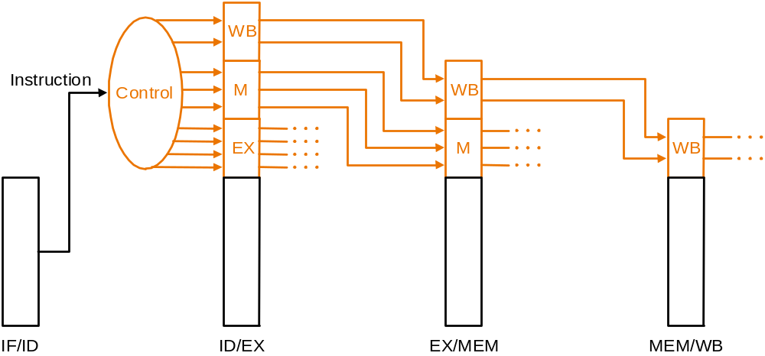
Control Signals in a Pipeline
For a given instruction
  same control signals as single-cycle, but
  control signals required at different cycles, depending on stage
  Option 1: decode once using the same logic as single-cycle and buffer signals until consumed
  Option 2: carry relevant “instruction word/field” down the pipeline and decode locally within each or in a previous stage
  Which one is better?

Slide 45
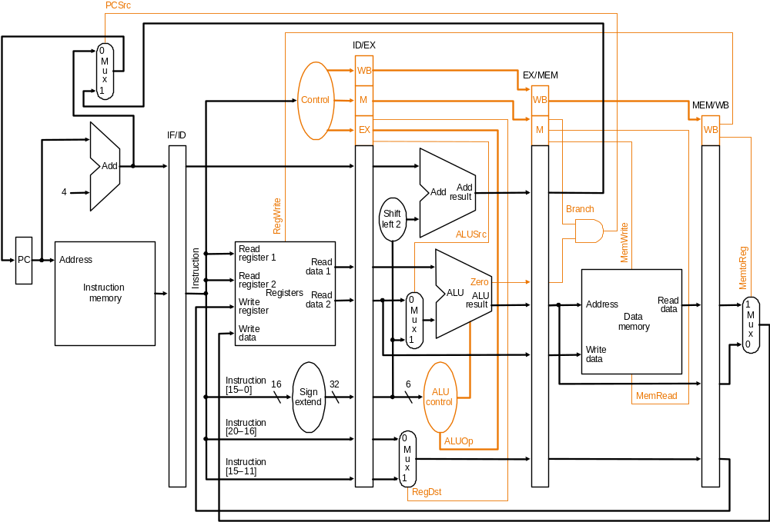
Pipelined Control Signals
Based on original figure from [P&H CO&D, COPYRIGHT 2004 Elsevier. ALL RIGHTS RESERVED.]

Slide 46
Remember: An Ideal Pipeline
Goal: Increase throughput with little increase in cost (hardware cost, in case of instruction processing)
Repetition of identical operations
  The same operation is repeated on a large number of different inputs (e.g., all laundry loads go through the same steps)
Repetition of independent operations
  No dependencies between repeated operations
Uniformly partitionable suboperations
  Processing an be evenly divided into uniform-latency suboperations (that do not share resources)
Fitting examples: automobile assembly line, doing laundry
  What about the instruction processing “cycle”?

Slide 47
Instruction Pipeline: Not An Ideal Pipeline
Identical operations ... NOT!
⇒ different instructions → not all need the same stages
    Forcing different instructions to go through the same pipe stages
    → external fragmentation (some pipe stages idle for some instructions)
Uniform suboperations ... NOT!
⇒ different pipeline stages → not the same latency
Need to force each stage to be controlled by the same clock
    → internal fragmentation (some pipe stages are too fast but all take the same clock cycle time)
Independent operations ... NOT!
⇒ instructions are not independent of each other
    Need to detect and resolve inter-instruction dependencies to ensure the pipeline provides correct results
    → pipeline stalls (pipeline is not always moving)

Slide 48
Issues in Pipeline Design
Balancing work in pipeline stages
  How many stages and what is done in each stage
Keeping the pipeline correct, moving, and full in the presence of events that disrupt pipeline flow
  Handling dependences
    Data
    Control
  Handling resource contention
  Handling long-latency (multi-cycle) operations
Handling exceptions, interrupts
Advanced: Improving pipeline throughput
  Minimizing stalls

Slide 49
Causes of Pipeline Stalls
Stall: A condition when the pipeline stops moving
Resource contention
Dependences (between instructions)
  Data
  Control
Long-latency (multi-cycle) operations

Slide 50
Dependences and Their Types
Also called “dependency” or less desirably “hazard”
Dependences dictate ordering requirements between instructions
Two types
  Data dependence
  Control dependence
Resource contention is sometimes called resource dependence
  However, this is not fundamental to (dictated by) program semantics, so we will treat it separately

Slide 51
Handling Resource Contention
Happens when instructions in two pipeline stages need the same resource
Solution 1: Eliminate the cause of contention
  Duplicate the resource or increase its throughput
    E.g., use separate instruction and data memories (caches)
    E.g., use multiple ports for memory structures
Solution 2: Detect the resource contention and stall one of the contending stages
  Which stage do you stall?
  Example: What if you had a single read and write port for the register file?

Slide 52
Data Dependences
Types of data dependences
  Flow dependence (true data dependence – read after write)
  Output dependence (write after write)
  Anti dependence (write after read)
Which ones cause stalls in a pipelined machine?
  For all of them, we need to ensure semantics of the program is correct
  Flow dependences always need to be obeyed because they constitute true dependence on a value
  Anti and output dependences exist due to limited number of architectural registers
    They are dependence on a name, not a value
    We will later see what we can do about them

Slide 53
Data Dependence Types
Flow dependence
      r₃ ← r₁ op r₂ Read-after-Write
      r₅ ← r₃ op r₄ (RAW)
Anti dependence
      r₃ ← r₁ op r₂ Write-after-Read
      r₁ ← r₄ op r₅ (WAR)
Output-dependence
      r₃ ← r₁ op r₂ Write-after-Write
      r₅ ← r₃ op r₄ (WAW)
      r₃ ← r₆ op r₇

Slide 54
Pipelined Operation Example
What if the SUB were dependent on LW?
Based on original figure from [P&H CO&D, COPYRIGHT 2004 Elsevier. ALL RIGHTS RESERVED.]

Slide 55
Data Dependence Handling

Slide 56
Readings for Next Few Lectures
P&H Chapter 4.9-4.11
Smith and Sohi, “The Microarchitecture of Superscalar Processors,” Proceedings of the IEEE, 1995
  More advanced pipelining
  Interrupt and exception handling
  Out-of-order and superscalar execution concepts

Slide 57
How to Handle Data Dependences
Anti and output dependences are easier to handle
  write to the destination in one stage and in program order
Flow dependences are more interesting
Five fundamental ways of handling flow dependences
  Detect and wait until value is available in register file
  Detect and forward/bypass data to dependent instruction
  Detect and eliminate the dependence at the software level
    No need for the hardware to detect dependence
  Predict the needed value(s), execute “speculatively”, and verify
  Do something else (fine-grained multithreading)
    No need to detect

Slide 58
Interlocking
Detection of dependence between instructions in a pipelined processor to guarantee correct execution
Software based interlocking
vs.
Hardware based interlocking
MIPS acronym?

Slide 59
Approaches to Dependence Detection (I)
Scoreboarding
  Each register in register file has a Valid bit associated with it
  An instruction that is writing to the register resets the Valid bit
  An instruction in Decode stage checks if all its source and destination registers are Valid
    Yes: No need to stall… No dependence
    No: Stall the instruction
Advantage:
  Simple. 1 bit per register
Disadvantage:
  Need to stall for all types of dependences, not only flow dep.

Slide 60
Not Stalling on Anti and Output Dependences
What changes would you make to the scoreboard to enable this?

Slide 61
Approaches to Dependence Detection (II)
Combinational dependence check logic
  Special logic that checks if any instruction in later stages is supposed to write to any source register of the instruction that is being decoded
  Yes: stall the instruction/pipeline
  No: no need to stall… no flow dependence
Advantage:
  No need to stall on anti and output dependences
Disadvantage:
  Logic is more complex than a scoreboard
  Logic becomes more complex as we make the pipeline deeper and wider (flash-forward: think superscalar execution)

Slide 62
Once You Detect the Dependence in Hardware
What do you do afterwards?
Observation: Dependence between two instructions is detected before the communicated data value becomes available
Option 1: Stall the dependent instruction right away
Option 2: Stall the dependent instruction only when necessary → data forwarding/bypassing
Option 3: …

Slide 63
We did not cover the following slides in lecture. These are for your preparation for the next lecture.

Slide 64
Data Forwarding/Bypassing
Problem: A consumer (dependent) instruction has to wait in decode stage until the producer instruction writes its value in the register file
Goal: We do not want to stall the pipeline unnecessarily
Observation: The data value needed by the consumer instruction can be supplied directly from a later stage in the pipeline (instead of only from the register file)
Idea: Add additional dependence check logic and data forwarding paths (buses) to supply the producer’s value to the consumer right after the value is available
Benefit: Consumer can move in the pipeline until the point the value can be supplied → less stalling

Slide 65
A Special Case of Data Dependence
Control dependence
  Data dependence on the Instruction Pointer / Program Counter

Slide 66
Control Dependence
Question: What should the fetch PC be in the next cycle?
Answer: The address of the next instruction
  All instructions are control dependent on previous ones. Why?
If the fetched instruction is a non-control-flow instruction:
  Next Fetch PC is the address of the next-sequential instruction
  Easy to determine if we know the size of the fetched instruction
If the instruction that is fetched is a control-flow instruction:
  How do we determine the next Fetch PC?
In fact, how do we know whether or not the fetched instruction is a control-flow instruction?

