Slide 1
18-447
Computer Architecture
Lecture 8: Pipelining II:
Data and Control Dependence Handling
Prof. Onur Mutlu
Carnegie Mellon University
Spring 2015, 2/2/2015

Slide 2
Agenda for Today & Next Few Lectures
Single-cycle Microarchitectures
Multi-cycle and Microprogrammed Microarchitectures
Pipelining
Issues in Pipelining: Control & Data Dependence Handling, State Maintenance and Recovery, …
Out-of-Order Execution
Issues in OoO Execution: Load-Store Handling, …

Slide 3
Readings for Next Few Lectures (I)
P&H Chapter 4.9-4.11
Smith and Sohi, “The Microarchitecture of Superscalar Processors,” Proceedings of the IEEE, 1995
  More advanced pipelining
  Interrupt and exception handling
  Out-of-order and superscalar execution concepts
McFarling, “Combining Branch Predictors,” DEC WRL Technical Report, 1993.
Kessler, “The Alpha 21264 Microprocessor,” IEEE Micro 1999.

Slide 4
Readings for Next Few Lectures (II)
Smith and Plezskun, “Implementing Precise Interrupts in Pipelined Processors,” IEEE Trans on Computers 1988 (earlier version in ISCA 1985).

Slide 5
Recap of Last Lecture
Wrap Up Microprogramming
  Horizontal vs. Vertical Microcode
  Nanocode vs. Millicode
Pipelining
  Basic Idea and Characteristics of An Ideal Pipeline
  Pipelined Datapath and Control
  Issues in Pipeline Design
  Resource Contention
  Dependences and Their Types
    Control vs. data (flow, anti, output)
  Five Fundamental Ways of Handling Data Dependences
  Dependence Detection
    Interlocking
    Scoreboarding vs. Combinational

Slide 6
Review: Issues in Pipeline Design
Balancing work in pipeline stages
  How many stages and what is done in each stage
Keeping the pipeline correct, moving, and full in the presence of events that disrupt pipeline flow
  Handling dependences
    Data
    Control
  Handling resource contention
  Handling long-latency (multi-cycle) operations
Handling exceptions, interrupts
Advanced: Improving pipeline throughput
  Minimizing stalls

Slide 7
Review: Dependences and Their Types
Also called “dependency” or less desirably “hazard”
Dependences dictate ordering requirements between instructions
Two types
  Data dependence
  Control dependence
Resource contention is sometimes called resource dependence
  However, this is not fundamental to (dictated by) program semantics, so we will treat it separately

Slide 8
Review: Interlocking
Detection of dependence between instructions in a pipelined processor to guarantee correct execution
Software based interlocking
vs.
Hardware based interlocking
MIPS acronym?

Slide 9
Review: Once You Detect the Dependence in Hardware
What do you do afterwards?
Observation: Dependence between two instructions is detected before the communicated data value becomes available
Option 1: Stall the dependent instruction right away
Option 2: Stall the dependent instruction only when necessary → data forwarding/bypassing
Option 3: …

Slide 10
Data Forwarding/Bypassing
Problem: A consumer (dependent) instruction has to wait in decode stage until the producer instruction writes its value in the register file
Goal: We do not want to stall the pipeline unnecessarily
Observation: The data value needed by the consumer instruction can be supplied directly from a later stage in the pipeline (instead of only from the register file)
Idea: Add additional dependence check logic and data forwarding paths (buses) to supply the producer’s value to the consumer right after the value is available
Benefit: Consumer can move in the pipeline until the point the value can be supplied → less stalling

Slide 11
A Special Case of Data Dependence
Control dependence
  Data dependence on the Instruction Pointer / Program Counter

Slide 12
Control Dependence
Question: What should the fetch PC be in the next cycle?
Answer: The address of the next instruction
  All instructions are control dependent on previous ones. Why?
If the fetched instruction is a non-control-flow instruction:
  Next Fetch PC is the address of the next-sequential instruction
  Easy to determine if we know the size of the fetched instruction
If the instruction that is fetched is a control-flow instruction:
  How do we determine the next Fetch PC?
In fact, how do we know whether or not the fetched instruction is a control-flow instruction?

Slide 13
Data Dependence Handling:
More Depth & Implementation

Slide 14

Remember: Data Dependence Types
Flow dependence
      r₃ ← r₁ op r₂ Read-after-Write
      r₅ ← r₃ op r₄ (RAW)
Anti dependence
      r₃ ← r₁ op r₂ Write-after-Read
      r₁ ← r₄ op r₅ (WAR)
Output-dependence
      r₃ ← r₁ op r₂ Write-after-Write
      r₅ ← r₃ op r₄ (WAW)
      r₃ ← r₆ op r₇

Slide 15
Remember: How to Handle Data Dependences
Anti and output dependences are easier to handle
  write to the destination in one stage and in program order
Flow dependences are more interesting
Five fundamental ways of handling flow dependences
  Detect and wait until value is available in register file
  Detect and forward/bypass data to dependent instruction
  Detect and eliminate the dependence at the software level
    No need for the hardware to detect dependence
  Predict the needed value(s), execute “speculatively”, and verify
  Do something else (fine-grained multithreading)
    No need to detect

Slide 16
Aside: Relevant Seminar Announcement
Practical Data Value Speculation for Future High-End Processors
  Arthur Perais, INRIA (France)
  Thursday, Feb 5, 4:30-5:30pm, CIC Panther Hollow Room
Summary:
  Value prediction (VP) was proposed to enhance the performance of superscalar processors by breaking RAW dependencies. However, it has generally been considered too complex to implement. During this presentation, we will review different sources of additional complexity and propose solutions to address them.
http://www.ece.cmu.edu/~calcm/doku.php?id=seminars:seminars

Slide 17
RAW Dependence Handling
Which one of the following flow dependences lead to conflicts in the 5-stage pipeline?
addi ra r- -
IF
ID
EX
MEM
WB
addi r- ra -
IF
ID
EX
MEM
WB
addi r- ra -
IF
ID
EX
MEM
addi r- ra -
IF
ID
EX
IF
?
addi r- ra -
ID
addi r- ra -
IF

Slide 18
Register Data Dependence Analysis
For a given pipeline, when is there a potential conflict between two data dependent instructions?
  dependence type: RAW, WAR, WAW?
  instruction types involved?
  distance between the two instructions?
 | R/I-Type | LW | SW | Br | J | Jr
IF
ID | read RF | read RF | read RF | read RF |  | read RF
EX
MEM
WB | write RF | write RF

Slide 19
Safe and Unsafe Movement of Pipeline
stage X
j:_←r_{k}
Reg Read
j:r_{k}←_
Reg Write
j:r_{k}←_
Reg Write
i_{F}j
i_{A}j
i_{O}j
stage Y
i:r_{k}←_
Reg Write
i:_←r_{k}
Reg Read
i:r_{k}←_
Reg Write
RAW Dependence
WAR Dependence
WAW Dependence
dist(i,j) ≤ dist(X,Y) ⇒ ??
dist(i,j) > dist(X,Y) ⇒ ??
dist(i,j) ≤ dist(X,Y) ⇒ Unsafe to keep j moving
dist(i,j) > dist(X,Y) ⇒ Safe

Slide 20
RAW Dependence Analysis Example
Instructions I_{A} and I_{B} (where I_{A} comes before I_{B}) have RAW dependence iff
  I_{B} (R/I, LW, SW, Br or JR) reads a register written by I_{A} (R/I or LW)
  dist(I_{A}, I_{B}) ≤ dist(ID, WB) = 3
What about WAW and WAR dependence?
What about memory data dependence?
 | R/I-Type | LW | SW | Br | J | Jr
IF
ID | read RF | read RF | read RF | read RF |  | read RF
EX
MEM
WB | write RF | write RF

Slide 21
Pipeline Stall: Resolving Data Dependence
t₀
t₀
t₀
t₀
t₁
t₁
t₁
t₁
t₂
t₂
t₂
t₂
t₃
t₃
t₃
t₃
t₄
t₄
t₄
t₄
t₅
t₅
t₅
t₅
Inst_{h}
Inst_{h}
Inst_{h}
Inst_{h}
IF
IF
IF
IF
ID
ID
ID
ID
ALU
ALU
ALU
ALU
MEM
MEM
MEM
MEM
WB
WB
WB
WB
i
i
i
Inst_{i}
i
Inst_{i}
Inst_{i}
Inst_{i}
IF
IF
IF
IF
ID
ID
ID
ID
ALU
ALU
ALU
ALU
MEM
MEM
MEM
MEM
WB
WB
WB
WB
j
j
j
Inst_{j}
j
Inst_{j}
Inst_{j}
Inst_{j}
IF
IF
IF
IF
ID
ID
ID
ID
ALU
ID
ID
ID
MEM
ALU
ID
ID
WB
MEM
ALU
ID
WB
MEM
ALU
Inst_{k}
Inst_{k}
Inst_{k}
Inst_{k}
IF
IF
IF
IF
ID
IF
IF
IF
ALU
ID
IF
IF
MEM
ALU
ID
IF
WB
MEM
ALU
ID
Inst_{l}
Inst_{l}
Inst_{l}
Inst_{l}
IF
ID
IF
ALU
ID
IF
MEM
ALU
ID
IF
IF
ID
IF
ALU
ID
IF
i: r_{x} ← _
j: _ ← r_{x} dist(i,j)=1
i: r_{x} ← _
bubble
j: _ ← r_{x} dist(i,j)=2
i: r_{x} ← _
bubble
bubble
j: _ ← r_{x} dist(i,j)=3
i: r_{x} ← _
bubble
bubble
bubble
j: _ ← r_{x} dist(i,j)=4
IF
ID
IF
Stall = make the dependent instruction
wait until its source data value is available
1. stop all up-stream stages
2. drain all down-stream stages
IF

Slide 22
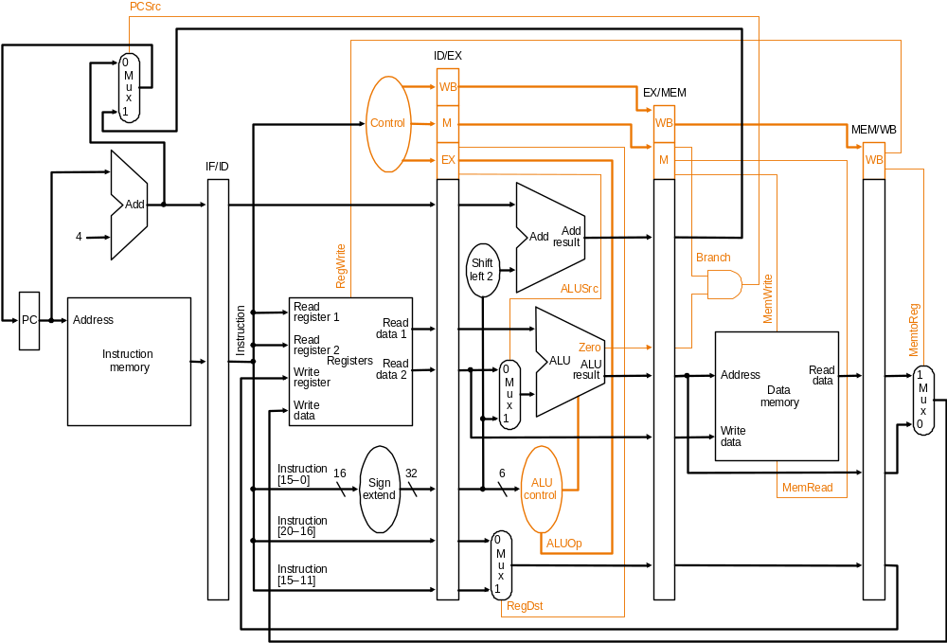
How to Implement Stalling
Stall
  disable PC and IR latching; ensure stalled instruction stays in its stage
  Insert “invalid” instructions/nops into the stage following the stalled one (called “bubbles”)
Based on original figure from [P&H CO&D, COPYRIGHT 2004 Elsevier. ALL RIGHTS RESERVED.]

Slide 23
Stall Conditions
Instructions I_{A} and I_{B} (where I_{A} comes before I_{B}) have RAW dependence iff
  I_{B} (R/I, LW, SW, Br or JR) reads a register written by I_{A} (R/I or LW)
  dist(I_{A}, I_{B}) ≤ dist(ID, WB) = 3
Must stall the ID stage when I_{B} in ID stage wants to read a register to be written by I_{A} in EX, MEM or WB stage

Slide 24
Stall Condition Evaluation Logic
Helper functions
  rs(I) returns the rs field of I
  use_rs(I) returns true if I requires RF[rs] and rs!=r0
Stall when
  (rs(IR_{ID})==dest_{EX}) && use_rs(IR_{ID}) && RegWrite_{EX} or
  (rs(IR_{ID})==dest_{MEM}) && use_rs(IR_{ID}) && RegWrite_{MEM} or
  (rs(IR_{ID})==dest_{WB}) && use_rs(IR_{ID}) && RegWrite_{WB} or
  (rt(IR_{ID})==dest_{EX}) && use_rt(IR_{ID}) && RegWrite_{EX} or
  (rt(IR_{ID})==dest_{MEM}) && use_rt(IR_{ID}) && RegWrite_{MEM} or
  (rt(IR_{ID})==dest_{WB}) && use_rt(IR_{ID}) && RegWrite_{WB}
It is crucial that the EX, MEM and WB stages continue to advance normally during stall cycles

Slide 25
Impact of Stall on Performance
Each stall cycle corresponds to one lost cycle in which no instruction can be completed
For a program with N instructions and S stall cycles, Average CPI=(N+S)/N
S depends on
  frequency of RAW dependences
  exact distance between the dependent instructions
  distance between dependences
  suppose i₁,i₂ and i₃ all depend on i₀, once i₁’s dependence is resolved, i₂ and i₃ must be okay too

Slide 26
Sample Assembly (P&H)
for (j=i-1; j>=0 && v[j] > v[j+1]; j-=1) { ...... }
  addi $s1, $s0, -1
  for2tst: slti $t0, $s1, 0
  bne $t0, $zero, exit2
  sll $t1, $s1, 2
  add $t2, $a0, $t1
  lw $t3, 0($t2)
  lw $t4, 4($t2)
  slt $t0, $t4, $t3
  beq $t0, $zero, exit2
  .........
  addi $s1, $s1, -1
  j for2tst
  exit2:
3 stalls
3 stalls
3 stalls
3 stalls
3 stalls
3 stalls

Slide 27
Reducing Stalls with Data Forwarding
Also called Data Bypassing
We have already seen the basic idea before
Forward the value to the dependent instruction as soon as it is available
Remember dataflow?
  Data value supplied to dependent instruction as soon as it is available
  Instruction executes when all its operands are available
Data forwarding brings a pipeline closer to data flow execution principles

Slide 28
Data Forwarding (or Data Bypassing)
It is intuitive to think of RF as state
  “add rx ry rz” literally means get values from RF[ry] and RF[rz] respectively and put result in RF[rx]
But, RF is just a part of a communication abstraction
  “add rx ry rz” means
  1. get the results of the last instructions to define the values of RF[ry] and RF[rz], respectively,
  2. until another instruction redefines RF[rx], younger instructions that refer to RF[rx] should use this instruction’s result
What matters is to maintain the correct “data flow” between operations, thus
add rz r- r-
IF
ID
EX
MEM
WB
IF
EX
MEM
WB
addi r- rz r-
IF
ID
ID
ID
ID

Slide 29
Resolving RAW Dependence with Forwarding
Instructions I_{A} and I_{B} (where I_{A} comes before I_{B}) have RAW dependence iff
  I_{B} (R/I, LW, SW, Br or JR) reads a register written by I_{A} (R/I or LW)
  dist(I_{A}, I_{B}) ≤ dist(ID, WB) = 3
In other words, if I_{B} in ID stage reads a register written by I_{A} in EX, MEM or WB stage, then the operand required by I_{B} is not yet in RF
⇒ retrieve operand from datapath instead of the RF
⇒ retrieve operand from the youngest definition if multiple definitions are outstanding

Slide 30
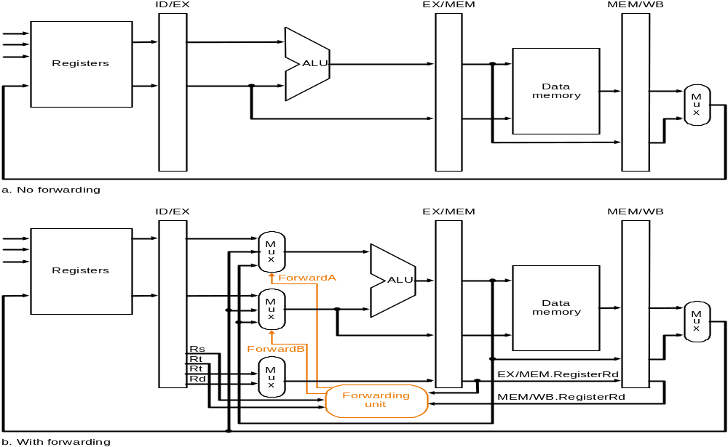
Data Forwarding Paths (v1)
dist(i,j)=3
dist(i,j)=2
dist(i,j)=1
internal
forward?
dist(i,j)=3
[Based on original figure from P&H CO&D, COPYRIGHT 2004 Elsevier. ALL RIGHTS RESERVED.]

Slide 31
Data Forwarding Paths (v2)
dist(i,j)=3
dist(i,j)=2
dist(i,j)=1
Assumes RF forwards internally
[Based on original figure from P&H CO&D, COPYRIGHT 2004 Elsevier. ALL RIGHTS RESERVED.]

Slide 32
Data Forwarding Logic (for v2)
if (rs_{EX}!=0) && (rs_{EX}==dest_{MEM}) && RegWrite_{MEM} then
forward operand from MEM stage // dist=1
else if (rs_{EX}!=0) && (rs_{EX}==dest_{WB}) && RegWrite_{WB} then
forward operand from WB stage // dist=2
else
use operand from register file // dist >= 3
Ordering matters!! Must check youngest match first
Why doesn’t use_rs( ) appear in the forwarding logic?
What does the above not take into account?
Notes:
Validness of the forwarding instruction!

Slide 33
Data Forwarding (Dependence Analysis)
Even with data-forwarding, RAW dependence on an immediately preceding LW instruction requires a stall
 | R/I-Type | LW | SW | Br | J | Jr
IF
ID |  |  |  |  |  | use
EX | use produce | use | use | use
MEM |  | produce | (use)
WB

Slide 34
Sample Assembly, No Forwarding (P&H)
for (j=i-1; j>=0 && v[j] > v[j+1]; j-=1) { ...... }
  addi $s1, $s0, -1
  for2tst: slti $t0, $s1, 0
  bne $t0, $zero, exit2
  sll $t1, $s1, 2
  add $t2, $a0, $t1
  lw $t3, 0($t2)
  lw $t4, 4($t2)
  slt $t0, $t4, $t3
  beq $t0, $zero, exit2
  .........
  addi $s1, $s1, -1
  j for2tst
  exit2:
3 stalls
3 stalls
3 stalls
3 stalls
3 stalls
3 stalls

Slide 35
Sample Assembly, Revisited (P&H)
  addi $s1, $s0, -1
  for2tst: slti $t0, $s1, 0
  bne $t0, $zero, exit2
  sll $t1, $s1, 2
  add $t2, $a0, $t1
  lw $t3, 0($t2)
  lw $t4, 4($t2)
  nop
  slt $t0, $t4, $t3
  beq $t0, $zero, exit2
  .........
  addi $s1, $s1, -1
  j for2tst
  exit2:
for (j=i-1; j>=0 && v[j] > v[j+1]; j-=1) { ...... }

Slide 36
Pipelining the LC-3b

Slide 37
Pipelining the LC-3b
Let’s remember the single-bus datapath
We’ll divide it into 5 stages
  Fetch
  Decode/RF Access
  Address Generation/Execute
  Memory
  Store Result
Conservative handling of data and control dependences
  Stall on branch
  Stall on flow dependence

Slide 38
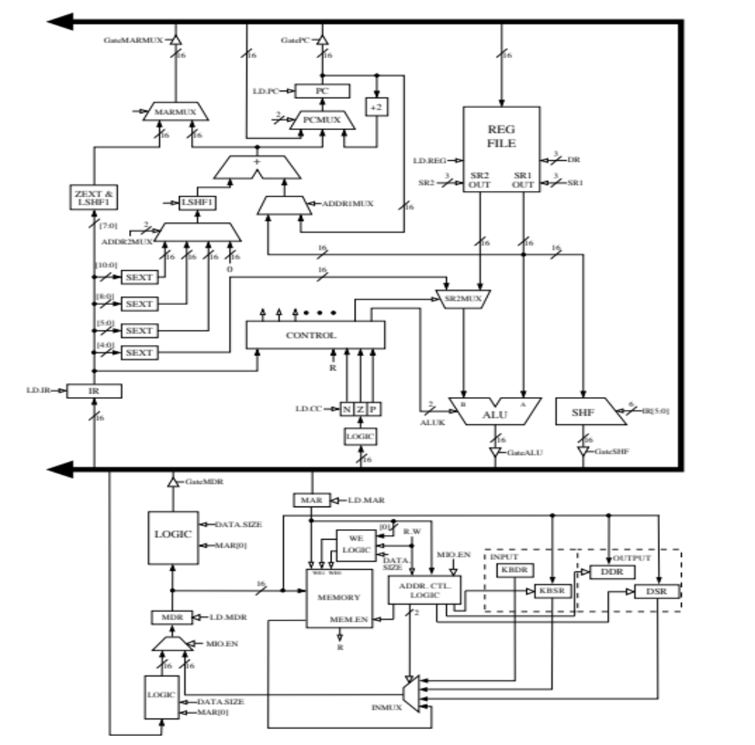

Slide 39
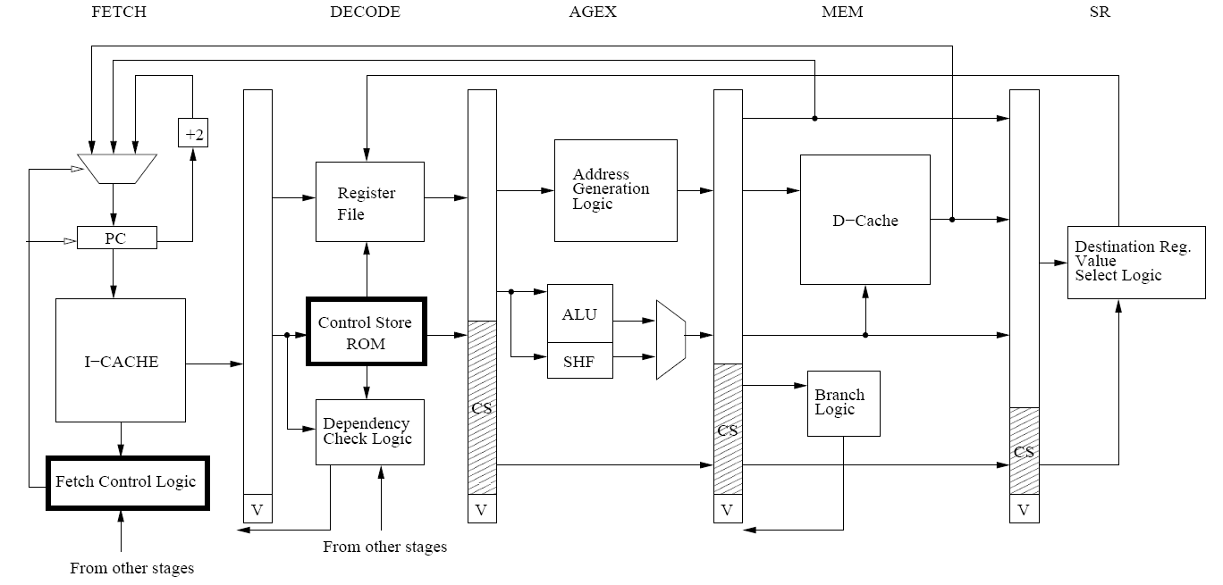
An Example LC-3b Pipeline

Slide 40
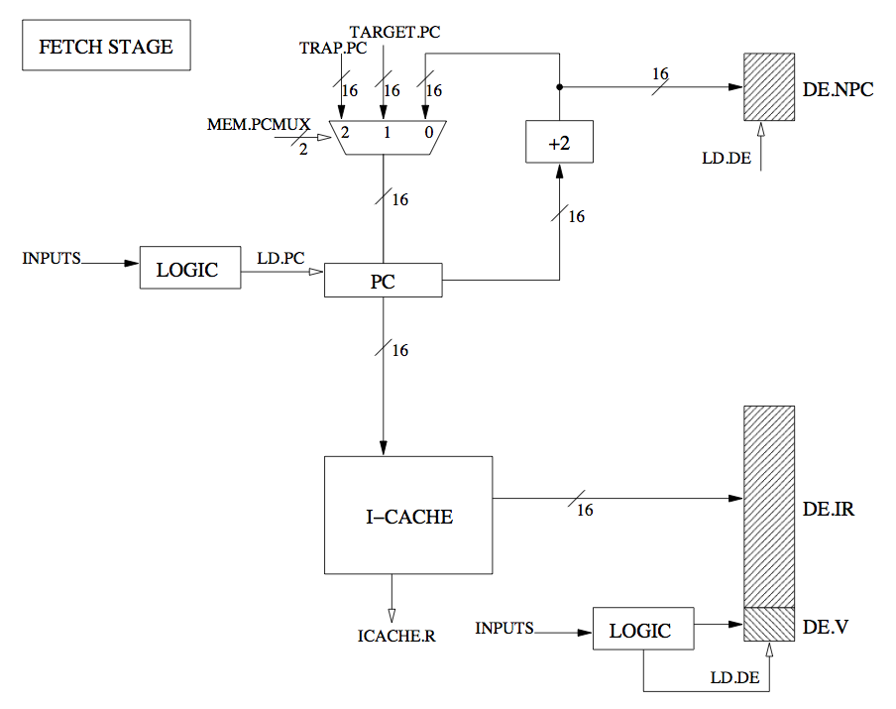

Slide 41
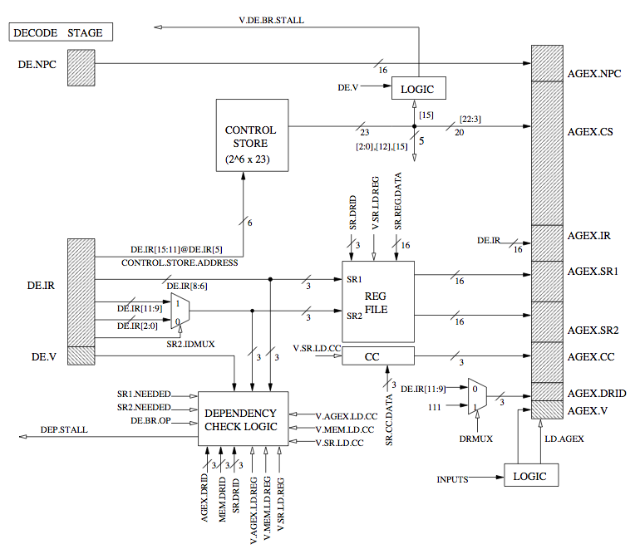

Slide 42
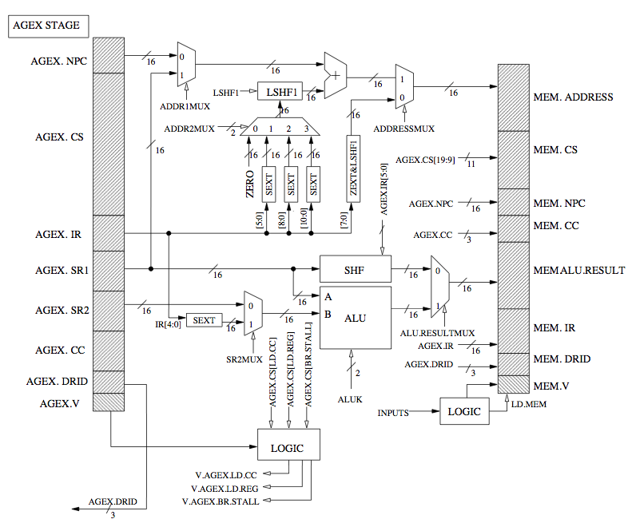

Slide 43
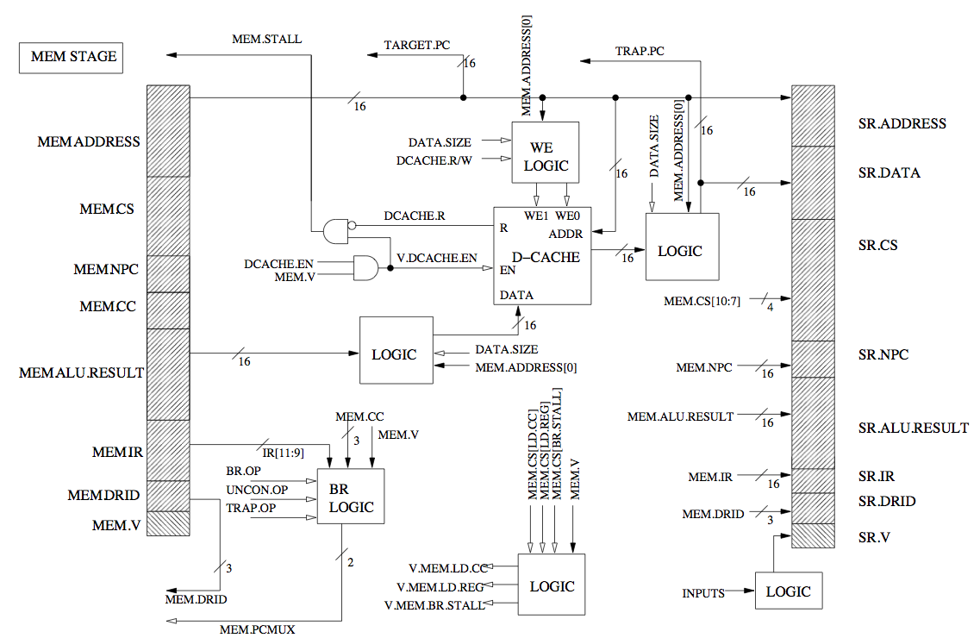

Slide 44
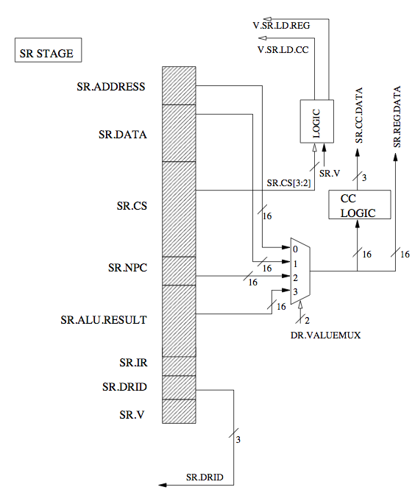

Slide 45
Control of the LC-3b Pipeline
Three types of control signals
Datapath Control Signals
  Control signals that control the operation of the datapath
Control Store Signals
  Control signals (microinstructions) stored in control store to be used in pipelined datapath (can be propagated to stages later than decode)
Stall Signals
  Ensure the pipeline operates correctly in the presence of dependencies

Slide 46
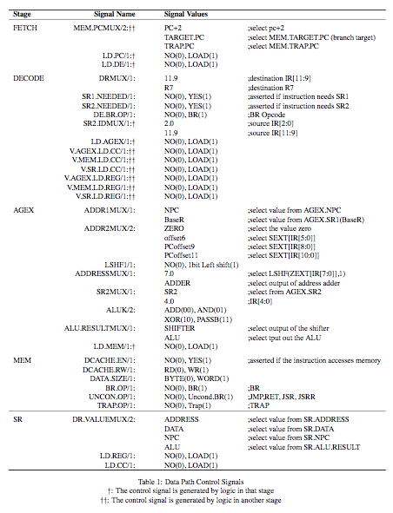

Slide 47
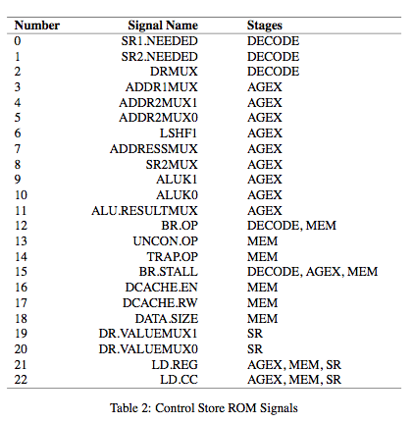
Control Store in a Pipelined Machine

Slide 48
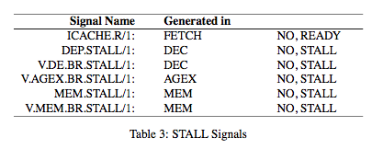
Stall Signals
Pipeline stall: Pipeline does not move because an operation in a stage cannot complete
Stall Signals: Ensure the pipeline operates correctly in the presence of such an operation
Why could an operation in a stage not complete?

Slide 49
Pipelined LC-3b
http://www.ece.cmu.edu/~ece447/s14/lib/exe/fetch.php?media=18447-lc3b-pipelining.pdf

Slide 50
End of Pipelining the LC-3b

Slide 51
Questions to Ponder
What is the role of the hardware vs. the software in data dependence handling?
  Software based interlocking
  Hardware based interlocking
  Who inserts/manages the pipeline bubbles?
  Who finds the independent instructions to fill “empty” pipeline slots?
  What are the advantages/disadvantages of each?

Slide 52
Questions to Ponder
What is the role of the hardware vs. the software in the order in which instructions are executed in the pipeline?
  Software based instruction scheduling → static scheduling
  Hardware based instruction scheduling → dynamic scheduling

Slide 53
More on Software vs. Hardware
Software based scheduling of instructions → static scheduling
  Compiler orders the instructions, hardware executes them in that order
  Contrast this with dynamic scheduling (in which hardware can execute instructions out of the compiler-specified order)
  How does the compiler know the latency of each instruction?
What information does the compiler not know that makes static scheduling difficult?
  Answer: Anything that is determined at run time
    Variable-length operation latency, memory addr, branch direction
How can the compiler alleviate this (i.e., estimate the unknown)?
  Answer: Profiling

Slide 54
Control Dependence Handling

Slide 55
Review: Control Dependence
Question: What should the fetch PC be in the next cycle?
Answer: The address of the next instruction
  All instructions are control dependent on previous ones. Why?
If the fetched instruction is a non-control-flow instruction:
  Next Fetch PC is the address of the next-sequential instruction
  Easy to determine if we know the size of the fetched instruction
If the instruction that is fetched is a control-flow instruction:
  How do we determine the next Fetch PC?
In fact, how do we even know whether or not the fetched instruction is a control-flow instruction?

Slide 56
Branch Types
Type | Direction at fetch time | Number of possible next fetch addresses? | When is next fetch address resolved?
Conditional | Unknown | 2 | Execution (register dependent)
Unconditional | Always taken | 1 | Decode (PC + offset)
Call | Always taken | 1 | Decode (PC + offset)
Return | Always taken | Many | Execution (register dependent)
Indirect | Always taken | Many | Execution (register dependent)
Different branch types can be handled differently

Slide 57
How to Handle Control Dependences
Critical to keep the pipeline full with correct sequence of dynamic instructions.
Potential solutions if the instruction is a control-flow instruction:
Stall the pipeline until we know the next fetch address
Guess the next fetch address (branch prediction)
Employ delayed branching (branch delay slot)
Do something else (fine-grained multithreading)
Eliminate control-flow instructions (predicated execution)
Fetch from both possible paths (if you know the addresses of both possible paths) (multipath execution)

Slide 58
Stall Fetch Until Next PC is Available: Good Idea?
t₀
t₀
t₀
t₁
t₁
t₁
t₂
t₂
t₂
t₃
t₃
t₃
t₄
t₄
t₄
t₅
t₅
t₀
t₅
t₀
t₀
t₀
t₁
t₁
t₁
t₁
t₂
t₂
t₂
t₂
t₃
t₃
t₃
t₃
t₄
t₄
t₄
t₄
t₅
t₅
t₅
t₅
Inst_{h}
Inst_{h}
Inst_{h}
Inst_{h}
Inst_{h}
Inst_{h}
Inst_{h}
IF
IF
IF
IF
IF
IF
IF
ID
ID
ID
ID
ID
ID
ALU
ALU
ALU
ALU
ALU
MEM
MEM
MEM
MEM
WB
WB
WB
Inst_{i}
Inst_{i}
Inst_{i}
Inst_{i}
Inst_{i}
Inst_{i}
Inst_{i}
IF
IF
IF
IF
IF
IF
IF
IF
IF
IF
IF
ID
ID
ID
ID
ALU
ALU
ALU
MEM
MEM
WB
Inst_{j}
Inst_{j}
Inst_{j}
Inst_{j}
Inst_{j}
Inst_{j}
Inst_{j}
IF
IF
IF
IF
IF
IF
IF
ID
ID
ALU
Inst_{k}
Inst_{k}
Inst_{k}
Inst_{k}
Inst_{k}
Inst_{k}
Inst_{k}
IF
IF
IF
Inst_{l}
Inst_{l}
Inst_{l}
Inst_{l}
Inst_{l}
Inst_{l}
Inst_{l}
This is the case with non-control-flow and unconditional br instructions!

Slide 59
Doing Better than Stalling Fetch …
Rather than waiting for true-dependence on PC to resolve, just guess nextPC = PC+4 to keep fetching every cycle Is this a good guess?
What do you lose if you guessed incorrectly?
~20% of the instruction mix is control flow
  ~50 % of “forward” control flow (i.e., if-then-else) is taken
  ~90% of “backward” control flow (i.e., loop back) is taken
  Overall, typically ~70% taken and ~30% not taken [Lee and Smith, 1984]
Expect “nextPC = PC+4” ~86% of the time, but what about the remaining 14%?

Slide 60
Guessing NextPC = PC + 4
Always predict the next sequential instruction is the next instruction to be executed
This is a form of next fetch address prediction (and branch prediction)
How can you make this more effective?
Idea: Maximize the chances that the next sequential instruction is the next instruction to be executed
  Software: Lay out the control flow graph such that the “likely next instruction” is on the not-taken path of a branch
    Profile guided code positioning → Pettis & Hansen, PLDI 1990.
  Hardware: ??? (how can you do this in hardware…)
    Cache traces of executed instructions → Trace cache
Notes:
Pettis and Hansen, Profile guided code positioning, PLDI 1990.
Trace caches…

Slide 61
Guessing NextPC = PC + 4
How else can you make this more effective?
Idea: Get rid of control flow instructions (or minimize their occurrence)
How?
  1. Get rid of unnecessary control flow instructions → combine predicates (predicate combining)
  2. Convert control dependences into data dependences → predicated execution

Slide 62
Predicate Combining (not Predicated Execution)
Complex predicates are converted into multiple branches
  if ((a == b) && (c < d) && (a > 5000)) { … }
    3 conditional branches
Problem: This increases the number of control dependencies
Idea: Combine predicate operations to feed a single branch instruction instead of having one branch for each
  Predicates stored and operated on using condition registers
  A single branch checks the value of the combined predicate
+ Fewer branches in code → fewer mipredictions/stalls
-- Possibly unnecessary work
-- If the first predicate is false, no need to compute other predicates
Condition registers exist in IBM RS6000 and the POWER architecture

