Slide 1
18-447
Computer Architecture
Lecture 9: Branch Prediction I
Prof. Onur Mutlu
Carnegie Mellon University
Spring 2015, 2/4/2015

Slide 2
Agenda for Today & Next Few Lectures
Single-cycle Microarchitectures
Multi-cycle and Microprogrammed Microarchitectures
Pipelining
Issues in Pipelining: Control & Data Dependence Handling, State Maintenance and Recovery, …
Out-of-Order Execution
Issues in OoO Execution: Load-Store Handling, …

Slide 3
Reminder: Readings for Next Few Lectures (I)
P&H Chapter 4.9-4.11
Smith and Sohi, “The Microarchitecture of Superscalar Processors,” Proceedings of the IEEE, 1995
  More advanced pipelining
  Interrupt and exception handling
  Out-of-order and superscalar execution concepts
McFarling, “Combining Branch Predictors,” DEC WRL Technical Report, 1993. HW3 summary paper
Kessler, “The Alpha 21264 Microprocessor,” IEEE Micro 1999.

Slide 4
Reminder: Readings for Next Few Lectures (II)
Smith and Plezskun, “Implementing Precise Interrupts in Pipelined Processors,” IEEE Trans on Computers 1988 (earlier version in ISCA 1985). HW3 summary paper

Slide 5
Reminder: Relevant Seminar Tomorrow
Practical Data Value Speculation for Future High-End Processors
  Arthur Perais, INRIA (France)
  Thursday, Feb 5, 4:30-5:30pm, CIC Panther Hollow Room
Summary:
  Value prediction (VP) was proposed to enhance the performance of superscalar processors by breaking RAW dependencies. However, it has generally been considered too complex to implement. During this presentation, we will review different sources of additional complexity and propose solutions to address them.
http://www.ece.cmu.edu/~calcm/doku.php?id=seminars:seminars

Slide 6
Recap of Last Lecture
Data Dependence Handling
  Data Forwarding/Bypassing
  In-depth Implementation
    Register dependence analysis
    Stalling
    Performance analysis with and without forwarding
    LC-3b Pipelining
  Questions to Ponder
    HW vs. SW handling of data dependences
    Static versus dynamic scheduling
    What makes compiler based instruction scheduling difficult?
    Profiling (representative input sets needed; dynamic adaptation difficult)
    Introduction to static instruction scheduling (e.g., fix-up code)
Control Dependence Handling
  Six ways of handling control dependences
  Stalling until next fetch address is available: Bad idea
  Predicting the next-sequential instruction as next fetch address

Slide 7
Tentative Plan for Friday and Monday
I will be out of town
  Attending the HPCA Conference
We will finish Branch Prediction on either of these days
Lab 2 is due Friday
  Step 1: Get the baseline functionality correct
  Step 2: Do the extra credit portion (it will be rewarding)
Tentative Plan:
  Friday: Recitation session → Come with questions on Lab 2, HW 2, lectures, concepts, etc
  Monday: Finish branch prediction (Rachata)

Slide 8
Sample Papers from HPCA
Donghyuk Lee+, “Adaptive Latency DRAM: Optimizing DRAM Timing for the Common Case,” HPCA 2015.
  http://users.ece.cmu.edu/~omutlu/pub/adaptive-latency-dram_hpca15.pdf
Gennady Pekhimenko+, “Exploiting Compressed Block Size as an Indicator of Future Reuse,” HPCA 2015.
  http://users.ece.cmu.edu/~omutlu/pub/compression-aware-cache-management_hpca15.pdf
Yu Cai, Yixin Luo+, “Data Retention in MLC NAND Flash Memory: Characterization, Optimization and Recovery,” HPCA 2015.
  http://users.ece.cmu.edu/~omutlu/pub/flash-memory-data-retention_hpca15.pdf

Slide 9
Control Dependence Handling

Slide 10
Review: Control Dependence
Question: What should the fetch PC be in the next cycle?
If the instruction that is fetched is a control-flow instruction:
  How do we determine the next Fetch PC?
In fact, how do we even know whether or not the fetched instruction is a control-flow instruction?

Slide 11
How to Handle Control Dependences
Critical to keep the pipeline full with correct sequence of dynamic instructions.
Potential solutions if the instruction is a control-flow instruction:
Stall the pipeline until we know the next fetch address
Guess the next fetch address (branch prediction)
Employ delayed branching (branch delay slot)
Do something else (fine-grained multithreading)
Eliminate control-flow instructions (predicated execution)
Fetch from both possible paths (if you know the addresses of both possible paths) (multipath execution)

Slide 12
Review: Guessing NextPC = PC + 4
Always predict the next sequential instruction is the next instruction to be executed
This is a form of next fetch address prediction (and branch prediction)
How can you make this more effective?
Idea: Maximize the chances that the next sequential instruction is the next instruction to be executed
  Software: Lay out the control flow graph such that the “likely next instruction” is on the not-taken path of a branch
    Profile guided code positioning → Pettis & Hansen, PLDI 1990.
  Hardware: ??? (how can you do this in hardware…)
    Cache traces of executed instructions → Trace cache
Notes:
Pettis and Hansen, Profile guided code positioning, PLDI 1990.
Trace caches…

Slide 13
Review: Guessing NextPC = PC + 4
How else can you make this more effective?
Idea: Get rid of control flow instructions (or minimize their occurrence)
How?
  1. Get rid of unnecessary control flow instructions → combine predicates (predicate combining)
  2. Convert control dependences into data dependences → predicated execution

Slide 14
Review: Predicate Combining (not Predicated Execution)
Complex predicates are converted into multiple branches
  if ((a == b) && (c < d) && (a > 5000)) { … }
    3 conditional branches
Problem: This increases the number of control dependencies
Idea: Combine predicate operations to feed a single branch instruction instead of having one branch for each
  Predicates stored and operated on using condition registers
  A single branch checks the value of the combined predicate
+ Fewer branches in code → fewer mipredictions/stalls
-- Possibly unnecessary work
-- If the first predicate is false, no need to compute other predicates
Condition registers exist in IBM RS6000 and the POWER architecture

Slide 15
Predicated Execution
Idea: Convert control dependence to data dependence
Simple example: Suppose we had a Conditional Move instruction…
  CMOV condition, R1 ← R2
  R1 = (condition == true) ? R2 : R1
  Employed in most modern ISAs (x86, Alpha)
Code example with branches vs. CMOVs
  if (a == 5) {b = 4;} else {b = 3;}
  CMPEQ condition, a, 5;
  CMOV condition, b ← 4;
  CMOV !condition, b ← 3;

Slide 16
Conditional Execution in ARM
Same as predicated execution
Every instruction is conditionally executed

Slide 17
Predicated Execution
Eliminates branches → enables straight line code (i.e., larger basic blocks in code)
Advantages
  Always-not-taken prediction works better (no branches)
  Compiler has more freedom to optimize code (no branches)
    control flow does not hinder inst. reordering optimizations
    code optimizations hindered only by data dependencies
Disadvantages
  Useless work: some instructions fetched/executed but discarded (especially bad for easy-to-predict branches)
  Requires additional ISA support
Can we eliminate all branches this way?

Slide 18
Predicated Execution
We will get back to this…
Some readings (optional):
  Allen et al., “Conversion of control dependence to data dependence,” POPL 1983.
  Kim et al., “Wish Branches: Combining Conditional Branching and Predication for Adaptive Predicated Execution,” MICRO 2005.

Slide 19
How to Handle Control Dependences
Critical to keep the pipeline full with correct sequence of dynamic instructions.
Potential solutions if the instruction is a control-flow instruction:
Stall the pipeline until we know the next fetch address
Guess the next fetch address (branch prediction)
Employ delayed branching (branch delay slot)
Do something else (fine-grained multithreading)
Eliminate control-flow instructions (predicated execution)
Fetch from both possible paths (if you know the addresses of both possible paths) (multipath execution)

Slide 20
Delayed Branching (I)
Change the semantics of a branch instruction
  Branch after N instructions
  Branch after N cycles
Idea: Delay the execution of a branch. N instructions (delay slots) that come after the branch are always executed regardless of branch direction.
Problem: How do you find instructions to fill the delay slots?
  Branch must be independent of delay slot instructions
Unconditional branch: Easier to find instructions to fill the delay slot
Conditional branch: Condition computation should not depend on instructions in delay slots → difficult to fill the delay slot

Slide 21

Delayed Branching (II)
Normal code:
Timeline:
Delayed branch code:
Timeline:
A
if
ex
A
if
ex
B
C
C
A
BC X
A
BC X
B
A
B
C
A
D
C
B
D
BC
C
E
BC
C
E
B
BC
F
--
BC
F
G
B
X:
G
G
--
X:
G
6 cycles
5 cycles

Slide 22
Fancy Delayed Branching (III)
Delayed branch with squashing
  In SPARC
  Semantics: If the branch falls through (i.e., it is not taken), the delay slot instruction is not executed
  Why could this help?
Normal code:
Delayed branch code:
Delayed branch w/ squashing:
X:
A
X:
A
A
B
B
X:
B
C
C
C
BC X
BC X
BC X
D
NOP
A
E
D
D
E
E

Slide 23
Delayed Branching (IV)
Advantages:
+ Keeps the pipeline full with useful instructions in a simple way assuming
1. Number of delay slots == number of instructions to keep the pipeline full before the branch resolves
2. All delay slots can be filled with useful instructions
Disadvantages:
  -- Not easy to fill the delay slots (even with a 2-stage pipeline)
  1. Number of delay slots increases with pipeline depth, superscalar execution width
  2. Number of delay slots should be variable with variable latency operations. Why?
-- Ties ISA semantics to hardware implementation
-- SPARC, MIPS, HP-PA: 1 delay slot
-- What if pipeline implementation changes with the next design?

Slide 24
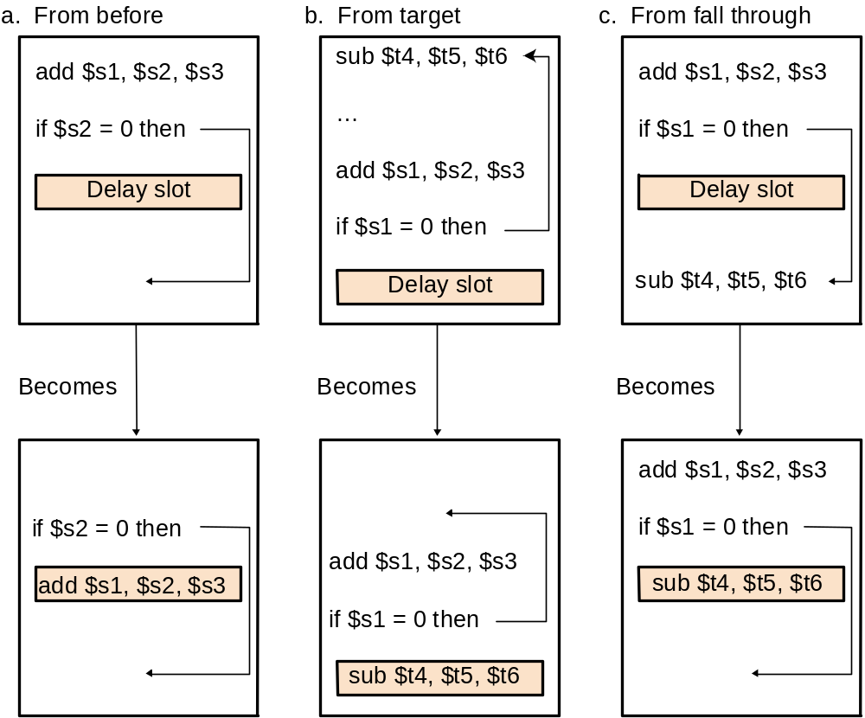
An Aside: Filling the Delay Slot
reordering data
independent
(RAW, WAW,
WAR)
instructions
does not change
program semantics
Safe?
within same
basic block
For correctness:
add a new instruction
to the not-taken path?
For correctness:
add a new instruction
to the taken path?
[Based on original figure from P&H CO&D, COPYRIGHT 2004 Elsevier. ALL RIGHTS RESERVED.]

Slide 25
How to Handle Control Dependences
Critical to keep the pipeline full with correct sequence of dynamic instructions.
Potential solutions if the instruction is a control-flow instruction:
Stall the pipeline until we know the next fetch address
Guess the next fetch address (branch prediction)
Employ delayed branching (branch delay slot)
Do something else (fine-grained multithreading)
Eliminate control-flow instructions (predicated execution)
Fetch from both possible paths (if you know the addresses of both possible paths) (multipath execution)

Slide 26
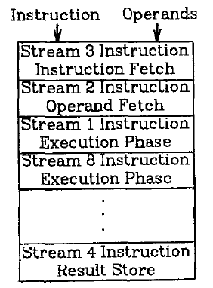
Fine-Grained Multithreading
Idea: Hardware has multiple thread contexts. Each cycle, fetch engine fetches from a different thread.
  By the time the fetched branch/instruction resolves, no instruction is fetched from the same thread
  Branch/instruction resolution latency overlapped with execution of other threads’ instructions
+ No logic needed for handling control and
data dependences within a thread
-- Single thread performance suffers
-- Extra logic for keeping thread contexts
-- Does not overlap latency if not enough
threads to cover the whole pipeline
Notes:
Latency overlap/hiding

Slide 27
Fine-grained Multithreading (II)
Idea: Switch to another thread every cycle such that no two instructions from a thread are in the pipeline concurrently
Tolerates the control and data dependency latencies by overlapping the latency with useful work from other threads
Improves pipeline utilization by taking advantage of multiple threads
  Thornton, “Parallel Operation in the Control Data 6600,” AFIPS 1964.
  Smith, “A pipelined, shared resource MIMD computer,” ICPP 1978.

Slide 28
Fine-grained Multithreading: History
CDC 6600’s peripheral processing unit is fine-grained multithreaded
  Thornton, “Parallel Operation in the Control Data 6600,” AFIPS 1964.
  Processor executes a different I/O thread every cycle
  An operation from the same thread is executed every 10 cycles
Denelcor HEP (Heterogeneous Element Processor)
  Smith, “A pipelined, shared resource MIMD computer,” ICPP 1978.
  120 threads/processor
  available queue vs. unavailable (waiting) queue for threads
  each thread can have only 1 instruction in the processor pipeline; each thread independent
  to each thread, processor looks like a non-pipelined machine
  system throughput vs. single thread performance tradeoff

Slide 29
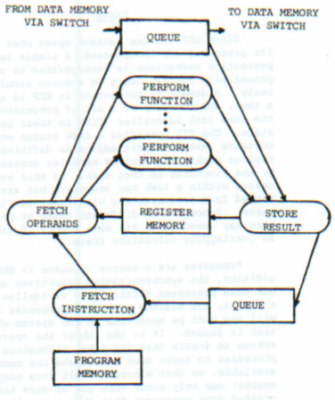

Fine-grained Multithreading in HEP
Cycle time: 100ns
8 stages → 800 ns to complete an instruction
  assuming no memory access
No control and data dependency checking

Slide 30
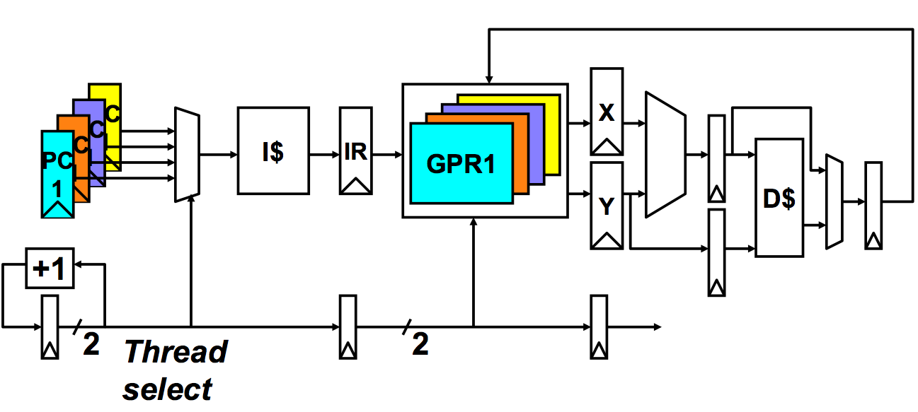
Multithreaded Pipeline Example
Slide credit: Joel Emer

Slide 31
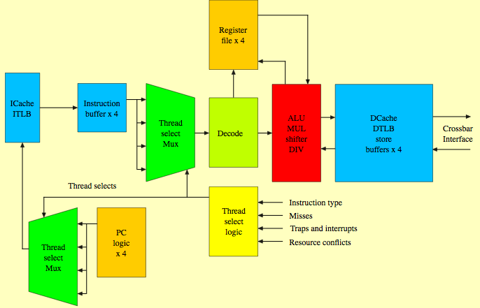
Sun Niagara Multithreaded Pipeline
Kongetira et al., “Niagara: A 32-Way Multithreaded Sparc Processor,” IEEE Micro 2005.

Slide 32
Fine-grained Multithreading
Advantages
  + No need for dependency checking between instructions
  (only one instruction in pipeline from a single thread)
  + No need for branch prediction logic
  + Otherwise-bubble cycles used for executing useful instructions from different threads
  + Improved system throughput, latency tolerance, utilization
Disadvantages
  - Extra hardware complexity: multiple hardware contexts (PCs, register files, …), thread selection logic
  - Reduced single thread performance (one instruction fetched every N cycles from the same thread)
  - Resource contention between threads in caches and memory
  - Some dependency checking logic between threads remains (load/store)

Slide 33
How to Handle Control Dependences
Critical to keep the pipeline full with correct sequence of dynamic instructions.
Potential solutions if the instruction is a control-flow instruction:
Stall the pipeline until we know the next fetch address
Guess the next fetch address (branch prediction)
Employ delayed branching (branch delay slot)
Do something else (fine-grained multithreading)
Eliminate control-flow instructions (predicated execution)
Fetch from both possible paths (if you know the addresses of both possible paths) (multipath execution)

Slide 34
Branch Prediction

Slide 35
Branch Prediction: Guess the Next Instruction to Fetch
PC
??
0x0006
0x0007
0x0008
0x0005
0x0004
I-$
DEC
RF
WB
0x0001
LD R1, MEM[R0]
0x0002
ADD R2, R2, #1
D-$
0x0003
BRZERO 0x0001
0x0004
ADD R3, R2, #1
12 cycles
0x0005
MUL R1, R2, R3
0x0006
LD R2, MEM[R2]
Branch prediction
0x0007
LD R0, MEM[R2]
8 cycles

Slide 36
Misprediction Penalty
PC
Flush!!
I-$
DEC
RF
WB
0x0001
LD R1, MEM[R0]
0x0007
0x0006
0x0005
0x0004
0x0003
0x0002
ADD R2, R2, #1
D-$
0x0003
BRZERO 0x0001
0x0004
ADD R3, R2, #1
0x0005
MUL R1, R2, R3
0x0006
LD R2, MEM[R2]
0x0007
LD R0, MEM[R2]

Slide 37
Branch Prediction
Processors are pipelined to increase concurrency
How do we keep the pipeline full in the presence of branches?
  Guess the next instruction when a branch is fetched
  Requires guessing the direction and target of a branch
A
Branch condition, TARGET
B1
B3
Pipeline
Fetch Decode Rename Schedule RegisterRead Execute
D
D
B1
A
F
D
B1
A
F
E
E
E
E
F
F
E
F
D
B1
A
A
E
E
B3
F
F
D
B1
D
B1
E
A
A
F
A
D
B1
A
E
D
B1
A
F
D
B1
D
B1
A
D
B1
B1
E
D
B1
A
A
A
E
What to fetch next?
Verify the Prediction
Target Misprediction Detected! Flush the pipeline
Fetch from the correct target
F

Slide 38
Branch Prediction: Always PC+4
t₀
t₀
t₀
t₁
t₁
t₁
t₂
t₂
t₂
t₃
t₃
t₃
t₄
t₄
t₄
t₅
t₅
t₅
Inst_{h}
Inst_{h}
Inst_{h}
IF_{PC}
IF_{PC}
IF_{PC}
ID
ID
ALU
ALU
MEM
Inst_{i}
Inst_{i}
Inst_{i}
IF_{PC+4}
IF_{PC+4}
ID
ID
ALU
Inst_{j}
Inst_{j}
Inst_{j}
IF_{PC+8}
IF_{PC+8}
ID
Inst_{k}
Inst_{k}
Inst_{k}
IF_{target}
Inst_{l}
Inst_{l}
Inst_{l}
Inst_{h} branch condition and target
evaluated in ALU
When a branch resolves
- branch target (Inst_{k}) is fetched
- all instructions fetched since
inst_{h} (so called “wrong-path”
instructions) must be flushed
Inst_{h} is a branch

Slide 39
Pipeline Flush on a Misprediction
t₀
t₁
t₂
t₃
t₄
t₅
Inst_{h}
IF_{PC}
ID
ALU
MEM
WB
Inst_{i}
IF_{PC+4}
ID
killed
Inst_{j}
IF_{PC+8}
killed
Inst_{k}
IF_{target}
ID
ALU
WB
Inst_{l}
IF
ID
ALU
IF
ID
IF
Inst_{h} is a branch

Slide 40
Performance Analysis
correct guess ⇒ no penalty ~86% of the time
incorrect guess ⇒ 2 bubbles
Assume
  no data dependency related stalls
  20% control flow instructions
  70% of control flow instructions are taken
  CPI = [ 1 + (0.20*0.7) * 2 ] =
  = [ 1 + 0.14 * 2 ] = 1.28
probability of
a wrong guess
penalty for
a wrong guess
Can we reduce either of the two penalty terms?

Slide 41
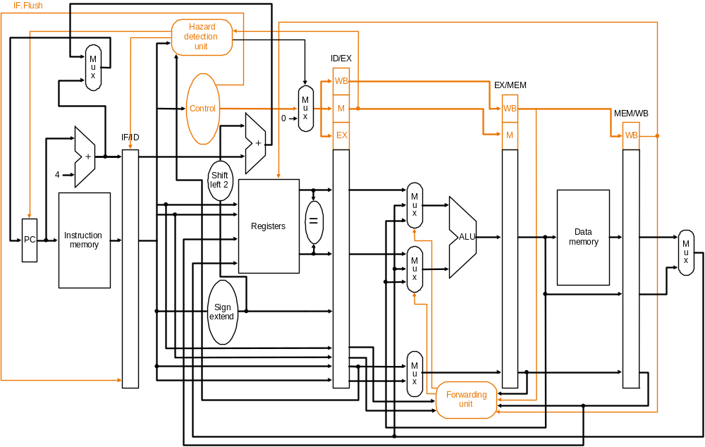
Reducing Branch Misprediction Penalty
Resolve branch condition and target address early
Is this a good idea?
  CPI = [ 1 + (0.2*0.7) * 1 ] = 1.14
[Based on original figure from P&H CO&D, COPYRIGHT 2004 Elsevier. ALL RIGHTS RESERVED.]

Slide 42
Branch Prediction (Enhanced)
Idea: Predict the next fetch address (to be used in the next cycle)
Requires three things to be predicted at fetch stage:
  Whether the fetched instruction is a branch
  (Conditional) branch direction
  Branch target address (if taken)
Observation: Target address remains the same for a conditional direct branch across dynamic instances
  Idea: Store the target address from previous instance and access it with the PC
  Called Branch Target Buffer (BTB) or Branch Target Address Cache

Slide 43
Fetch Stage with BTB and Direction Prediction
Direction predictor (taken?)
taken?
PC + inst size
Next Fetch
Address
Program
Counter
hit?
Address of the
current branch
target address
Cache of Target Addresses (BTB: Branch Target Buffer)
Always taken CPI = [ 1 + (0.20*0.3) * 2 ] = 1.12 (70% of branches taken)

Slide 44
More Sophisticated Branch Direction Prediction
Which direction earlier
branches went
Direction predictor (taken?)
taken?
Global branch
history
PC + inst size
Next Fetch
Address
XOR
Program
Counter
hit?
Address of the
current branch
target address
Cache of Target Addresses (BTB: Branch Target Buffer)

Slide 45
Three Things to Be Predicted
Requires three things to be predicted at fetch stage:
  1. Whether the fetched instruction is a branch
  2. (Conditional) branch direction
  3. Branch target address (if taken)
Third (3.) can be accomplished using a BTB
  Remember target address computed last time branch was executed
First (1.) can be accomplished using a BTB
  If BTB provides a target address for the program counter, then it must be a branch
  Or, we can store “branch metadata” bits in instruction cache/memory → partially decoded instruction stored in I-cache
Second (2.): How do we predict the direction?

Slide 46
Simple Branch Direction Prediction Schemes
Compile time (static)
  Always not taken
  Always taken
  BTFN (Backward taken, forward not taken)
  Profile based (likely direction)
Run time (dynamic)
  Last time prediction (single-bit)

Slide 47
More Sophisticated Direction Prediction
Compile time (static)
  Always not taken
  Always taken
  BTFN (Backward taken, forward not taken)
  Profile based (likely direction)
  Program analysis based (likely direction)
Run time (dynamic)
  Last time prediction (single-bit)
  Two-bit counter based prediction
  Two-level prediction (global vs. local)
  Hybrid

Slide 48
Static Branch Prediction (I)
Always not-taken
  Simple to implement: no need for BTB, no direction prediction
  Low accuracy: ~30-40% (for conditional branches)
  Remember: Compiler can layout code such that the likely path is the “not-taken” path → more effective prediction
Always taken
  No direction prediction
  Better accuracy: ~60-70% (for conditional branches)
    Backward branches (i.e. loop branches) are usually taken
    Backward branch: target address lower than branch PC
Backward taken, forward not taken (BTFN)
  Predict backward (loop) branches as taken, others not-taken

Slide 49
Static Branch Prediction (II)
Profile-based
  Idea: Compiler determines likely direction for each branch using a profile run. Encodes that direction as a hint bit in the branch instruction format.
+ Per branch prediction (more accurate than schemes in previous slide) → accurate if profile is representative!
-- Requires hint bits in the branch instruction format
-- Accuracy depends on dynamic branch behavior:
TTTTTTTTTTNNNNNNNNNN → 50% accuracy TNTNTNTNTNTNTNTNTNTN → 50% accuracy
-- Accuracy depends on the representativeness of profile input set

Slide 50
Static Branch Prediction (III)
Program-based (or, program analysis based)
  Idea: Use heuristics based on program analysis to determine statically-predicted direction
  Example opcode heuristic: Predict BLEZ as NT (negative integers used as error values in many programs)
  Example loop heuristic: Predict a branch guarding a loop execution as taken (i.e., execute the loop)
  Pointer and FP comparisons: Predict not equal
+ Does not require profiling
-- Heuristics might be not representative or good
-- Requires compiler analysis and ISA support (ditto for other static methods)
Ball and Larus, ”Branch prediction for free,” PLDI 1993.
  20% misprediction rate

Slide 51
Static Branch Prediction (IV)
Programmer-based
  Idea: Programmer provides the statically-predicted direction
  Via pragmas in the programming language that qualify a branch as likely-taken versus likely-not-taken
+ Does not require profiling or program analysis
+ Programmer may know some branches and their program better than other analysis techniques
-- Requires programming language, compiler, ISA support
-- Burdens the programmer?

Slide 52
Pragmas
Idea: Keywords that enable a programmer to convey hints to lower levels of the transformation hierarchy
if (likely(x)) { ... }
if (unlikely(error)) { … }
Many other hints and optimizations can be enabled with pragmas
  E.g., whether a loop can be parallelized
  #pragma omp parallel
  Description
    The omp parallel directive explicitly instructs the compiler to parallelize the chosen segment of code.

Slide 53
Static Branch Prediction
All previous techniques can be combined
  Profile based
  Program based
  Programmer based
How would you do that?
What is the common disadvantage of all three techniques?
  Cannot adapt to dynamic changes in branch behavior
    This can be mitigated by a dynamic compiler, but not at a fine granularity (and a dynamic compiler has its overheads…)
    What is a Dynamic Compiler?
      Remember Transmeta? Code Morphing Software?
      Java JIT (just in time) compiler, Microsoft CLR (common lang. runtime)

Slide 54
Dynamic Branch Prediction
Idea: Predict branches based on dynamic information (collected at run-time)
Advantages
  + Prediction based on history of the execution of branches
  + It can adapt to dynamic changes in branch behavior
  + No need for static profiling: input set representativeness problem goes away
Disadvantages
  -- More complex (requires additional hardware)

Slide 55
Last Time Predictor
Last time predictor
  Single bit per branch (stored in BTB)
  Indicates which direction branch went last time it executed
  TTTTTTTTTTNNNNNNNNNN → 90% accuracy
Always mispredicts the last iteration and the first iteration of a loop branch
  Accuracy for a loop with N iterations = (N-2)/N
+ Loop branches for loops with large N (number of iterations)
-- Loop branches for loops will small N (number of iterations)
TNTNTNTNTNTNTNTNTNTN → 0% accuracy
Last-time predictor CPI = [ 1 + (0.20*0.15) * 2 ] = 1.06 (Assuming 85% accuracy)

Slide 56
Implementing the Last-Time Predictor
tag
BTB idx
N-bit
tag
table
BHT:
One
Bit
per
entry
BTB: one target
address per entry
taken?
PC+4
=
¹ ⁰
nextPC
The 1-bit BHT (Branch History Table) entry is updated with the correct outcome after each execution of a branch

Slide 57
State Machine for Last-Time Prediction
actually
taken
predict
not
taken
predict
taken
actually
not taken
actually
taken
actually
not taken

Slide 58
Improving the Last Time Predictor
Problem: A last-time predictor changes its prediction from T→NT or NT→T too quickly
  even though the branch may be mostly taken or mostly not taken
Solution Idea: Add hysteresis to the predictor so that prediction does not change on a single different outcome
  Use two bits to track the history of predictions for a branch instead of a single bit
  Can have 2 states for T or NT instead of 1 state for each
Smith, “A Study of Branch Prediction Strategies,” ISCA 1981.

Slide 59
Two-Bit Counter Based Prediction
Each branch associated with a two-bit counter
One more bit provides hysteresis
A strong prediction does not change with one single different outcome
  Accuracy for a loop with N iterations = (N-1)/N
  TNTNTNTNTNTNTNTNTNTN → 50% accuracy
  (assuming counter initialized to weakly taken)
  + Better prediction accuracy
  -- More hardware cost (but counter can be part of a BTB entry)
2BC predictor CPI = [ 1 + (0.20*0.10) * 2 ] = 1.04 (90% accuracy)

Slide 60
State Machine for 2-bit Saturating Counter
Counter using saturating arithmetic
  Arithmetic with maximum and minimum values
actually
taken
actually
!taken
pred
taken
11
pred
taken
10
actually
taken
actually
taken
actually
!taken
actually
!taken
pred
!taken
01
pred
!taken
00
actually
!taken
actually
taken

Slide 61
Hysteresis Using a 2-bit Counter
actually
taken
actually
!taken
“weakly
taken”
“strongly
taken”
pred
taken
pred
taken
actually
taken
actually
!taken
actually
taken
actually
!taken
“strongly
!taken”
pred
!taken
pred
!taken
“weakly
!taken”
actually
!taken
actually
taken
Change prediction after 2 consecutive mistakes

Slide 62
Is This Good Enough?
~85-90% accuracy for many programs with 2-bit counter based prediction (also called bimodal prediction)
Is this good enough?
How big is the branch problem?

Slide 63
Rethinking the The Branch Problem
Control flow instructions (branches) are frequent
  15-25% of all instructions
Problem: Next fetch address after a control-flow instruction is not determined after N cycles in a pipelined processor
  N cycles: (minimum) branch resolution latency
If we are fetching W instructions per cycle (i.e., if the pipeline is W wide)
  A branch misprediction leads to N x W wasted instruction slots

Slide 64
Importance of The Branch Problem
Assume N = 20 (20 pipe stages), W = 5 (5 wide fetch)
  Assume: 1 out of 5 instructions is a branch
  Assume: Each 5 instruction-block ends with a branch
How long does it take to fetch 500 instructions?
  100% accuracy
    100 cycles (all instructions fetched on the correct path)
    No wasted work
  99% accuracy
    100 (correct path) + 20 (wrong path) = 120 cycles
    20% extra instructions fetched
  98% accuracy
    100 (correct path) + 20 * 2 (wrong path) = 140 cycles
    40% extra instructions fetched
  95% accuracy
    100 (correct path) + 20 * 5 (wrong path) = 200 cycles
    100% extra instructions fetched

Slide 65
Can We Do Better?
Last-time and 2BC predictors exploit “last-time” predictability
Realization 1: A branch’s outcome can be correlated with other branches’ outcomes
  Global branch correlation
Realization 2: A branch’s outcome can be correlated with past outcomes of the same branch (other than the outcome of the branch “last-time” it was executed)
  Local branch correlation

