Slide 1
SimpleDB Overview
9/17/2014

Slide 2
What is SimpleDB?
A basic database system
SQL Front-end (Provided for later labs)
  Heap files (Lab 1)
  Buffer Pool (Labs 1-6)
  Basic Operators (Labs 1 & 2)
    Scan, Filter, JOIN, Aggregate
  B-Tree Indexes (Lab 3)
  Transactions (Lab 4)
  Query optimizer (Lab 5)
  Recovery (Lab 6)
Javadoc is your friend!

Slide 3
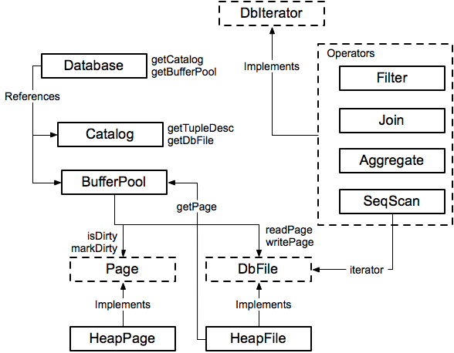
Module Diagram

Slide 4
Database
Singleton Database:
Database.getCatalog()
Database.getBufferPool()
Catalog
=> List of DB tables
BufferPool
=> Caches DB pages in memory
Database.getLogFile()
LogFile
(Ignore for Lab 1)

Slide 5
Catalog
Catalog:
DbFile ID | Table
001 | Table1
002 | Table2
003 | Table3
Table:
DbFile file
String name
String primary_key
=> Stores a list of all tables in the database
Notes:
Catalog stores a list of available tables, TupleDesc
void addTable(DbFile d, TupleDesc d)‏
DbFile getTable(int tableid)‏
TupleDesc getTupleDesc(int tableid)‏
Not persisted to disk

Slide 6
BufferPool
Buffer Pool:
Page ID | Page
001 | Page1
003 | Page3
007 | Page7
Page:
PageId id
Tuple tuples[]
Byte header[]
=> Caches recently accessed database pages in memory
Notes:
Manages cache of pages
Evicts pages when cache is full [not lab 1]
All page accesses should use getPage
Even from inside DbFile!
You will eventually implement
locking for transactions
Flushing of pages for recovery

Slide 7
HeapFile
(Implements DbFile)
File (on disk):
_______________
Heap File:
File file
TupleDesc td
DbFileIterator it
Tuple Descriptor:
Field1 Type Field1 Name | Field2 Type Field2 Name | Field3 Type Field3 Name | …
Iterate through Tuples in Heap Pages:
Page1 | Page2 | Page3 | …
Notes:
An array of HeapPages on disk
Javadoc is your friend!
Implement everything except addTuple and removeTuple

Slide 8
HeapPage
(Implements Page)
Tuple Descriptor:
Heap Page:
Field1 Type Field1 Name | Field2 Type Field2 Name | Field3 Type Field3 Name | …
HeapPageId pid
TupleDesc td
Byte header[]
Tuple tuples[]
Header:
01100110 | 11111111 | 11101101 | …
Tuples:
Empty | Tuple1 | Tuple2 | …
Tuple:
Field1 | Field2 | Field3 | …
Fields and Tuples are Fixed Width!
Notes:
Format
Header is a bitmap
Page contents are an array of fixed-length Tuples
Full page size = BufferPool.PAGE_SIZE
Number of bits in Header = number of Tuples
Header size + size of tuples = BufferPool.PAGE_SIZE
Note endianness!

Slide 9
SeqScan
(Implements DbIterator)
DbIterator class implemented by all operators
  open()‏
  close()‏
  getTupleDesc()‏
  hasNext()‏
  next()‏
  rewind()‏
Iterator model: chain iterators together
  Use DbFileIterator from HeapFile

Slide 10
// construct a 3-column table schema
Type types[] = new Type[]{ Type.INT_TYPE, Type.INT_TYPE, Type.INT_TYPE };
String names[] = new String[]{ "field0", "field1", "field2" };
TupleDesc descriptor = new TupleDesc(types, names);
// create the table, associate it with some_data_file.dat
// and tell the catalog about the schema of this table.
HeapFile table1 = new HeapFile(new File("some_data_file.dat"), descriptor);
Database.getCatalog().addTable(table1);
// construct the query: we use a simple SeqScan, which spoonfeeds
// tuples via its iterator.
TransactionId tid = new TransactionId();
SeqScan f = new SeqScan(tid, table1.id());
// and run it
f.open();
while (f.hasNext()) {
Tuple tup = f.next();
System.out.println(tup);
}
f.close();
Database.getBufferPool().transactionComplete();

Slide 11
HeapFileEncoder.java
Because you haven’t implemented insertTuple, you have no way to create data files
HeapFileEncoder converts CSV files to HeapFiles
Usage:
  java -jar dist/simpledb.jar convert csv-file.txt numFields
Produces a file csv-file.dat, that can be passed to HeapFile constructor.

Slide 12
Compiling, Testing, and Running
Demo on running tests and debugging with Eclipse

