Slide 1

Google Cloud Platform & Services
Presented by Rajdeep Dua

Slide 2
Agenda
  Google App Engine
  Google App Engine for Business
  Google Storage for Developers
  Prediction API
  Big Query APIs

Slide 3


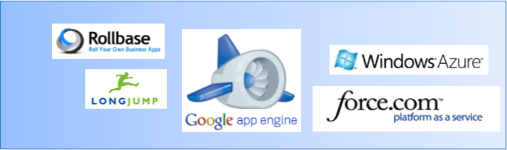

Understanding the Cloud Computing Landscape
SaaS
PaaS
IaaS
Source: Gartner AADI Summit Dec 2009

Slide 4

Our New Offerings
Google App Engine
Platform
Big Query
Prediction APIs
Infrastructure
Google Storage
Google’s Infrastructure : GFS, BigTable

Slide 5

Google App Engine
Easy to build
Easy to manage
Easy to scale
Notes:
- SCALABLE web hosting platform
- Built on Google technology: on existing Google SERVICES
- Utilizing the same INFRASTRUCTURE you probably already use each day
BUILD - Rapid application development for Java & Python; ONE CLICK DEPLOYMENT to the cloudMANAGE - Full featured cloud based management of applicationsSCALE - RAPIDLY scale to handle the dynamic needs of your business and the GROWING NUMBER OF APPS it requires

Slide 6

















App Engine
Notes:
Via YouTube Direct: The Washington Post, The San Francisco Chronicle, NPR, The Huffington Post and ABC's Good Morning America?

Slide 7
Google App Engine -Details

Slide 8
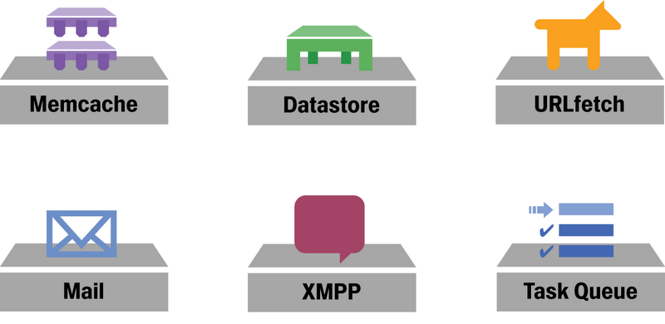

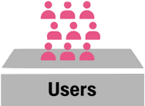
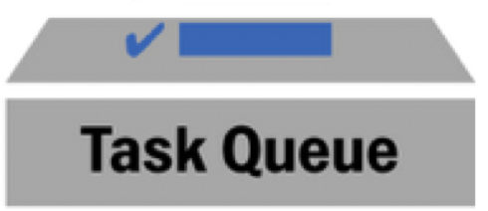
Distributed Meme: Divide & Conquer
Specialized services
Memcache
Datastore
URL Fetch
Mail
XMPP
Task Queue
Images
Blobstore
User Service
Notes:
EXISTING GOOGLE SERVICES made available to your App Engine apps
SPECIALIZATION: Do ONE THING. Do it WELL.
- Doing one thing well is EASIER than doing a lot of different things
- Less complexity: fewer corner cases, fewer bugs
- Offload App Servers - they SPECIALIZE in serving web requests

Slide 9


Language runtimes
Duke, the Java mascot
Copyright © Sun Microsystems Inc., all rights reserved.

Slide 10
JVM languages
Scala
JRuby (Ruby)
Groovy
Quercus (PHP)
Rhino (JavaScript)
Jython (Python)

Slide 11
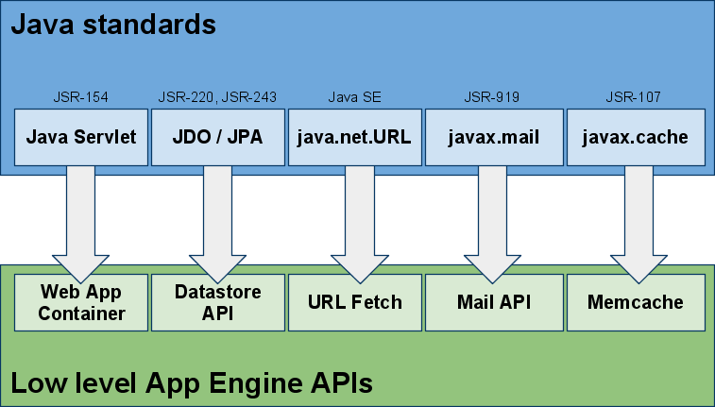
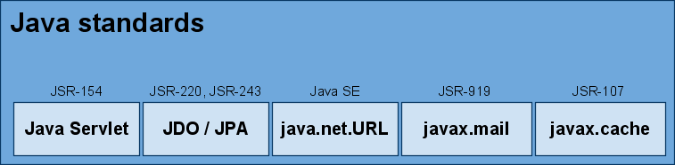
Ensuring portability

Slide 12
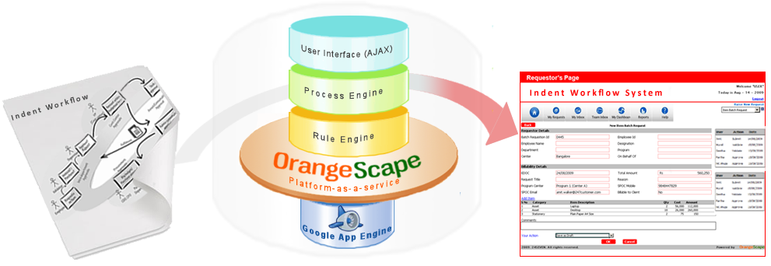

GAE in Enterprise – Build business applications using OrangeScape
Case in point:
24SEVEN Customer runs its Purchase system on OrangeScape/GAE and integrates with Oracle ERP
OrangeScape for Application design - “Build business apps faster, easier”
Google App Engine for Application architecture -“Build apps that scale, highly available”

Slide 13
New Features in GAE 1.4

Slide 14
New Features in App Engine 1.4
Always on Instances
Warming requests
Increased time limit for Task Queues and cron jobs
Increased size for URL Fetch
Channel APIs

Slide 15
App Engine Instances
App Engine Instance
  Basic unit in App Engine
  App engine applications are deployed in sandboxed instances
Scaling
  App is scaled by deploying it on new instances
  Deployment on new instances increases latency (because of load time)

Slide 16
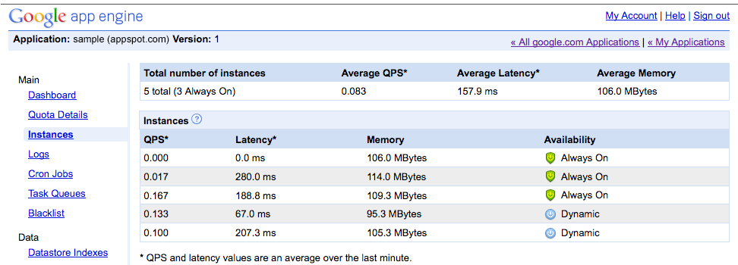
App Engine Instances
Always On Instances
  Specify always on instances for your app
  $9 per month
  Max number of reserved Instances : 3

Slide 17

App Engine Instances
Warming requests : Preload part of the initialization code to reduce load time
  Java
    Configuration – one of the following
      appengine-web.xml :<warmup-requests-enabled>false</warmup-requests-enabled> : warming is turned on by default
      web.xml : <load-on-startup>1</load-on-startup>
      Servlet Context Listener
      Warm up servlet : use built in definition :_ah_warmup

Slide 18

Google App Engine for Business
Build and deploy apps. Without all the hassles.

Slide 19


Google App Engine for Business
Same scalable cloud hosting platform. Designed for the enterprise.
Enterprise application management
  Centralized domain console
Enterprise reliability and support
  99.9% Service Level Agreement
  Premium Developer Support
Hosted SQL
  Managed relational SQL database in the cloud
SSL on your domain
  Including "naked" domain support
Secure by default
  Integrated Single Sign On (SSO)
Pricing that makes sense
  Pay only for what you use
Google App Engine
for Business
* Hosted SQL and SSL on your domain available later this year
Notes:
GAE4B = APP ENGINE ++

Slide 20
Google Storage for Developers
Store your data in Google's cloud

Slide 21
What Is Google Storage?
Store your data in Google's cloud
any format, any amount, any time
You control access to your data
private, shared, or public
Access via Google APIs or 3rd party tools/libraries

Slide 22
Sample Use Cases
Static content hosting
e.g. static html, images, music, video
Backup and recovery
e.g. personal data, business records
Sharing
e.g. share data with your customers
Data storage for applications
e.g. used as storage backend for Android, App Engine, Cloud based apps
Storage for Computation
e.g. BigQuery, Prediction API

Slide 23



Google Storage Benefits
High Performance and Scalability
Backed by Google infrastructure
Strong Security and Privacy
Control access to your data
Easy to Use
Get started fast with Google & 3rd party tools

Slide 24
Google Storage Technical Details
RESTful API
Verbs: GET, PUT, POST, HEAD, DELETE
Resources: identified by URI
Compatible with S3
Buckets
Flat containers, i.e. no bucket hierarchy
Objects
Any type
Size: 100 GB / object
Access Control for Google Accounts
For individuals and groups
Two Ways to Authenticate Requests
Sign request using access keys
Web browser login

Slide 25
Performance and Scalability
Objects of any type and 100 GB / Object
Unlimited numbers of objects, 1000s of buckets
All data replicated to multiple US data centers
Leveraging Google's worldwide network for data delivery
Only you can use bucket names with your domain names
“Read-your-writes” data consistency
Range Get

Slide 26
Security and Privacy Features
Key-based authentication
Authenticated downloads from a web browser
Sharing with individuals
Group sharing via Google Groups
Access control for buckets and objects
Set Read/Write/List permissions

Slide 27
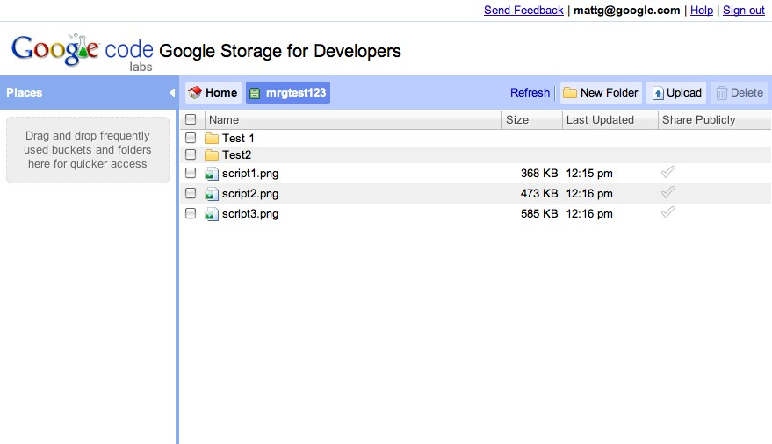
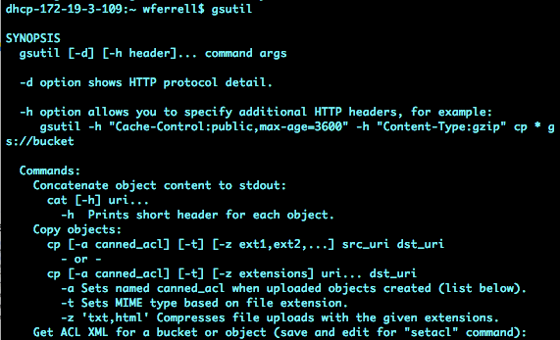
Tools
Google Storage Manager
gsutil

Slide 28







Google Storage usage within Google
Google BigQuery
Google
Prediction API
Haiti Relief Imagery
USPTO data
Partner Reporting
Partner Reporting

Slide 29













Some Early Google Storage Adopters
Notes:
CloudSherpas (Google Apps management tools) porting to Google Storage
MediaBeacon publishes US Navy Image Services Media files to media outlets
SocialWork is "Facebook for the enterprise". Share image including Phone in demo

Slide 30
Google Storage - Pricing
Storage
$0.17/GB/Month
Network
Upload - $0.10/GB
Download
$0.30/GB APAC
$0.15/GB Americas / EMEA
Requests
PUT, POST, LIST - $0.01 / 1,000 Requests
GET, HEAD - $0.01 / 10,000 Requests

Slide 31
Google Storage - Availability
Limited preview in US* currently
100GB free storage and network per account
Sign up for wait list at
    http://code.google.com/apis/storage/
* Non-US preview available on case-by-case basis

Slide 32
Google Storage Summary
Store any kind of data using Google's cloud infrastructure
Easy to Use APIs
Many available tools and libraries
gsutil, Google Storage Manager
3rd party:
Boto, CloudBerry, CyberDuck, JetS3t, …

Slide 33
Google Prediction API
Google's prediction engine in the cloud

Slide 34
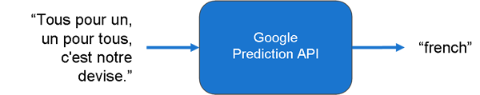
Introducing the Google Prediction API
  Google's sophisticated machine learning technology
  Available as an on-demand RESTful HTTP web service

Slide 35

How does it work?
1. TRAIN
The Prediction API
finds relevant
features in the sample data during training.
"english" | The quick brown fox jumped over the lazy dog.
"english" | To err is human, but to really foul things up you need a computer.
"spanish" | No hay mal que por bien no venga.
"spanish" | La tercera es la vencida.
2. PREDICT
The Prediction API
later searches for
those features
during prediction.
? | To be or not to be, that is the question.
? | La fe mueve montañas.

Slide 36



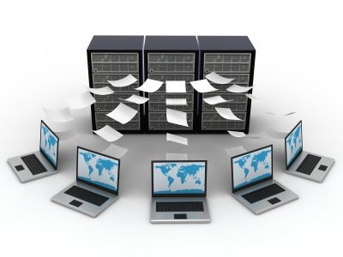











A virtually endless number of applications...
Customer
Sentiment
Transaction
Risk
Species
Identification
Message
Routing
Diagnostics
Churn
Prediction
Legal Docket
Classification
Suspicious
Activity
Work Roster
Assignment
Inappropriate
Content
Recommend
Products
Political
Bias
Uplift
Marketing
Email
Filtering
Career
Counseling
... and many more ...
Notes:
Unending number of example uses across many domains...
emphasize: sentiment in restaurant reviews, email message routing, racy content identification, product recommendations

Slide 37
A Prediction API Example
Automatically categorize and respond to emails by language
  Customer: ACME Corp, a multinational organization
  Goal: Respond to customer emails in their language
  Data: Many emails, tagged with their languages
  Outcome: Predict language and respond accordingly
Notes:
"Well, if you wanted exactly this task, you could use our translation toolkit, but here's how yu might build one yourself"

Slide 38



Using the Prediction API
A simple three step process...
Upload your training data to
Google Storage
1. Upload
Build a model from your data
2. Train
3. Predict
Make new predictions

Slide 39
Step 1: Upload
Upload your training data to Google Storage
  Training data: outputs and input features
  Data format: comma separated value format (CSV), result in first column
"english","To err is human, but to really ..."
"spanish","No hay mal que por bien no venga."
...
Upload to Google Storage
gsutil cp ${data} gs://yourbucket/${data}

Slide 40
Step 2: Train
Create a new model by training on data
To train a model:
POST prediction/v1.1/training?data=mybucket%2Fmydata
Training runs asynchronously. To see if it has finished:
GET prediction/v1.1/training/mybucket%2Fmydata
{"data":{
"data":"mybucket/mydata",
"modelinfo":"estimated accuracy: 0.xx"}}}

Slide 41
Step 3: Predict
Apply the trained model to make predictions on new data
POST prediction/v1.1/query/mybucket%2Fmydata/predict
{ "data":{
"input": { "text" : [
"J'aime X! C'est le meilleur" ]}}}

Slide 42
Step 3: Predict
Apply the trained model to make predictions on new data
POST prediction/v1.1/query/mybucket%2Fmydata/predict
{ "data":{
"input": { "text" : [
"J'aime X! C'est le meilleur" ]}}}
{ data : {
"kind" : "prediction#output",
"outputLabel":"French",
"outputMulti" :[
{"label":"French", "score": x.xx}
{"label":"English", "score": x.xx}
{"label":"Spanish", "score": x.xx}]}}

Slide 43
Step 3: Predict
Apply the trained model to make predictions on new data
import httplib
# put new data in JSON format
params = { ... }
header = {"Content-Type" : "application/json"}
conn = httplib.HTTPConnection("www.googleapis.com")conn.request("POST",
"/prediction/v1.1/query/mybucket%2Fmydata/predict",
params, header)
print conn.getresponse()
Notes:
We could then upload this python script to AppEngine and run it from there as part of a deployed application.

Slide 44
Prediction API Capabilities
Data
  Input Features: numeric or unstructured text
  Output: up to hundreds of discrete categories
Training
  Many machine learning techniques
  Automatically selected
  Performed asynchronously
Access from many platforms:
  Web app from Google App Engine
  Apps Script (e.g. from Google Spreadsheet)
  Desktop app
Notes:
emphasize:
-- we run the hardware
-- we worry about keeping the service up and running, you just use it.

Slide 45
Prediction API v1.1 - new features
  Updated Syntax
  Multi-category prediction
    Tag entry with multiple labels
  Continuous Output
    Finer grained prediction rankings based on multiple labels
  Mixed Inputs
    Both numeric and text inputs are now supported
Can combine continuous output with mixed inputs
Notes:
emphasize:
-- we run the hardware
-- we worry about keeping the service up and running, you just use it.

Slide 46
Google BigQuery
Interactive analysis of large datasets in Google's cloud

Slide 47
Introducing Google BigQuery
  Google's large data adhoc analysis technology
    Analyze massive amounts of data in seconds
  Simple SQL-like query language
  Flexible access
    REST APIs, JSON-RPC, Google Apps Script
Notes:
would like to add graphic

Slide 48
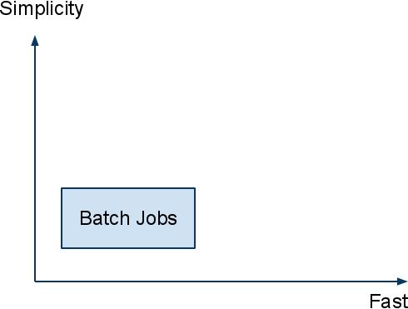

Why BigQuery?
Working with large data is a challenge

Slide 49




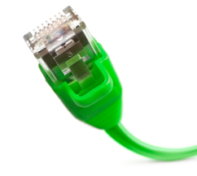

Many Use Cases ...
Trends
Detection
Interactive Tools
Spam
Web Dashboards
Network Optimization

Slide 50
Key Capabilities of BigQuery
  Scalable: Billions of rows
  Fast: Response in seconds
  Simple: Queries in SQL
  Web Service
    REST
    JSON-RPC
    Google App Scripts

Slide 51
Using BigQuery
Another simple three step process...
Upload your raw data to
Google Storage
1. Upload
Import raw data into BigQuery table
2. Import
3. Query
Perform SQL queries on table

Slide 52
Writing Queries
Compact subset of SQL
    SELECT ... FROM ...
    WHERE ...
    GROUP BY ... ORDER BY ...
    LIMIT ...;
Common functions
    Math, String, Time, ...
Additional statistical approximations
    TOP
    COUNT DISTINCT

Slide 53
BigQuery via REST
GET /bigquery/v1/tables/{table name}
GET /bigquery/v1/query?q={query}
Sample JSON Reply:
{
"results": {
"fields": { [
{"id":"COUNT(*)","type":"uint64"}, ... ]
},
"rows": [
{"f":[{"v":"2949"}, ...]},
{"f":[{"v":"5387"}, ...]}, ... ]
}
}
Also supports JSON-RPC

Slide 54
Security and Privacy
Standard Google Authentication
  Client Login
  OAuth
  AuthSub
HTTPS support
  protects your credentials
  protects your data
Relies on Google Storage to manage access

Slide 55
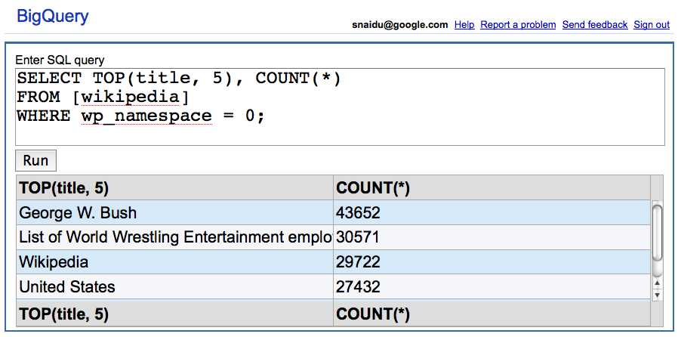
Large Data Analysis Example
Wikimedia Revision History
Wikimedia Revision history data from:
http://download.wikimedia.org/enwiki/latest/enwiki-latest-pages-meta-history.xml.7z

Slide 56
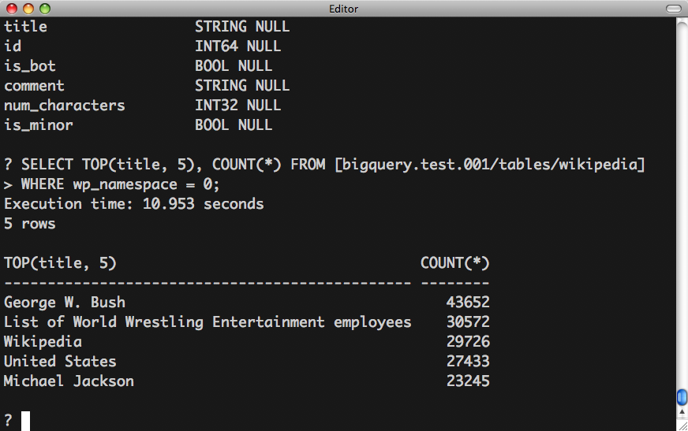
Using BigQuery Shell
Python DB API 2.0 + B. Clapper's sqlcmd
http://www.clapper.org/software/python/sqlcmd/

Slide 57
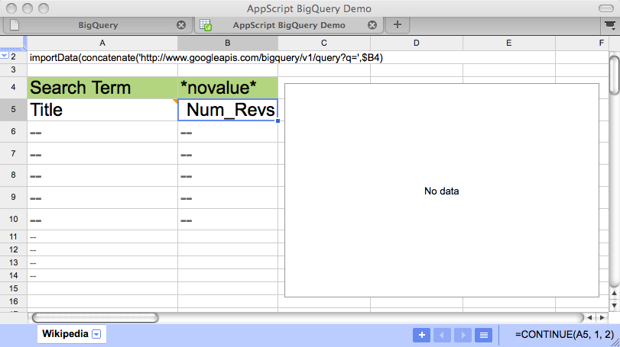
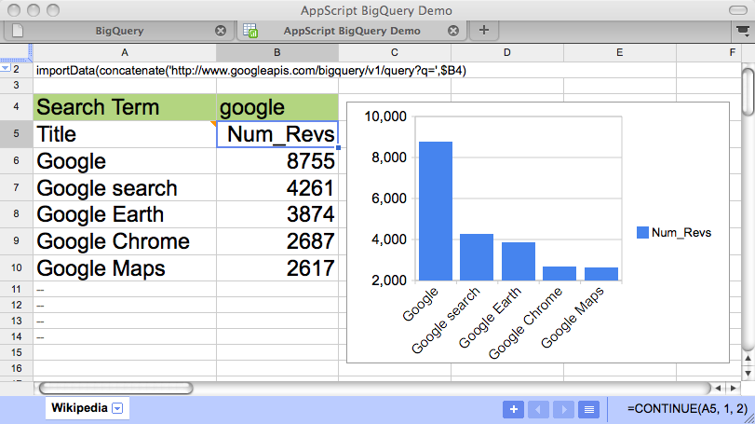
BigQuery from a Spreadsheet

Slide 58
Recap
  Google Storage
    High speed data storage on Google Cloud
  Prediction API
    Google's machine learning technology able to predict outcomes based on sample data
  BigQuery
    Interactive analysis of very large data sets
    Simple SQL query language access

Slide 59
More information
  Google Storage for Developers
    http://code.google.com/apis/storage
  Prediction API
    http://code.google.com/apis/prediction
  BigQuery
    http://code.google.com/apis/bigquery

