Slide 1
The LLVM Compiler Framework and Infrastructure
Chris Lattner
lattner@cs.uiuc.edu
Vikram Adve
vadve@cs.uiuc.edu
http://llvm.cs.uiuc.edu/
LCPC Tutorial: September 22, 2004

Slide 2
Acknowledgements
UIUC Contributors:
  Tanya Brethour
  Misha Brukman
  Cameron Buschardt
  John Criswell
  Alkis Evlogimenos
  Brian Gaeke
  Ruchira Sasanka
  Anand Shukla
  Bill Wendling
External Contributors:
  Henrik Bach
  Nate Begeman
  Jeff Cohen
  Paolo Invernizzi
  Brad Jones
  Vladimir Merzliakov
  Vladimir Prus
  Reid Spencer
Funding:
This work is sponsored by the NSF Next Generation Software program through grants EIA-0093426 (an NSF CAREER award) and EIA-0103756. It is also supported in part by the NSF Operating Systems and Compilers program (grant #CCR-9988482), the NSF Embedded Systems program (grant #CCR-0209202), the MARCO/DARPA Gigascale Systems Research Center (GSRC), IBM through the DARPA-funded PERCS project, and the Motorola University Partnerships in Research program.

Slide 3
LLVM Compiler System
The LLVM Compiler Infrastructure
  Provides reusable components for building compilers
  Reduce the time/cost to build a new compiler
  Build static compilers, JITs, trace-based optimizers, ...
The LLVM Compiler Framework
  End-to-end compilers using the LLVM infrastructure
  C and C++ are robust and aggressive:
    Java, Scheme and others are in development
  Emit C code or native code for X86, Sparc, PowerPC

Slide 4
Three primary LLVM components
The LLVM Virtual Instruction Set
  The common language- and target-independent IR
  Internal (IR) and external (persistent) representation
A collection of well-integrated libraries
  Analyses, optimizations, code generators, JIT compiler, garbage collection support, profiling, …
A collection of tools built from the libraries
  Assemblers, automatic debugger, linker, code generator, compiler driver, modular optimizer, …

Slide 5
Tutorial Overview
Introduction to the running example
LLVM C/C++ Compiler Overview
  High-level view of an example LLVM compiler
The LLVM Virtual Instruction Set
  IR overview and type-system
LLVM C++ IR and important API’s
  Basics, PassManager, dataflow, ArgPromotion
Important LLVM Tools
  opt, code generator, JIT, test suite, bugpoint
Example applications of LLVM

Slide 6
Running example: arg promotion
Consider use of by-reference parameters:
int callee(const int &X) {
return X+1;
}
int caller() {
return callee(4);
}
int callee(const int *X) {
return *X+1; // memory load
}
int caller() {
int tmp; // stack object
tmp = 4; // memory store
return callee(&tmp);
}
compiles to
We want:
int callee(int X) {
return X+1;
}
int caller() {
return callee(4);
}
Eliminated load in callee
Eliminated store in caller
Eliminated stack slot for ‘tmp’

Slide 7
Why is this hard?
Requires interprocedural analysis:
  Must change the prototype of the callee
  Must update all call sites → we must know all callers
  What about callers outside the translation unit?
Requires alias analysis:
  Reference could alias other pointers in callee
  Must know that loaded value doesn’t change from function entry to the load
  Must know the pointer is not being stored through
Reference might not be to a stack object!

Slide 8
Tutorial Overview
Introduction to the running example
LLVM C/C++ Compiler Overview
  High-level view of an example LLVM compiler
The LLVM Virtual Instruction Set
  IR overview and type-system
LLVM C++ IR and important API’s
  Basics, PassManager, dataflow, ArgPromotion
Important LLVM Tools
  opt, code generator, JIT, test suite, bugpoint
Example applications of LLVM

Slide 9
The LLVM C/C++ Compiler
From the high level, it is a standard compiler:
  Compatible with standard makefiles
  Uses GCC 3.4 C and C++ parser
Distinguishing features:
  Uses LLVM optimizers, not GCC optimizers
  .o files contain LLVM IR/bytecode, not machine code
  Executable can be bytecode (JIT’d) or machine code
C file
llvmgcc
.o file
llvm linker
executable
C++ file
llvmg++
.o file
Compile Time
Link Time

Slide 10
Looking into events at compile-time
C file
llvmgcc
.o file
C++ file
llvmg++
.o file
C to LLVM Frontend
Compile-time Optimizer
C++ to LLVM Frontend
Compile-time Optimizer
“cc1”
“gccas”
“cc1plus”
“gccas”
Modified version of GCC
Emits LLVM IR as text file
Lowers C AST to LLVM
Modified version of G++
Emits LLVM IR as text file
Lowers C++ AST to LLVM
LLVM IR Parser
LLVM Verifier
40 LLVM Analysis & Optimization Passes
LLVM .bc File Writer
Dead Global Elimination, IP Constant Propagation, Dead Argument Elimination, Inlining, Reassociation, LICM, Loop Opts, Memory Promotion, Dead Store Elimination, ADCE, …

Slide 11
Looking into events at link-time
.o file
llvm linker
executable
.o file
.o file
LLVM Linker
Link-time Optimizer
.bc file for LLVM JIT
.o file
Native Code Backend
Native executable
20 LLVM Analysis & Optimization Passes
“llc”
C Code Backend
C Compiler
Native executable
Optionally “internalizes”: marks most functions as internal, to improve IPO
“gcc”
“llc –march=c”
Link in native .o files and libraries here
Perfect place for argument promotion optimization!

Slide 12
Goals of the compiler design
Analyze and optimize as early as possible:
  Compile-time opts reduce modify-rebuild-execute cycle
  Compile-time optimizations reduce work at link-time (by shrinking the program)
All IPA/IPO make an open-world assumption
  Thus, they all work on libraries and at compile-time
  “Internalize” pass enables “whole program” optzn
One IR (without lowering) for analysis & optzn
  Compile-time optzns can be run at link-time too!
  The same IR is used as input to the JIT
  IR design is the key to these goals!

Slide 13
Tutorial Overview
Introduction to the running example
LLVM C/C++ Compiler Overview
  High-level view of an example LLVM compiler
The LLVM Virtual Instruction Set
  IR overview and type-system
LLVM C++ IR and important API’s
  Basics, PassManager, dataflow, ArgPromotion
Important LLVM Tools
  opt, code generator, JIT, test suite, bugpoint
Example applications of LLVM

Slide 14
Goals of LLVM IR
Easy to produce, understand, and define!
Language- and Target-Independent
  AST-level IR (e.g. ANDF, UNCOL) is not very feasible
    Every analysis/xform must know about ‘all’ languages
One IR for analysis and optimization
  IR must be able to support aggressive IPO, loop opts, scalar opts, … high- and low-level optimization!
Optimize as much as early as possible
  Can’t postpone everything until link or runtime
  No lowering in the IR!

Slide 15
LLVM Instruction Set Overview #1
Low-level and target-independent semantics
  RISC-like three address code
  Infinite virtual register set in SSA form
  Simple, low-level control flow constructs
  Load/store instructions with typed-pointers
IR has text, binary, and in-memory forms
loop:
%i.1 = phi int [ 0, %bb0 ], [ %i.2, %loop ]
%AiAddr = getelementptr float* %A, int %i.1
call void %Sum(float %AiAddr, %pair* %P)
%i.2 = add int %i.1, 1
%tmp.4 = setlt int %i.1, %N
br bool %tmp.4, label %loop, label %outloop
for (i = 0; i < N;
++i)
Sum(&A[i], &P);

Slide 16
LLVM Instruction Set Overview #2
High-level information exposed in the code
  Explicit dataflow through SSA form
  Explicit control-flow graph (even for exceptions)
  Explicit language-independent type-information
  Explicit typed pointer arithmetic
    Preserve array subscript and structure indexing
loop:
%i.1 = phi int [ 0, %bb0 ], [ %i.2, %loop ]
%AiAddr = getelementptr float* %A, int %i.1
call void %Sum(float %AiAddr, %pair* %P)
%i.2 = add int %i.1, 1
%tmp.4 = setlt int %i.1, %N
br bool %tmp.4, label %loop, label %outloop
for (i = 0; i < N;
++i)
Sum(&A[i], &P);

Slide 17
LLVM Type System Details
The entire type system consists of:
  Primitives: void, bool, float, ushort, opaque, …
  Derived: pointer, array, structure, function
  No high-level types: type-system is language neutral!
Type system allows arbitrary casts:
  Allows expressing weakly-typed languages, like C
  Front-ends can implement safe languages
  Also easy to define a type-safe subset of LLVM
See also: docs/LangRef.html

Slide 18
Lowering source-level types to LLVM
Source language types are lowered:
  Rich type systems expanded to simple type system
  Implicit & abstract types are made explicit & concrete
Examples of lowering:
  References turn into pointers: T& → T*
  Complex numbers: complex float → { float, float }
  Bitfields: struct X { int Y:4; int Z:2; } → { int }
  Inheritance: class T : S { int X; } → { S, int }
  Methods: class T { void foo(); } → void foo(T*)
Same idea as lowering to machine code

Slide 19
LLVM Program Structure
Module contains Functions/GlobalVariables
  Module is unit of compilation/analysis/optimization
Function contains BasicBlocks/Arguments
  Functions roughly correspond to functions in C
BasicBlock contains list of instructions
  Each block ends in a control flow instruction
Instruction is opcode + vector of operands
  All operands have types
  Instruction result is typed

Slide 20
Our example, compiled to LLVM
int callee(const int *X) {
return *X+1; // load
}
int caller() {
int T; // on stack
T = 4; // store
return callee(&T);
}
internal int %callee(int* %X) {
%tmp.1 = load int* %X
%tmp.2 = add int %tmp.1, 1
ret int %tmp.2
}
int %caller() {
%T = alloca int
store int 4, int* %T
%tmp.3 = call int %callee(int* %T)
ret int %tmp.3
}
Stack allocation is explicit in LLVM
All loads/stores are explicit in the LLVM representation
Linker “internalizes” most functions in most cases

Slide 21
Our example, desired transformation
internal int %callee(int* %X) {
%tmp.1 = load int* %X
%tmp.2 = add int %tmp.1, 1
ret int %tmp.2
}
int %caller() {
%T = alloca int
store int 4, int* %T
%tmp.3 = call int %callee(int* %T)
ret int %tmp.3
}
internal int %callee(int %X.val) {
%tmp.2 = add int %X.val, 1
ret int %tmp.2
}
int %caller() {
%T = alloca int
store int 4, int* %T
%tmp.1 = load int* %T
%tmp.3 = call int %callee(%tmp.1)
ret int %tmp.3
}
Update all call sites of ‘callee’
Other transformation
(-mem2reg) cleans up the rest
Change the prototype for the function
Insert load instructions into all callers
int %caller() {
%tmp.3 = call int %callee(int 4)
ret int %tmp.3
}

Slide 22
Tutorial Overview
Introduction to the running example
LLVM C/C++ Compiler Overview
  High-level view of an example LLVM compiler
The LLVM Virtual Instruction Set
  IR overview and type-system
LLVM C++ IR and important API’s
  Basics, PassManager, dataflow, ArgPromotion
Important LLVM Tools
  opt, code generator, JIT, test suite, bugpoint
Example applications of LLVM

Slide 23
LLVM Coding Basics
Written in modern C++, uses the STL:
  Particularly the vector, set, and map classes
LLVM IR is almost all doubly-linked lists:
  Module contains lists of Functions & GlobalVariables
  Function contains lists of BasicBlocks & Arguments
  BasicBlock contains list of Instructions
Linked lists are traversed with iterators:
  Function *M = …
  for (Function::iterator I = M->begin(); I != M->end(); ++I) {
  BasicBlock &BB = *I;
  ...
See also: docs/ProgrammersManual.html

Slide 24
LLVM Pass Manager
Compiler is organized as a series of ‘passes’:
  Each pass is one analysis or transformation
Four types of Pass:
  ModulePass: general interprocedural pass
  CallGraphSCCPass: bottom-up on the call graph
  FunctionPass: process a function at a time
  BasicBlockPass: process a basic block at a time
Constraints imposed (e.g. FunctionPass):
  FunctionPass can only look at “current function”
  Cannot maintain state across functions
See also: docs/WritingAnLLVMPass.html

Slide 25
Services provided by PassManager
Optimization of pass execution:
  Process a function at a time instead of a pass at a time
  Example: If F, G, H are three functions in input pgm: “FFFFGGGGHHHH” not “FGHFGHFGHFGH”
  Process functions in parallel on an SMP (future work)
Declarative dependency management:
  Automatically fulfill and manage analysis pass lifetimes
  Share analyses between passes when safe:
    e.g. “DominatorSet live unless pass modifies CFG”
Avoid boilerplate for traversal of program
See also: docs/WritingAnLLVMPass.html

Slide 26
Pass Manager + Arg Promotion #1/2
Arg Promotion is a CallGraphSCCPass:
  Naturally operates bottom-up on the CallGraph
    Bubble pointers from callees out to callers
24: #include "llvm/CallGraphSCCPass.h"
47: struct SimpleArgPromotion : public CallGraphSCCPass {
Arg Promotion requires AliasAnalysis info
  To prove safety of transformation
    Works with any alias analysis algorithm though
48: virtual void getAnalysisUsage(AnalysisUsage &AU) const {
AU.addRequired<AliasAnalysis>(); // Get aliases
AU.addRequired<TargetData>(); // Get data layout
CallGraphSCCPass::getAnalysisUsage(AU); // Get CallGraph
}

Slide 27
Pass Manager + Arg Promotion #2/2
Finally, implement runOnSCC (line 65):
bool SimpleArgPromotion::
runOnSCC(const std::vector<CallGraphNode*> &SCC) {
bool Changed = false, LocalChange;
do { // Iterate until we stop promoting from this SCC.
LocalChange = false;
// Attempt to promote arguments from all functions in this SCC.
for (unsigned i = 0, e = SCC.size(); i != e; ++i)
LocalChange |= PromoteArguments(SCC[i]);
Changed |= LocalChange; // Remember that we changed something.
} while (LocalChange);
return Changed; // Passes return true if something changed.
}
static int foo(int ***P) {
return ***P;
}
static int foo(int P_val_val_val) {
return P_val_val_val;
}

Slide 28
LLVM Dataflow Analysis
LLVM IR is in SSA form:
  use-def and def-use chains are always available
  All objects have user/use info, even functions
Control Flow Graph is always available:
  Exposed as BasicBlock predecessor/successor lists
  Many generic graph algorithms usable with the CFG
Higher-level info implemented as passes:
  Dominators, CallGraph, induction vars, aliasing, GVN, …
See also: docs/ProgrammersManual.html

Slide 29
Arg Promotion: safety check #1/4
#1: Function must be “internal” (aka “static”)
88: if (!F || !F->hasInternalLinkage()) return false;
#2: Make sure address of F is not taken
  In LLVM, check that there are only direct calls using F
99: for (Value::use_iterator UI = F->use_begin();
UI != F->use_end(); ++UI) {
CallSite CS = CallSite::get(*UI);
if (!CS.getInstruction()) // "Taking the address" of F.
return false;
#3: Check to see if any args are promotable:
114: for (unsigned i = 0; i != PointerArgs.size(); ++i)
if (!isSafeToPromoteArgument(PointerArgs[i]))
PointerArgs.erase(PointerArgs.begin()+i);
if (PointerArgs.empty()) return false; // no args promotable
Notes:
Checks are ordered from least costly to most costly. The idea is to reject a candidate function as fast as possible.

Slide 30
Arg Promotion: safety check #2/4
#4: Argument pointer can only be loaded from:
  No stores through argument pointer allowed!
// Loop over all uses of the argument (use-def chains).
138: for (Value::use_iterator UI = Arg->use_begin();
UI != Arg->use_end(); ++UI) {
// If the user is a load:
if (LoadInst *LI = dyn_cast<LoadInst>(*UI)) {
// Don't modify volatile loads.
if (LI->isVolatile()) return false;
Loads.push_back(LI);
} else {
return false; // Not a load.
}
}

Slide 31
Arg Promotion: safety check #3/4
#5: Value of “*P” must not change in the BB
  We move load out to the caller, value cannot change!
// Get AliasAnalysis implementation from the pass manager.
156: AliasAnalysis &AA = getAnalysis<AliasAnalysis>();
// Ensure *P is not modified from start of block to load
169: if (AA.canInstructionRangeModify(BB->front(), *Load,
Arg, LoadSize))
return false; // Pointer is invalidated!
Modifies “*P”?
…
…
load P
…
See also: docs/AliasAnalysis.html

Slide 32
Arg Promotion: safety check #4/4
#6: “*P” cannot change from Fn entry to BB
175: for (pred_iterator PI = pred_begin(BB), E = pred_end(BB);
PI != E; ++PI) // Loop over predecessors of BB.
// Check each block from BB to entry (DF search on inverse graph).
for (idf_iterator<BasicBlock*> I = idf_begin(*PI);
I != idf_end(*PI); ++I)
// Might *P be modified in this basic block?
if (AA.canBasicBlockModify(**I, Arg, LoadSize))
return false;
Modifies “*P”?
Modifies “*P”?
Entry
Entry
load P
load P

Slide 33
Arg Promotion: xform outline #1/4
#1: Make prototype with new arg types: #197
  Basically just replaces ‘int*’ with ‘int’ in prototype
#2: Create function with new prototype:
214: Function *NF = new Function(NFTy, F->getLinkage(),
F->getName());
F->getParent()->getFunctionList().insert(F, NF);
#3: Change all callers of F to call NF:
// If there are uses of F, then calls to it remain.
221: while (!F->use_empty()) {
// Get a caller of F.
CallSite CS = CallSite::get(F->use_back());

Slide 34
Arg Promotion: xform outline #2/4
#4: For each caller, add loads, determine args
  Loop over the args, inserting the loads in the caller
220: std::vector<Value*> Args;
226: CallSite::arg_iterator AI = CS.arg_begin();
for (Function::aiterator I = F->abegin(); I != F->aend();
++I, ++AI)
if (!ArgsToPromote.count(I)) // Unmodified argument.
Args.push_back(*AI);
else { // Insert the load before the call.
LoadInst *LI = new LoadInst(*AI, (*AI)->getName()+".val",
Call); // Insertion point
Args.push_back(LI);
}

Slide 35
Arg Promotion: xform outline #3/4
#5: Replace the call site of F with call of NF
// Create the call to NF with the adjusted arguments.
242: Instruction *New = new CallInst(NF, Args, "", Call);
// If the return value of the old call was used, use the retval of the new call.
if (!Call->use_empty())
Call->replaceAllUsesWith(New);
// Finally, remove the old call from the program, reducing the use-count of F.
Call->getParent()->getInstList().erase(Call);
#6: Move code from old function to new Fn
259: NF->getBasicBlockList().splice(NF->begin(),
F->getBasicBlockList());

Slide 36
Arg Promotion: xform outline #4/4
#7: Change users of F’s arguments to use NF’s
264: for (Function::aiterator I = F->abegin(), I2 = NF->abegin();
I != F->aend(); ++I, ++I2)
if (!ArgsToPromote.count(I)) { // Not promoting this arg?
I->replaceAllUsesWith(I2); // Use new arg, not old arg.
} else {
while (!I->use_empty()) { // Only users can be loads.
LoadInst *LI = cast<LoadInst>(I->use_back());
LI->replaceAllUsesWith(I2);
LI->getParent()->getInstList().erase(LI);
}
}
#8: Delete old function:
286: F->getParent()->getFunctionList().erase(F);

Slide 37
Tutorial Overview
Introduction to the running example
LLVM C/C++ Compiler Overview
  High-level view of an example LLVM compiler
The LLVM Virtual Instruction Set
  IR overview and type-system
LLVM C++ IR and important API’s
  Basics, PassManager, dataflow, ArgPromotion
Important LLVM Tools
  opt, code generator, JIT, test suite, bugpoint
Example applications of LLVM

Slide 38
LLVM tools: two flavors
“Primitive” tools: do a single job
  llvm-as: Convert from .ll (text) to .bc (binary)
  llvm-dis: Convert from .bc (binary) to .ll (text)
  llvm-link: Link multiple .bc files together
  llvm-prof: Print profile output to human readers
  llvmc: Configurable compiler driver
Aggregate tools: pull in multiple features
  gccas/gccld: Compile/link-time optimizers for C/C++ FE
  bugpoint: automatic compiler debugger
  llvm-gcc/llvm-g++: C/C++ compilers
See also: docs/CommandGuide/

Slide 39
opt tool: LLVM modular optimizer
Invoke arbitrary sequence of passes:
  Completely control PassManager from command line
  Supports loading passes as plugins from .so files
opt -load foo.so -pass1 -pass2 -pass3 x.bc -o y.bc
Passes “register” themselves:
61: RegisterOpt<SimpleArgPromotion> X("simpleargpromotion",
"Promote 'by reference' arguments to 'by value'");
From this, they are exposed through opt:
  > opt -load libsimpleargpromote.so –help
  ...
  -sccp - Sparse Conditional Constant Propagation
  -simpleargpromotion - Promote 'by reference' arguments to 'by
  -simplifycfg - Simplify the CFG
  ...

Slide 40
Running Arg Promotion with opt
Basic execution with ‘opt’:
  opt -simpleargpromotion in.bc -o out.bc
  Load .bc file, run pass, write out results
  Use “-load filename.so” if compiled into a library
  PassManager resolves all dependencies
Optionally choose an alias analysis to use:
  opt –basicaa –simpleargpromotion (default)
  Alternatively, –steens-aa, –anders-aa, –ds-aa, …
Other useful options available:
  -stats: Print statistics collected from the passes
  -time-passes: Time each pass being run, print output

Slide 41
Example -stats output (gccas 176.gcc)
===-------------------------------------------------------------------------===
... Statistics Collected ...
===-------------------------------------------------------------------------===
23426 adce - Number of instructions removed
1663 adce - Number of basic blocks removed
5052592 bytecodewriter - Number of bytecode bytes written
57489 cfgsimplify - Number of blocks simplified
4186 constmerge - Number of global constants merged
211 dse - Number of stores deleted
15943 gcse - Number of loads removed
54245 gcse - Number of instructions removed
253 inline - Number of functions deleted because all callers found
3952 inline - Number of functions inlined
9425 instcombine - Number of constant folds
160469 instcombine - Number of insts combined
208 licm - Number of load insts hoisted or sunk
4982 licm - Number of instructions hoisted out of loop
350 loop-unroll - Number of loops completely unrolled
30156 mem2reg - Number of alloca's promoted
2934 reassociate - Number of insts with operands swapped
650 reassociate - Number of insts reassociated
67 scalarrepl - Number of allocas broken up
279 tailcallelim - Number of tail calls removed
25395 tailduplicate - Number of unconditional branches eliminated
..........................
Notes:
Numbers excerpted from gccas on the entire 176.gcc program linked together into one module

Slide 42
Example -time-passes (gccas 176.gcc)
===-------------------------------------------------------------------------===
... Pass execution timing report ...
===-------------------------------------------------------------------------===
---User Time--- --System Time-- --User+System-- ---Wall Time--- --- Name ---
16.2400 ( 23.0%) 0.0000 ( 0.0%) 16.2400 ( 22.9%) 16.2192 ( 22.9%) Global Common Subexpression Elimination
11.1200 ( 15.8%) 0.0499 ( 13.8%) 11.1700 ( 15.8%) 11.1028 ( 15.7%) Reassociate expressions
6.5499 ( 9.3%) 0.0300 ( 8.3%) 6.5799 ( 9.3%) 6.5824 ( 9.3%) Bytecode Writer
3.2499 ( 4.6%) 0.0100 ( 2.7%) 3.2599 ( 4.6%) 3.2140 ( 4.5%) Scalar Replacement of Aggregates
3.0300 ( 4.3%) 0.0499 ( 13.8%) 3.0800 ( 4.3%) 3.0382 ( 4.2%) Combine redundant instructions
2.6599 ( 3.7%) 0.0100 ( 2.7%) 2.6699 ( 3.7%) 2.7339 ( 3.8%) Dead Store Elimination
2.1600 ( 3.0%) 0.0300 ( 8.3%) 2.1900 ( 3.0%) 2.1924 ( 3.1%) Function Integration/Inlining
2.1600 ( 3.0%) 0.0100 ( 2.7%) 2.1700 ( 3.0%) 2.1125 ( 2.9%) Sparse Conditional Constant Propagation
1.6600 ( 2.3%) 0.0000 ( 0.0%) 1.6600 ( 2.3%) 1.6389 ( 2.3%) Aggressive Dead Code Elimination
1.4999 ( 2.1%) 0.0100 ( 2.7%) 1.5099 ( 2.1%) 1.4462 ( 2.0%) Tail Duplication
1.5000 ( 2.1%) 0.0000 ( 0.0%) 1.5000 ( 2.1%) 1.4410 ( 2.0%) Post-Dominator Set Construction
1.3200 ( 1.8%) 0.0000 ( 0.0%) 1.3200 ( 1.8%) 1.3722 ( 1.9%) Canonicalize natural loops
1.2700 ( 1.8%) 0.0000 ( 0.0%) 1.2700 ( 1.7%) 1.2717 ( 1.7%) Merge Duplicate Global Constants
1.0300 ( 1.4%) 0.0000 ( 0.0%) 1.0300 ( 1.4%) 1.1418 ( 1.6%) Combine redundant instructions
0.9499 ( 1.3%) 0.0400 ( 11.1%) 0.9899 ( 1.4%) 0.9979 ( 1.4%) Raise Pointer References
0.9399 ( 1.3%) 0.0100 ( 2.7%) 0.9499 ( 1.3%) 0.9688 ( 1.3%) Simplify the CFG
0.9199 ( 1.3%) 0.0300 ( 8.3%) 0.9499 ( 1.3%) 0.8993 ( 1.2%) Promote Memory to Register
0.9600 ( 1.3%) 0.0000 ( 0.0%) 0.9600 ( 1.3%) 0.8742 ( 1.2%) Loop Invariant Code Motion
0.5600 ( 0.7%) 0.0000 ( 0.0%) 0.5600 ( 0.7%) 0.6022 ( 0.8%) Module Verifier
…
Notes:
Numbers excerpted from gccas on the entire 176.gcc program linked together into one module

Slide 43
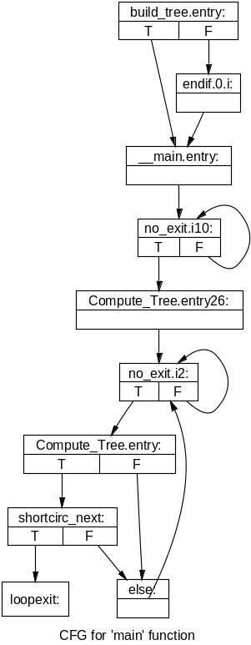
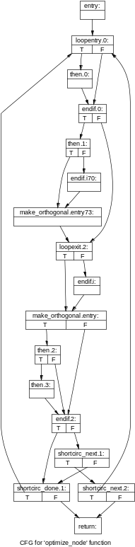
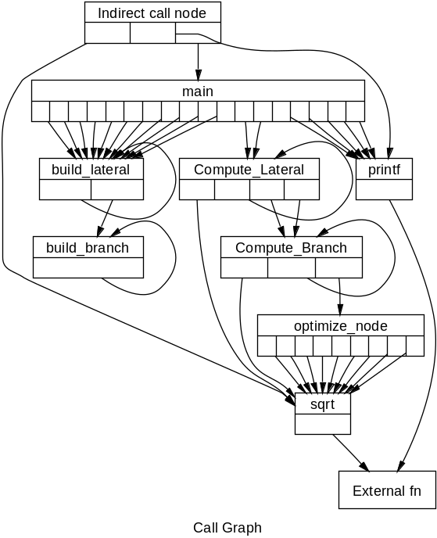
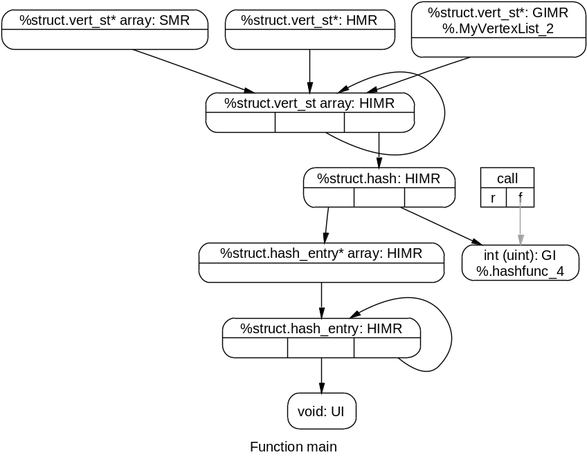
Analyze tool: Visualize analysis results
Print most LLVM data structures
  Dominators, loops, alias sets, CFG, call graph, …
  Converts most LLVM data structures to ‘dot’ graphs
Notes:
Left to right: CFG, CFG, Call Graph, Recursive Data Structure Graph

Slide 44
LLC Tool: Static code generator
Compiles LLVM → native assembly language
  Currently for X86, Sparc, PowerPC (others in alpha)
  llc file.bc -o file.s -march=x86
  as file.s –o file.o
Compiles LLVM → portable C code
  llc file.bc -o file.c -march=c
  gcc –c file.c –o file.o
Targets are modular & dynamically loadable:
  llc –load libarm.so file.bc -march=arm

Slide 45
The LLVM Code Generator
Target independent:
  Driven by an algorithm independent target description
    Data layout, Register, Instruction, Scheduling, …
Basic code generator layout:
All passes are replaceable
  e.g. Trivial to change and add register allocators
Targets can add custom passes
  e.g. X86 has special support for FP stack
Instruction Selection
Machine SSA Opts
Register Allocator
Instr Sched
Code Emission
LLVM
.s file
Target Specific (by hand for now)
Target Specific (generated)
Target Independent
4 algorithms available today
llc -regalloc=foo
Scheduling, Peephole, ?
Exposes all target-specific details about a function (calling conventions, etc)
See also: docs/CodeGenerator.html

Slide 46
Porting LLVM to a new target
LLVM targets are very easy to write:
  Anecdotal evidence suggests 1 week for a basic port
    … for someone familiar with the target machine and compilers in general, but not with LLVM
LLVM targets are written with “tablegen” tool
  Simple declarative syntax
  Designed to factor out redundancy in target desc
Some C++ code is still required
  Primarily in the instruction selector
  Continuing work to improve this
See also: docs/TableGenFundamentals.html and WritingAnLLVMBackend.html

Slide 47
LLI Tool: LLVM Execution Engine
LLI allows direct execution of .bc files
  E.g.: lli grep.bc -i foo *.c
LLI uses a Just-In-Time compiler if available:
  Uses same code generator as LLC
    Optionally uses faster components than LLC
  Emits machine code to memory instead of “.s” file
  JIT is a library that can be embedded in other tools
Otherwise, it uses the LLVM interpreter:
  Interpreter is extremely simple and very slow
  Interpreter is portable though!

Slide 48
C and C++ Program Test Suite
Large collection of programs and benchmarks:
  Standard suites (e.g. SPEC 95/2000, Olden, Ptrdist, McCat, Stanford, Freebench, Shootout…)
  Individual programs: sgefa, siod, sim, pi, povray, …
  Proprietary suites (e.g. SPEC) require suite source
Consistent build environment:
  Easy add hooks to build for profiling/instrumentation
  Easy to get performance numbers from entire test suite
Entire test suite is checked every night:
  Hosted on Linux,Solaris,FreeBSD on X86,Sparc & PPC
See also: docs/TestingGuide.html

Slide 49
Integrated Debugging Tools
Extensive assertions throughout code
  Find problems as early as possible (close to source)
LLVM IR Verifier: Checks modules for validity
  Checks type properties, dominance properties, etc.
  Automatically run by opt
  Problem found?: print an error message and abort
LLVM IR Leak Detector
  Efficient and simple “garbage collector” for IR objects
  Ensure IR objects are deallocated appropriately

Slide 50

The Bugpoint automated bug finder
Simple idea: automate ‘binary’ search for bug
  Bug isolation: which passes interact to produce bug
  Test case reduction: reduce input program
Optimizer/Codegen crashes:
  Throw portion of test case away, check for crash
    If so, keep going
    Otherwise, revert and try something else
  Extremely effective in practice
Simple greedy algorithms for test reduction
Completely black-box approach
See also: docs/Bugpoint.html

Slide 51
Debugging Miscompilations
Optimizer miscompilation:
  Split testcase in two, optimize one. Still broken?
  Keep shrinking the portion being optimized
Codegen miscompilation:
  Split testcase in two, compile one with CBE, broken?
  Shrink portion being compiled with non CBE codegen
Code splitting granularities:
  Take out whole functions
  Take out loop nests
  Take out individual basic blocks

Slide 52
How well does this thing work?
Extremely effective:
  Can often reduce a 100K LOC program and 60 passes to a few basic blocks and 1 pass in 5 minutes
  Crashes are found much faster than miscompilations
    no need to run the program to test a reduction
Interacts with integrated debugging tools
  Runtime errors are detected faster
Limitations:
  Program must be deterministic
    … or modified to be so
  Finds “a” bug, not “the” bug

Slide 53
Tutorial Overview
Introduction to the running example
LLVM C/C++ Compiler Overview
  High-level view of an example LLVM compiler
The LLVM Virtual Instruction Set
  IR overview and type-system
LLVM C++ IR and important API’s
  Basics, PassManager, dataflow, ArgPromotion
Important LLVM Tools
  opt, code generator, JIT, test suite, bugpoint
Example applications of LLVM

Slide 54
Use Case 1: Edge or Path Profiling
Goal: Profiling Research or PGO
Implementation:
  FunctionPass: LLVM-to-LLVM transformation
  Instrumentation: Use CFG, intervals, dominators
  Code generation: Use C or any native back end
  Profile feedback: Use profile query interface
Core extensions needed: none
Major LLVM Benefits
  Language-independence, CFG, very simple IR

Slide 55
Use Case 2: Alias Analysis
Goal: Research on new alias analysis algorithms
Implementation:
  ModulePass: Whole-program analysis pass on LLVM
  Use type information; SSA; heap/stack/globals
  Compare SimpleAA, Steensgard’s, Andersen’s, DSA
  Evaluate many clients via AliasAnalysis interface
Core extensions needed: none
Major LLVM Benefits
  Language-independence, type info, SSA, DSA, IPO
  AliasAnalysis interface with many pre-existing clients

Slide 56
Use Case 3: LDS Prefetching
Goal: Prefetching linked data structures
Implementation:
  ModulePass: Link-time LLVM-to-LLVM transformation
  Code transformations: use type info, loop analysis, unrolling, prefetch insertion
  Data transformations (e.g,. adding history pointers): use strong type info from DSA, IPO
Core extensions needed:
  Prefetch operation: add as intrinsic (in progress)
Major LLVM Benefits
    Language-independence, type info, DSA, IPO

Slide 57
Use Case 4: Language Front end
Goal: Use LLVM to implement a new language
Implementation:
  Parser (say to AST), Semantic checking
  AST-to-LLVM translator
Core extensions needed: depends
  High-level type system is omitted by design
Major LLVM Benefits
  Low-level, but powerful type system
  Very simple IR to generate (e.g., compare GCC RTL)
  Extensive global and IP optimization framework
  JIT engine, native back-ends, C back-end

Slide 58
Use Case 5: JIT Compiler
Goal: Write JIT compiler for a bytecode language
Implementation:
  Extend the LLVM JIT framework
  Simple JIT: Fast translation from bytecode to LLVM (then use LLVM JIT + GC)
  Optimizing JIT: Language-specific optimizations + fast translation (then use LLVM optimizations, JIT, GC)
Core extensions needed: none in general
Major LLVM Benefits
  Compact, typed, language-independent IR
  Existing JIT framework and GC

Slide 59
Use Case 6: Architecture Research
Goal: Compiler support for new architectures
Implementation:
  Add new machine description (or modify one)
  Add any new LLVM-to-LLVM transformations
Core extensions needed: depends on goals
  Imminent features: modulo sched; vector ops
Major LLVM Benefits
  Low-level, typed, machine-independent IR
  Explicit register/memory architecture
  Aggressive mid-level and back-end compiler framework
  Full-system evaluation: applications, libraries, even OS

Slide 60
Five point LLVM Review
Extremely simple IR to learn and use
  1-to-1 correspondence between .ll, .bc, and C++ IR
  Very positive user reactions
Powerful and modular optimizer
  Easy to extend, or just use what is already there
Clean and modular code generator
  Easy to retarget, easy to replace/tweak components
Many “productivity tools” (bugpoint, verifier)
  Get more done, quicker!
Active dev community, good documentation
  Mailing lists, IRC, doxygen, extensive docs

Slide 61
Get started with LLVM!
Download latest release or CVS:
http://llvm.cs.uiuc.edu/releases/
Follow the “Getting Started Guide”:
http://llvm.cs.uiuc.edu/docs/GettingStarted.html
  Walks you through install and setup
  Lots of other docs available in “docs” directory
  Join us on mailing lists and IRC
Happy hacking!

