Slide 1
Query Processing and Optimization

Slide 2
Basic Concepts
Query Processing – activities involved in retrieving data from the database:
  SQL query translation into low-level language implementing relational algebra
  Query execution
Query Optimization – selection of an efficient query execution plan

Slide 3
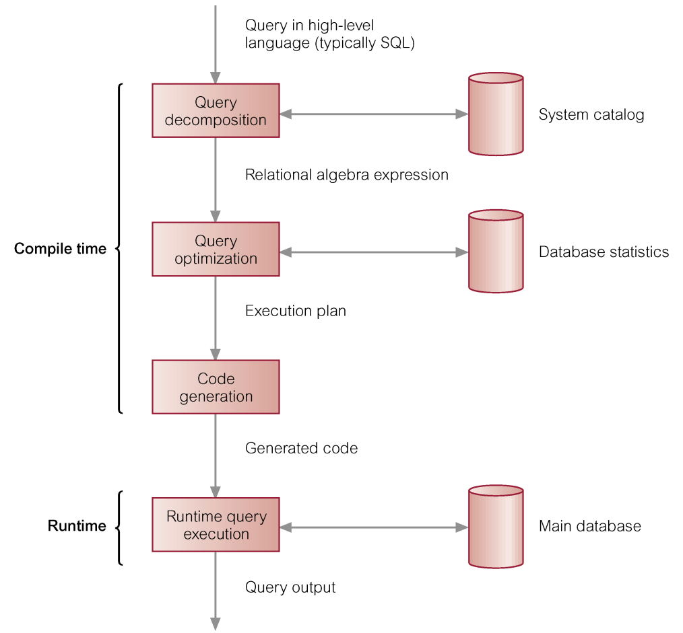
Phases of Query Processing

Slide 4
Relational Algebra
Relational algebra defines basic operations on relation instances
Results of operations are also relation instances

Slide 5
Basic Operations
Unary algebra operations:
  Selection
  Projection
Binary algebra operations:
  Union
  Set difference
  Cross-product

Slide 6
Additional Operations
Can be expressed through 5 basic operations:
  Join
  Intersection
  Division

Slide 7
Selection
σ_{criterion}(I)
where criterion – selection condition, and I- an instance of a relation.
Result:
  the same schema
  A subset of tuples from the instance I
Criterion: conjunction (AND) and disjunction (OR)
Comparison operators: <,<=,=,≠,>=,>

Slide 8
Projection
Vertical subset of input relation instance
The schema of the result :
  is determined by the list of desired fields
  types of fields are inherited
Π_{a1,a2,…,am}(I),
where a1,a2,…,am – desired fields from the relation with the instance I

Slide 9
Binary Operations
Union-compatible relations:
  The same number of fields
  Corresponding fields have the same domains
Union of 2 relations
Intersection of 2 relations
Set-difference
Cross-product – does not require union-compatibility
Marina G. Erechtchoukova

Slide 10
Joins
Join is defined as cross-product followed by selections
Based on the conditions, joins are classified:
  Theta-joins
  Natural joins
  Other…

Slide 11
Theta Join
R_{Cond} S = σ_{Cond}(R x S)
Where Cond – refers to the attributes of both relations R and S in the form of comparison expressions with operators:
<,<=,=,≠,>=,>

Slide 12
Relational Algebra Expressions
The result of a relational operation is a relation instance
Relational algebra expression combines relation instances using relational algebra operations
Relational algebra expression produces the result of a query

Slide 13
Simple SQL Query
SELECT select-list → πselect-list
FROM from-list → Cross Product
WHERE qualification; → σqualification

Slide 14
Conceptual Evaluation Strategy for Simple Query
Compute the cross-product of tables in from-list
Delete those rows which fail the qualification condition
Delete all columns that do not appear in the select-list
If DISTINCT clause is specified, eliminate duplicate rows.

Slide 15
Nested Queries
Query block:
  Single SELECT_FROM_WHERE expression
  May include GROUP BY and HAVING
Query block – basic unit that is translated into RA expression and optimized
SQL query is decomposed into query blocks

Slide 16
Different Processing Strategies
Algorithms implementing basic relational algebra operations
Algorithms implementing additional relational algebra operations
Example:
Find the students who have marks higher than 75 and are younger than 23

Slide 17
Query Decomposition
Analysis
  Relational algebra tree
Normalization
Semantic analysis
Simplification
Query restructuring

Slide 18
Analysis
Analyze query using compiler techniques
Verify that relations and attributes exist
Verify that operations are appropriate for object type
Transform the query into some internal representation

Slide 19
Relational Algebra Tree
Leaf nodes are created for each base relation.
Non-leaf nodes are created for each intermediate relation produced by RA operation.
Root of the tree represents query result.
Sequence is directed from leaves to root.

Slide 20
Relational Algebra Tree (Cont…)
Root
Intermediate operations
…
Intermediate operations
Leaves

Slide 21
Criterion Normalization
Conjunctive normal form – a sequence of boolean expressions connected by conjunction (AND):
  Each expression contains terms of comparison operators connected by disjunctions (OR)
Disjunctive normal form – a sequence of boolean expressions connected by disjunction (OR):
  Each expression contains terms of comparison operators connected by conjunction (AND)

Slide 22
Criterion Normalization (Cont…)
Arbitrary complex qualification condition can be converted into one of the normal forms
Algorithms for computation:
  CNF – only tuples that satisfy all expressions
  DNF – tuples that are the result of union of tuples that satisfy the exprssions

Slide 23
Semantic Analysis
Applied to normalized queries
Rejects contradictory queries:
  Qualification condition cannot be satisfied by any tuple
Rejects incorrectly formulated queries:
  Condition components do not contribute to generation of the result.

Slide 24
Relation Connection Graph
Conjunctive queries without negation
Each node corresponds to a base relation and the result
An edge between two nodes is created:
  If there a join
  If a node is a source for projection.
If the graph is not connected, the query is incorrectly formulated

Slide 25
Simplification
Eliminates redundancy in qualification
Queries against views:
  Access privileges
  Redundancy in qualification
Transform query to equivalent efficiently computed form
Main tool – rules of boolean algebra

Slide 26
Queries against Views
View resolution:
  View select-list is translated into corresponding select-list in the view defining query
  From-list of the query is modified to hold the names of base tables
  Qualifications from WHERE clause are combined
  GROUP BY and HAVING clauses are modified

Slide 27
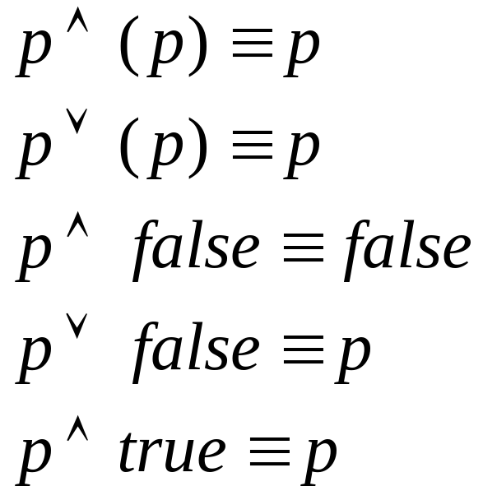
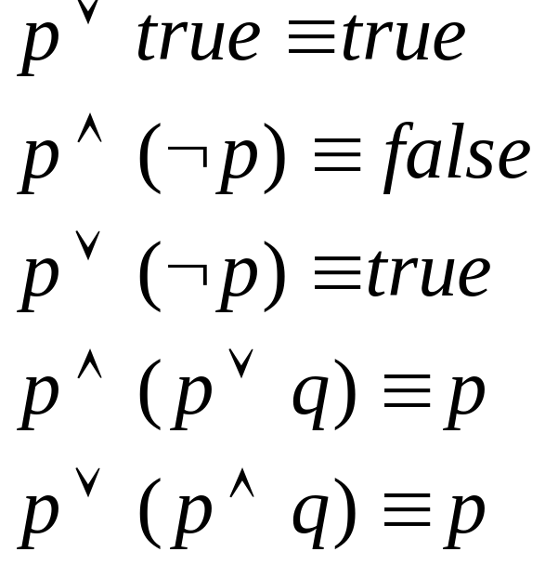

Rules of Boolean Algebra

Slide 28
Query Restructuring
Rewriting a query using relational algebra operations
Modifying relational algebra expression to provide more efficient implementation

Slide 29
Query Optimization
Optimization criteria:
  Reduce total execution time of the query:
    Minimize the sum of the execution times of all individual operations
    Reduce the number of disk accesses
  Reduce response time of the query:
    Maximize parallel operations
Dynamic vs. static optimization

Slide 30
Heuristic Approach
Heuristic - problem-solving by experimental methods
Applying general rules to choose the most appropriate internal query representation
Based on transformation rules for relational algebra operations

Slide 31
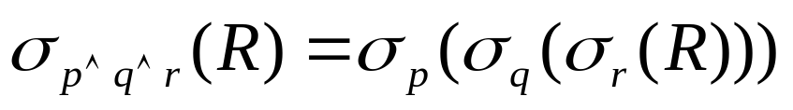
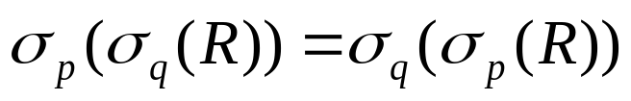
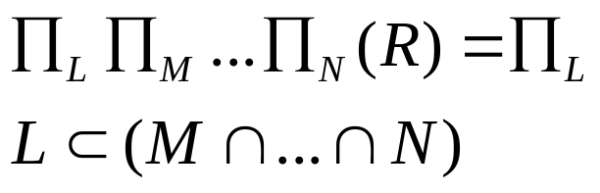
Transformation Rules
Cascade of selection operations:
Commutativity of selection operations
Sequence of projection operations
where

Slide 32
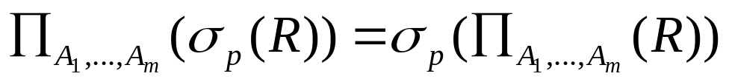
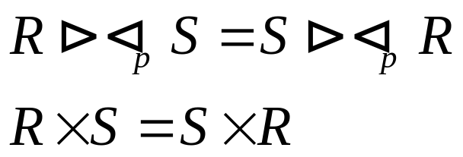

Transformation Rules (Cont…)
Commutativity of selection and projection
where p involves only attributes from {A₁,…,A_{m}}
Commutativity of binary operations
; ;
;

Slide 33
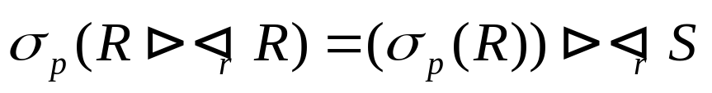
Transformation Rules (Cont…)
Commutativity of selection and theta join
Commutativity of projection and theta join
Where A₁contains only attributes from R and A₂-only attributes from S

Slide 34
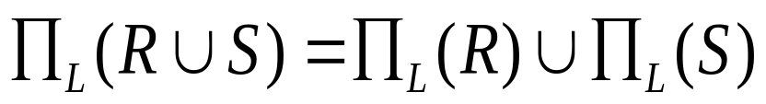
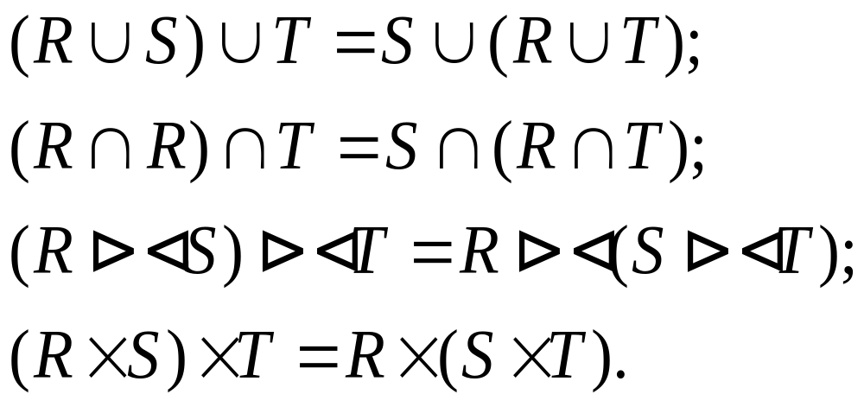
Transformation Rules (Cont…)
Commutativity of projection and union
Associativity of binary operations

Slide 35
Heirustic Rules
Perform selection as early as possible
Combine Cross product with a subsequent selection
Rearrange base relations so that the most restrictive selection is executed first.
Perform projection as early as possible
Compute common expressions once.

Slide 36
Cost Estimation Components
Cost of access to secondary storage
Storage cost – cost of storing intermediate results
Computation cost
Memory usage cost – usage of RAM buffers

Slide 37
Cost Estimation for Relational Algebra Expressions
Formulae for cost estimation of each operation
Estimation of relational algebra expression
Choosing the expression with the lowest cost

Slide 38
Cost Estimation in Query Optimization
Based on relational algebra tree
For each node in the tree the estimation is to be done for:
  the cost of performing the operation;
  the size of the result of the operation;
  whether the result is sorted.

Slide 39
Database Statistics for a Relation
Cardinality of relation instance
Block (of tuples) – page
Number of blocks required to store a relation (data)
Blocking factor – number of tuples in one block
Number of blocks required to store an index

Slide 40
Database Statistics for an Attribute of a Relation
The number of distinct values
Possible minimum and maximum values
Selection cardinality of an attribute:
  For equality condition on the attribute
  For inequality condition on the attribute

Slide 41
Algorithms for Relational Algebra Operations Implementation
Linear search
Binary search
Sort-merge
External sorting
Hashing

Slide 42
File Organization
The physical arrangement of data in a file into records and blocks (pages) on secondary storage
Storing and retrieving data depends on the file organization

Slide 43
Heap Files
Unordered files
Records are placed in the file in the same order as they are inserted
If there is insufficient space in the last block, a new block is added.
Records are retrieved based on scan

Slide 44
Ordered Files
Files sorted on the values of the ordering fields
Ordering key – ordering fields with unique constraint
Under certain conditions records can be retrieved based on binary search

Slide 45
Hash Files
Records are randomly distributed across the available space
To store a record the address of the block (page) is calculated by Hash function
Blocks are kept at about 80% occupancy
To retrieve the data all blocks are scanned which is about 1.25 times more than for heap files

Slide 46
Indexes
A data structure that allows the DBMS to locate particular records
Index files are not required but very helpful
Index files can be ordered by the values of indexing fields

Slide 47
Retrieval Algorithms
Files without indexes:
  Records are selected by scanning data files
Indexed files:
  Matching selection condition
  Records are selected by scanning index files and finding corresponding blocks in data files

Slide 48
Search Space
Collection of possible execution strategies for a query
Strategies can use:
  Different join ordering
  Different selection methods
  Different join methods
Enumeration algorithm – an algorithm to determine an optimal strategy from the search space

Slide 49
Pipelining
Materialization - saving intermediate results in a temporary table
Pipelining – submitting the results of one operation to another operation without creating a temporary table
A pipeline is implemented for each join operation
Requires specific algorithms

Slide 50
Linear Trees
In a linear tree at least one child of a join node is a base relation
Left-deep tree – the right child of each join node is a base relation
Right-deep tree – the left child of each join node is a base relation
Bushy tree – non-linear tree

Slide 51
Left-Deep Tree
Supports fully pipelined strategies
Advantage:
  Reduces search space
Disadvantage:
  Excludes alternative strategies which may be of a lower cost

Slide 52
Query Optimization in Oracle
Rule-based optimizer
  Specify the goal in init.ora file
  OPTIMIZER_MODE = RULE
Cost-based optimizer
  Specify the goal in init.ora file
  OPTIMIZER_MODE = CHOOSE

Slide 53
Rule-Based Optimizer
15 rules are ranked
RowID describes the physical location of the record
RowID is associated with table indeces
Access path for a table only chosen if statement contains a predicate or other construct that makes that access path available.

Slide 54
Cost-Based Optimizer
Statistics:
  ANALYZE - command to generates statistics
  PL/SQL package DBMS_STAT
Hints
  To access full table
  To use a rule
  To use a certain index
  …

Slide 55
Example
SELECT /*+ full(student) */ sname FROM student WHERE Y_of_B = 1983;

