Slide 1
CS 347:
Parallel and Distributed
Data Management
Notes 13:
BigTable, HBASE, Cassandra
Hector Garcia-Molina
CS 347
Lecture 9B

Slide 2
Sources
HBASE: The Definitive Guide, Lars George, O’Reilly Publishers, 2011.
Cassandra: The Definitive Guide, Eben Hewitt, O’Reilly Publishers, 2011.
BigTable: A Distributed Storage System for Structured Data, F. Chang et al, ACM Transactions on Computer Systems, Vol. 26, No. 2, June 2008.
CS 347
Lecture 9B

Slide 3
Lots of Buzz Words!
“Apache Cassandra is an open-source, distributed, decentralized, elastically scalable, highly available, fault-tolerant, tunably consistent, column-oriented database that bases its distribution design on Amazon’s dynamo and its data model on Google’s Big Table.”
Clearly, it is buzz-word compliant!!
CS 347
Lecture 9B

Slide 4
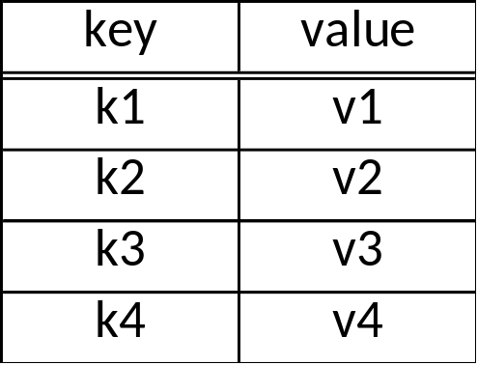
Basic Idea: Key-Value Store
Table T:
CS 347
Lecture 9B

Slide 5
Basic Idea: Key-Value Store
API:
  lookup(key) → value
  lookup(key range) → values
  getNext → value
  insert(key, value)
  delete(key)
Each row has timestemp
Single row actions atomic
(but not persistent in some systems?)
No multi-key transactions
No query language!
Table T:
keys are sorted
CS 347
Lecture 9B

Slide 6

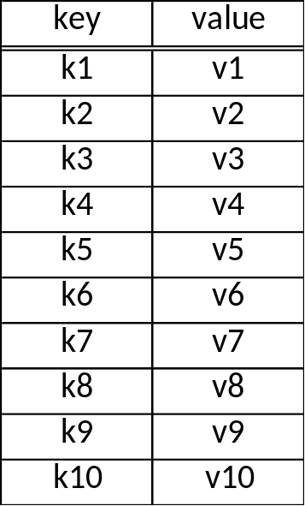
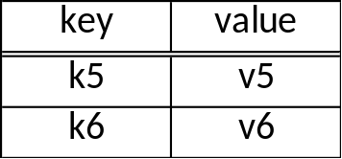
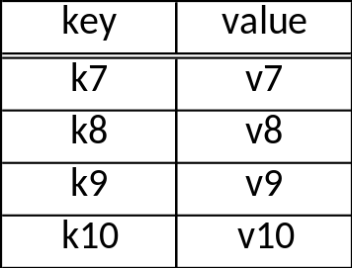
Fragmentation (Sharding)
server 1
server 2
server 3
tablet
use a partition vector
“auto-sharding”: vector selected automatically
CS 347
Lecture 9B

Slide 7
Tablet Replication
server 3
server 4
server 5
primary
backup
backup
Cassandra:
Replication Factor (# copies)
R/W Rule: One, Quorum, All
Policy (e.g., Rack Unaware, Rack Aware, ...)
Read all copies (return fastest reply, do repairs if necessary)
HBase: Does not manage replication, relies on HDFS
CS 347
Lecture 9B

Slide 8
Need a “directory”
Table Name: Key → Server that stores key
→ Backup servers
Can be implemented as a special table.
CS 347
Lecture 9B

Slide 9
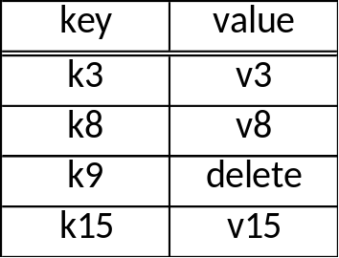
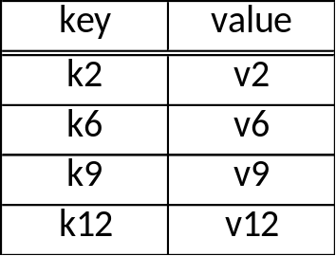
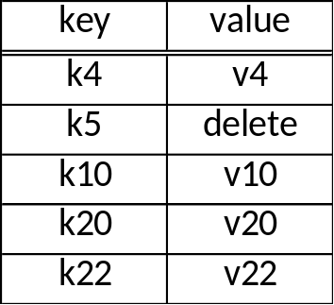
Tablet Internals
memory
disk
Design Philosophy (?): Primary scenario is where all data is in memory.
Disk storage added as an afterthought
CS 347
Lecture 9B

Slide 10
Tablet Internals
tombstone
memory
flush periodically
disk
tablet is merge of all segments (files)
disk segments imutable
writes efficient; reads only efficient when all data in memory
periodically reorganize into single segment
CS 347
Lecture 9B

Slide 11
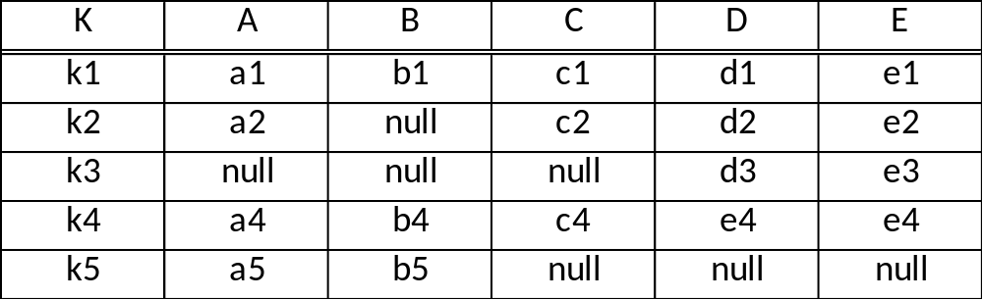
Column Family
CS 347
Lecture 9B

Slide 12
Column Family
for storage, treat each row as a single “super value”
API provides access to sub-values
(use family:qualifier to refer to sub-values
e.g., price:euros, price:dollars )
Cassandra allows “super-column”:
two level nesting of columns
(e.g., Column A can have sub-columns X & Y )
CS 347
Lecture 9B

Slide 13
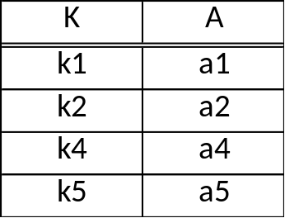
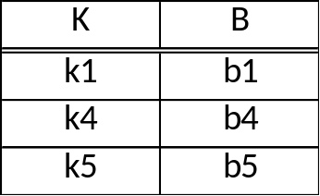
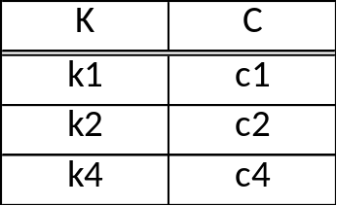
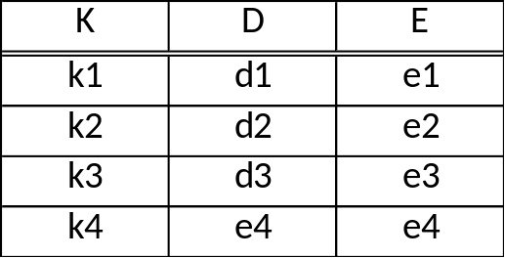
Vertical Partitions
can be manually implemented as
CS 347
Lecture 9B

Slide 14
Vertical Partitions
column family
good for sparse data;
good for column scans
not so good for tuple reads
are atomic updates to row still supported?
API supports actions on full table; mapped to actions on column tables
API supports column “project”
To decide on vertical partition, need to know access patterns
CS 347
Lecture 9B

Slide 15
Failure Recovery (BigTable, HBase)
ping
memory
tablet server
master node
spare
tablet server
write ahead logging
log
GFS or HFS
CS 347
Lecture 9B

Slide 16
Failure recovery (Cassandra)
No master node, all nodes in “cluster” equal
server 1
server 2
server 3
CS 347
Lecture 9B

Slide 17
Failure recovery (Cassandra)
No master node, all nodes in “cluster” equal
access any table in cluster
at any server
server 1
server 2
server 3
that server sends requests
to other servers
CS 347
Lecture 9B

