Slide 1
CS 245: Database System Principles
Notes 09: Concurrency Control
Hector Garcia-Molina
CS 245
Notes 09

Slide 2
Chapter 18 [18] Concurrency Control
T1 T2 … Tn
DB
(consistency
constraints)
CS 245
Notes 09

Slide 3
Example:
T1: Read(A) T2: Read(A)
A ← A+100 A ← A×2
Write(A) Write(A)
Read(B) Read(B)
B ← B+100 B ← B×2
Write(B) Write(B)
Constraint: A=B
CS 245
Notes 09

Slide 4
Schedule A
T1 T2
Read(A); A ← A+100
Write(A);
Read(B); B ← B+100;
Write(B);
Read(A);A ← A×2;
Write(A);
Read(B);B ← B×2;
Write(B);
CS 245
Notes 09

Slide 5
Schedule A
A B
25 25
125
125
250
250
250 250
T1 T2
Read(A); A ← A+100
Write(A);
Read(B); B ← B+100;
Write(B);
Read(A);A ← A×2;
Write(A);
Read(B);B ← B×2;
Write(B);
CS 245
Notes 09

Slide 6
Schedule B
T1 T2
Read(A);A ← A×2;
Write(A);
Read(B);B ← B×2;
Write(B);
Read(A); A ← A+100
Write(A);
Read(B); B ← B+100;
Write(B);
CS 245
Notes 09

Slide 7
Schedule B
A B
25 25
50
50
150
150
150 150
T1 T2
Read(A);A ← A×2;
Write(A);
Read(B);B ← B×2;
Write(B);
Read(A); A ← A+100
Write(A);
Read(B); B ← B+100;
Write(B);
CS 245
Notes 09

Slide 8
Schedule C
T1 T2
Read(A); A ← A+100
Write(A);
Read(A);A ← A×2;
Write(A);
Read(B); B ← B+100;
Write(B);
Read(B);B ← B×2;
Write(B);
CS 245
Notes 09

Slide 9
Schedule C
A B
25 25
125
250
125
250
250 250
T1 T2
Read(A); A ← A+100
Write(A);
Read(A);A ← A×2;
Write(A);
Read(B); B ← B+100;
Write(B);
Read(B);B ← B×2;
Write(B);
CS 245
Notes 09

Slide 10
Schedule D
T1 T2
Read(A); A ← A+100
Write(A);
Read(A);A ← A×2;
Write(A);
Read(B);B ← B×2;
Write(B);
Read(B); B ← B+100;
Write(B);
CS 245
Notes 09

Slide 11
Schedule D
A B
25 25
125
250
50
150
250 150
T1 T2
Read(A); A ← A+100
Write(A);
Read(A);A ← A×2;
Write(A);
Read(B);B ← B×2;
Write(B);
Read(B); B ← B+100;
Write(B);
CS 245
Notes 09

Slide 12
Schedule E
Same as Schedule D
but with new T2’
T1 T2’
Read(A); A ← A+100
Write(A);
Read(A);A ← A×1;
Write(A);
Read(B);B ← B×1;
Write(B);
Read(B); B ← B+100;
Write(B);
CS 245
Notes 09

Slide 13
Schedule E
Same as Schedule D
but with new T2’
A B
25 25
125
125
25
125
125 125
T1 T2’
Read(A); A ← A+100
Write(A);
Read(A);A ← A×1;
Write(A);
Read(B);B ← B×1;
Write(B);
Read(B); B ← B+100;
Write(B);
CS 245
Notes 09

Slide 14
Want schedules that are “good”, regardless of
  initial state and
  transaction semantics
Only look at order of read and writes
Example:
Sc=r1(A)w1(A)r2(A)w2(A)r1(B)w1(B)r2(B)w2(B)
CS 245
Notes 09

Slide 15
Example:
Sc=r1(A)w1(A)r2(A)w2(A)r1(B)w1(B)r2(B)w2(B)
Sc’=r1(A)w1(A) r1(B)w1(B)r2(A)w2(A)r2(B)w2(B)
T1 T2
CS 245
Notes 09

Slide 16
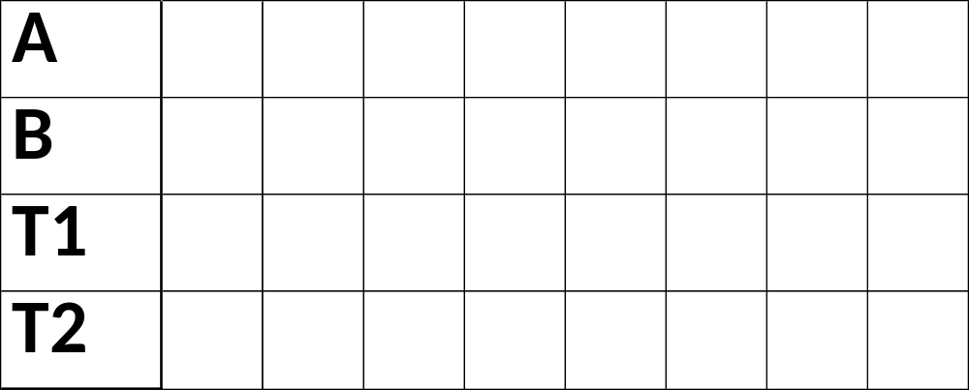
The Transaction Game
CS 245
Notes 09

Slide 17
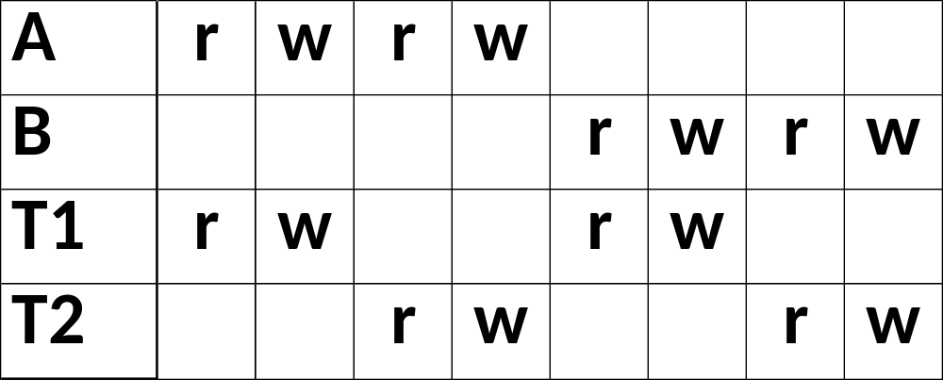
The Transaction Game
CS 245
Notes 09

Slide 18
The Transaction Game
until column
hits something
can move column
CS 245
Notes 09

Slide 19
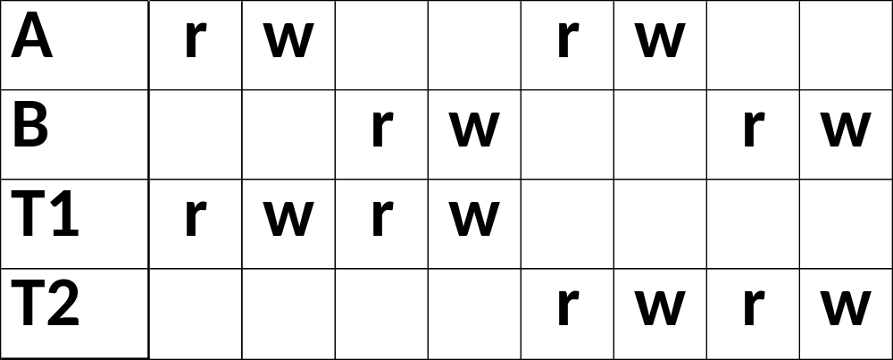
move
move
CS 245
Notes 09

Slide 20
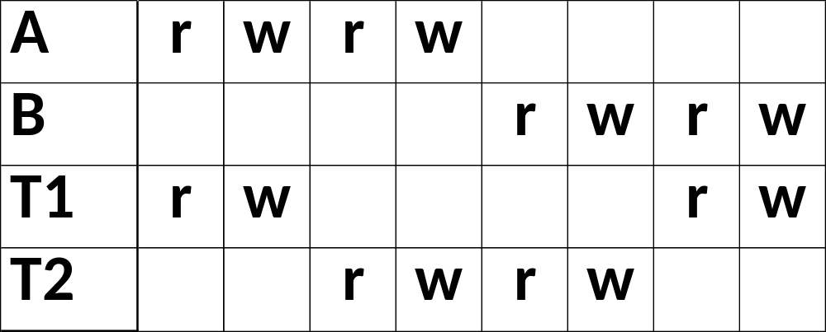
Schedule D
CS 245
Notes 09

Slide 21
However, for Sd:
Sd=r1(A)w1(A)r2(A)w2(A) r2(B)w2(B)r1(B)w1(B)
as a matter of fact,
T2 must precede T1
in any equivalent schedule,
i.e., T2 → T1
CS 245
Notes 09

Slide 22
T2 → T1
Also, T1 → T2
T1 T2 Sd cannot be rearranged
into a serial schedule
Sd is not “equivalent” to
any serial schedule
Sd is “bad”
CS 245
Notes 09

Slide 23
Returning to Sc
Sc=r1(A)w1(A)r2(A)w2(A)r1(B)w1(B)r2(B)w2(B)
T1 → T2 T1 → T2
CS 245
Notes 09

Slide 24
Returning to Sc
Sc=r1(A)w1(A)r2(A)w2(A)r1(B)w1(B)r2(B)w2(B)
T1 → T2 T1 → T2
 no cycles ⇒ Sc is “equivalent” to a
serial schedule
(in this case T1,T2)
CS 245
Notes 09

Slide 25
Concepts
Transaction: sequence of ri(x), wi(x) actions
Conflicting actions: r1(A) w2(A) w1(A)
w2(A) r1(A) w2(A)
Schedule: represents chronological order in which actions are executed
Serial schedule: no interleaving of actions or transactions
CS 245
Notes 09

Slide 26
Is it OK to model reads & writes as occurring at a single point
in time in a schedule?
S=… r1(x) … w2(b) …
CS 245
Notes 09

Slide 27
What about conflicting, concurrent actions on same object?
start r1(A) end r1(A)
start w2(A) end w2(A)
time
CS 245
Notes 09

Slide 28
What about conflicting, concurrent actions on same object?
start r1(A) end r1(A)
start w2(A) end w2(A)
time
Assume equivalent to either r1(A) w2(A)
      or w2(A) r1(A)
⇒ low level synchronization mechanism
Assumption called “atomic actions”
CS 245
Notes 09

Slide 29
Definition
S1, S2 are conflict equivalent schedules
if S1 can be transformed into S2 by a series of swaps on non-conflicting actions.
CS 245
Notes 09

Slide 30
Definition
A schedule is conflict serializable if it is conflict equivalent to some serial schedule.
CS 245
Notes 09

Slide 31
Precedence graph P(S) (S is schedule)
Nodes: transactions in S
Arcs: Ti → Tj whenever
- pi(A), qj(A) are actions in S
- pi(A) <_{S} qj(A)
- at least one of pi, qj is a write
CS 245
Notes 09

Slide 32
Exercise:
What is P(S) for
S = w3(A) w2(C) r1(A) w1(B) r1(C) w2(A) r4(A) w4(D)
Is S serializable?
CS 245
Notes 09

Slide 33
Another Exercise:
What is P(S) for
S = w1(A) r2(A) r3(A) w4(A) ?
CS 245
Notes 09

Slide 34
Lemma
S1, S2 conflict equivalent ⇒ P(S1)=P(S2)
CS 245
Notes 09

Slide 35
Lemma
S1, S2 conflict equivalent ⇒ P(S1)=P(S2)
Proof:
Assume P(S1) ≠ P(S2)
⇒ ∃ Ti: Ti → Tj in S1 and not in S2
⇒ S1 = …pi(A)... qj(A)… pi, qj
S2 = …qj(A)…pi(A)... conflict
⇒ S1, S2 not conflict equivalent
CS 245
Notes 09

Slide 36
Note: P(S1)=P(S2) ⇒ S1, S2 conflict equivalent
CS 245
Notes 09

Slide 37
Note: P(S1)=P(S2) ⇒ S1, S2 conflict equivalent
Counter example:
S1=w1(A) r2(A) w2(B) r1(B)
S2=r2(A) w1(A) r1(B) w2(B)
CS 245
Notes 09

Slide 38
Theorem
P(S1) acyclic ⇐⇒ S1 conflict serializable
(⇐) Assume S1 is conflict serializable
⇒ ∃ Ss: Ss, S1 conflict equivalent
⇒ P(Ss) = P(S1)
⇒ P(S1) acyclic since P(Ss) is acyclic
CS 245
Notes 09

Slide 39
Theorem
P(S1) acyclic ⇐⇒ S1 conflict serializable
T1
T2 T3
T4
(⇒) Assume P(S1) is acyclic
Transform S1 as follows:
(1) Take T1 to be transaction with no incident arcs
(2) Move all T1 actions to the front
S1 = ……. qj(A)…….p1(A)…..
(3) we now have S1 = < T1 actions ><... rest ...>
(4) repeat above steps to serialize rest!
CS 245
Notes 09

Slide 40
How to enforce serializable schedules?
Option 1: run system, recording P(S); at end of day, check for P(S) cycles and declare if execution was good
CS 245
Notes 09

Slide 41
How to enforce serializable schedules?
Option 2: prevent P(S) cycles from occurring
T1 T2 ….. Tn
Scheduler
DB
CS 245
Notes 09

Slide 42
A locking protocol
Two new actions:
lock (exclusive): li (A)
unlock: ui (A)
T1 T2
lock
table
scheduler
CS 245
Notes 09

Slide 43
Rule #1: Well-formed transactions
Ti: … li(A) … pi(A) … ui(A) ...
CS 245
Notes 09

Slide 44
Rule #2 Legal scheduler
S = …….. li(A) ………... ui(A) ……...
no lj(A)
CS 245
Notes 09

Slide 45
Exercise:
What schedules are legal?
What transactions are well-formed?
  S1 = l1(A)l1(B)r1(A)w1(B)l2(B)u1(A)u1(B)
  r2(B)w2(B)u2(B)l3(B)r3(B)u3(B)
  S2 = l1(A)r1(A)w1(B)u1(A)u1(B)
  l2(B)r2(B)w2(B)l3(B)r3(B)u3(B)
  S3 = l1(A)r1(A)u1(A)l1(B)w1(B)u1(B)
  l2(B)r2(B)w2(B)u2(B)l3(B)r3(B)u3(B)
CS 245
Notes 09

Slide 46
Exercise:
What schedules are legal?
What transactions are well-formed?
  S1 = l1(A)l1(B)r1(A)w1(B)l2(B)u1(A)u1(B)
  r2(B)w2(B)u2(B)l3(B)r3(B)u3(B)
  S2 = l1(A)r1(A)w1(B)u1(A)u1(B)
  l2(B)r2(B)w2(B)l3(B)r3(B)u3(B) u2(B)?
  S3 = l1(A)r1(A)u1(A)l1(B)w1(B)u1(B)
  l2(B)r2(B)w2(B)u2(B)l3(B)r3(B)u3(B)
CS 245
Notes 09

Slide 47
Schedule F
T1 T2
l1(A);Read(A)
A A+100;Write(A);u1(A)
l2(A);Read(A)
A Ax2;Write(A);u2(A)
l2(B);Read(B)
B Bx2;Write(B);u2(B)
l1(B);Read(B)
B B+100;Write(B);u1(B)
CS 245
Notes 09

Slide 48
Schedule F
A B
T1 T2 25 25
l1(A);Read(A)
A A+100;Write(A);u1(A) 125
l2(A);Read(A)
A Ax2;Write(A);u2(A) 250
l2(B);Read(B)
B Bx2;Write(B);u2(B) 50
l1(B);Read(B)
B B+100;Write(B);u1(B) 150
250 150
CS 245
Notes 09

Slide 49
Rule #3 Two phase locking (2PL) for transactions
Ti = ……. li(A) ………... ui(A) ……...
no unlocks no locks
CS 245
Notes 09

Slide 50
# locks
held by
Ti
Time
Growing Shrinking
Phase Phase
CS 245
Notes 09

Slide 51
Schedule G
T1 T2
l1(A);Read(A)
A A+100;Write(A)
l1(B); u1(A)
l2(A);Read(A)
A Ax2;Write(A);l2(B)
delayed
CS 245
Notes 09

Slide 52
Schedule G
T1 T2
l1(A);Read(A)
A A+100;Write(A)
l1(B); u1(A)
l2(A);Read(A)
A Ax2;Write(A);l2(B)
Read(B);B B+100
Write(B); u1(B)
delayed
CS 245
Notes 09

Slide 53
Schedule G
T1 T2
l1(A);Read(A)
A A+100;Write(A)
l1(B); u1(A)
l2(A);Read(A)
A Ax2;Write(A);l2(B)
Read(B);B B+100
Write(B); u1(B)
l2(B); u2(A);Read(B)
B Bx2;Write(B);u2(B);
delayed
CS 245
Notes 09

Slide 54
Schedule H (T2 reversed)
T1 T2
l1(A); Read(A) l2(B);Read(B)
A A+100;Write(A) B Bx2;Write(B)
l1(B) l2(A)
delayed
delayed
CS 245
Notes 09

Slide 55
Assume deadlocked transactions are rolled back
  They have no effect
  They do not appear in schedule
E.g., Schedule H =
This space intentionally
left blank!
CS 245
Notes 09

Slide 56
Next step:
Show that rules #1,2,3 ⇒ conflict-
serializable
schedules
CS 245
Notes 09

Slide 57
Conflict rules for li(A), ui(A):
li(A), lj(A) conflict
li(A), uj(A) conflict
Note: no conflict < ui(A), uj(A)>, < li(A), rj(A)>,...
CS 245
Notes 09

Slide 58
Theorem Rules #1,2,3 ⇒ conflict
(2PL) serializable
schedule
CS 245
Notes 09

Slide 59
Theorem Rules #1,2,3 ⇒ conflict
(2PL) serializable
schedule
To help in proof:
Definition Shrink(Ti) = SH(Ti) = first unlock action of Ti
CS 245
Notes 09

Slide 60
Lemma
Ti → Tj in S ⇒ SH(Ti) <_{S} SH(Tj)
CS 245
Notes 09

Slide 61
Lemma
Ti → Tj in S ⇒ SH(Ti) <_{S} SH(Tj)
Proof of lemma:
Ti → Tj means that
S = … pi(A) … qj(A) …; p,q conflict
By rules 1,2:
S = … pi(A) … ui(A) … lj(A) ... qj(A) …
CS 245
Notes 09

Slide 62
Lemma
Ti → Tj in S ⇒ SH(Ti) <_{S} SH(Tj)
Proof of lemma:
Ti → Tj means that
S = … pi(A) … qj(A) …; p,q conflict
By rules 1,2:
S = … pi(A) … ui(A) … lj(A) ... qj(A) …
By rule 3: SH(Ti) SH(Tj)
So, SH(Ti) <_{S} SH(Tj)
CS 245
Notes 09

Slide 63
Theorem Rules #1,2,3 ⇒ conflict
(2PL) serializable schedule
Proof:
(1) Assume P(S) has cycle
T1 → T2 →…. Tn → T1
(2) By lemma: SH(T1) < SH(T2) < ... < SH(T1)
(3) Impossible, so P(S) acyclic
(4) ⇒ S is conflict serializable
CS 245
Notes 09

Slide 64
2PL subset of Serializable
Serializable
2PL
CS 245
Notes 09

Slide 65
S1: w1(x) w3(x) w2(y) w1(y)
S1 cannot be achieved via 2PL:
The lock by T1 for y must occur after w2(y), so the unlock by T1 for x must occur after this point (and before w1(x)). Thus, w3(x) cannot occur under 2PL where shown in S1 because T1 holds the x lock at that point.
However, S1 is serializable
(equivalent to T2, T1, T3).
CS 245
Notes 09

Slide 66
S_{C}: w1(A) w2(A) w1(B) w2(B)
If you need a bit more practice:
Are our schedules S_{C} and S_{D} 2PL schedules?
S_{D}: w1(A) w2(A) w2(B) w1(B)
CS 245
Notes 09

Slide 67
Beyond this simple 2PL protocol, it is all a matter of improving performance and allowing more concurrency….
  Shared locks
  Multiple granularity
  Inserts, deletes and phantoms
  Other types of C.C. mechanisms
CS 245
Notes 09

Slide 68
Shared locks
So far:
S = ...l1(A) r1(A) u1(A) … l2(A) r2(A) u2(A) …
Do not conflict
CS 245
Notes 09

Slide 69
Shared locks
So far:
S = ...l1(A) r1(A) u1(A) … l2(A) r2(A) u2(A) …
Do not conflict
Instead:
S=... ls1(A) r1(A) ls2(A) r2(A) …. us1(A) us2(A)
CS 245
Notes 09

Slide 70
Lock actions
l-ti(A): lock A in t mode (t is S or X)
u-ti(A): unlock t mode (t is S or X)
Shorthand:
ui(A): unlock whatever modes
Ti has locked A
CS 245
Notes 09

Slide 71
Rule #1 Well formed transactions
Ti =... l-S1(A) … r1(A) … u1 (A) …
Ti =... l-X1(A) … w1(A) … u1 (A) …
CS 245
Notes 09

Slide 72
What about transactions that read and write same object?
Option 1: Request exclusive lock
Ti = ...l-X1(A) … r1(A) ... w1(A) ... u(A) …
CS 245
Notes 09

Slide 73
Option 2: Upgrade
What about transactions that read and
write same object?
(E.g., need to read, but don’t know if will write…)
Ti=... l-S1(A) … r1(A) ... l-X1(A) …w1(A) ...u(A)…
Think of
- Get 2nd lock on A, or
- Drop S, get X lock
CS 245
Notes 09

Slide 74
Rule #2 Legal scheduler
S = ....l-Si(A) … … ui(A) …
no l-Xj(A)
S = ... l-Xi(A) … … ui(A) …
no l-Xj(A)
no l-Sj(A)
CS 245
Notes 09

Slide 75
A way to summarize Rule #2
Compatibility matrix
Comp S X
S true false
X false false
CS 245
Notes 09

Slide 76
Rule # 3 2PL transactions
No change except for upgrades:
(I) If upgrade gets more locks
(e.g., S → {S, X}) then no change!
(II) If upgrade releases read (shared) lock (e.g., S → X)
- can be allowed in growing phase
CS 245
Notes 09

Slide 77
Proof: similar to X locks case
Theorem Rules 1,2,3 ⇒ Conf.serializable
for S/X locks schedules
Detail:
l-ti(A), l-rj(A) do not conflict if comp(t,r)
l-ti(A), u-rj(A) do not conflict if comp(t,r)
CS 245
Notes 09

Slide 78
Lock types beyond S/X
Examples:
(1) increment lock
(2) update lock
CS 245
Notes 09

Slide 79
Example (1): increment lock
Atomic increment action: INi(A)
{Read(A); A ← A+k; Write(A)}
INi(A), INj(A) do not conflict!
A=7
A=5 A=17
A=15
INi(A)
+2
INj(A)
+10
+10
INj(A)
+2
INi(A)
CS 245
Notes 09

Slide 80
Comp S X I
S
X
I
CS 245
Notes 09

Slide 81
Comp S X I
S T F F
X F F F
I F F T
CS 245
Notes 09

Slide 82
Update locks
A common deadlock problem with upgrades:
T1 T2
l-S1(A)
l-S2(A)
l-X1(A)
l-X2(A)
--- Deadlock ---
CS 245
Notes 09

Slide 83
Solution
If Ti wants to read A and knows it
may later want to write A, it requests
update lock (not shared)
CS 245
Notes 09

Slide 84
New request
Comp S X U
S
X
U
Lock
already
held in
CS 245
Notes 09

Slide 85
New request
Comp S X U
S T F T
X F F F
U TorF F F
-> symmetric table?
Lock
already
held in
CS 245
Notes 09

Slide 86
Note: object A may be locked in different modes at the same time...
S1=...l-S1(A)…l-S2(A)…l-U3(A)… l-S4(A)…?
l-U4(A)…?
CS 245
Notes 09

Slide 87
Note: object A may be locked in different modes at the same time...
S1=...l-S1(A)…l-S2(A)…l-U3(A)… l-S4(A)…?
l-U4(A)…?
To grant a lock in mode t, mode t must be compatible with all currently held locks on object
CS 245
Notes 09

Slide 88
How does locking work in practice?
Every system is different
(E.g., may not even provide
CONFLICT-SERIALIZABLE schedules)
But here is one (simplified) way ...
CS 245
Notes 09

Slide 89
Sample Locking System:
(1) Don’t trust transactions to request/release locks
(2) Hold all locks until transaction commits
#
locks
time
CS 245
Notes 09

Slide 90
        Ti
        Read(A),Write(B)
        l(A),Read(A),l(B),Write(B)…
        Read(A),Write(B)
Scheduler, part I
lock
table
Scheduler, part II
DB
CS 245
Notes 09

Slide 91
Lock table Conceptually
If null, object is unlocked
A
Λ
B
Lock info for B
C
Lock info for C
Λ
Every possible object
...
CS 245
Notes 09

Slide 92
But use hash table:
...
A
If object not found in hash table, it is unlocked
A
Lock info for A
H
...
CS 245
Notes 09

Slide 93
Lock info for A - example
tran mode wait? Nxt T_link
Object:A
Group mode:U
Waiting:yes
List:
T1
S
no
T2
U
no
T3
X
yes
Λ
To other T3
records
CS 245
Notes 09

Slide 94
What are the objects we lock?
?
Relation A
Tuple A
Disk
block
A
Tuple B
Relation B
Tuple C
Disk
block
B
...
...
...
DB
DB
DB
CS 245
Notes 09

Slide 95
Locking works in any case, but should we choose small or large objects?
CS 245
Notes 09

Slide 96
Locking works in any case, but should we choose small or large objects?
If we lock large objects (e.g., Relations)
  Need few locks
  Low concurrency
If we lock small objects (e.g., tuples,fields)
  Need more locks
  More concurrency
CS 245
Notes 09

Slide 97
We can have it both ways!!
Ask any janitor to give you the solution...
Stall 1
Stall 2
Stall 3
Stall 4
restroom
hall
CS 245
Notes 09

Slide 98
Example
R1
t1
t4
t2
t3
CS 245
Notes 09

Slide 99
Example
T1(IS)
R1
t1
t4
t2
t3
T1(S)
CS 245
Notes 09

Slide 100
Example
T1(IS)
, T2(S)
R1
t1
t4
t2
t3
T1(S)
CS 245
Notes 09

Slide 101
Example (b)
T1(IS)
R1
t1
t4
t2
t3
T1(S)
CS 245
Notes 09

Slide 102
Example
T1(IS)
, T2(IX)
R1
t1
t4
t2
t3
T1(S)
T2(IX)
CS 245
Notes 09

Slide 103
Multiple granularity
Comp Requestor
IS IX S SIX X
IS
Holder IX
S
SIX
X
CS 245
Notes 09

Slide 104
Multiple granularity
Comp Requestor
IS IX S SIX X
IS
Holder IX
S
SIX
X
T
T
T
T
F
T
T
F
F
F
T
F
T
F
F
T
F
F
F
F
F
F
F
F
F
CS 245
Notes 09

Slide 105
Parent Child can be
locked in locked in
IS
IX
S
SIX
X
P
C
CS 245
Notes 09

Slide 106
Parent Child can be locked
locked in by same transaction in
IS
IX
S
SIX
X
IS, S
IS, S, IX, X, SIX
none
X, IX, [SIX]
none
P
C
not necessary
CS 245
Notes 09

Slide 107
Rules
(1) Follow multiple granularity comp function
(2) Lock root of tree first, any mode
(3) Node Q can be locked by Ti in S or IS only if
parent(Q) locked by Ti in IX or IS
(4) Node Q can be locked by Ti in X,SIX,IX only
if parent(Q) locked by Ti in IX,SIX
(5) Ti is two-phase
(6) Ti can unlock node Q only if none of Q’s
children are locked by Ti
CS 245
Notes 09

Slide 108
Exercise:
Can T2 access object f2.2 in X mode? What locks will T2 get?
T1(IX)
R1
t1
T1(IX)
t2
t4
t3
f2.1
f2.2
f3.1
f3.2
T1(X)
CS 245
Notes 09

Slide 109
Exercise:
Can T2 access object f2.2 in X mode? What locks will T2 get?
T1(IX)
R1
t1
T1(X)
t2
t4
t3
f2.1
f2.2
f3.1
f3.2
CS 245
Notes 09

Slide 110
Exercise:
Can T2 access object f3.1 in X mode? What locks will T2 get?
T1(IS)
R1
t1
T1(S)
t2
t4
t3
f2.1
f2.2
f3.1
f3.2
CS 245
Notes 09

Slide 111
Exercise:
Can T2 access object f2.2 in S mode? What locks will T2 get?
T1(SIX)
R1
t1
T1(IX)
t2
t4
t3
f2.1
f2.2
f3.1
f3.2
T1(X)
CS 245
Notes 09

Slide 112
Exercise:
Can T2 access object f2.2 in X mode? What locks will T2 get?
T1(SIX)
R1
t1
T1(IX)
t2
t4
t3
f2.1
f2.2
f3.1
f3.2
T1(X)
CS 245
Notes 09

Slide 113
Insert + delete operations
Insert
A
...
Z
α
CS 245
Notes 09

Slide 114
Modifications to locking rules:
(1) Get exclusive lock on A before deleting A
(2) At insert A operation by Ti,
Ti is given exclusive lock on A
CS 245
Notes 09

Slide 115
Still have a problem: Phantoms
Example: relation R (E#,name,…)
constraint: E# is key
use tuple locking
R E# Name ….
o1 55 Smith
o2 75 Jones
CS 245
Notes 09

Slide 116
T1: Insert <12,Obama,…> into R
T2: Insert <12,Romney,…> into R
T1 T2
S1(o1) S2(o1)
S1(o2) S2(o2)
Check Constraint Check Constraint
Insert o3[12,Obama,..]
Insert o4[12,Romney,..]
...
...
CS 245
Notes 09

Slide 117
Solution
Use multiple granularity tree
Before insert of node Q,
lock parent(Q) in
X mode
R1
t1
t2
t3
CS 245
Notes 09

Slide 118
Back to example
T1: Insert<12,Obama> T2: Insert<12,Romney>
T1 T2
X1(R)
Check constraint
Insert<12,Obama>
U₁(R)
X2(R)
Check constraint
Oops! e# = 12 already in R!
X2(R)
delayed
CS 245
Notes 09

Slide 119
Instead of using R, can use index on R:
Example:
R
Index
0<E#<100
Index
100<E#<200
...
E#=2
E#=5
...
E#=107
E#=109
...
CS 245
Notes 09

Slide 120
This approach can be generalized to multiple indexes...
CS 245
Notes 09

Slide 121
Next:
Tree-based concurrency control
Validation concurrency control
CS 245
Notes 09

Slide 122
Example
all objects accessed
through root,
following pointers
A
B
C
D
E
F
CS 245
Notes 09

Slide 123
Example
all objects accessed
through root,
following pointers
T1 lock
A
B
C
T1 lock
T1 lock
D
E
F
CS 245
Notes 09

Slide 124
Example
all objects accessed
through root,
following pointers
T1 lock
A
B
C
T1 lock
T1 lock
D
E
F
 can we release A lock
if we no longer need A??
CS 245
Notes 09

Slide 125
Idea: traverse like “Monkey Bars”
A
B
C
D
E
F
CS 245
Notes 09

Slide 126
Idea: traverse like “Monkey Bars”
T1 lock
A
B
C
T1 lock
D
E
F
CS 245
Notes 09

Slide 127
Idea: traverse like “Monkey Bars”
A
T1 lock
B
C
T1 lock
D
E
F
CS 245
Notes 09

Slide 128
Why does this work?
Assume all Ti start at root; exclusive lock
Ti → Tj ⇒ Ti locks root before Tj
Actually works if we don’t always
start at root
Root
Q
Ti → Tj
CS 245
Notes 09

Slide 129
Rules: tree protocol (exclusive locks)
(1) First lock by Ti may be on any item
(2) After that, item Q can be locked by Ti only if parent(Q) locked by Ti
(3) Items may be unlocked at any time
(4) After Ti unlocks Q, it cannot relock Q
CS 245
Notes 09

Slide 130
Tree-like protocols are used typically for B-tree concurrency control
E.g., during insert, do not release parent lock, until you are certain child does not have to split
Root
CS 245
Notes 09

Slide 131
Tree Protocol with Shared Locks
Rules for shared & exclusive locks?
T1 S lock(released)
A
T1 X lock (released)
B
C
T1 S lock (held)
D
E
F
T1 X lock (will get)
CS 245
Notes 09

Slide 132
Tree Protocol with Shared Locks
Rules for shared & exclusive locks?
T1 S lock(released)
A
T1 X lock (released)
B
C
T1 S lock (held)
T2 reads:
B modified by T1
F not yet modified by T1
D
E
F
T1 X lock (will get)
CS 245
Notes 09

Slide 133
Tree Protocol with Shared Locks
Need more restrictive protocol
Will this work??
  Once T₁ locks one object in X mode,
  all further locks down the tree must be
  in X mode
CS 245
Notes 09

Slide 134
Validation
Transactions have 3 phases:
(1) Read
  all DB values read
  writes to temporary storage
  no locking
(2) Validate
  check if schedule so far is serializable
(3) Write
  if validate ok, write to DB
CS 245
Notes 09

Slide 135
Key idea
Make validation atomic
If T1, T2, T3, … is validation order, then resulting schedule will be conflict equivalent to Ss = T1 T2 T3...
CS 245
Notes 09

Slide 136
To implement validation, system keeps two sets:
FIN = transactions that have finished phase 3 (and are all done)
VAL = transactions that have successfully finished phase 2 (validation)
CS 245
Notes 09

Slide 137
Example of what validation must prevent:
RS(T2)={B} RS(T3)={A,B}
WS(T2)={B,D} WS(T3)={C}
∩
= φ
T2
start
T3
start
T2
validated
T3
validated
time
CS 245
Notes 09

Slide 138
Example of what validation must prevent:
allow
RS(T2)={B} RS(T3)={A,B}
WS(T2)={B,D} WS(T3)={C}
∩
= φ
T2
start
T3
start
T2
validated
T3
validated
T2
finish
phase 3
T3
start
time
CS 245
Notes 09

Slide 139
Another thing validation must prevent:
RS(T2)={A} RS(T3)={A,B}
WS(T2)={D,E} WS(T3)={C,D}
T2
validated
T3
validated
finish
T2
time
CS 245
Notes 09

Slide 140
Another thing validation must prevent:
RS(T2)={A} RS(T3)={A,B}
WS(T2)={D,E} WS(T3)={C,D}
T2
validated
T3
validated
finish
T2
time
BAD: w3(D) w2(D)
CS 245
Notes 09

Slide 141
Another thing validation must prevent:
allow
RS(T2)={A} RS(T3)={A,B}
WS(T2)={D,E} WS(T3)={C,D}
T2
validated
T3
validated
finish
T2
finish
T2
time
CS 245
Notes 09

Slide 142
Validation rules for Tj:
(1) When Tj starts phase 1:
ignore(Tj) ← FIN
(2) at Tj Validation:
if check (Tj) then
[ VAL ← VAL U {Tj};
do write phase;
FIN ←FIN U {Tj} ]
CS 245
Notes 09

Slide 143
Check (Tj):
For Ti ∈ VAL - IGNORE (Tj) DO
IF [ WS(Ti) ∩ RS(Tj) ≠ ∅ OR Ti ∉ FIN ] THEN RETURN false;
RETURN true;
CS 245
Notes 09

Slide 144
Check (Tj):
For Ti ∈ VAL - IGNORE (Tj) DO
IF [ WS(Ti) ∩ RS(Tj) ≠ ∅ OR Ti ∉ FIN ] THEN RETURN false;
RETURN true;
Is this check too restrictive ?
CS 245
Notes 09

Slide 145
Improving Check(Tj)
For Ti ∈ VAL - IGNORE (Tj) DO
IF [ WS(Ti) ∩ RS(Tj) ≠ ∅ OR
(Ti ∉ FIN AND WS(Ti) ∩ WS(Tj) ≠ ∅)]
THEN RETURN false;
RETURN true;
CS 245
Notes 09

Slide 146
Exercise:
start
validate
finish
U: RS(U)={B}
WS(U)={D}
W: RS(W)={A,D}
WS(W)={A,C}
T: RS(T)={A,B}
WS(T)={A,C}
V: RS(V)={B}
WS(V)={D,E}
CS 245
Notes 09

Slide 147
Is Validation = 2PL?
Val
Val
2PL
2PL
Val
2PL
2PL
Val
CS 245
Notes 09

Slide 148
S2: w2(y) w1(x) w2(x)
Achievable with 2PL?
Achievable with validation?
CS 245
Notes 09

Slide 149
S2: w2(y) w1(x) w2(x)
S2 can be achieved with 2PL:
l2(y) w2(y) l1(x) w1(x) u1(x) l2(x) w2(x) u2(y) u2(x)
S2 cannot be achieved by validation:
The validation point of T2, val2 must occur before w2(y) since transactions do not write to the database until after validation. Because of the conflict on x,
val1 < val2, so we must have something like
S2: val1 val2 w2(y) w1(x) w2(x)
With the validation protocol, the writes of T2 should not start until T1 is all done with its writes, which is not the case.
CS 245
Notes 09

Slide 150
Validation subset of 2PL?
Possible proof (Check!):
  Let S be validation schedule
  For each T in S insert lock/unlocks, get S’:
    At T start: request read locks for all of RS(T)
    At T validation: request write locks for WS(T);
    release read locks for read-only objects
    At T end: release all write locks
  Clearly transactions well-formed and 2PL
  Must show S’ is legal (next page)
CS 245
Notes 09

Slide 151
Say S’ not legal (due to w-r conflict):
S’: ... l1(x) w2(x) r1(x) val1 u1(x) ...
  At val1: T2 not in Ignore(T1); T2 in VAL
  T1 does not validate: WS(T2) ∩ RS(T1) ≠ ∅
  contradiction!
Say S’ not legal (due to w-w conflict):
S’: ... val1 l1(x) w2(x) w1(x) u1(x) ...
  Say T2 validates first (proof similar if T1 validates first)
  At val1: T2 not in Ignore(T1); T2 in VAL
  T1 does not validate:
  T2 ∉ FIN AND WS(T1) ∩ WS(T2) ≠ ∅)
  contradiction!
CS 245
Notes 09

Slide 152
Conclusion:
Validation subset 2PL
Val
Val
2PL
2PL
Val
2PL
2PL
Val
CS 245
Notes 09

Slide 153
Validation (also called optimistic concurrency control) is useful in some cases:
- Conflicts rare
- System resources plentiful
- Have real time constraints
CS 245
Notes 09

Slide 154
Summary
Have studied C.C. mechanisms used in practice
- 2 PL
- Multiple granularity
- Tree (index) protocols
- Validation
CS 245
Notes 09

