Slide 1
CS 245: Database System Principles
Notes 12: Distributed Databases
Hector Garcia-Molina
CS 245
Notes 12

Slide 2
Distributed Databases
Distributed Database System
DBMS
DBMS
DBMS
DBMS
data
data
data
data
CS 245
Notes 12

Slide 3
Advantages of a DDBS
Modularity
Fault Tolerance
High Performance
Data Sharing
Low Cost Components
CS 245
Notes 12

Slide 4
Issues
Data Distribution
Exploiting Parallelism
Concurrency and Recovery
Heterogeneity
CS 245
Notes 12

Slide 5
Parallelism: Pipelining
Example:
  T₁ ← SELECT *
  FROM A WHERE cond
  T₂ ← JOIN T₁ and B
select
join
A
B
(with index)
CS 245
Notes 12

Slide 6
Parallelism: Concurrent Operations
Example: SELECT * FROM A WHERE cond
merge
data location is
important...
select
select
select
A where
A.x < 10
A where
10 ≤ A.x < 20
A where
20 ≤ A.x
CS 245
Notes 12

Slide 7
Join Processing
Example: JOIN A, B over attribute X
A₁
A₂
B₁
B₂
A.x < 10
A.x ≥ 10
B.x < 10
B.x ≥ 10
join strategy
CS 245
Notes 12

Slide 8
Join Processing
Example: JOIN A, B over attribute X
A₁
A₂
B₁
B₂
A.z < 10
A.z ≥ 10
B.z < 10
B.z ≥ 10
join strategy
CS 245
Notes 12

Slide 9
Concurrency & Recovery
Two Phase Commit
Bank
Mainframe
ATM
CS 245
Notes 12

Slide 10
2PC: ATM Withdrawl
Mainframe is coordinator
Phase 1: ATM checks if money available; mainframe checks if account has funds (money and funds are “reserved”)
Phase 2: ATM releases funds; mainframe debits account
CS 245
Notes 12

Slide 11
Replicated Data Mangement
Key to fault-tolerance, durability
Illustrates transaction processing issues
Various concurrency control/recovery algorithms available
CS 245
Notes 12

Slide 12
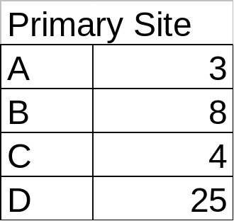
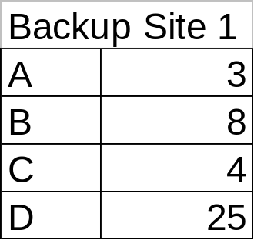

Primary Copy Algorithm
Updates run at primary site
Backups repeat writes;
backups allow “out-of-date” reads
CS 245
Notes 12

Slide 13
Primary Copy Algorithm
Updates run at primary site
Backups repeat writes;
backups allow “out-of-date” reads
5
9
7
6
T1: A:5; C:6
T2: B:9; C: 7
CS 245
Notes 12

Slide 14
Primary Copy Algorithm
Updates run at primary site
Backups repeat writes;
backups allow “out-of-date” reads
5
5
5
9
9
7
6
7
6
6
T1: A:5; C:6
T2: B:9; C: 7
propagate in order
CS 245
Notes 12

Slide 15
To be covered in CS347
More replicated data algorithms
More commit protocols
Distributed query processing
Open Source Systems for Distributed Data
  Storm, S4, Hadoop, Cassandra, Pregel, etc
Peer to peer systems
Distributed information retrieval
And many, many more fun topics!!
CS 245
Notes 12

