Slide 1
Clojure
Lisp on the JVM
Scott Rallya <srallya@gmail.com>

Slide 2
Overview
Clojure Introduction
Clojure Syntax
Clojure-Java Interop
Clojure and Concurrency
Wrap-up
Questions

Slide 3
What is Clojure?
Developed by Rich Hickey
First appeared in 2007, now up to version 1.1.0.
Dynamic and Interactive
Clojure is a Lisp, mostly functional, and has strong support for concurrency.

Slide 4
Dynamic and Interactive
Embedded or used interactively
Read-Print-Eval-Loop (REPL)
“But is it compiled?”
  Yes!
REPL-input or loaded files are compiled to bytecode on the fly.

Slide 5
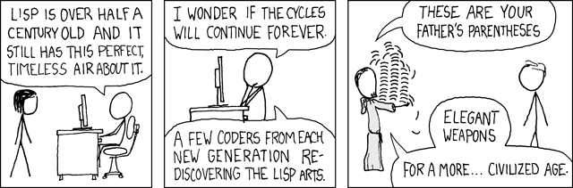
(defun clojure-isa-lisp ())
Source: http://xkcd.com/297

Slide 6
Why Lisp?
Extremely Simple Syntax
  There is no syntax!
  You operate on the level of an AST.
Homoiconicity
  Code is Data, Data is Code
  Program representation is a primary data structure of the language.
Metaprogramming
  Domain Specific Languages
  Macros (done right)
  Write your own language.

Slide 7
How Clojure Compares
Clojure is a Lisp-1, like Scheme
  Single namespace for functions and variables/data.
Clojure’s macros are not hygenic, like Common Lisp.
  Symbol capture is still an issue, lot easier to manage than in CL.
Lists aren’t the only core data-types.
No tail-call optimization due to JVM limitations.
Customer reader macros aren’t supported.
An empty list ‘() is not equivalent to nil.

Slide 8
Why Functional Programming
Concurrency is inevitable.
Extremely difficult to write safe, multithreaded programs due to state.
Lot of stress over locking, race conditions, and dead locks.
But...what if we removed state from the equation?

Slide 9
Functional Programming
Emphasis on computation rather than state.
Avoid side-effects by returning new data instead of modified data.
Accomplished through immutable data structures and software transactional memory.
The result is code that is:
  Easy to read
  Easy to test
  Easy to understand

Slide 10
Clojure and FP
Just a subset of functional programming idioms Clojure supports.
Lazy evaluation and (infinite) sequences.
Functions are first-class citizens
  Pass as parameters to other functions or create anonymous functions (lambdas)
Data structures are immutable

Slide 11
Concurrency and FP
Easy to reason about a concurrent program in absence of state.
However, our world isn’t static.
We can model changes in state through Clojure’s implementation of software transactional memory.
Clojure offers various APIs for changing state: whether its coordinated vs uncoordinated, thread-local, or synchronous vs asynchronous.

Slide 12
All this is great but...
How do I use it?

Slide 13
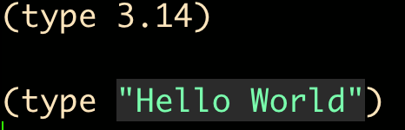
Typing
Clojure supports heterogenous data structures, but at the core everything is still a Java data type.
Possible to give type hints to Java when optimization is needed.

Slide 14


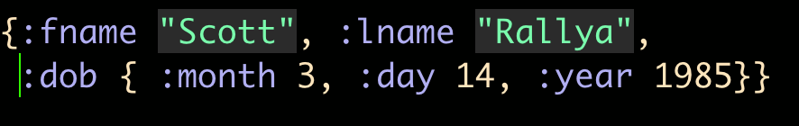

Four Fundamental Data Structures
Lists
Vectors
Maps
Sets

Slide 15
Four Fundamental Data Structures
All data structures are immutable and persistent
Clojure provides a number of functions for manipulating each data structure.
Data structures can be treated as sequences.
Support iteration via Iterable interface.
Support portions of java.lang.Collection.

Slide 16
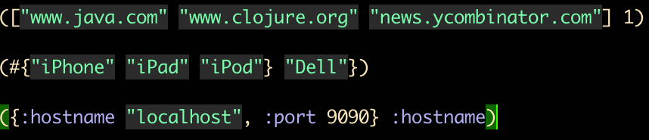
Data Structures as Functions
Data structures can be used as functions.
Works on maps, vectors, and sets.
Maps are function of their keys, vectors a function of their index, and sets a function of membership in the set.

Slide 17
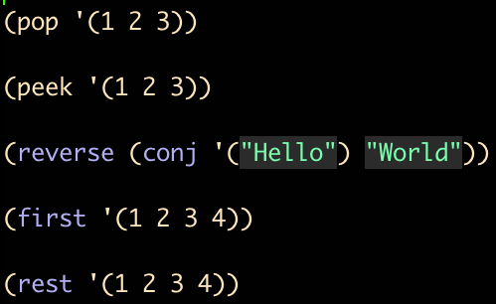
Lists
Lists implement IPersistentList

Slide 18
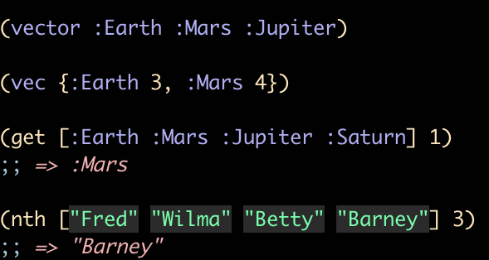
Vectors
Also supports functions on lists, but operate on the end (except first and rest, which still operate on the front.)

Slide 19
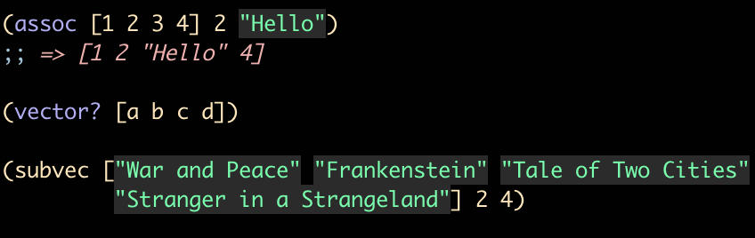
Vectors
(get ...) operates slightly different than (nth ...)
Given an empty vector:
  (get ...) returns nil
  (nth ...) throws an exception

Slide 20

Maps
Two map types are supported - Hashed and Sorted.
Sorted requires the Comparable interface be defined for the keys.
Creating Maps:
sorted-map and sorted-map-by also provides
(keys [map]) and (vals [map])
(assoc [map key val]) and (dissoc [map key])

Slide 21
Structs
Often you may operate on many instances of a map that are the same.
You can create a struct via ‘defstruct’
Create instance of struct using struct-map

Slide 22
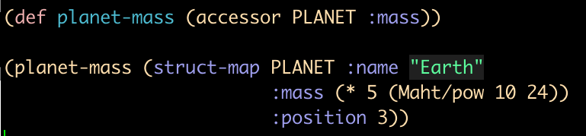
Structs
(accessor [struct key] creates a function that returns the value at the key

Slide 23
Moving On
Symbols are defined using (def ...)
Number of additional macros build upon (def ...)
  (defn ....) for defining functions
  (defn- ....) for defining non-public functions
  (defmacro ...) for defining macros

Slide 24
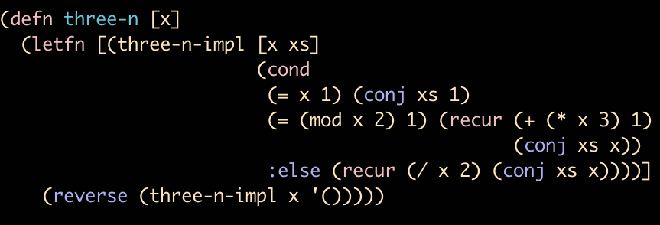
Defining Functions
(defn ...) takes a name, a vector of arguments, an optional doc-string and the function body.

Slide 25
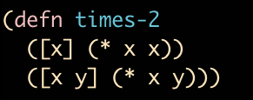
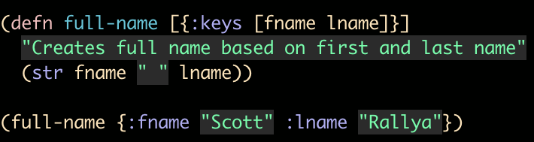
Functions
Functions support dispatch based on arguments.
Support for keyword arguments and doc strings

Slide 26
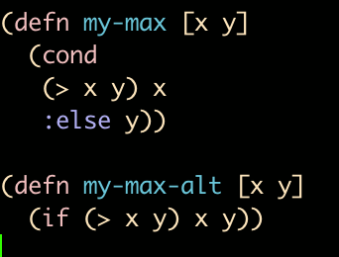
Control Structures
(if ...) and (cond ...) provided.

Slide 27
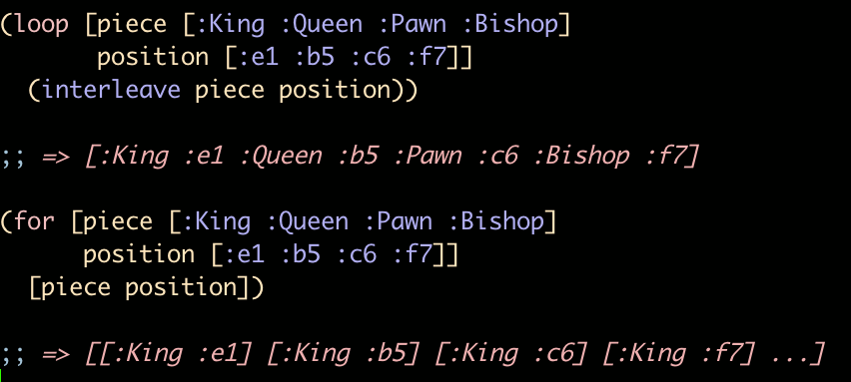
Looping
(loop ...) and (for ...) provided.
Clojure’s (for ...) is slightly different form Java’s.

Slide 28
Sequences
An obstacle for new Clojure developers is to think in terms of sequences instead of iteratively using loops.
Most functions that operate on sequences do so lazily.
Native Java arrays and collections can be treated as sequences as well.
  The result is a sequence which is immutable and persistent.
  However, another pass with (seq ...), for example, might yield different results due to the stateful changes that occur outside of Clojure.

Slide 29
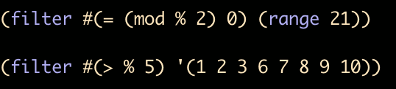
Sequences and Functional Programming
Given a list, we want to filter out elements which don’t match our criteria.
We can easily reverse this behavior by using (remove ...)

Slide 30
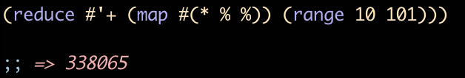
Sequences and Functional Programming
(map ...) applies a function to each element in a sequence.
(reduce ...) reduces a sequence to a single value.

Slide 31
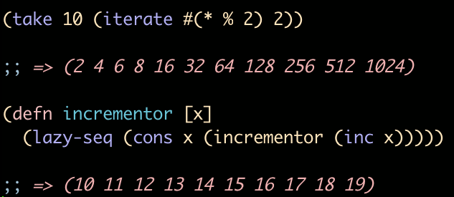
Creating Sequences
Clojure offers a number of ways of creating sequences.
Its necessary to remember that when creating a function that is used to generate lazy sequences avoid any side effects.
Utilize lazy-seq to create a function that acts as a sequence generator.

Slide 32


Java Interop
Clojure provides syntactical sugar for intearacting with Java APIs.
Creating an instance of a Java Class
Or, we can do better:

Slide 33
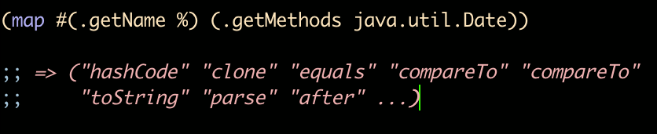
Java Interop
APIs can be large.
Quick, name all the methods of java.util.Date
... what if there as a quick way to get them all?

Slide 34
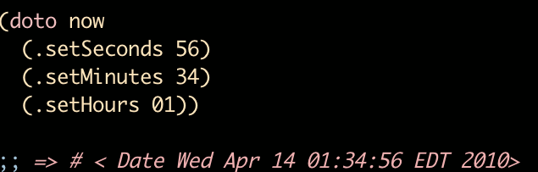
Java Interop
(doto obj ...) allows you to invoke multiple methods on an object.

Slide 35
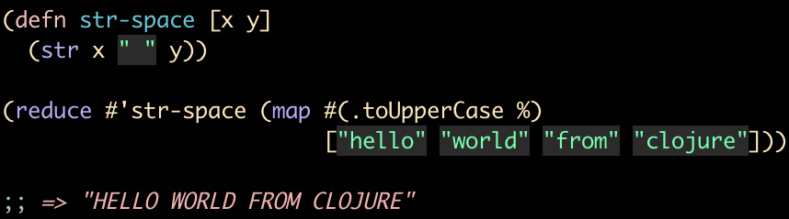
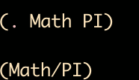
More Examples
Static fields can be accessed in one of two ways:

Slide 36
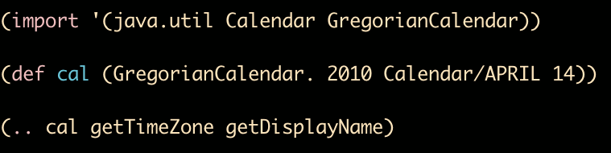
Chaining Methods
Often you may be chaining method calls together.
Clojure provides a macro in the form of (.. ) to make this easier to do.
(import ...) for including Java classes.
(import java.util.Date) for a single class
(import ‘(java.util BitSet HashSet)) for multiple classes.

Slide 37
Java Considerations
Clojure is not object-oriented, though encapsulation and polymorphism provided through multi-methods.
The Java world is not immutable - a consideration in mind whenever calling into any Java APIs.
Any Java library is accessible form Clojure using the same syntactical sugar.

Slide 38
Multi-methods
Clojure provides a powerful multi-method system that dispatches on type, value, and hierarchies.
Multi-methods require a dispatching function to dispatch inputs on.
Declare a multi-method using defmulti and instances with defmethod.

Slide 39
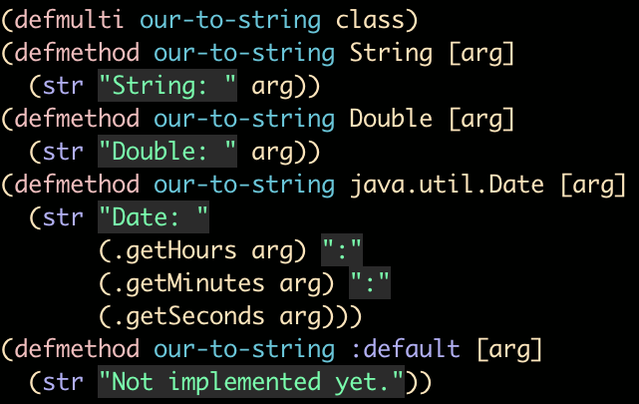
Multi-methods

Slide 40
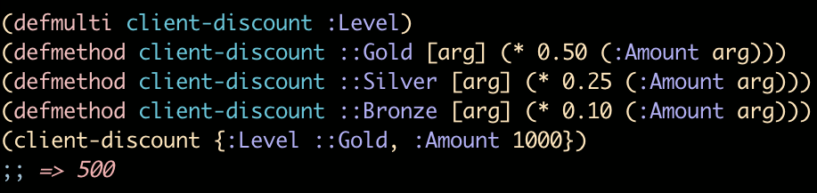
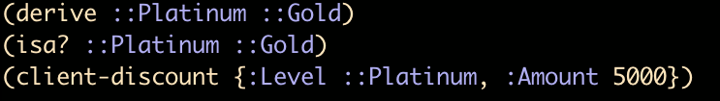
Multi-methods - Another Example
What if we wanted to add a Platinum level that has the same discount as the Gold level?
We could add another instance of (defmethod ...) supplying Platinum as the dispatch value or....

Slide 41
Concurrency
Most languages we encounter in enterprise settings are imperative and mutable.
State is continuously updated, functions may behave differently if its callee or any functions it calls changes state.
In a single-threaded program this may not always be a problem.
However, once we start introducing additional threads spread across multiple CPUs the issue of maintaining and rationalizing about state becomes more pronounced.
Locks are required to ‘stop’ the world as we update memory.

Slide 42
Concurrency
Clojure’s approach is a world that is primarily immutable.
Functions should be designed as to not introduce side-effects.
State, however, does need to be updated.
Encapsulate these changes in state using transactions and limit the scope of state change.
The result is software with a large functional model with no state, and a small mutable model where its necessary.

Slide 43
Concurrency
Four APIs are provided by Clojure for concurrency.
Vars, which manage thread-local changes.
Agents, used for asynchronous changes.
Atoms for uncoordinated, synchronous changes.
And finally refs, which manage coordinated, synchronous changes.

Slide 44
Concurrency - Vars
We’ve seen vars through the use of (def ...) form.
We can redefine using (def ...)
We can update a var using (set! ...) provided we are within a (binding ...)

Slide 45
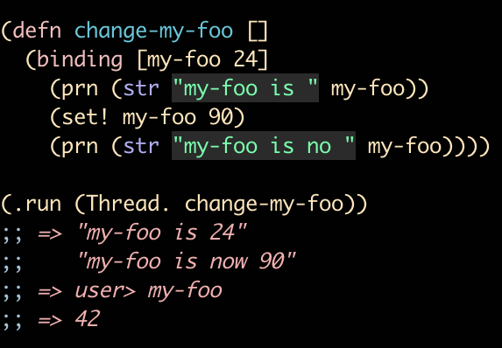
Vars - Example

Slide 46
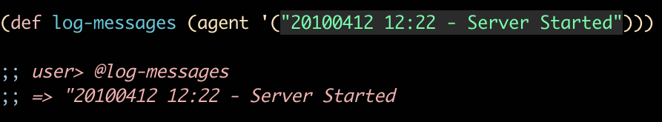
Agents
Certain tasks may be independent and uncoordinated.
Agents are used to support this style.
(agent ...) used to create an agent.

Slide 47
Agents
We want to add messages to log-messages, but don’t care when the actual addition occurs.
(send ...) returns the Agent itself, not the value of log messages.
You can use (await & agent) to ensure that the agent has completed the transaction.
(clear-agent-errors agent) ill clear any errors if the agent is used in an improper way.

Slide 48
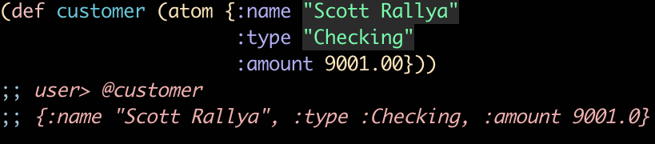
Atoms
Atoms manage uncoordinated, synchronous updates.
If a single value requires updating synchronously, atoms are the way to go.

Slide 49
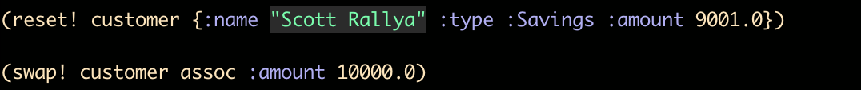
Atoms
(reset! atom new-val) to update an atom’s value.
Or use (swap! atom fn & args) to apply a function to an atom.
When (reset!) or (swap!) returns, the value has been updated (as opposed to the asynchronous nature of agents.)

Slide 50
Refs
Used for managing coordinated, synchronous updates to data.
Clojure accomplishes the software transaction memory using multi-version concurrency control (which is used in databases.)
Instead of modifying a variable directly, we update a reference to the data stored in the variable.

Slide 51


Refs
We can create a ref using (ref ...)
And update the value using (ref-set ...), but ref-set must be performed within the context of a transaction.

Slide 52
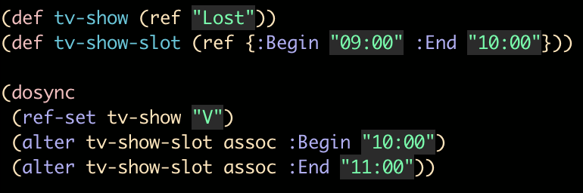
Refs
Perhaps e have two variables, tv-show and tv-show-slot.
Update the variables in a (dosync ...) block.

Slide 53
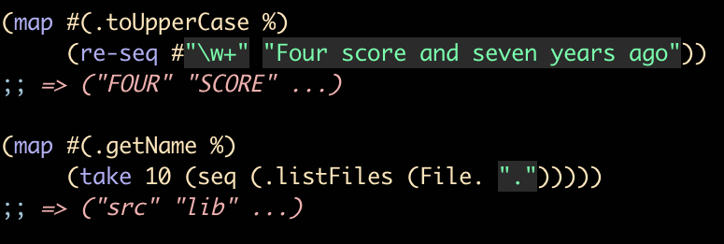
Wrapping Up
Many features still not covered
A few additional examples to demonstrate Clojure’s Power.

Slide 54
Clojure Ecosystem
Diverse ecosystem with a lot of new and interesting projects.
Compojure -
  http://github.com/weavejester/compojure
  Web application framework - used in this presentation.
Incanter
  http://github.com/liebke/incanter
  Statistical computing and plotting library.

Slide 55
Enterprise Clojure
Used in several Enterprise settings
Stuart Sierra’s AltLaw.org
TheDeadline - An intelligent project management system.

Slide 56
Clojure Editors
I prefer Emacs + Slime + Swank-Clojure
Enclojure - A Netbeans plugin
IntellJ IDEA - La Clojure
Eclipse - Counterclockwise Plugin

Slide 57
Clojure Websites
Clojure.org - http://www.clojure.org
Clojure Google Groups - http://groups.google.com/groups/clojure
Clojure Podcasts - http://clojure.blip.tv/
Reddit Clojure - http://reddit.com/r/clojure

Slide 58
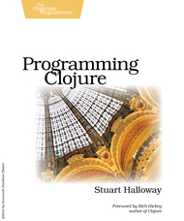

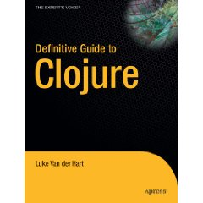
Clojure - Books
Currently Out
Upcoming

Slide 59
Contact Information
I can be reached at srallya@gmail.com
Feel free to e-mail me with any questions or if you are working on a cool Clojure project.

Slide 60
Fin
Questions, Comments, Suggestions?

