Slide 1
Randomized Algorithms
Chapter 12
Jason Eric Johnson
Presentation #3
CS6030 - Bioinformatics

Slide 2
In General
Make random decisions in operation
Non-deterministic sequence of operations
No input reliably gives worst-case results

Slide 3
Sorting
Classic Quicksort
Can be fast - O(n log n)
Can be slow - O(n²)
Based on how good a “splitter” is chosen

Slide 4
Good Splitters
We want the set to be split into roughly even halves
Worst case when one half empty and the other has all elements
O(n log n) when both splits are larger than n/4

Slide 5
Good Splitters
So, (3/4)n - (1/4)n = n/2 are good splitters
If we choose a splitter at random we have a 50% chance of getting a good one

Slide 6
Las Vegas vs. Monte Carlo
Randomized Quicksort always returns the correct answer, making it a Las Vegas algorithm
Monte Carlo algorithms return approximate answers (Monte Carlo Pi)

Slide 7
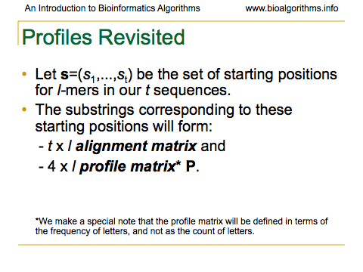

Slide 8
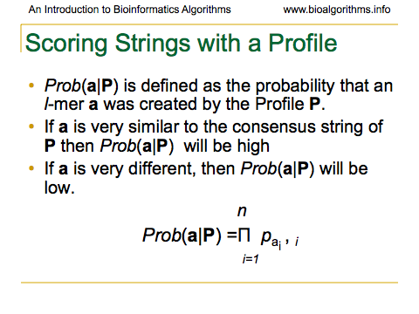

Slide 9
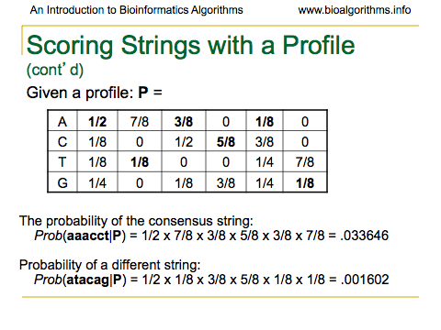

Slide 10
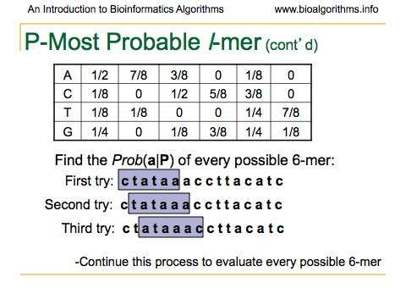

Slide 11
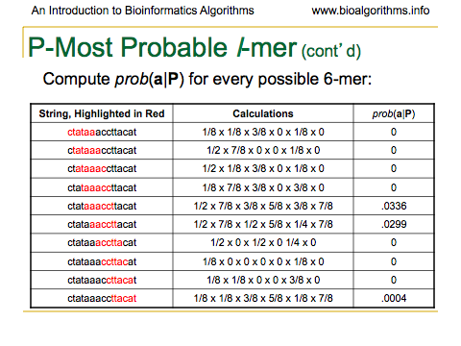

Slide 12
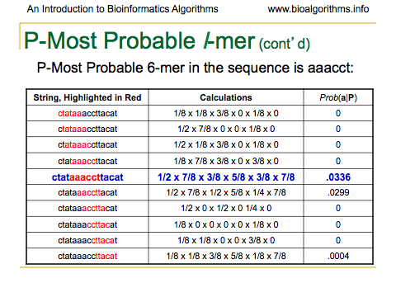

Slide 13
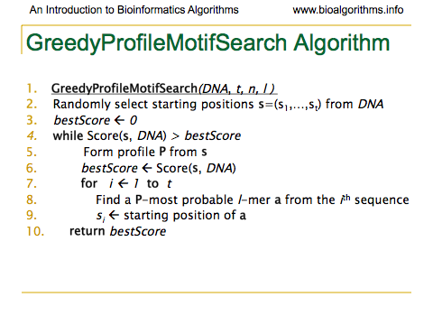

Slide 14
Problems With GreedyProfileMotifSearch
Very little chance of guess being optimal
Unlikely to lead to correct solution at all
Generally run many many times
Basically, hoping to stumble on the right solution (optimal motif)

Slide 15
Gibbs Sampling
Discards one l-mer per iteration
Chooses the new l-mer at random
Moves more slowly than Greedy strategy
More likely to converge to correct solution

Slide 16
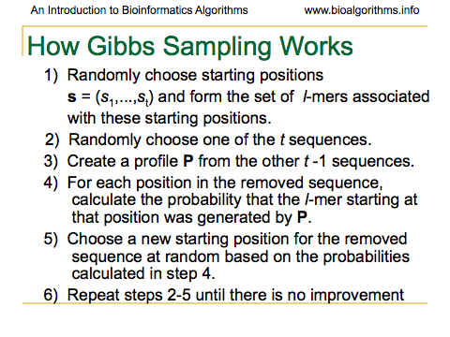

Slide 17
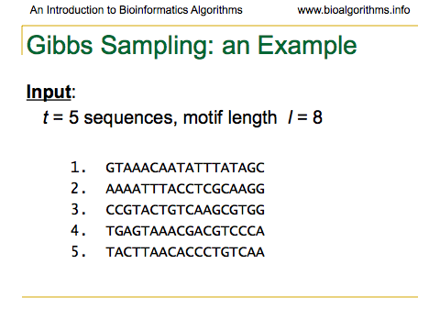

Slide 18
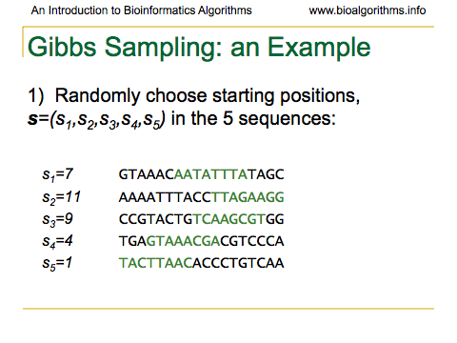

Slide 19
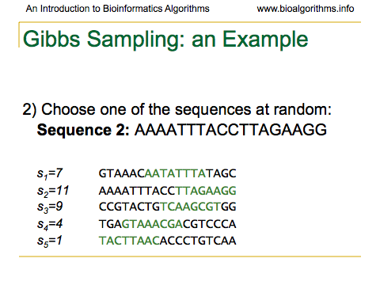

Slide 20


Slide 21
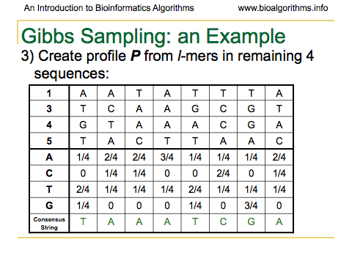

Slide 22
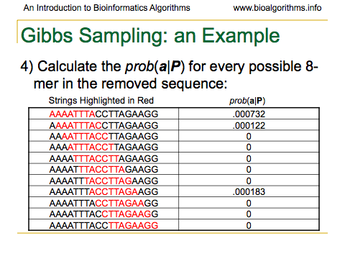

Slide 23
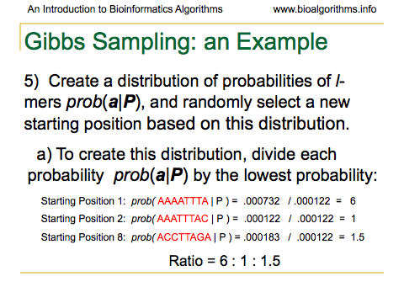

Slide 24
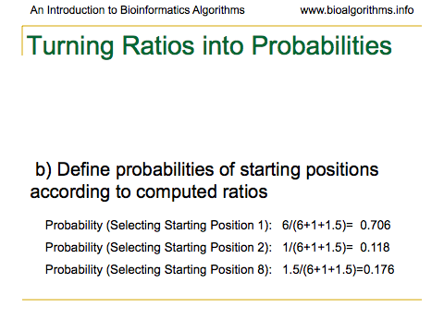

Slide 25
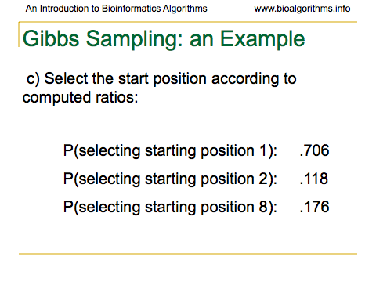

Slide 26
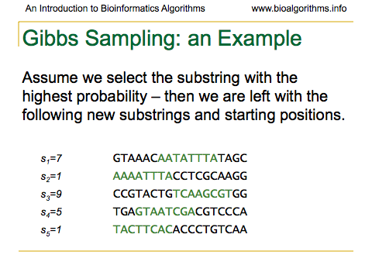

Slide 27
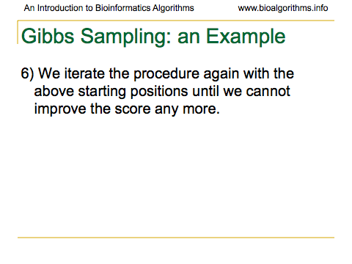

Slide 28
Problems with Gibbs Sampling
Needs to be modified if applied to samples with uneven nucleotide distribution
  Way more of one than others can lead to identifying group of like nucleotides rather than the biologically significant sequence

Slide 29
Problems with Gibbs Sampling
Often converges to a locally optimal motif rather than a global optimum
Needs to be run many times with random seeds to get a good result

Slide 30
Random Projection
Motif with mutations will agree on a subset of positions
Randomly select subset of positions
Search for projection hoping that it is unaffected (at least in most cases) by mutation

Slide 31
Random Projection
Select k positions in length l string
For each l-tuple in input sequences that has projection k at correct locations, hash into a bucket
Recover motif from the bucket containing many l-mers (Use Gibbs, etc.)

Slide 32
Random Projection
Get motif from sequences in the bucket
Use the information for a local refinement scheme, such as Gibbs Sampling

Slide 33
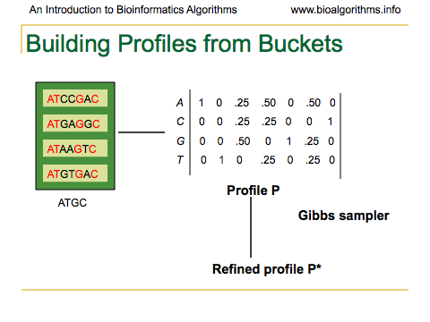

Slide 34
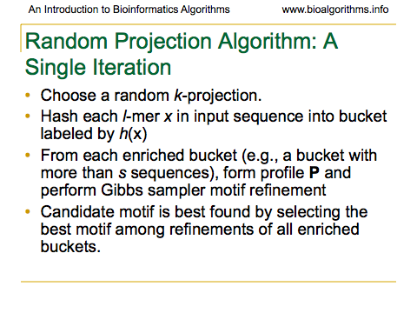

Slide 35
References
Generated from:
An Introduction to Bioinformatics Algorithms, Neil C. Jones, Pavel A. Pevzner, A Bradford Book, The MIT Press, Cambridge, Mass., London, England, 2004
Slides 7-13, 16-27, 33-34 from http://bix.ucsd.edu/bioalgorithms/slides.php#Ch12

