Slide 1
Biobrick
Jiale Wang
SUSTC

Slide 2

Definition
What is Biobrick ?
BioBrick standard biological parts are DNA sequences of defined structure and function; they share a common interface and are designed to be composed and incorporated into living cells such as E. coli to construct new biological systems. ------ From Wikipedia

Slide 3
So why we need that ?
Old molecular biological technique has two shortages:
1. If we want to use a new gene sequence, we need to find a new replication method of this sequence.
2. And the intermediate can’t be used efficiently.
However, biobrick solve all this problem !
We will look back to this later.

Slide 4
The composition of Biobrick
BioBrick Prefix
The standard BioBrick prefix depends on the part that follows it.
If the following part is a coding sequence or any other part that starts "ATG", the BioBrick prefix is: gaattcgcggccgcttctag(ATG)
Otherwise, the BioBrick prefix is: gaattcgcggccgcttctagag(CA)
BioBrick Suffix
The standard BioBrick suffix is always: tactagtagcggccgctgcag
BioBrick Scar
When BioBricks with these prefix and suffix sequencees are assembled, there is a "scar" between these parts.
If the second part starts "AT", the scar is: tactag
Otherwise, the scar is: tactagag
BioBrick Body : A DNA sequence which has some specific functions.

Slide 5

Biobrick Restriction Enzyme Cut Sites :
Inside the prefix : gaattc (EcoRI) gcggccgct (NotI) tctaga (XbaI)
Inside the suffix : t actagt (SpeI) agcggccg (NotI) ctgcag (PstI)

Slide 6



The advantages inside this is :
( Very Unusual ! )
+
And this protect the sequence from being destroyed during the next experiment circulation because the cut sites are destroyed .

Slide 7
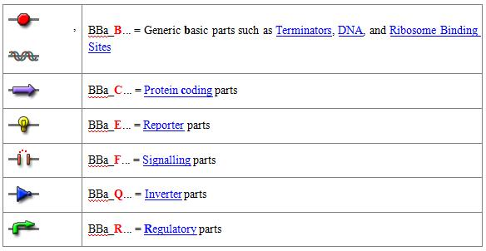
Some Important Part Names & Types

Slide 8
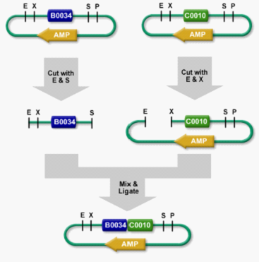
Building Biobrick Systems
Standard Assembly
Insert

Slide 9

Building Biobrick Systems
Parallel Assembly
One could spend many weeks building a 50-part system by assembling the first two parts, adding the third part, adding the fourth part, and so on. However, because BioBrick assembly is composable, assembly need not be done sequentially.
By performing multiple pairwise assemblies in parallel, a long assembly can be done in stages. The total amount of work is about the same, but the number of stages is the log (base 2) of the length of the assembly.
We call this system Parallel Assembly and have tools to manage the assembly of many BioBrick systems at the same time.

Slide 10
Let’s back to our first questions
Old molecular biological technique has two shortages:
1. If we want to use a new gene sequence, we need to find a new replication method (primer) of this sequence.
2. And the intermediate can’t be used efficiently.
However, biobrick solve all this problem :
For 1 : We don’t need to find a new replication method now because the primer are all the same for different biobrick .
For 2 : Because they have almost the same prefix and suffix, so the intermediate can be used many times.
Key : Biobricks are all in the same form, and the difference between them are just because of the body.

Slide 11
谢谢 ！
Thank you !

