Slide 1
MapReduce Online
Created by: Rajesh Gadipuuri
Modified by: Ying Lu

Slide 2
MapReduce Programming Model
Programmers think in a data-centric fashion
  Apply transformations to data sets
The MR framework handles the Hard Stuff:
  Fault tolerance
  Distributed execution, scheduling, concurrency
  Coordination
  Network communication
Notes:
MapReduce is a popular framework for data-intensive distributed computing of batch jobs. It used mainly to harness the power of large clusters of computers. allows programmers focus on applying transformations to sets of data records. MapReduce materialize the entire output of each map and reduce task before it can be consumed.

Slide 3
MapReduce System Model
Designed for batch-oriented computations over large data sets
  Each operator runs to completion before producing any output
  Operator output is written to stable storage
    Map output to local disk, reduce output to HDFS
Simple, elegant fault tolerance model: operator restart
  Critical for large clusters
Notes:
Concerned primarily with time to job completion. The entire output of each map and reduce task is materialized to a local file before it can be consumed by the next stage - checkpoint/restart fault tolerance ,critical in large deployments, which have a high probability of slowdowns or failures.

Slide 4
Life Beyond Batch Processing
Can we apply the MR programming model outside batch processing?
Domains of interest: Interactive data analysis
    Enabled by high-level MR query languages, e.g. Hive, Pig, Jaql
    Batch processing is a poor fit
    Batch processing adds massive latency
    Requires saving and reloading analysis state
Notes:
Since reducers cannot processing data as soon as it is produced by mappers, they have to wait for all the mappers to complete. MP cannot delivers data to downstream operators.
Jaql: Query Language for JavaScript.

Slide 5
MapReduce Online
Pipeline data between operators as it is produced
Hadoop Online Prototype (HOP): Hadoop with pipelining support
  Preserves the Hadoop interfaces and APIs
  Challenge: to retain elegant fault tolerance model
Reduces job response time
Enables online aggregation and continuous queries
Notes:
Since reducers begin processing data as soon as it is produced by mappers, they can generate and refine an approximation of their final answer during the course of execution - online aggregation.
HOP can be used to support continuous queries. MapReduce jobs can run continuously, accepting new data as it arrives and analyzing it immediately. This allows MapReduce to be used for applications such as event monitoring and stream processing.

Slide 6
Functionalities Supported by HOP
Reducers begin processing data as soon as it is produced by mappers, they can generate and refine an approximation of their final answer during the course of execution (online aggregation)
HOP can be used to support continuous queries, where MapReduce jobs can run continuously, accepting new data as it arrives and analyzing it immediately. This allows MapReduce to be used for applications such as event monitoring and stream processing

Slide 7
Outline
Hadoop Background
HOP Architecture
Online Aggregation
Stream Processing
Conclusions

Slide 8
Hadoop Architecture
Hadoop MapReduce
  Single master node, many worker nodes
  Client submits a job to master node
  Master splits each job into tasks (map/reduce), and assigns tasks to worker nodes
Hadoop Distributed File System (HDFS)
  Single name node, many data nodes
  Files stored as large, fixed-size (e.g. 64MB) blocks
  HDFS typically holds map input and reduce output
Notes:
The master node holds Job-Tracker process . Each worker runs a Task- Tracker process that manages the execution of the tasks currently assigned to that node. Each Task Tracker has a fixed number of slots for executing tasks. Each map task is assigned a portion of the input file called a split. By default, a split contains a single HDFS block, so the total number of file blocks determines the number of map tasks.

Slide 9
Job Scheduling in Hadoop
One map task for each block of the input file
  Applies user-defined map function to each record in the block
  Record = <key, value>
User-defined number of reduce tasks
  Each reduce task is assigned a set of record groups, i.e., intermediate records corresponding to a group of keys
  For each group, apply user-defined reduce function to the record values in that group
Reduce tasks read from every map task
  Each read returns the record groups for that reduce task
Notes:
The input to a job is an input specification that is in key-value pairs. Each job consists of two stages: first, a user defin map function is applied to each input record to produce a list of intermediate key-value pairs. Second, a user-defined reduce function is called once for each distinct key in the map output and passed the list of intermediate values associated with that key. Reduce - The shuffle phase (Each reduce task is assigned a partition of the key
range produced by the map step, so the reduce task must fetch the content of this partition from every map task’s output). The sort phase groups records with the same key. Apply the user-defined reduce function

Slide 10
Map Task Execution
Map phase
  Read the assigned input split from HDFS
    Split = file block by default
  Parses input into records (key/value pairs)
  Applies map function to each record
    Returns zero or more new records
Commit phase
  Registers the final output with the worker node
    Stored in the local filesystem as a file
    Sorted first by bucket number then by key
  Informs master node of its completion

Slide 11
Reduce Task Execution
Shuffle phase
  Fetches input data from all map tasks
    The portion corresponding to the reduce task’s bucket
Sort phase
  Merge-sort *all* map outputs into a single run
Reduce phase
  Applies user-defined reduce function to the merged run
    Arguments: key and corresponding list of values
  Write output to a temp file in HDFS
    Atomic rename when finished

Slide 12
Dataflow in Hadoop
Map tasks write their output to local disk
  Output available after map task has completed
Reduce tasks write their output to HDFS
  Once job is finished, next job’s map tasks can be scheduled, and will read input from HDFS
Therefore, fault tolerance is simple: simply re-run tasks on failure
  No consumers see partial operator output
Notes:
The buffer content is written to the local file system as an index file and a data file . Index file for indexing and The data file contains only the records, which are sorted by the key within each partition segment. A reduce task fetches data from each map task by issuing HTTP requests to a configurable
number of TaskTrackers at once (5 by default). The Job- Tracker relays the location of every TaskTracker that hosts map output to every TaskTracker that is executing a reduce task. a reduce task cannot fetch the output of a map task until the map has finished executing and committed its final output to disk.

Slide 13
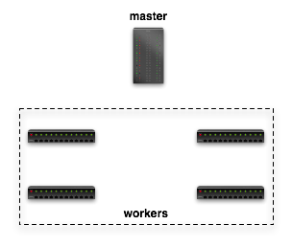

Dataflow in Hadoop
Submit job
map
schedule
reduce
map
reduce

Slide 14
Dataflow in Hadoop
Read
Input File
map
reduce
Block 1
HDFS
Block 2
map
reduce
Notes:
The map phase reads the task’s split/HDFS blocks from HDFS,parses it into records (key/value pairs), and applies the map function to each record.
After the map function has been applied to each input record, the commit phase registers the final output with the TaskTracker, which then informs the
JobTracker that the task has finished executing.

Slide 15
Dataflow in Hadoop
map
Local FS
reduce
HTTP GET
map
Local FS
reduce
Notes:
a reduce task fetches data from map tasks by issuing HTTP requests to a configurable number of TaskTrackers at once (5 by default). The Job-
Tracker relays the location of every TaskTracker that hosts map output to every TaskTracker that is executing a reduce task. Note that a reduce task cannot fetch the output of a map task until the map has finished executing and committed its final output to disk

Slide 16
Dataflow in Hadoop
Write Final Answer
reduce
HDFS
reduce
Notes:
In this design, the output of both map and reduce tasks is written to disk before it can be consumed. This is particularly expensive for reduce tasks, because their output is written to HDFS. Output materialization simplifies fault tolerance, because it reduces the amount of state that must be restored to consistency after a node failure. If any task (either map or reduce) fails, the JobTracker simply schedules a new task to perform the same work as the failed task.

Slide 17
Design Implications
Fault Tolerance
  Tasks that fail are simply restarted
  No further steps required since nothing left the task
“Straggler” handling
  Job response time affected by slow task
  Slow tasks get executed redundantly
    Take result from the first to finish
    Assumes slowdown is due to physical components (e.g., network, host machine)
Pipelining can support both!

Slide 18

Hadoop Online Prototype (HOP)

Slide 19
Hadoop Online Prototype
HOP supports pipelining within and between MapReduce jobs: push rather than pull
  Preserves simple fault tolerance scheme
  Improved job completion time (better cluster utilization)
  Improved detection and handling of stragglers
MapReduce programming model unchanged
  Clients supply same job parameters
Hadoop client interface backward compatible
  Extended to take a series of jobs
Notes:
A modified Hadoop will send data directly from map to reduce tasks. When a client submits a new job to Hadoop, the JobTracker assigns the map and reduce tasks associated with the job to the available TaskTracker slots. Hadoop is modified so that each reduce task contacts every map task upon initiation of the job, and opens a TCP socket which will be used to pipeline the output of the map function. the mapper determines which partition (reduce task) the record should be sent to, and immediately sends it via the appropriate socket. the reduce task learns that every map task has completed, it performs a final merge of all the sorted runs and applies the user-defined reduce function as normal.

Slide 20
Pipelining Batch Size
Initial design: pipeline eagerly (for each row)
  Moves more sorting work to reducer
  Prevents use of combiner
  Map function can block on network I/O
Revised design: map writes into buffer
  Spill thread: sort & combine buffer, spill to disk
  Send thread: pipeline spill files => reducers
Notes:
sends each record as soon as it is produced, which prevents the use of combiners. combiners allow map-side “preaggregation”: by applying a reduce-like function to each distinct key at the mapper, network traffic can often be substantially reduced. Instead of sending the buffer contents to reducers directly, we wait for the buffer to grow to a threshold size. The mapper then applies the combiner function, sorts the output by partition and reduce key, and writes the buffer to disk. the map function was invoked by the same thread that wrote output records to the pipeline sockets.

Slide 21
Fault Tolerance
Fault tolerance in MR is simple and elegant
  Simply recompute on failure, no state recovery
Initial design for pipelining FT:
  Reduce treats in-progress map output as tentative, that is: can merge together spill files generated by the same uncommitted mapper, but not combine those spill files with the output of other map tasks
Revised design:
  Pipelining maps periodically checkpoint output
  Reducers can consume output <= checkpoint
  Bonus: improved speculative execution
Notes:
To recover from map task failures, bookkeeping. A reducer treats the output of a pipelined map task as “tentative” until the JobTracker informs the reducer that the map task has committed successfully. The reducer can merge together spill files generated by the same uncommitted mapper, but will not combine those spill files with the output of other map tasks until it has been notified that the map task has committed. Thus, if a map task fails, reduce task can ignore any tentative spill files. The JobTracker will take care of scheduling a new map task attempt, as in stock Hadoop. Mapper uses a “checkpoint” concept: as a map task runs, it will periodically notify the JobTracker that it has reached
offset x in its input split. The JobTracker will notify any connected reducers; map task output that was produced before offset x can then be merged by reducers with other map task output as normal.

Slide 22
Fault Tolerance in HOP
Traditional fault tolerance algorithms for pipelined dataflow systems are complex
HOP approach: write to disk and pipeline
  Producers write data into in-memory buffer
  In-memory buffer periodically spilled to disk
  Spills are also sent to consumers
  Consumers treat pipelined data as “tentative” until producer is known to complete
  Fault tolerance via task restart, tentative output discarded

Slide 23
Refinement: Checkpoints
Problem: Treating output as tentative inhibits parallelism
Solution: Producers periodically “checkpoint” with Hadoop master node
  “Output split x corresponds to input offset y”
  Pipelined data <= split x is now non-tentative
  Also improves speculation for straggler tasks, reduces redundant work on task failure

Slide 24
Online Aggregation
Traditional MR: poor UI for data analysis
Pipelining means that data is available at consumers “early”
  Can be used to compute and refine an approximate answer
  Often sufficient for interactive data analysis, developing new MapReduce jobs, ...
Within a single job: periodically invoke reduce function at each reduce task on available data
Between jobs: periodically send a “snapshot” to consumer jobs
Notes:
poor interface for interactive data analysis, because they do not emit any output until the job has been executed. Now its used for interactive data analysis: a user submits a job to extract information from a data set, and then waits to view the results before proceeding with the next step in the data analysis process. an interactive user would prefer a “quick and dirty” approximation over a correct answer that takes much longer to compute.
Single - can support online aggregation by simply applying the reduce function to the data that a reduce task has received so far. We call the output of such an intermediate reduce operation a snapshot. we report job progress that shows how much data is accurate. Snapshots are computed periodically, as new data arrives at each reducer. The user specifies how often snapshots should be computed, using the progress metric as the unit of measure

Slide 25

Online Aggregation in HOP
Read
Input File
map
reduce
Block 1
HDFS
HDFS
Block 2
map
reduce
Write Snapshot
Answer

Slide 26
Inter-Job Online Aggregation
Like intra-job OA, but approximate answers are pipelined to map tasks of next job
  Requires co-scheduling a sequence of jobs
Consumer job computes an approximation
  Can be used to feed an arbitrary chain of consumer jobs with approximate answers
Notes:
This feature can be used to support online aggregation for a sequence of jobs, j1-reducer & j2-map. the output of a reduce function is not
“monotonic”: the output of a reduce function on the first 50% of the input data may not be obviously related to the output of the reduce function on the first 25%. Thus, as new snapshots are produced by j1, j2 must be recomputed from scratch using the new snapshot. fault tolerance for multi-job online aggregation for three cases. Tasks that fail in j1 recover as discussed earlier. If a task in j2 fails, the system simply restarts the failed task. Since subsequent snapshots produced by j1 are taken from a superset of the mapper output in j1, the next snapshot received by the restarted reduce task in j2 will have a higher progress score. To handle failures in j1, tasks in j2 cache the most recent received from j1 and replace when new one comes. If tasks
from both jobs fail, a new task in j2 recovers the most recent snapshot from j1.

Slide 27
Inter-Job Online Aggregation
Write Answer
reduce
map
HDFS
reduce
map
Job 1 Reducers
Job 2 Mappers

Slide 28
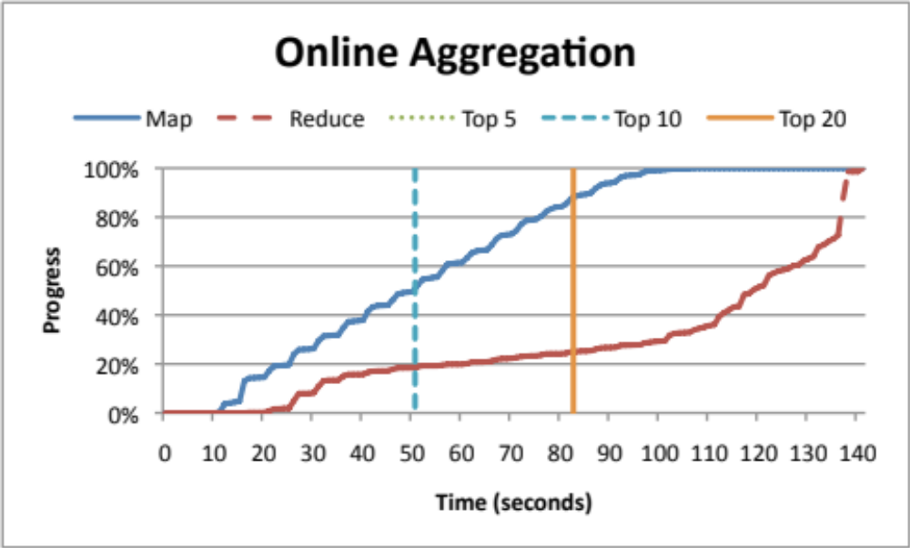
Example Scenario
Top K most-frequent-words in 5.5GB Wikipedia corpus (implemented as 2 MR jobs)
60 node EC2 cluster
Notes:
Evaluate online aggregation. two experiments on Amazon EC2 using different data sets and query workloads. In our first experiment, we wrote a “Top-K” query using two MapReduce jobs: the first job counts the frequency of each word and the second job selects the K most frequent words. We ran
this workload on 5.5GB of Wikipedia article text stored in HDFS, using a 128MB block size. We used a 60-node EC2 cluster; each node was a “high-CPU medium” EC2 instance with 1.7GB of RAM and 2 virtual cores. Above for a Top-100 query. we note the time at which the Top-K words in the snapshot are the Top-K words in the final result.

Slide 29
Fault Tolerance
For instance: j1-reducer & j2-map
  As new snapshots produced by j1, j2 re-computes from scratch using the new snapshot;
  Tasks that fail in j1 recover as discussed earlier;
  If a task in j2 fails, the system simply restarts the failed task. The next snapshot received by the restarted reduce task in j2 will always have a higher progress score than that received by the failed task;
  To handle failures in j1, tasks in j2 cache the most recent snapshot received from j1 and replace it when new one comes;
  If tasks from both jobs fail, a new task in j2 recovers the most recent snapshot from j1.
Notes:
The output of a reduce function is not “monotonic”: the output of a reduce function on the first 50% of the input data may not be obviously related to the output of the reduce function on the first 25%.

Slide 30
Stream Processing
MapReduce is often applied to streams of data that arrive continuously
  Click streams, network traffic, web crawl data, …
Traditional approach: buffer, batch process
  Poor latency
  Analysis state must be reloaded for each batch
Instead, run MR jobs continuously, and analyze data as it arrives
Notes:
MapReduce is often used to analyze streams of constantly arriving data, such as URL access logs and system console logs. this is done in large batches that can only provide periodic views of activity. This introduces significant latency into a data analysis process that ideally should run in near-real time. It is also potentially inefficient: each new MapReduce job does not have access to the computational state of the last analysis run, so this state must be recomputed from scratch.

Slide 31
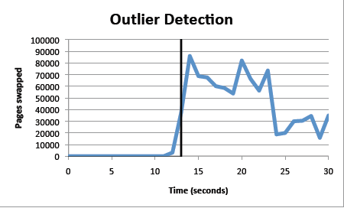
Monitoring
The thrashing host was detected very rapidly—notably faster than the 5-second TaskTracker- JobTracker heartbeat cycle that is used to detect straggler tasks in stock Hadoop. We envision using these alerts to do early detection of stragglers within a MapReduce job.
Notes:
We report detection latency in Figure 6. The vertical bar indicates the time at which the monitoring tool fired a (non-tentative) alert. The thrashing host was detected very rapidly—notably faster than the 5-second TaskTracker- JobTracker heartbeat cycle that is used to detect straggler tasks in stock Hadoop. We envision using these alerts to do early detection of stragglers within a MapReduce job.

Slide 32
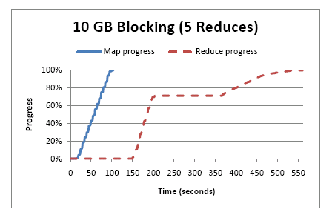
Performance: Blocking
10 GB input file
20 map tasks, 5 reduce tasks
Notes:
A reduce task in HOP is divided into three work phases: shuffle, reduce, and commit. In the shuffle phase, reduce tasks receive their portion of the output from each map. In HOP, the shuffle phase consumes 75% of the overall reduce task progress while the remaining 25% is allocated to the reduce and commit phase.3 In the shuffle phase, reduce tasks periodically perform a merge sort on the already received map output. These intermediate merge
sorts decrease the amount of sorting work performed at the end of the shuffle phase

Slide 33
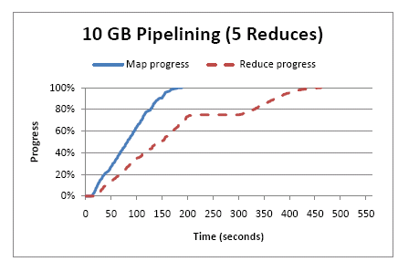
Performance: Pipelining
462 seconds vs. 561seconds
Notes:
By pushing work from map tasks to reduce tasks more aggressively, pipelining can enable better overlapping of map and reduce computation, especially when the node on which a reduce task is scheduled would otherwise be underutilized. However, when reduce tasks are already the bottleneck, pipelining offers fewer performance benefits, and may even hurt performance by placing additional load on the reduce nodes.

Slide 34
Other HOP Benefits
Shorter job completion time via improved cluster utilization: reduce work starts early
  Important for high-priority jobs, interactive jobs
Adaptive load management
  Better detection and handling of “straggler” tasks

Slide 35
Conclusions
HOP extends the applicability of the model to pipelining behaviors, while preserving the simple programming model and fault tolerance of a full-featured MapReduce framework.
Future topics
  Scheduling
  explore using MapReduce-style programming for even more interactive applications.

