Slide 1

SMARTCITIESANDBIGDATA
Anne Galang :: ENGL 794 :: TRANSMEDIA

Slide 2
Research questions
  Where are sensors being located in cities?
  What types of information are gleaned from this technology?
  How does this relate to big data and how is this data being used to improve cities?

Slide 3
Contents
Smart cities
Sensor technology
Big data, open data
Observations
Glossary of terms
Bibliography

Slide 4
Smart Cities

Slide 5
The need for smarter cities
Challenges cities face today
  Growing population
  Traffic congestion
  Space – homes and public space
  Resource management (water and energy use)
  Global warming (carbon emissions)
  Tighter city budgets
  Aging infrastructure
Resources:
Kent Larson’s TEDx Boston talk: “Brilliant Designs to Fit More People in Every City”
Stanley S. Litow: “America’s Cities need to get smarter”

Slide 6
The need for smarter cities
Some stats
  More than 50% of the world’s population live in cities
  In China alone, 300-400 million people will move to cities in the next 15 years
  In the 21st century, cities will account for
    90% of population growth
    80% of global CO2 emissions
    75% of energy use

Slide 7
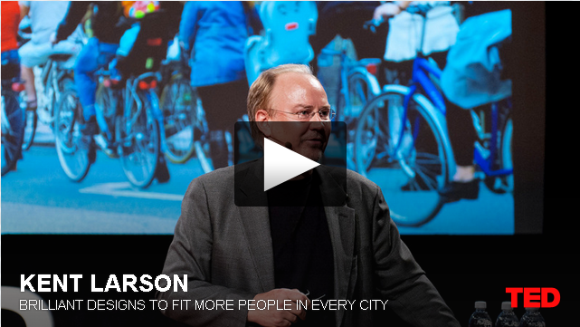
Smart cities
Kent Larson’s, “Brilliant Designs to Fit More People in Every City” (TEDx Boston, June 2012)
http://embed.ted.com/talks/kent_larson_brilliant_designs_to_fit_more_people_in_every_city.html
Or: http://cities.media.mit.edu/projects/examples
Notes:
Sources
Kent Larson’s TEDx Boston talk: “Brilliant Designs to Fit More People in Every City”
http://embed.ted.com/talks/kent_larson_brilliant_designs_to_fit_more_people_in_every_city.html
History of Cities – From 0:00 – 2:50
Pre-industrialization - home was center of learning, work, health
Industrialization – centralized work, production, energy production, learning (schools), health care
Water, sewer networks, roads, rails – allowed for unchecked expansion
“Give everybody a car, build roads to everything” – not a very functional model, but that’s where we live today. Crowded sprawls.

Slide 8
What are smart cities?
Vision of smarter cities
  Environmental sustainability and efficiency
  Sustainable homes and buildings
  Efficient use of resources
  Efficient and sustainable transportation
  Better urban planning - livable cities
Notes:
-Transportation: smart city cars, shared vehicles, use less space, exercise, bikes
-Housing: making use of small spaces – chasey/sensor walls; sensor furniture – smart lighting
-Livable cities
Distribution of amenities
Walkable cities

Slide 9
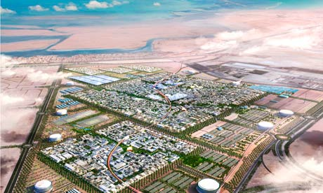
A computer generated graphic of Masdar city, currently under construction in Abu Dhabi. Photograph: Fosters + Partners.
(Accessed from The Guardian)
Notes:
Masdar City
Project in Abu Dhabi, United Arab Emirates.
Its core is a planned city, which is being built by the Abu Dhabi Future Energy Company and designed by the British architectural firm Foster and Partners. The city will rely entirely on solar energy and other renewable energy sources, with a sustainable, zero-carbon, zero-waste ecology and will be a car free city.
More: http://en.wikipedia.org/wiki/Masdar_City

Slide 10
Sensor technology and applications

Slide 11
Sensor networks
(Electronic) sensor: Measures physical properties and converts signal into electronic signal.
  “Interface between the physical world and world of electrical devices, such as computers”
  Actuator: Converts electronic signal into physical property - displays information for humans to interpret
    E.g. Speedometer, thermostat temperature reader
  Integration with ICT
    Store, aggregate and organize data for analysis.

Slide 12
Sensor networks
Data captured through sensors
    Movement
    Temperature
    Force
    Acceleration
    Flow
    Position
    Light
    Etc
Resources
Chong, Chee-Yee. “Sensor Networks: Evolution, Opportunities, and Challenges.” Proceedings of the EEE, 91.8. August 2003.
OECD. “Smart Sensor Networks: Technologies and Applications for Green Growth.” December 2009.
Verdone, R., D. Dardari, G. Mazzini and A. Conti. Wireless Sensor and Actuator Networks. Academic Press/Elsevier, London, 2008.

Slide 13
City applications - at a glance
  Smart parking: Monitoring of parking spaces availability in the city.
  Structural Health: Monitoring of vibrations and material conditions in buildings, bridges and historical monuments.
  Noise Urban maps: Sound monitoring in bar areas and centric zones in real time.
  Smartphone detection: Detect smart phones and in general any device which works with Wifi or Bluetooth interfaces.
  Electromagnetic field levels: Measurement of the energy radiated by cell stations and and WiFi routers.
  Traffic Congestion: Monitoring of vehicles and pedestrian levels to optimize driving and walking routes.
  Smart lighting: Intelligent and weather adaptive lighting in street lights.
  Waste management: Detection of rubbish levels in containers to optimize the trash collection routes.
  Smart roads: Intelligent Highways with warning messages and diversions according to climate conditions and unexpected events like accidents or traffic jams.
Source
“50 Sensor Applications for a Smarter World” Libelium.
Notes:
Top “Smart City” applications according to Libelium
“50 Sensor Applications for a Smarter World”: http://www.libelium.com/top_50_iot_sensor_applications_ranking/

Slide 14
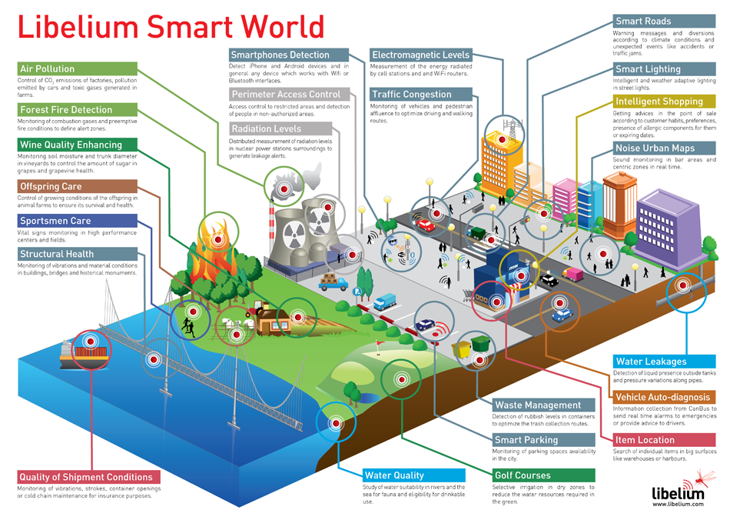

Slide 15
City applications
Focused examples:
  Energy (production, distribution and use)
  Smart buildings
  Intelligent transportation systems

Slide 16
Efficient energy
More efficient energy production
  Light sensors on solar panels track sun rays to ensure power is gathered in a more efficient manner
Distribution
  Smart grids: Highly complex systems technically integrating digital and non-digital technologies. Characterized by:
    More efficient energy routing (reduces excess capacity)
    Better monitoring and control
    Improved data capture and measurement
    Automation
Use
  Smart devices and metering – at the city, building, and home levels

Slide 17
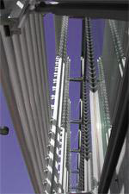
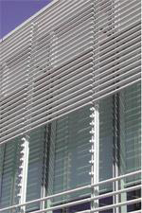
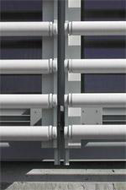
Smart buildings
Sensors technology used in buildings for monitoring and control
Increase energy efficiency, user comfort, and security
    Heating, ventilation and air conditioning systems
    Lighting/shading
    Air quality and window control
    Systems switching off devices
    Metering
    Access control (security)
Notes:
“The headquarters of the New York Times is an example of how different smart building technologies can be
combined to reduce energy consumption and to increase user comfort. Overall, the building consumes 30% less
energy than traditional office skyscrapers.
Equipped with lighting and shading control systems based on ICT technologies. The lighting system ensures that electrical light is only used when required. Further daylighting measures include a garden in the centre of the ground floor which is open to the sky as well as a
large area skylight. The electrical ballasts in the lighting system are equipped with chips that allow each ballast to be controlled separately. The shading system tracks the position of the sun and relies on a sensor network to automatically actuate the raising and lowering of the shades.”
(OECD 25)

Slide 18
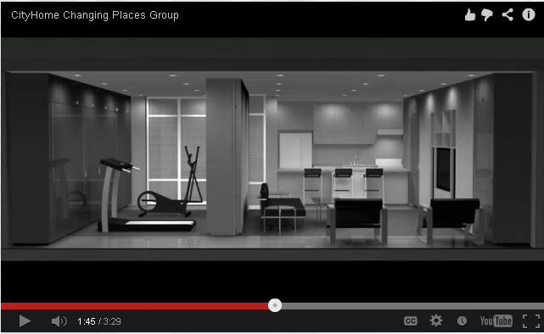
City Home
Sensor technology for more efficient use of space within buildings
City Home design, Changing Places Group video (1:44)
http://cities.media.mit.edu/projects/examples
Notes:
“Demonstrates how the CityHome, which has a very small footprint (840 square feet), can function as an apartment two to three times that size. This is achieved through a transformable wall system which integrates furniture, storage, exercise equipment, lighting, office equipment, and entertainment systems.” http://cp.media.mit.edu/research/67-cityhome

Slide 19
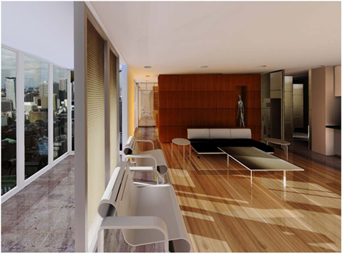
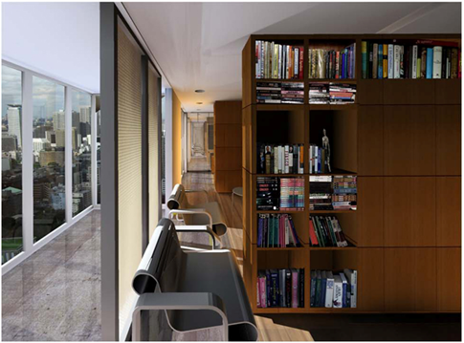
Resources:
City Home project site
MIT Media Lab City Science Projects

Slide 20
Transportation
Intelligent transportation systems (ITS)
Smarter infrastructure and vehicles:
  Infrastructure: Sensors in roads monitor intensity and fluidity of traffic to help control traffic lights more efficiently
  Vehicles: Sensors on smart vehicles
    Collision avoidance
    Navigation
  Public transit: Tracking use for more efficient route planning

Slide 21
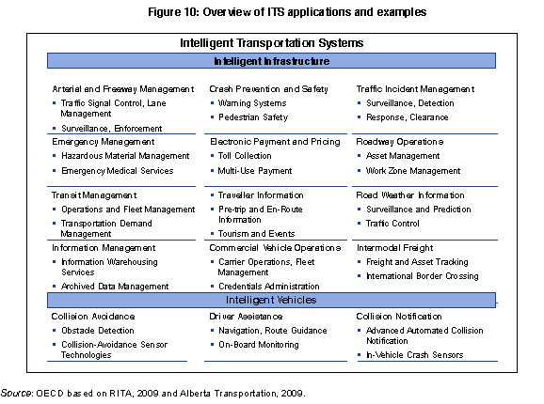
Notes:
(OECD 30)

Slide 22
Traffic management
IBM Smart Cities project - Traffic Management solutions
  Analyzing traffic patterns of buses, trains, traffic lights to
    Improve travel times
    Minimize impacts during emergencies, special events, etc
  Data collection: http://www-03.ibm.com/innovation/us/thesmartercity/traffic/index.html#!/1

Slide 23
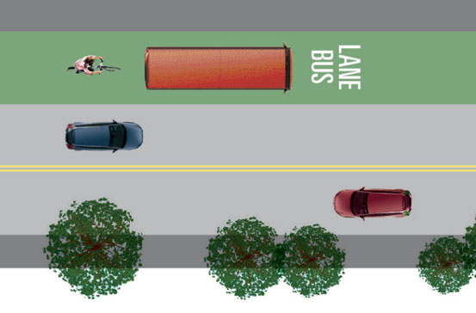
Smart public transit example
Intermittent bus lanes in Lisbon, Portugal
  Bus/HOV lanes, though they improve traffic flow, are often empty
  Research project in Lisbon, Portugal: wireless sensors in the ground detect presence of public transport in the bus lanes, so that lanes are only reserved when public transit vehicles approaching
Notes:
(OECD 31)

Slide 24
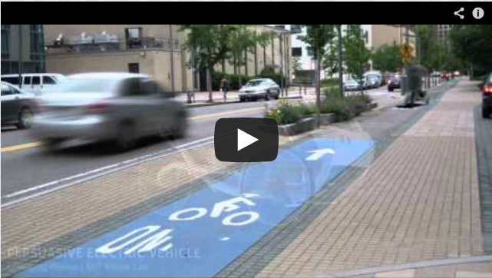
Intelligent vehicles of tomorrow
  MIT Media Lab, City Science - Persuasive electric vehicle
  http://www.youtube.com/watch?v=oahOWPtinec&feature=player_embedded or http://cities.media.mit.edu/projects/examples
Notes:
Or Larson talk at 7:49 - citycar

Slide 25
Other applications
Health care
  Fall detection – for seniors and people with mobility disabilities
Agriculture
Air quality, global warming
Global warming
Industry
  Shopping logistics, fleet tracking
  Industrial control – temperature monitoring, air quality
Entertainment

Slide 26
Projects
MIT Media Lab – City Science:
  http://cities.media.mit.edu/
  http://cities.media.mit.edu/projects/examples
IBM smart cities projects:
  http://www.ibm.com/smarterplanet/us/en/smarter_cities/overview/
  http://www-03.ibm.com/innovation/us/thesmartercity/index.html

Slide 27
Big data, open data

Slide 28
Data-driven cities
"We are increasingly able to digitally search and interrogate the city. Social tools can be layered over the city, giving us real-time access to information about the things and people that surround us, helping us to connect in new ways and giving rise to a data-driven society.
Cities today are vast repositories of information, endlessly collecting and archiving data. When semantically organised, the data can be exposed, shared, and interconnected. Giving people the right kind of access to this information can spark new applications and services, new ways of living, creating and being.”
(qtd in Kirby)

Slide 29
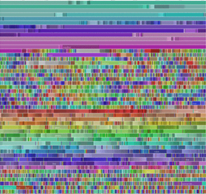
Big data
We’re collecting so much data…
  Datasets are becoming so large that they are becoming difficult to use
  If all sensor data were to be recorded, the data flow would be nearly 500 exabytes per day (Wikipedia)
    1 EB
    = 1000000000000000000B
    = 10¹⁸ bytes = 1000000000gigabytes
    =1000000terabytes
    = 1000petabytes
Visualization of all editing activity by robot user "Pearle" on Wikipedia.
“Viegas-UserActivityonWikipedia.gif”, Wikipedia.
Notes:
Collecting data through sensors, and through open data sets (public reports, city data, census data, etc)

Slide 30
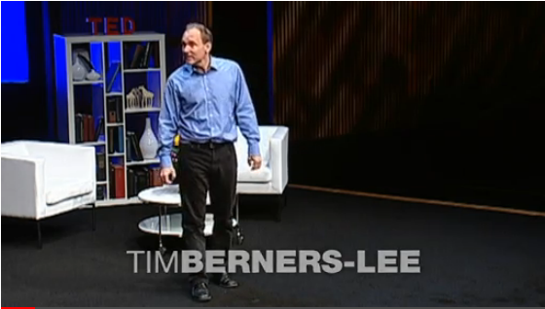
Open Data
Berners Lee, “The year open data went worldwide”, TED talks:
  http://www.ted.com/talks/tim_berners_lee_the_year_open_data_went_worldwide.html
Notes:
Lee calls for people to put their data on the web so it can be used by others to do “wonderful things in ways you may never have imagined”
Linked data standards to create data “mashups” -
Using public data to create open street maps

Slide 31
Open Data
Global movement to open up pubic data sets to make public data more accessible
  Sparks innovation
    Creation of apps and services
  Greater transparency in government
    Example: Open data revealed 3 billion dollars of charity fraud in Canada
  Citizen participation in decision making
“Open data enables citizens to have meaningful interaction with the information that surrounds them” FutureEverything
Notes:
“Case Study: How Open data saved Canada $3.2 Billion”
http://eaves.ca/2010/04/14/case-study-open-data-and-the-public-purse/
Future Everything Project: http://futureeverything.org/ongoing-projects/open-data-cities-datagm/

Slide 32
Open data
Future Internet Assembly session “Big data and smart cities” addressed challenges and opportunities
    “Big data needs to be made ‘small’ (i.e. accessible to citizens)”
    “Open data is only open if it is accessible: easy to obtain and easy to understand”
    “Open data is a political issue which should be addressed at a policy level”
    “Organizations could be provided with incentives for opening their data”
Resource
Future Internet Assembly, Aalborg
Session 3.1 – Smart cities and big data

Slide 33
Open data standards
Data standards make data more accessible and usable
Examples
  Linked data: http://linkeddata.org/
    “Linked Data is about using the Web to connect related data that wasn't previously linked, or using the Web to lower the barriers to linking data currently linked using other methods.”
  Open 3-1-1: http://open311.org/
    “Open311 is an open communication standard for public services and local government. Primarily, Open311 refers to a standardized protocol for location-based collaborative issue-tracking. By offering free web API access to an existing 311 service, Open311 is an evolution of the phone-based 311 systems that many cities in North America offer.
Notes:
More info:
What is 311? Slide deck: http://open311.org/2012/07/open311-at-the-association-of-government-contact-center-professionals/
List of Open 311 cities: http://wiki.open311.org/GeoReport_v2/Servers

Slide 34
What can open data tell us?
What a Hundred Million Calls to 311 Reveal About New York…

Slide 35
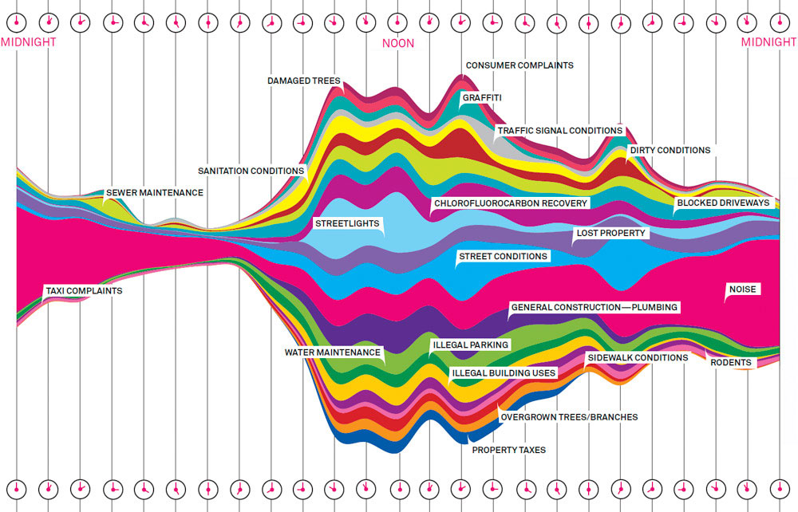
From Wired magazine.
“There were 34,522 complaints called in to 311 between September 8 and September 15, 2010. Here are the most common, plotted by time of day.
Illustration: Pitch Interactive”
Notes:
http://www.wired.com/magazine/2010/11/ff_311_new_york/

Slide 36
Open Data Projects
Vancouver’s open data initiatives:
  http://vancouver.ca/your-government/open-data-catalogue.aspx
FutureEverything’s Open Data Project
  http://futureeverything.org/ongoing-projects/open-data-cities-datagm/
European Commission Big Data Forum:
  http://www.future-internet.eu/home/future-internet-assembly/aalborg-may-2012/31-smart-cities-and-big-data.html

Slide 37
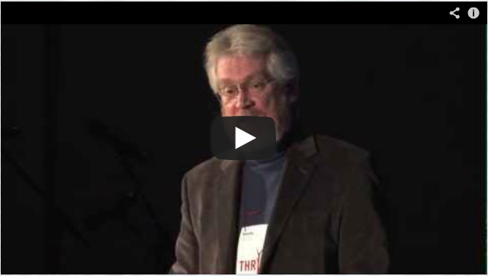
A human approach to data
Sandy Pentland, “Using personal data to benefit citizenry”, TEDxCambridge
    _x000b_
    http://cities.media.mit.edu/projects/examples
Notes:
Opportunities to use personal data for social good rather than “spying”

Slide 38
Observations

Slide 39
Observations
While initial focus of smart technology and data use within cities was driven by need for efficiency and sustainability, recent focus on human-centered approaches
  User-friendly interfaces
  Increased focus aesthetics, design
  Focus on quality of life
Proliferation of collaborative projects bringing together private companies, municipal governments, and researchers aimed at
  Improving cities
  Harnessing public data sets

Slide 40
Where do we go from here?
Open questions
  How to encourage civic engagement in smart cities?
  How to better share and use the data we’re capturing and make it more accessible?
  How to better use Big Data in the humanities?

Slide 41
Artistic applications of sensors and data

Slide 42
San Francisco Emotional Map
Project by artist Christian Nold, 2007
“The project invited the public to go for a walk using [a biosensor] device, which records the wearer’s physiological response to their surroundings. The results of these walks are represented on this map using colored dots and participant’s personal annotations. The San Francisco Emotion Map is a collective attempt at creating an emotional portrait of a neighborhood and envisions new tools that allow people to share and interpret their own bio data.”
http://www.sf.biomapping.net/map.htm

Slide 43
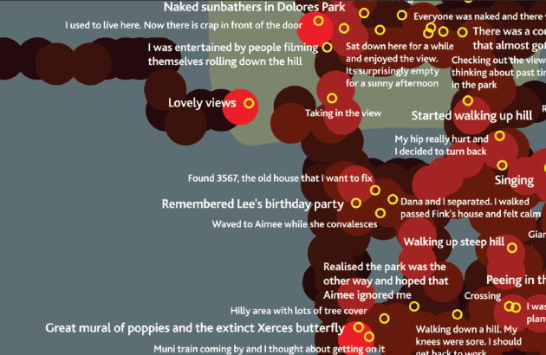
San Francisco Emotional Map. Christian Nold 2007.

Slide 44
Glossary of Terms

Slide 45
Glossary
Smart cities
Smart technology
Sensor networks
Sensor
Actuator
Wireless mesh networks
Information and Communications Technology (ICT)
Smart grid
Intelligent Transportation Systems (ITS)
Intelligent vehicles
Smart homes and buildings
Big data
Open data
Linked data
Open 3-1-1

Slide 46
Bibliography

Slide 47
Smart Cities
City Science. MIT Media Lab, 2012. Web. February 2013. http://cities.media.mit.edu/
Kirby, Terry. “City design: Transforming tomorrow.” The Guardian. N.d. Web. February 2013.
Larson, Kent. “Brilliant designs to fit more people every city.” TEDxBoston, Boston, MA. June 2012. Web. Feb 2013. <http://cities.media.mit.edu/projects/examples>
Smart Cities. IBM. N.d. Web. Feburary 2013. <http://www.ibm.com/smarterplanet/us/en/smarter_cities/overview/>
Sensor network technology
Chong, Chee-Yee. “Sensor Networks: Evolution, Opportunities, and Challenges.” Proceedings of the EEE, 91.8. August 2003.
OECD. “Smart Sensor Networks: Technologies and Applications for Green Growth.” December
“50 Sensor Applications for a Smarter World.” Libelium.
Murty, Rohan Naraya et al. “City Sense: An Urban-Scale Wireless Sensor Network and Testbed.”

Slide 48
Big data and open data
“Smart Cities and Big Data post event session summary.” Future Internet Assembly. 10-11 May 2012, Aalborg, Denmark. Web. Feb 2013. <http://www.future-internet.eu/home/future-internet-assembly/aalborg-may-2012/31-smart-cities-and-big-data.html>
“Big data.” Wikipedia. <http://en.wikipedia.org/wiki/Big_data>
Berners-Lee, Tim. “The year open data went worldwide.” TED 2010. Feb 2010. Web. Feb 2013.
Pentland, Sandy. “Using personal data to benefit citizenry.” TEDxCambridge. Mar 2012. Cambridge, MA. Web. Feb 2013. http://cities.media.mit.edu/projects/examples
Open data projects
Vancouver’s open data catalogue: http://vancouver.ca/your-government/open-data-catalogue.aspx
FutureEverything’s Open Data Project: http://futureeverything.org/ongoing-projects/open-data-cities-datagm/
Linked data: http://linkeddata.org/
Open 3-1-1: http://open311.org/
Code for America: http://codeforamerica.org/cities/
Open North: http://opennorth.ca/about/

Slide 49
Artistic city data projects
Flowing city http://flowingcity.com/
Nold, Christian. San Francisco Emotional Map. 2007. Web. Accessed March 2013. http://www.sf.biomapping.net/map.htm

