Slide 1
Smart Factory
By InTouch Systems Pvt. Ltd.

Slide 2


The data between the shop floor and ERP is transferred manually using documents.
------
Data
------
ERP
Top Floor
Data
------
Data
------
Shop Floor
In a Traditional Enterprise Resource Planning (ERP)

Slide 3
The data between the ERP and MES is transferred electronically whereas the data between the shop floor and MES is transferred manually using documents.
ERP
01
Top Floor
01
------
Data
------
MES
Data
------
Data
------
Shop Floor
ERP with Manufacturing Execution System (MES)

Slide 4
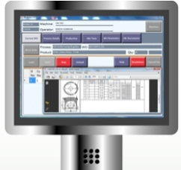
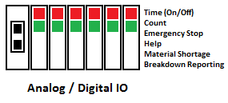
The data between the ERP and MES is transferred electronically.
Also the data on the shop floor is acquired electronically and transferred to MES electronically.
ERP
01
Top Floor
01
MES
01
01
HMI
& SCADA
Data
Shop Floor
ERP with MES & Smart Factory

Slide 5
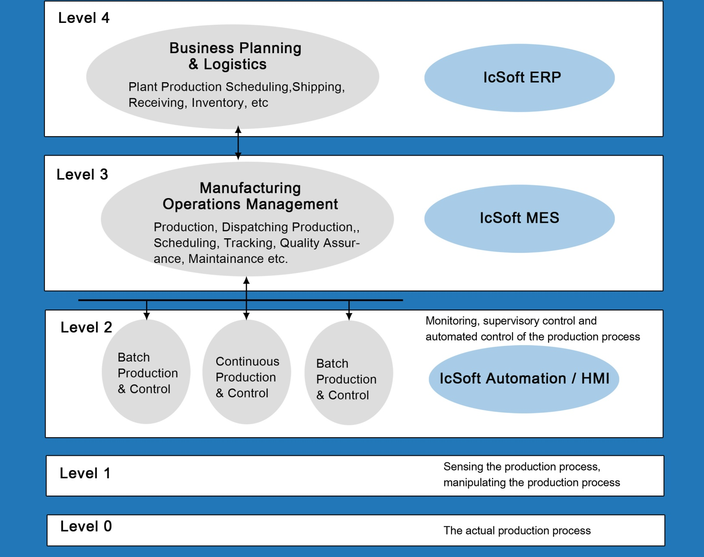
ERP
IcSoft MES
IcSoft Kiosk / HMI

Slide 6

Application
Steel / Allied Manufacturing
Foundry / Forging
Machine Shop / Auto Component
Assembly
Material Handling
Notes:
Whoever is making this presentation should focus on the fact that this product was developed with client input at every stage and from the customers point of view keeping the end-user in mind. Therefore, the huge client buy-in as well as flexibility of the product to fit various manufacturing industry needs.

Slide 7
Benefits
Lean Manufacturing
Improved Productivity / OEE
Online tracking of Bottle Necks
Agile Manufacturing
Notes:
Whoever is making this presentation should focus on the fact that this product was developed with client input at every stage and from the customers point of view keeping the end-user in mind. Therefore, the huge client buy-in as well as flexibility of the product to fit various manufacturing industry needs.

Slide 8
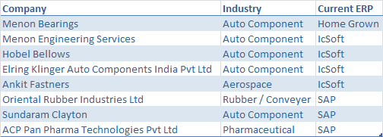
Trials / Demo’s Under Progress
Notes:
Whoever is making this presentation should focus on the fact that this product was developed with client input at every stage and from the customers point of view keeping the end-user in mind. Therefore, the huge client buy-in as well as flexibility of the product to fit various manufacturing industry needs.

Slide 9
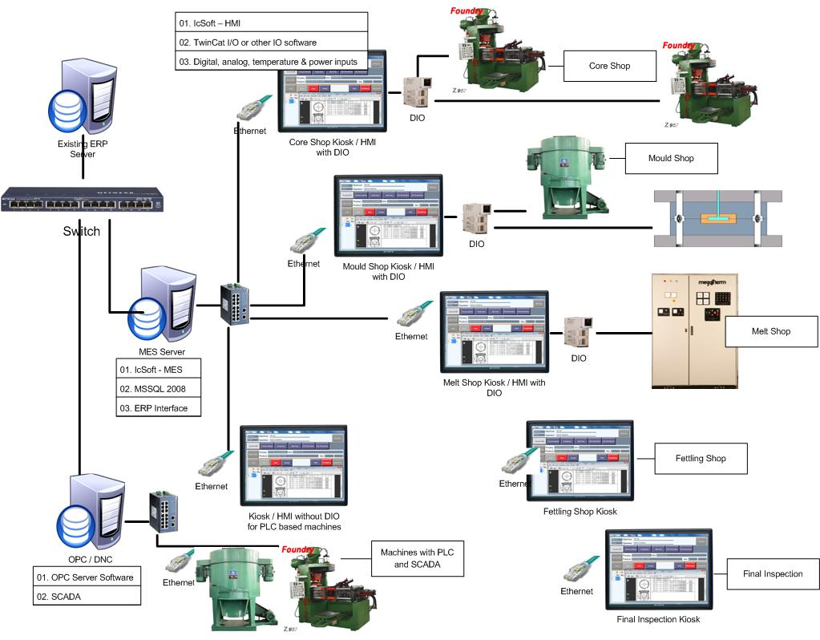
Data acquisition - Foundry

Slide 10
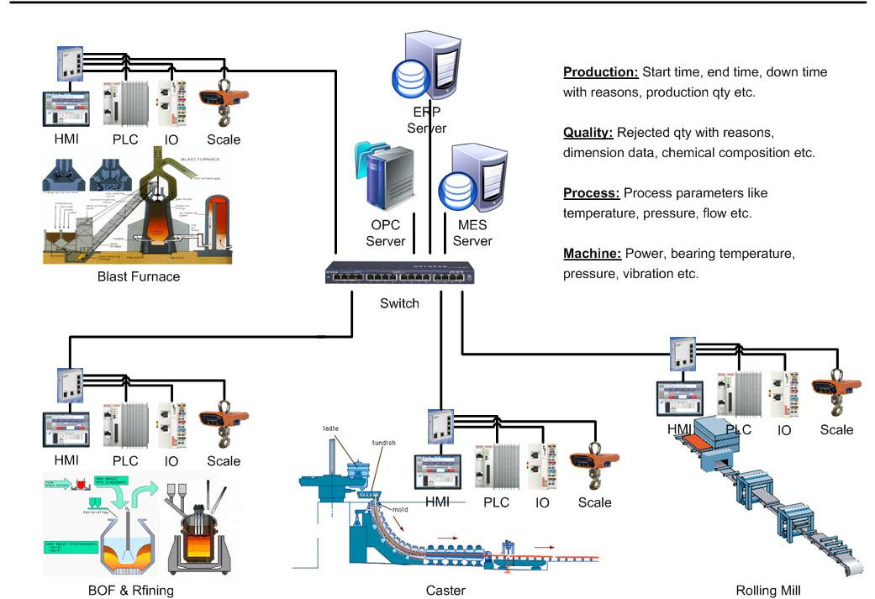
Data acquisition - Steel

Slide 11
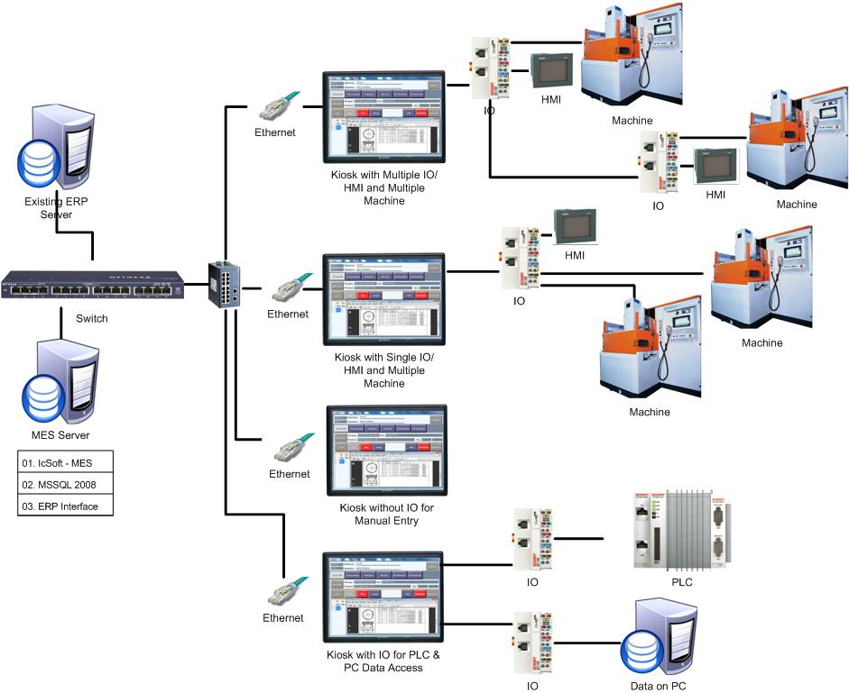
Data acquisition – Machine Shop

Slide 12
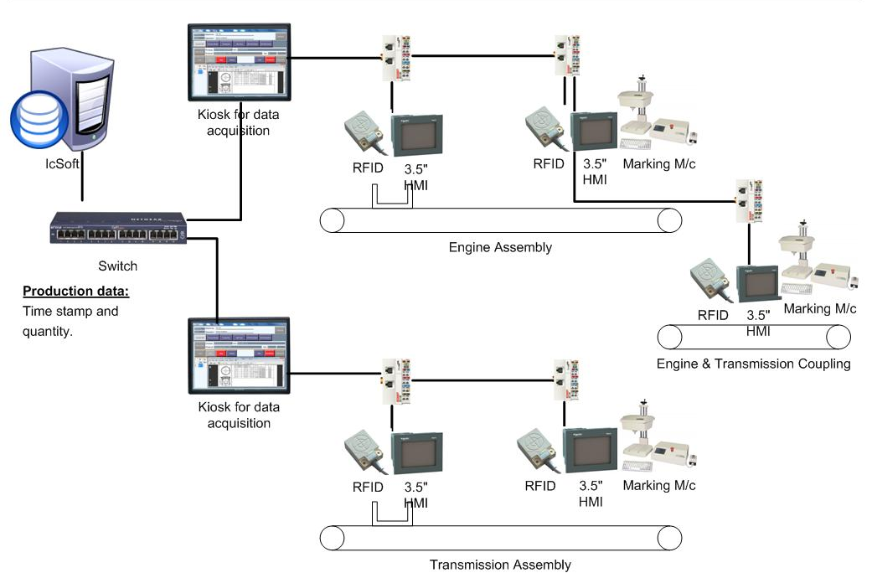
Data acquisition – Assembly Line

