Slide 1
Collision Detection and Distance Computation
CS 326A: Motion Planning

Slide 2
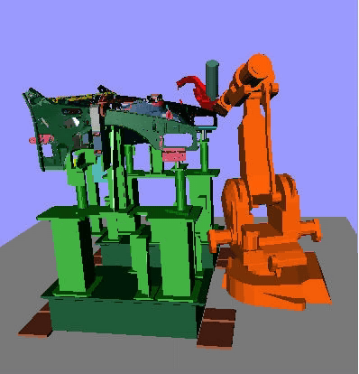
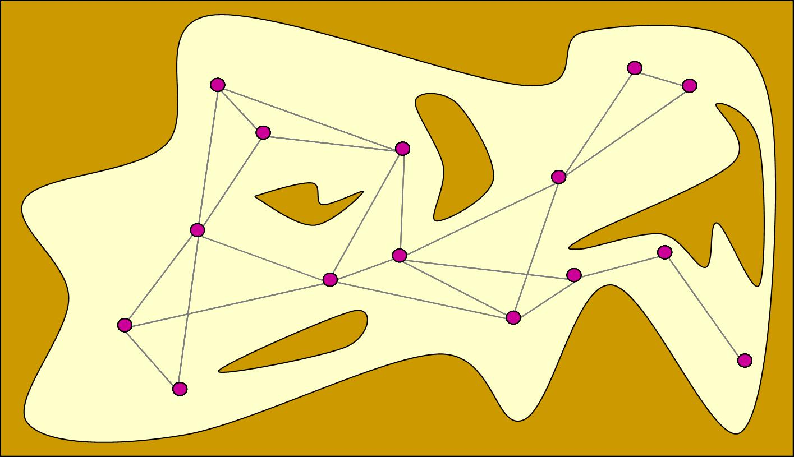
Probabilistic Roadmaps
Few moving objects,
but complex geometry

Slide 3
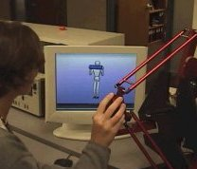
Haptic Interaction

Slide 4
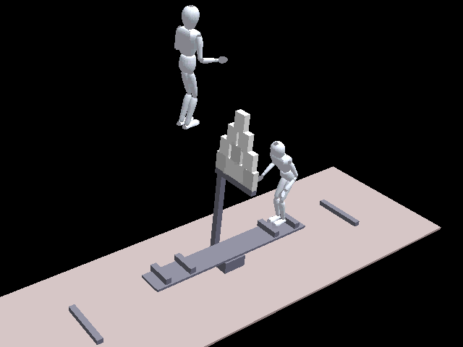
Graphic Animation
Many moving objects

Slide 5
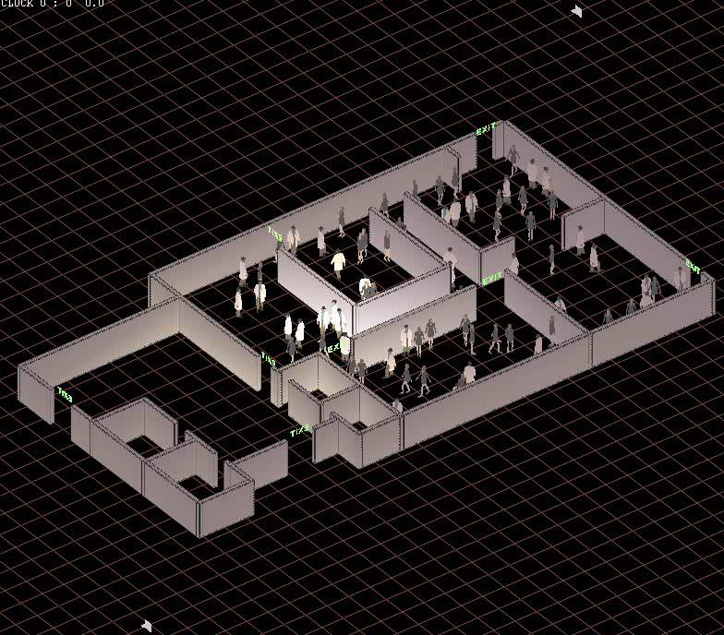
Crowd Simulation
Many moving objects,
but simple geometry
(discs)
Need to also
compute distances
(vision, sounds)

Slide 6
Collision Detection Methods
Many different methods
In particular:
  Grid method: good for many simple moving objects of about the same size (e.g., many moving discs with similar radii)
  Closest-feature tracking: good for moving polyhedral objects
  Bounding Volume Hierarchy (BVH) method: good for few moving objects with complex and diverse geometry

Slide 7
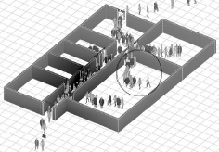
Grid Method
d
Subdivide space into a regular grid cubic of square bins
Index each object in a bin

Slide 8
Grid Method
d
Running time is proportional to
number of moving objects
Useful also to compute pairs of
objects within some distance (vision,
sound, …)

Slide 9
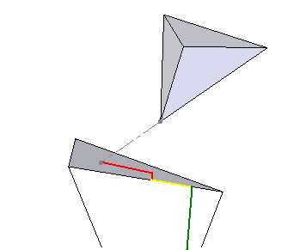
Closest-Feature Tracking
(M. Lin and J. Canny. A Fast Algorithm for Incremental Distance Calculation. Proc. IEEE Int. Conf. on Robotics and Automation, 1991)
The closest pair of features (vertex, edge, face) between two polyhedral objects are computed at the start configurations of the objects
During motion, at each small increment of the motion, they are updated
Efficiency derives from two observations:
  The pair of closest features
  changes relatively infrequently
  When it changes the new closest features will usually be on a boundary
  of the previous closest features

Slide 10
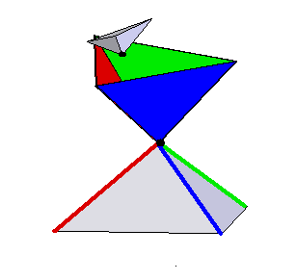
Closest-Feature Test for Vertex-Vertex
Vertex
Vertex

Slide 11
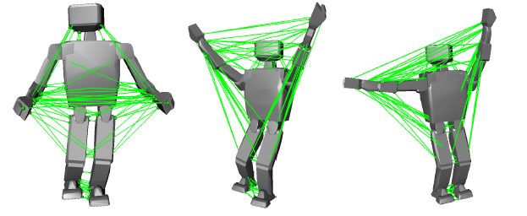
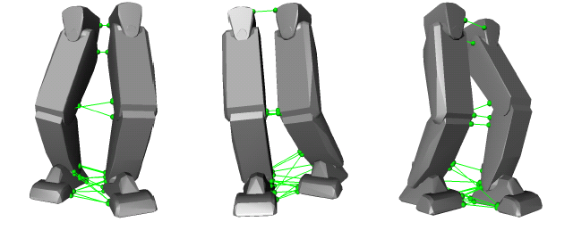
Application: Detecting Self-Collision in Humanoid Robots
(J. Kuffner et al. Self-Collision and Prevention for Humanoid Robots. Proc. IEEE Int. Conf. on Robotics and Automation, 2002)

Slide 12
Bounding Volume Hierarchy Method
BVH with spheres:
S. Quinlan. Efficient Distance Computation Between Non-Convex Objects. Proc. IEEE Int. Conf. on Robotics and Automation, 1994.
BVH with Oriented Bounding Boxes:
S. Gottschalk, M. Lin, and D. Manocha. OBB-Tree: A Hierarchical Structure for Rapid Interference Detection. Proc. ACM SIGGRAPH '96, 1996.
Combination of BVH and feature-tracking:
S.A. Ehmann and M.C. Lin. Accurate and Fast Proximity Queries Between Polyhedra Using Convex Surface Decomposition. Proc. 2001 Eurographics, Vol. 20, No. 3, pp. 500-510, 2001.
Adaptive bisection in dynamic collision checking:
F. Schwarzer, M. Saha, J.C. Latombe. Adaptive Dynamic Collision Checking for Single and Multiple Articulated Robots in Complex Environments, manuscript, 2003.

Slide 13
Bounding Volume Hierarchy Method
Enclose objects into bounding volumes (spheres or boxes)
Check the bounding volumes first
Decompose an object into two

Slide 14
Bounding Volume Hierarchy Method
Enclose objects into bounding volumes (spheres or boxes)
Check the bounding volumes first
Decompose an object into two
Proceed hierarchically

Slide 15
Bounding Volume Hierarchy Method
Enclose objects into bounding volumes (spheres or boxes)
Check the bounding volumes first
Decompose an object into two
Proceed hierarchically

Slide 16
Bounding Volume Hierarchy Method
BVH is pre-computed for each object

Slide 17
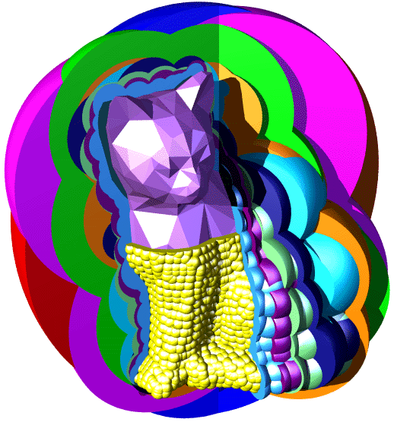
BVH in 3D

Slide 18
Collision Detection
A
A
B
C
B
C
D
E
F
G
D
E
F
G
Two objects described by their
precomputed BVHs

Slide 19
Collision Detection
Search tree
AA
pruning
A
A

Slide 20
Collision Detection
A
B
C
Search tree
AA
D
E
F
G
BB
BC
CB
CC
A
A

Slide 21
Collision Detection
A
B
C
Search tree
AA
D
E
F
G
BB
BC
CB
CC
pruning

Slide 22
Collision Detection
A
B
C
Search tree
AA
D
E
F
G
BB
BC
CB
CC
FD
FE
GD
GE
G
If two leaves of the BVH’s overlap
(here, G and D) check their content
for collision
D

Slide 23
Variant
A
B
C
Search tree
AA
AA
D
E
F
G
BB
BC
CB
CC
BA
CA
A
A

Slide 24
Collision Detection
Pruning discards subsets of the two objects that are separated by the BVs
Each path is followed until pruning or until two leaves overlap
When two leaves overlap, their contents are tested for overlap

Slide 25
Search Strategy and Heuristics
If there is no collision, all paths must eventually be followed down to pruning or a leaf node
But if there is collision, it is desirable to detect it as quickly as possible
→ Greedy best-first search strategy with
f(N) = d/(r_{X}+r_{Y})
[Expand the node XY
with largest relative
overlap (most likely to
contain a collision)]
r_{Y}
r_{X}
d
Y
X

Slide 26
Recursive (Depth-First)
Collision Detection Algorithm
Test(A,B)
  If A and B do not overlap, then return 1
  If A and B are both leaves, then return 0 if their contents overlap and 1 otherwise
  Switch A and B if A is a leaf, or if B is bigger and not a leaf
  Set A₁ and A₂ to be A’s children
  If Test(A₁,B) = 1 then return Test(A₂,B) else return 0

Slide 27
Performance
Several thousand collision checks per second for 2 three-dimensional objects each described by 500,000 triangles, on a 1-GHz PC

Slide 28
Greedy Distance Computation
(same recursion as collision detection)
Greedy-Distance(A,B)
  If dist(A,B) > 0, then return dist(A,B)
  If A and B are both leaves, then return distance between their contents
  Switch A and B if A is a leaf, or if B is bigger and not a leaf
  Set A₁ and A₂ to be A’s children
  d₁ ← Greedy-Distance(A₁,B)
  If d₁ > 0 then
      d₂ ← Greedy-Distance(A₂,B)
      If d₂ > 0 then return Min(d₁,d₂)
  Return 0

Slide 29
Exact Distance Computation
M (upper bound on distance) is initialized to very large number
Distance(A,B)
  If dist(A,B) > M, then return M
  If A and B are both leaves, then
      d ← distance between their contents
      Return Min(d,M)
  Switch A and B if A is a leaf, or if B is bigger and not a leaf
  Set A₁ and A₂ to be A’s children
  M ← Distance(A₁,B)
  If M > 0 then return Distance(A₂,B)
  Else return 0

Slide 30
Approximate Distance Computation
M (upper bound on distance) is initialized to very large number
Approx-Distance(A,B) [→ d_{a} : d_{a} ≤ d_{e} and d_{e}-d_{a} ≤ αd_{e}]
  If dist(A,B) > M, then return M
  If A and B are both leaves, then
      d ← distance between their contents
      If d < M then return (1-α)×d else return M
  Switch A and B if A is a leaf, or if B is bigger and
  not a leaf
  Set A₁ and A₂ to be A’s children
  M ← Approx-Distance(A₁,B)
  If M > 0 then return Approx-Distance(A₂,B)
  Return 0

Slide 31
Approximate Distance Computation
M (upper bound on distance) is initialized to very large number
Approx-Distance(A,B) [→ d_{a} : d_{a} ≤ d_{e} and d_{e}-d_{a} ≤ αd_{e}]
  If dist(A,B) > M, then return M
  If A and B are both leaves, then
      d ← distance between their contents
      If d < M then return (1-α)×d
  Switch A and B if A is a leaf, or if B is bigger and
  not a leaf
  Set A₁ and A₂ to be A’s children
  M ← Approx-Distance(A₁,B)
  If M > 0 then return Approx-Distance(A₂,B)
  Return 0
Garanteed to return an approximate
distance between (1-α)d and d

Slide 32
Greedy Distance Computation
Use BV hierarchy + same recursion as for pure cc
But compute distance between BVs instead of
just testing BV overlap
returns values often much larger than ½ distances
small factor slower than a pure collision checking
much faster than BV-based exact or ½-approximate
distance computation

Slide 33
Desirable Properties of
BVs and BVHs
BVs:
Tightness
Efficient testing
Invariance
BVH:
Separation
Balanced tree
?

Slide 34
Desirable Properties of
BVs and BVHs
BVs:
Tightness
Efficient testing
Invariance
BVH:
Separation
Balanced tree

Slide 35
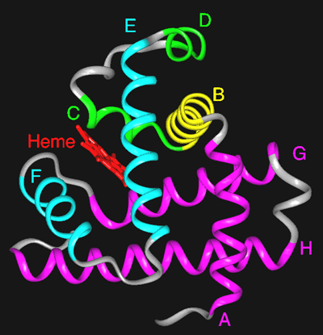
Spheres
Invariant
Efficient to test
But tight?

Slide 36
Axis-Aligned Bounding Box (AABB)

Slide 37
Axis-Aligned Bounding Box (AABB)
Not invariant
Efficient to test
Not tight

Slide 38
Oriented Bounding Box (OBB)

Slide 39
Oriented Bounding Box (OBB)
Invariant
Less efficient to test
Tight

Slide 40
Comparison of BVs
 | Sphere | AABB | OBB
Tightness | - | -- | +
Testing | + | + | o
Invariance | yes | no | yes
No type of BV is optimal for all situations

Slide 41
Desirable Properties of
BVs and BVHs
BVs:
Tightness
Efficient testing
Invariance
BVH:
Separation
Balanced tree
?

Slide 42
Desirable Properties of
BVs and BVHs
BVs:
Tightness
Efficient testing
Invariance
BVH:
Separation
Balanced tree

Slide 43
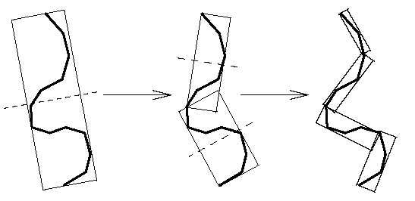
Construction of a BVH
Top-down construction
At each step, create the two children of a BV
Example:
For OBB, split longest side at midpoint

Slide 44
Computation of an OBB
[Gottschalk, Lin, and Manocha, 96]
N points a_{i} = (x_{i}, y_{i}, z_{i})^{T}, i = 1,…, N
SVD of A = (a₁ a₂ ... a_{N})
→ A = UDV^{T} where
  D = diag(σ₁,σ₂,σ₃) such
  that σ₁ ≥ σ₂ ≥ σ₃ ≥ 0
  U is a 3x3 rotation matrix
  that defines the principal
  axes of variance of the a_{i}’s
  → OBB’s directions
The OBB is defined by max and min
coordinates of the a_{i}’s along these directions
Possible improvements: use vertices of convex hull of the a_{i}’s or dense uniform sampling of convex hull
y
X
Y
rotation
described by
matrix U
x

Slide 45
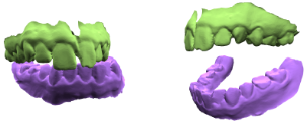
Combining Bounding Volume and Feature Tracking Methods
S.A. Ehmann and M.C. Lin. Accurate and Fast Proximity Queries Between Polyhedra Using Convex Surface Decomposition. Proc. 2001 Eurographics, Vol. 20, No. 3, pp. 500-510, 2001.
→ Use BVH to quickly identify close pairs of polyhedra
→ Use feature-tracking to check these pairs

Slide 46
Static vs. Dynamic
Collision Detection
Static checks
Dynamic checks

Slide 47
Usual Approach to Dynamic Checking (in PRM Planning)
Discretize path at some fine resolution ε
Test statically each intermediate configuration
3
2
3
1
3
2
3
ε too large → collisions are missed
ε too small → slow test of local paths
< ε

Slide 48
Testing Path Segment vs. Finding First Collision
PRM planning
Detect collision as quickly as possible
→ Bisection strategy
Physical simulation, haptic interaction
Find first collision
→ Sequential strategy

Slide 49
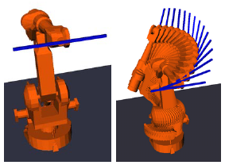
ε too large → collisions are missed
ε too small → slow test of local paths

Slide 50
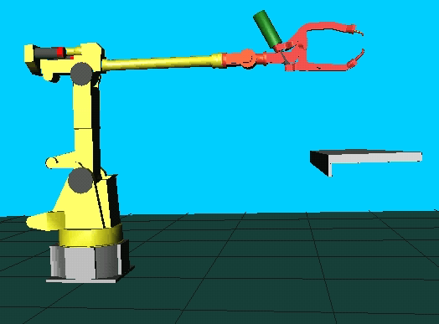
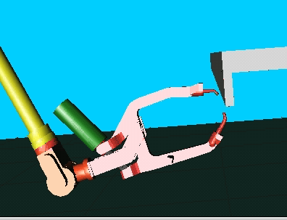
ε too large → collisions are missed
ε too small → slow test of local paths

Slide 51
Previous Approaches to
Dynamic Collision Detection
Bounding-volume (BV) hierarchies
→ Discretization issue
Feature-tracking methods
[Lin, Canny, 91]
[Mirtich, 98] V-Clip
[Cohen, Lin, Manocha, Ponamgi, 95] I-Collide
[Basch, Guibas, Hershberger, 97] KDS
→ Geometric complexity issue with highly non-convex objects
→ Sequential strategy (first collision) that is not efficient for PRM path segments
Swept-volume intersection
[Cameron, 85]
[Foisy, Hayward, 93]
→ Swept-volumes are expensive to compute. Too much data.
→ No pre-computed BV hierarchies
Algebraic trajectory parameterization
[Canny, 86]
[Schweikard, 91]
[Redon, Kheddar, Coquillard, 00]
→ High-degree polynomials, expensive
→ Floating-point arithmetics difficulties
→ Sequential strategy
Combination
[Redon, Kheddar, Coquillard, 00] BVH + algebraic parameterization
[Ehmann, Lin, 01] BVH + feature tracking
→ Sequential strategy

Slide 52
Adaptive Bisection
Ideas:
  Relate configuration changes to path lengths in workspace
  Use distance computation rather than pure collision checking
  Bisect adaptively

Slide 53
Ideas:
  Relate configuration changes to path lengths in workspace
  Use distance computation rather than pure collision checking
  Bisect adaptively
q = (q₁,q₂,q₃)
q’ = (q’₁,q’₂,q’₃)
δq_{i} = q’_{i}-q_{i}
q₃
q₂
For any q and q’ no robot point traces a path longer than:
λ(q,q’) = 3|δq₁|+2|δq₂|+|δq₃|
q₁

Slide 54
Ideas:
  Relate configuration changes to path lengths in workspace
  Use distance computation rather than pure collision checking
  Bisect adaptively
η(q) = Euclidean distance between
robot and obstacles
(or lower bound)
q₃
η(q)
q₂
If λ(q,q’) < η(q) + η(q’)
then the straight path between
q and q’ is collision-free
q₁

Slide 55
Ideas:
  Relate configuration changes to path lengths in workspace
  Use distance computation rather than pure collision checking
  Bisect adaptively
λ(q,q’) < η(q) + η(q’)
q’
q
{q” | λ(q’,q”) < η(q’)}
{q” | λ(q,q”) < η(q)}

Slide 56
Ideas:
  Relate configuration changes to path lengths in workspace
  Use distance computation rather than pure collision checking
  Bisect adaptively
λ(q,q’) = λ(q,q_{int}) + λ(q_{int},q’) < η(q) + η(q’)
λ(q,q’) < η(q) + η(q’)
q’
q_{int}
q
{q” | λ(q’,q”) < η(q’)}
{q” | λ(q,q”) < η(q)}

Slide 57
Ideas:
  Relate configuration changes to path lengths in workspace
  Use distance computation rather than pure collision checking
  Bisect adaptively
λ(q,q’) > η(q) + η(q’)
Bisection
q’
q
{q” | λ(q’,q”) < η(q’)}
{q” | λ(q,q”) < η(q)}

Slide 58
But …
Some links move much less than others
Some links may be closer to obstacles than others
There might be several interacting robots
After all, distances are computed between pairs of rigid bodies
So …

Slide 59
Generalization
Robot(s) and static obstacles treated as collection of rigid bodies A1, …, An.
λ_{i}(q,q’): upper bound on length of curve segment traced by any point on Ai when robot system is linearly interpolated between q and q’
q₃
λ₁(q,q’) = |δq₁|
λ₂(q,q’) = 2|δq₁|+|δq₂|
λ₃(q,q’) = 3|δq₁|+2|δq₂|+|δq₃|
q₂
q₁

Slide 60

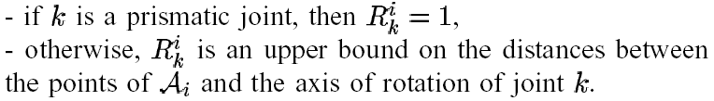
Generalization
Robot(s) and static obstacles treated as collection of rigid bodies A1, …, An.
λ_{i}(q,q’): upper bound on length of curve segment traced by any point on Ai when robot system is linearly interpolated between q and q’
q₃
λ₁(q,q’) = |δq₁|
λ₂(q,q’) = 2|δq₁|+|δq₂|
λ₃(q,q’) = 3|δq₁|+2|δq₂|+|δq₃|
q₂
q₁

Slide 61
Generalization
Robot(s) and static obstacles treated as collection of rigid bodies A1, …, An.
λ_{i}(q,q’): upper bound on length of curve segment traced by any point on Ai when robot system is linearly interpolated between q and q’
If λ_{i}(q,q’) + λ_{j}(q,q’) < η_{ij}(q) + η_{ij}(q’)
then Ai and Aj do not collide between q and q’

Slide 62
Generalized Bisection Method
Each pair of bodies is checked independently of the
others → priority queue Q of elements [q_{a},q_{b}]_{ij}
Initially, Q consists of [q,q’]_{ij} for all pairs of bodies
Ai and Aj that need to be tested.
Until Q is not empty do:
  [q_{a},q_{b}]_{ij} ← remove-first(Q)
  If λ_{i}(q_{a},q_{b}) + λ_{j}(q_{a},q_{b}) ≥ η_{ij}(q_{a}) + η_{ij}(q_{b}) then
    q_{mid} ← (q_{a}+q_{b})/2
    If η_{ij}(q_{mid}) = 0 then return collision
    Else insert [q_{a},q_{mid}]_{ij} and [q_{mid},q_{b}]_{ij} into Q
Return no collision

Slide 63
Heuristic Ordering Q
Goal: Discover collision quicker if there is one.
Sort Q by decreasing values of:
[λ_{i}(q_{a},q_{b}) + λ_{j}(q_{a},q_{b})] – [η_{ij}(q_{a}) + η_{ij}(q_{b})]
Possible extension to multi-segment paths
(very useful with lazy collision-checking PRM)

Slide 64
Segment Covering Strategies
Allows caching of
forward kinematic results

Slide 65
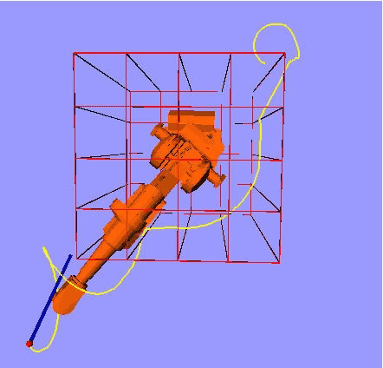
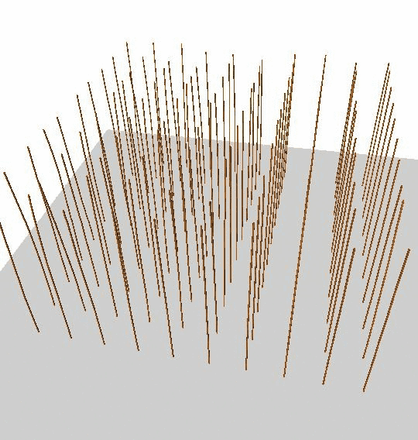
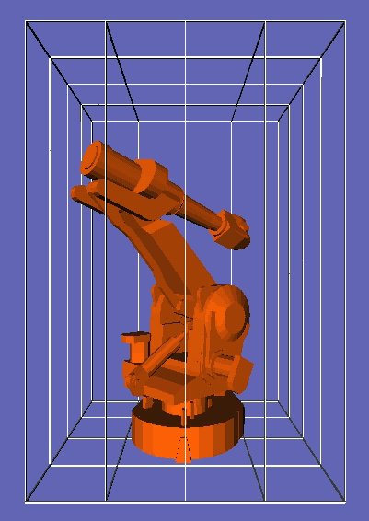
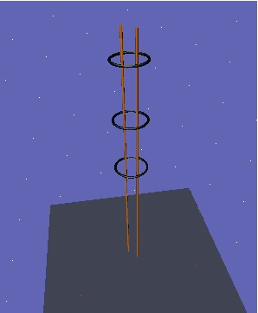
Collision Checker in Action

Slide 66
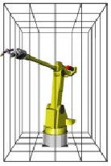
Comparative Experiment
SBL: PRM planner (single-query, bi-directional, lazy in cc)
with fixed-discretization collision checker
A-SBL: Same planner, with adaptive collision checker
Experiment:
Run SBL 10 times on same planning problem with some resolution ε
If a collision has been missed, reduce ε and repeat
If no collision has been missed, return average planning time
Run A-SBL 10 times and return average planning time
Robot: 2,502 triangles
Obstacles: 432 Triangles
SBL → 17 sec
A-SBL → 4.8 sec

Slide 67
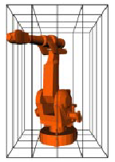
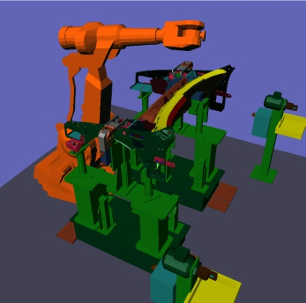
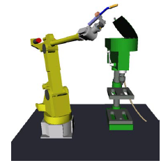
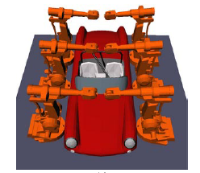
Some Results
Robot: 2,502 triangles
Obstacles: 432 Triangles
SBL → 17 sec
A-SBL → 4.8 sec
Robot: 2,991 triangles
Obstacles: 432 Triangles
SBL → 83 sec
A-SBL → 44 sec
Robot: 2,991 triangles
Obstacles: 74,681 triangles
SBL → 1.20 sec
A-SBL → 0.81 sec
Robot: 2,502 triangles
Obstacles: 34,171 triangles
SBL → 3.2 sec
A-SBL → 2.1 sec
Robots: 6 x 2,991 triangles
Obstacles: 19,668 triangles
SBL → 85 sec
A-SBL → 52 sec

