Slide 1

A warehouse solution
over
map-reduce framework
Dony Ang
Ashish Thusoo, Joydeep Sen Sarma, Namit Jain, Zheng Shao,
Prasad Chakka, Suresh Anthony, Hao Liu, Pete Wyckoff and Raghotham Murthy
HIVE - A warehouse solution over Map Reduce Framework

Slide 2
overview
background
what is Hive
Hive DB
Hive architecture
Hive datatypes
hiveQL
hive components
execution flows
compiler in details
pros and cons
conclusion
HIVE - A warehouse solution over Map Reduce Framework

Slide 3
background
Size of collected and analyzed datasets for business intelligence is growing rapidly, making traditional warehousing more $$$
Hadoop is a popular open source map-reduce as an alternative to store and process extremely large data sets on commodity hardware
However, map reduce itself is very low-level and required developers to write custom code.
HIVE - A warehouse solution over Map Reduce Framework

Slide 4
General Ecosystem of DW
Reporting / BI layer
SQL
Hadoop
M / R
M / R
SQL
ETL
HIVE - A warehouse solution over Map Reduce Framework

Slide 5
what is hive ?
Open-source DW solution built on top of Hadoop
Support SQL-like declarative language called HiveQL which are compiled into map-reduce jobs executed on Hadoop
Also support custom map-reduce script to be plugged into query.
Includes a system catalog, Hive Metastore for query optimizations and data exploration
HIVE - A warehouse solution over Map Reduce Framework

Slide 6
Hive Database
Data Model
  Tables
    Analogous to tables in relational database
    Each table has a corresponding HDFS dir
    Data is serialized and stored in files within dir
    Support external tables on data stored in HDFS, NFS or local directory.
  Partitions
    @table can have 1 or more partitions (1-level) which determine the distribution of data within subdirectories of table directory.
HIVE - A warehouse solution over Map Reduce Framework

Slide 7
HIVE Database cont.
  e.q : Table T under /wh/T and is partitioned on column ds + ctry
  For ds=20090101
  ctry=US
  Then data is stored within dir /wh/T/ds=20090101/ctry=US
  Buckets
    Data in each partition are divided into buckets based on hash of a column in the table. Each bucket is stored as a file in the partition directory.
HIVE - A warehouse solution over Map Reduce Framework

Slide 8
HIVE datatype
Support primitive column types
  Integer
  Floating point
  Strings
  Date
  Boolean
As well as nestable collections such as array or map
User can also define their own type programmatically
HIVE - A warehouse solution over Map Reduce Framework

Slide 9
hiveQL
Support SQL-like query language called HiveQL for select,join, aggregate, union all and sub-query in the from clause
Support DDL stmt such as CREATE table with serialization format, partitioning and bucketing columns
Command to load data from external sources and INSERT into HIVE tables.
    LOAD DATA LOCAL INPATH ‘/logs/status_updates’
    INTO TABLE status_updates PARTITION (ds=‘2009-03-20’)
DO NOT support UPDATE and DELETE
HIVE - A warehouse solution over Map Reduce Framework

Slide 10
hiveQL cont.
Support multi-table INSERT
  FROM (SELECT a.status, b.schoold, b.gender
  FROM status_updates a JOIN profiles b
  ON (a..userid = b.userid)
  and a.ds=‘2009-03-20’)
  ) subq1
  INSERT OVERWRITE TABLE gender_summary PARTITION (ds=‘2009-03-20’)
  SELECT subq1.gender,COUNT(1) GROUP BY subq1.gender
  INSERT OVERWRITE TABLE school_summary PARTITION (ds=‘009-03-20’)
  SELECT subq.school, COUNT(1) GROUP BY subq1.school
Also support User-defined column transformation (UDF) and aggregation (UDAF) function written in Java
HIVE - A warehouse solution over Map Reduce Framework

Slide 11
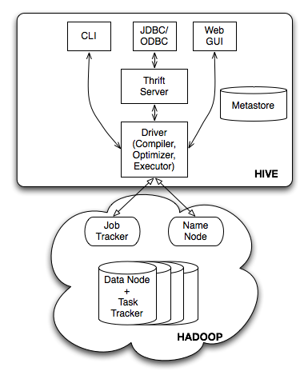
HIVE Architecture
HIVE - A warehouse solution over Map Reduce Framework

Slide 12
HIVE Components
External Interfaces
  User Interfaces both CLI and Web UI and API likes JDBC and ODBC.
Hive Thrift Server
  simple client API to execute HiveQL statements
Metastore – system catalog
Driver
  Manages the lifecycle of HiveQL for compilation, optimization and execution.
HIVE - A warehouse solution over Map Reduce Framework

Slide 13


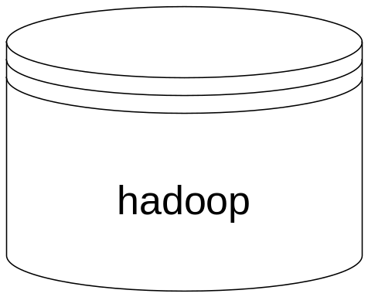

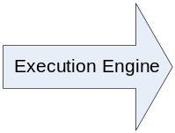

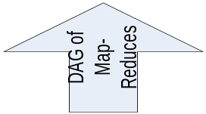

Execution Flow
HIVE - A warehouse solution over Map Reduce Framework

Slide 14
Compiler in details
When driver invokes compiler with HiveQL, the compiler converts string into a plan.
Plan can be
  Metadata operation for DDL statement
  HDFS operation for LOAD statement
  For Insert / Queries consists of DAG (Directed Acyclic Graph) of map-reduce jobs.
HIVE - A warehouse solution over Map Reduce Framework

Slide 15
Compiler cont.
Parser transform query into a parse tree representation
Semantic Analyzer transform parse tree to a block-based internal query representation – retrieve schema information of the input table from metastore and verifies the column names, expand SELECT * and does type-checking including implicit type conversions
HIVE - A warehouse solution over Map Reduce Framework

Slide 16
Compiler cont.
Physical Plan Generator converts logical plan into physical plan consisting of DAG of map-reduce jobs
HIVE - A warehouse solution over Map Reduce Framework

Slide 17
Compiler cont
Logical Plan Generator converts internal query representation to a logical plan consists of a tree of logical operators.
Optimizer perform multiple passes over logical plan and rewrites in several ways
  Combine multiple joins which share the join key into a single multi-way JOIN -> a single map reduce job.
  Prune columns early and pushes predicates closer to the table scan operator to minimize data transfer.
  Prunes unneeded partitions by query
  For sampling query – prunes unneeded bucket.
HIVE - A warehouse solution over Map Reduce Framework

Slide 18
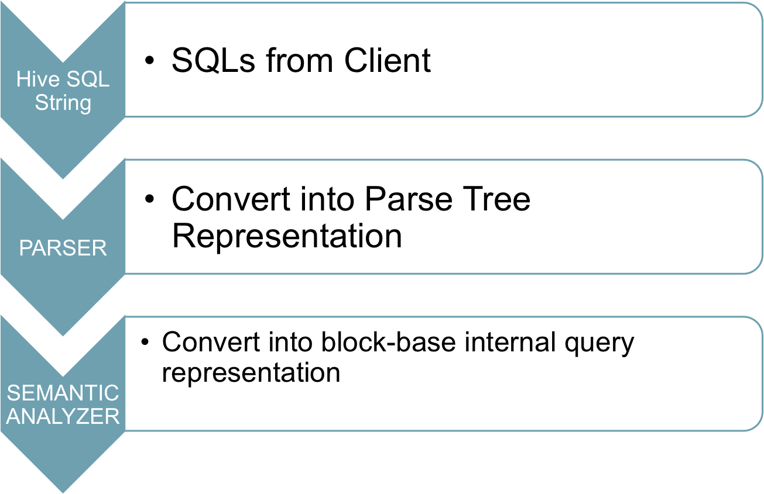

“Plumbing” of HIVE compiler
HIVE - A warehouse solution over Map Reduce Framework

Slide 19
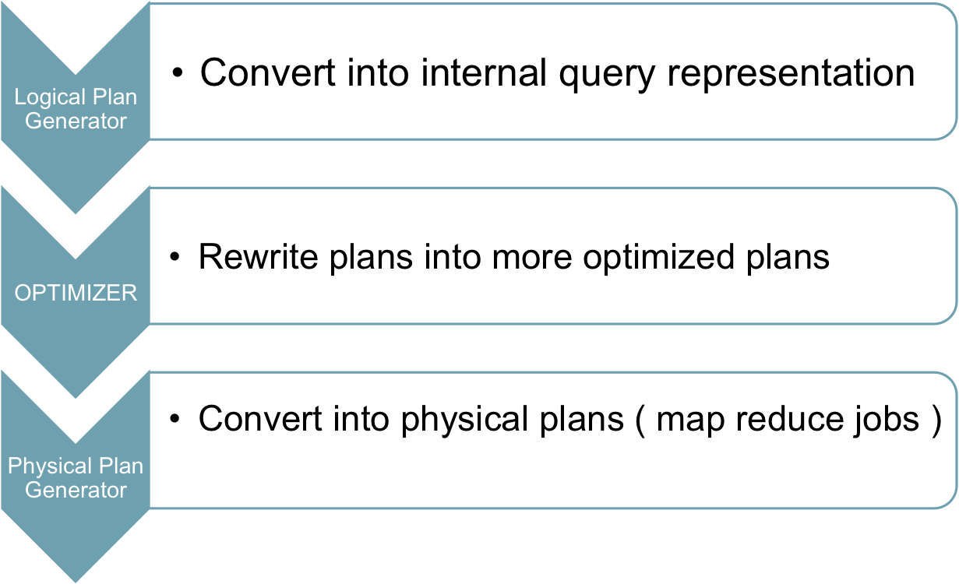
Plumbing cont.
HIVE - A warehouse solution over Map Reduce Framework

Slide 20
Pros
HIVE is a great supplement of Hadoop to bridge the gap between low-level interface requirements required by Hadoop and industry-standard SQL which is more commonplace.
Support of External Tables which makes it easy to access data without ingesting it into HDFS.
Support of ODBC/JDBC which enables the connectivity with many commercial Business Intelligence and/or ETL tools.
Having Intelligence Optimizer (naïve rule-based) which optimizes logical plans by rewriting them into more efficient plans.
Support of Table-level Partitioning to speed up the query times.
A great design decision by using traditional RDBMS to keep Metadata information (Metastore) which is more optimal and proven for random access.
HIVE - A warehouse solution over Map Reduce Framework

Slide 21
Cons
hiveSQL is not 100% ANSI-Compliant SQL.
No support for UPDATE & DELETE
No support for singleton INSERT
There is only 1-level of partitioning available.
Rule-based Optimizer doesn’t take into account available resources in generating logical and physical plans.
No Access Control Language supported
No full support for subquery (correlated subquery ).
HIVE - A warehouse solution over Map Reduce Framework

Slide 22
Conclusion
With the increasing popularity of Hadoop as data platform of choice for many organizations, HIVE becomes a ‘must-have supplement’ to provide greater usability and connectivity within the organization by introducing high-level language support known as hiveQL.
HIVE - A warehouse solution over Map Reduce Framework

Slide 23
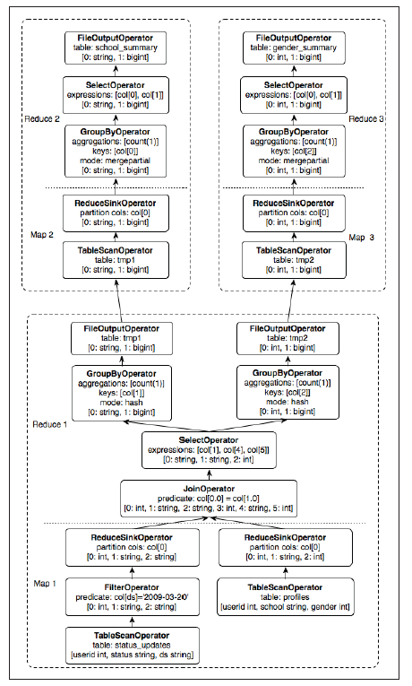
Example of Query Plans
HIVE - A warehouse solution over Map Reduce Framework

Slide 24
Comparable work
Apache Pig
  Similar approach to HIVE with support of high-level language which generates a sequence of map reduce programs.
  The language is a proprietary language (aka Pig latin) and it’s NOT a SQL-like language.
  Performance of any Pig queries tend to be slower in comparison to HIVE or Hadoop.
HIVE - A warehouse solution over Map Reduce Framework

Slide 25
References
[1] A. Pavlo et. al. A Comparison of Approaches to Large-Scale Data Analysis. Proc. ACM SIGMOD, 2009.
[2] C.Ronnie et al. SCOPE: Easy and Ecient Parallel Processing of Massive Data Sets. Proc. VLDB Endow., 1(2):1265{1276, 2008.
[3] Apache Hadoop. Available at http://wiki.apache.org/hadoop.
[4] Hive Performance Benchmark. Available at https://issues.apache.org/jira/browse/HIVE-396.
[5] Hive Language Manual. Available at http://wiki.apache.org/hadoop/Hive/LanguageManual.
[6] Facebook Lexicon. Available at http://www.facebook.com/lexicon.
[7] Apache Pig. http://wiki.apache.org/pig.
[8] Apache Thrift. http://incubator.apache.org/thrift.
HIVE - A warehouse solution over Map Reduce Framework

Slide 26

Q & A
HIVE - A warehouse solution over Map Reduce Framework

