Slide 1
Introduction to LLVM
on Program Analysis
Tao He
elfinhe@gmail.com
Department of Computer Science, Sun Yat-Sen University
Department of Computer Science and Engineering, HKUST
Group Discussion
June 2012
HKUST, Hong Kong, China
<number>/34

Slide 2
Outline
Objectives
A quick scenario
LLVM IR
‘opt’ command
Installation of LLVM
<number>/34

Slide 3
Objectives -
What do we want to do?
<number>/34

Slide 4
Objectives
To implement a symbolic execution engine.
  A expression-based engine ^{[BH07]} different from most existing implementations (path-based engines).
  Program analysis on C programs.
To generate static single assignment (SSA) representation of C first.
[BH07] Domagoj Babić and Alan J. Hu. Structural Abstraction of Software Verification Conditions. In Proceedings of the 19th international conference on Computer aided verification (CAV'07), Lecture Notes in Computer Science, 2007, Volume 4590/2007, 366-378
<number>/34

Slide 5
A Quick Scenario -
What can LLVM do?
<number>/34

Slide 6
!A Quick Scenario
Given a C program:
  #include <stdio.h>
      int branch(int n){
      if (n>0) printf("Positive\n");
      else if (n==0) printf("Zero\n");
      else if (n<0) printf("Negative\n");
      return 0;
      }
      int main() {
      branch(-4); branch(0); branch(6);
      return 0;
      }
<number>/34

Slide 7
!A Quick Scenario
Generate immediate representation (IR) of LLVM – the SSA representation in LLVM
  clang -O3 -emit-llvm hello.c -S -o hello.ll
      define i32 @main() nounwind uwtable {
      %1 = alloca i32, align 4
      store i32 0, i32* %1
      %2 = call i32 @branch(i32 -4)
      %3 = call i32 @branch(i32 0)
      %4 = call i32 @branch(i32 6)
      ret i32 0
      }
      ...
[SH] Reid Spencer and Gordon Henriksen. LLVM's Analysis and Transform Passes.
URL: http://llvm.org/docs/Passes.html.
<number>/34

Slide 8
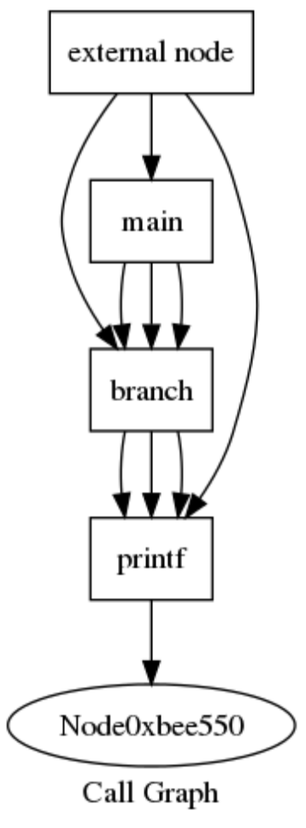
!A Quick Scenario
Print call graph
  opt method_para_int_branch.ll -S -dot-callgraph 2>output_file >/dev/null
  dot -Tsvg in.dot -o out.svg
[SH] Reid Spencer and Gordon Henriksen. LLVM's Analysis and Transform Passes.
URL: http://llvm.org/docs/Passes.html.
<number>/34

Slide 9
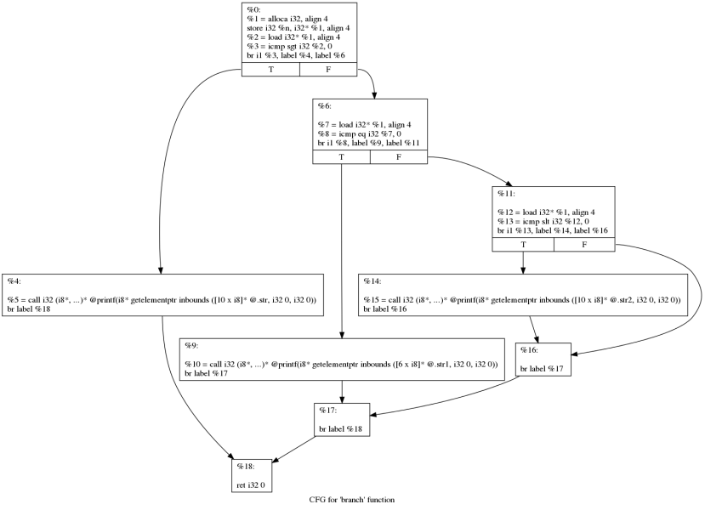
!A Quick Scenario
Print control flow graph (CFG)
  opt method_para_int_branch.ll -S -dot-cfg 2>output_file >/dev/null
[SH] Reid Spencer and Gordon Henriksen. LLVM's Analysis and Transform Passes.
URL: http://llvm.org/docs/Passes.html.
<number>/34

Slide 10
# A Quick Scenario
More:
  Dead Global Elimination
  Interprocedural Constant Propagation
  Dead Argument Elimination
  Inlining
  Reassociation
  Loop Invariant Code Motion
  Loop Opts
  Memory Promotion
  Dead Store Elimination
  Aggressive Dead Code Elimination
[LA04] Chris Lattner and Vikram Adve. The LLVM Compiler Framework and Infrastructure Tutorial. Mini Workshop on Compiler Research Infrastructures (LCPC'04), West Lafayette, Indiana, Sep. 2004.
<number>/34

Slide 11
What is the SSA representation in LLVM?
- LLVM IR
<number>/34

Slide 12
LLVM IR
“A Static Single Assignment (SSA) based representation that provides type safety, low-level operations, flexibility, and the capability of representing 'all' high-level languages cleanly.”
[Lat] Chris Lattner. LLVM Language Reference Manual. URL: http://llvm.org/docs/LangRef.html
[LA04] Chris Lattner and Vikram Adve. The LLVM Compiler Framework and Infrastructure Tutorial. Mini Workshop on Compiler Research Infrastructures (LCPC'04), West Lafayette, Indiana, Sep. 2004.
<number>/34

Slide 13
LLVM IR
Three address code
SSA-based
Three different forms
  An in-memory compiler IR
  An on-disk bitcode representation (suitable for fast loading by a Just-In-Time compiler)
  A human readable assembly language representation
[Lat] Chris Lattner. LLVM Language Reference Manual. URL: http://llvm.org/docs/LangRef.html
[LA04] Chris Lattner and Vikram Adve. The LLVM Compiler Framework and Infrastructure Tutorial. Mini Workshop on Compiler Research Infrastructures (LCPC'04), West Lafayette, Indiana, Sep. 2004.
<number>/34

Slide 14
LLVM IR
An example
  To multiply the integer variable '%X' by 8
Syntax:
    <result> = mul <ty> <op1>, <op2>
IR code:
    %result = mul i32 %X, 8
More
  For floating point, use fmul
[Lat] Chris Lattner. LLVM Language Reference Manual. URL: http://llvm.org/docs/LangRef.html
[LA04] Chris Lattner and Vikram Adve. The LLVM Compiler Framework and Infrastructure Tutorial. Mini Workshop on Compiler Research Infrastructures (LCPC'04), West Lafayette, Indiana, Sep. 2004.
<number>/34

Slide 15
LLVM IR
Another example
  Instruction jump – to change control flow
  Branches or loops
Syntax:
    br i1 <cond>, label <iftrue>, label <iffalse>
    br label <dest> ; Unconditional branch
[Lat] Chris Lattner. LLVM Language Reference Manual. URL: http://llvm.org/docs/LangRef.html
[LA04] Chris Lattner and Vikram Adve. The LLVM Compiler Framework and Infrastructure Tutorial. Mini Workshop on Compiler Research Infrastructures (LCPC'04), West Lafayette, Indiana, Sep. 2004.
<number>/34

Slide 16
LLVM IR
IR code:
    Test:
    %cond = icmp eq i32 %a, %b
    br i1 %cond, label %IfEqual, label %IfUnequal
    IfEqual:
    ret i32 1
    IfUnequal:
[Lat] Chris Lattner. LLVM Language Reference Manual. URL: http://llvm.org/docs/LangRef.html
[LA04] Chris Lattner and Vikram Adve. The LLVM Compiler Framework and Infrastructure Tutorial. Mini Workshop on Compiler Research Infrastructures (LCPC'04), West Lafayette, Indiana, Sep. 2004.
<number>/34

Slide 17
LLVM IR
3rd example
  Function call
A simplified syntax:
    <result> = call <ty> <fnptrval>(<function args>)
IR code:
    call i32 (i8*, ...)* @printf(i8* %msg, i32 12, i8 42)
[Lat] Chris Lattner. LLVM Language Reference Manual. URL: http://llvm.org/docs/LangRef.html
[LA04] Chris Lattner and Vikram Adve. The LLVM Compiler Framework and Infrastructure Tutorial. Mini Workshop on Compiler Research Infrastructures (LCPC'04), West Lafayette, Indiana, Sep. 2004.
<number>/34

Slide 18
LLVM IR
4th example
  Function definition
A simplified syntax:
    define <ResultType> @<FunctionName> ([argument list]) { ... }
IR code:
    define i32 @main() { … }
    define i32 @test(i32 %X, ...) { … }
[Lat] Chris Lattner. LLVM Language Reference Manual. URL: http://llvm.org/docs/LangRef.html
[LA04] Chris Lattner and Vikram Adve. The LLVM Compiler Framework and Infrastructure Tutorial. Mini Workshop on Compiler Research Infrastructures (LCPC'04), West Lafayette, Indiana, Sep. 2004.
<number>/34

Slide 19
LLVM IR
The majority of instructions in C programs:
  Operations (binary/bitwise)
  Jumps
  Function calls
  Function definitions
Many keywords in LLVM IR will not be used for C programs. (e.g., invoke)
[Lat] Chris Lattner. LLVM Language Reference Manual. URL: http://llvm.org/docs/LangRef.html
[LA04] Chris Lattner and Vikram Adve. The LLVM Compiler Framework and Infrastructure Tutorial. Mini Workshop on Compiler Research Infrastructures (LCPC'04), West Lafayette, Indiana, Sep. 2004.
<number>/34

Slide 20
How to analyze programs
by using LLVM?
- ‘opt’ command
<number>/34

Slide 21
‘opt’ command
Compiler is organized as a series of ‘passes’:
  Each pass is one analysis or transformation
[SH] Reid Spencer and Gordon Henriksen. LLVM's Analysis and Transform Passes.
URL: http://llvm.org/docs/Passes.html.
[LA04] Chris Lattner and Vikram Adve. The LLVM Compiler Framework and Infrastructure Tutorial. Mini Workshop on Compiler Research Infrastructures (LCPC'04), West Lafayette, Indiana, Sep. 2004.
<number>/34

Slide 22
!‘opt’ command
An example
  -dot-callgraph
[SH] Reid Spencer and Gordon Henriksen. LLVM's Analysis and Transform Passes.
URL: http://llvm.org/docs/Passes.html.
[LA04] Chris Lattner and Vikram Adve. The LLVM Compiler Framework and Infrastructure Tutorial. Mini Workshop on Compiler Research Infrastructures (LCPC'04), West Lafayette, Indiana, Sep. 2004.
<number>/34

Slide 23
!‘opt’ command
An example
Print call graph: -dot-callgraph
  opt method_para_int_branch.ll -S -dot-callgraph 2>output_file >/dev/null
  dot -Tsvg in.dot -o out.svg
[SH] Reid Spencer and Gordon Henriksen. LLVM's Analysis and Transform Passes.
URL: http://llvm.org/docs/Passes.html.
[LA04] Chris Lattner and Vikram Adve. The LLVM Compiler Framework and Infrastructure Tutorial. Mini Workshop on Compiler Research Infrastructures (LCPC'04), West Lafayette, Indiana, Sep. 2004.
<number>/34

Slide 24
How to write your own pass?
<number>/34

Slide 25
How to write your own pass?
Four types of pass:
  ModulePass: general interprocedural pass
  CallGraphSCCPass: bottom-up on the call graph
  FunctionPass: process a function at a time
  BasicBlockPass: process a basic block at a time
<number>/34

Slide 26
How to write your own pass?
Two important classes
  User: http://llvm.org/docs/doxygen/html/classllvm_1_1User.html
    This class defines the interface that one who uses a Value must implement.
      Instructions
      Constants
      Operators
  Value: http://llvm.org/docs/doxygen/html/classllvm_1_1Value.html
    It is the base class of all values computed by a program that may be used as operands to other values.
      e.g., instruction and function.
<number>/34

Slide 27
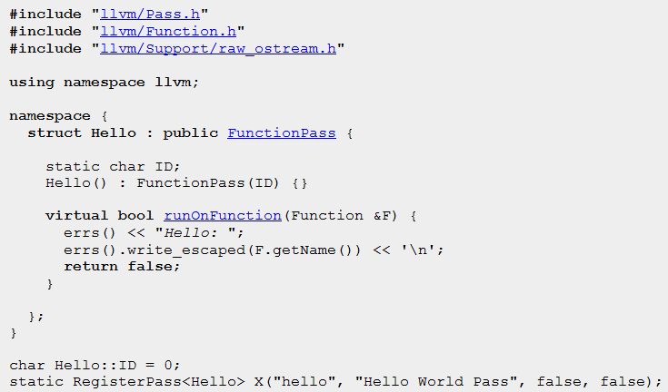
How to write your own pass?
An example – print function names
<number>/34

Slide 28

How to write your own pass?
An example – print function names
  First generate bytecode:
    clang -emit-llvm hello.c -o hello.bc
  Then
<number>/34

Slide 29
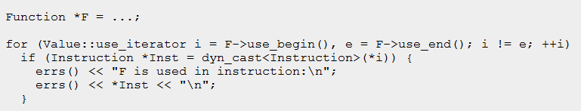
How to write your own pass?
Another example – print def-use chain
<number>/34

Slide 30
How to install LLVM?
<number>/34

Slide 31
How to install LLVM?
To compile programs faster and use built-in transformation and analysis
  Install both ‘llvm’ and ‘clang’ from package management software
      E.g., Synaptic, yum, apt.
To write your own pass
  Build from source code and add your own pass
    http://llvm.org/docs/GettingStarted.html#quickstart
    http://llvm.org/docs/WritingAnLLVMPass.html
<number>/34

Slide 32
LLVM IR
The majority of instructions in C programs:
  Operation (binary/bitwise)
  Jump
  Function call
  Function definition
[Lat] Chris Lattner. LLVM Language Reference Manual. URL: http://llvm.org/docs/LangRef.html
[LA04] Chris Lattner and Vikram Adve. The LLVM Compiler Framework and Infrastructure Tutorial. Mini Workshop on Compiler Research Infrastructures (LCPC'04), West Lafayette, Indiana, Sep. 2004.
<number>/34

Slide 33
Q & A
<number>/34

Slide 34
Thank you!
Contact me via elfinhe@gmail.com
<number>/34

