Slide 1
VoltDB: an SQL Developer’s Perspective
Tim Callaghan, VoltDB Field Engineer tcallaghan@voltdb.com

Slide 2
Agenda
VoltDB Technical Overview
Comparing VoltDB to Traditional OLTP
Migration and Development
Q+A

Slide 3
About Me
VoltDB Field Engineer/Community Advocate
  Joined VoltDB in September, 2009
  Support commercial and community customers
  Built many examples and POCs
Technical background
  18 years of Oracle design/development/administration
  User of many programming languages – database and traditional
See last slide for full contact information

Slide 4
VoltDB
Technical
Overview

Slide 5
Before I Begin…
VoltDB is available in community and commercial editions
Runs on Linux + Mac*

Slide 6
Scaling Traditional OLTP Databases
Sharding improves performance but introduces…
  Management complexity
    disjointed backup/recovery and replication
    manual effort to re-partition data
  Application complexity
    shard awareness
    cross partition joins
    cross partition transactions
  And, each shard still suffers from traditional OLTP performance limitations
If you can shard, your application is probably great in VoltDB.
X
X
X
X
X

Slide 7
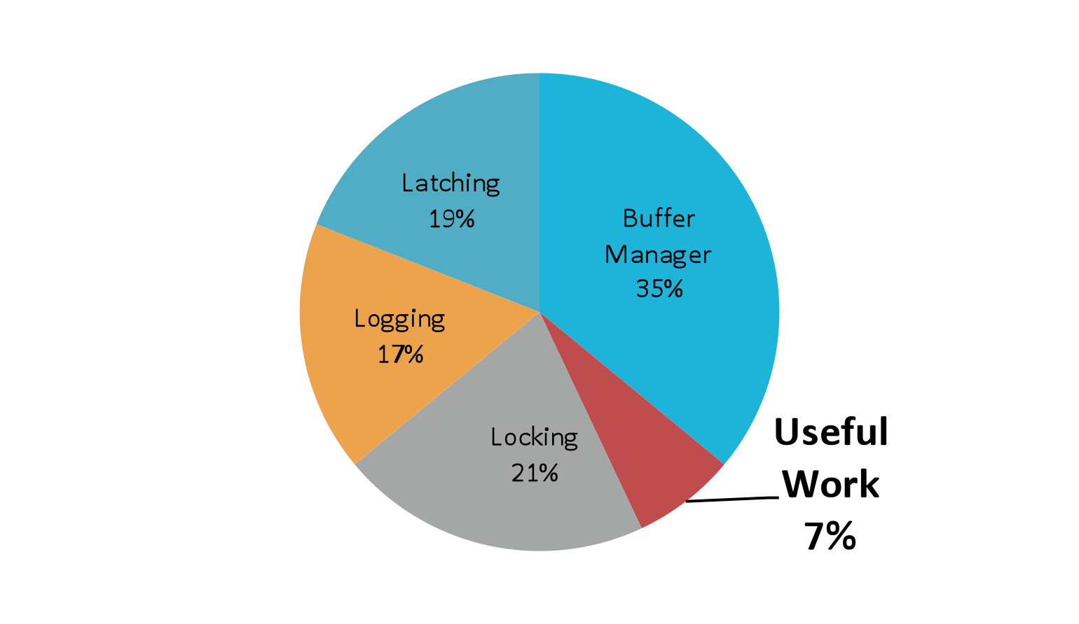
Technical Overview
“OLTP Through the Looking Glass”
http://cs-www.cs.yale.edu/homes/dna/papers/oltpperf-sigmod08.pdf
VoltDB avoids the overhead of traditional databases
  K-safety for fault tolerance
  - no logging
  In memory operation for maximum throughput
  - no buffer management
  Partitions operate autonomously
  and single-threaded
  - no latching or locking
Built to horizontally scale
X
X
X
X

Slide 8
Technical Overview – Partitions (1/3)
1 partition per physical CPU core
  Each physical server has multiple VoltDB partitions
Data - Two types of tables
  Partitioned
    Single column serves as partitioning key
    Rows are spread across all VoltDB partitions by partition column
    Transactional data (high frequency of modification)
  Replicated
    All rows exist within all VoltDB partitions
    Relatively static data (low frequency of modification)
Code - Two types of work – both ACID
  Single-Partition
    All insert/update/delete operations within single partition
    Majority of transactional workload
  Multi-Partition
    CRUD against partitioned tables across multiple partitions
    Insert/update/delete on replicated tables
X
X
X
X
X

Slide 9
Technical Overview – Partitions (2/3)
Single-partition vs. Multi-partition
select count(*) from orders where customer_id = 5
single-partition
select count(*) from orders where product_id = 3
multi-partition
insert into orders (customer_id, order_id, product_id) values (3,303,2)
single-partition
update products set product_name = ‘spork’ where product_id = 3
multi-partition
Partition 1
Partition 2
Partition 3
1 101 2
1 101 3
4 401 2
2 201 1
5 501 3
5 502 2
3 201 1
6 601 1
6 601 2
table orders : customer_id (partition key)
(partitioned) order_id
product_id
1 knife
2 spoon
3 fork
1 knife
2 spoon
3 fork
1 knife
2 spoon
3 fork
table products : product_id
(replicated) product_name

Slide 10

Technical Overview – Partitions (3/3)
Looking inside a VoltDB partition…
  Each partition contains data and an execution engine.
  The execution engine contains a queue for transaction requests.
  Requests are executed sequentially (single threaded).
Work
Queue
execution engine
Table Data
Index Data
- Complete copy of all replicated tables
- Portion of rows (about 1/partitions) of all partitioned tables

Slide 11
Technical Overview – Compiling
Schema
Stored Procedures
The database is constructed from
  The schema (DDL)
  The work load (Java stored procedures)
  The Project (users, groups, partitioning)
VoltCompiler creates application catalog
  Copy to servers along with 1 .jar and 1 .so
  Start servers
CREATE TABLE HELLOWORLD (
HELLO CHAR(15),
WORLD CHAR(15),
DIALECT CHAR(15),
PRIMARY KEY (DIALECT)
);
import org.voltdb. * ;
@ProcInfo(
partitionInfo = "HE
singlePartition = t
public final SQLStmt
public VoltTable[] run
import org.voltdb. * ;
@ProcInfo(
partitionInfo = "HELLOWORLD.DIA
singlePartition = true
)
public class Insert extends VoltPr
public final SQLStmt sql =
new SQLStmt("INSERT INTO HELLO
public VoltTable[] run( String hel
import org.voltdb. * ;
@ProcInfo(
partitionInfo = "HELLOWORLD.DIA
singlePartition = true
)
public class Insert extends VoltPr
public final SQLStmt sql =
new SQLStmt("INSERT INTO HELLO
public VoltTable[] run( String hel
Project.xml
<?xml version="1.0"?>
<project>
<database name='data
<schema path='ddl.
<partition table=‘
</database>
</project>

Slide 12

Technical Overview - Transactions
All access to VoltDB is via Java stored procedures (Java + SQL)
A single invocation of a stored procedure is a transaction (committed on success)
Limits round trips between DBMS
and application
High performance client applications communicate asynchronously with VoltDB
SQL

Slide 13
Technical Overview – Clusters/Durability
Scalability
  Increase RAM in servers to add capacity
  Add servers to increase performance / capacity
  Consistently measuring 90% of single-node performance increase per additional node
High availability
  K-safety for redundancy
Snapshots
  Scheduled, continuous, on demand
Spooling to data warehouse
Disaster Recovery/WAN replication (Future)
  Asynchronous replication

Slide 14
Comparing VoltDB to Traditional OLTP
(in no particular order)

Slide 15
Asynchronous Communications
Client applications communicate asynchronously with VoltDB
  Stored procedure invocations are placed “on the wire”
  Responses are pulled from the server
  Allows a single client application to generate > 100K TPS
  Our client library will simulate synchronous if needed
  Traditional
    salary := get_salary(employee_id);
  VoltDB
    callProcedure(asyncCallback, “get_salary”, employee_id);

Slide 16
Transaction Control
VoltDB does not support client-side transaction control
  Client applications cannot:
    insert into t_colors (color_name) values (‘purple’);
    rollback;
  Stored procedures commit if successful, rollback if failed
  Client code in stored procedure can call for rollback

Slide 17
Interfacing with VoltDB
Client applications interface with VoltDB via stored procedures
  Java stored procedures – Java and SQL
  No ODBC/JDBC

Slide 18
Lack of concurrency
Single-threaded execution within partitions (single-partition) or across partitions (multi-partition)
No need to worry about locking/dead-locks
  great for “inventory” type applications
    checking inventory levels
    creating line items for customers
Because of this, transactions execute in microseconds.
However, single-threaded comes at a price
  Other transactions wait for running transaction to complete
  Don’t do anything crazy in a SP (request web page, send email)
  Useful for OLTP, not OLAP

Slide 19
Throughput vs. Latency
VoltDB is built for throughput over latency
Latency measured in mid single-digits in a properly sized cluster
Do not estimate latency as (1 / TPS)

Slide 20
SQL Support
SELECT, INSERT (using values), UPDATE, and DELETE
Aggregate SQL supports AVG, COUNT, MAX, MIN, SUM
Materialized views using COUNT and SUM
Hash and Tree Indexes
SQL functions and functionality will be added over time, for now I do it in Java
Execution plan for all SQL is created at compile time and available for analysis

Slide 21
SQL in Stored Procedures
SQL can be parameterized, but not dynamic
    “select * from foo where bar = ?;” (YES)
    “select * from ? where bar = ?;” (NO)

Slide 22
Connecting to the Cluster
Clients connect to one or more nodes in the VoltDB cluster, transactions are forwarded to the correct node
  Clients are not aware of partitioning strategy
  In the future we may send back data in the response indicating if the transaction was sent to the correct node.

Slide 23
Schema Changes
Traditional OLTP
  add table…
  alter table…
VoltDB
  modify schema and stored procedures
  build catalog
  deploy catalog
V1.0: Add/drop users, stored procedures
V1.1: Add/drop tables
Future: Add/drop column, …

Slide 24
Table/Index Storage
VoltDB is entirely in-memory
Cluster must collectively have enough RAM to hold all tables/indexes (k + 1 copies)
Even data distribution is important

Slide 25
Migration
and
Development

Slide 26
Migrating to VoltDB
Grab your existing DDL, SQL, and stored procedures.
Compile your VoltDB Application.
Sorry…
Review your application as a whole
Partitioning is HUGE
Everything inside stored procedures
SQL requirements

Slide 27
Client Libraries
We support Java and C++ natively
PHP is via C++/SWIG
SWIG can produce many others
Long-term roadmap is native PHP, Python, C#, and others.
Community has developed Erlang (wire protocol) and Ruby (HTTP/JSON)
HTTP/JSON interface also available
  Easily used by most languages
  Server can handle ~1,000 requests per second

Slide 28
Getting Data In and Out
In: Create simple client application to read flat file and load into table(s).
  1 SQL stored procedures can be defined in XML
  Working on a generic utility for loading
Out: Snapshot to flat file
  Snapshots can be converted to CSV/TSV data
Out: EL
  Special type of tables in VoltDB
    export (insert/update/delete) or export only (insert only)
    client application reads from buffers and acks when done
      currently targeting file-system, JDBC coming

Slide 29
Q & A
Visit http://voltdb.com to…
  Download VoltDB
  Get sample app code
Join the VoltDB community
  VoltDB user groups: www.meetup.com/voltdb
  Follow VoltDB on Twitter @voltdb
Contact me
  tcallaghan@voltdb.com (email)
  @tmcallaghan (Twitter)

