Slide 1
The End of an Architectural Era
Shimin Chen
(Big Data Reading Group)
(many slides are copied from Stonebraker’s presentation)

Slide 2
Papers
"One size fits all: an idea whose time has come and gone." M. Stonebraker and U. Centintemel. ICDE 2005.
"One size fits all? - part 2: benchmarking results." M. Stonebraker, C. Breat, U. Cetintemel, M. Cherniack, T. Ge, N. Hackem, S. Harizopoulos, J. Lifter, J. Rogers, S. Zdonik. CIDR 2007.
"The end of an architectural era. (It's time for a complete rewrite)" M. Stonebraker, S. Madden, D. Abadi, S. Harizopoulos, N. Hachem, P. Helland. VLDB 2007.

Slide 3
History of RDBMS
Popular RDBMSs all trace their roots to System R from the 1970s:
  DB2, Oracle, Sybase, MS SQL Server
At that time, single market in mind:
  business data processing (OLTP)
Typical features:
  Row-store, Btree indexing, ACID transactions, cost-based optimizers, etc.

Slide 4
Extensions Over the Years
Shared-nothing, shared-disk
Warehouse support: bitmap indexing, materialized views, etc.
Object relational: user-defined functions
XML …

Slide 5
One-Size-Fits-All Design
Why?
  Engineering costs: maintaining a single code line
  Marketing & sales costs: clear market position, simple for salesperson

Slide 6
What’s Wrong?
Domain-specific engines can beat RDBMS by 10X
  Data warehouse
  Text search
  Stream Processing
  Scientific Data

Slide 7
Moreover, OLTP
Redesigning an OLTP system can dramatically improve performance
  Taking advantage of current hardware

Slide 8
Outline
Introduction
Data Warehouse
Text Search
Stream Processing
Scientific Data
OLTP
Summary

Slide 9
Data Warehouse
Early 1990s
Business intelligence
Combine multiple operational DBs into a warehouse for processing
1/3 of RDBMS market in 2005

Slide 10
Different Characteristics
Updates:
  OLTP: frequent updates
  Warehouse: periodical load of new data
Queries:
  OLTP: simple, short queries, on a small number of records
  Warehouse: ad-hoc complex queries on a large number of records, mostly on a small number of attributes
Historical trends are important in warehouse

Slide 11
RDBMS: row-store
Record 1
Record 2
Record 3
Record 4

Slide 12
Column-store for Warehouse

Slide 13
Benefits of Vertica (C-Store)
Smaller I/Os: retrieving the necessary data only (not all the records)
Better compression: column-wise compression
Support for sorting, indexing

Slide 14
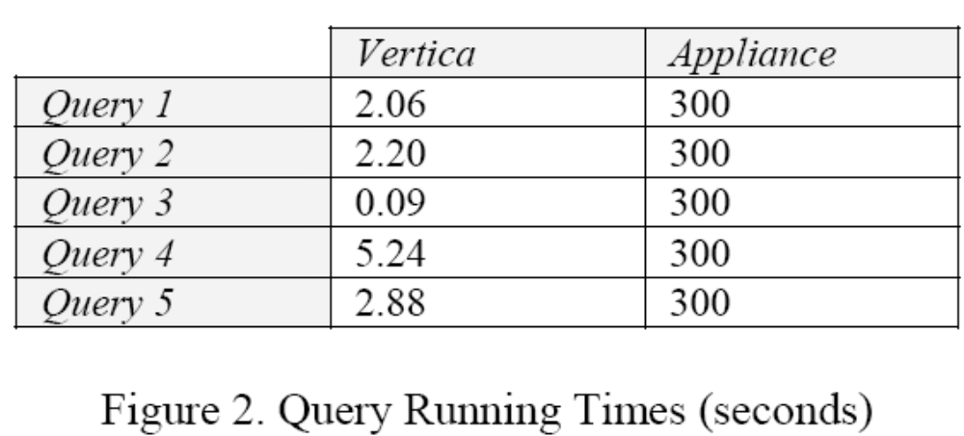
Vertica vs. RDBMS: Telco
Dual-core dual-CPU Opteron, $2.5K
RDBMS on 28-blade appliance, $300K

Slide 15
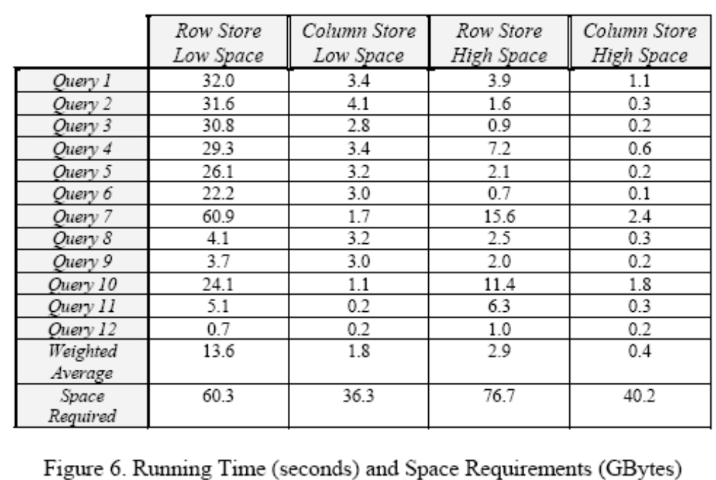
Vertica vs. RDBMS: simplified TPC-H

Slide 16
Outline
Introduction
Data Warehouse
Text Search
Stream Processing
Scientific Data
OLTP
Summary

Slide 17
An Anecdote
Inktomi (Eric Brewer):
  Used a commercial RDBMS in an early version of their product
  Quickly gave up
  Why?
    Inktomi ran exactly one query
    This query can be easily hard coded to run 100X faster

Slide 18
Why Text Search Engines Do NOT Use RDBMS?
Lack of need for transactions
Lack of need for data types other than text
Repeatable answers
Need for application-specific compression
Etc.

Slide 19
Outline
Introduction
Data Warehouse
Text Search
Stream Processing
Scientific Data
OLTP
Summary

Slide 20
Example Application – Financial Feed Alarms
Feed A
Custom-coded
Feed alarm
application
alarms
Feed B

Slide 21
Characteristics of Feed Alarm Pilot
500 rapidly updating tickers (5 sec. interval) +
4000 slowly updating tickers (60 sec. interval) in each FEED.
Problem Types
  Low-level alarm 
    Ticker not seen within update interval.
  Problem in Feed 
    More than 100 low-alarms from Feed A or Feed B
  Problem in Exchange 
    More than 100 low-level alarms from NASDAQ or NYSE
Suppression:
  When problems of type 2 or 3 detected, do not emit (distracting) problems of type 1.

Slide 22
Results
StreamBase stream processing engine:
  ~ 160K msgs/sec on a 3.2GHz Linux pentium
On a popular RDBMS:
  ~900 msgs/sec on the same hardware
More than 2 orders of magnitude difference……

Slide 23
Why?
Inbound vs outbound processing
The right primitives
Integration of application logic

Slide 24
Traditional Model
Outbound Processing: query-after-store
Processing
And
queries
Data
Updates
Storage

Slide 25
Stream Processing Model
Inbound Processing
Application
Input
Data
Optional storage
Optional archive access
Storage
Never store the data!
Lower overhead
Lower latency

Slide 26
Windowed Time Series Operators
Support queries on time windows
Support timeouts
Timeout can be used to detect delays in this application

Slide 27
Integration of Application Logic
All required capabilities in single system
  No process switches
  Integrated storage (not client-server)

Slide 28
Application Integration in RDBMSs
Client-server present for protection
Stored procedures are a start
  tough to do control flow
Object-relational blades are better
  But still tough to do control flow
Unified programming language never made it
  E.g. Rigel or Pascal R
No support for embedded DBMS applications

Slide 29
Transactions in Streams
Locking
  Critical sections are enough; no need for xacts
Crash recovery
  Log-based recovery slow
  doesn’t recover whole state
  System unavailable during recovery
Much better to just do high availability (HA)
  Failover to a backup (Tandem-style)
  Forget about state recovery

Slide 30
Outline
Introduction
Data Warehouse
Text Search
Stream Processing
Scientific Data
OLTP
Summary

Slide 31
Project Sequoia
DEC-sponsored Sequoia project [Seq93]
Goal: apply POSTGRES to support scientific DBMS users
  Earth science group at UC Santa Barbara
  Climate modeling group at UCLA
Why failed?
  No support for multi-dimensional arrays
  No support for linkage and uncertainty

Slide 32
A New DBMS Prototype: ASAP
Use multi-dimensional arrays as basic storage and processing objects

Slide 33
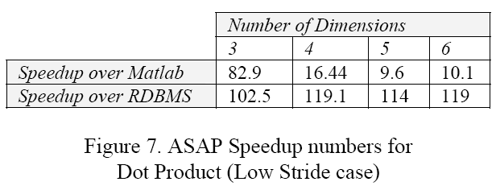
Results: Dot-product
ASAP vs. Matlab: two 2GB raw data arrays, on a 2GHz Athlon with 1GB RAM
ASAP vs. RDBMS: two 100MB raw data arrays on a 3.2GHz Pentium with 1GB RAM

Slide 34
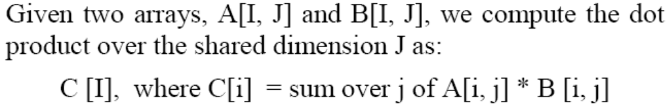
Results: Dot-product
ASAP vs. Matlab: two 2GB raw data arrays, on a 2GHz Athlon with 1GB RAM
ASAP vs. RDBMS: two 100MB raw data arrays on a 3.2GHz Pentium with 1GB RAM

Slide 35
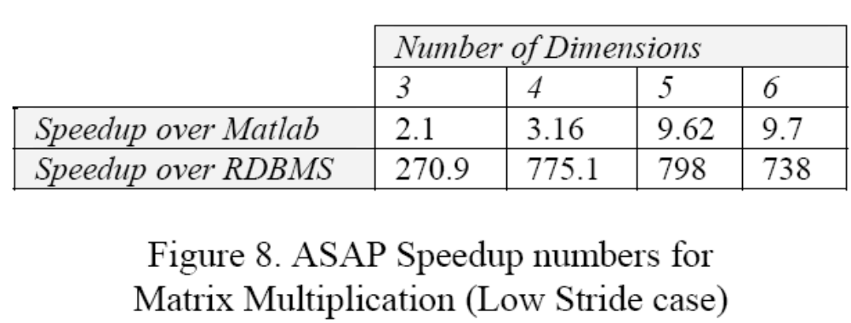
Results:

Slide 36
Discussions on ASAP
Store: dense, sparse, hybrid
Operators:
Compression
Coarse-grain lineage tracking
Probabilistic treatment of data:
  Value uncertainty, position uncertainty, function result uncertainty

Slide 37
Outline
Introduction
Data Warehouse
Text Search
Stream Processing
Scientific Data
OLTP
Summary

Slide 38
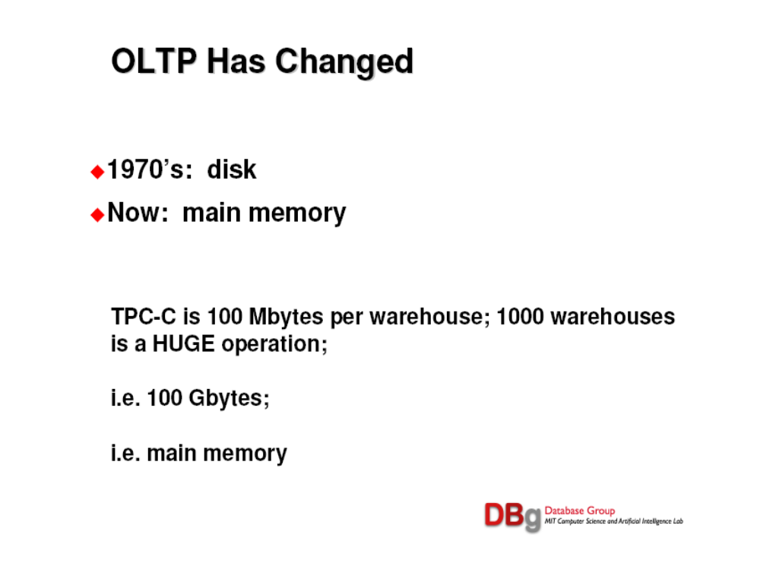
1 warehouse==30K customer accounts

Slide 39
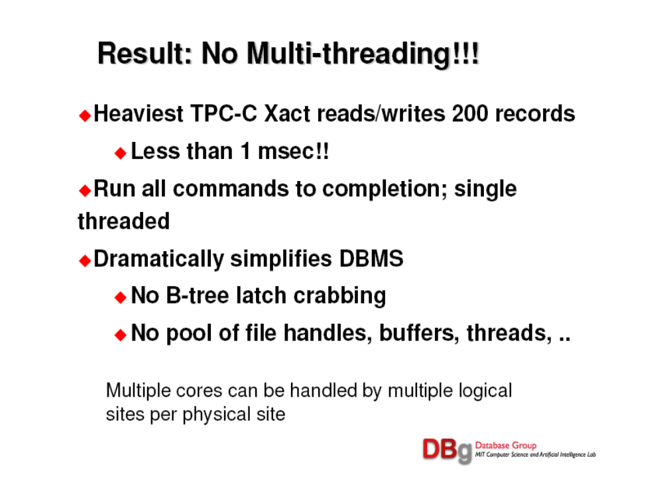

Slide 40
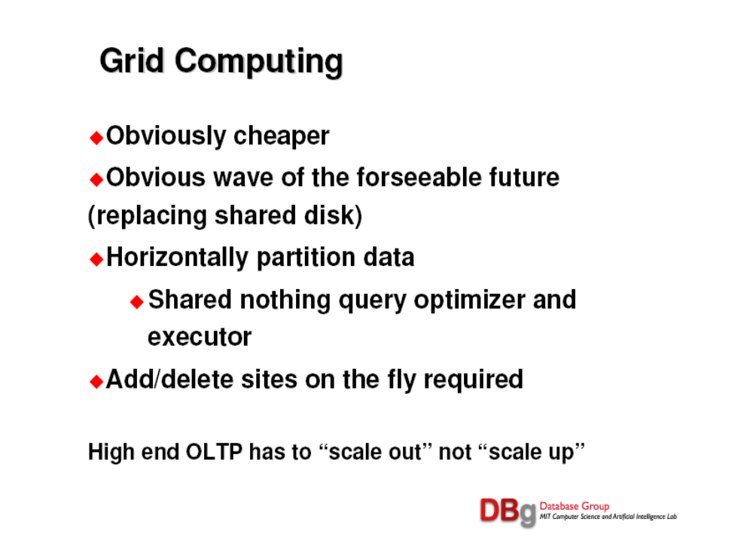

Slide 41
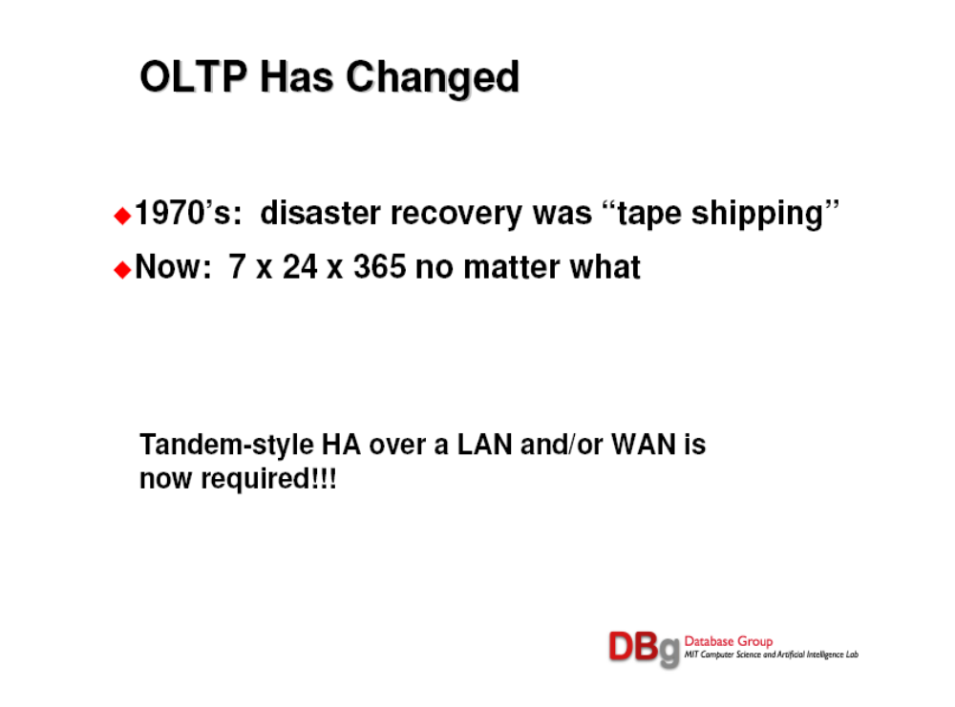

Slide 42
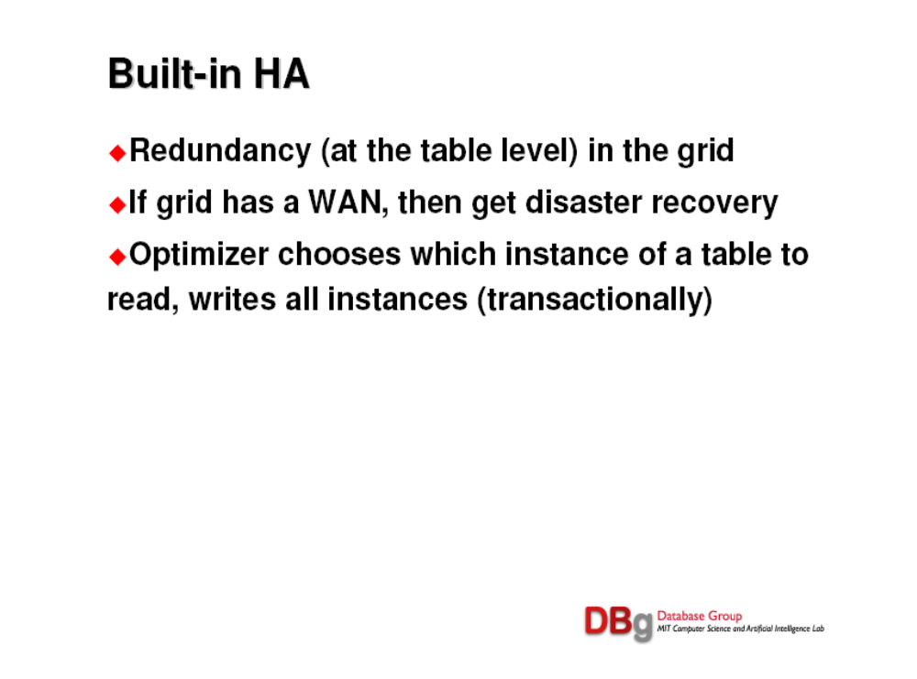

Slide 43
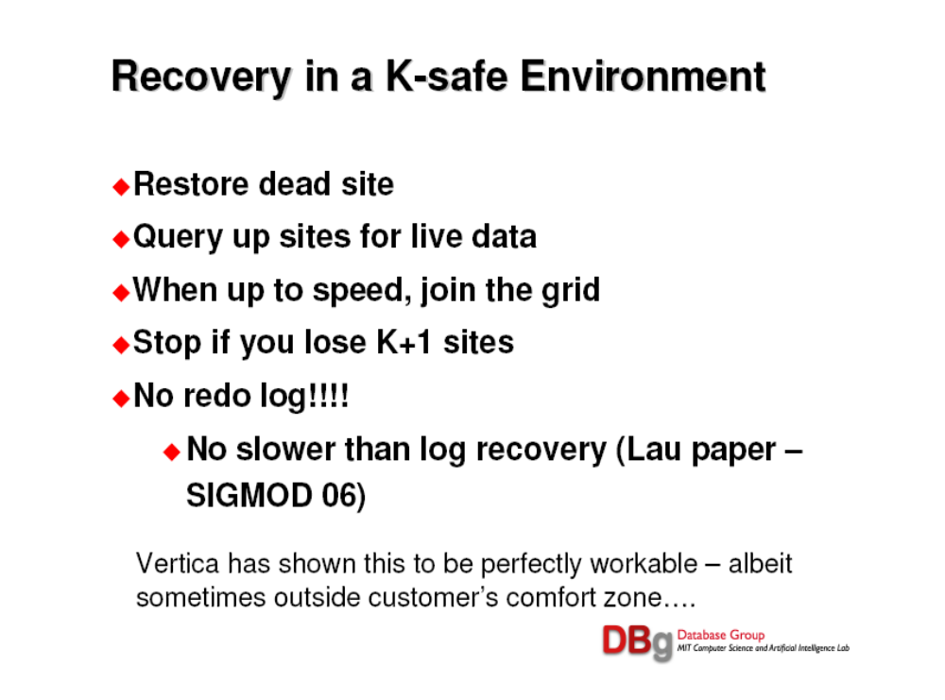

Slide 44
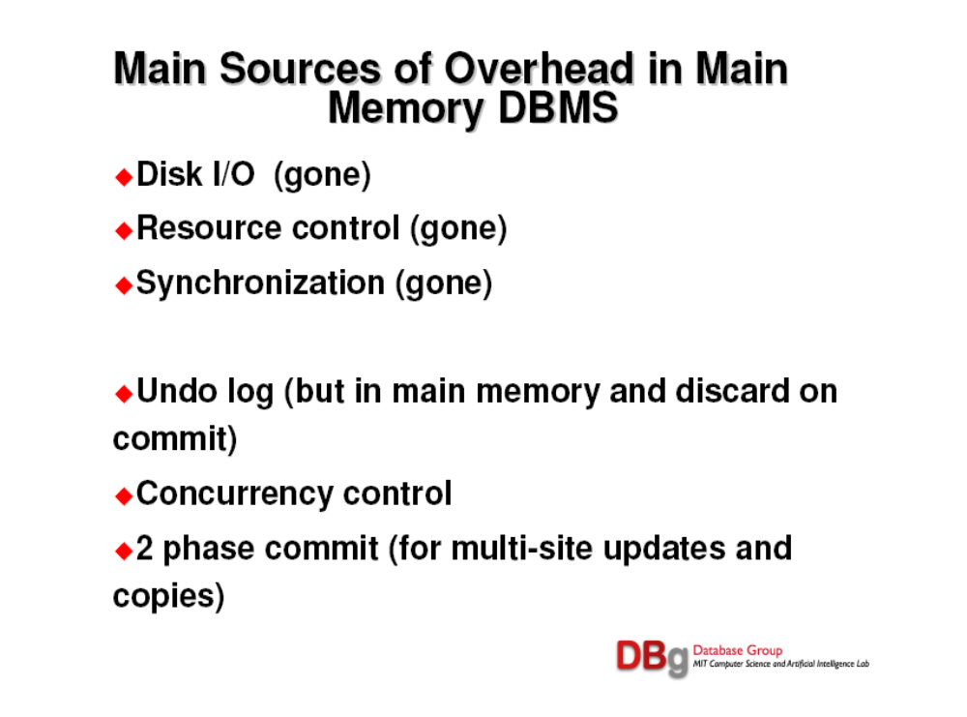

Slide 45
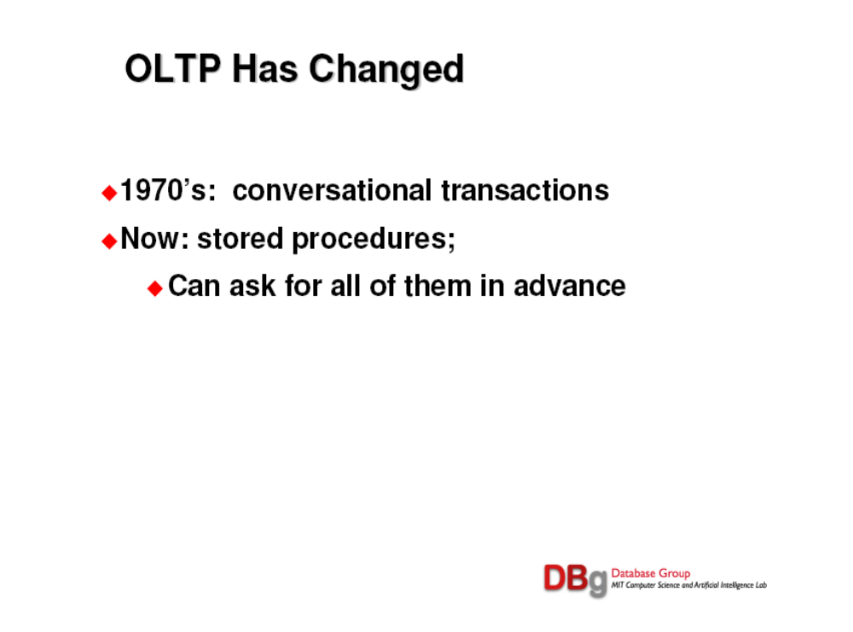

Slide 46
H-Store
Main memory: rows are contiguous, Btrees with cache-line sized nodes
Every H-Store site (process) is single threaded; one logical site per core.
H-Store can only execute a predefined transaction, which is written in C++:
  Execute transaction (parameter_list)
  Clients send transaction name and parameters
Construct a horizontal partition
Analyze the transactions for leverage points

Slide 47
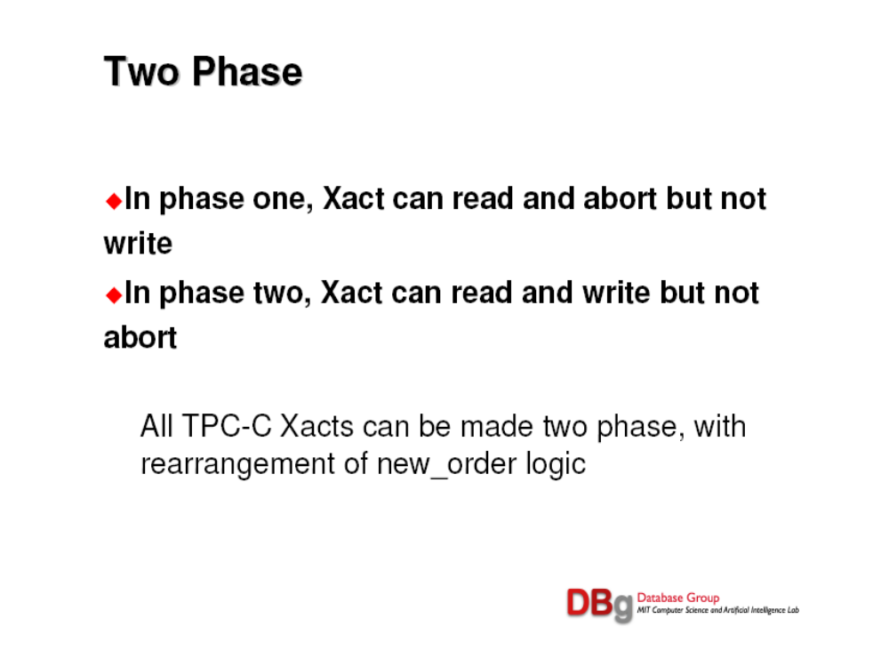

Slide 48
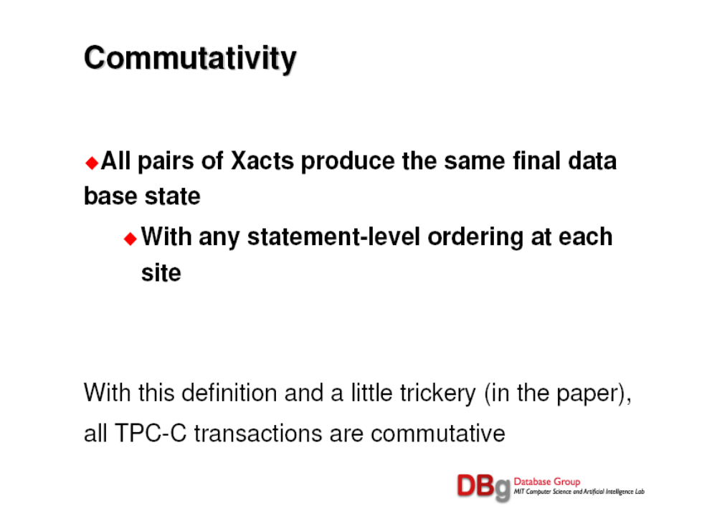

Slide 49
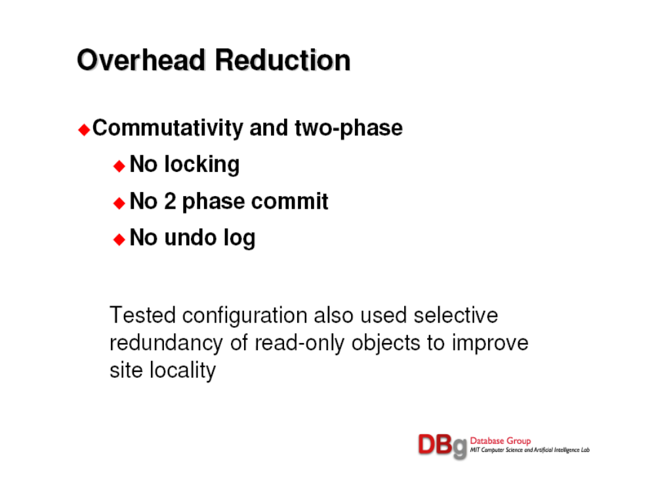

Slide 50
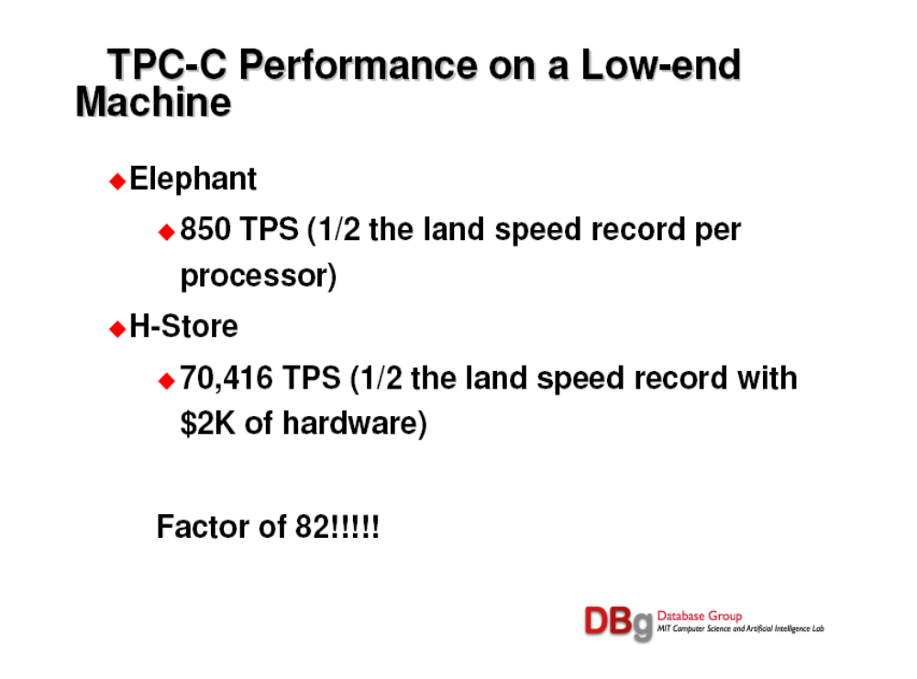
RDBMS

Slide 51
Outline
Introduction
Data Warehouse
Text Search
Stream Processing
Scientific Data
OLTP
Summary

Slide 52
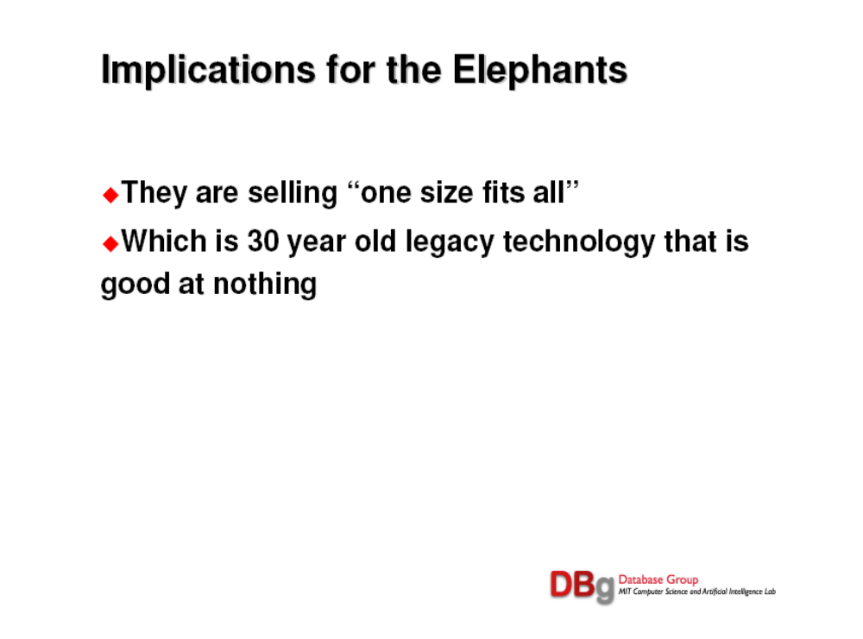

Slide 53
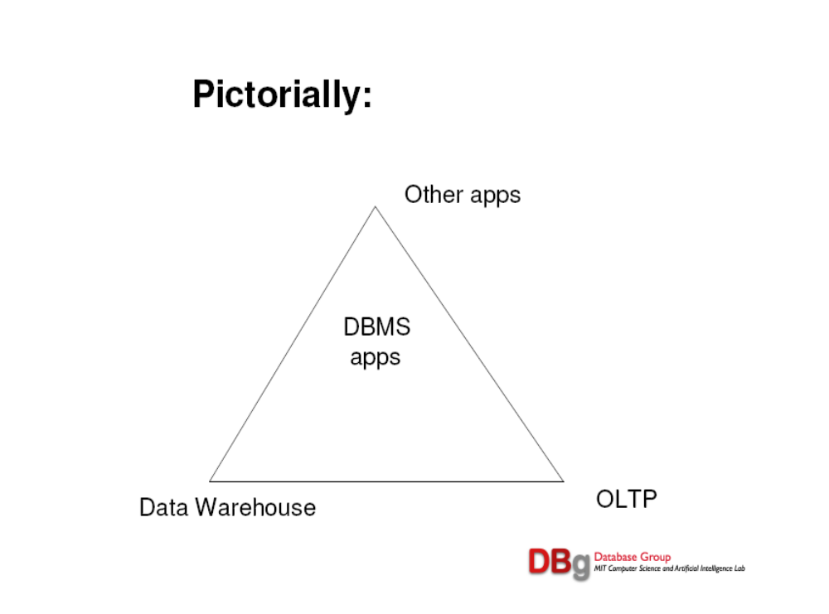

Slide 54
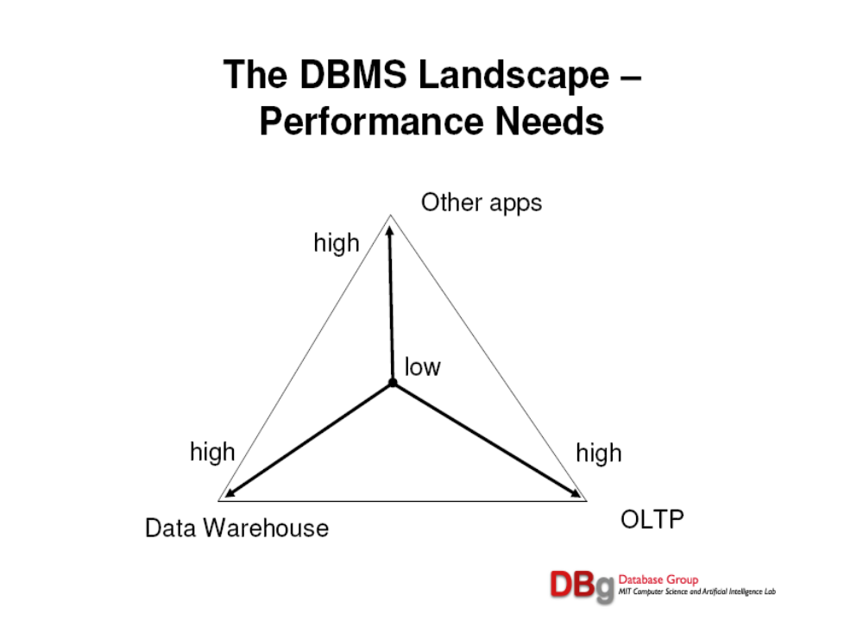

Slide 55
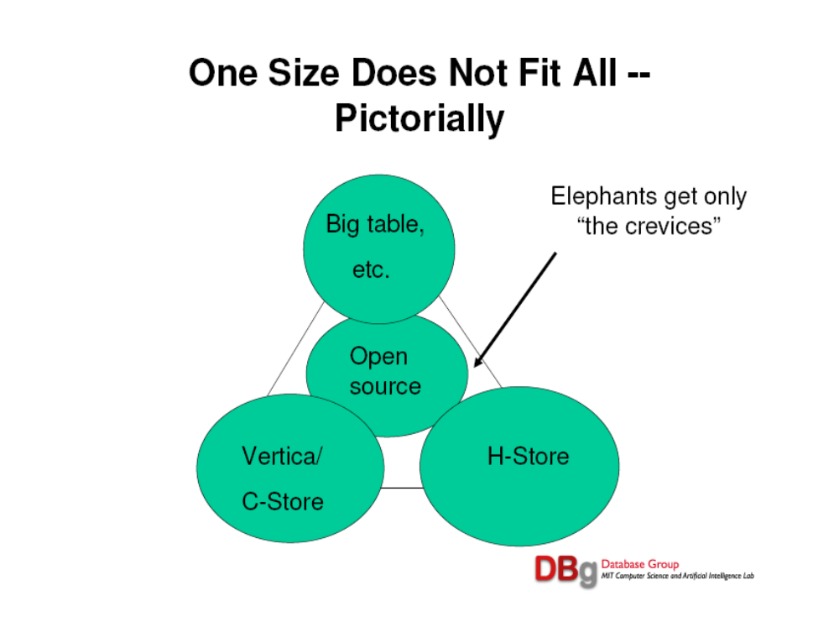

Slide 56
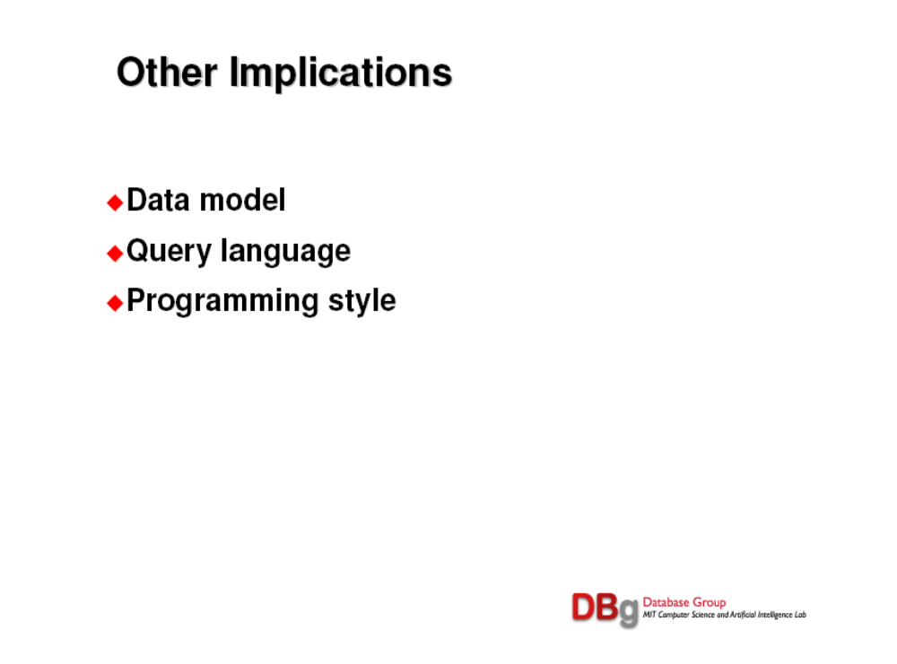

Slide 57
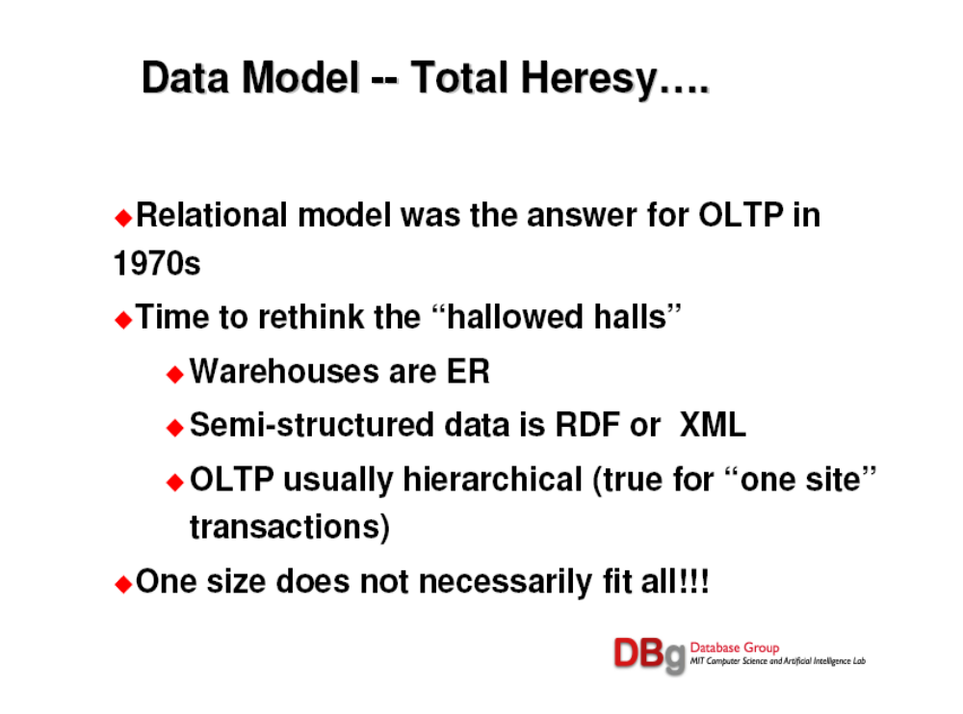

Slide 58
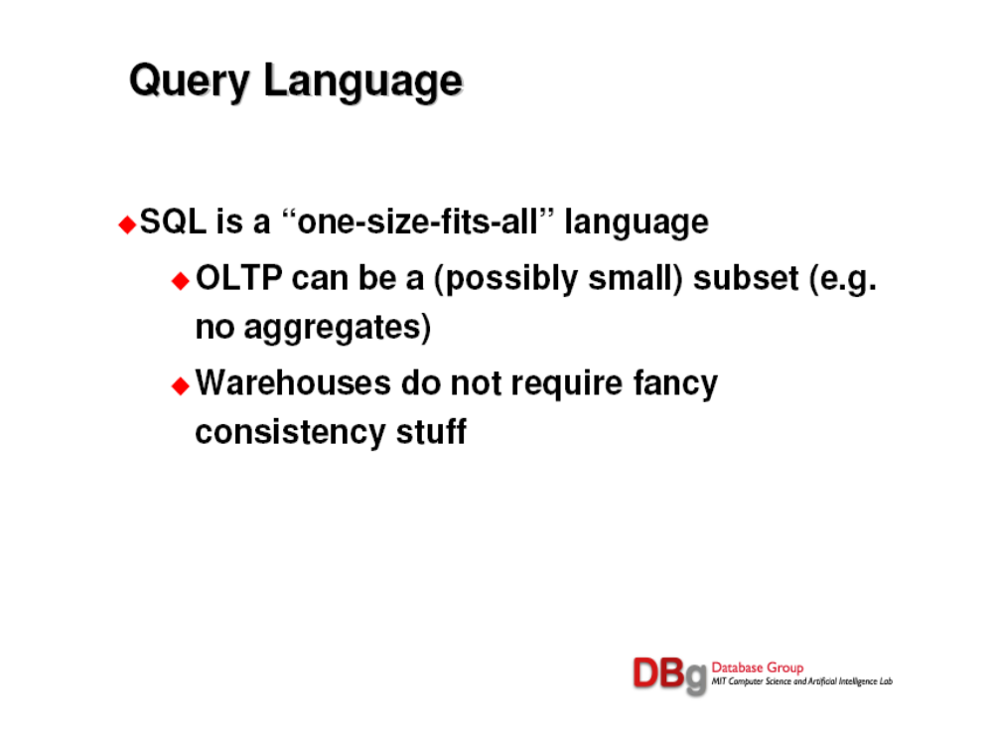

Slide 59
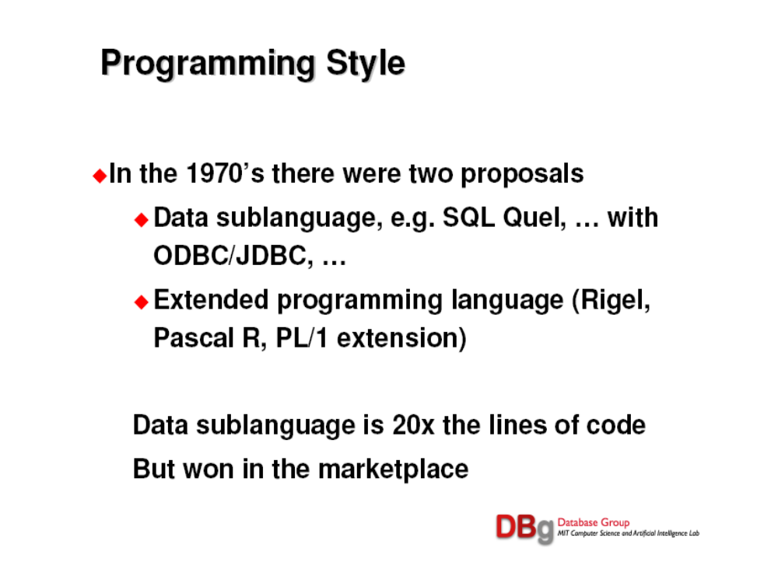

Slide 60
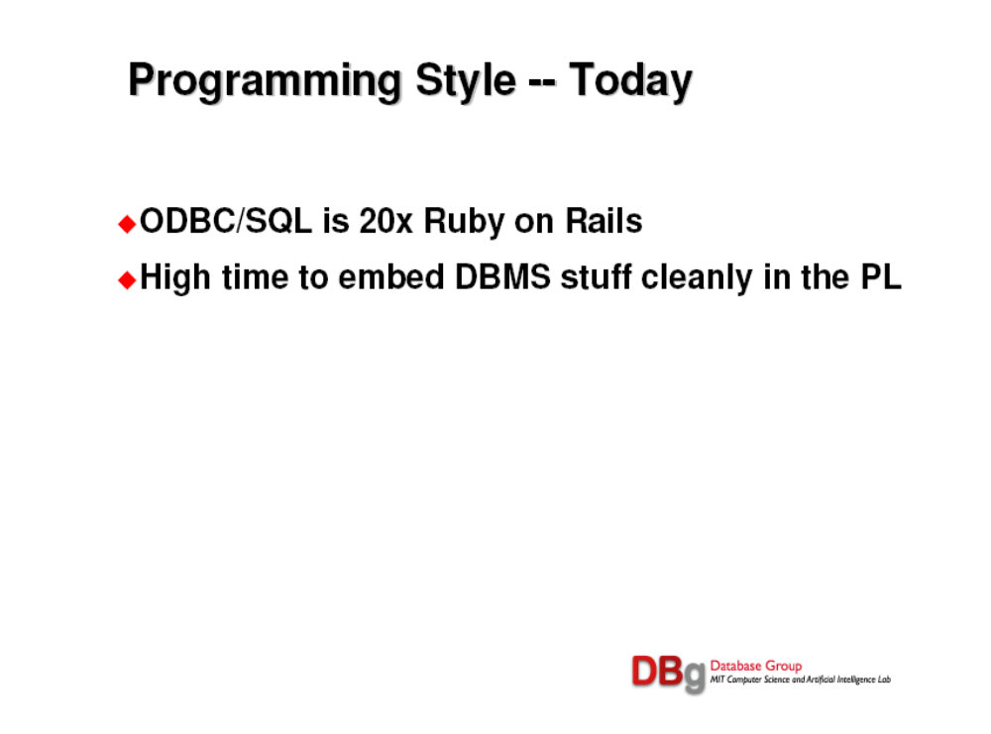

Slide 61
