Slide 1

A Comparison of Join Algorithms for Log Processing in MapReduce
-Liu Ya (CS yliu8@wpi.edu)
-Zhou Hao (CS hzhou@wpi.edu)

Slide 2

OutLine
Introduction & background
Log processing and MapReduce
Join Algorithms
Experimental Evaluation
Discussion
Conclusion and Future Work

Slide 3
Introduction
Since its introduction just a few years ago, the MapReduce framework has become extremely popular for analyzing large datasets in cluster environments.
Postives:
Hiding the details of parallelization, fault tolerance, and load balancing in a simple programming framework.
Negatives:
Ignores many of the valuable lessons learned in Parallel RDBMs.
Lack of a schema, declarative query language, and indexes.

Slide 4
What's happening now?
Google, Yahoo, Facebook and many Web 2.0 companies are highly interested in Map Reduce.
Why ?
Log processing is very important data analysis that is required by these companies.
Map Reduce absolutely suits their Requirement.

Slide 5
Part 2:
So what is Log Processing
&
why use Map Reduce for Log Processing?

Slide 6
Log Processing
What is Log Processing ?
Log of events such as click-stream,phone call records or sequence of transactions are collected and are stored in flat files.
Then these files are processed to compute various statistics to derive some business insights.

Slide 7
Log Processing in MapReduce
There are several reasons that make MapReduce preferable over a parallel RDBMS for log processing
  There is the sheer amount of data
    China Mobile gathers 5–8TB of phone call records per day
    At Facebook, almost 6TB of new log data is collected every day, with 1.7PB of log data accumulated over time
  The log records do not always follow the same schema
    Developers often want the flexibility to add and drop attributes and the interpretation of a log record may also change over time
    This makes the lack of a rigid schema in MapReduce a feature rather than a shortcoming
  All the log records within a time period are typically analyzed together, making simple scans preferable to index scans

Slide 8
Log Processing in MapReduce
  Log processing can be very time consuming and therefore it is important to keep the analysis job going even in the event of failures
    In most of RDBMSs, a query usually has to be restarted from scratch even if just one node in the cluster fails
  The Hadoop implementation of MapReduce is freely available as open-source and runs well on inexpensive commodity hardware
    For non-critical log data that is analyzed and eventually discarded, cost can be an important factor
The equi-join between the log and the reference data can have a large impact on the performance of log processing, Unfortunately, the MapReduce framework is somewhat cumbersome for joins, since it was not originally designed to combine information from two or more data sources.

Slide 9
Where there's a weakness there're contribitions.

Slide 10
The contributions of this paper
We provide a detailed description of several equi-join implementations for the MapReduce framework
For each algorithm, we design various practical preprocessing techniques to further improve the join performance at query time
We conduct an extensive experimental evaluation to compare the various join algorithms on a 100-node Hadoop cluster
Our results show that the tradeoffs on this new platform are quite different from those found in a parallel RDBMS, due to deliberate design choices that sacrifice performance for scalability in MapReduce.
  Our findings provide an important first step for query optimization in declarative query languages

Slide 11
Part 3:
Join Algorithms in MapReduce

Slide 12
Assumptions made for our JOIN ALGORITHMS IN MAPREDUCE
We consider an equi-join between a log table L and a reference table R on a single column.
L,R and the Join Result is stored in DFS.
Scans are used to access L and R.
Each map or reduce task can optionally implement two additional functions: init() and close() .
These functions can be called before or after each map or reduce task.
L ⨝_{L.k=R.k} R, with |L| ≫ |R|

Slide 13
Four Join Algorithms Discussed
Algorithms
  Repartition Join
  Broadcast Join
  Semi-Join
  Per-Split Semi-Join

Slide 14
Repartition Join
  R(A,B) L(B,C)
Input
R
Reduce input
A | B
a0 | b0
a1 | b1
a2 | b2
… | …
K | V
b0 | R:(a0, b0)
b0 | L:(b0, c0)
b0 | L:(b0, c1)
… | …
Final output
A | B | C
a0 | b0 | c0
a0 | b0 | c1
a1 | b1 | c2
… | … | …
Map
Reduce
L
K | V
b1 | R:(a1, b1)
b1 | L:(b1, c2)
… | …
B | C
b0 | c0
b0 | c1
b1 | c2
… | …

Slide 15
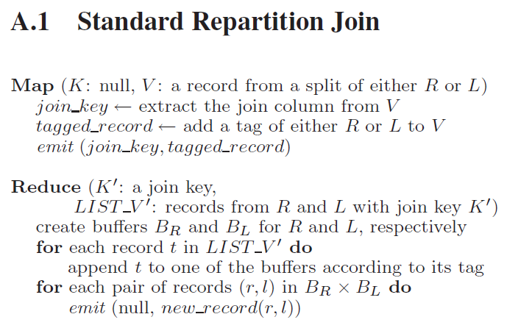
Repartition Join – Pseudo Code

Slide 16
Problems with Repartition Join
Standard Repartition Join
  Potential problem
    all records have to be buffered.
  May not fit in memory (out of memory)
    The data is highly skewed
    The key cardinality is small
  Variants of the standard repartition join are used in Pig, Hive, and Jaql today.
    They all suffer from the buffering problem

Slide 17
Improved Repartition Join
Improved Repartition Join
  The output key is changed to a composite of the join key and the table tag
    The table tags are generated in a way that ensure records from R will be sorted ahead of those from L on a give join key
  The partitioning & grouping function is customized by a hash function
  Records from the smaller table R are guaranteed to be ahead of those from L for a given key
    Only R records are buffered and L records are streamed to generate the join output
K | V
b0 | R:(a0, b0)
K | V
R:b0 | R:(a0, b0)

Slide 18
Directed Join--Preprocessing for Repartition Join
  Purpose: To make the shuffle overhead in the repartition join decreased
  Goal: Both L and R have already been partitioned on the join key before the join operation
    Then at query time, matching partitions from L and R can be directly joined
  A map-only MapReduce job.
    Each map task is scheduled on a split of L_{i}. (* L_{i} means a split of L)
    During the initialization phase,Ri is ret rieved from the DFS, if it’s not already in local storage, and a main-memory hash table is built on it .
    Then the map function scans each record from a split of L_{i} and probes the hash table to do the join .

Slide 19
Broadcast Join
  Some applications, |R| << |L| : Instead of moving both R and L across the network,broadcasting the smaller table R to avoid the network overhead.
  A map-only job: Each map task uses a main-memory hash table for either L or R

Slide 20
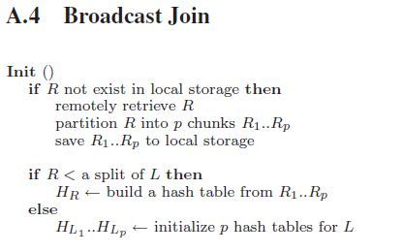
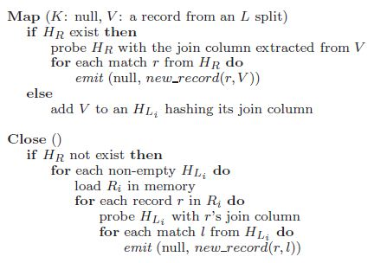
Broadcast Join
Broadcast Join
  If R < a split of L
    To build the hash table on R
  If R > a split of L
    To build the hash table on a split of L
Preprocessing for Broadcast Join
  Increasing the replication factor for R -> Most nodes in the cluster
  have a local copy of R in advance
  To avoid retrieving R
  from the DFS in its init() function

Slide 21
Semi-Join
Often , when R is large, many records in R may not be actually referenced by any records in table L.
Consider Facebook as an example.
  Its user table has hundreds of millions of records. However, an hour worth of log data likely contains the activities of only a few million unique users and the majority of the users are not present in this log at all.

Slide 22
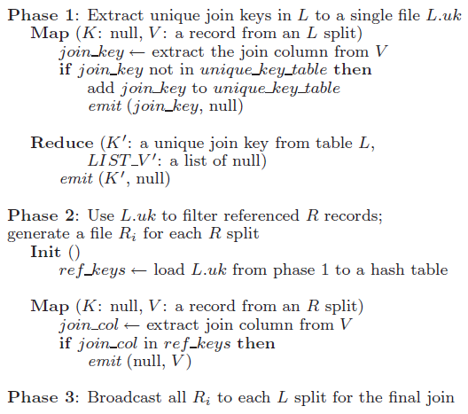
Semi-Join
To avoid sending the records in R over the network that will not join with L
Preprocessing for Semi-Join
  First two phases of semi-join can be moved to a preprocessing step

Slide 23
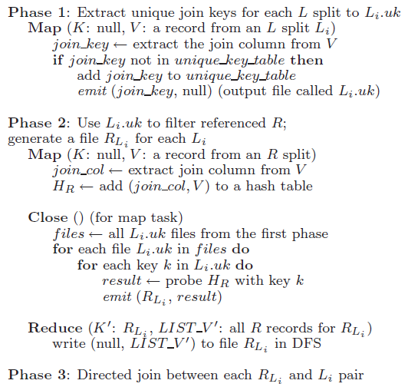
Per-Split Semi-Join
Per-Split Semi-Join
  The problem of Semi-join : not every record in the filtered version of R will join with a particular split L_{i} of L
Preprocessing for Per-split Semi-join
  Also benefit from moving its first two phases to a preprocessing step

Slide 24
Algorithm | Problem or Case | Key Method/Point for achieving solution
Broadcast Join | If the reference table R is much smaller than the log table L, i.e. |R| ≪ |L| | Broadcast the smaller table R, as it avoids sorting on both tables and more importantly avoids the network overhead for moving the larger table L.
Semi-Join | R is large, many records in R may not be actually referenced by any records in table L | In the map function, a main-memory hash table is used to determine the set of unique join keys in a split of L.
Per-Split Semi-Join | One problem with semi-join is that not every record in the ﬁltered version of R will join with a particular split Li of L. | Moves just the records in R that will join with each split of L.

Slide 25
Part 4:
Experimental Evaluation

Slide 26
Experimental Evaluation
System Specification
  All experiments run on a 100-node cluster
  Single 2.4GHz Intel Core 2 Duo processor
  4GB of DRAM and two SATA disks
  Red Hat Enterprise Server 5.2 running Linux 2.6.18
Network Specification
  The 100 nodes were spread across two racks
  Each node can execute two map and two reduce tasks concurrently
  Each rack had its own gigabit Ethernet switch
  The rack level bandwidth is 32Gb/s
  Under full load, 35MB/s cross-rack node-to-node bandwidth

Slide 27
Experimental Evaluation
Hardware/software/procedure | Configuration /version
Cluster | 100 node
Each node | 2.4GHz Intel Core 2 Duo processor 4GB of DRAM two SATA disks
Operating System | Red Hat Enterprise Server 5.2 running Linux 2.6.18
2 Racks | own gigabit Ethernet switch
rack level bandwidth | 32Gb/s
Hadoop version | 0.19.0 conﬁgured it to run up to two map and two reduce tasks concurrently per node
block size | 128 Mb
Replication | Each HDFs block was replicated 3 times

Slide 28
Experimental Evaluation
Datasets
 | Event Log (L) | User Info (R)
Join column size | 10 bytes | 5 bytes
Record size | 100bytes (average) | 100 bytes (exactly)
Total size | 500GB | 10MB~100GB
Join result is a 10 bytes join key n-to-1 join (one or more L referencing exactly one R) The fraction of R that was referenced by L to be 0.1%, 1%, or 10% (because many users are inactive) All the records in L always appear in the result

Slide 29
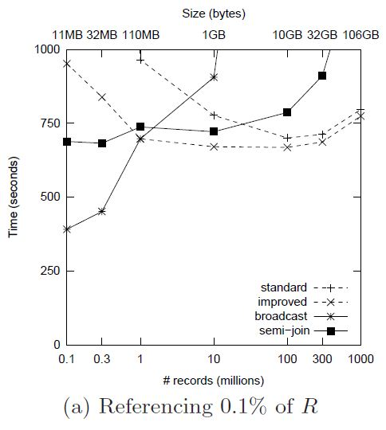
Experimental Evaluation
Standard
  As R got smaller, there were more records in L with the same join key
    Out of memory
Improved
  As R got smaller, join key list is smaller.
Broadcast
  Rapidly degraded as R got bigger
Semi-join
  Extra scan of L required

Slide 30
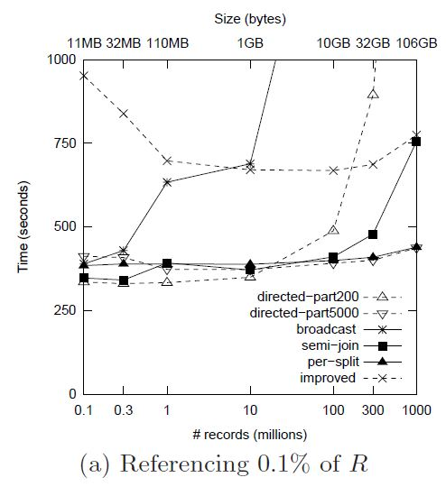
Experimental Evaluation
Baseline
  Improved repartition join
As the size of R increased, broadcast join degraded the fastest, followed by direct-200 and semi-join.
In general,
  preprocessing lowered the time by almost 60% (about 700 to 300 Sec)
Preprocessing cost
  Semi-join : 5 min.
  Per-Split : 30 min.
  Direct-5000 : 60 min.

Slide 31
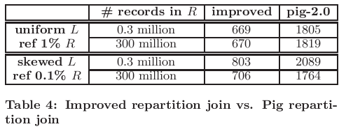
Comparison with Join Algorithm in Pig
There are two join strategies provided in Pig: repartition join and fragment replicate join. They resemble our improved repartition join and broadcast join, respectively.

Slide 32
Comparison with Join Algorithm in Pig
Broadcast join against the fragment replicate join in Pig
For 0.3 million records in R, the broadcast join is consistently more than 3 times faster than the fragment replicate join, on both uniform and skewed L referencing 0.1% and 1% of R.
Our broadcast join is more efficient because
All map tasks on the same node share one local copy of R, whereas the fragment replicate join always re-reads R from DFS in every map task.
Our broadcast join dynamically selects the smaller input (R or the split of L) for the in-memory hash table, whereas Pig always loads the full R in memory.

Slide 33
Part 5:
Discussion

Slide 34
Performance Analysis & Customized Splits
Performance Analysis : Different environments and join algorithms have different performance gaps. And the performance gap among various join strategies would be larger.
Customized Splits : Instead of each map task working on a single DFS block, we can assign multiple blocks to a map task.
big split: To preserve locality, we customized the function that generates splits in Hadoop, so that multiple non-consecutive blocks co-located on the same node are grouped into one logical split, which we call a big split.

Slide 35
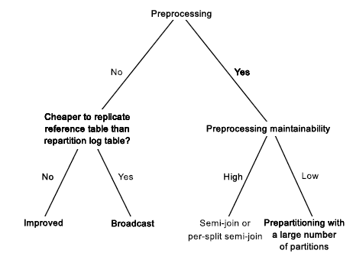
Choosing the Right Strategy
Choosing the Right Strategy
  To determine what is the right join strategy for a given circumstance
  To provide an important first step for query optimization

Slide 36
Part 6:
Conclusion & Future Work

Slide 37
Conclusion & Future Work
Joining log data with reference data in MapReduce has emerged as an important part
  Analytic operations for enterprise customers
  Web 2.0 companies
To design a series of join algorithms on top of MapReduce
  Without requiring any modification to the actual framework
  To propose many details for efficient implementation
    Two additional function: Init(), close()
    Practical preprocessing techniques
Future work
  Multi-way joins
  Indexing methods to speedup join queries
  Optimization module (selecting appropriate join algorithms)

Slide 38
Thanks
&
Discussion

