Slide 1
Running TPC-H On Pig
Jie Li, Koichi Ishida, Muzhi Zhao,
Ralf Diestelkaemper, Xuan Wang, Yin Lin
CPS 216: Data Intensive Computing Systems
Dec 9, 2011

Slide 2
Goals
Project 1
  develop correct Pig scripts
  compare with Hive’s TPC-H benchmark[1]
Project 2
  analyze the results and identify Pig’s bottlenecks
  rewrite some Pig scripts
[1] https://issues.apache.org/jira/browse/HIVE-600

Slide 3
Benchmark Set Up
  TPC-H 2.8.0 100GB data
  Hadoop 0.20.203.0
  Pig 0.9.0
  Hive 0.7.1
  EC2 small instances (1.7GB memory, 160GB storage)
  8 slaves each 2 map slots and 1 reduce slot
  Each job 8 reducers

Slide 4
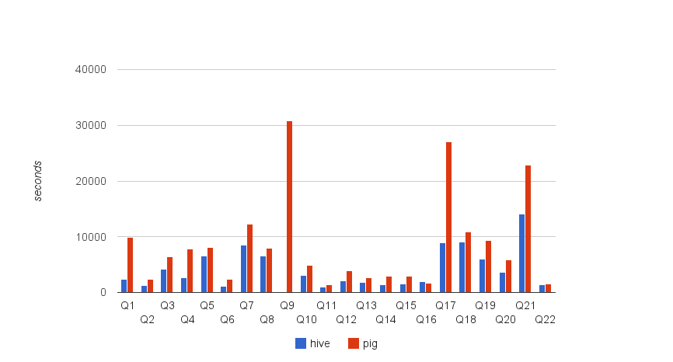
Initial Result
Except Q9 (Hive failed), only for Q16 Pig was faster than Hive.
These Pig scripts were written in project 1.

Slide 5
Six Rules Of Writing Efficient Pig Scripts
Reorder JOINs properly
Use COGROUP for JOIN + GROUP
Use FLATTEN for self-join
Project before (CO)GROUP
Remove types in LOAD
Use hash-based aggregation

Slide 6
Rule 1: Reorder JOINs properly
Join* = Map + Shuffle + Reduce = huge I/O
Reorder Joins to minimize intermediate results
Joins with less outputs first:
  Joins with small tables
  Joins with filtered tables
  Joins between primary-key and foreign-key
* We focused on the default hash join. The replicated join does not apply to
most of the TPC-H joins and its benefit is ignorable in most queries.

Slide 7
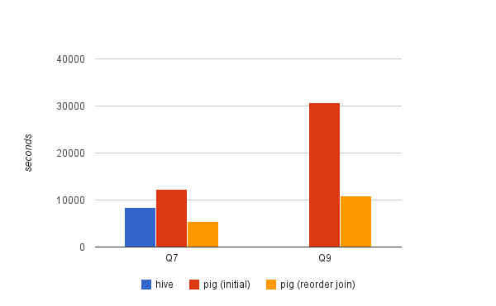
Apply Rule 1 to TPC-H
Both Q7 and Q9 contains 5+ joins.
Hive queries can also be rewritten in the same way.

Slide 8
Rule 2: COGROUP
Condition:
join followed by group-by on the same key
Advantage:
join and group can be done in a single COGROUP,
that reduces the number of MapReduce jobs by one

Slide 9
Rule 2 Example
SQL
select A.x, COUNT(B.y)
from A JOIN B on A.x = B.x
GROUP by A.x
Pig
t1 = COGROUP A by A.x ,B by B.x;
t2 = FOREACH t1 GENERATE group, COUNT(B.y);

Slide 10
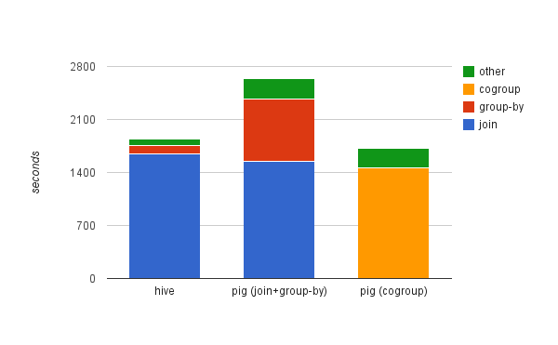
Apply Rule 2 to TPC-H Query 13
COGROUP has less output than the join thus faster.
Hive pushed the aggregation into the join.

Slide 11
Rule 3: FLATTEN
Condition:
group-by followed by self-join on the same key
Advantage:
the self-join can be performed in group-by after FLATTEN,
that eliminates one MapReduce job

Slide 12
Rule 3 Example
SQL
select *
from A as A1
where A1.y < ( select AVG(A2.y)
from A as A2
        where A2.x = A1.x )
Pig
t1 = group A by x;
t2 = foreach t1 generate FLATTEN(A), AVG(A.y) as avg_y;
t3 = filter t2 by y < avg_y;

Slide 13
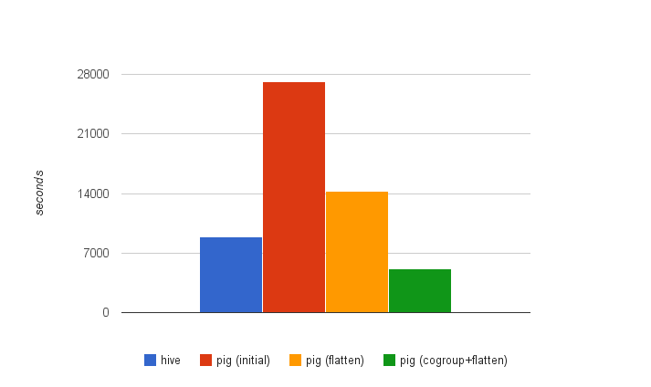
Apply Rule 2 and 3 to TPC-H Query 17
Q17 contains one regular join, one self join and one group-by, all on the same key
pig (flatten) applies Rule 3 to perform the self-join in group-by.
pig (cogroup+flatten) furthur applies Rule 2 to perform the regular join and group-by together in COGROUP.

Slide 14
Rule 4: Project before (CO)GROUP
Pig doesn’t prune nested columns in (CO)GROUP
Turns out to be the most effective rule
Otherwise Rule 2&3 won’t take effect
Open issue:
  https://issues.apache.org/jira/browse/PIG-1324

Slide 15
Rule 4 Example
A = load 'A.in' as (a,b,c,d,e,f,g,h,i,j,k,l,m,n);
A = foreach A generate a, b; -- project before GROUP
t1 = GROUP A by a;
t2 = foreach t1 generate group, SUM(A.b);

Slide 16
Rule 5: Remove types in LOAD
With types, Pig casts them upon loading. Overhead!
Without types, Pig does lazy conversion, but may uses a more expensive type!
Is it possible to keep the types and do lazy conversion?
Open issue (since 2008):
  https://issues.apache.org/jira/browse/PIG-410

Slide 17
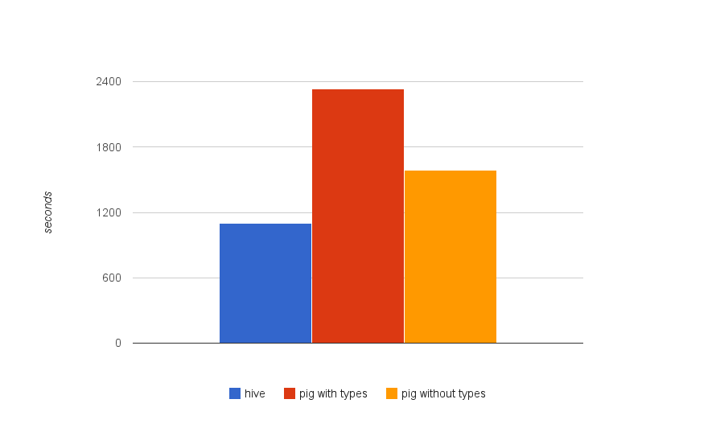
Apply Rule 5 to TPC-H Query 6
Q6 reads one table, applies some filters and returns a global aggregation.
Pig is slower than Hive due to the aggregation. See next rule.

Slide 18
Rule 6: Use hash-based aggregation
Sort-based aggregation is expensive due to sorting, spilling, shuffling, etc.
Hash-based aggregation keeps a hash table inside Map
Hive supports this already
Pig is going to support it soon!

Slide 19
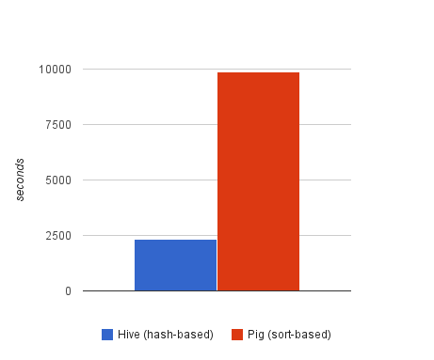
Query 1 (Rule 6 will be applicable soon)
Q1 has a group-by and several aggregations.

Slide 20
Six Rules Summary
Choose a better query plan for Pig, especially the order of joins
Making full use of Pig’s features, like COGROUP, FLATTEN, etc
Be aware of Pig’s current issues, such as projection, type conversions, sort-based aggregation

Slide 21
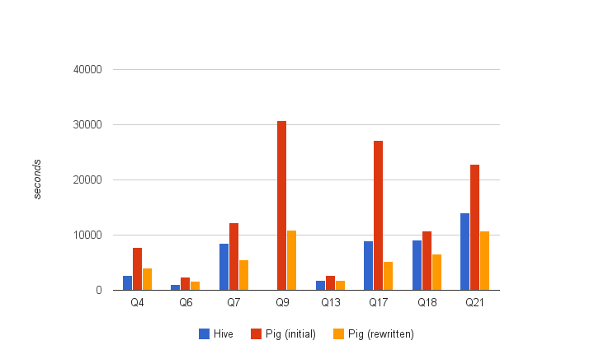
All rewritten queries based on Rule 1~5

Slide 22
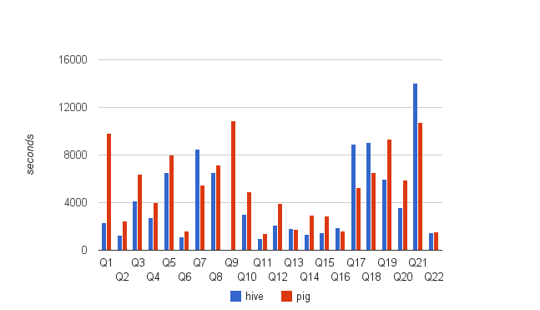
Updated Result

Slide 23
Acknowledgements
We referred to six Pig scripts used in Query optimization for massively parallel data processing (SOCC '11)
We appreciate Amazon EC2’s education grants
All scripts are available at https://issues.apache.org/jira/browse/PIG-2397

