Slide 1
TPC Benchmarks
Charles Levine
Microsoft
clevine@microsoft.com
Western Institute of Computer Science
Stanford, CA
August 6, 1999

Slide 2
Outline
Introduction
History of TPC
TPC-A/B Legacy
TPC-C
TPC-H/R
TPC Futures

Slide 3
Benchmarks: What and Why
What is a benchmark?
Domain specific
  No single metric possible
  The more general the benchmark, the less useful it is for anything in particular.
  A benchmark is a distillation of the essential attributes of a workload
Desirable attributes
  Relevant ➔ meaningful within the target domain
  Understandable
  Good metric(s) ➔ linear, orthogonal, monotonic
  Scaleable ➔ applicable to a broad spectrum of hardware/architecture
  Coverage ➔ does not oversimplify the typical environment
  Acceptance ➔ Vendors and Users embrace it

Slide 4
Benefits and Liabilities
Good benchmarks
  Define the playing field
  Accelerate progress
    Engineers do a great job once objective is
    measureable and repeatable
  Set the performance agenda
    Measure release-to-release progress
    Set goals (e.g., 100,000 tpmC, < 10 $/tpmC)
    Something managers can understand (!)
Benchmark abuse
  Benchmarketing
  Benchmark wars
    more $ on ads than development

Slide 5
Benchmarks have a Lifetime
Good benchmarks drive industry and technology forward.
At some point, all reasonable advances have been made.
Benchmarks can become counter productive by encouraging artificial optimizations.
So, even good benchmarks become obsolete over time.

Slide 6
Outline
Introduction
History of TPC
TPC-A Legacy
TPC-C
TPC-H/R
TPC Futures

Slide 7
What is the TPC?
TPC = Transaction Processing Performance Council
Founded in Aug/88 by Omri Serlin and 8 vendors.
Membership of 40-45 for last several years
    Everybody who’s anybody in software & hardware
De facto industry standards body for OLTP performance
Administered by:
Shanley Public Relations ph: (408) 295-8894
650 N. Winchester Blvd, Suite 1 fax: (408) 271-6648
San Jose, CA 95128 email: shanley@tpc.org
Most TPC specs, info, results are on the web page:
http: www.tpc.org

Slide 8
Two Seminal Events Leading to TPC
Anon, et al, “A Measure of Transaction Processing Power”, Datamation, April fools day, 1985.
  Anon = Jim Gray (Dr. E. A. Anon)
  Sort: 1M 100 byte records
  Mini-batch: copy 1000 records
  DebitCredit: simple ATM style transaction
Tandem TopGun Benchmark
  DebitCredit
  212 tps on NonStop SQL in 1987 (!)
  Audited by Tom Sawyer of Codd and Date (A first)
  Full Disclosure of all aspects of tests (A first)
  Started the ET1/TP1 Benchmark wars of ’87-’89

Slide 9
TPC Milestones
1989: TPC-A ~ industry standard for Debit Credit
1990: TPC-B ~ database only version of TPC-A
1992: TPC-C ~ more representative, balanced OLTP
1994: TPC requires all results must be audited
1995: TPC-D ~ complex decision support (query)
1995: TPC-A/B declared obsolete by TPC
Non-starters:
  TPC-E ~ “Enterprise” for the mainframers
  TPC-S ~ “Server” component of TPC-C
  Both failed during final approval in 1996
1999: TPC-D replaced by TPC-H and TPC-R

Slide 10
TPC vs. SPEC
SPEC (System Performance Evaluation Cooperative)
  SPECMarks
SPEC ships code
  Unix centric
  CPU centric
TPC ships specifications
  Ecumenical
  Database/System/TP centric
  Price/Performance
The TPC and SPEC happily coexist
  There is plenty of room for both

Slide 11
Outline
Introduction
History of TPC
TPC-A/B Legacy
TPC-C
TPC-H/R
TPC Futures

Slide 12
TPC-A Legacy
First results in 1990: 38.2 tpsA, 29.2K$/tpsA (HP)
Last results in 1994: 3700 tpsA, 4.8 K$/tpsA (DEC)
WOW! 100x on performance and 6x on price in five years!!!
TPC cut its teeth on TPC-A/B; became functioning, representative body
Learned a lot of lessons:
  If benchmark is not meaningful, it doesn’t matter how many numbers or how easy to run (TPC-B).
  How to resolve ambiguities in spec
  How to police compliance
  Rules of engagement

Slide 13
TPC-A Established OLTP Playing Field
TPC-A criticized for being irrelevant, unrepresentative, misleading
But, truth is that TPC-A drove performance, drove price/performance, and forced everyone to clean up their products to be competitive.
Trend forced industry toward one price/performance, regardless of size.
Became means to achieve legitimacy in OLTP for some.

Slide 14
Outline
Introduction
History of TPC
TPC-A/B Legacy
TPC-C
TPC-D
TPC Futures

Slide 15
TPC-C Overview
Moderately complex OLTP
The result of 2+ years of development by the TPC
Application models a wholesale supplier managing orders.
Order-entry provides a conceptual model for the benchmark; underlying components are typical of any OLTP system.
Workload consists of five transaction types.
Users and database scale linearly with throughput.
Spec defines full-screen end-user interface.
Metrics are new-order txn rate (tpmC) and
price/performance ($/tpmC)
Specification was approved July 23, 1992.

Slide 16
TPC-C’s Five Transactions
OLTP transactions:
  New-order: enter a new order from a customer
  Payment: update customer balance to reflect a payment
  Delivery: deliver orders (done as a batch transaction)
  Order-status: retrieve status of customer’s most recent order
  Stock-level: monitor warehouse inventory
Transactions operate against a database of nine tables.
Transactions do update, insert, delete, and abort;
primary and secondary key access.
Response time requirement: 90% of each type of transaction must have a response time ≤ 5 seconds, except stock-level which is ≤ 20 seconds.

Slide 17
TPC-C Database Schema
Warehouse
W
Stock
W*100K
Item
100K (fixed)
100K
W
10
Legend
Table Name
<cardinality>
District
W*10
one-to-many
relationship
secondary index
3K
Customer
W*30K
Order
W*30K+
New-Order
W*5K
1+
0-1
1+
10-15
History
W*30K+
Order-Line
W*300K+

Slide 18

TPC-C Workflow
1
Select txn from menu:
1. New-Order 45%
2. Payment 43%
3. Order-Status 4%
4. Delivery 4%
5. Stock-Level 4%
Cycle Time Decomposition
(typical values, in seconds,
for weighted average txn)
Menu = 0.3
Keying = 9.6
Txn RT = 2.1
Think = 11.4
Average cycle time = 23.4
2
Measure menu Response Time
Input screen
Keying time
3
Measure txn Response Time
Output screen
Think time
Go back to 1

Slide 19
Data Skew
NURand - Non Uniform Random
  NURand(A,x,y) = (((random(0,A) | random(x,y)) + C) % (y-x+1)) + x
    Customer Last Name: NURand(255, 0, 999)
    Customer ID: NURand(1023, 1, 3000)
    Item ID: NURand(8191, 1, 100000)
  bitwise OR of two random values
  skews distribution toward values with more bits on
    75% chance that a given bit is one (1 - ½ * ½)
  skewed data pattern repeats with period of smaller random number

Slide 20
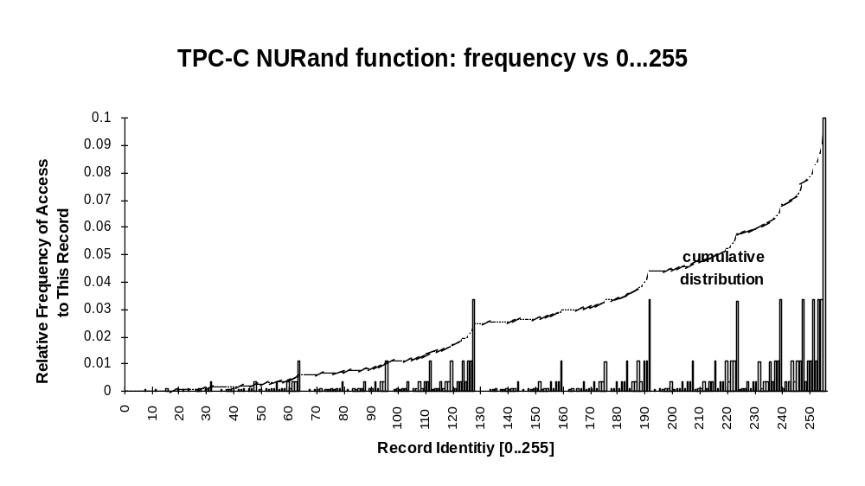
NURand Distribution

Slide 21
ACID Tests
TPC-C requires transactions be ACID.
Tests included to demonstrate ACID properties met.
Atomicity
  Verify that all changes within a transaction commit or abort.
Consistency
Isolation
  ANSI Repeatable reads for all but Stock-Level transactions.
  Committed reads for Stock-Level.
Durability
  Must demonstrate recovery from
    Loss of power
    Loss of memory
    Loss of media (e.g., disk crash)

Slide 22
Transparency
TPC-C requires that all data partitioning be fully transparent to the application code. (See TPC-C Clause 1.6)
  Both horizontal and vertical partitioning is allowed
  All partitioning must be hidden from the application
    Most DBMS’s do this today for single-node horizontal partitioning.
    Much harder: multiple-node transparency.
  For example, in a two-node cluster:
Any DML operation must be
able to operate against the
entire database, regardless of
physical location.
Node A
select *
from warehouse
where W_ID = 150
Node B
select *
from warehouse
where W_ID = 77
Warehouses:
1-100
100-200

Slide 23
Transparency (cont.)
How does transparency affect TPC-C?
  Payment txn: 15% of Customer table records are non-local to the home warehouse.
  New-order txn: 1% of Stock table records are non-local to the home warehouse.
In a distributed cluster, the cross warehouse traffic causes cross node traffic and either 2 phase commit, distributed lock management, or both.
For example, with distributed txns:
Number of nodes % Network Txns
1 0
2 5.5
3 7.3
n → ∞10.9

Slide 24
TPC-C Rules of Thumb
1.2 tpmC per User/terminal (maximum)
10 terminals per warehouse (fixed)
65-70 MB/tpmC priced disk capacity (minimum)
~ 0.5 physical IOs/sec/tpmC (typical)
100-700 KB main memory/tpmC (how much $ do you have?)
So use rules of thumb to size 5000 tpmC system:
  How many terminals?
  How many warehouses?
  How much memory?
  How much disk capacity?
  How many spindles?
» 4170 = 5000 / 1.2
» 417 = 4170 / 10
» 1.5 - 3.5 GB
» 325 GB = 5000 * 65
» Depends on MB capacity vs. physical IO. Capacity: 325 / 18 = 18 or 325 / 9 = 36 spindles
IO: 5000*.5 / 18 = 138 IO/sec TOO HOT!
IO: 5000*.5 / 36 = 69 IO/sec OK

Slide 25
Typical TPC-C Configuration (Conceptual)
Emulated User Load
Presentation Services
Database Functions
Term.
LAN
C/S
LAN
Database
Server
Driver System
Client
Hardware
...
Response Time
measured here
RTE, e.g.:
Performix,
LoadRunner,
or proprietary
TPC-C application +
Txn Monitor and/or
database RPC library
e.g., Tuxedo, ODBC
TPC-C application
(stored procedures) +
Database engine
e.g., SQL Server
Software

Slide 26
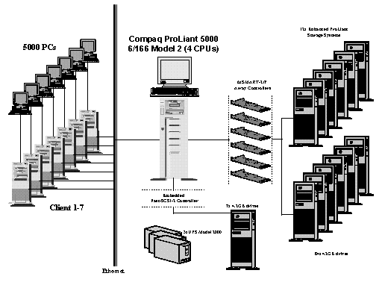
Competitive TPC-C Configuration 1996
5677 tpmC; $135/tpmC; 5-yr COO= 770.2 K$
2 GB memory, 91 4-GB disks (381 GB total)
4xPent 166 MHz
5000 users

Slide 27
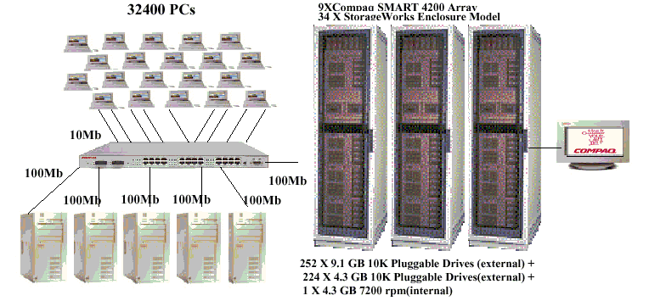
Competitive TPC-C Configuration Today
40,013 tpmC; $18.86/tpmC; 5-yr COO= 754.7 K$
4 GB memory, 252 9-GB disks & 225 4-GB disks (5.1 TB total)
8xPentium III Xeon 550MHz
32,400 users

Slide 28
The Complete Guide to TPC-C
In the spirit of The Compleat Works of Wllm Shkspr (Abridged)…
The Complete Guide to TPC-C:
  First, do several years of prep work. Next,
  Install OS
  Install and configure database
  Build TPC-C database
  Install and configure TPC-C application
  Install and configure RTE
  Run benchmark
  Analyze results
  Publish
Typical elapsed time: 2 – 6 months
The Challenge: Do it all in the next 30 minutes!

Slide 29
TPC-C Demo Configuration
Emulated User Load
Presentation Services
Database Functions
Driver System
Client
DB Server
Browser
LAN
C/S
LAN
SQL
Server
Web Server
UI APP
New-Order
Remote
Terminal
Emulator
(RTE)
COM+
Response Time
measured here
Payment
COMPONENT
Delivery
ODBC APP
Stock-Level
ODBC
Order-Status
...
Legend:
Products
Application Code

Slide 30
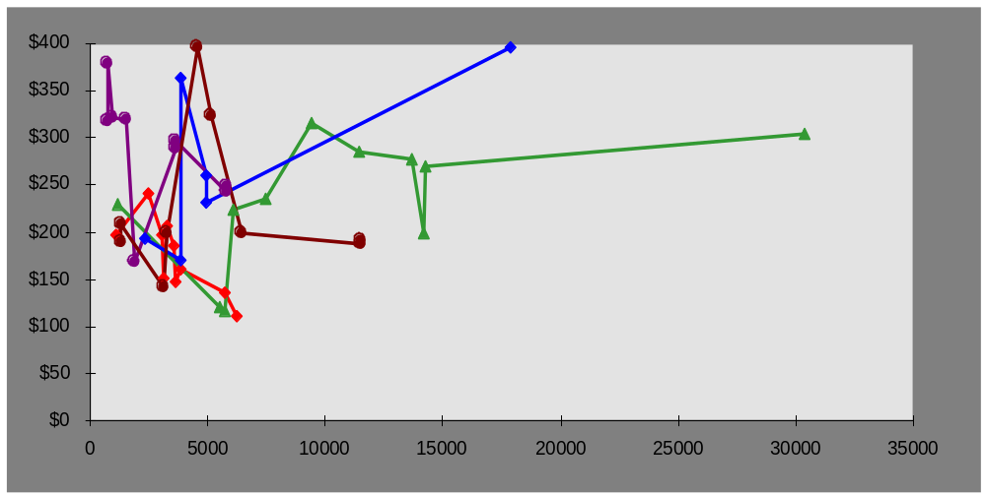
TPC-C Current Results - 1996
Best Performance is 30,390 tpmC @ $305/tpmC (Digital)
Best Price/Perf. is 6,185 tpmC @ $111/tpmC (Compaq)
IBM
HP
Digital
Sun
Compaq
$100/tpmC not yet. Soon!

Slide 31
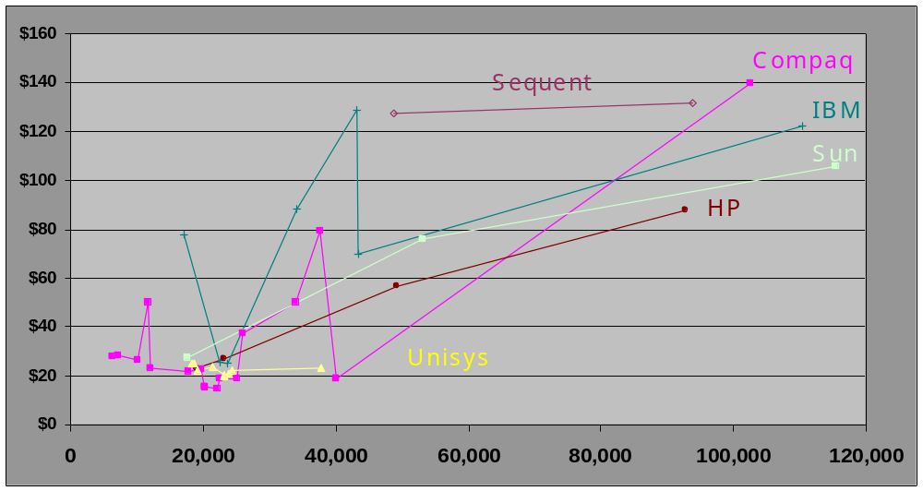
TPC-C Current Results
Best Performance is 115,395 tpmC @ $105/tpmC (Sun)
Best Price/Perf. is 20,195 tpmC @ $15/tpmC (Compaq)
$10/tpmC not yet. Soon!

Slide 32
TPC-C Summary
Balanced, representative OLTP mix
  Five transaction types
  Database intensive; substantial IO and cache load
  Scaleable workload
  Complex data: data attributes, size, skew
Requires Transparency and ACID
Full screen presentation services
De facto standard for OLTP performance

Slide 33
Preview of TPC-C rev 4.0
Rev 4.0 is major revision. Previous results will not be comparable; dropped from result list after six months.
Make txns heavier, so fewer users compared to rev 3.
Add referential integrity.
Adjust R/W mix to have more read, less write.
Reduce response time limits (e.g., 2 sec 90th %-tile vs 5 sec)
TVRand – Time Varying Random – causes workload activity to vary across database

Slide 34
Outline
Introduction
History of TPC
TPC-A/B Legacy
TPC-C
TPC-H/R
TPC Futures

Slide 35
TPC-H/R Overview
Complex Decision Support workload
Originally released as TPC-D
  the result of 5 years of development by the TPC
Benchmark models ad hoc queries (TPC-H) or
reporting (TPC-R)
  extract database with concurrent updates
  multi-user environment
Workload consists of 22 queries and 2 update streams
  SQL as written in spec
Database is quantized into fixed sizes (e.g., 1, 10, 30, … GB)
Metrics are Composite Queries-per-Hour (QphH or QphR), and Price/Performance ($/QphH or $/QphR)
TPC-D specification was approved April 5, 1995
TPC-H/R specifications were approved April, 1999

Slide 36
TPC-H/R Schema
Customer
SF*150K
Nation
25
Region
5
Order
SF*1500K
Supplier
SF*10K
Part
SF*200K
LineItem
SF*6000K
PartSupp
SF*800K
Legend:
• Arrows point in the direction of one-to-many relationships.
• The value below each table name is its cardinality. SF is the Scale Factor.

Slide 37
TPC-H/R Database Scaling and Load
Database size is determined from fixed Scale Factors (SF):
  1, 10, 30, 100, 300, 1000, 3000, 10000 (note that 3 is missing, not a typo)
  These correspond to the nominal database size in GB.
  (i.e., SF 10 is approx. 10 GB, not including indexes and temp tables.)
  Indices and temporary tables can significantly increase the total disk capacity. (3-5x is typical)
Database is generated by DBGEN
  DBGEN is a C program which is part of the TPC-H/R specs
  Use of DBGEN is strongly recommended.
  TPC-H/R database contents must be exact.
Database Load time must be reported
  Includes time to create indexes and update statistics.
  Not included in primary metrics.

Slide 38
How are TPC-H and TPC-R Different?
Partitioning
  TPC-H: only on primary keys, foreign keys, and date columns; only using “simple” key breaks
  TPC-R: unrestricted for horizontal partitioning
  Vertical partitioning is not allowed
Indexes
  TPC-H: only on primary keys, foreign keys, and date columns; cannot span multiple tables
  TPC-R: unrestricted
Auxiliary Structures
  What? materialized views, summary tables, join indexes
  TPC-H: not allowed
  TPC-R: allowed

Slide 39
TPC-H/R Query Set
22 queries written in SQL92 to implement business questions.
Queries are pseudo ad hoc:
  Substitution parameters are replaced with constants by QGEN
  QGEN replaces substitution parameters with random values
  No host variables
  No static SQL
Queries cannot be modified -- “SQL as written”
  There are some minor exceptions.
  All variants must be approved in advance by the TPC

Slide 40
TPC-H/R Update Streams
Update 0.1% of data per query stream
  About as long as a medium sized TPC-H/R query
Implementation of updates is left to sponsor, except:
ACID properties must be maintained
Update Function 1 (RF1)
  Insert new rows into ORDER and LINEITEM tables
  equal to 0.1% of table size
Update Function 2 (RF2)
  Delete rows from ORDER and LINEITEM tables
  equal to 0.1% of table size

Slide 41
TPC-H/R Execution
Database Build
  Timed and reported, but not a primary metric
Power Test
  Queries submitted in a single stream (i.e., no concurrency)
  Sequence:
Create
DB
Load
Data
Build
Indexes
Proceed directly to
Power Test
Build Database (timed)
Query
Set 0
RF1
RF2
Proceed directly to
Throughput Test
Timed Sequence

Slide 42
TPC-H/R Execution (cont.)
Throughput Test
  Multiple concurrent query streams
  Number of Streams (S) is determined by Scale Factor (SF)
    e.g.: SF=1 ➔ S=2; SF=100 ➔ S=5; SF=1000 ➔ S=7
  Single update stream
  Sequence:
Query Set 1
Query Set 2
...
Query Set N
Updates:
RF1 RF2 RF1 RF2 … RF1 RF2
1 2 … N

Slide 43
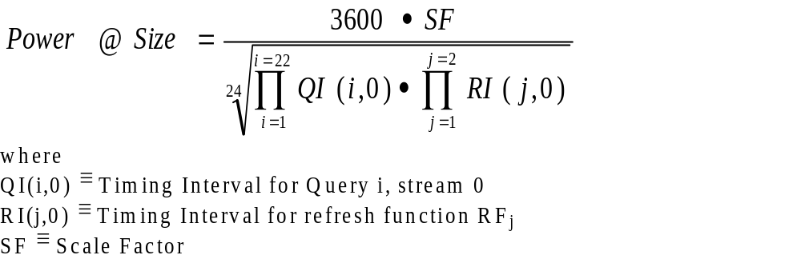
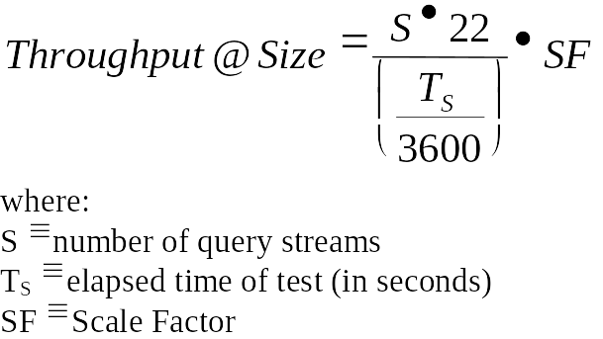
TPC-H/R Secondary Metrics
Power Metric
  Geometric queries per hour times SF
Throughput Metric
  Linear queries per hour times SF

Slide 44
TPC-R/H Primary Metrics
Composite Query-Per-Hour Rating (QphH or QphR)
  The Power and Throughput metrics are combined to get
  the composite queries per hour.
Reported metrics are:
  Composite: QphH@Size
  Price/Performance: $/QphH@Size
  Availability Date
Comparability:
  Results within a size category (SF) are comparable.
  Comparisons among different size databases are strongly discouraged.

Slide 45
TPC-H/R Results
No TPC-R results yet.
One TPC-H result:
  Sun Enterprise 4500 (Informix), 1280 QphH@100GB,
  816 $/QphH@100GB, available 11/15/99
Too early to know how TPC-H and TPC-R will fare
  In general, hardware vendors seem to be more interested in TPC-H

Slide 46
Outline
Introduction
History of TPC
TPC-A/B
TPC-C
TPC-H/R
TPC Futures

Slide 47
Next TPC Benchmark: TPC-W
TPC-W (Web) is a transactional web benchmark.
TPC-W models a controlled Internet Commerce environment that simulates the activities of a business oriented web server.
The application portrayed by the benchmark is a Retail Store on the Internet with a customer browse-and-order scenario.
TPC-W measures how fast an E-commerce system completes various E-commerce-type transactions

Slide 48
TPC-W Characteristics
TPC-W features:
The simultaneous execution of multiple transaction types that span a breadth of complexity.
On-line transaction execution modes.
Databases consisting of many tables with a wide variety of sizes, attributes, and relationship.
Multiple on-line browser sessions.
Secure browser interaction for confidential data.
On-line secure payment authorization to an external server.
Consistent web object update.
Transaction integrity (ACID properties).
Contention on data access and update.
24x7 operations requirement.
Three year total cost of ownership pricing model.

Slide 49
TPC-W Metrics
There are three workloads in the benchmark, representing different customer environments.
  Primarily shopping (WIPS). Representing typical browsing, searching and ordering activities of on-line shopping.
  Browsing (WIPSB). Representing browsing activities with dynamic web page generation and searching activities.
  Web-based Ordering (WIPSO). Representing intranet and business to business secure web activities.
Primary metrics are: WIPS rate (WIPS), price/performance ($/WIPS), and the availability date of the priced configuration.

Slide 50
TPC-W Public Review
TPC-W specification is currently available for public review on TPC web site.
Approved standard likely in Q1/2000

Slide 51
Reference Material
Jim Gray, The Benchmark Handbook for Database and Transaction Processing Systems, Morgan Kaufmann, San Mateo, CA, 1991.
Raj Jain, The Art of Computer Systems Performance Analysis: Techniques for Experimental Design, Measurement, Simulation, and Modeling, John Wiley & Sons, New York, 1991.
William Highleyman, Performance Analysis of Transaction Processing Systems, Prentice Hall, Englewood Cliffs, NJ, 1988.
TPC Web site: www.tpc.org
IDEAS web site: www.ideasinternational.com

Slide 52
The End

Slide 53
Background Material on TPC-A/B

Slide 54
TPC-A Overview
Transaction is simple bank account debit/credit
Database scales with throughput
Transaction submitted from terminal
TPC-A Transaction
Read 100 bytes including Aid, Tid, Bid, Delta from terminal (see Clause 1.3)
BEGIN TRANSACTION
Update Account where Account_ID = Aid:
Read Account_Balance from Account
Set Account_Balance = Account_Balance + Delta
Write Account_Balance to Account
Write to History:
Aid, Tid, Bid, Delta, Time_stamp
Update Teller where Teller_ID = Tid:
Set Teller_Balance = Teller_Balance + Delta
Write Teller_Balance to Teller
Update Branch where Branch_ID = Bid:
Set Branch_Balance = Branch_Balance + Delta
Write Branch_Balance to Branch
COMMIT TRANSACTION
Write 200 bytes including Aid, Tid, Bid, Delta, Account_Balance to terminal

Slide 55
TPC-A Database Schema
Branch
B
Teller
B*10
10
100K
Account
B*100K
History
B*2.6M
10 Terminals per Branch row
10 second cycle time per terminal
1 transaction/second per Branch row
Legend
Table Name
<cardinality>
one-to-many
relationship

Slide 56
TPC-A Transaction
Workload is vertically aligned with Branch
  Makes scaling easy
  But not very realistic
15% of accounts non-local
  Produces cross database activity
What’s good about TPC-A?
  Easy to understand
  Easy to measured
  Stresses high transaction rate, lots of physical IO
What’s bad about TPC-A?
  Too simplistic! Lends itself to unrealistic optimizations

Slide 57
TPC-A Design Rationale
Branch & Teller
  in cache, hotspot on branch
Account
  too big to cache ⇒ requires disk access
History
  sequential insert
  hotspot at end
  90-day capacity ensures reasonable ratio of disk to cpu

Slide 58
RTE ⇔ SUT
RTE - Remote Terminal Emulator
  Emulates real user behavior
    Submits txns to SUT, measures RT
    Transaction rate includes think time
    Many, many users (10 x tpsA)
SUT - System Under Test
  All components except for terminal
Model of system:
RTE
SUT
T
Host System(s)
C
S
T - C
L
C - S
E
S - S
Network*
I
Network*
R
Network*
E
V
N
E
T
T
R
Response Time Measured Here

Slide 59
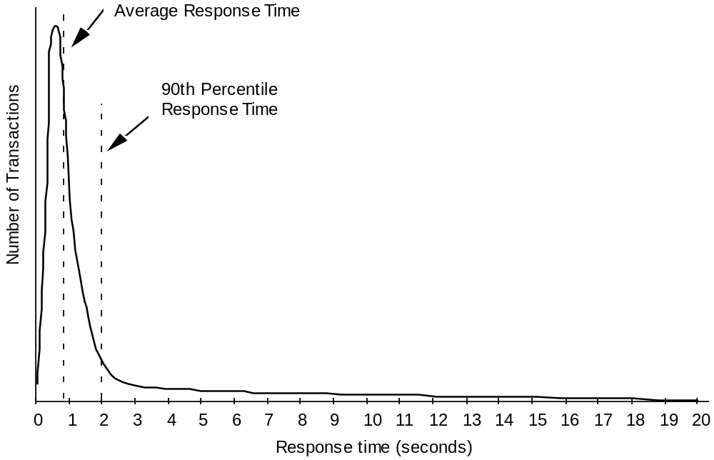
TPC-A Metric
tpsA = transactions per second, average rate over 15+ minute interval, at which 90% of txns get <= 2 second RT

Slide 60
TPC-A Price
Price
  5 year Cost of Ownership: hardware, software, maintenance
  Does not include development, comm lines, operators, power, cooling, etc.
  Strict pricing model ⇒ one of TPC’s big contributions
  List prices
  System must be orderable & commercially available
  Committed ship date

Slide 61
Differences between TPC-A and TPC-B
TPC-B is database only portion of TPC-A
  No terminals
  No think times
TPC-B reduces history capacity to 30 days
  Less disk in priced configuration
TPC-B was easier to configure and run, BUT
  Even though TPC-B was more popular with vendors,
  it did not have much credibility with customers.

Slide 62
TPC Loopholes
Pricing
  Package pricing
  Price does not include cost of five star wizards needed to get optimal performance, so performance is not what a customer could get.
Client/Server
  Offload presentation services to cheap clients, but report performance of server
Benchmark specials
  Discrete transactions
  Custom transaction monitors
  Hand coded presentation services

