Slide 1
Dynamic Sample Selection for Approximate Query Processing
Brian Babcock
Stanford University
Surajit Chaudhuri
Microsoft Research
Gautam Das
Microsoft Research

Slide 2
Why Approximation is Useful
Large data warehouses
  Gigabytes to terabytes of data
Data analysis applications
  Decision support
  Data Mining
Query characteristics:
  Access large fraction of database
  Seek to identify general patterns / trends
  Absolute precision unnecessary
    $89,000 after 5 secs vs. $89,034.57 after 2 hrs

Slide 3
Two Phases of Approximate Query Processing (AQP)
Offline pre-processing of the database
  E.g. generate histograms or random samples
  OK to use considerable space and time (hours)
Runtime query processing
  Query answers must be fast (seconds)
  Only time to access small amount of data
  E.g. extrapolate from random sample

Slide 4
AQP Example
Sales
SalesSample
Product | Amount
CPU | 1
CPU | 1
CPU | 2
CPU | 3
CPU | 4
Disk | 1
Disk | 2
Monitor | 1
Product | Amount
CPU | 1
CPU | 2
CPU | 3
Disk | 2
SELECT SUM(Amount)
FROM Sales
WHERE Product = 'CPU'
Exact Answer: 1+1+2+3+4 = 11
Approx. Answer: (1+2+3)*2= 12

Slide 5
Non-uniform Sampling
“Biased” samples often more accurate than uniform samples
All data records are not created equal
  Frequently queried values
  Extreme high and low values
  Uncommon values
Optimal bias differs from query to query
Past work: carefully select biased sample to give good answers for many queries

Slide 6
Related Work
Non-sampling-based approaches
  Online Aggregation Hellerstein, Haas, and Wang 97
  Histograms Ioannidis and Poosala 99
  Wavelets Chakrabarti, Garofalakis, Rastogi, and Shim 00
Sampling-based approaches
  AQUA project Acharya, Gibbons, and Poosala 99
  Congressional Acharya, Gibbons, and Poosala 00
  Self-Tuning Ganti, Lee, and Ramakrishnan 00
  Outliers Chaudhuri, Das, Datar, Motwani, and Narasayya 01
  Workload Chaudhuri, Das, and Narasayya 01

Slide 7
Dynamic Sample Selection
Standard Sampling
Dynamic Sample Selection
SAMPLE
DATA
DATA
SAMPLE
?
SAMPLE
?
SAMPLE
SAMPLE

Slide 8
Dynamic Sample Selection
Improved accuracy, no change to query time
  Query time is the scarce resource
  OK to use extra pre-processing, disk space
How to pick a good set of samples?
Construct many differently-biased samples
For each query, use the best sample and ignore the others
Given a query, what’s the best sample?

Slide 9
Small vs. Large Groups
Consider group-by aggregation queries.
  E.g. Total sales of CPUs in each state
  E.g. Avg sale price for each product in each state
Number of records per group may vary widely
Problem: Rare values are under-represented in uniform sample
  “California” much more common than “Alaska”
  “Alaska” only appears a few times in the sample
  Approximate answer for “Alaska” likely to be bad
In a group-by query, small groups are hard

Slide 10
Small Group Sampling
Main idea: Treat small and large groups differently
Large Groups:
Use Uniform Random Sample
Well-represented in sample
Good quality of approximation

Slide 11
Small Group Sampling
Main idea: Treat small and large groups differently
Small Groups: Use Original Data
Contain few records, by definition
Thus can be scanned very quickly

Slide 12
Small Group Sampling
Main idea: Treat small and large groups differently
Small groups are query-dependent
  Depend on grouping attributes
  Depend on selection predicates
How do we know which rows to scan to find the small groups?

Slide 13
Finding the Small Groups
Heuristic idea:
Most small groups in most queries have a
rare value for at least one grouping attribute
Small group in this query → rare value in entire DB
  Not always true (snowblower sales in California)
Summary of Small Group Sampling:
  Identify rare values during pre-processing
  Store rows with rare values in a different (small) table for each attribute: the small groups tables
  At query time, scan small groups table for each grouping attribute

Slide 14
Pre-Processing Steps
Create a table sample_all containing a uniform random sample of all data
For each attribute A in the schema:
  Identify rare values for attribute A
  Create a table smGrps_A containing all records with rare A values
  Size of smGrps_A table limited by threshold
  (2:1 ratio between sample_all and smGrps)
smGrps_A
sample_all
smGrps_B
smGrps_C
smGrps_D

Slide 15
Pre-Processing Steps
Augment rows in sample_all, smGrps_* with table membership information
  Some rows may be added to multiple tables
  One extra bitmask column: which small group tables contain this row?
  Used to avoid double-counting during query processing
DATA
smGrps_A
sample_all
smGrps_B
smGrps_C
smGrps_D

Slide 16
Answering Queries Using
Small Group Sampling
Values of attribute A
Common
Rare
Values of attribute B
sample_all
Common
smGrps_A
Rare
smGrps_B

Slide 17
Query Answering Example
Run query on small group table for each grouping attribute
Run scaled query on sample_all
Combine answers
SELECT A,B,COUNT(*) as cnt
FROM smGrps_A
WHERE C=10
GROUP BY A,B UNION ALL
SELECT A,B,COUNT(*)
FROM FACT_TBL
WHERE C=10
GROUP BY A,B
SELECT A,B,COUNT(*) as cnt
FROM smGrps_B
WHERE C=10 AND bitmask & 1 = 0
GROUP BY A,B UNION ALL
SELECT A,B,100 * COUNT(*) as cnt
FROM sample_all
WHERE C=10 AND bitmask & 3 = 0
GROUP BY A,B

Slide 18
Experimental Setup
Two data sources
  Skewed version of TPC-H benchmark database
  Real-world database: 1 month of product sales
Randomly generated queries
Compared different AQP methods
  Small Group, Uniform, Basic Congress
  Each allowed to query same number of rows
Evaluating approximate answers
  Average relative error in approximate answer across groups
  Number of groups absent from approximate answer (not present in sample)

Slide 19
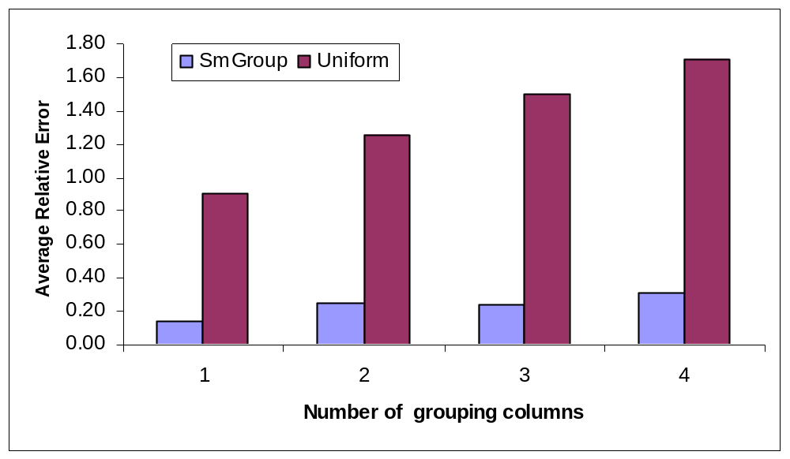
Relative Error – TPC-H

Slide 20
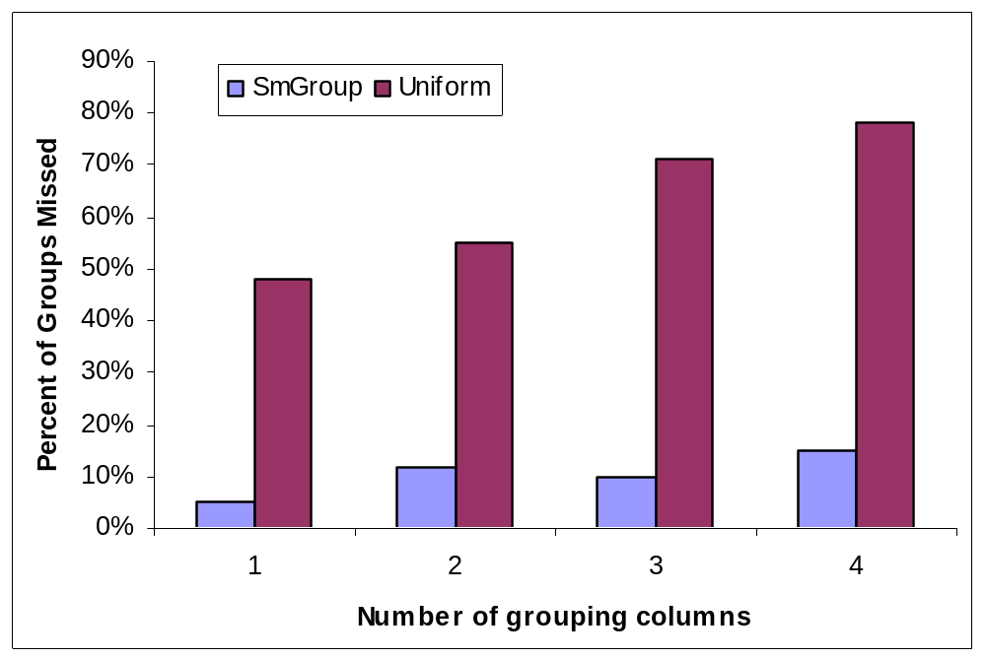
Groups Missed – TPC-H

Slide 21
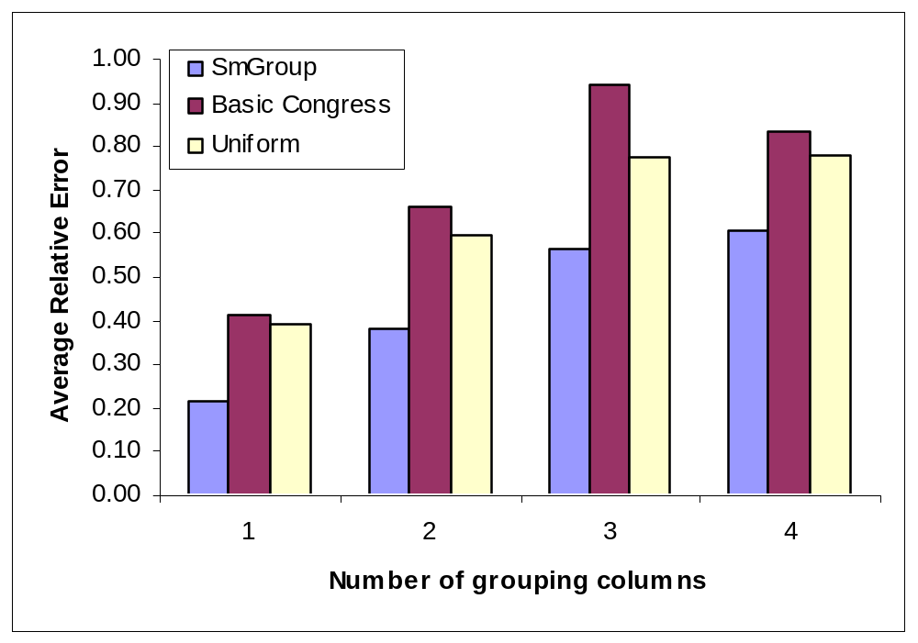
Relative Error – Sales Data

Slide 22
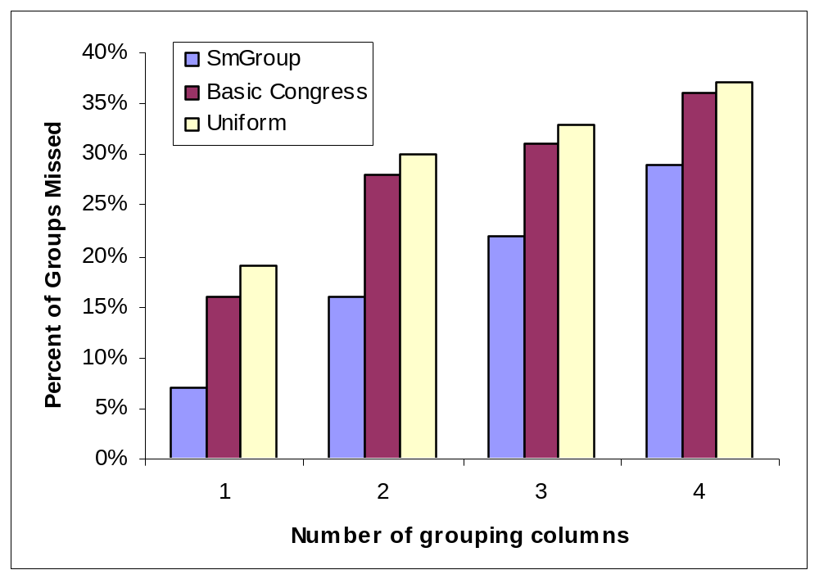
Groups Missed – Sales Data

Slide 23
Summary
Dynamic Sample Selection
  Gain accuracy at the cost of disk space.
  Non-uniform samples are good, but different ones are good for different queries.
  Build lots of different non-uniform samples.
  For each query, pick the best sample.
Small Group Sampling
  Treat large and small groups differently.
  Uniform sampling works well for large groups.
  Small groups are cheap to scan in their entirety.

