Slide 1
First steps in SparkR
Mikael Huss
SciLifeLab / Stockholm University
16 February, 2015

Slide 2
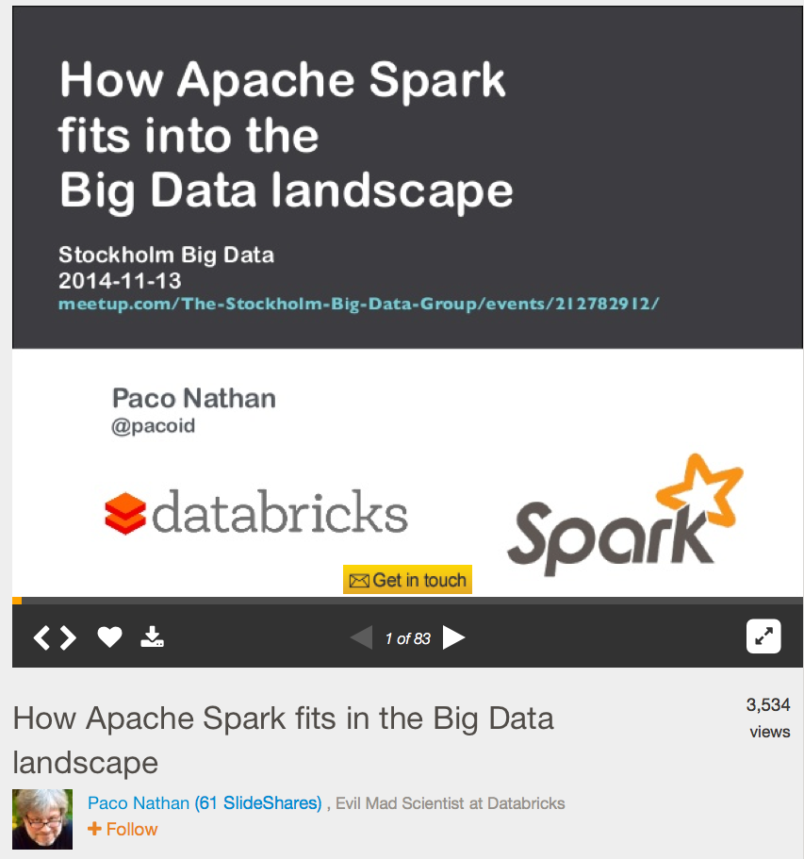
http://www.slideshare.net/pacoid/how-apache-spark-fits-in-the-big-data-landscape

Slide 3
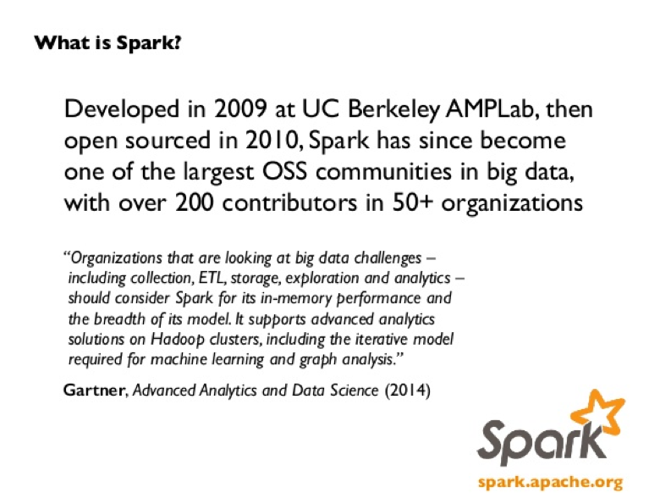

Slide 4
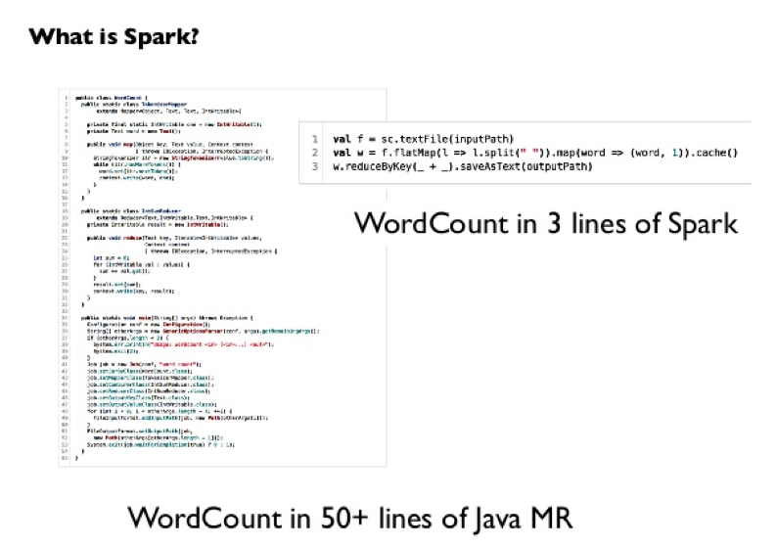

Slide 5
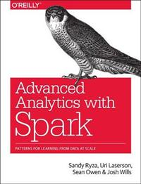
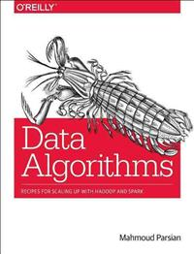
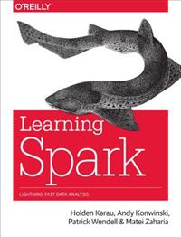
441 kr
317 kr
232 kr

Slide 6
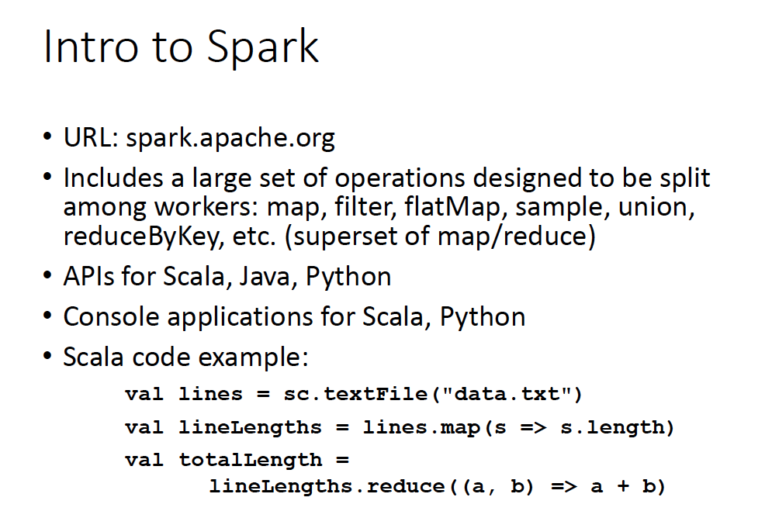
Borrowed from:
http://www.hpl.hp.com/research/systems-research/R-workshop/Sannella-talk7.pdf

Slide 7
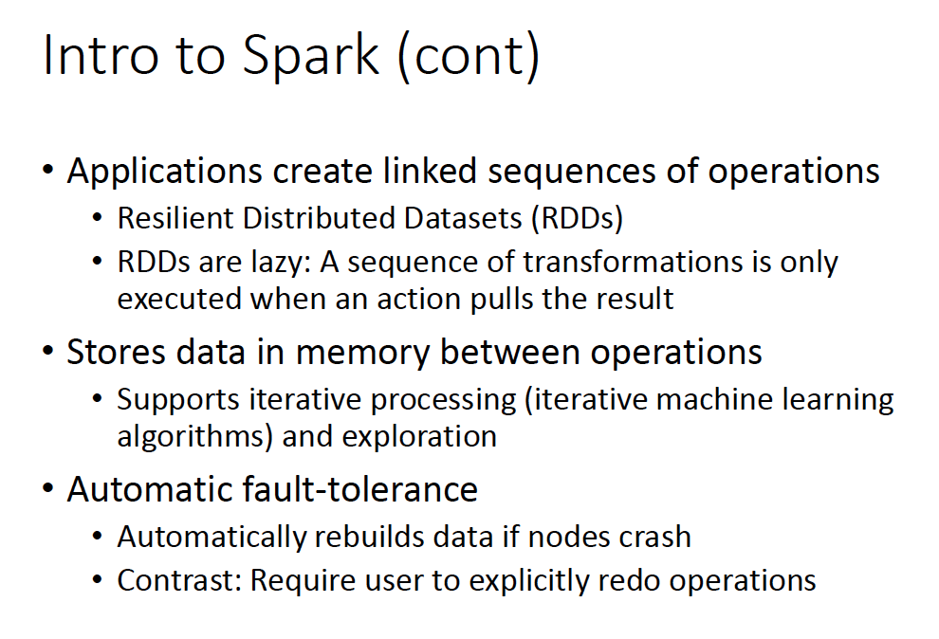
Borrowed from:
http://www.hpl.hp.com/research/systems-research/R-workshop/Sannella-talk7.pdf

Slide 8
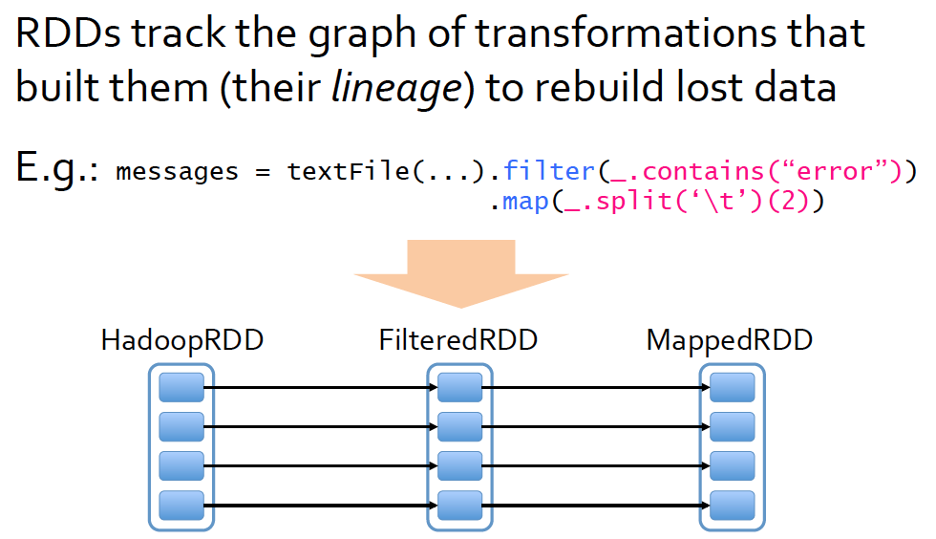
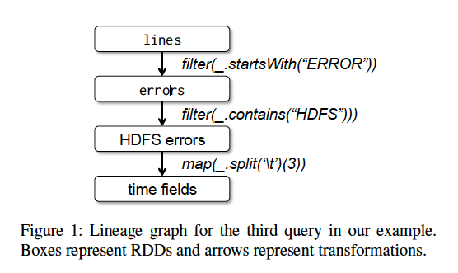
Resilient Distributed Datasets (RDDs)
Data sets have a lineage
https://www.usenix.org/sites/default/files/conference/protected-files/nsdi_zaharia.pdf
Example from original RDD paper
https://www.usenix.org/system/files/conference/nsdi12/nsdi12-final138.pdf

Slide 9
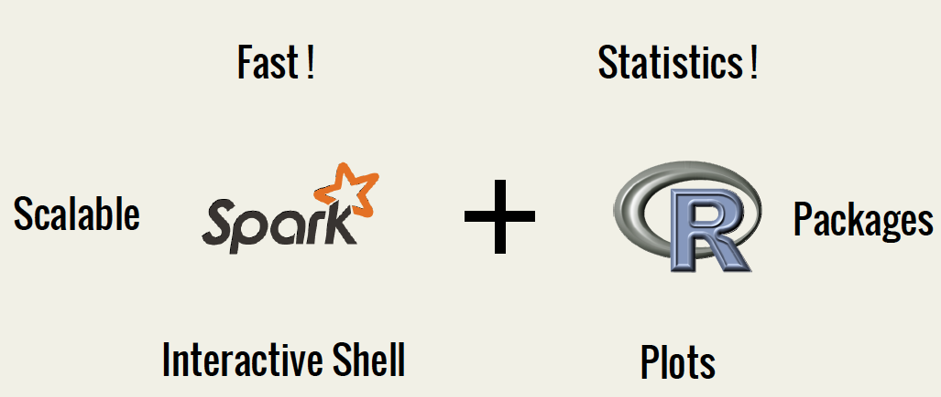
SparkR
SparkR reimplements lapply so that it works on RDDs, and implements other transformations on RDDs in R
http://files.meetup.com/3138542/SparkR-meetup.pdf
Overview by Shivaram Venkataraman & Zongheng Yang from AMPlab

Slide 10
SparkR example (on a single node)
library(SparkR)
Sys.setenv(SPARK_MEM="1g")
sc <- sparkR.init(master="local[*]") # creating a SparkContext
sc
Also check out this “AmpCamp” exercise
http://ampcamp.berkeley.edu/5/exercises/sparkr.html

Slide 11
SparkR example (on a single node)
library(SparkR)
Sys.setenv(SPARK_MEM="1g")
sc <- sparkR.init(master="local[*]") # creating a SparkContext
sc
lines <- textFile(sc=sc,path="rodarummet.txt”)
lines
take(lines, 2)
count(lines)

Slide 12
SparkR example (on a single node)
library(SparkR)
Sys.setenv(SPARK_MEM="1g")
sc <- sparkR.init(master="local[*]") # creating a SparkContext
sc
lines <- textFile(sc=sc,path="rodarummet.txt”)
lines
take(lines, 2)
count(lines)
words <- flatMap(lines, function(line){strsplit(line," ")[[1]]})
take(words,5)

Slide 13
SparkR example (on a single node)
library(SparkR)
Sys.setenv(SPARK_MEM="1g")
sc <- sparkR.init(master="local[*]") # creating a SparkContext
sc
lines <- textFile(sc=sc,path="rodarummet.txt”)
lines
take(lines, 2)
count(lines)
words <- flatMap(lines, function(line){strsplit(line," ")[[1]]})
take(words,5)
wordCount <- lapply(words, function(word){list(word,1L)})
counts<-reduceByKey(wordCount,"+",2L)
res <- collect(counts)
df <- data.frame(matrix(unlist(res), nrow=length(res),byrow=T))

Slide 14

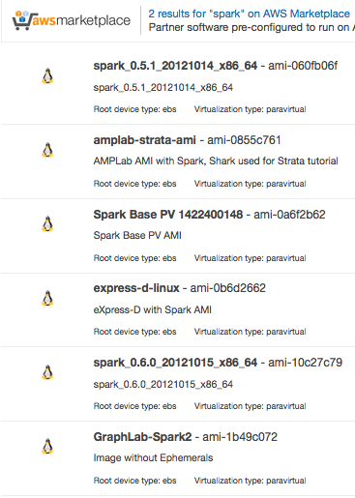
Installing SparkR
(on a single node)
All-in-one?
https://registry.hub.docker.com/u/beniyama/sparkr-docker/
Installing Spark first
Docker (https://github.com/amplab/docker-scripts)
Amazon AMIs (note: US East is the region you want)
But really, all you need to do is to download a binary distribution

Slide 15
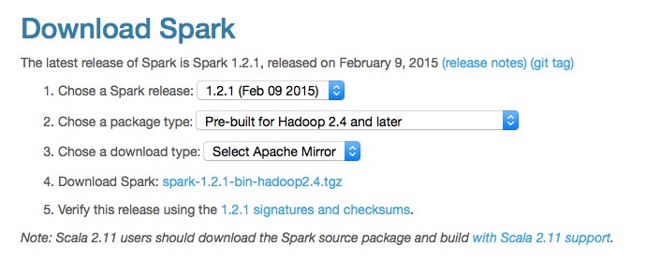
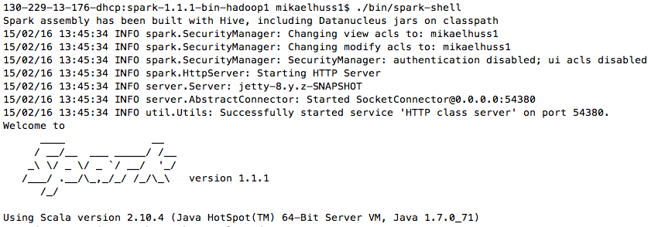
Installing SparkR
(on a single node)
http://spark.apache.org/downloads.html
After downloading, you should be able to simply run spark-shell

Slide 16
Installing SparkR
(on a single node)
Now we have Spark itself – what about the SparkR part?
Need to install the rJava package. Try:
install.packages(“rJava”)
Doesn’t work? If you are on Ubuntu, try:
apt-get install r-cran-rjava
Not on Ubuntu/still doesn’t work? (I feel your pain)
Fiddle around with R CMD javareconf and look for StackOverflow questions such as:
http://stackoverflow.com/questions/24624097/unable-to-install-rjava-in-centos-r
Also:
http://www.rforge.net/rJava/

Slide 17
Installing SparkR
(on a single node)
Assuming you have successfully installed rJava:
library(devtools)
install_github("amplab-extras/SparkR-pkg", subdir="pkg")
… and you should be ready to go with e g the word count example shown earlier!

Slide 18
Installing SparkR
(on multiple nodes)
On Amazon EC2
https://github.com/amplab-extras/SparkR-pkg/wiki/SparkR-on-EC2
Note: not super easy to install SparkR afterwards! I found these notes helpful:
https://gist.github.com/shivaram/9240335
Standalone mode
Install Spark separately on each node
http://spark.apache.org/docs/latest/spark-standalone.html

Slide 19
That’s it…
A lot more detail on how to use Spark:
http://training.databricks.com/workshop/itas_workshop.pdf
(nothing about SparkR though …)

