Slide 1


Slide 2
Chapter 29
Overview of
Data Warehousing and OLAP

Slide 3
Chapter 29 Outline
Purpose of Data Warehousing
Introduction, Definitions, and Terminology
Comparison with Traditional Databases
Characteristics of Data Warehouses
Classification of Data Warehouses
Multi-dimensional Schemas
Building a Data Warehouse
Functionality of a Data Warehouse
Warehouse vs. Data Views
Implementation difficulties and open issues

Slide 4
Purpose of Data Warehousing
Traditional databases are not optimized for data access only they have to balance the requirement of data access with the need to ensure integrity of data.
Most of the times the data warehouse users need only read access but, need the access to be fast over a large volume of data.
Most of the data required for data warehouse analysis comes from multiple databases and these analysis are recurrent and predictable to be able to design specific software to meet the requirements.
There is a great need for tools that provide decision makers with information to make decisions quickly and reliably based on historical data.
The above functionality is achieved by Data Warehousing and Online analytical processing (OLAP)

Slide 5
Introduction, Definitions, and Terminology
W. H Inmon characterized a data warehouse as:
  “A subject-oriented, integrated, nonvolatile, time-variant collection of data in support of management’s decisions.”

Slide 6
Introduction, Definitions, and Terminology
Data warehouses have the distinguishing characteristic that they are mainly intended for decision support applications.
  Traditional databases are transactional.
Applications that data warehouse supports are:
  OLAP (Online Analytical Processing) is a term used to describe the analysis of complex data from the data warehouse.
  DSS (Decision Support Systems) also known as EIS (Executive Information Systems) supports organization’s leading decision makers for making complex and important decisions.
  Data Mining is used for knowledge discovery, the process of searching data for unanticipated new knowledge.

Slide 7
Conceptual Structure of Data Warehouse
Data Warehouse processing involves
  Cleaning and reformatting of data
  OLAP
  Data Mining

Slide 8
Comparison with Traditional Databases
Data Warehouses are mainly optimized for appropriate data access.
  Traditional databases are transactional and are optimized for both access mechanisms and integrity assurance measures.
Data warehouses emphasize more on historical data as their main purpose is to support time-series and trend analysis.
Compared with transactional databases, data warehouses are nonvolatile.
In transactional databases transaction is the mechanism change to the database. By contrast information in data warehouse is relatively coarse grained and refresh policy is carefully chosen, usually incremental.

Slide 9
Characteristics of Data Warehouses
Multidimensional conceptual view
Generic dimensionality
Unlimited dimensions and aggregation levels
Unrestricted cross-dimensional operations
Dynamic sparse matrix handling
Client-server architecture
Multi-user support
Accessibility
Transparency
Intuitive data manipulation
Consistent reporting performance
Flexible reporting

Slide 10
Classification of Data Warehouses
Generally, Data Warehouses are an order of magnitude larger than the source databases.
The sheer volume of data is an issue, based on which Data Warehouses could be classified as follows.
  Enterprise-wide data warehouses
    They are huge projects requiring massive investment of time and resources.
  Virtual data warehouses
    They provide views of operational databases that are materialized for efficient access.
  Data marts
    These are generally targeted to a subset of organization, such as a department, and are more tightly focused.

Slide 11
Data Modeling for Data Warehouses
Traditional Databases generally deal with two-dimensional data (similar to a spread sheet).
  However, querying performance in a multi-dimensional data storage model is much more efficient.
Data warehouses can take advantage of this feature as generally these are
  Non volatile
  The degree of predictability of the analysis that will be performed on them is high.

Slide 12
Data Modeling for Data Warehouses
Example of Two- Dimensional vs. Multi- Dimensional

Slide 13
Data Modeling for Data Warehouses
Advantages of a multi-dimensional model
  Multi-dimensional models lend themselves readily to hierarchical views in what is known as roll-up display and drill-down display.
  The data can be directly queried in any combination of dimensions, bypassing complex database queries.

Slide 14
Multi-dimensional Schemas
Multi-dimensional schemas are specified using:
  Dimension table
    It consists of tuples of attributes of the dimension.
  Fact table
    Each tuple is a recorded fact. This fact contains some measured or observed variable (s) and identifies it with pointers to dimension tables. The fact table contains the data, and the dimensions to identify each tuple in the data.

Slide 15
Multi-dimensional Schemas
Two common multi-dimensional schemas are
  Star schema:
    Consists of a fact table with a single table for each dimension
  Snowflake Schema:
    It is a variation of star schema, in which the dimensional tables from a star schema are organized into a hierarchy by normalizing them.

Slide 16
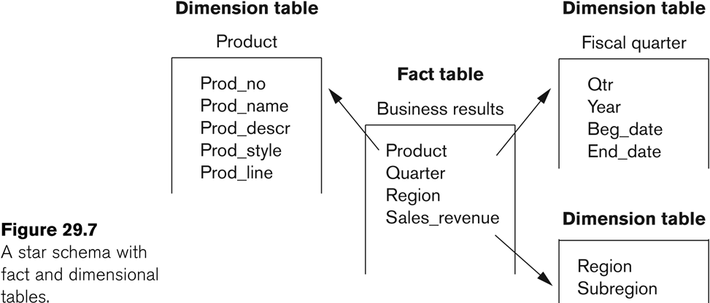
Multi-dimensional Schemas
Star schema:
  Consists of a fact table with a single table for each dimension.

Slide 17
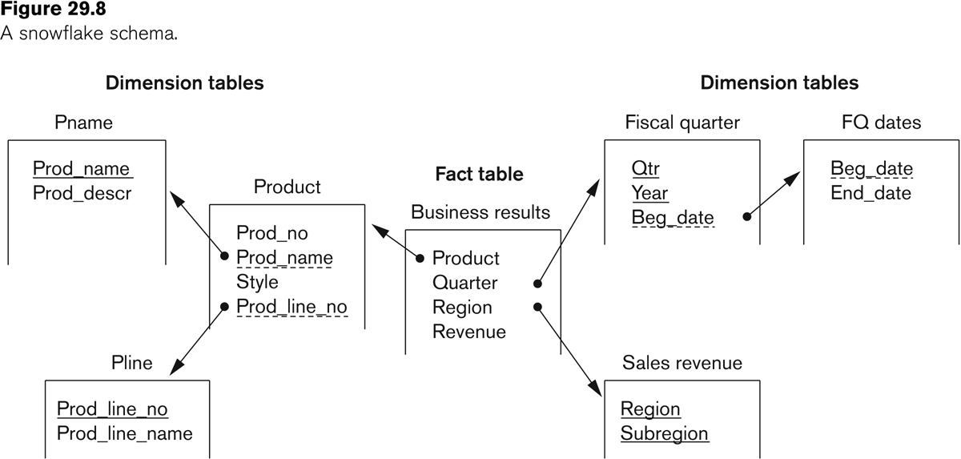
Multi-dimensional Schemas
Snowflake Schema:
  It is a variation of star schema, in which the dimensional tables from a star schema are organized into a hierarchy by normalizing them.

Slide 18
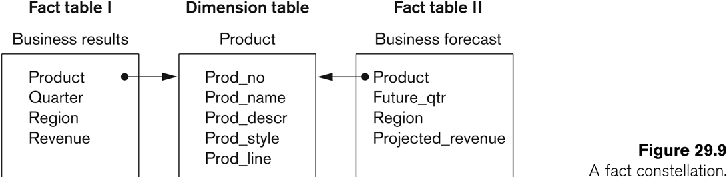
Multi-dimensional Schemas
Fact Constellation
  Fact constellation is a set of tables that share some dimension tables. However, fact constellations limit the possible queries for the warehouse.

Slide 19
Multi-dimensional Schemas
Indexing
  Data warehouse also utilizes indexing to support high performance access.
  A technique called bitmap indexing constructs a bit vector for each value in domain being indexed.
  Indexing works very well for domains of low cardinality.

Slide 20
Building A Data Warehouse
The builders of Data warehouse should take a broad view of the anticipated use of the warehouse.
  The design should support ad-hoc querying
  An appropriate schema should be chosen that reflects the anticipated usage.

Slide 21
Building A Data Warehouse
The Design of a Data Warehouse involves following steps.
  Acquisition of data for the warehouse.
  Ensuring that Data Storage meets the query requirements efficiently.
  Giving full consideration to the environment in which the data warehouse resides.

Slide 22
Building A Data Warehouse
Acquisition of data for the warehouse
  The data must be extracted from multiple, heterogeneous sources.
  Data must be formatted for consistency within the warehouse.
  The data must be cleaned to ensure validity.
    Difficult to automate cleaning process.
    Back flushing, upgrading the data with cleaned data.

Slide 23
Building A Data Warehouse
Acquisition of data for the warehouse (contd.)
  The data must be fitted into the data model of the warehouse.
  The data must be loaded into the warehouse.
    Proper design for refresh policy should be considered.

Slide 24
Building A Data Warehouse
Storing the data according to the data model of the warehouse
Creating and maintaining required data structures
Creating and maintaining appropriate access paths
Providing for time-variant data as new data are added
Supporting the updating of warehouse data.
Refreshing the data
Purging data

Slide 25
Building A Data Warehouse
Usage projections
The fit of the data model
Characteristics of available resources
Design of the metadata component
Modular component design
Design for manageability and change
Considerations of distributed and parallel architecture
  Distributed vs. federated warehouses

Slide 26
Functionality of a Data Warehouse
Functionality that can be expected:
  Roll-up: Data is summarized with increasing generalization
  Drill-Down: Increasing levels of detail are revealed
  Pivot: Cross tabulation is performed
  Slice and dice: Performing projection operations on the dimensions.
  Sorting: Data is sorted by ordinal value.
  Selection: Data is available by value or range.
  Derived attributes: Attributes are computed by operations on stored derived values.

Slide 27
Warehouse vs. Data Views
Views and data warehouses are alike in that they both have read-only extracts from the databases.
However, data warehouses are different from views in the following ways:
  Data Warehouses exist as persistent storage instead of being materialized on demand.
  Data Warehouses are not usually relational, but rather multi-dimensional.
  Data Warehouses can be indexed for optimization.
  Data Warehouses provide specific support of functionality.
  Data Warehouses deals huge volumes of data that is contained generally in more than one database.

Slide 28
Difficulties of implementing Data Warehouses
Lead time is huge in building a data warehouse
  Potentially it takes years to build and efficiently maintain a data warehouse.
Both quality and consistency of data are major concerns.
Revising the usage projections regularly to meet the current requirements.
  The data warehouse should be designed to accommodate addition and attrition of data sources without major redesign
Administration of data warehouse would require far broader skills than are needed for a traditional database.

Slide 29
Open Issues in Data Warehousing
Data cleaning, indexing, partitioning, and views could be given new attention with perspective to data warehousing.
Automation of
  data acquisition
  data quality management
  selection and construction of access paths and structures
  self-maintainability
  functionality and performance optimization
Incorporating of domain and business rules appropriately into the warehouse creation and maintenance process more intelligently.

Slide 30
Recap
Purpose of Data Warehousing
Introduction, Definitions, and Terminology
Comparison with Traditional Databases
Characteristics of data Warehouses
Classification of Data Warehouses
Multi-dimensional Schemas
Building A Data Warehouse
Functionality of a Data Warehouse
Warehouse vs. Data Views
Implementation difficulties and open issues

