Slide 1
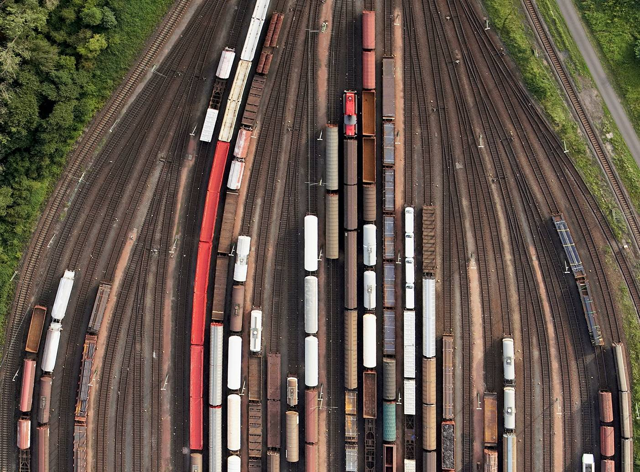



CHAPTER 10: DATA WAREHOUSING & CACHING
PRINCIPLES OF
DATA INTEGRATION
ANHAI DOAN ALON HALEVY ZACHARY IVES

Slide 2
Data Warehousing and Materialization
We have mostly focused on techniques for virtual data integration (see Ch. 1)
  Queries are composed with mappings on the fly and data is fetched on demand
  This represents one extreme point
In this chapter, we consider cases where data is transformed and materialized “in advance” of the queries
  The main scenario: the data warehouse

Slide 3
What Is a Data Warehouse?
In many organizations, we want a central “store” of all of our entities, concepts, metadata, and historical information
  For doing data validation, complex mining, analysis, prediction, …
  This is the data warehouse
To this point we’ve focused on scenarios where the data “lives” in the sources – here we may have a “master” version (and archival version) in a central database
  For performance reasons, availability reasons, archival reasons, …

Slide 4
In the Rest of this Chapter…
The data warehouse as the master data instance
Data warehouse architectures, design, loading
Data exchange: declarative data warehousing
Hybrid models: caching and partial materialization
Querying externally archived data

Slide 5
Outline
The data warehouse
  Motivation: Master data management
  Physical design
  Extract/transform/load
Data exchange
Caching & partial materialization
Operating on external data

Slide 6
Master Data Management
One of the “modern” uses of the data warehouse is not only to support analytics but to serve as a reference to all of the entities in the organization
  A cleaned, validated repository of what we know
  … which can be linked to by data sources
  … which may help with data cleaning
  … and which may be the basis of data governance (processes by which data is created and modified in a systematic way, e.g., to comply with gov’t regulations)
There is an emerging field called master data management out the process of creating these

Slide 7
Data Warehouse Architecture
At the top – a centralized database
  Generally configured for queries and appends – not transactions
  Many indices, materialized views, etc.
Data is loaded and periodically updated via Extract/Transform/Load (ETL) tools
Data Warehouse
ETL pipeline
outputs
ETL
ETL
ETL
ETL
ETL
RDBMS
1
RDBMS
2
HTML
1
XML
1

Slide 8
ETL Tools
ETL tools are the equivalent of schema mappings in virtual integration, but are more powerful
Arbitrary pieces of code to take data from a source, convert it into data for the warehouse:
  import filters – read and convert from data sources
  data transformations – join, aggregate, filter, convert data
  de-duplication – finds multiple records referring to the same entity, merges them
  profiling – builds tables, histograms, etc. to summarize data
  quality management – test against master values, known business rules, constraints, etc.

Slide 9

Example ETL Tool Chain
Item
Customer
records
records
Split
Filter
Filter
Filter
Group by
Date
-
invalid
Join
invalid
non
-
customer
time
match
Invoice
Customer
line items
balance
Invalid
Invalid
Invalid
dates
/
times
items
customers
This is an example for e-commerce loading
Note multiple stages of filtering (using selection or join-like operations), logging bad records, before we group and load

Slide 10
Basic Data Warehouse – Summary
Two aspects:
  A central DBMS optimized for appends and querying
    The “master data” instance
    Or the instance for doing mining, analytics, and prediction
  A set of procedural ETL “pipelines” to fetch, transform, filter, clean, and load data
    Often these tools are more expressive than standard conjunctive queries (as in Chapters 2-3)
    … But not always!
    This raises a question – can we do warehousing with declarative mappings?

Slide 11
Outline
The data warehouse
Data exchange
Caching & partial materialization
Operating on external data

Slide 12
Data Exchange
Intuitively, a declarative setup for data warehousing
  Declarative schema mappings as in Ch. 2-3
  Materialized database as in the previous section
Also allow for unknown values when we map from source to target (warehouse) instance
  If we know a professor teaches a student, then there must exist a course C that the student took and the professor taught – but we may not know which…

Slide 13
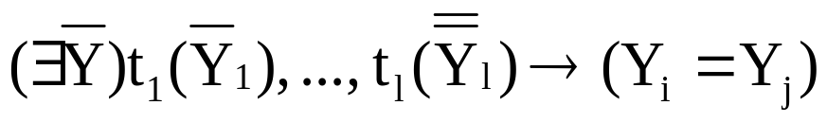
Data Exchange Formulation
A data exchange setting (S,T,M,C_{T}) has:
  S, source schema representing all of the source tables jointly
  T, target schema
  A set of mappings or tuple-generating dependencies
    relating S and T
  A set of constraints (equality-generating dependencies)

Slide 14
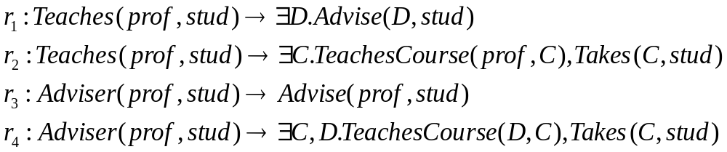
An Example
Source S has
  Teaches(prof, student)
  Adviser(adviser, student)
Target T has
  Advise(adviser, student)
  TeachesCourse(prof, course)
  Takes(course, student)
existential variables represent unknowns

Slide 15
The Data Exchange Solution
The goal of data exchange is to compute an instance of the target schema, given a data exchange setting D = (S,T,M,C_{T}) and an instance I(S)
An instance J of Schema T is a data exchange solution for D and I if
  the pair (I,J) satisfies schema mapping M, and
  J satisfies constraints C_{T}

Slide 16
Back to the Example, Now with Data
Instance I(S) has
  Teaches
  Adviser
Instance J(T) has
  Advise
  TeachesCourse
  Takes
prof | student
Ann | Bob
Chloe | David
adviser | student
Ellen | Bob
Felicia | David
prof | course
Ann | C₁
Chloe | C₂
adviser | student
Ellen | Bob
Felicia | David
course | student
C₁ | Bob
C₂ | David
variables or labeled nulls
represent unknown values

Slide 17
This Is also a Solution
Instance I(S) has
  Teaches
  Adviser
Instance J(T) has
  Advise
  TeachesCourse
  Takes
prof | student
Ann | Bob
Chloe | David
adviser | student
Ellen | Bob
Felicia | David
prof | course
Ann | C₁
Chloe | C₁
adviser | student
Ellen | Bob
Felicia | David
course | student
C₁ | Bob
C₁ | David
this time the labeled
nulls are all the same!

Slide 18
Universal Solutions
Intuitively, the first solution should be better than the second
  The first solution uses the same variable for the course taught by Ann and by Chloe – they are the same course
  But this was not specified in the original schema!
We formalize that through the notion of the universal solution, which must not lose any information

Slide 19
Formalizing the Universal Solution
First we define instance homomorphism:
  Let J₁, J₂ be two instances of schema T
  A mapping h: J₁ → J₂ is a homomorphism from J₁ to J₂ if
    h(c) = c for every c ∈ C,
    for every tuple R(a₁,…,a_{n}) ∈ J₁ the tuple R(h(a₁),…,h(a_{n})) ∈ J₂
  J₁, J₂ are homomorphically equivalent if there are homomorphisms h: J₁ → J₂ and h’: J₂ → J₁
Def: Universal solution for data exchange setting
D = (S,T,M,C_{T}), where I is an instance of S.
  A data exchange solution J for D and I is a universal solution if, for every other data exchange solution J’ for D and I, there exists a homomorphism h: J → J’

Slide 20
Computing Universal Solutions
The standard process is to use a procedure called the chase
Informally:
  Consider every formula r of M in turn:
    If there is a variable substitution for the left-hand side (lhs) of r where the right-hand side (rhs) is not in the solution – add it
    If we create a new tuple, for every existential variable in the rhs, substitute a new fresh variable
See Chapter 10 Algorithm 10 for full pseudocode

Slide 21
Core Universal Solutions
Universal solutions may be of arbitrary size
The core universal solution is the minimal universal solution

Slide 22
Data Exchange and Querying
As with the data warehouse, all queries are directly posed over the target database – no reformulation necessary
However, we typically assume certain answers semantics
  To get the certain answers (which are the same as in the virtual integration setting with GLAV/TGD mappings) – compute the query answers and then drop any tuples with labeled nulls (variables)

Slide 23
Data Exchange vs. Warehousing
From an external perspective, exchange and warehousing are essentially equivalent
But there are different trade-offs in procedural vs. declarative mappings
  Procedural – more expressive
  Declarative – easier to reason about, compose, invert, create matieralized views for, etc. (see Chapter 6)

Slide 24
Outline
The data warehouse
Data exchange
Caching & partial materialization
Operating on external data

Slide 25
The Spectrum of Materialization
Virtual integration
(EII)
Data exchange /
data warehouse
sources materialized
all mediated relations
materialized
caching or partial materialization –
some views materialized
Many real EII systems compute and maintain materialized views, or cache results
  A “hybrid” point between the fully virtual and fully materialized approaches

Slide 26
Possible Techniques for Choosing What to Materialize
Cache results of prior queries
  Take the results of each query, materialize them
  Use answering queries using views to reuse
  Expire using time-to-live… May not always be fresh!
Administrator-selected views
  Someone manually specifies views to compute and maintain, as with a relational DBMS
  System automatically maintains
Automatic view selection
  Using query workload, update frequencies – a view materialization wizard chooses what to materialize

Slide 27
Outline
The data warehouse
Data exchange
Caching & partial materialization
Operating on external data

Slide 28
Many “Integration-Like” Scenarios over Historical Data
Many Web scenarios where we have large logs of data accesses, created by the server
Goal: put these together and query them!
Looks like a very simple data integration scenario – external data, but single schema
A common approach: use programming environments like MapReduce (or SQL layers above) to query the data on a cluster
  MapReduce reliably runs large jobs across 100s or 1000s of “shared nothing” nodes in a cluster

Slide 29
MapReduce Basics
MapReduce is essentially a template for writing distributed programs – corresponding to a single SQL SELECT..FROM..WHERE..GROUP BY..HAVING block with user-defined functions
The MapReduce runtime calls a set of functions:
  map is given a tuple, outputs 0 or more tuples in response
    roughly like the WHERE clause
  shuffle is a stage for doing sort-based grouping on a key (specified by the map)
  reduce is an aggregate function called over the set of tuples with the same grouping key

Slide 30








MapReduce Dataflow “Template”: Tuples → Map “worker” → Shuffle → Reduce “worker”
emit aggregate results
emit tuples
Reduce
Worker
Map
Worker
Reduce
Worker
Map
Worker
Reduce
Worker
Map
Worker
Reduce
Worker
Map
Worker
Reduce
Worker

Slide 31
MapReduce as ETL
Some people use MapReduce to take data, transform it, and load it into a warehouse
… which is basically what ETL tools do!
The dividing line between DBMSs, EII, MapReduce is blurring as of the development of this book
  SQL → MapReduce
  MapReduce over SQL engines
  Shared-nothing DBMSs
  NoSQL

Slide 32
Warehousing & Materialization Wrap-up
There are benefits to centralizing & materializing data
  Performance, especially for analytics / mining
  Archival
  Standardization / canonicalization
Data warehouses typically use procedural ETL tools to extract, transform, load (and clean) data
Data exchange replaces ETL with declarative mappings (where feasible)
Hybrid schemes exist for partial materialization
Increasingly we are integrating via MapReduce and its cousins

