Slide 1
Data-intensive Computing Systems
Introduction to MapReduce and Hadoop
Shivnath Babu

Slide 2
Word Count over a Given Set of Web Pages
  see 1
  bob 1
  throw 1
  see 1
  spot 1
  run 1
  bob 1
  run 1
  see 2
  spot 1
  throw 1
  see bob throw
  see spot run
Can we do word count in parallel?

Slide 3
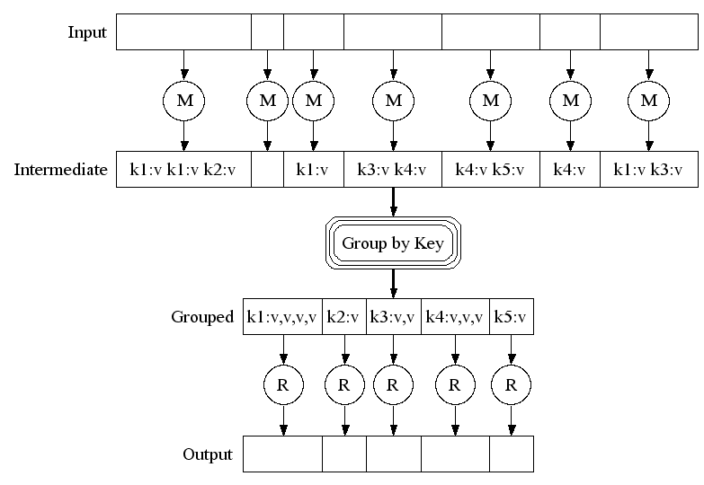
The MapReduce Framework (pioneered by Google)

Slide 4
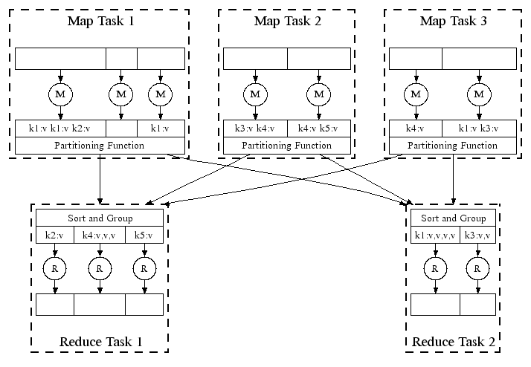
Automatic Parallel Execution in MapReduce (Google)
Handles failures automatically, e.g., restarts tasks if a node fails; runs multiples copies of the same task to avoid a slow task slowing down the whole job

Slide 5
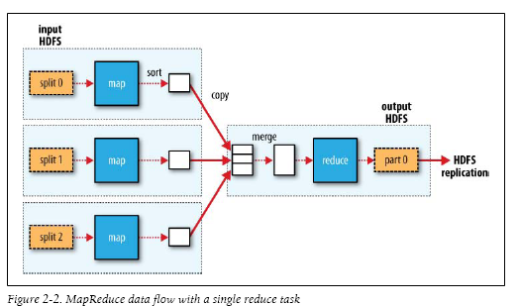
MapReduce in Hadoop (1)

Slide 6
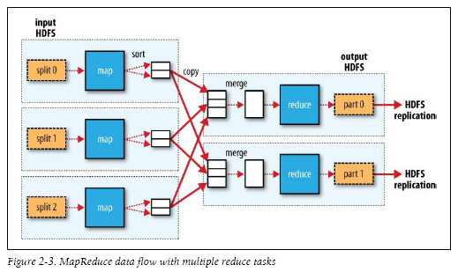
MapReduce in Hadoop (2)

Slide 7
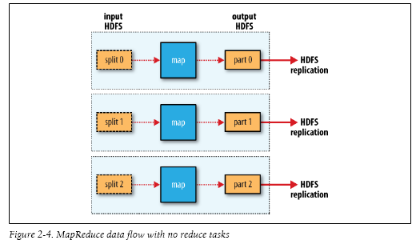
MapReduce in Hadoop (3)

Slide 8
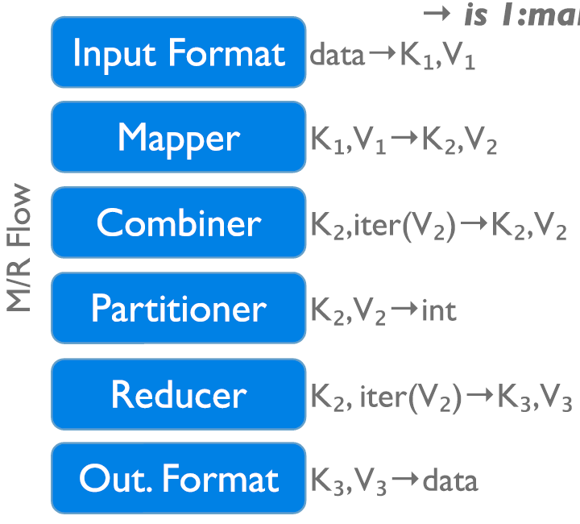
Data Flow in a MapReduce Program in Hadoop
→ 1:many
InputFormat
Map function
Partitioner
Sorting & Merging
Combiner
Shuffling
Merging
Reduce function
OutputFormat

Slide 9
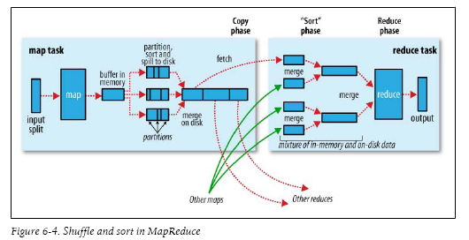

Slide 10
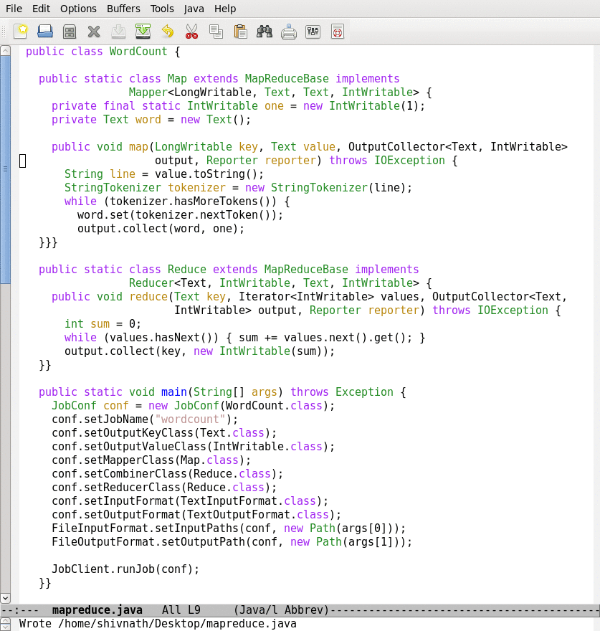
Lifecycle of a MapReduce Job
Map function
Reduce function
Run this program as a
MapReduce job

Slide 11
Lifecycle of a MapReduce Job
Map function
Reduce function
Run this program as a
MapReduce job

Slide 12
Lifecycle of a MapReduce Job
Time
Input
Splits
Map
Wave 1
Map
Wave 2
Reduce
Wave 1
Reduce
Wave 2
How are the number of splits, number of map and reduce
tasks, memory allocation to tasks, etc., determined?
Notes:
Industry wide it is recognized that to manage the complexity of today’s systems, we need to make systems self-managing. IBM’s autonomic computing, Microsoft’s DSI, and Intel’s proactive computing are some of the major efforts in this direction.

Slide 13
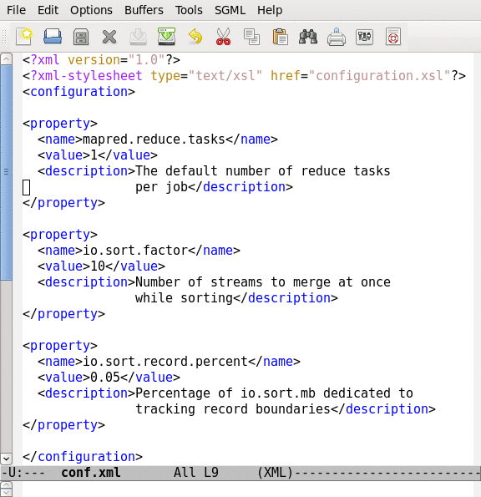
Job Configuration Parameters
190+ parameters in Hadoop
Set manually or defaults are used

Slide 14
How to sort data using Hadoop?

Slide 15
Let us look at a complete example MapReduce program in Hadoop

