Slide 1
Pig, a high level data processing system on Hadoop

Slide 2
Is MapReduce not Good Enough?
Restricted programming model
  Only two phases
  Job chain for long data flow
Too many lines of code even for simple logic
  How many lines do you have for word count?
  Programmers are responsible for this

Slide 3
Pig to the Rescue
High level dataflow language (Pig Latin)
  Much simpler than Java
  Simplifies the data processing
Puts the operations at the apropriate phases
Chains multiple MR jobs

Slide 4
How Pig is used in the Industry
At Yahoo, 70% MapReduce jobs are written in Pig
Used to
  Process web logs
  Build user behavior models
  Process images
  Data mining
Also used by Twitter, LinkedIn, eBay, AOL, ...

Slide 5
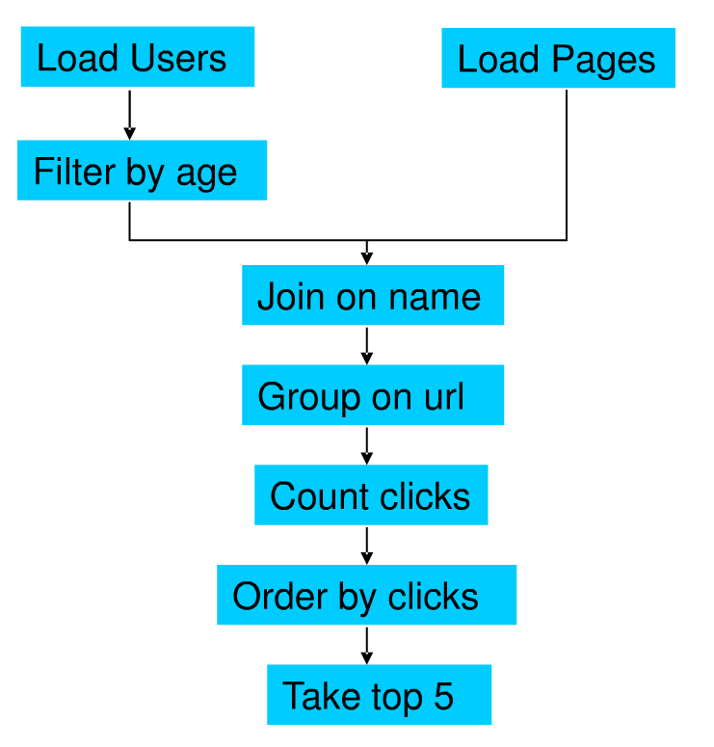
Motivation by Example
Suppose we have user data in one file, website data in another file.
We need to find the top 5 most visited pages by users aged 18-25

Slide 6

In MapReduce

Slide 7
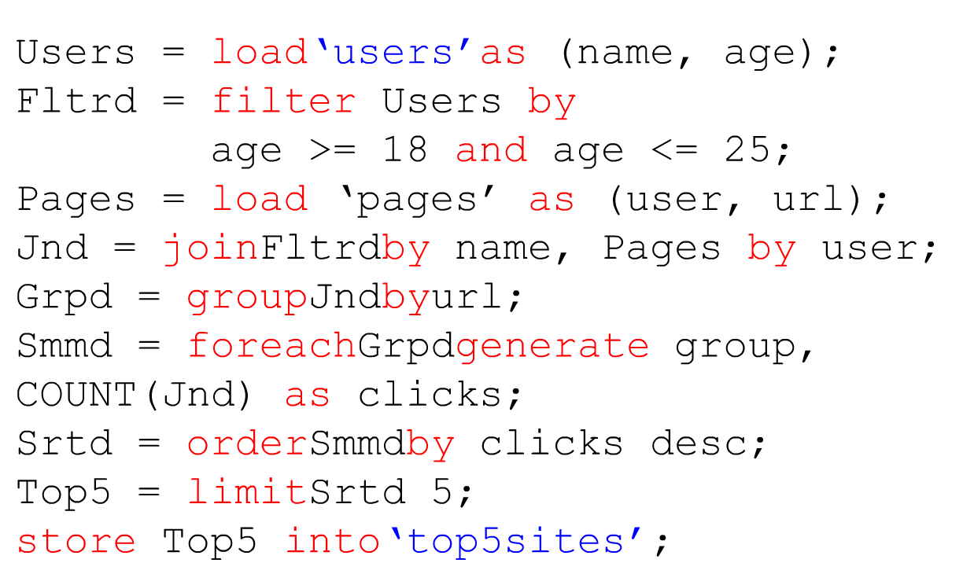
In Pig Latin

Slide 8
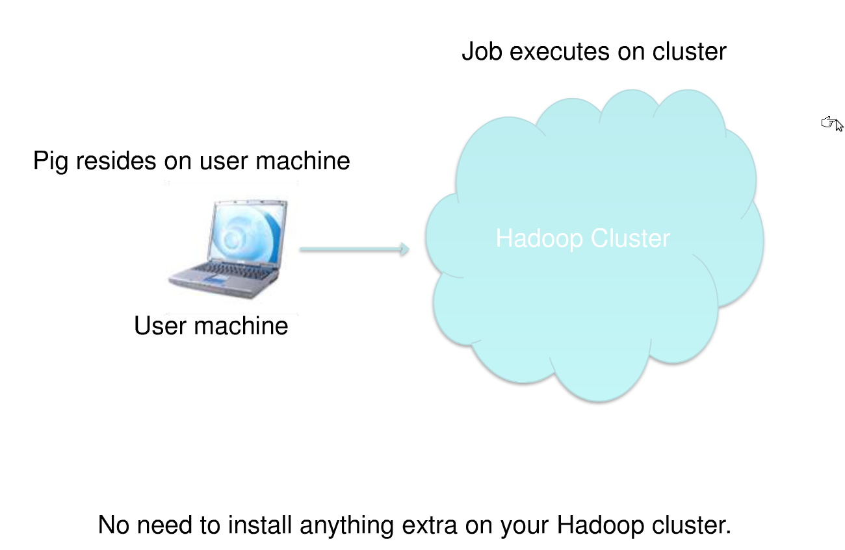
Pig runs over Hadoop

Slide 9
Wait a minute
How to map the data to records
  By default, one line → one record
  User can customize the loading process
How to identify attributes and map them to the schema
  Delimiter to separate different attributes
  By default, delimiter is tab. Customizable.

Slide 10
MapReduce Vs. Pig cont.
Join in MapReduce
  Various algorithms. None of them are easy to implement in MapReduce
  Multi-way join is more complicated
  Hard to integrate into SPJA workflow

Slide 11
MapReduce Vs. Pig cont.
Join in Pig
  Various algorithms are already available.
  Some of them are generic to support multi-way join
  No need to consider integration into SPJA workflow. Pig does that for you!
  A = LOAD 'input/join/A';
B = LOAD 'input/join/B';
C = JOIN A BY $0, B BY $1;
DUMP C;

Slide 12
Pig Latin
Data flow language
  Users specify a sequence of operations to process data
  More control on the process, compared with declarative language
Various data types are supported
Schema is supported
User-defined functions are supported

Slide 13
Statement
A statement represents an operation, or a stage in the data flow
Usually a variable is used to represent the result of the statement
Not limited to data processing operations, but also contains filesystem operations

Slide 14
Schema
User can optionally define the schema of the input data
Once the schema of the source data is given, the schema of the intermediate relation will be induced by Pig

Slide 15
Schema cont.
Why schema?
  Scripts are more readable (by alias)
  Help system validate the input
Similar to Database?
  Yes. But schema here is optional
  Schema is not fixed for a particular dataset, but changable

Slide 16
Schema cont.
Schema 1
  A = LOAD 'input/A' as (name:chararray, age:int);
  B = FILTER A BY age != 20;
Schema 2
  A = LOAD 'input/A' as (name:chararray, age:chararray);
  B = FILTER A BY age != '20';
No Schema
  A = LOAD 'input/A' ;
  B = FILTER A BY A.$1 != '20';

Slide 17
Data Types
Every attribute can always be interpreted as a bytearray, without further type definition
Simple data types
  For each attribute
  Defined by user in the schema
  Int, double, chararray ...
Complex data types
  Usually contructed by relational operations
  Tuple, bag, map

Slide 18
Data Types cont.
Type casting
  Pig will try to cast data types when type inconsistency is seen.
  Warning will be thrown if casting fails. Process still goes on
Validation
  Null will replace the inconvertable data type in type casting
  User can tell a corrupted record by detecting whether a particular attribute is null

Slide 19
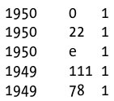
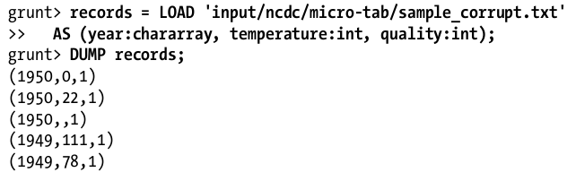

Date Types cont.

Slide 20
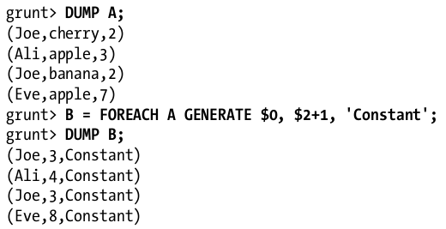
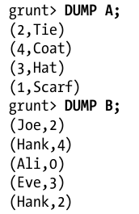
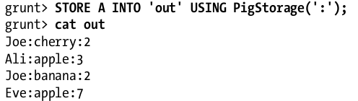
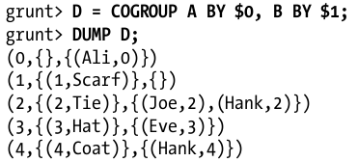
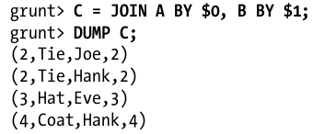
Operators
Relational Operators
  Represent an operation that will be added to the logical plan
  LOAD, STORE, FILTER, JOIN, FOREACH...GENERATE

Slide 21

Operators
Diagnostic Operators
  Show the status/metadata of the relations
  Used for debugging
  Will not be integrated into execution plan
  DESCRIBE, EXPLAIN, ILLUSTRATE.

Slide 22
Functions
Eval Functions
  Record transformation
Filter Functions
  Test whether a record satisfies particular predicate
Comparison Functions
  Impose ordering between two records. Used by ORDER operation
Load Functions
  Specify how to load data into relations
Store Functions
  Specify how to store relations to external storage

Slide 23
Functions
Built-in Functions
  Hard-coded routines offered by Pig.
User Defined Function (UDF)
  Supports customized functionalities
  Piggy Bank, a warehouse for UDFs

Slide 24
View of Pig from inside

Slide 25
Pig Execution Modes
Local mode
  Launch single JVM
  Access local file system
  No MR job running
Hadoop mode
  Execute a sequence of MR jobs
  Pig interacts with Hadoop master node

Slide 26
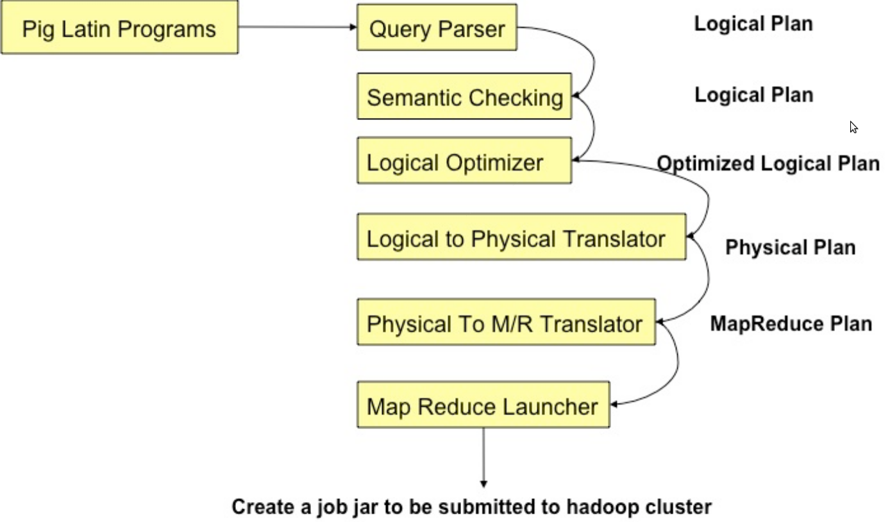
Compilation
Compilation

Slide 27
Parsing
Parsing
Type checking with schema
Reference verification
Logical plan generation
  One-to-one fashion
  Independent of execution platform
  Limited optimization
  No execution until DUMP or STORE
04/13/10

Slide 28
Logical Plan
Logic Plan
LOAD
A=LOAD 'file1' AS (x, y, z);
B=LOAD 'file2' AS (t, u, v);
C=FILTER A by y > 0;
D=JOIN C BY x, B BY u;
E=GROUP D BY z;
F=FOREACH E GENERATE group, COUNT(D);
STORE F INTO 'output';
LOAD
FILTER
JOIN
GROUP
FOREACH
STORE
04/13/10

Slide 29
Physical Plan
Physical Plan
1:1 correspondence with most logical operators
Except for:
  DISTINCT
  (CO)GROUP
  JOIN
  ORDER
04/13/10

Slide 30
Joins in MapReduce
Two typical types of join
  Map-side join
  Reduce-side join

Slide 31
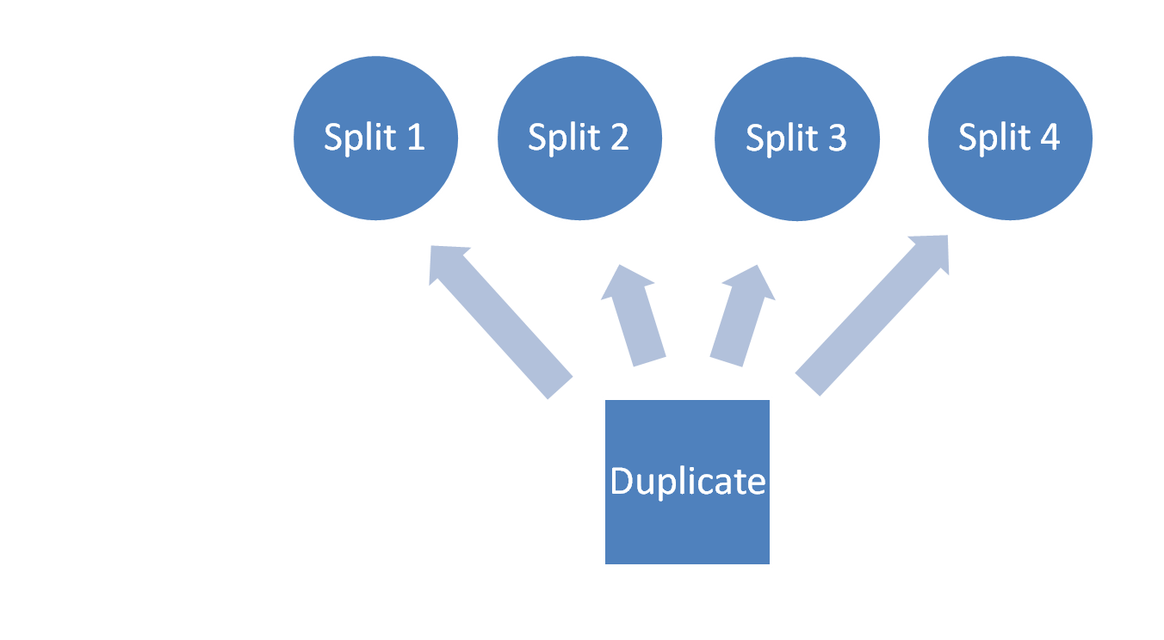
Map-side Join
Table L
Map tasks:
Table R

Slide 32














REDUCE-SIDE JOIN
Pairs: (key, targeted record)
Group by join key
{(661::James…) }
X
(1::661::3::97…),
(1::661::3::97…),
(1::661::4::97…)
1::1193::5::978300760
1::661::3::978302109
1::661::3::978301968
1::661::4::978300275
1 ::1193::5::97882429
(661, …)
(661, …)
(661, …)
1193, L:1::1193::5::978300760
661, L :1::661::3::978302109
661, L :1::661::3::978301968
661, L :1::661::4::978300275
1193, L :1 ::1193::5 ::97882429
(661,
[L :1::661::3::97…],
[R:661::James…],
[L:1::661::3::978…],
[L :1::661::4::97…])
(1,Ja..,3, …)
(1,Ja..,3, …)
(1,Ja..,4, …)
(1193, …)
(1193, …)
L: ratings.dat
Buffers records into two sets according to the table tag
+
Cross-product
661::James and the Glant…
914::My Fair Lady..
1193::One Flew Over the…
2355::Bug’s Life, A…
3408::Erin Brockovich…
(661, …)
(2355, …)
(3048, …)
(2355, [R:2355::B’…])
(3408, [R:3408::Eri…])
661, R:661::James and the Gla…
914, R: 914::My Fair Lady..
1193, R: 1193::One Flew Over …
2355, R: 2355::Bug’s Life, A…
3408, R: 3408::Erin Brockovi…
(914, …)
(1193, …)
Drawback: all records may have to be buffered
R: movies.dat
Out of memory
The key cardinality is small
The data is highly skewed
Phase /Function | Improvement
Map Function | Output key is changed to a composite of the join key and the table tag.
Partitioning function | Hashcode is computed from just the join key part of the composite key
Grouping function | Records are grouped on just the join key

Slide 33
Physical Plan
Physical Plan
1:1 correspondence with most logical operators
Except for:
  DISTINCT
  (CO)GROUP
  JOIN
  ORDER
04/13/10

Slide 34
LOAD
LOAD
FILTER
LOAD
LOCAL REARRANGE
LOAD
GLOBAL REARRANGE
FILTER
PACKAGE
JOIN
FOREACH
LOCAL REARRANGE
GROUP
GLOBAL REARRANGE
FOREACH
PACKAGE
FOREACH
STORE
04/13/10
STORE

Slide 35
Physical Optimizations
Physical Optimization
Always use combiner for pre-aggregation
Insert SPLIT to re-use intermediate result
Early projection (logical or physical?)
04/13/10

Slide 36
MapReduce Plan
MapReduce Plan
Determine MapReduce boundaries
  GLOBAL REARRANGE
  STORE/LOAD
Some operations are done by MapReduce framework
Coalesce other operators into Map & Reduce stages
Generate job jar file
04/13/10

Slide 37
LOAD
FILTER
LOAD
Map
FILTER
LOCAL REARRANGE
LOCAL REARRANGE
GLOBAL REARRANGE
Reduce
PACKAGE
PACKAGE
FOREACH
FOREACH
LOCAL REARRANGE
Map
LOCAL REARRANGE
GLOBAL REARRANGE
PACKAGE
FOREACH
Reduce
PACKAGE
STORE
FOREACH
04/13/10

Slide 38
Execution in Hadoop Mode
The MR jobs not dependent on anything in the MR plan will be submitted for execution
MR jobs will be removed from MR plan after completion
  Jobs whose dependencies are satisfied are now ready for execution
Currently, no support for inter-job fault-tolerance

Slide 39
Discussion of the Two Readings on Pig (SIGMOD 2008 and VLDB 2009)

Slide 40
Discussion Points for Reading 1
Examples of the nested data model, CoGroup, and Join (Figure 2)
Nested query in Section 3.7

Slide 41
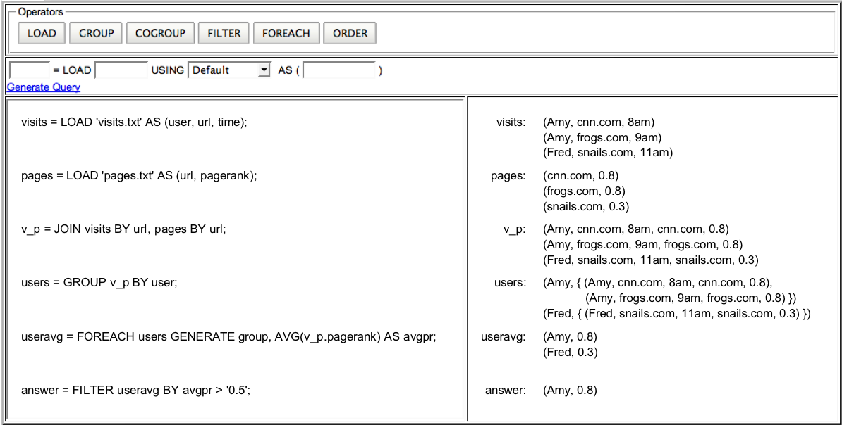
What are the Logical, Physical, and MapReduce plans for:
STORE answer INTO ‘/user/alan/answer’;

Slide 42
LOAD
LOAD
Map
LOCAL REARRANGE
LOCAL REARRANGE
GLOBAL REARRANGE
Reduce
PACKAGE
PACKAGE
FOREACH
FOREACH
Map
LOCAL REARRANGE
LOCAL REARRANGE
GLOBAL REARRANGE
PACKAGE
Reduce
PACKAGE
FOREACH
FOREACH
FILTER
FILTER
STORE
04/13/10

Slide 43
Recall Operator Plumbing
π_{B,D}
σ_{R.A = “c”}
S
R
Materialization: output of one operator written to disk, next operator reads from the disk
Pipelining: output of one operator directly fed to next operator

Slide 44
Materialization
π_{B,D}
Materialized here
σ_{R.A = “c”}
S
R

Slide 45
Iterators: Pipelining
π_{B,D}
➔ Each operator supports:
  Open()
  GetNext()
  Close()
σ_{R.A = “c”}
S
R

Slide 46
How do these operators execute in Pig?
Hints (based on Reading 2):
  What will Hadoop’s map function and reduce function calls do in this case?
  How does each operator work? What does each operator do? (Section 4.3)
  Outermost operator graph (Section 5)
  Iterator model (Section 5)
Map
FILTER
LOCAL REARRANGE
Reduce
PACKAGE
FOREACH
04/13/10

Slide 47
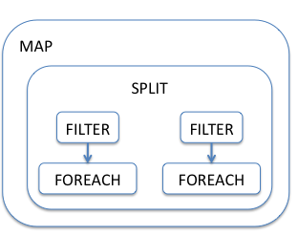
Branching Flows in Pig
clicks = LOAD `clicks'
AS (userid, pageid, linkid, viewedat);
SPLIT clicks INTO
pages IF pageid IS NOT NULL,
links IF linkid IS NOT NULL;
cpages = FOREACH pages GENERATE userid,
CanonicalizePage(pageid) AS cpage,
viewedat;
clinks = FOREACH links GENERATE userid,
CanonicalizeLink(linkid) AS clink,
viewedat;
STORE cpages INTO `pages';
STORE clinks INTO `links';
Hints (based on Reading 2, Section 5.1, last two paras before Section 5.1.1):
  Outermost data flow graph
  New pause signal for iterators
04/13/10

Slide 48
Branching Flows in Pig
Draw the MapReduce plan for this query
clicks = LOAD `clicks'
AS (userid, pageid, linkid, viewedat);
byuser = GROUP clicks BY userid;
result = FOREACH byuser {
uniqPages = DISTINCT clicks.pageid;
uniqLinks = DISTINCT clicks.linkid;
GENERATE group, COUNT(uniqPages),
COUNT(uniqLinks);
};
04/13/10

Slide 49
Branching Flows in Pig
Draw the MapReduce plan for this query
clicks = LOAD `clicks'
AS (userid, pageid, linkid, viewedat);
byuser = GROUP clicks BY userid;
result = FOREACH byuser {
fltrd = FILTER clicks BY viewedat IS NOT NULL;
uniqPages = DISTINCT fltrd.pageid;
uniqLinks = DISTINCT fltrd.linkid;
GENERATE group, COUNT(uniqPages),
COUNT(uniqLinks);
};
04/13/10

Slide 50
Performance and future improvement

Slide 51
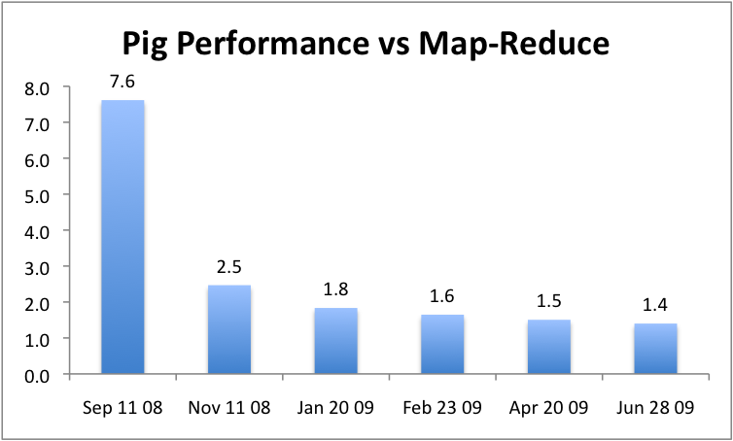
Pig Performance
Images from http://wiki.apache.org/pig/PigTalksPapers

Slide 52
Future Improvements
Query optimization
  Currently rule-based optimizer for plan rearrangement and join selection
  Cost-based in the future
Non-Java UDFs
Grouping and joining on pre-partitioned/sorted data
  Avoid data shuffling for grouping and joining
  Building metadata facilities to keep track of data layout
Skew handling
  For load balancing

Slide 53
Get more information at the Pig website
You can work with the source code to implement something new in Pig
Also take a look at Hive, a similar system from Facebook

Slide 54
References
Some of the content come from the following presentations:
  Introduction to data processing using Hadoop and Pig, by Ricardo Varela
  Pig, Making Hadoop Easy, by Alan F. Gates
  Large-scale social media analysis with Hadoop, by Jake Hofman
  Getting Started on Hadoop, by Paco Nathan
  MapReduce Online, by Tyson Condie and Neil Conway

