Slide 1
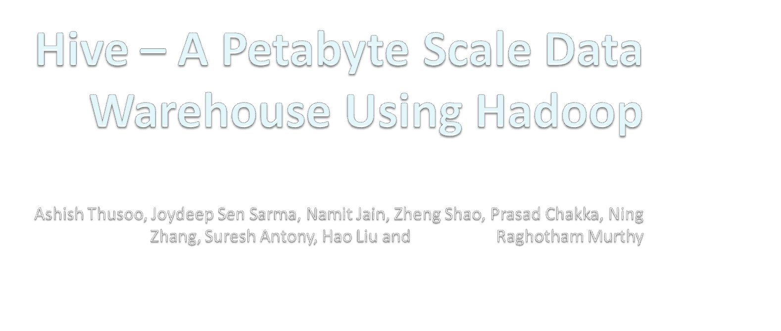
Raghav Ayyamani

Slide 2
Why Another Data Warehousing System?
Problem : Data, data and more data
  Several TBs of data everyday
The Hadoop Experiment:
  Uses Hadoop File System (HDFS)
  Scalable/Available
Problem
  Lacked Expressiveness
  Map-Reduce hard to program
Solution : HIVE

Slide 3
What is HIVE?
A system for managing and querying unstructured data as if it were structured
  Uses Map-Reduce for execution
  HDFS for Storage
Key Building Principles
  SQL as a familiar data warehousing tool
  Extensibility (Pluggable map/reduce scripts in the language of your choice, Rich and User Defined Data Types, User Defined Functions)
  Interoperability (Extensible Framework to support different file and data formats)
  Performance

Slide 4
Type System
Primitive types
  Integers:TINYINT, SMALLINT, INT, BIGINT.
  Boolean: BOOLEAN.
  Floating point numbers: FLOAT, DOUBLE .
  String: STRING.
Complex types
  Structs: {a INT; b INT}.
  Maps: M['group'].
  Arrays: ['a', 'b', 'c'], A[1] returns 'b'.

Slide 5
Data Model- Tables
Tables
  Analogous to tables in relational DBs.
  Each table has corresponding directory in HDFS.
  Example
    Page view table name – pvs
    HDFS directory
      /wh/pvs
Example:
CREATE TABLE t1(ds string, ctry float, li list<map<string,
struct<p1:int, p2:int>>);

Slide 6
Data Model - Partitions
Partitions
  Analogous to dense indexes on partition columns
  Nested sub-directories in HDFS for each combination of partition column values.
  Allows users to efficiently retrieve rows
  Example
    Partition columns: ds, ctry
    HDFS for ds=20120410, ctry=US
      /wh/pvs/ds=20120410/ctry=US
    HDFS for ds=20120410, ctry=IN
      /wh/pvs/ds=20120410/ctry=IN

Slide 7
Hive Query Language –Contd.
Partitioning – Creating partitions
CREATE TABLE test_part(ds string, hr int)
PARTITIONED BY (ds string, hr int);
INSERT OVERWRITE TABLE
test_part PARTITION(ds='2009-01-01', hr=12)
SELECT * FROM t;
ALTER TABLE test_part
ADD PARTITION(ds='2009-02-02', hr=11);

Slide 8
Partitioning - Contd..
SELECT * FROM test_part WHERE ds='2009-01-01';
will only scan all the files within the
/user/hive/warehouse/test_part/ds=2009-01-01 directory
SELECT * FROM test_part
WHERE ds='2009-02-02' AND hr=11;
will only scan all the files within the /user/hive/warehouse/test_part/ds=2009-02-02/hr=11 directory.

Slide 9
Data Model
Buckets
  Split data based on hash of a column – mainly for parallelism
  Data in each partition may in turn be divided into Buckets based on the value of a hash function of some column of a table.
  Example
    Bucket column: user into 32 buckets
    HDFS file for user hash 0
      /wh/pvs/ds=20120410/cntr=US/part-00000
    HDFS file for user hash bucket 20
      /wh/pvs/ds=20120410/cntr=US/part-00020

Slide 10
Data Model
External Tables
  Point to existing data directories in HDFS
  Can create table and partitions
  Data is assumed to be in Hive-compatible format
  Dropping external table drops only the metadata
  Example: create external table
  CREATE EXTERNAL TABLE test_extern(c1 string, c2 int)
  LOCATION '/user/mytables/mydata';

Slide 11
Serialization/Deserialization
Generic (De)Serialzation Interface SerDe
Uses LazySerDe
Flexibile Interface to translate unstructured data into structured data
Designed to read data separated by different delimiter characters
The SerDes are located in 'hive_contrib.jar';

Slide 12
Hive File Formats
Hive lets users store different file formats
Helps in performance improvements
SQL Example:
CREATE TABLE dest1(key INT, value STRING)
STORED AS
INPUTFORMAT
'org.apache.hadoop.mapred.SequenceFileInputFormat'
OUTPUTFORMAT
'org.apache.hadoop.mapred.SequenceFileOutputFormat'

Slide 13
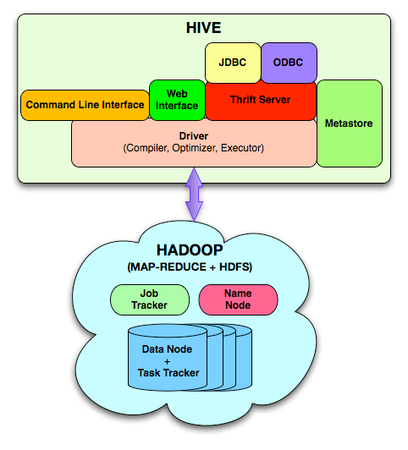
System Architecture and Components

Slide 14







System Architecture and Components
JDBC
ODBC
Web
Interface
Command Line Interface
Thrift Server
Metastore
Driver
(Compiler, Optimizer, Executor)
Metastore
The component that store the system catalog and meta data about tables, columns, partitions etc.
Stored on a traditional RDBMS

Slide 15


System Architecture and Components
JDBC
ODBC
Web
Interface
Command Line Interface
Thrift Server
Metastore
Driver
(Compiler, Optimizer, Executor)
Driver
  The component that manages the lifecycle of a HiveQL statement as it moves through Hive. The driver also maintains a session handle and any session statistics.

Slide 16
System Architecture and Components
JDBC
ODBC
Web
Interface
Command Line Interface
Thrift Server
Metastore
Driver
(Compiler, Optimizer, Executor)
Query Compiler
  The component that compiles HiveQL into a directed acyclic graph of map/reduce tasks.

Slide 17
System Architecture and Components
JDBC
ODBC
Web
Interface
Command Line Interface
Thrift Server
Metastore
Driver
(Compiler, Optimizer, Executor)
Optimizer
consists of a chain of transformations such that the operator DAG resulting from one transformation is passed as input to the next transformation
Performs tasks like Column Pruning , Partition Pruning, Repartitioning of Data

Slide 18
System Architecture and Components
JDBC
ODBC
Web
Interface
Command Line Interface
Thrift Server
Metastore
Driver
(Compiler, Optimizer, Executor)
Execution Engine
  The component that executes the tasks produced by the compiler in proper dependency order. The execution engine interacts with the underlying Hadoop instance.

Slide 19


System Architecture and Components
JDBC
ODBC
Web
Interface
Command Line Interface
Thrift Server
Metastore
Driver
(Compiler, Optimizer, Executor)
HiveServer
  The component that provides a trift interface and a JDBC/ODBC server and provides a way of integrating Hive with other applications.

Slide 20




System Architecture and Components
JDBC
ODBC
Web
Interface
Command Line Interface
Thrift Server
Metastore
Driver
(Compiler, Optimizer, Executor)
Client Components
  Client component like Command Line Interface(CLI), the web UI and JDBC/ODBC driver.

Slide 21
Hive Query Language
Basic SQL
  From clause sub-query
  ANSI JOIN (equi-join only)
  Multi-Table insert
  Multi group-by
  Sampling
  Objects Traversal
Extensibility
  Pluggable Map-reduce scripts using TRANSFORM

Slide 22
Hive Query Language
JOIN
SELECT t1.a1 as c1, t2.b1 as c2
FROM t1 JOIN t2 ON (t1.a2 = t2.b2);
INSERTION
INSERT OVERWRITE TABLE t1
SELECT * FROM t2;

Slide 23
Hive Query Language –Contd.
Insertion
INSERT OVERWRITE TABLE sample1 '/tmp/hdfs_out' SELECT * FROM sample WHERE ds='2012-02-24';
INSERT OVERWRITE DIRECTORY '/tmp/hdfs_out' SELECT * FROM sample WHERE ds='2012-02-24';
INSERT OVERWRITE LOCAL DIRECTORY '/tmp/hive-sample-out' SELECT * FROM sample;

Slide 24
Hive Query Language –Contd.
Map Reduce
FROM (MAP doctext USING 'python wc_mapper.py' AS (word, cnt)
FROM docs
CLUSTER BY word
)
REDUCE word, cnt USING 'python wc_reduce.py';
FROM (FROM session_table
SELECT sessionid, tstamp, data
DISTRIBUTE BY sessionid SORT BY tstamp
)
REDUCE sessionid, tstamp, data USING 'session_reducer.sh';

Slide 25
Hive Query Language
Example of multi-table insert query and its optimization
FROM (SELECT a.status, b.school, b.gender
FROM status_updates a JOIN profiles b
ON (a.userid = b.userid AND a.ds='2009-03-20' )) subq1
INSERT OVERWRITE TABLE gender_summary
PARTITION(ds='2009-03-20')
SELECT subq1.gender, COUNT(1)
GROUP BY subq1.gender
INSERT OVERWRITE TABLE school_summary
PARTITION(ds='2009-03-20')
SELECT subq1.school, COUNT(1)
GROUP BY subq1.school

Slide 26
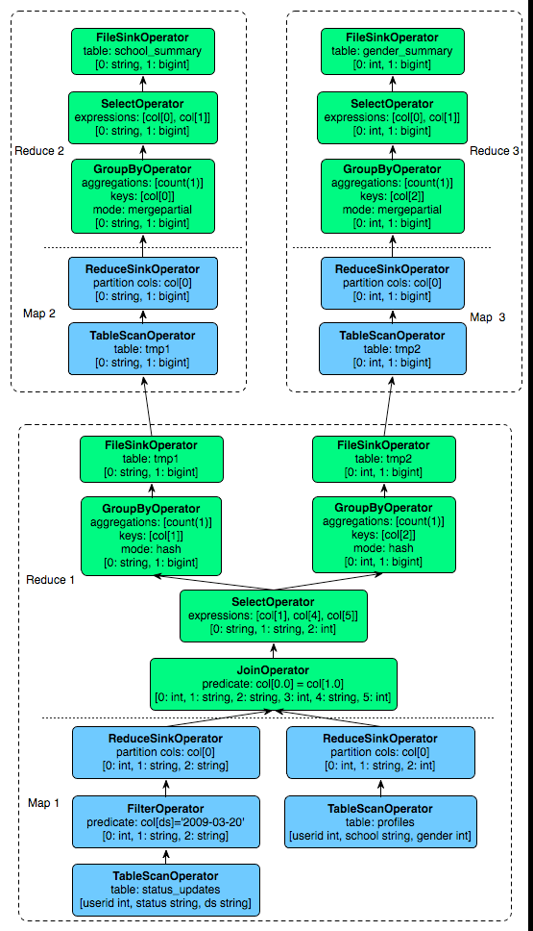
Hive Query Language

Slide 27
Related Work
Scope
Pig
HadoopDB

Slide 28
Conclusion
Pros
  Good explanation of Hive and HiveQL with proper examples
  Architecture is well explained
  Usage of Hive is properly given
Cons
  Accepts only a subset of SQL queries
  Performance comparisons with other systems would have been more appreciable

Slide 29


