Slide 1
Hadoop/Hive
General Introduction
Open-Source Solution for Huge Data Sets
Zheng Shao
  Hadoop Committer - Apache Software Foundation
  11/23/2008

Slide 2
Data Scalability Problems
Search Engine
  10KB / doc * 20B docs = 200TB
  Reindex every 30 days: 200TB/30days = 6 TB/day
Log Processing / Data Warehousing
  0.5KB/events * 3B pageview events/day = 1.5TB/day
  100M users * 5 events * 100 feed/event * 0.1KB/feed = 5TB/day
Multipliers: 3 copies of data, 3-10 passes of raw data
Processing Speed (Single Machine)
  2-20MB/second * 100K seconds/day = 0.2-2 TB/day

Slide 3
Google’s Solution
Google File System – SOSP’2003
Map-Reduce – OSDI’2004
Sawzall – Scientific Programming Journal’2005
Big Table – OSDI’2006
Chubby – OSDI’2006

Slide 4
Open Source World’s Solution
Google File System – Hadoop Distributed FS
Map-Reduce – Hadoop Map-Reduce
Sawzall – Pig, Hive, JAQL
Big Table – Hadoop HBase, Cassandra
Chubby – Zookeeper

Slide 5

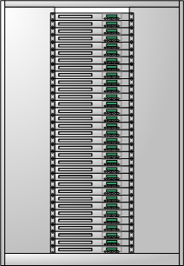




Simplified Search Engine Architecture
Spider
Runtime
Batch Processing System on top of Hadoop
Internet
Search Log Storage
SE Web Server
Notes:
# Duplicate Implementation of common algorithms and infrastructure (cluster management, load balancing etc)
# Unable to easily join the data from different parts of the system, which limits the speed of innovation
# Not easy to change the number of machines in different clusters to achieve the best utilization, Not easy to add more machines
# High operational / management costs

Slide 6
Simplified Data Warehouse Architecture
Business Intelligence
Database
Batch Processing System on top fo Hadoop
Domain Knowledge
View/Click/Events Log Storage
Web Server

Slide 7
Hadoop History
Jan 2006 – Doug Cutting joins Yahoo
Feb 2006 – Hadoop splits out of Nutch and Yahoo starts using it.
Dec 2006 – Yahoo creating 100-node Webmap with Hadoop
Apr 2007 – Yahoo on 1000-node cluster
Jan 2008 – Hadoop made a top-level Apache project
Dec 2007 – Yahoo creating 1000-node Webmap with Hadoop
Sep 2008 – Hive added to Hadoop as a contrib project

Slide 8
Hadoop Introduction
Open Source Apache Project
  http://hadoop.apache.org/
  Book: http://oreilly.com/catalog/9780596521998/index.html
Written in Java
  Does work with other languages
Runs on
  Linux, Windows and more
  Commodity hardware with high failure rate

Slide 9
Current Status of Hadoop
Largest Cluster
  2000 nodes (8 cores, 4TB disk)
Used by 40+ companies / universities over the world
  Yahoo, Facebook, etc
  Cloud Computing Donation from Google and IBM
Startup focusing on providing services for hadoop
  Cloudera

Slide 10
Hadoop Components
Hadoop Distributed File System (HDFS)
Hadoop Map-Reduce
Contributes
  Hadoop Streaming
  Pig / JAQL / Hive
  HBase
  Hama / Mahout

Slide 11
Hadoop Distributed File System

Slide 12
Goals of HDFS
Very Large Distributed File System
  10K nodes, 100 million files, 10 PB
Convenient Cluster Management
  Load balancing
  Node failures
  Cluster expansion
Optimized for Batch Processing
  Allow move computation to data
  Maximize throughput
Notes:
Very Large Distributed File System
10K nodes, 100 million files, 10 PB
Assumes Commodity Hardware
Files are replicated to handle hardware failure
Detect failures and recovers from them
Optimized for Batch Processing
Data locations exposed so that computations can move to where data resides
Provides very high aggregate bandwidth

Slide 13
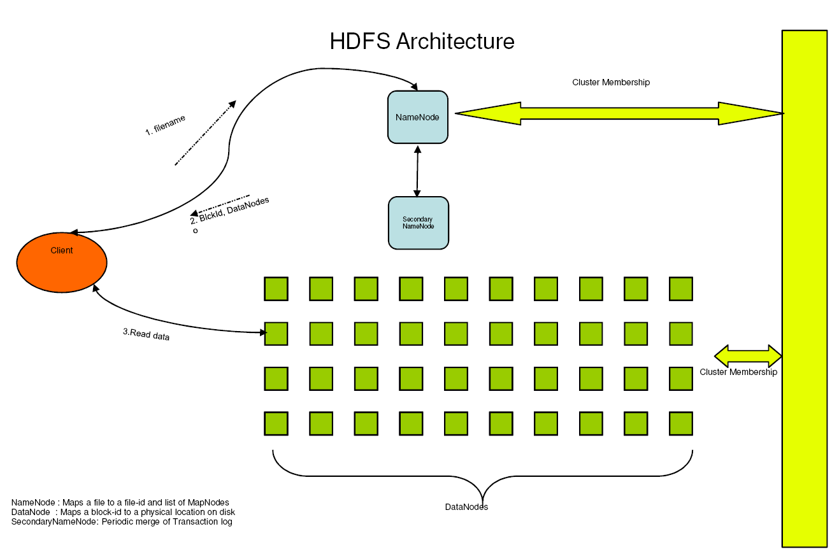
HDFS Architecture
Notes:
Name node: single point of failure, so we have secondary name node.
Secondary name node: read transaction log from name node, and upload FSImage to name node.
Single name node avoids metadata conflict etc.
Data node: easy to join and leave cluster.
Heartbeat protocol.

Slide 14
HDFS Details
Data Coherency
  Write-once-read-many access model
  Client can only append to existing files
Files are broken up into blocks
  Typically 128 MB block size
  Each block replicated on multiple DataNodes
Intelligent Client
  Client can find location of blocks
  Client accesses data directly from DataNode

Slide 15
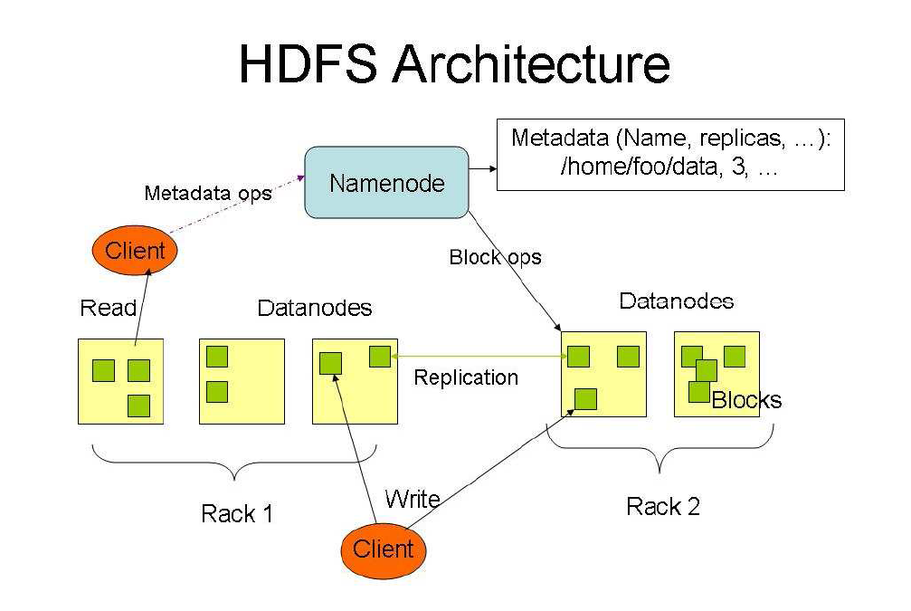
Notes:
Block placement policy
Block balancing
Block replication on node failure

Slide 16
HDFS User Interface
Java API
Command Line
  hadoop dfs -mkdir /foodir
  hadoop dfs -cat /foodir/myfile.txt
  hadoop dfs -rm /foodir myfile.txt
  hadoop dfsadmin -report
  hadoop dfsadmin -decommission datanodename
Web Interface
  http://host:port/dfshealth.jsp

Slide 17
More about HDFS
http://hadoop.apache.org/core/docs/current/hdfs_design.html
Hadoop FileSystem API
  HDFS
  Local File System
  Kosmos File System (KFS)
  Amazon S3 File System

Slide 18
Hadoop Map-Reduce and
Hadoop Streaming

Slide 19
Hadoop Map-Reduce Introduction
Map/Reduce works like a parallel Unix pipeline:
  cat input | grep | sort | uniq -c | cat > output
  Input | Map | Shuffle & Sort | Reduce | Output
Framework does inter-node communication
  Failure recovery, consistency etc
  Load balancing, scalability etc
Fits a lot of batch processing applications
  Log processing
  Web index building

Slide 20
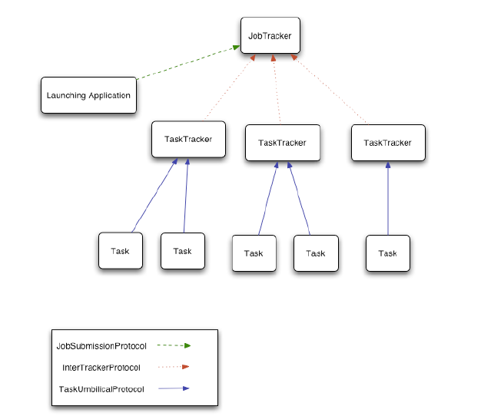

Slide 21
(Simplified) Map Reduce Review
Machine 1
<k1, v1>
<k2, v2>
<k3, v3>
<nk1, nv1>
<nk2, nv2>
<nk3, nv3>
<nk1, nv1>
<nk3, nv3>
<nk1, nv6>
<nk1, nv1>
<nk1, nv6>
<nk3, nv3>
<nk1, 2>
<nk3, 1>
Local
Map
Global
Shuffle
Local
Sort
Local
Reduce
Machine 2
<k4, v4>
<k5, v5>
<k6, v6>
<nk2, nv4>
<nk2, nv5>
<nk1, nv6>
<nk2, nv4>
<nk2, nv5>
<nk2, nv2>
<nk2, nv4>
<nk2, nv5>
<nk2, nv2>
<nk2, 3>
Notes:
We assume there are only 2 mappers and 2 reducers. Each machine runs 1 mapper and 1 reducer.

Slide 22
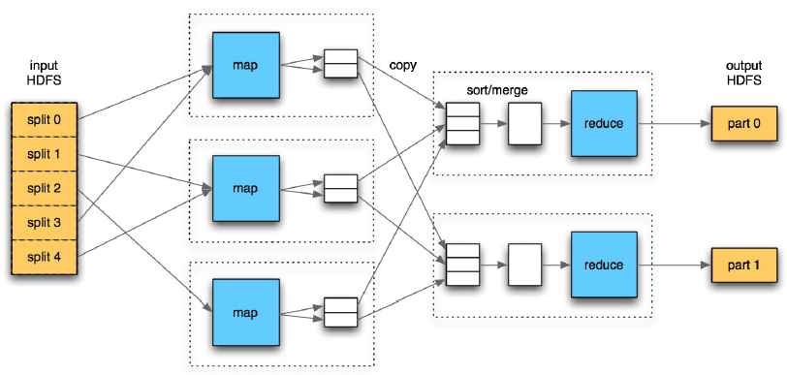
Physical Flow

Slide 23
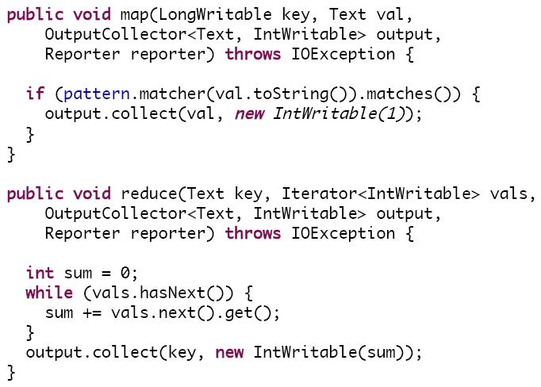
Example Code

Slide 24
Hadoop Streaming
Allow to write Map and Reduce functions in any languages
  Hadoop Map/Reduce only accepts Java
Example: Word Count
  hadoop streaming
  -input /user/zshao/articles
  -mapper ‘tr “ ” “\n”’
  -reducer ‘uniq -c‘
  -output /user/zshao/
  -numReduceTasks 32

Slide 25
Example: Log Processing
Generate #pageview and #distinct users
for each page each day
  Input: timestamp url userid
Generate the number of page views
  Map: emit < <date(timestamp), url>, 1>
  Reduce: add up the values for each row
Generate the number of distinct users
  Map: emit < <date(timestamp), url, userid>, 1>
  Reduce: For the set of rows with the same <date(timestamp), url>, count the number of distinct users by “uniq –c"

Slide 26
Example: Page Rank
In each Map/Reduce Job:
  Map: emit <link, eigenvalue(url)/#links>
  for each input: <url, <eigenvalue, vector<link>> >
  Reduce: add all values up for each link, to generate the new eigenvalue for that link.
Run 50 map/reduce jobs till the eigenvalues are stable.

Slide 27
TODO: Split Job Scheduler and Map-Reduce
Allow easy plug-in of different scheduling algorithms
  Scheduling based on job priority, size, etc
  Scheduling for CPU, disk, memory, network bandwidth
  Preemptive scheduling
Allow to run MPI or other jobs on the same cluster
  PageRank is best done with MPI

Slide 28
TODO: Faster Map-Reduce
Mapper
Sender
Receiver
Reducer
R1
Merge
Reduce
sort
map
R2
R3
sort
…
map
R1
sort
R2
R3
…
Sender
Receiver
Receiver merge N flows into 1, call user function Compare to sort, dump buffer to disk, and do checkpointing
Mapper calls user functions: Map and Partition
Sender does flow control
Reducer calls user functions: Compare and Reduce

Slide 29
Hive - SQL on top of Hadoop

Slide 30
Map-Reduce and SQL
Map-Reduce is scalable
  SQL has a huge user base
  SQL is easy to code
Solution: Combine SQL and Map-Reduce
  Hive on top of Hadoop (open source)
  Aster Data (proprietary)
  Green Plum (proprietary)

Slide 31
Hive
A database/data warehouse on top of Hadoop
  Rich data types (structs, lists and maps)
  Efficient implementations of SQL filters, joins and group-by’s on top of map reduce
Allow users to access Hive data without using Hive
Link:
  http://svn.apache.org/repos/asf/hadoop/hive/trunk/

Slide 32

Hive Architecture
Map Reduce
HDFS
Web UI
Hive CLI
Mgmt, etc
Browsing
Queries
DDL
MetaStore
Hive QL
Parser
Planner
Planner
Execution
SerDe
Thrift
Jute
JSON
Thrift API

Slide 33
Hive QL – Join
page_view
pv_users
user
pageid | userid | time
1 | 111 | 9:08:01
2 | 111 | 9:08:13
1 | 222 | 9:08:14
pageid | age
1 | 25
2 | 25
1 | 32
userid | age | gender
111 | 25 | female
222 | 32 | male
X
=
SQL:
  INSERT INTO TABLE pv_users
  SELECT pv.pageid, u.age
  FROM page_view pv JOIN user u ON (pv.userid = u.userid);

Slide 34
Hive QL – Join in Map Reduce
page_view
pv_users
pageid | userid | time
1 | 111 | 9:08:01
2 | 111 | 9:08:13
1 | 222 | 9:08:14
key | value
111 | <1,1>
111 | <1,2>
111 | <2,25>
key | value
111 | <1,1>
111 | <1,2>
222 | <1,1>
Shuffle
Sort
pageid | age
1 | 25
2 | 25
user
Map
Reduce
userid | age | gender
111 | 25 | female
222 | 32 | male
key | value
111 | <2,25>
222 | <2,32>
key | value
222 | <1,1>
222 | <2,32>
pageid | age
1 | 32

Slide 35
Hive QL – Group By
pv_users
pageid_age_sum
pageid | age
1 | 25
2 | 25
1 | 32
2 | 25
pageid | age | Count
1 | 25 | 1
2 | 25 | 2
1 | 32 | 1
SQL:
      INSERT INTO TABLE pageid_age_sum
      SELECT pageid, age, count(1)
      FROM pv_users
      GROUP BY pageid, age;

Slide 36
Hive QL – Group By in Map Reduce
pv_users
pageid_age_sum
pageid | age
1 | 25
2 | 25
key | value
<1,25> | 1
<2,25> | 1
key | value
<1,25> | 1
<1,32> | 1
pageid | age | Count
1 | 25 | 1
1 | 32 | 1
Shuffle
Sort
Map
Reduce
pageid | age
1 | 32
2 | 25
key | value
<1,32> | 1
<2,25> | 1
key | value
<2,25> | 1
<2,25> | 1
pageid | age | Count
2 | 25 | 2

Slide 37
Hive QL – Group By with Distinct
page_view
pageid | userid | time
1 | 111 | 9:08:01
2 | 111 | 9:08:13
1 | 222 | 9:08:14
2 | 111 | 9:08:20
result
pageid | count_distinct_userid
1 | 2
2 | 1
SQL
  SELECT pageid, COUNT(DISTINCT userid)
  FROM page_view GROUP BY pageid

Slide 38
Hive QL – Group By with Distinct in Map Reduce
page_view
pageid | userid | time
1 | 111 | 9:08:01
2 | 111 | 9:08:13
key | v
<1,111>
<1,222>
pageid | count
1 | 2
Shuffle
and
Sort
Reduce
pageid | userid | time
1 | 222 | 9:08:14
2 | 111 | 9:08:20
key | v
<2,111>
<2,111>
pageid | count
2 | 1
Shuffle key is a prefix of the sort key.

Slide 39
Hive QL: Order By
page_view
pageid | userid | time
2 | 111 | 9:08:13
1 | 111 | 9:08:01
key | v
<1,111> | 9:08:01
<2,111> | 9:08:13
pageid | userid | time
1 | 111 | 9:08:01
2 | 111 | 9:08:13
Shuffle
and
Sort
Reduce
pageid | userid | time
2 | 111 | 9:08:20
1 | 222 | 9:08:14
key | v
<1,222> | 9:08:14
<2,111> | 9:08:20
pageid | userid | time
1 | 222 | 9:08:14
2 | 111 | 9:08:20
Shuffle randomly.

Slide 40
Hive Optimizations
Efficient Execution of SQL on top of Map-Reduce

Slide 41
(Simplified) Map Reduce Revisit
Machine 1
<k1, v1>
<k2, v2>
<k3, v3>
<nk1, nv1>
<nk2, nv2>
<nk3, nv3>
<nk1, nv1>
<nk3, nv3>
<nk1, nv6>
<nk1, nv1>
<nk1, nv6>
<nk3, nv3>
<nk1, 2>
<nk3, 1>
Local
Map
Global
Shuffle
Local
Sort
Local
Reduce
Machine 2
<k4, v4>
<k5, v5>
<k6, v6>
<nk2, nv4>
<nk2, nv5>
<nk1, nv6>
<nk2, nv4>
<nk2, nv5>
<nk2, nv2>
<nk2, nv4>
<nk2, nv5>
<nk2, nv2>
<nk2, 3>

Slide 42
Merge Sequential Map Reduce Jobs
A
key | av
1 | 111
AB
Map Reduce
key | av | bv
1 | 111 | 222
B
Map Reduce
ABC
key | bv
1 | 222
key | av | bv | cv
1 | 111 | 222 | 333
C
key | cv
1 | 333
SQL:
  FROM (a join b on a.key = b.key) join c on a.key = c.key SELECT …

Slide 43
Share Common Read Operations
Extended SQL
    FROM pv_users
    INSERT INTO TABLE pv_pageid_sum
      SELECT pageid, count(1)
      GROUP BY pageid
    INSERT INTO TABLE pv_age_sum
      SELECT age, count(1)
      GROUP BY age;
pageid | age
1 | 25
2 | 32
Map Reduce
pageid | count
1 | 1
2 | 1
pageid | age
1 | 25
2 | 32
Map Reduce
age | count
25 | 1
32 | 1

Slide 44
Load Balance Problem
pv_users
pageid | age
1 | 25
1 | 25
1 | 25
2 | 32
1 | 25
Map-Reduce
Map-Reduce
pageid_age_partial_sum
pageid_age_sum
pageid | age | count
1 | 25 | 2
2 | 32 | 1
1 | 25 | 2
pageid | age | count
1 | 25 | 4
2 | 32 | 1

Slide 45
Map-side Aggregation / Combiner
Machine 1
<k1, v1>
<k2, v2>
<k3, v3>
<male, 343>
<female, 128>
<male, 343>
<male, 123>
<male, 343>
<male, 123>
<male, 466>
Local
Map
Global
Shuffle
Local
Sort
Local
Reduce
Machine 2
<k4, v4>
<k5, v5>
<k6, v6>
<male, 123>
<female, 244>
<female, 128>
<female, 244>
<female, 128>
<female, 244>
<female, 372>

Slide 46
Query Rewrite
Predicate Push-down
  select * from (select * from t) where col1 = ‘2008’;
Column Pruning
  select col1, col3 from (select * from t);

Slide 47
TODO: Column-based Storage and Map-side Join
url | page quality | IP
http://a.com/ | 90 | 65.1.2.3
http://b.com/ | 20 | 68.9.0.81
http://c.com/ | 68 | 11.3.85.1
url | clicked | viewed
http://a.com/ | 12 | 145
http://b.com/ | 45 | 383
http://c.com/ | 23 | 67

Slide 48
Credits
Presentations about Hadoop from ApacheCon
Data Management at Facebook, Jeff Hammerbacher
Hive – Data Warehousing & Analytics on Hadoop, Joydeep Sen Sarma, Ashish Thusoo
People (for Hive project)
Suresh Anthony
Prasad Chakka
Namit Jain
Hao Liu
Raghu Murthy
Zheng Shao
Joydeep Sen Sarma
Ashish Thusoo
Pete Wyckoff

Slide 49
Questions? zshao@apache.org

Slide 50
Appendix Pages

Slide 51
Dealing with Structured Data
Type system
  Primitive types
  Recursively build up using Composition/Maps/Lists
Generic (De)Serialization Interface (SerDe)
  To recursively list schema
  To recursively access fields within a row object
Serialization families implement interface
  Thrift DDL based SerDe
  Delimited text based SerDe
  You can write your own SerDe
Schema Evolution

Slide 52
MetaStore
Stores Table/Partition properties:
  Table schema and SerDe library
  Table Location on HDFS
  Logical Partitioning keys and types
  Other information
Thrift API
  Current clients in Php (Web Interface), Python (old CLI), Java (Query Engine and CLI), Perl (Tests)
Metadata can be stored as text files or even in a SQL backend

Slide 53
Hive CLI
DDL:
  create table/drop table/rename table
  alter table add column
Browsing:
  show tables
  describe table
  cat table
Loading Data
Queries

Slide 54
Web UI for Hive
MetaStore UI:
  Browse and navigate all tables in the system
  Comment on each table and each column
  Also captures data dependencies
HiPal:
  Interactively construct SQL queries by mouse clicks
  Support projection, filtering, group by and joining
  Also support

Slide 55
Hive Query Language
Philosophy
  SQL
  Map-Reduce with custom scripts (hadoop streaming)
Query Operators
  Projections
  Equi-joins
  Group by
  Sampling
  Order By

Slide 56
Hive QL – Custom Map/Reduce Scripts
Extended SQL:
    FROM (
      FROM pv_users
      MAP pv_users.userid, pv_users.date
      USING 'map_script' AS (dt, uid)
      CLUSTER BY dt) map
    INSERT INTO TABLE pv_users_reduced
      REDUCE map.dt, map.uid
      USING 'reduce_script' AS (date, count);
Map-Reduce: similar to hadoop streaming

