Slide 1
Data Warehouse Toolkit
Introduction

Slide 2
Data Warehouse
Bill Inmon's paradigm: Data warehouse is one part of the overall business intelligence system. An enterprise has one data warehouse, and data marts source their information from the data warehouse. In the data warehouse, information is stored in 3rd normal form.
Ralph Kimball's paradigm: Data warehouse is the conglomerate of all data marts within the enterprise. Information is always stored in the dimensional model.
Notes:
http://www.1keydata.com/datawarehousing/inmon-kimball.html

Slide 3
Characteristics of DW/BI
High profile and high impact
High risk
Highly political
Requires sophisticated and complex data gathering
Requires intensive user access, training and support
Will be high maintenance
Notes:
Intro, xxvi

Slide 4
DW Lifecycle Principles
Focus on the business
Build an information infrastructure
Deliver in meaningful increments: six to twelve month timeframes
Deliver the entire solution: query and display tools in addition to the database
Notes:
Intro: xxix

Slide 5
DW Lifecycle
Business
Requirements
Definition
Technical
Architecture
Design
Product
Selection &
Installation
Growth
Project
Planning
Dimensional
Modeling
Physical
Design
ETL Design &
Development
Deployment
BI
Application
Specification
BI
Application
Development
Maintenance
Project Management

Slide 6
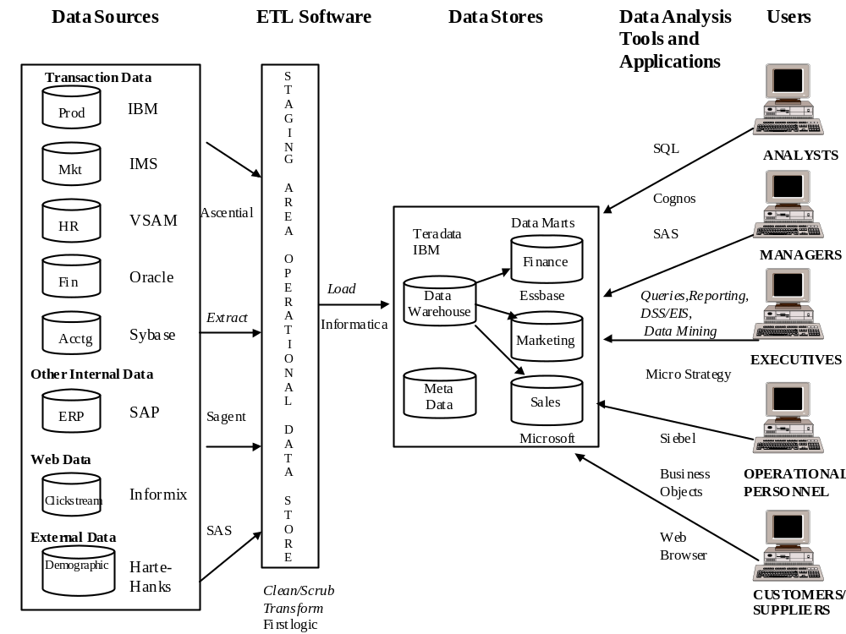
Notes:
This provides an example of a comprehensive data warehousing architecture. It illustrates the large number of possible source systems, ETL processes, sample products, the data warehouse, dependent data marts, meta data, data access tools and applications, and various kinds of users. Inmon calls a comprehensive architecture like this one a Corporate Information Factory.

Slide 7
Key Terms
Data warehouse
Dimensional model
Normalized model
Relational database
OLAP (online analytical processing)
ETL (extraction, transformation, load)
Business Intelligence (BI) application
Data mining model
Ad hoc query

Slide 8
Project Roles
Business Sponsor* – approves and pays for the project
DW/BI manager – organizational DW sponsor
Project manager – day to day leader
Business project lead – business community interface
Business systems analyst – business requirements
Data modeler – detailed data analysis
Systems Architect – system components

Slide 9
Specialized Roles
Data warehouse DBA
OLAP designer
ETL system developer
DW/BI management tools developer
BI applications developer

Slide 10
General IT roles
Data steward
Security manager
BI portal content manager
DW/BI educator
Relational database administrator
OLAP DBA
Compliance manager
Metadata manager
Data mining analyst
User support personnel

