Slide 1
K-structure, Separating Chain, Gap Tree, and Layered DAG
Presented by
Dave Tahmoush

Slide 2
Overview
Improvement on Gap Tree and K-structure
  Faster point location
Encompasses Separating Chain
  Better storage
Designed for point location in polygonal maps

Slide 3
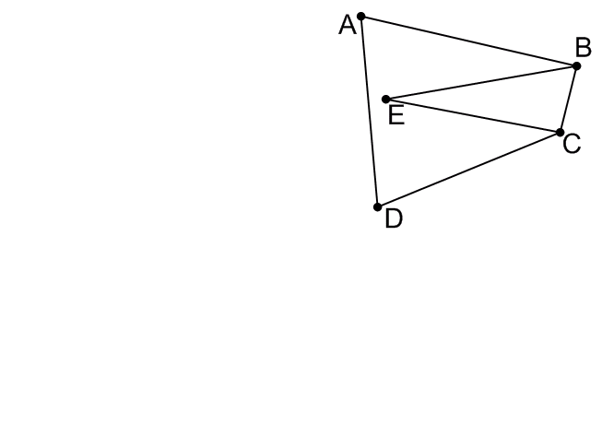
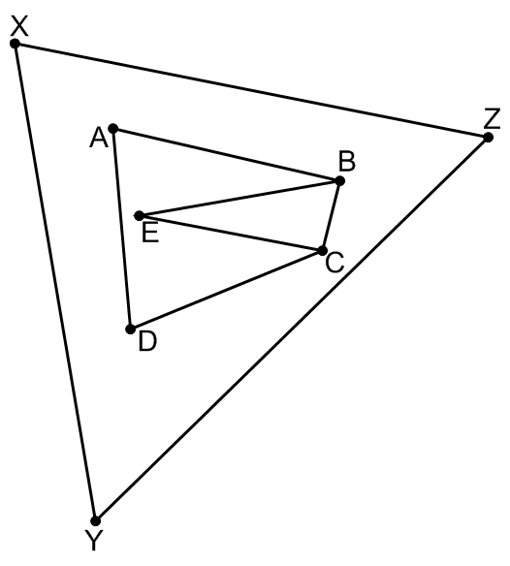
K-structure
By Kirkpatrick
First triangulate polygonal map
  Bound with triangle (XYZ)
  Then triangulate with plane sweep
Then build triangle hierarchy for searching
  Replace group of triangles by smaller group of triangles
  Remove vertices
  Simplification

Slide 4
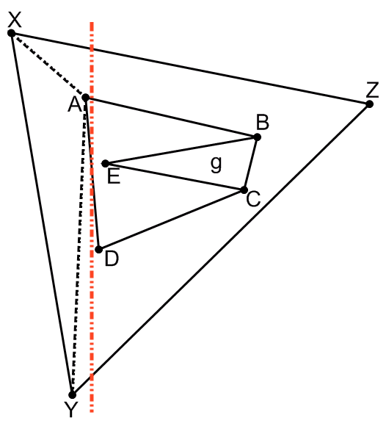
Triangulation with Plane Sweep
Sweep red line from left to right in x
Encounter new vertex
  Create edges to all previous vertices when they do not intersect existing edges
Introduces new edges XA and YA (dashed)

Slide 5
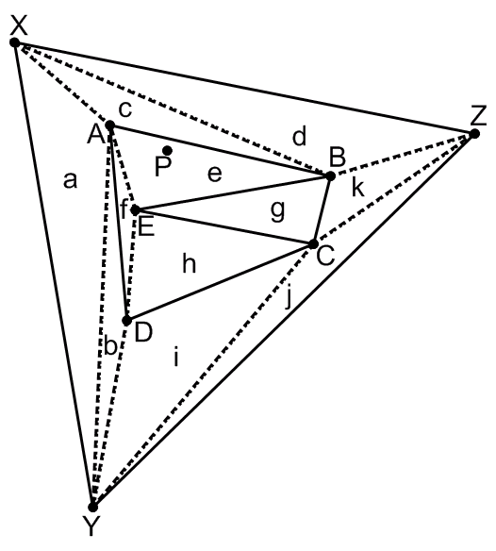
Building Hierarchy
Vertices are independent if no edge between them
Find a maximal set of mutually independent vertices in interior
  From the edge-adjacency list
Remove and retriangulate
  bottom up simplification
Only remove vertices with 11 edges or less because then the retriangluation is bounded
Continue simplifying layers until only have triangle XYZ left
Regions a-k will be linked to regions in next higher level

Slide 6
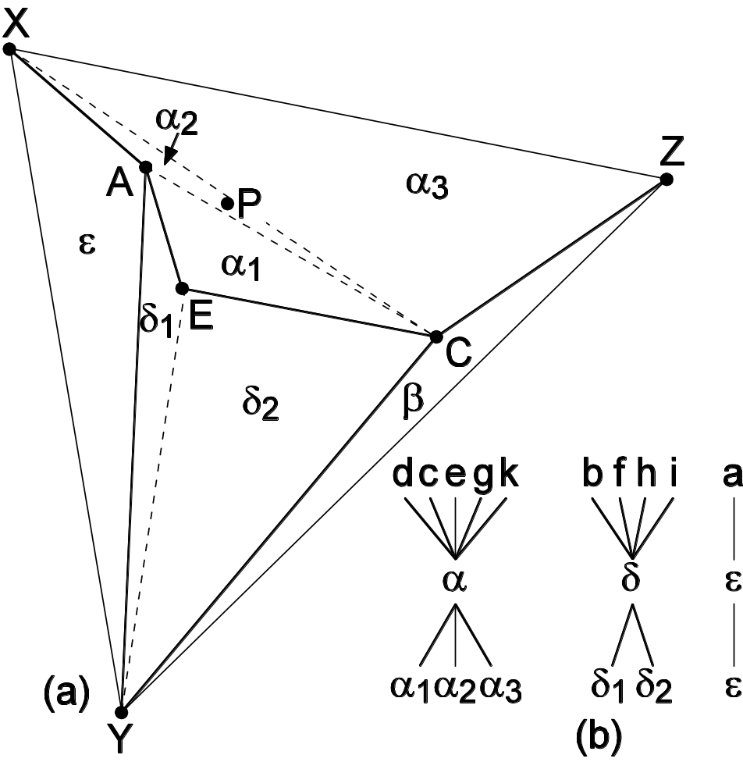
Simplification Hierarchy
Remove vertices B,D
Retriangulate

Slide 7
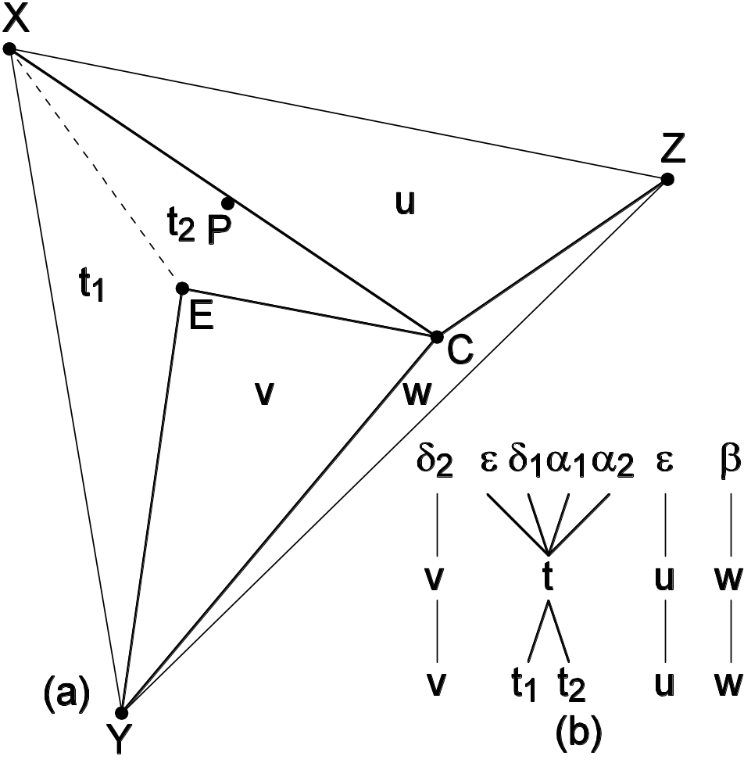
Simplification Hierarchy
Remove vertices B,D
Retriangulate
Remove vertex A
Retriangulate

Slide 8
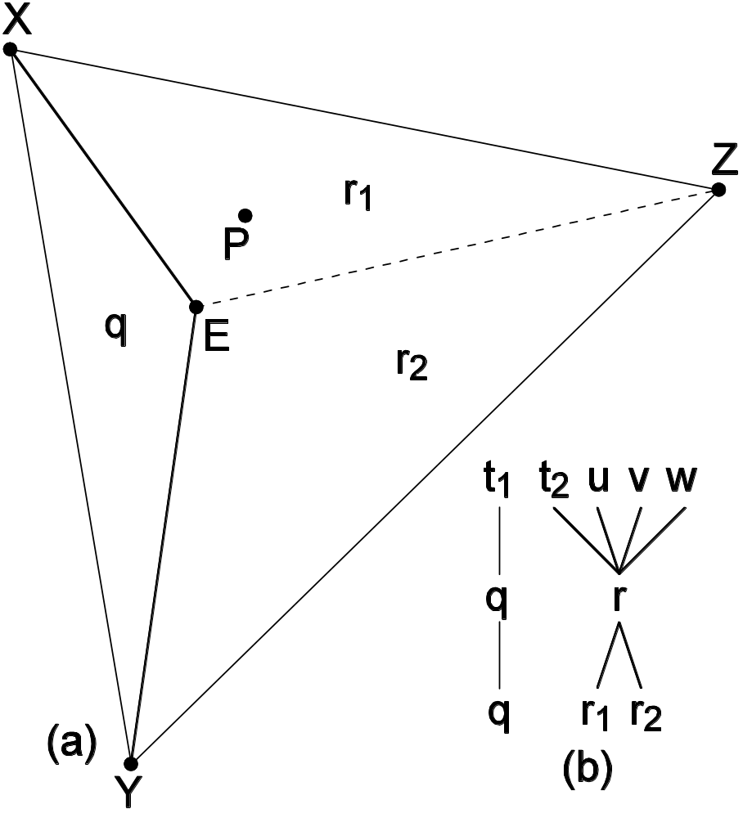
Simplification Hierarchy
Remove vertices B,D
Retriangulate
Remove vertex A
Retriangulate
Remove vertex C
Retriangulate

Slide 9
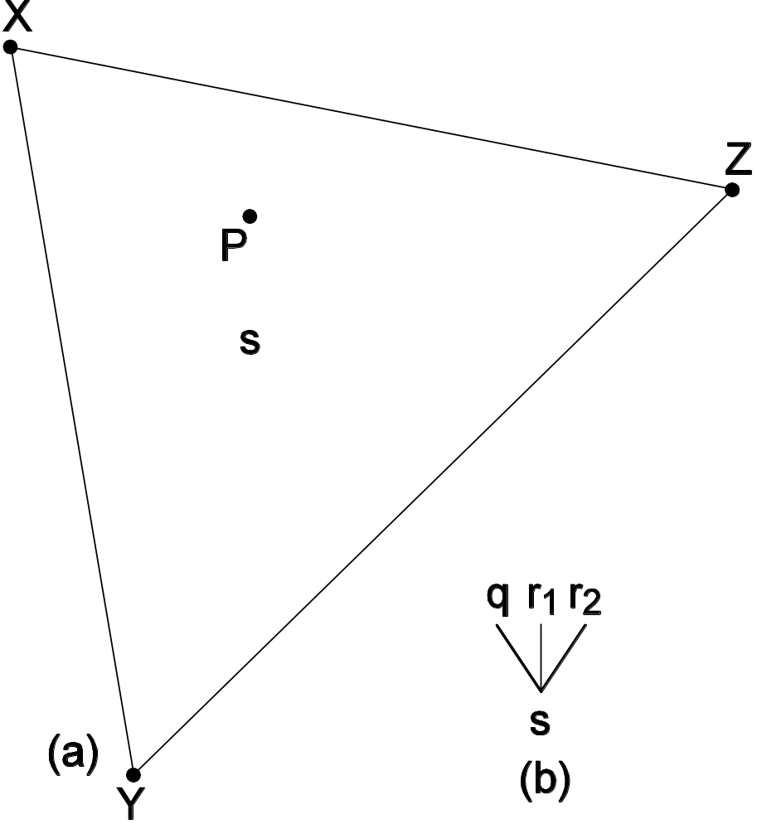
Simplification Hierarchy
Remove vertices B,D
Retriangulate
Remove vertex A
Retriangulate
Remove vertex C
Retriangulate
Remove vertex E
Done

Slide 10
Point Location in K-structure
Descend hierarchy of regions
Check each set of triangles in next level
Triangles grouped into polygons when not disjoint sets below
  Extra triangles to check, but disjoint regions
Each level guaranteed to shrink to less than 23/24th of the previous levels (# of vertices)
  Since only remove vertex if has eleven or less edges and mutually independent

Slide 11
Separating Chain
Avoids many extra edges
  Uses regularization instead of triangulation
  Builds Y-Monotone Subdivision
Hierarchy based on groups of regions, not triangles
  Polygonal regions allowed, not just triangular, so fewer
Original implementation slower than K-structure
  Faster when using Layered DAG
Improved storage using Gap Tree and Layered DAG

Slide 12
Y-Monotone Subdivision
No vertical line intersect a region’s boundary more than twice
  Creates polygons that are convex in x, not in y
Every vertex has edge to left and right in x
Regularization creates a Y-Monotone Subdivision from a polygonal map
  Adds endpoints at extremes in x
  And adds edges
  To get edges to the left and right of each vertex
  To ensure that regions with boundaries crossed more than twice are broken up

Slide 13
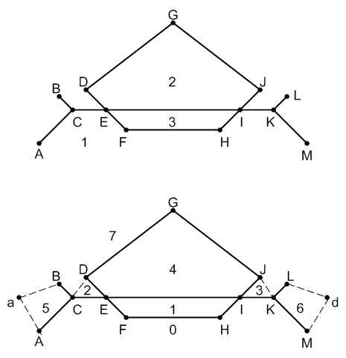
Regularization of Polygonal Maps
Insert vertices a,d at extreme edges in x
Add edges CD and JK, aA, aB, Ld, Md to have edges to left and right of every vertex
Broken lines are added edges
Not as many extra edges as triangulation
Polygonal Map
Y-Monotone Subdivision

Slide 14
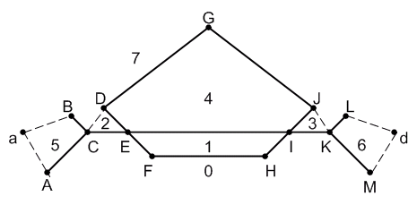
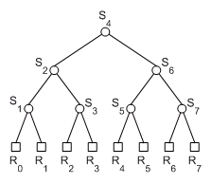
Region Ordering
Region number higher than region below (compared in y)
Only partial ordering (region 5 and 6 could have different numbers)
Can be used to create region tree
Need to determine separators S_{i}, set of edges that reach from a to d (all x)
Ordering used later for traversing the tree in point location
Region Tree

Slide 15
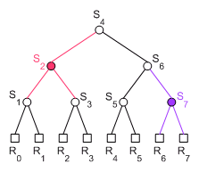
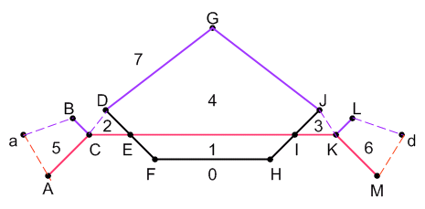
Finding Separating Chains
Boundary between regions as list of vertices
S₂ is between (0,1) and (2,3,4,5,6,7)
S₂ is then aACEIKMd
and S₇ is aBCDGJKLd

Slide 16
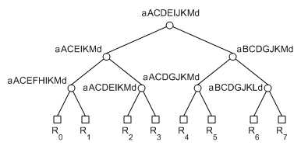
Separating Chain Tree
Region tree with separating chains stored in non-leaf nodes
Storage can be O(n²) since storing edges multiple times

Slide 17
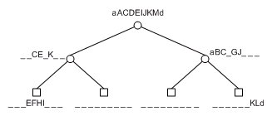
Gap Tree
Edges stored with first separator that contains it, not lower levels
Edges only stored once
Reduced storage over Chain Tree
Notation shows vertices
Chain Tree
Gap Tree

Slide 18
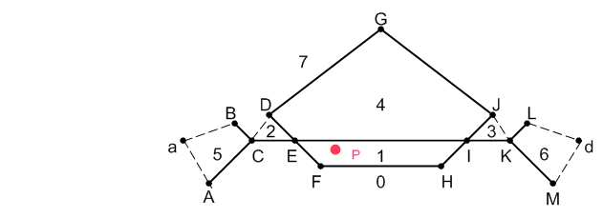
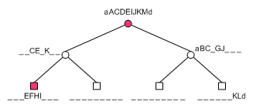
Point Location in Chain Tree or Gap Tree
Start at root with valid regions (0-7)
Search chain for segment with right x interval (EI)
Check if above or below segment (below)
Update valid regions (1 stored with edge EI as region below) to (0,1)
Move to least common ancestor of valid regions, possibly skipping levels, check chain (skip to S₁ as it is the least common ancestor of regions 0-1)

Slide 19
Gap Tree Search Performance
Gap Tree with m edges searches each separating chain for correct x interval, O(log(m)) since sorted
n separating chains in gap tree, so search log(n) separating chains at worst
Total search then O(log(m)log(n)) ~O(log²(m))
Layered DAG breaks x axis into intervals to speed up search, achieving O(log(m))
  Don’t redo search for correct x interval

Slide 20
Layered DAG
Avoids searching separating chains with hierarchy
Pointers from x-interval of one chain to the next
Avoid O(m²) space by allowing two child intervals
  If only one child per parent would get worst case O(m²) space
  For good worst-case space (linear in m edges) instead of m² need to have splits
  But limit parent interval to two child intervals
  Adds complexity to the structure, requires bottom-up construction
Combines edges, gaps, and vertices in representation
By Edelsbrunner, Guibas, and Stolfi

Slide 21
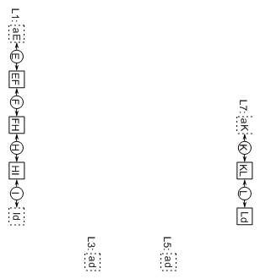
Building a Layered DAG
Start with lowest levels of the gap tree (L1, L3, L5, L7)
Insert gaps (dashed squares) and edges (solid squares) separated by vertices (circles)
Links from vertices to edges and gaps (arrows)
Bottom-up construction
Edges and gaps from higher levels will link down

Slide 22
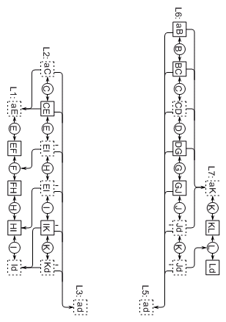
Building a Layered DAG
Next level is separating chain but only two intervals in child allowed per parent interval (L2)
  Edge or gap replicated (EI)
  Take alternating vertices up to next level to guarantee only 2 child intervals
Include links from parent interval to child interval(s)
  Pointer to vertex if two child intervals since need to check which interval
  Otherwise pointer to edge/gap

Slide 23
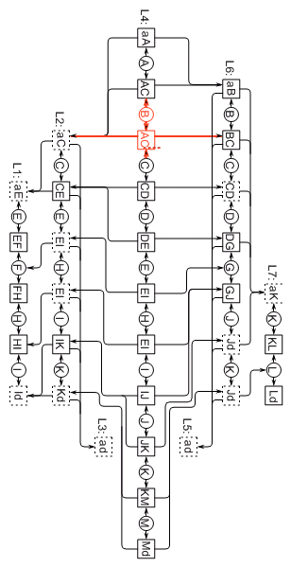
Build a Layered DAG
Iteratively build up, maintaining only two child intervals per parent interval
Maintain accurate names from the separating chain (AC in red) not names from vertices (would have been BC)
Note that adding alternating vertices from children is only one way to guarantee two child to one parent
  Other methods would simplify structure but complicate build

Slide 24
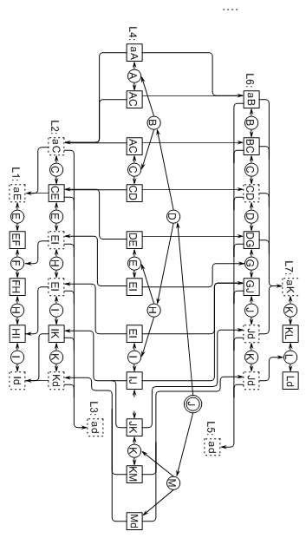
Point Location in DAG
Can use binary tree to access root separating chain
  Compare against x-value of vertices to traverse binary tree
Trace down through links in Layered DAG, comparing with the edges to traverse, comparing against x value of vertices if two child edges

Slide 25
Summary
Avoid extra edges
  Use regularization instead of triangulation
  Like Gap Tree, Layered DAG
Hierarchy based on polygons, not triangles
  Fewer regions if allowed to be polygonal, not just triangular
Need fast Hierarchical implementation
  Separating Chains and Gap Tree hierarchy requires redundant search
  Faster when using Layered DAG
Improve storage by storing only once
  Gap Tree and Layered DAG

