Slide 1
Buzzword List
OLTP – OnLine Transaction Processing (normalized, typically 3nf)
DSS – Decision Support System (de-normalized)
OLAP – OnLine Analytic Processing
BI – Business Intelligence
Data Warehouse
Operational Datastore
ETL – Extract Transform and Load
Star schema
Snowflake schema
De-normalization
Aggregation
DSS vs. OLTP benchmarks

Slide 2
Decision Support Systems
Decision-support systems are used to make business decisions, often based on data collected by on-line transaction-processing systems.
Examples of business decisions:
  What items to stock?
  What insurance premium to change?
  To whom to send advertisements?
Examples of data used for making decisions
  Retail sales transaction details
  Customer profiles (income, age, gender, etc.)

Slide 3
Decision-Support Systems: Overview
Data analysis tasks are simplified by specialized tools and SQL extensions
  Example tasks
    For each product category and each region, what were the total sales in the last quarter and how do they compare with the same quarter last year
    As above, for each product category and each customer category
Statistical analysis packages (e.g., : S++) can be interfaced with databases
  Statistical analysis is a large field, but not covered here
Data mining seeks to discover knowledge automatically in the form of statistical rules and patterns from large databases.
A data warehouse archives information gathered from multiple sources, and stores it under a unified schema, at a single site.
  Important for large businesses that generate data from multiple divisions, possibly at multiple sites
  Data may also be purchased externally

Slide 4
Data Analysis and OLAP
Online Analytical Processing (OLAP)
  Interactive analysis of data, allowing data to be summarized and viewed in different ways in an online fashion (with negligible delay)
Data that can be modeled as dimension attributes and measure attributes are called multidimensional data.
  Measure attributes
    measure some value
    can be aggregated upon
    e.g. the attribute number of the sales relation
  Dimension attributes
    define the dimensions on which measure attributes (or aggregates thereof) are viewed
    e.g. the attributes item_name, color, and size of the sales relation

Slide 5
Data Warehousing
Data sources often store only current data, not historical data
Corporate decision making requires a unified view of all organizational data, including historical data
A data warehouse is a repository (archive) of information gathered from multiple sources, stored under a unified schema, at a single site
  Greatly simplifies querying, permits study of historical trends
  Shifts decision support query load away from transaction processing systems

Slide 6
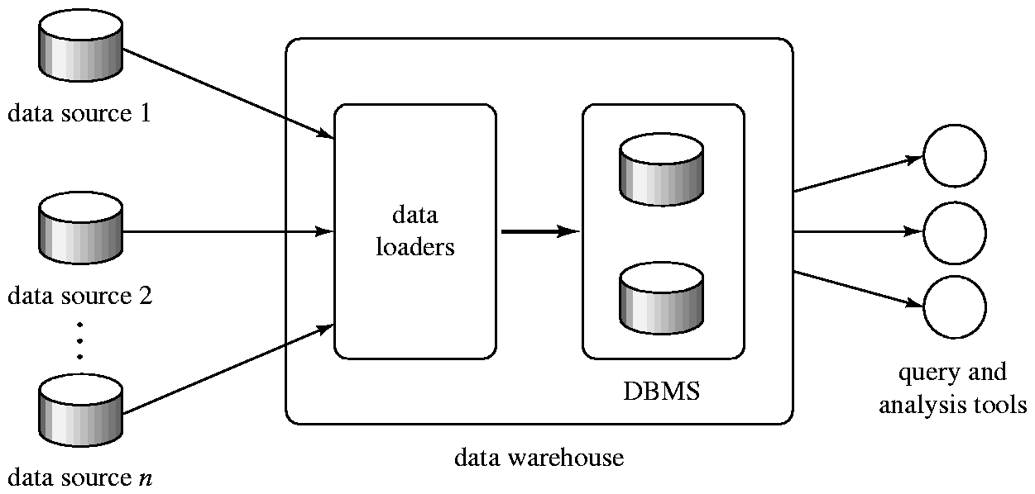
Data Warehousing

Slide 7
Design Issues
When and how to gather data
  Source driven architecture: data sources transmit new information to warehouse, either continuously or periodically (e.g. at night)
  Destination driven architecture: warehouse periodically requests new information from data sources
  Keeping warehouse exactly synchronized with data sources (e.g. using two-phase commit) is too expensive
    Usually OK to have slightly out-of-date data at warehouse
    Data/updates are periodically downloaded form online transaction processing (OLTP) systems.
What schema to use
  Schema integration

Slide 8
More Warehouse Design Issues
Data cleansing
  E.g. correct mistakes in addresses (misspellings, zip code errors)
  Merge address lists from different sources and purge duplicates
How to propagate updates
  Warehouse schema may be a (materialized) view of schema from data sources
What data to summarize
  Raw data may be too large to store on-line
  Aggregate values (totals/subtotals) often suffice
  Queries on raw data can often be transformed by query optimizer to use aggregate values

Slide 9
Warehouse Schemas
Dimension values are usually encoded using small integers and mapped to full values via dimension tables
Resultant schema is called a star schema
  More complicated schema structures
    Snowflake schema: multiple levels of dimension tables
    Constellation: multiple fact tables

Slide 10
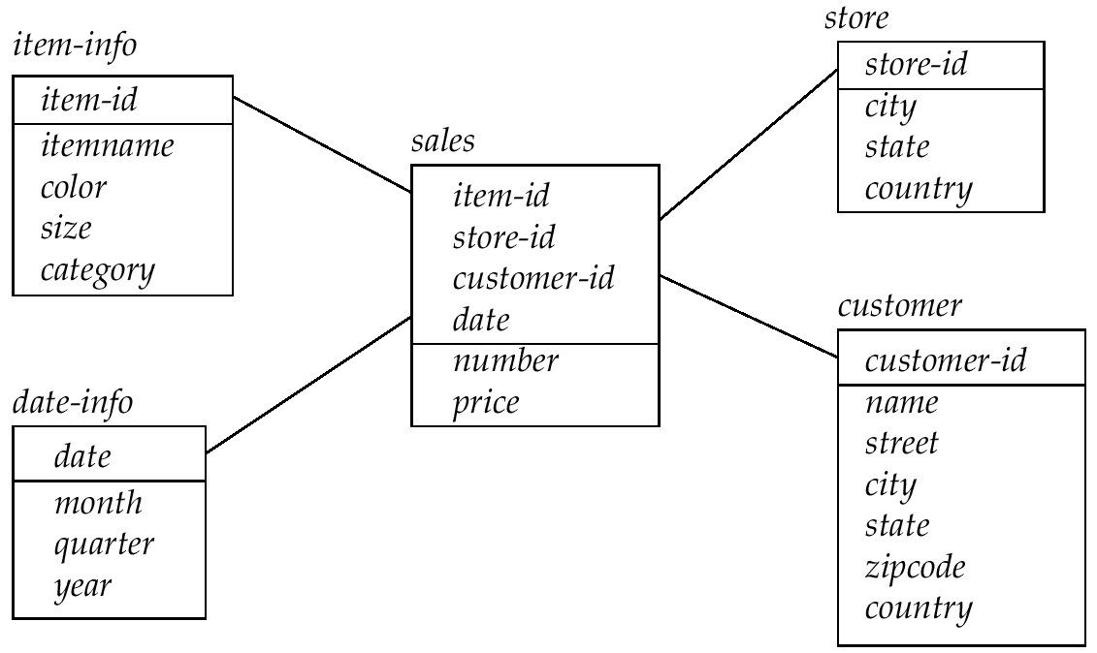
Data Warehouse Schema

