Slide 1
Introduction to VoltDB
Big Data & Analytics – Unites States AFPOA
Fred Holahan, CMO, VoltDB, Inc.
e: fholahan@voltdb.com
p: +1.978.528.0560
February 2012

Slide 2
Objectives of this Talk
Define Big Data – briefly
  Velocity, Volume and Variety
Identify a few high velocity applications in the military
Discuss VoltDB in the context of high velocity systems
  Design goals and concepts
Identify helpful learning resources
Q&A

Slide 3
Big Data – 3 Vs
 | Properties | Applications | Solutions
Velocity | Data that’s moving at very high speeds, often coming from real-time acquisition sources such as scanners, sensors and software-based monitors/collectors. | Hot caching Real-time analytics Real-time alerting Pre-export enrichment | VoltDB and other in-memory RDBMSs
Volume | Data coming from a variety of sources, accumulating into massive (Petabyte+) historical volumes. | Cold storage Batch analytics (patterns, trends, anomalies) | Hadoop and analytic datastores
Variety | Data with properties that are best supported by purpose-built datastores. Examples include document, graph and scientific data. | Blogs Online forums Social networks | NoSQL datastores

Slide 4







Connecting Velocity and Volume
DEEP ANALYTICS
(hours and up of latency)
TRANSACTIONS,
DASHBOARDS,
FAST ANALYTICS
(milliseconds of latency)
High Volume
Analytic Engine
Incoming
Events
High Velocity
Engine
Processed
Events
Gigabytes to Terabytes of
hot state
Terabytes and up of
cold history
Others
Notes:
Do we put a Variety “stream” in this image? Skipping the Velociy Engine?

Slide 5
High Velocity Database Requirements
Handle lots of independent events are at a very high frequency
  Update state, decisioning, transactions, enrichment, etc…
Stay up in the face of failures
  Make handling failures and recovery as automatic as possible
Support complex manipulations of state per event
  Support a range of real-time (or “near-time”) analytics
Integrate easily with high volume analytic datastores
  Raw, enriched or sampled data is migrated to companion stores
VoltDB

Slide 6
High Velocity Data in the Military
Real-time battlefield applications
  Including simulation and training systems
Surveillance
  Including real-time, constraint-based alerting
Network intrusion – detect, isolate, mitigate
Asset tracking
  Personnel
  Equipment and parts
  Ordinance
  Anything with a RFID tag
VoltDB is being used today by the DIA, NSA and CIA for performance-sensitive intelligence applications.

Slide 7
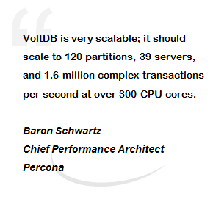
What Is VoltDB?
In-memory relational DBMS
Ultra-high performance
  Millions of ACID TPS
  Single-millisecond latencies
Scale out on commodity gear
  Choose a partitioning key, VoltDB does the heavy lifting
Built-in fault tolerance and crash recovery
Standard programming interfaces
  Build apps in the language of your choice
  Call Java stored procedures with parameterized, embedded SQL
Open source (GPL3) and commercial licenses

Slide 8
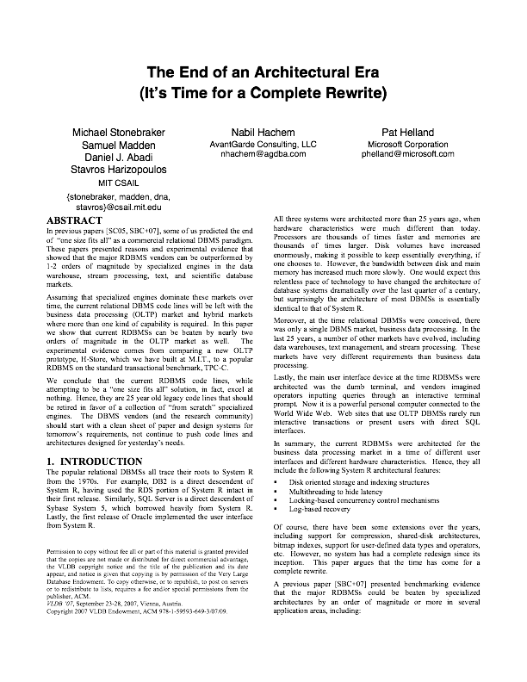
Started with H-Store
Project at MIT/Yale/Brown
Rethink the RDBMS for 21st Century
Built Screaming Fast In-memory RDBMS Prototype
Productized as VoltDB
H-Store research continues:
http://hstore.cs.brown.edu/
Notes:
----- Meeting Notes (6/2/11 13:30) -----
Barron Schwartz quote

Slide 9
VoltDB Now: 1 Node Edition
Per 8-core node:
> 1 million SQL statements per second
> 50,000 multi-statement procedures per second
> 100,000 simpler procedures per second
Notes:
----- Meeting Notes (6/2/11 13:30) -----
Barron Schwartz quote

Slide 10
Throughput & Scaling
Scales to dozens of node
Can easily scale to millions of events/transactions per second
Most deployments use fewer than 10 nodes
Notes:
----- Meeting Notes (6/2/11 13:30) -----
Barron Schwartz quote

Slide 11
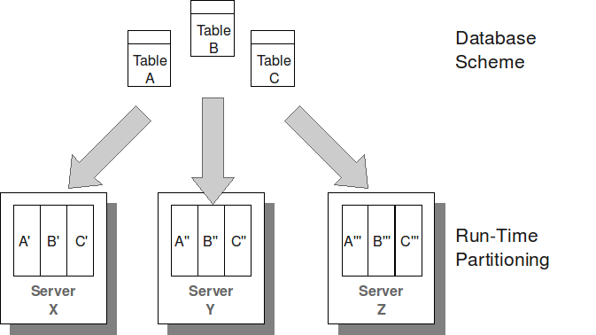
VoltDB Scaling Model
Tables are horizontally split into partitions
Partitions deployed to CPU cores – scale up and out
Infrequently-changing tables replicated across partitions

Slide 12

Inside a VoltDB Partition
Each partition contains data and an execution engine
The execution engine contains a queue for transaction requests
Requests run to completion, serially, at each partition
Work
Queue
execution engine
Table Data
Index Data

Slide 13

VoltDB Transactions
Transaction == Single SQL Statement or Stored Procedure Invocation
  Committed on Success
Java Stored Procedures
  Java statements with embedded, parameterized SQL
  Efficiently process SQL at the server
  Move the code to the data, not the other way around
SQL

Slide 14
Client Application Interfaces
Client Options
  Libraries for Java, C++, C#, PHP, Python, Node.js (Javascript) and other popular languages
  JSON via HTTP
Client connects to the cluster
  Data location is transparent
  Topology is transparent
  Cluster manages routing, data movement and consistency

Slide 15
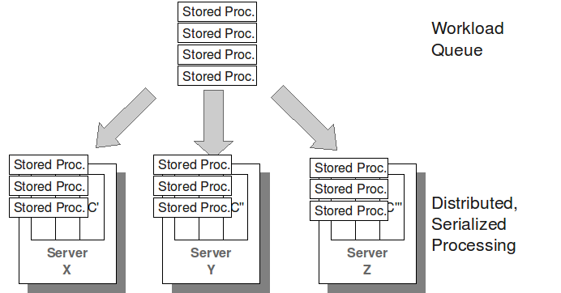
VoltDB Transaction Model
Procedures routed to, ordered and run at partitions
VoltDB

Slide 16
Transaction Execution
VoltDB Cluster
Single partition transactions
  All data is in one partition
  Each partition operates autonomously
Multi-partition transactions
  One partition distributes and coordinates work plans
Server
1
Partition 1
Partition 2
Partition 3
Server
2
Partition 4
Partition 5
Partition 6
Server
3
Partition 7
Partition 8
Partition 9

Slide 17
Data Availability and Durability
High Availability
  Data stored on server replicas (user configurable)
  Failover data redundancy
  No single point of failure
Database Snapshots
  Simplifies backup/restore
  Scheduled, continuous, on demand
  Cluster-wide consistent copy of all data
Command Logging
  Between Snapshots, every transaction is durable to disk

Slide 18
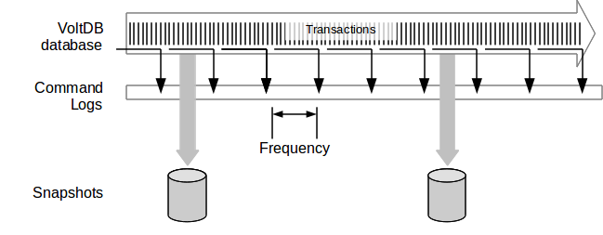
Command Logging
Tunable fsynch*
frequency
Tunable snapshot interval
Synchronous logging provides highest durability at reduced performance
Asynchronous logging best performance at reduced durability
* fsynch is when command log buffers are flushed to disk (or SSD)

Slide 19
Hadoop/OLAP Database Integration
VoltDB high-throughput export feature
  Export of real-time and “near-time” data to target data stores
  Enrich data prior to export
    Pre-join, de-duplicate, aggregate
VoltDB Export key features
  Loosely-coupled integration
  Buffer for impedance mismatches
  Auto-discovery of cluster configurations with retry
Direct Hadoop integration

Slide 20

Hadoop/OLAP Database Integration
Connector
Receiver
Data Queue
VoltDB
Server
Target
Database
Queue
Overflow
Records are streamed to the export connector data queue (in-memory)
Export receiver pulls from data queue, writes to downstream datastore
Data queue overflows to disk if receiver doesn’t keep up
Mitigates “impedance mismatches”
Provides bi-directional durability

Slide 21
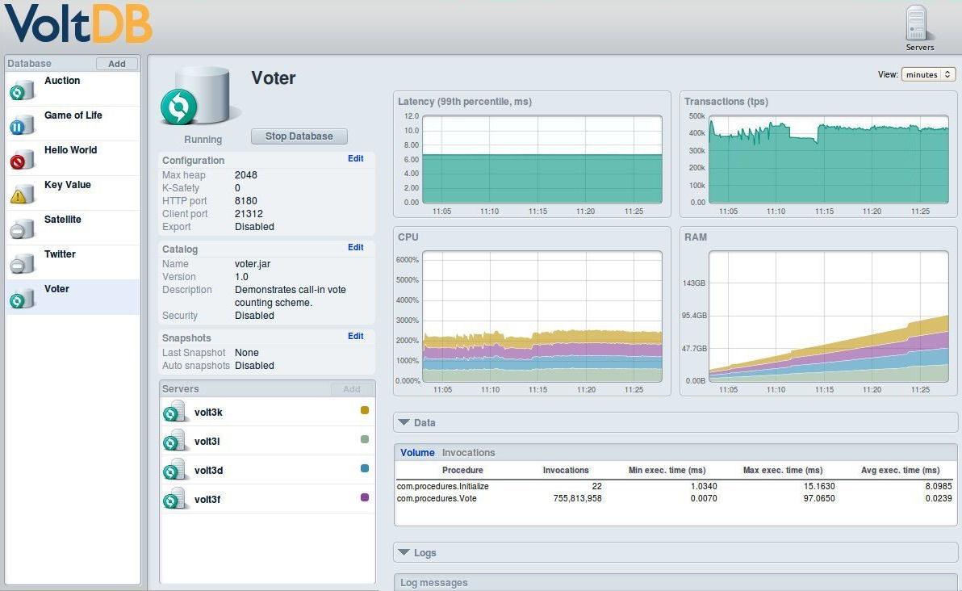
Database Management & Monitoring

Slide 22
VEM REST Management API
Provides public interface to VoltDB’s admin and management services
First-class citizen interface (used by VEM UI)
Allows user-controlled actions
  Custom database admin UIs
  Scripting of common, repeatable activities
Supports integration of 3rd party tools and cloud deployment environments

Slide 23


VoltDB Disaster Recovery (Beta)
Disk snapshots replicated via storage system
Stream command logs from Primary to Replica
Run from Replica on DR event, reverse on recovery
Primary Site
Remote Replica Site
(read only)
Snap
Shots
VoltDB
Cluster
VoltDB
Cluster

Slide 24











VoltDB Customers

Slide 25
VoltDB Resources
Technical white papers | http://voltdb.com/resources/whitepapers
VoltDB documentation | http://community.voltdb.com/documentation
Software downloads | http://voltdb.com/products-services/downloads
Community forums | http://community.voltdb.com/forum
Sales contact | +1.978.528.4660 sales@voltdb.com

Slide 26
- Thank You -
Questions?

