Slide 1
TurboGraph:
A Fast Parallel Graph Engine Handling Billion-scale Graphs in a Single PC
Wook-Shin Han, Sangyeon Lee
POSTECH, DGIST

Slide 2
outlines
INTRODUCTION
RELATED WORK
EFFICIENT GRAPH STORAGE
DISK-BASED PARALLEL GRAPH COMPUTATION
PROCESSING GRAPH QUERIES
EXPERIMENTS
CONCLUSION

Slide 3
about TurboGraph
TurboGraph is the first truly parallel graph engine that exploits :
1) full parallelism including multi-core parallelism and FlashSSD IO parallelismand
2) full overlap of CPU processing and I/O processing as much as possible.
3) Specifically, we propose a novel parallel execution model, called pin-and-slide.
4) TurboGraph also provides engine-level operators such as BFS which are implemented under the pin-and-slide model.

Slide 4
problems of PSW from Graphchi
1) In order to start updating vertices/edges in a shard file, their in-edges must be fully loaded in memory.
2) All edges in the shard file whose source and target vertices are in the same execution interval are processed in sequential order, which hinders full parallelism.
3) At each iteration, a significant number of updated edges can be flushed to disk.
4) Even if a query needs to access a small portion of the data graph, it reads the whole graph at the first iteration.

Slide 5
contributions
1) a general and scalable graph engine on a single machine
2) efficient disk and memory structures for representing billion-scale graphs
3) fast and scalable core graph operations which implement the pin-and-slide model.
4) TurboGraph consistently and significantly outperforms the state-of-the-art methods by up to four orders of magnitude!

Slide 6
outlines
INTRODUCTION
RELATED WORK
EFFICIENT GRAPH STORAGE
DISK-BASED PARALLEL GRAPH COMPUTATION
PROCESSING GRAPH QUERIES
EXPERIMENTS
CONCLUSION

Slide 7
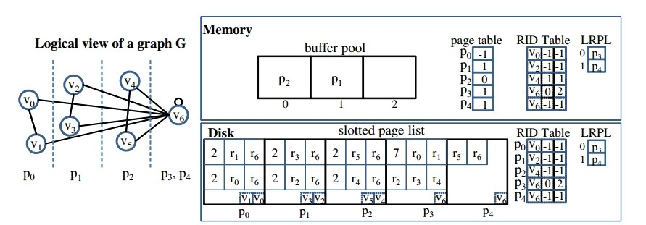
Disk-based Graph Representation

Slide 8
In-memory Data Structures
The buffer manager of TurboGraphmaintains a buffer pool, actually, an array offrames, each of which consists of the page-sized sequences of main memory bytes and some meta information such as pin count, reference bit, and dirty bit.

Slide 9
Core Operations
PINCOMPUTEUNPIN(PageID pid, list<RID> RIDList, UserObject uo), in order to allow asynchronous I/Os to the FlashSSD.

Slide 10
outlines
INTRODUCTION
RELATED WORK
EFFICIENT GRAPH STORAGE
DISK-BASED PARALLEL GRAPH COMPUTATION
PROCESSING GRAPH QUERIES
EXPERIMENTS
CONCLUSION

Slide 11
The Pin-and-Slide Model(based on bit)
a buffer pool
a graph database
two types of threads: execution threads
callback threads.

Slide 12
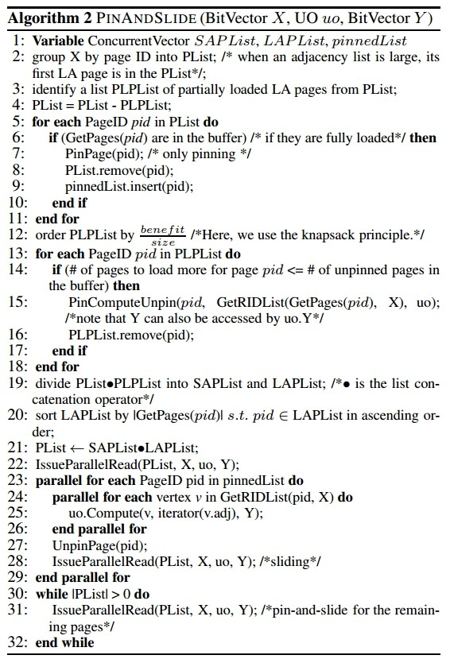

Slide 13
The Pin-and-Slide Model(based on bit)
the size
= the number of the total LA pages
−the number of its PL pages
maximize the benefit of all items in the 0-1 knapsack.

Slide 14
Handling General Vectors
The main idea is to adopt the concept of the block-based nested loop join, which is well-known in the database area. We regard the set of pages pinned in the current buffer as a blockand also assume that a general vector is partitioned into multiplechunkssuch that each chunk fits in memory.

Slide 15
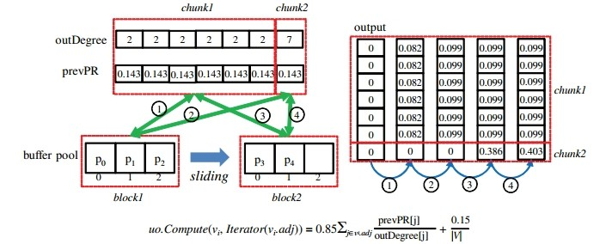
Handling General Vectors---PageRank

Slide 16
outlines
INTRODUCTION
RELATED WORK
EFFICIENT GRAPH STORAGE
DISK-BASED PARALLEL GRAPH COMPUTATION
PROCESSING GRAPH QUERIES
EXPERIMENTS
CONCLUSION

Slide 17
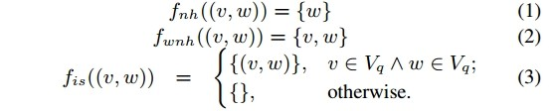
Targeted Queries
neighborhood, induced subgraph, egonet, K-core,
and crossedges

Slide 18
outlines
INTRODUCTION
RELATED WORK
EFFICIENT GRAPH STORAGE
DISK-BASED PARALLEL GRAPH COMPUTATION
PROCESSING GRAPH QUERIES
EXPERIMENTS
CONCLUSION

Slide 19
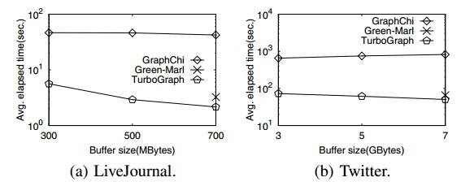

Slide 20
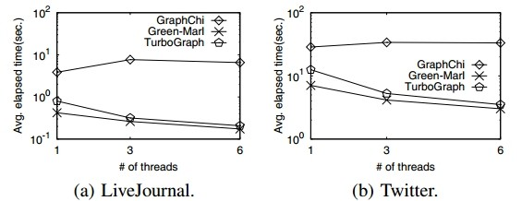

Slide 21
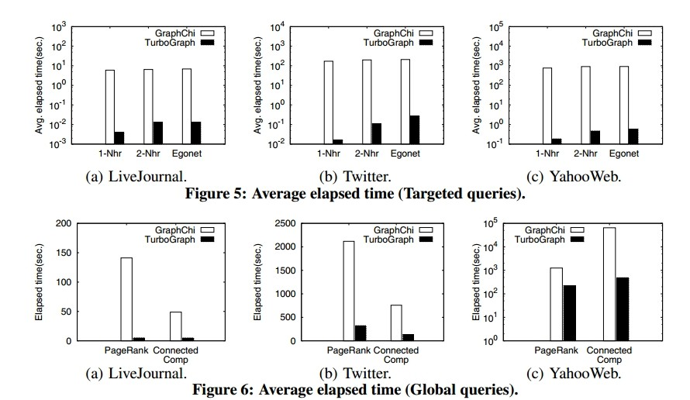

Slide 22
outlines
INTRODUCTION
RELATED WORK
EFFICIENT GRAPH STORAGE
DISK-BASED PARALLEL GRAPH COMPUTATION
PROCESSING GRAPH QUERIES
EXPERIMENTS
CONCLUSION

Slide 23
Through extensive experiments on large, real graphs, including billion-nodegraphs, we showed that TurboGraphoutperforms the state-of-the-art algorithms by up to four orders of magnitude. Overall, we believe we provide comprehensive insight and a substantial framework for future research.
thx @hh's

