Slide 1
The Volcano/Cascades Query Optimization Framework
S. Sudarshan

Slide 2

Transformation Rules
Commutativity
Associativity
Selection Push Down

Slide 3
Volcano/Cascades Framework for Query Optimization
Based on equivalence rules
Key benefit: extensibility
  As compared to System-R style join-order optimization+extensions:
  easy to add rules to deal with new operators
    e.g. outerjoin group-by/aggregate, limit, ...
  Memoization technique which generalizes System R style dynamic programming applicable even with equivalence rules
Developed by Goetz Graefe as follow up to Exodus optimizer
Used in SQL Server, Tandem, and Greenplum/Orca, and several other databases, increasing adoption
Description in this talk based on Prasan Roy’s thesis
IIT Bombay
4
Notes:
Point 2 – not clear

Slide 4
Enumeration of Equivalent Expressions
Query optimizers use equivalence rules to systematically generate expressions equivalent to the given expression
Can generate all equivalent expressions as follows:
  Repeat
    apply all applicable equivalence rules on every equivalent expression found so far
    add newly generated expressions to the set of equivalent expressions
    Until no new equivalent expressions are generated above

Slide 5
The above approach is very expensive in space and time
  Two approaches
    Optimized plan generation based on transformation rules
    Special case approach for queries with only selections, projections and joins

Slide 6
Implementing Transformation Based Optimization
Space requirements reduced by sharing common sub-expressions:
  when E1 is generated from E2 by an equivalence rule, usually only the top level of the two are different, subtrees below are the same and can be shared using pointers
    E.g. when applying join commutativity
  Same sub-expression may get generated multiple times
    Detect duplicate sub-expressions and share one copy
E1
E2

Slide 7
Implementing Transformation Based Optimization
Time requirements are reduced by not generating all expressions
  Dynamic programming
    We will study only the special case of dynamic programming for join order optimization
E1
E2

Slide 8
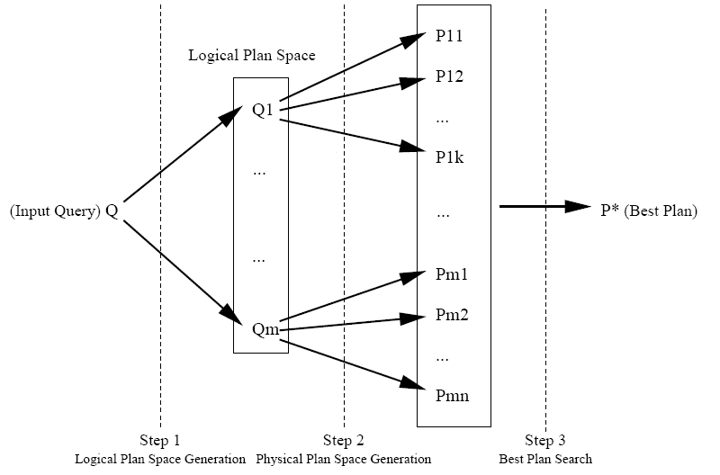
Steps in Transformation Rule Based Query Optimization
1. Logical plan space generation
2. Physical plan space generation
3. Search for best plan

Slide 9
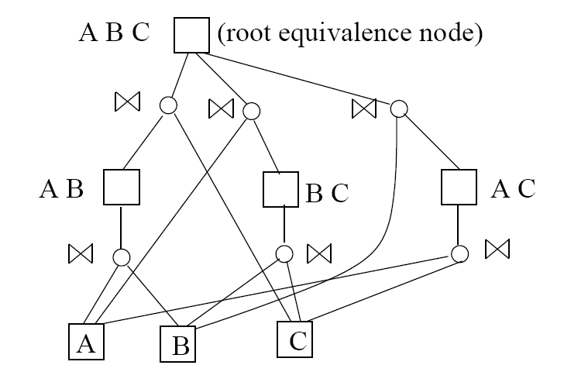
Logical Query DAG

Slide 10
Logical Query DAG
A Logical Query DAG (LQDAG) is a directed acyclic graph whose nodes can be divided into
  equivalence nodes and
  operation nodes
Equivalence nodes have only operation nodes as children and
Operation nodes have only equivalence nodes as children.

Slide 11
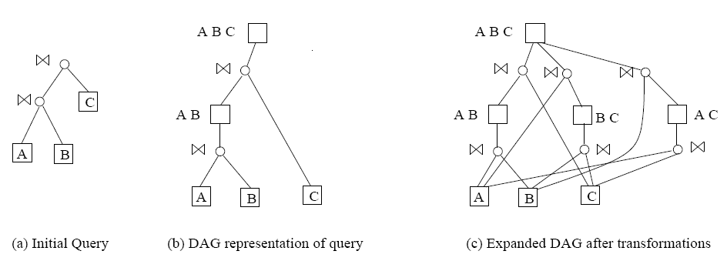
Steps in Creating LQDAG

Slide 12
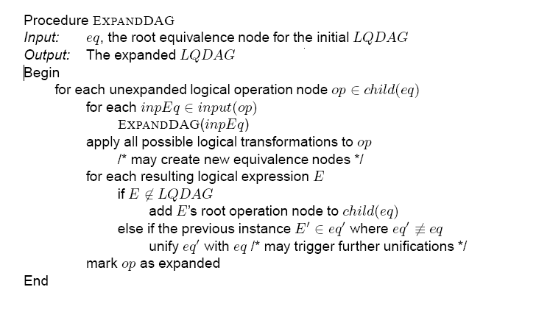
Creating the LQDAG
How to do
this efficiently?

Slide 13
Checking for Duplicates
Each equivalence node has an ID
  base case: relation IDs
When a transformation is applied, need to check if expression is already present
  Idea: transformation is local, some equivalence nodes are just copied unchanged
  For all new operations in the transformation result, check (bottom up) if already present
    using a hash table
  hash table (aka memo structure in Volcano/Cascades)
    hash function h(operation, IDs of operation inputs)
    stores ID of equivalence node for which the above is a child
    if not present in hash table, create new equivalence node
    else reuse equivalence nodes ID when computing hash for parent

Slide 14
Physical Query DAG
Take into account
  algorithms for computing operations
  useful physical properties
Physical properties
  generalizes System R notion of “interesting sort order”
  e.g. compression, encryption, location (in a distributed DB), etc.
  Enforcers returns same logical result, but with different physical properties
  Algorithms may also generate results with useful physical properties

Slide 15
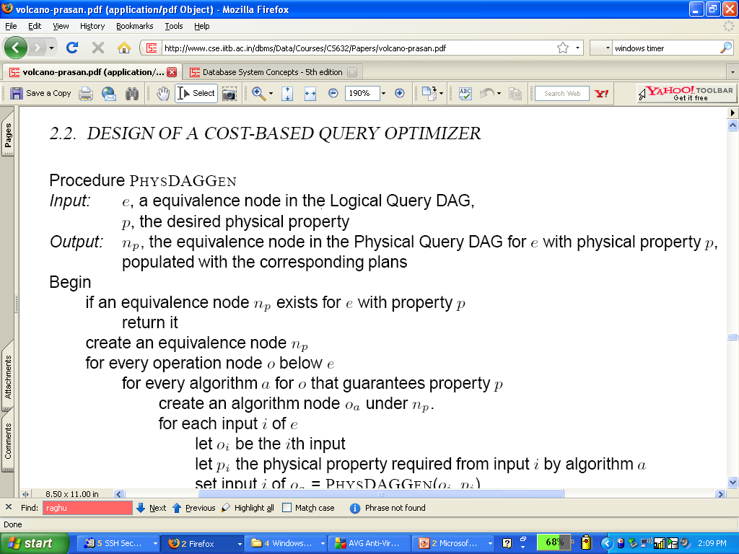
Physical DAG Generation
(e,p)
……cont ……

Slide 16
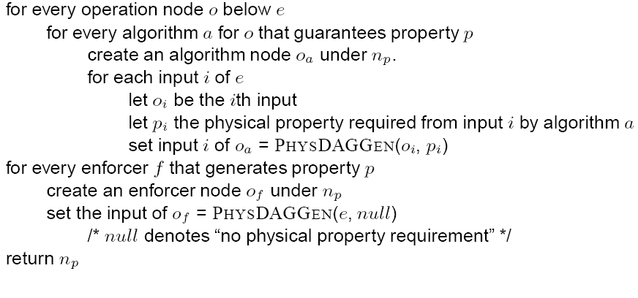
Physical DAG Generation

Slide 17
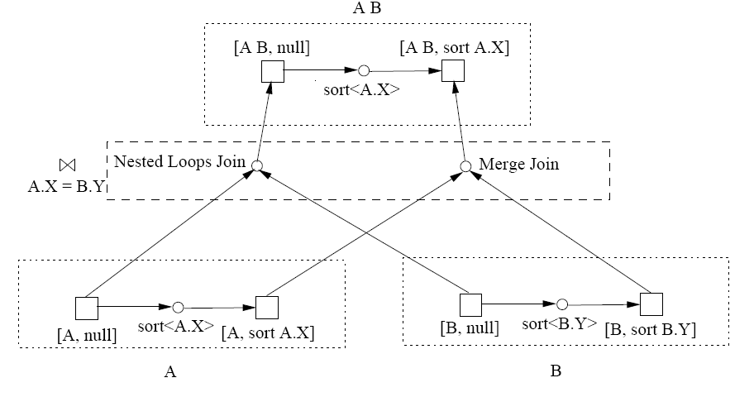
Physical Query DAG
Physical Query DAG for A join_{A.X=B.Y} B

Slide 18
Physical Property Subsumption
E.g. sort on (A,B) subsumes sort on (A)
  and sort(A) subsumes unsorted
physical equivalence node e subsumes physical equivalence node e’ iff any plan that computes e can be used as a plan that computes e’
  Useful for multiquery optimization
  But ignored by Volcano

Slide 19
Finding The Best Plan
In Volcano: physical DAG generation interleaved with finding best plan
  branch and bound pruning, avoids exploring much of the search space
  in Prasan’s version: no pruning (required for MQO)
Also in Prasan’s version: find best plan procedure split into two procedures
  one for best enforcer plan, and
  one for best algorithm plan

Slide 20
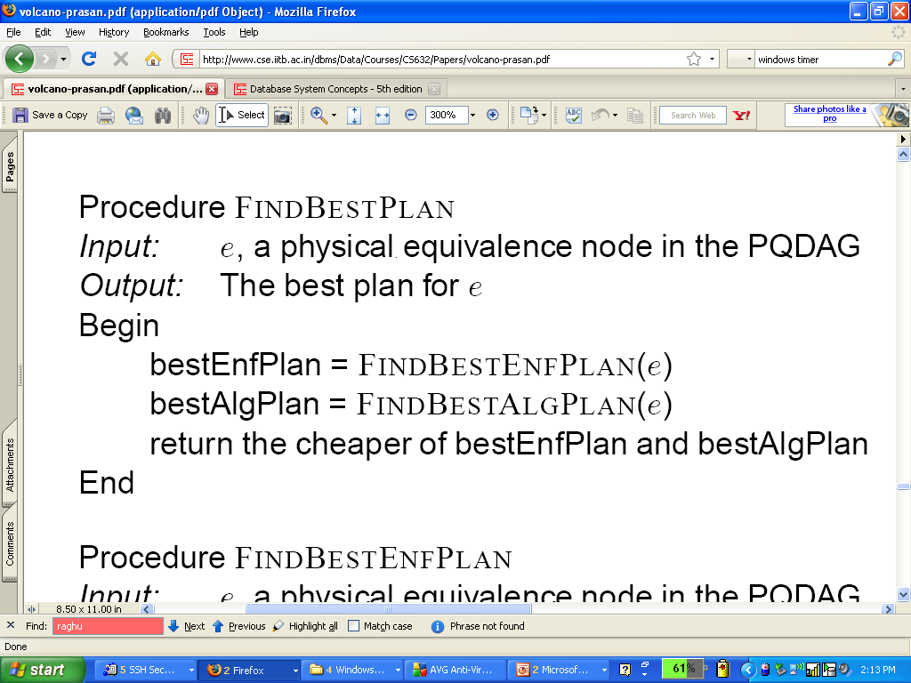
Finding The Best Plan

Slide 21
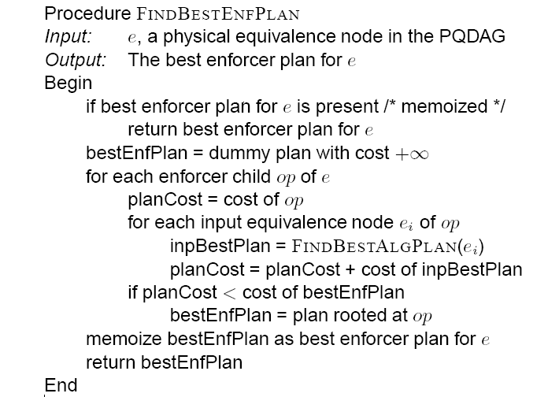
Finding Best Enforcer Plan

Slide 22
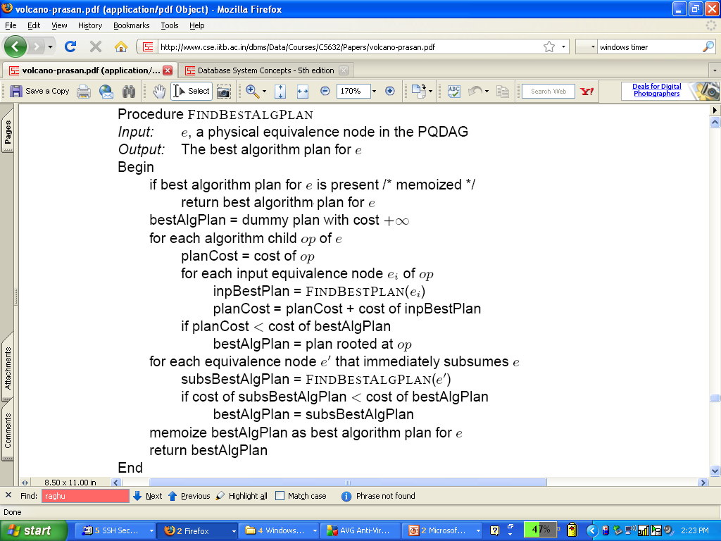
Finding Best Algorithm Plan

Slide 23
Original Volcano FindBestPlan
FindBestPlan (LogExpr, PhysProp, Limit)
if the pair LogExpr and PhysProp is in the look-up table
  if the cost in the look-up table < Limit
    return Plan and Cost
  else return failure
/* else: optimization required */
create the set of possible "moves" from
  applicable transformations
  algorithms that give the required PhysProp
  enforcers for required PhysProp
order the set of moves by promise

Slide 24
Original Volcano FindBestPlan
for the most promising moves
  if the move uses a transformation
    apply the transformation creating NewLogExpr
    call FindBestPlan (NewLogExpr, PhysProp, Limit)
  else if the move uses an algorithm
    TotalCost := cost of the algorithm
    for each input I while TotalCost < Limit
      determine required physical properties PP for I
        Cost = FindBestPlan (I, PP, Limit − TotalCost)
        add Cost to TotalCost
  else /* move uses an enforcer */
    TotalCost := cost of the enforcer
    modify PhysProp for enforced property
    call FindBestPlan for LogExpr with new PhysProp

Slide 25
Original Volcano FindBestPlan
/* maintain the look-up table of explored facts */
if LogExpr is not in the look-up table
  insert LogExpr into the look-up table
  insert PhysProp and best plan found into look-up table
return best Plan and Cost

Slide 26
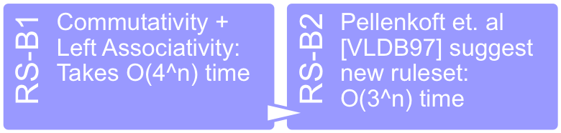
Complexity of Rule Sets
Pellenkoft [1997] showed that
  Associativity+commutativity leads to O(4^{n}) time cost
  Due to duplicates, as against O(3^{n}) with System-R style dynamic programming
  Proposed new ruleset RS-B2 ensuring O(3^{n}) cost

Slide 27
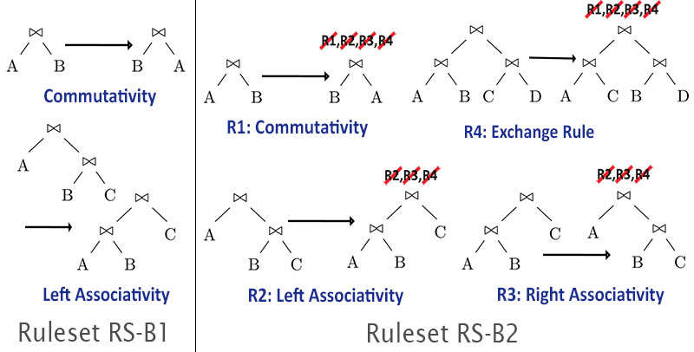
Pellenkoft et al.’s Rule Set RS-B2
Key idea: disable certain transformation on the result of a transformation
IIT Bombay
5

Slide 28
Avoiding Cross Products
System R algorithm
  Dynamic programming algorithm to find best join order
  Time complexity: O(3^{n}) for bushy join orders
  Plan space considered includes cross products
For some common join topologies #cross-product free intermediate join results is polynomial
  E.g. chain, cycle, ..
Can we reduce optimization time by avoiding cross products?
  Algorithms for generation of cross-product free join space
    Bottom up: DPccp (Moerkotte and Newmann [VLDB06])
    Top-down: TDMinCutBranch (Fender et al. [ICDE11]), TDMinCutConservative (Fender et al. [ICDE12])
  Time complexity is polynomial if #cross-product free intermediate join results is polynomial in size
IIT Bombay
2

Slide 29
Cross-Product-Free Join Order Enumeration using Graph Partitioning
Key idea for avoiding cross products while finding best join tree:
For set S of relations, find all ways to partition S into S1 and S2 s.t.
  the join graph of S1 is connected,
  and so is the join graph of S2
  there is an edge (join predicate) between S1 and S2
Simple recursive algorithm to find best plan in
cross-product free join space using partitioning
as above
Efficient algorithms for finding all ways to partition S into S1 and S2 as above
  MinCutLazy (Dehaan and Tompa [SIGMOD07])
  Fender et. al proposed MinCutBranch [ICDE11] and MinCutConservative [ICDE12]
    MinCutConservative is the most efficient currently.
S
S1
R1
R2
S2
R4
R3
IIT Bombay

Slide 30
Avoiding Cross-products in Transformation-Based Optimizers
Key idea: suppress a transformation if its results in a cross-product
Shanbhag and S., VLDB 2014 show
  RS-B1 modified to suppress cross products is complete but expensive
  RS-B2 extended to suppress cross products is not complete
  Propose new ruleset for innerjoins which
    Works in a non-local manner (considers maximal sets of adjacent joins)
    Exploits graph partitioning to avoid cross products
    Is very efficient in practice

Slide 31
Cascades Optimization Framework
Extension to the Volcano framework, by Graefe et al.
Notion of tasks, e.g. application of logical or physical equivalence rule
  At an equivalence node or at an operation node
Execution of a task may result in creation of other tasks
Allows tasks to be prioritized (but still in DFS)

