Slide 1
How Google Works
Lisa Holmberg
Bibliographical Center for Research
lholmber@bcr.org
Notes:
REC

Slide 2
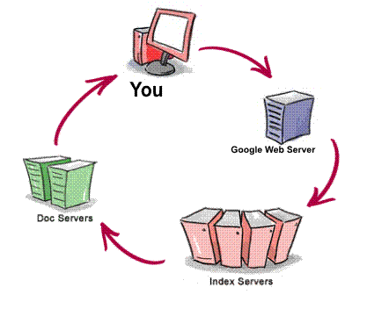
What happens when you Google?
Notes:
Google doesn’t actually search the web. It searches it’s index of the web… a copy.
The doc server assembles the results that the index server produces. This is where Google’s page rank software comes in to determine what order the results are in.

Slide 3
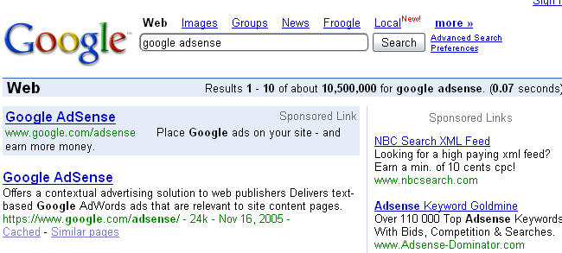
Google Search Results
Approximate # of hits
Ads selected by Google based on you search terms
Database Google Used
URL, size, date last crawled
Cached link
Pages like this one
Search terms are in bold
Notes:
Stress that Google is searching it’s database of copies of the web, spread out over 500 computers

Slide 4
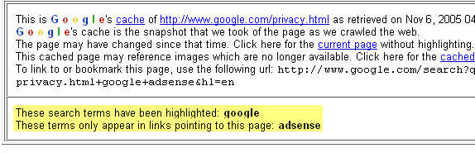
Google Cache
Notes:
Proof that Google is searching a database and not the real web.

Slide 5
Google Cached
Cached reveals the page as Google found it
  may differ from the current page
  Cached exists if a page is full-text indexed
    About 1 billion pages in Google are not cached
    Not fully searchable
  no Cached if a page owner requests not to be cached

Slide 6
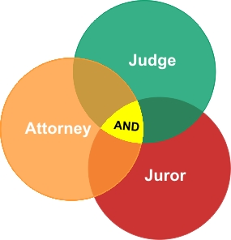
Boolean Searching
And
Notes:
Google’s default, but it’s fuzzy
Problems?
words can occur anywhere in results pages
may have different meanings or contexts
some pages may not contain all of your words
some may not have any of your words

Slide 7
Default AND between terms
The Fuzzy And
  only some of the words if a page is “important”
  words may occur only in link to the page
  words occur somewhere on the site a page belongs to
Notes:
And
Talk briefly about Boolean searches (how many know what this is)

Slide 8
Stemming
Google stems “when appropriate”
  Includes plural, singular, past, present tense of words in search
  Search: school librarian
  Result: library, librarian, library’s, librarian’s
  Single word searches aren’t stemmed
Notes:
Stemming
The word is automatically searched as the stem or root with many endings allowed.
kite flying retrieves words with kite kites, flying, fly, flyer’s, flyers’, flyers
--side note not case sensitive
Write in Turn off answers
Operator, quotes, single word searches or searches using only ‘stop words’

Slide 9
What Google doesn’t search
(unless you ask nicely)
Common or Stop words are ignored
  No official list from Google
  Auto-phrasing
  Searches containing only stop words
Notes:
Write in Turn off answers
Operator
Quotes
Single word

Slide 10
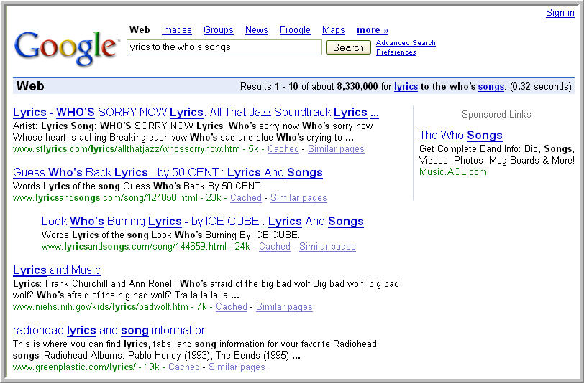
What Google doesn’t search
(unless you ask nicely)

Slide 11
Google Search Results
More than 100 factors in the metrics
On-the-page metrics
  Word order matters
    Word frequency
    Automatic-phrasing
  In the title
  In unique fonts
  In prominent areas (like lists)
Notes:
Google Metrics
Over 100 different factors in each search, algorithm is always changing + spider continually updating database (thus results change)
Proprietary software
Search words can appear in title of page, link to page, URL of the page & the page itself
Pages weight by prominence of words & frequency of words;
Searches for all your terms on a page, even better your terms near each other… best of all pages where your search terms appear in the order you typed them.
Weights links pointing to the page (popularity contest doesn’t return the most creditable resource)
Links from more popular sites are weighted more

Slide 12
PageRank
Off-the-page metrics
  Words describing the link
  Links on one site to another are like votes-- PageRank
    Stuffing the ballot box
    Reputation of the ‘voting’ page
  Can’t buy a better PageRank
  PageRank independent of search terms
Notes:
Reputation
Some receive high rep by default, gov agencies, well-know or prominent companies, university faculty (smithsonian, nasa, JAMA…)
Good rep by association with the above

Slide 13
But how do I make my searches better?

Slide 14
Improving Google’s AND
+ Inclusion operator
  Force searches on stop words
  Turns off stemming
Use quotation marks for phrases
  “public librarian” 234,000 .4% of
  public librarian 58,600,000
  Forces searches on stop words
  Turns off stemming
Notes:
Use quotes or inclusion operator to turn off stemming, force search on stop words,

Slide 15
Improving Google’s AND
Hyphen makes phrases and searches with and without hyphens
  bite-sized retrieves:
    bite-sized, bite sized, bitesized
    Other examples?
Notes:
Always use the hyphen on words that might be hyphenated since it searches both
Words are treated as a phrase – simliar to w/ quotes
Other examples: asian-american, african-american, mother-in-law, ex-wife, e-mail

Slide 16
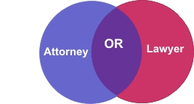
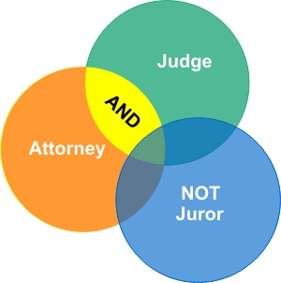
Boolean Searching
Or
Not
Notes:
OR
Useful when:
stemming doesn’t cover the variation your looking for;
To cover a common misspelling;
For synonyms – parent/guardian;
Address apostrophe variations
Can also use | instead of OR
NOT
Not isn’t supported by Google, will use (-) instead

Slide 17
Search Operators
OR search
    Search for two terms at once
- exclusion operator
    Use with care;
    Search:
    twins Minnesota 2,750,000
    Eliminate undesired words
    twins Minnesota –sports 1,300,000

Slide 18
Search Operators
* full-word wild card, word substitution
  Ideal for partly remembered quotes
  Searching for answers to questions
  Proximity searches
~ synonym operator
  ~guide searches for: tutorial, manual, help, map, tips
Notes:
Wildcard
Recently ‘softened’ no need to use more than one asterisk per word
-The parachute was invented by *
- Vitamin * is good for eyes
Ask class for examples
~college
~zoo
~library

Slide 19
Limitless Options for Limits
Intitle: terms are searched for in title only
  Pages concentrate on term
    Hybrid cars intitle:mileage
  Combine with OR
    intitle:"new urbanism" OR intitle:"sustainable communities”
  allintitle:
    Combine with site:
      allintitle: hybrid cars mileage –site:.com
Notes:
Other uses?

Slide 20
Using URL’s
Limit to a domain (edu, com, etc)
    site:edu OR site:gov OR site:lib.co.us
Search within a site
  site:memory.loc.gov “dust bowl”
      Use Google as a search engine for a site
      Can ONLY use first part of URL
      Omit http: & final /
    inurl:dustbowl
      searches for term anywhere in URL
Notes:
How would you use this?
Google toolbar feature

Slide 21
Finding that file
Filetype:
  Search for a particular type of document
    tax return filetype:pdf
  Exclude a filetype
    -filetype:xls
  Can use view as HTML
      Avoid viruses
      Allows you to read it even if you don’t have the software
Notes:
How would you use this?

Slide 22
More about Google
Google Guide
http://www.googleguide.com/
Google Librarian Center
http://www.google.com/librariancenter/index.html

