Slide 1
Decomposition Storage Model (DSM)
An alternative way to store records on disk
Notes:
Define context from the start. We’re talking about physical DB organization.

Slide 2
Outline
How DSM works
Advantages over traditional storage model
The problem of storage space
Update and retrieval query performance
Possible improvements

Slide 3
N-ary storage model (NSM)
Records stored on disk in same way they are seen at the logical (conceptual) level
disk block
ID | DEPT | SALARY
12 | Admin | 43000
86 | HQ | 45000
34 | HQ | 43000
16 | Admin | 33000
12 | Admin | 43000 | 86
HQ | 45000 | 34 | HQ
disk block
43000 | 16 | Admin | 33000
Notes:
This is the model we’ve been using in class all this time. This disk picture shows spanned records with contiguous allocation, though unspanned and linked would be fine too. The point of NSM is that all attributes of any particular record are together.

Slide 4
DSM structure
Records stored as set of binary relations
Each relation corresponds to a single attribute and holds <key, value> pairs
Each relation stored twice: one cluster indexed by key, the other cluster indexed by value
disk block
12 | Admin | 86 | HQ
34 | HQ | 16 | Admin
ID | DEPT
12 | Admin
86 | HQ
34 | HQ
16 | Admin
ID | SALARY
12 | 43000
86 | 45000
34 | 43000
16 | 33000
=
disk block
12 | 43000 | 86 | 45000
34 | 43000 | 16 | 33000
Notes:
Same table as previous slide, now stored via DSM. Disk configuration is shown in 2 ways: left pic shows more “realistic” structure with disk blocks. Right pic shows logical disk structuring, and may be easier to digest. Right pic is also more in line with how paper shows it. You can already see how more storage space is required than NSM, even without the second storage instance that is clustered by value (not shown).

Slide 5
Advantages of DSM over NSM
Eliminates null values
ACCT | TYPE | OVERDRAWN? | MIN BAL
335
690 | Checking | N
122 | Savings |  | 100
NSM:
ACCT
335
690
122
DSM:
ACCT | OVERDRAWN?
690 | N
ACCT | MIN BAL
122 | 100
Notes:
2 examples at once here. DSM can show entity existence with no attrs (like 335 above) and null values resulting from type attrs used to handle sibling subclasses (like checking and savings accts above).

Slide 6
Advantages of DSM over NSM
Supports distributed relations
R1
R2
SS# | NAME | DOB
123-45-6789 | Lara | 6/11/76
987-56-3488 | Nicole | 3/30/79
SS# | NAME | DOB
987-56-3488 | Nicole | 3/30/79
346-09-0227 | Amber | 9/17/80
NSM:
R1.SS#
123-45-6789
987-56-3488
SS# | NAME
123-45-6789 | Lara
987-56-3488 | Nicole
346-09-0227 | Amber
SS# | DOB
123-45-6789 | 6/11/76
987-56-3488 | 3/30/79
346-09-0227 | 9/17/80
DSM:
R2.SS#
987-56-3488
346-09-0227
Notes:
R1 and R2 are in different distributed DBs. Nicole is repeated – perhaps she is a student at 2 different sister schools. Non-key attrs are repeated in NSM but do not have to be repeated under DSM (Nicole’s name and DOB only appear once in DSM.) Only the key needs to be repeated to show the existence of Nicole in both DBs.

Slide 7
Advantages of DSM over NSM
More efficient differential files
SS# | NAME | PHONE
123-45-6789 | Lara | 1112222
987-56-3488 | Nicole | 3334444
Change Lara’s phone to 5556666
Base table
Update
SS# | NAME | PHONE
123-45-6789 | Lara | 5556666
NSM differential file:
DSM differential file:
SS# | PHONE
123-45-6789 | 5556666
Notes:
As noted in Severance and Lohman (1976), differential file is like errata section of a textbook. Original base table held on disk, updates are held in RAM. In N-ary model, entire record must be stored including unchanged attrs (as shown above). 2nd option: each attr has a dirty bit to show which has been modified. Both are less space efficient than DSM, which only has to store changed attr alone.

Slide 8
Advantages of DSM over NSM
Simpler storage structure
NSM records can vary widely in
  Number of attributes
  Length of each attribute
Contiguous vs. linked implementations
Spanned vs. unspanned implementations
DSM records have fixed structure
  Binary relations only
  Only 1 variable-length attribute if key is fixed

Slide 9
Advantages of DSM over NSM
Uniform access method
NSM records are organized in different ways:
  Sequential
  Heap
  Indexed
    Primary
    Clustered
    Secondary
DSM always uses same method: one instance clustered on key, the other on the attribute value
Notes:
Remember: clustered means ordered on non-unique attr. Good for query that is going to retrieve a lot of records based on the clustered attribute (since index is sparse, not going to spend a lot of time searching it). If query will retrieve very few records, you don’t want to spend a lot of time in the index. Better to use secondary index (which is dense) and get to those few answers more quickly.

Slide 10
Advantages of DSM over NSM
Summary
Eliminates null values
Supports distributed relations
More efficient differential files
Simpler storage structure
Uniform access method
Notes:
The paper lists 10 advantages. I only list 5 here since (1) I don’t have time to cover them all and (2) some are not that applicable today, such as the point about storing non-atomic attributes.

Slide 11
The problem of storage space
DSM uses between 1-4 times more storage than NSM
  Repeated keys
  Each binary relation stored twice
Increasingly cheap and plentiful disk space make this less of an issue
Notes:
This is the main disadvantage of DSM. Space is sacrificed for simplicity of access and structure. Paper lists 2:1 ratio as typical. Some people may take issue with the second bullet point above considering memory-resident and cache-resident DBs are becoming more popular, but the authors wouldn’t have known this in 1985.

Slide 12
Update query performance
Modifying an attribute
  NSM requires 2 disk writes: 1 for record, 1 for index
  DSM requires 3 disk writes: 2 for record, 1 for index
Inserting/deleting a record
  NSM requires 2 disk writes: 1 for record, 1 for index
  DSM requires 2 disk writes per attribute
Notes:
Modifying: DSM has 2 for record since there are 2 copies! A multi-level index may require more than 1 write.
In general, NSM wins here too, though there is only a certain probability that an index will have to be modified.

Slide 13
Retrieval query performance
Depends primarily on three factors:
  Number of projected attributes
  Size of intermediate results (due to joins)
  Number of records retrieved

Slide 14
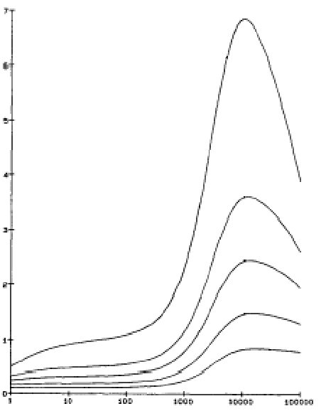
Retrieval query performance
npa = # of projected attributes
DSM better
nb:db
npa = 1
npa = 2
npa = 3
npa = 5
npa = 9
NSM better
Number of records retrieved
Notes:
nb = # disk accesses under NSM
db = # disk accesses under DSM
NSM is better when ratio is between 0-1. DSM better when ratio > 1.
DSM does worse with more projected attrs since more joins are required. Degenerative case: if there was 1 record in the database, and you wanted every attribute, no joins required under NSM (you just retrieve the 1 record!) Under DSM you need A-1 joins if A = # of attrs. since there would be A different binary relations you need to retrieve and merge together.

Slide 15
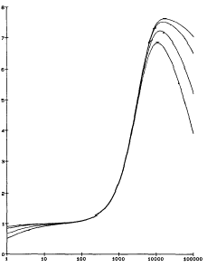
Retrieval query performance
njr = # of joined relations
njr = 9
njr = 5
njr = 2
DSM better
nb:db
njr = 1
njr = 9
NSM better
njr = 1
Number of records retrieved
Notes:
nb = # disk accesses under NSM
db = # disk accesses under DSM
NSM is better when ratio is between 0-1. DSM better when ratio > 1.
DSM improves as number of answers increases since each join is faster (since the relations are smaller in DSM).

Slide 16
Possible improvements
Multiple disks
  Storing each DSM attribute relation on a separate disk makes npa=1
Other indexing schemes
  Store 1 copy only, clustered on key
  Use secondary index on attribute value

