Slide 1
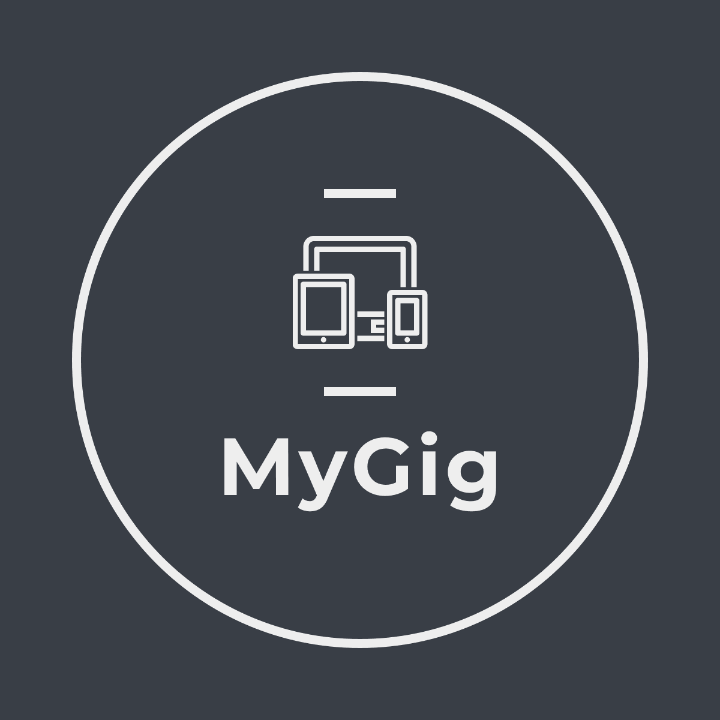

Slide 2
MyGig is not just a talent marketplace but a platform that enables inter-team collaboration, drives operational efficiency across the organization, improves employee retention and job satisfaction, and empowers Businesses to win in a tough job market

Slide 3
Types OF IT Organizations
Service-Oriented
PRODUCT-ORIENTED
Boundaries exist around teams
Team deliverables (SLA, etc.) are driving factors
Inconsistent work volume, fixed workforce
Talent consolidation (SMEs)
Monotonous Work
Ex: Network Team, Compute Team, DB Team
Teams Win
Boundary around Product, surpassing teams
Product success is the driving factor
On-demand mapping of work and talent
Efficient skill mix
Variety of work
Ex: Facebook Live, Apple Watch, CT-Core
Products Win

Slide 4
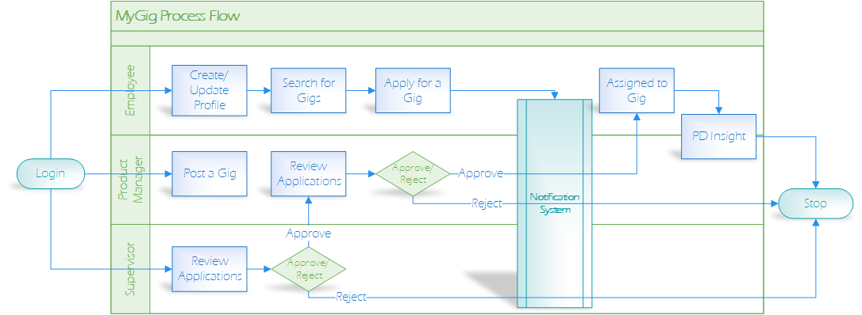
Process Flow

Slide 5
MyGig
a talent marketplace
a platform that enables inter-team collaboration
drives operational efficiency across the org
improves employee retention and job satisfaction
empowers Businesses to win in a tough job market
can enable CoreTech to transition into a Product-oriented company

Slide 6
About MyGIG
URL: https://mygigsdigital.herokuapp.com
Key technologies:
Model: MySQL / Sequelize
Controller: Node / Express / Handlebars / Plivo / Mailjet
View: HTML / Bootstrap / jQuery / Moment
Key features:
User Authorization / Tracking / RBAC
View / Post / Apply to Gigs
Notifications via SMS and Email
Future Enhancements:
SSO Integration
Approval process
PD Integration
Reporting / Dashboards
Tracking and deleting old/state Gigs/Applications

Slide 7
Project Team
Jay Cha
John Steskal
Ronald Chaudry
Siraj Mohammed
Sung Lee

