Slide 1
CSSE 220
Coupling and Cohesion
Scoping
Please turn in your assignment in the back

Slide 2
Review of Design Problems
Turn in your homework before we go over solution

Slide 3
Today’s topic
Minimize dependencies between objects when it does not disrupt usability or extendability
Tell don't ask
Don't have message chains

Slide 4
Principles of Design (for CSSE220)
Make sure your design allows proper functionality
Must be able to store required information (one/many to one/many relationships)
Must be able to access the required information to accomplish tasks
Data should not be duplicated (id/identifiers are OK!)
Structure design around the data to be stored
Nouns should become classes
Classes should have intelligent behaviors (methods) that may operate on their data
Functionality should be distributed efficiently
No class/part should get too large
Each class should have a single responsibility it accomplishes
Minimize dependencies between objects when it does not disrupt usability or extendability
Tell don't ask
Don't have message chains
Don't duplicate code
Similar "chunks" of code should be unified into functions
Classes with similar features should be given common interfaces
Classes with similar internals should be simplified using inheritance

Slide 5
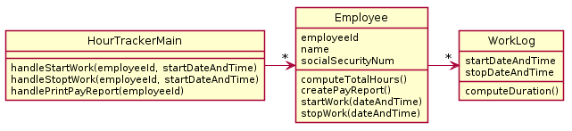
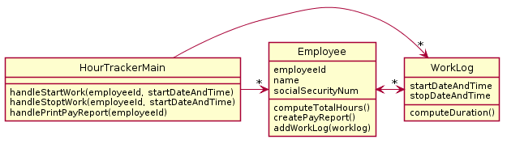
A system tracks employee hours at a particular company. Every time any employee starts work and stops work, the system must log it so the employee can be paid correctly and so management knows who was working when. The system must also print out a weekly pay report for each employee which includes total hours, the employee's name, social security number, and employee id.
Less Dependencies Solution
More Dependencies Solution

Slide 6
In less dependencies, Employee “insulates” HourTrackerMain from the existence of the WorkLog class. This means changes in the way WorkLog works cannot affect Employee. Similarly, changes in Employee cannot affect WorkLog.
The less dependencies solution is also simpler. Employee fully “owns” all it’s own data. In more dependencies, the worklog is edited without employee’s knowledge.
Less Dependencies Solution
HourTrackerMain
“knows” about
WorkLog, creates one,
then calls addWorkLog
More Dependencies Solution

Slide 7
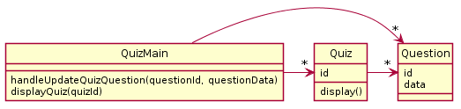
Oftentimes you cannot remove dependencies without breaking functionality though.

Slide 8
Today’s topic - #1
Minimize dependencies between objects when it does not disrupt usability or extendability
If you can see a simpler design that works use it
But if you can’t see a simpler design than the one that you have, at least ensure that you:
Tell don't ask
Don't have message chains
Notes:
If we can remove them we should
When we can’t remove them
FIX HANDOUT
TELL DON’T ASK

Slide 9
Tell Don’t Ask – getter methods
// Client program of region
Point2D center1 = region1.getPosition();
Point2D center2 = region2.getPosition();
double dist = center1.distance(center2);
if(dist > region1.getRadius()) {
region1.setIsOverlapping(true);
}
// This code is determining if two regions intersect
Many ASKS
Sometimes you’ll have code that calls a lot of getters on some other object. In essence, this code is Asking for a lot of information from the region object.
Note how much this code “knows” about the Region class. It knows about many of its fields. It has a very strong dependency on the Region class.
Notes:
Code depends heavily on the region class

Slide 10
Tell Don’t Ask Use Procedural Abstraction
TELL
region1.flagOverlappingWith(region2);
When client uses a collection of getters to do some computation, then that computation is a good candidate to become a new method in the called-upon class
In this code, we’ve moved the center point and distance calculations into the Region class. Now rather than asking the Region for all sorts of data we simply tell the region to handle the problem itself and rely on it to do it.
Now, because we rely on the Region object to handle its own data, we have a weaker dependence on the region object.

Slide 11
Tell Don’t Ask – Bad Design
public LogFramework getLogFramework() {
return this.framework;
}
ASK
Asking is especially a bad design when you return some internal class that the caller would otherwise not know exists. Why does the caller want the framework? Maybe that should be a tell?
Violates “separation of concerns” – Client now knows “how” called on code works – this increases “coupling” between client and called-on class/code, high coupling is usually a poorer design choice
public void activateVerboseLogging() {
this.framework.setLevel(5);
}
TELL
If the caller only needs to do one thing, just add a method to do that thing and insulate the caller from dependence on LogFramework.

Slide 12
Tell Don’t Ask
Be wary getter methods
Prefer methods that command (tell) a class to do something and be responsible for its own state and responsibilities
If client code accesses a lot of internal data of another class, consider if a tell method in that other class might improve the design

Slide 13
A simple example of Tell Don’t Ask
In your TeamGradebook classes, you need to calculate a student’s average grade. This could be accomplished by:
Adding a getAverage() method to the Student class which calculates the average
Adding a getGrades() method to the student class, which the TeamGradebook class could call, and then use to compute the average
Notes:
May make sense to put this on Friday instead, if time could introduce here, but provides nice example of tell don’t ask

Slide 14
A simple example of Tell Don’t Ask
In your TeamGradebook classes, you need to calculate a student’s average grade. This could be accomplished by:
Adding a getAverage() method to the Student class which calculates the average
This approach engineers Student class so that it “knows” more about what goes on with Students, and TeamGradeBook “knows” less
Notes:
May make sense to put this on Friday instead, if time could introduce here, but provides nice example of tell don’t ask

Slide 15
A simple example of Tell Don’t Ask
In your TeamGradebook classes, you need to calculate a student’s average grade. This could be accomplished by:
Second approach increases coupling between TeamGradeBook and Student class, i.e., TeamGradBook “knows” more about Student
Adding a getGrades() method to the student class, which the TeamGradebook class could call, and then use to compute the average
Notes:
May make sense to put this on Friday instead, if time could introduce here, but provides nice example of tell don’t ask

Slide 16
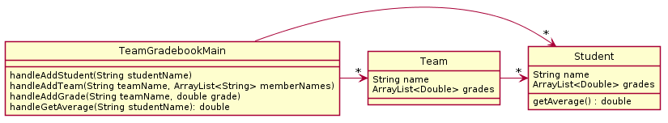
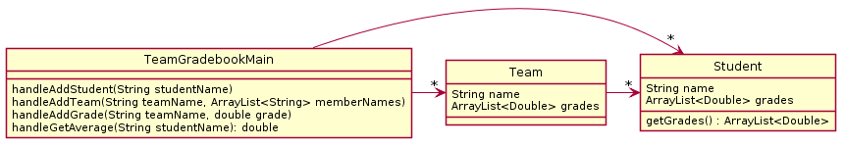
Diagrams look similar!
Notes:
@startuml
skinparam style strictuml
class TeamGradebookMain{
handleAddStudent(String studentName)
handleAddTeam(String teamName, ArrayList<String> memberNames)
handleAddGrade(String teamName, double grade)
handleGetAverage(String studentName): double
}
class Student{
String name
ArrayList<Double> grades
getAverage() : double
}
class Team{
String name
ArrayList<Double> grades
}
TeamGradebookMain -> "*" Student
TeamGradebookMain -> "*" Team
Team -> "*" Student
@enduml
@startuml
skinparam style strictuml
class TeamGradebookMain{
handleAddStudent(String studentName)
handleAddTeam(String teamName, ArrayList<String> memberNames)
handleAddGrade(String teamName, double grade)
handleGetAverage(String studentName): double
}
class Student{
String name
ArrayList<Double> grades
getGrades() : ArrayList<Double>
}
class Team{
String name
ArrayList<Double> grades
}
TeamGradebookMain -> "*" Student
TeamGradebookMain -> "*" Team
Team -> "*" Student
@enduml

Slide 17
Diagrams look similar!
How would the actual code compare when performing the stated task “calculate a student’s average grade”?

Slide 18
getGrades()
public class TeamGradebook {
…
private String handleGetAverage(String studentName) {
Student student = getStudentByName(studentName);
if (student == null) {
return "student " + student + " not found";
}
double total = 0;
for (double d: student.getGrades() ) {
total += d;
}
double average = total / student.getGrades().size();
return Long.toString(Math.round(average));
}
…
}
Calculation happening in TeamGradebook!
Notes:
Red code shows the average being calculated

Slide 19
getAverage()
public class TeamGradebook {
…
private String handleGetAverage(String studentName) {
Student student = getStudentByName(studentName);
if (student == null) {
return "student " + student + " not found";
}
return Long.toString(Math.round(student.getAverage()));
}
…
}
Calculation happening in Student!
Notes:
Red code shows the average being requested of the Student class

Slide 20
Why does this improve the design?
Reduces coupling between two classes:
It makes the Student object more featureful, and puts the code in an expected place
Reduces the code in TeamGradebook which is already quite long
Allows you to change how the grades are represented in TeamGradebook, should you wish to (i.e. drop lowest score)

Slide 21
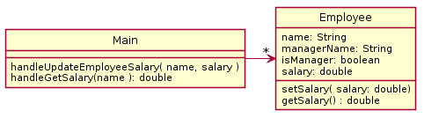
Employee Salary Problem In-Class Quiz Questions #1 & #2
There is a company which has employees, each of which has a salary. There are managers which oversee other employees. Employees have salaries which can be updated from time to time. Unlike employees, a manager’s salary is always 10% more than the salary of their top paid employee.
Notes:
QUIZ QUESTION 1 and 2
What is wrong with the following design?
Design your own improved UML diagram.
How could we actually write code for this?

Slide 22
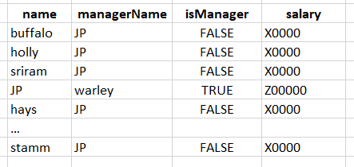
Employee Salary Problem In-Class Quiz Questions #1 & #2
Notes:
QUIZ QUESTION 1 and 2
What is wrong with the following design?
Design your own improved UML diagram.
How could we actually write code for this?

Slide 23
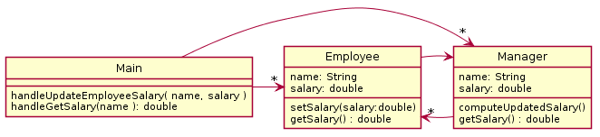
Better Solution
Anything wrong?
Room to improve?
Notes:
What happens when we go to update the salary?

Slide 24
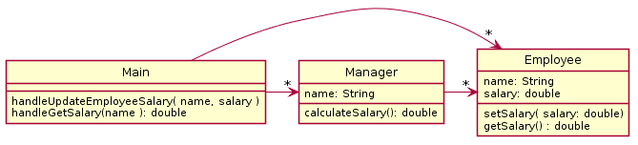
Eliminate manager salary field!
Data is technically duplicated if manager contains its own salary field.
What if the two pieces of data were out of sync?
Works well to calculate the salary as needed since it depends upon other data.
Notes:
QUIZ QUESTION 3
Notice the removed dependency (no line from Employee to Manager) this is possible since we don’t need to look up the manager to update its salary. We might want this for other reasons, but It is not strictly necessary here.
Lazy evaluation → pros and cons
Manager and Employee are flipped, might be worth re-creating

Slide 25
Eliminate manager name field!
In fact, we don’t even need the “name” field in the Manager class – the Manager is an Employee
Basic data principle: Avoid duplication of data
Notes:
QUIZ QUESTION 3
Notice the removed dependency (no line from Employee to Manager) this is possible since we don’t need to look up the manager to update its salary. We might want this for other reasons, but It is not strictly necessary here.
Lazy evaluation → pros and cons
Manager and Employee are flipped, might be worth re-creating

Slide 26
Today’s topic - #2
Minimize dependencies between objects when it does not disrupt usability or extendability
If you can see a simpler design that works use it
But if you can’t see a simpler design than the one that you have, at least ensure that you:
Tell don't ask
Don't have message chains

Slide 27
UML Interlude: Dependency Relationship
When one class requires another class to do its job, the first class depends on the second
Shown on UML diagrams as:
dashed line
with open arrowhead
CSSE_Freshmen
add(students: ArrayList<Student>)
…
Student
getFreshmen(): String
Notes:
Note CSSE_Freshmen depends on Student
But Student does NOT depend on CSSE_Freshmen

Slide 28
Message Chain – Don’t Have Them
A message chain is code in the form:
someObject.someMethod().otherMethod().stillOtherMethod();
For example
myFrame.getBufferStrategy().getCapabilities().getFlip().wait(17);
This is generally considered to a warning sign of excessive dependency and problems.

Slide 29

Message Chain Rewritten using variables
Message chains are not better if you space them across multiple lines, but it does make it more obvious what the problem is.
BufferStrategy strategy = myFrame.getBufferStrategy();
BufferCapabilities capabilities = strategy.getCapabilities();
FlipContents flip = capabilities.getFlipContents();
flip.wait(17);
You are depending on internal classes deep within some other object’s data
Notes:
@startuml
skinparam style strictuml
hide methods
hide fields
class YourCode {
}
YourCode -> JFrame
JFrame -> BufferStrategy
BufferStrategy -> BufferCapabilities
BufferCapabilities -> FlipContents
YourCode .> BufferStrategy
YourCode .> BufferCapabilities
YourCode .> FlipContents
@enduml

Slide 30
Message Chain Rewritten using variables
Message chains are not better if you space them across multiple lines, but it does make it more obvious what the problem is.
BufferStrategy strategy = myFrame.getBufferStrategy();
BufferCapabilities capabilities = strategy.getCapabilities();
FlipContents flip = capabilities.getFlipContents();
flip.wait(17);
You are depending on internal classes deep within some other object’s data
Client program – “knows” details 4 levels deep in called ops
So client is highly coupled with “how” things work
Notes:
@startuml
skinparam style strictuml
hide methods
hide fields
class YourCode {
}
YourCode -> JFrame
JFrame -> BufferStrategy
BufferStrategy -> BufferCapabilities
BufferCapabilities -> FlipContents
YourCode .> BufferStrategy
YourCode .> BufferCapabilities
YourCode .> FlipContents
@enduml

Slide 31
Message Chain: Solution
The solution is usually to embed the required feature in the first class in the chain. This insulates the caller from the inner classes. Then the first class might implement the feature itself OR if it still needs to rely on its internals repeat the message chain removal.
myFrame.setFlipWait(17);
This approach also actually decouples:
BufferCapabilities from FlipContents
BufferStrategy from BufferCapabilities
Jframe from BufferStrategy
Notes:
Unavoidable to communicate somehow…
@startuml
skinparam style strictuml
hide fields
hide YourCode methods
class YourCode {
}
class JFrame {
setFlipWait(seconds)
}
class BufferStrategy {
setFlipWait(seconds)
}
class BufferCapabilities {
setFlipWait(seconds)
}
class FlipContents {
wait(seconds)
}
YourCode -> JFrame
JFrame -> BufferStrategy
BufferStrategy -> BufferCapabilities
BufferCapabilities -> FlipContents
@enduml

Slide 32
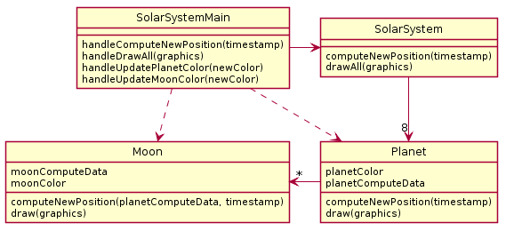
Solar System Problem In-Class Quiz Questions #4 & #5
A java program draws a minute by minute updated diagram of the solar system including all planets and moons. To update the moon's position, the moon's calculations must have the updated position of the planet it is orbiting. The diagram is colored - all planets are drawn the same color and all moons are drawn the same color. However, it needs to be possible to reset the planet color or the moon color and the diagram should reflect that.
Notes:
8:55 → 10:45
QUIZ QUESTION 4 and 5
Ask students to design a better version

Slide 33
What is wrong here?

Slide 34
What is wrong here?
4b. methodChain to update moon
ss.getPlanets().get(0).getMoons().get(0).setColor(color);

Slide 35
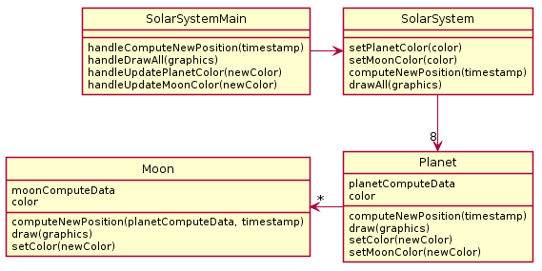
Partial Solution
Notes:
QUIZ QUESTION 6
This is what you'll get if you mechanically follow our advice to propagate the method into the first class of the chain.

Slide 36
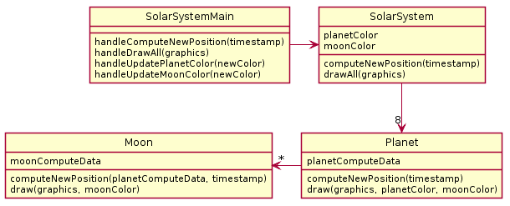
Better Solution Eliminate Data Duplication

Slide 37
Today’s topic
Minimize dependencies between objects when it does not disrupt usability or extendability
If you can see a simpler design that works use it
But if you can’t see a simpler design than the one that you have, at least ensure that you:
Tell don't ask
Don't have message chains
Now two related terms:
coupling
cohesion

Slide 38
The plan
Learn 3 essential object oriented design terms:
Encapsulation (done- yesterday)
Coupling
Cohesion
Scope (if we have time)

Slide 39
Coupling and Cohesion
Two terms you need to memorize
Good designs have:
High coHesion
Low coupLing
Consider the opposite:
Low cohesion means that you have a small number of really large classes that do too much stuff (i.e., do more than one thing)
High coupling means you have many classes that depend (“know”) too much on each other
Notes:
Easy way to remember:
H for High coHesion
L for Low coupLing

Slide 40
Imagine I want to make a Video Game. Here are two classes in my design. Which is more cohesive?
GameRunner
main(args:String)
loadLevel(levelName:String)
moveEnemies()
drawLevel(g:Graphics2D)
computeScore():int
computeEnemyDamage()
handlePlayerInput()
doPowerups(…)
runCutscene(cutsceneName:String)
//some more stuff
Image
loadImageFile(filename:String)
setPosition(x:int,y:int)
drawImage(g:Graphics2D)
*Note that in both these classes I’ve omitted the fields for clarity

Slide 41
Imagine I want to make a Video Game. Here are two classes in my design. Which is more cohesive?
GameRunner
main(args:String)
loadLevel(levelName:String)
moveEnemies()
drawLevel(g:Graphics2D)
computeScore():int
computeEnemyDamage()
handlePlayerInput()
doPowerups(…)
runCutscene(cutsceneName:String)
//some more stuff
Image
loadImageFile(filename:String)
setPosition(x:int,y:int)
drawImage(g:Graphics2D)
GameRunner does:
moves
draws
compute score
compute damage
… etc.
*Note that in both these classes I’ve omitted the fields for clarity

Slide 42
Cohesion – From Textbook
A class should represent a single concept. All interface features should be closely related to the single concept that the class represents. Such a class is said to be cohesive.
- Your textbook
On to coupling...

Slide 43
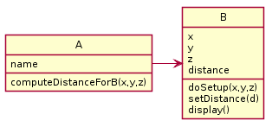
Coupling
Coupling is when one object depends strongly on another
//do setup must be called first
this.myB.doSetup(1, 2, 3);
//now we compute the parameter
double distance = computeDistanceForB(0,0,0);
this.myB.setDistance( distance );
//finally we display
this.myB.display();
Notes:
Maybe these two object ought to be of same class?
@startuml
skinparam style strictuml
class A {
name
computeDistanceForB(x,y,z)
}
class B {
x
y
z
distance
doSetup(x,y,z)
setDistance(d)
display()
}
A-> B
@enduml

Slide 44
Note that in this design, GameRunner probably had many objects of the image class, but Image does not know the GameRunner class even exists. That’s a sign of low coupling between Image and GameRunner.
GameRunner
main(args:String)
loadLevel(levelName:String)
moveEnemies()
drawLevel(g:Graphics2D)
computeScore():int
computeEnemyDamage()
handlePlayerInput()
doPowerups(…)
runCutscene(cutsceneName:String)
//some more stuff
Image
loadImageFile(filename:String)
setPosition(x:int,y:int)
drawImage(g:Graphics2D)

Slide 45
Coupling – UML Diagrams
Lot’s of dependencies ➔ high coupling
Few dependencies ➔ low coupling
How hard will it be to change code with:
High coupling? Low coupling?
Notes:
Makes it easier to swap out and replace a component when there are fewer lines going to and from it. Those represent places where code would need to change.

Slide 46
Coupling – UML Diagrams
Note:
“essential” dependencies cannot be eliminated
if they are eliminated, then functionality fails
Notes:
Makes it easier to swap out and replace a component when there are fewer lines going to and from it. Those represent places where code would need to change.

Slide 47
If we do our design job carefully
Divide & Conquer - Break our larger problem into several classes
Each of these classes will do one thing well (i.e. they will have high cohesion)
Our classes will only need to depend on each other in specific, highly limited essential ways (i.e. they will have low coupling).
Many classes won’t even be “know” of most of the other classes in the system

Slide 48
Imagine that you’re writing code to manage a school’s students
Things your design should accommodate:
Handle adding or removing students from the school
Students should have a name, phone number, and grades for specific courses (can use a courseId String)
Setting the individual course grades for a particular student
Compute the average GPA of all the students in the school
Sort the students by last name to print out a report of students and GPA
Discuss and come up with a design with those near you. How many classes does your system need?
Notes:
Give students 3-4 minutes to come up with a design with a group of 2-3
Suggest to the students after they have one design, to try to do a different design with 1 more or 1 less class
Then follow the slides to walk through examples of each design identifying coupling/cohesion levels

Slide 49
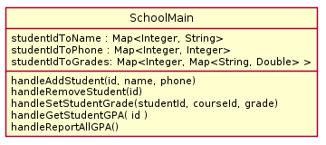
1 class solution
Skip
Coupling?
Cohesion?
Notes:
Coupling low (ZERO), cohesion low
@startuml
skinparam style strictuml
class SchoolMain {
studentIdToName : Map<Integer, String>
studentIdToPhone : Map<Integer, Integer>
studentIdToGrades: Map<Integer, Map<String, Double> >
handleAddStudent(id, name, phone)
handleRemoveStudent(id)
handleSetStudentGrade(studentId, courseId, grade)
handleGetStudentGPA( id )
handleReportAllGPA()
}
@enduml

Slide 50
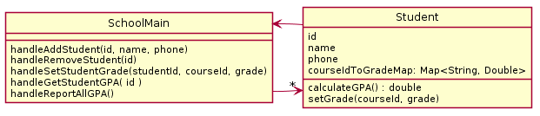
2 class solution
Skip
Coupling?
Cohesion?
Notes:
Coupling HIGH, cohesion still somewhat low (better than before!)
Ask students: IS EVERYTHING NEEDED HERE?
NO: Student does not need a SchoolMain to allow functionality
@startuml
skinparam style strictuml
class SchoolMain {
handleAddStudent(id, name, phone)
handleRemoveStudent(id)
handleSetStudentGrade(studentId, courseId, grade)
handleGetStudentGPA( id )
handleReportAllGPA()
}
class Student{
id
name
phone
courseIdToGradeMap: Map<String, Double>
calculateGPA() : double
setGrade(courseId, grade)
}
SchoolMain -> "*" Student
Student-> SchoolMain
@enduml

Slide 51
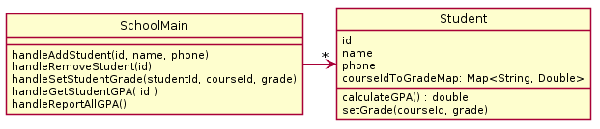
2 class solution
Skip
Coupling?
Cohesion?
Notes:
Coupling OK (Better! At least Student doesn’t have a SchoolMain)
Cohesion OK somewhat low (higher than before)
@startuml
skinparam style strictuml
class SchoolMain {
handleAddStudent(id, name, phone)
handleRemoveStudent(id)
handleSetStudentGrade(studentId, courseId, grade)
handleGetStudentGPA( id )
handleReportAllGPA()
}
class Student{
id
name
phone
courseIdToGradeMap: Map<String, Double>
calculateGPA() : double
setGrade(courseId, grade)
}
SchoolMain -> "*" Student
@enduml

Slide 52
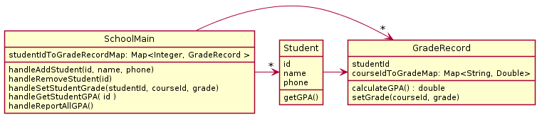
3 classes
Skip
Coupling?
Cohesion?
Notes:
Coupling HIGH (BAD), cohesion HIGH (GOOD)
@startuml
skinparam style strictuml
class SchoolMain {
studentIdToGradeRecordMap: Map<Integer, GradeRecord >
handleAddStudent(id, name, phone)
handleRemoveStudent(id)
handleSetStudentGrade(studentId, courseId, grade)
handleGetStudentGPA( id )
handleReportAllGPA()
}
class Student{
id
name
phone
getGPA()
}
class GradeRecord {
studentId
courseIdToGradeMap: Map<String, Double>
calculateGPA() : double
setGrade(courseId, grade)
}
SchoolMain -> "*" Student
Student -> GradeRecord
SchoolMain -> "*" GradeRecord
@enduml

Slide 53
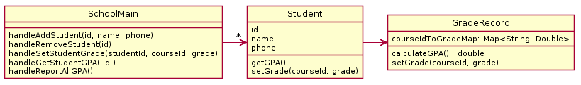
3 classes improved
Skip
Coupling?
Cohesion?
Notes:
Coupling LOW (higher),
cohesion HIGH (good!)
@startuml
skinparam style strictuml
class SchoolMain {
handleAddStudent(id, name, phone)
handleRemoveStudent(id)
handleSetStudentGrade(studentId, courseId, grade)
handleGetStudentGPA( id )
handleReportAllGPA()
}
class Student{
id
name
phone
getGPA()
setGrade(courseId, grade)
}
class GradeRecord {
courseIdToGradeMap: Map<String, Double>
calculateGPA() : double
setGrade(courseId, grade)
}
SchoolMain -> "*" Student
Student -> GradeRecord
@enduml

Slide 54
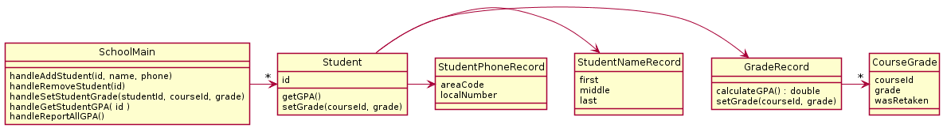
…6 classes
Skip
Coupling?
Cohesion?
Notes:
WOAH – things out of control…. Student has very high coupling-if it changes everything breaks!
Coupling HIGH, cohesion HIGH
@startuml
skinparam style strictuml
class SchoolMain {
handleAddStudent(id, name, phone)
handleRemoveStudent(id)
handleSetStudentGrade(studentId, courseId, grade)
handleGetStudentGPA( id )
handleReportAllGPA()
}
class Student{
id
getGPA()
setGrade(courseId, grade)
}
class GradeRecord {
calculateGPA() : double
setGrade(courseId, grade)
}
class CourseGrade {
courseId
grade
wasRetaken
}
class StudentNameRecord {
first
middle
last
}
class StudentPhoneRecord {
areaCode
localNumber
}
GradeRecord -> "*" CourseGrade
SchoolMain -> "*" Student
Student -> GradeRecord
Student -> StudentNameRecord
Student -> StudentPhoneRecord
@enduml

Slide 55
Note that
Cohesion makes us want:
Many smaller classes
Classes that do only one thing well
If classes are too small
Tend to need to depend on each other
Coupling rises
Want “Goldilocks” design

Slide 56
Rule of Thumb: No Global Variables
Or static variables that are used like globals
A static variable can be accessed/modified in any function at any time
As a result many parts of the code can be coupled to a single class

Slide 57
Rule of Thumb: No Global Variables
Or static variables that are used like globals
A static variable can be accessed/modified in any function at any time
As a result many parts of the code can be coupled to a single class
Why?
Increases coupling among all the clients that get or change value of the global variable

Slide 58
Stop Here Today

Slide 59
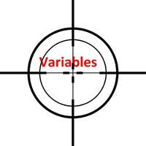
Variable Scope
Scope is the region of a program in which a variable can be accessed
Parameter scope: the whole method body
Local variable scope: from declaration to block end
public double myMethod() { double sum = 0.0; Point2D prev = this.pts.get(this.pts.size() - 1); for (Point2D p : this.pts) { sum += prev.getX() * p.getY(); sum -= prev.getY() * p.getX(); prev = p; } return Math.abs(sum / 2.0); }
Notes:
Scope refers to the lifetime and accessibility of a variable.
How large the scope is depends on where a variable is declared. For example, if a variable is declared at the top of a class then it will be accessible to all of the class methods. If it’s declared in a method then it can only be used in that method.
Show scope of:
- sum
- prev
- p

Slide 60
Member Scope (Field or Method)
Member Variable Scope
Member scope: anywhere in the class, including before its declaration
Lets methods call other methods later in the class
public static class members can be accessed from outside with “class qualified names”
Math.sqrt()
System.in
Class MyClass {
. . .
// member variable declarations
. . .
public void aMethod(params…) {
. . .
// local variable declarations
. . .
for(int i = 0; i < 10; i++)
{. . . }
. . .
}
. . .
}
Method Parameter Scope
Local Variable Scope
Block scope

Slide 61
Overlapping Scope and Shadowing
public class TempReading {
private double temp;
public void setTemp(double temp) {
… temp …
}
// …
}
this.temp = temp;
What does this “temp” refer to?
Always qualify field references with this. It prevents accidental shadowing.
Notes:
this.temp = temp; line is animated
The scope of this.temp overlaps with the scope of the parameter temp.
In Java, if you do not quality the field with “this”, the local variable shadows the instance field with the same name (local variable wins!)
Always… callout is animated
this will always recover the instance variable.
Shadowing is hiding a variable by defining another variable with the same name.

Slide 62
Work Time
ImplementingDesign2 – see due date on schedule page
ImplementingDesign1

Slide 63
ImplementingDesign2 Notes:
You will be given a starter uml file for plantuml
You must pass the unit tests, but don’t approach this by trying to a pass one test at a time
Instead test functionality as you go by running commands
Make a UML DESIGN BEFORE you code
It is required that you submit a first draft
(It does not have to be perfect, we expect you to have to change)

