Slide 1
CSSE 220: Object Design
Part 1 of Many
Also Class Diagrams

Slide 2
Designing Classes
Programs typically begin as abstract ideas
These ideas form a set of requirements (i.e. what the user wants)
We must take these requirements, and figure out an approach for our coding
Usually the approach is not obvious
So we propose designs, then iteratively refine them into something that might work (continued…)

Slide 3
So we propose designs, then iteratively refine them into something that might work
Many bad ideas in the process
We don’t want to go through the effort of implementing bad ideas in code
But we need a way to communicate/think concretely about these half-baked program approaches
We need a diagram language!

Slide 4
Tools of the Trade
Class Diagrams (UML)
UML – Unified Modeling Language
Language unspecific
Has a lot of different diagrams it provides specifications for – but the class diagram language is the most widely used

Slide 5
A little class diagram will get you a long way
3 sections
Not the final version of UML we will teach, but covers the main points
ClassName
Field names
Method names
Example
Team
teamAverage name students
addGrade(grade) getTeamAverage()
Student
grades name
addGrade(grade)

Slide 6
Lines
A has a B (field)
ClassName
Field names
Method names
ClassName
Field names
Method names
Example
Note the star means several… usually a list or collection.
Team
teamAverage name students
addGrade(grade) getTeamAverage()
Student
grades name
addGrade(grade)
*
1-2

Slide 7
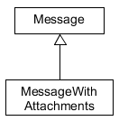
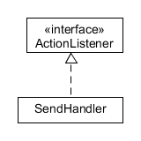
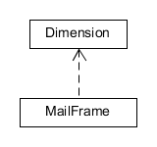
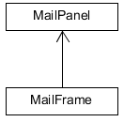



Summary of UML Class Diagram Arrows
Interface
Implementation
(is-a)
Association
(has-a-field)
Inheritance
(is-a)
Dependency
(depends-on)
Two-way Association
Two-Way Dependency
Cardinality
(one-to-one, one-to-many)
One-to-many is shown on left
Notes:
For a future class

Slide 8

Let’s try to code a simple UML diagram!
Try to make the classes and fields first!
You can create empty methods and leave TODOs
Implement the methods as the last thing you do.
Notes:
@startuml
skinparam style strictuml
class Main {
Main()
setAllBValuesTo3()
}
class A{
name
A( name )
setBValue( value)
}
class B{
count
B()
setValue( value )
}
Main -> "*" A
A-> B
@enduml

Slide 9
Principles of Design (for CSSE220)
Make sure your design allows proper functionality
Must be able to store required information (one/many to one/many relationships)
Must be able to access the required information to accomplish tasks
Data should not be duplicated (id/identifiers are OK!)
Structure design around the data to be stored
Nouns should become classes
Classes should have intelligent behaviors (methods) that may operate on their data
Functionality should be distributed efficiently
No class/part should get too large
Each class should have a single responsibility it accomplishes
Minimize dependencies between objects when it does not disrupt usability or extendability
Tell don't ask
Don't have message chains
Don't duplicate code
Similar "chunks" of code should be unified into functions
Classes with similar features should be given common interfaces
Classes with similar internals should be simplified using inheritance

Slide 10
The principles go from most important to least important. Today’s focus:
Make sure your design allows proper functionality
Must be able to store required information (one/many to one/many relationships)
Must be able to access the required information to accomplish tasks
Data should not be duplicated (id/identifiers are OK!)
Structure design around the data to be stored
Nouns should become classes
Classes should have intelligent behaviors (methods) that may operate on their data

Slide 11
A good object oriented design is structured around the data
Look for the nouns in your problem, consider making them classes
…if they are complex enough
Put the data you need to store as fields in your classes
Add operations to the classes to accomplish what your need
Avoid Plural Nouns
Notes:
Maybe mention in passing there are other design approaches that divide things differently, but we’ll be focusing on OO in this course

Slide 12
An object oriented design must work!
Make sure all the data that you need is stored somewhere
And that you can access it from the classes that need it
The solution is not to keep 2 copies of the same data.
Notes:
Maybe mention in passing there are other design approaches that divide things differently, but we’ll be focusing on OO in this course

Slide 13
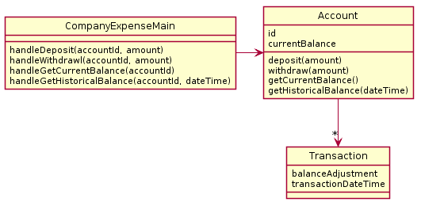
What is wrong with this design?
A particular company keeps a variety of different accounts for its projects. Each account has an account number and a balance. When a deposit or withdrawal occurs, the transaction occurs immediately and the current balance should be updated. The system should support getting the current balance.
The system should also support getting the balance as it existed at any date/time in the past. Note the input historical date/time may not correspond to a particular transaction time - e.g. if the system had a balance of $1 at 1pm and then was changed to $2 at 3pm., a request for the balance at 2pm should return $1.
3

Slide 14
Main class
Every program starts somewhere, and any design should make clear where the starting point is. In our class, we will name the starting point class SomethingMain
In our very simple designs, this class also deals with user input
"handle" methods will have special meaning for us, as they will represent places where user commands enter the system. By looking at parameters to the handle methods, you can sometimes get more info on how the various commands in the description should work.
Notes:
@startuml
skinparam style strictuml
class Book {
name
author
printReport()
addKid(kid)
}
class Kid {
name
gradeLevel
printReport()
addBook(book)
}
class BookMain {
handleNewReading(bookname,kidname)
printReportForBook(bookname)
printReportForKid(kidname)
}
Kid "*" <-> "*" Book
BookMain -> "*" Book
BookMain -> "*" Kid
@enduml

Slide 15
This design does not function correctly. Main has only one account, but the system needs to support many. Also, computing the data for historic balances is moderately hard.

Slide 16
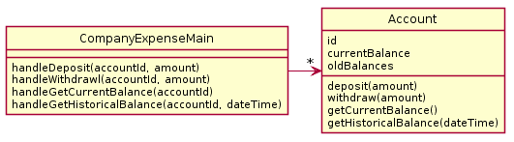
A particular company keeps a variety of different accounts for its projects. Each account has an account number and a balance. When a deposit or withdrawal occurs, the transaction occurs immediately and the current balance should be updated. The system should support getting the current balance.
The system should also support getting the balance as it existed at any date/time in the past. Note the input historical date/time may not correspond to a particular transaction time - e.g. if the system had a balance of $1 at 1pm and then was changed to $2 at 3pm., a request for the balance at 2pm should return $1.
Find the problem with this design and then propose your own.
4-5

Slide 17
This design does not function correctly. Account does not have enough data to make getHistoricalBalance work. oldBalances stores perhaps a list of balances? But the date of the transactions is not stored, so we can't look up the balance on a particular day/time.

Slide 18
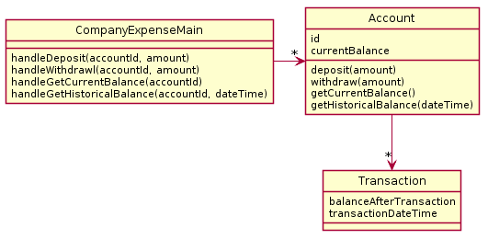
My solution 1

Slide 19

My Solution 2

Slide 20
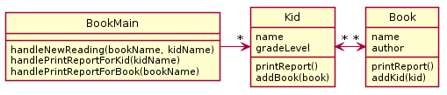
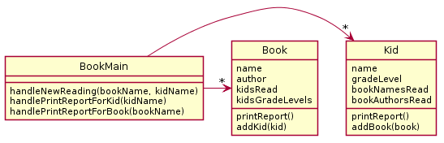
A website tracks books and the kids that read them. For each book the system stores the name and author. For each kid the system stores name and grade level. The teacher enters when a kid reads a particular book. It should be possible to print a report on a book that includes all kids who have read a particular book (with their grade level). It should be possible to print a report on a kid that includes the books (with authors) a particular kid has read.
Bad Solution A
Bad Solution B
6-8
Notes:
There is no (sane) way to lookup a book to either lookup a book to add to a kid or print a report
Duplication of data

Slide 21
This design does not function. There is no (sane) way to look up a book for printing a report or for associating with a Kid.

Slide 22
This design functions but there is a very large amount of duplication. In particular, the author/title information in the kid is duplicated and the name/grade level information in the book is duplicated.

Slide 23
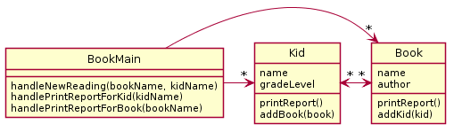
My Solution

Slide 24
In most cases non-workable design is caused by…
Not reading the problem carefully or not mapping it to design carefully (e.g. not noticing that each kid reads several books, not just one)
Not thinking about how specific required features might be implemented (e.g. how can we print a book report if we don’t have access to the book objects?)
Duplicating data (e.g. what does it matter if we store a copy of the author and title for every kid that reads the book)

Slide 25
For Next Class
Solve the 2 Design Problems in the handout
Bring your solution to be collected at the start of next class
We will go over the solution at the beginning of next class
Anything turned in late will be worth zero points
We’ll discuss more design principles after Exam 1
Notes:
Briefly show the website description and how points are awarded, especially making note of the reflection questions and sample output.

Slide 26
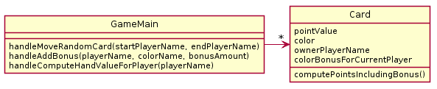
In a particular card game, players have hands of cards. Each card is worth some points and also has a color (red, blue, green). During play, players accrue bonuses that mean cards of a particular color are worth bonus points. During play, sometimes a random card is selected from one player's hand and moved to another player's hand. At the end of game, it is necessary to compute the total points for each player's hand.
What is wrong with this design? (Hint: look at and refer to your design principles by number). I see at least 2 separate categories violated.

Slide 27
My answer (in order of importance)
1a. The design does not function correctly
The player’s color bonus cannot be preserved if he/she loses all their cards of a particular color
It requires iterating over all objects to get the full set of cards in the players hands to move cards or compute final total
1c. Playername & player color bonus are duplicated across cards
2a. Player (common noun from problem) not represented
Notes:
Note for 1a – obviously you try to use nouns from the description. But its not required

Slide 28
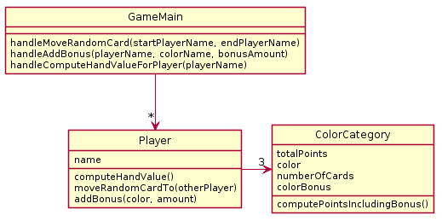
In a particular card game, players have hands of cards. Each card is worth some points and also has a color (red, blue, green). During play, players accrue bonuses that mean cards of a particular color are worth bonus points. During play, sometimes a random card is selected from one player's hand and moved to another player's hand. At the end of game, it is necessary to compute the total points for each player's hand.
What is wrong with this design? (Hint: look at and refer to your design guidelines). I see at least 2 separate categories violated.

Slide 29
My answer (in order of importance)
1a. The design does not function correctly
Once a card is added to a players hand, its specific point value is lost so the card cannot be randomly moved to another players hand
2a. Card (common noun from problem) not represented

Slide 30
In a particular card game, players have hands of cards. Each card is worth some points and also has a color (red, blue, green). During play, players accrue bonuses that mean cards of a particular color are worth bonus points. During play, sometimes a random card is selected from one player's hand and moved to another player's hand. At the end of game, it is necessary to compute the total points for each player's hand.
Now design your solution that solves all problems.

Slide 31
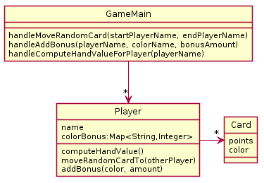
My Solution
getPoints(), getColor() too
Notes:
Since UML is meant to be a simple way to communicate, we often omit simple methods like getters and setters.
If we want you to show all methods, we will tell you to do so

