Slide 1
Solr

Slide 2
Solr 配置
1、基于6.5.1，开源solr，hdfs 创建目录/solr
2、在目录../solr/server/solr/configsets/data_driven_schema_configs/conf/solrconfig.xml
找到directoryFactory 的配置，替换为Hdfs存储
<directoryFactory name="DirectoryFactory" class="solr.HdfsDirectoryFactory"> <str name="solr.hdfs.home">hdfs://ip/solr</str> <bool name="solr.hdfs.blockcache.enabled">true</bool> <int name="solr.hdfs.blockcache.slab.count">1</int> <bool name="solr.hdfs.blockcache.direct.memory.allocation">true</bool> <int name="solr.hdfs.blockcache.blocksperbank">16384</int> <bool name="solr.hdfs.blockcache.read.enabled">true</bool> <bool name="solr.hdfs.blockcache.write.enabled">true</bool> <bool name="solr.hdfs.nrtcachingdirectory.enable">true</bool> <int name="solr.hdfs.nrtcachingdirectory.maxmergesizemb">16</int> <int name="solr.hdfs.nrtcachingdirectory.maxcachedmb">192</int>
</directoryFactory>

Slide 3
Solr 6.5.1版本
找到lockType 替换为<lockType>${solr.lock.type:hdfs}</lockType>

Slide 4
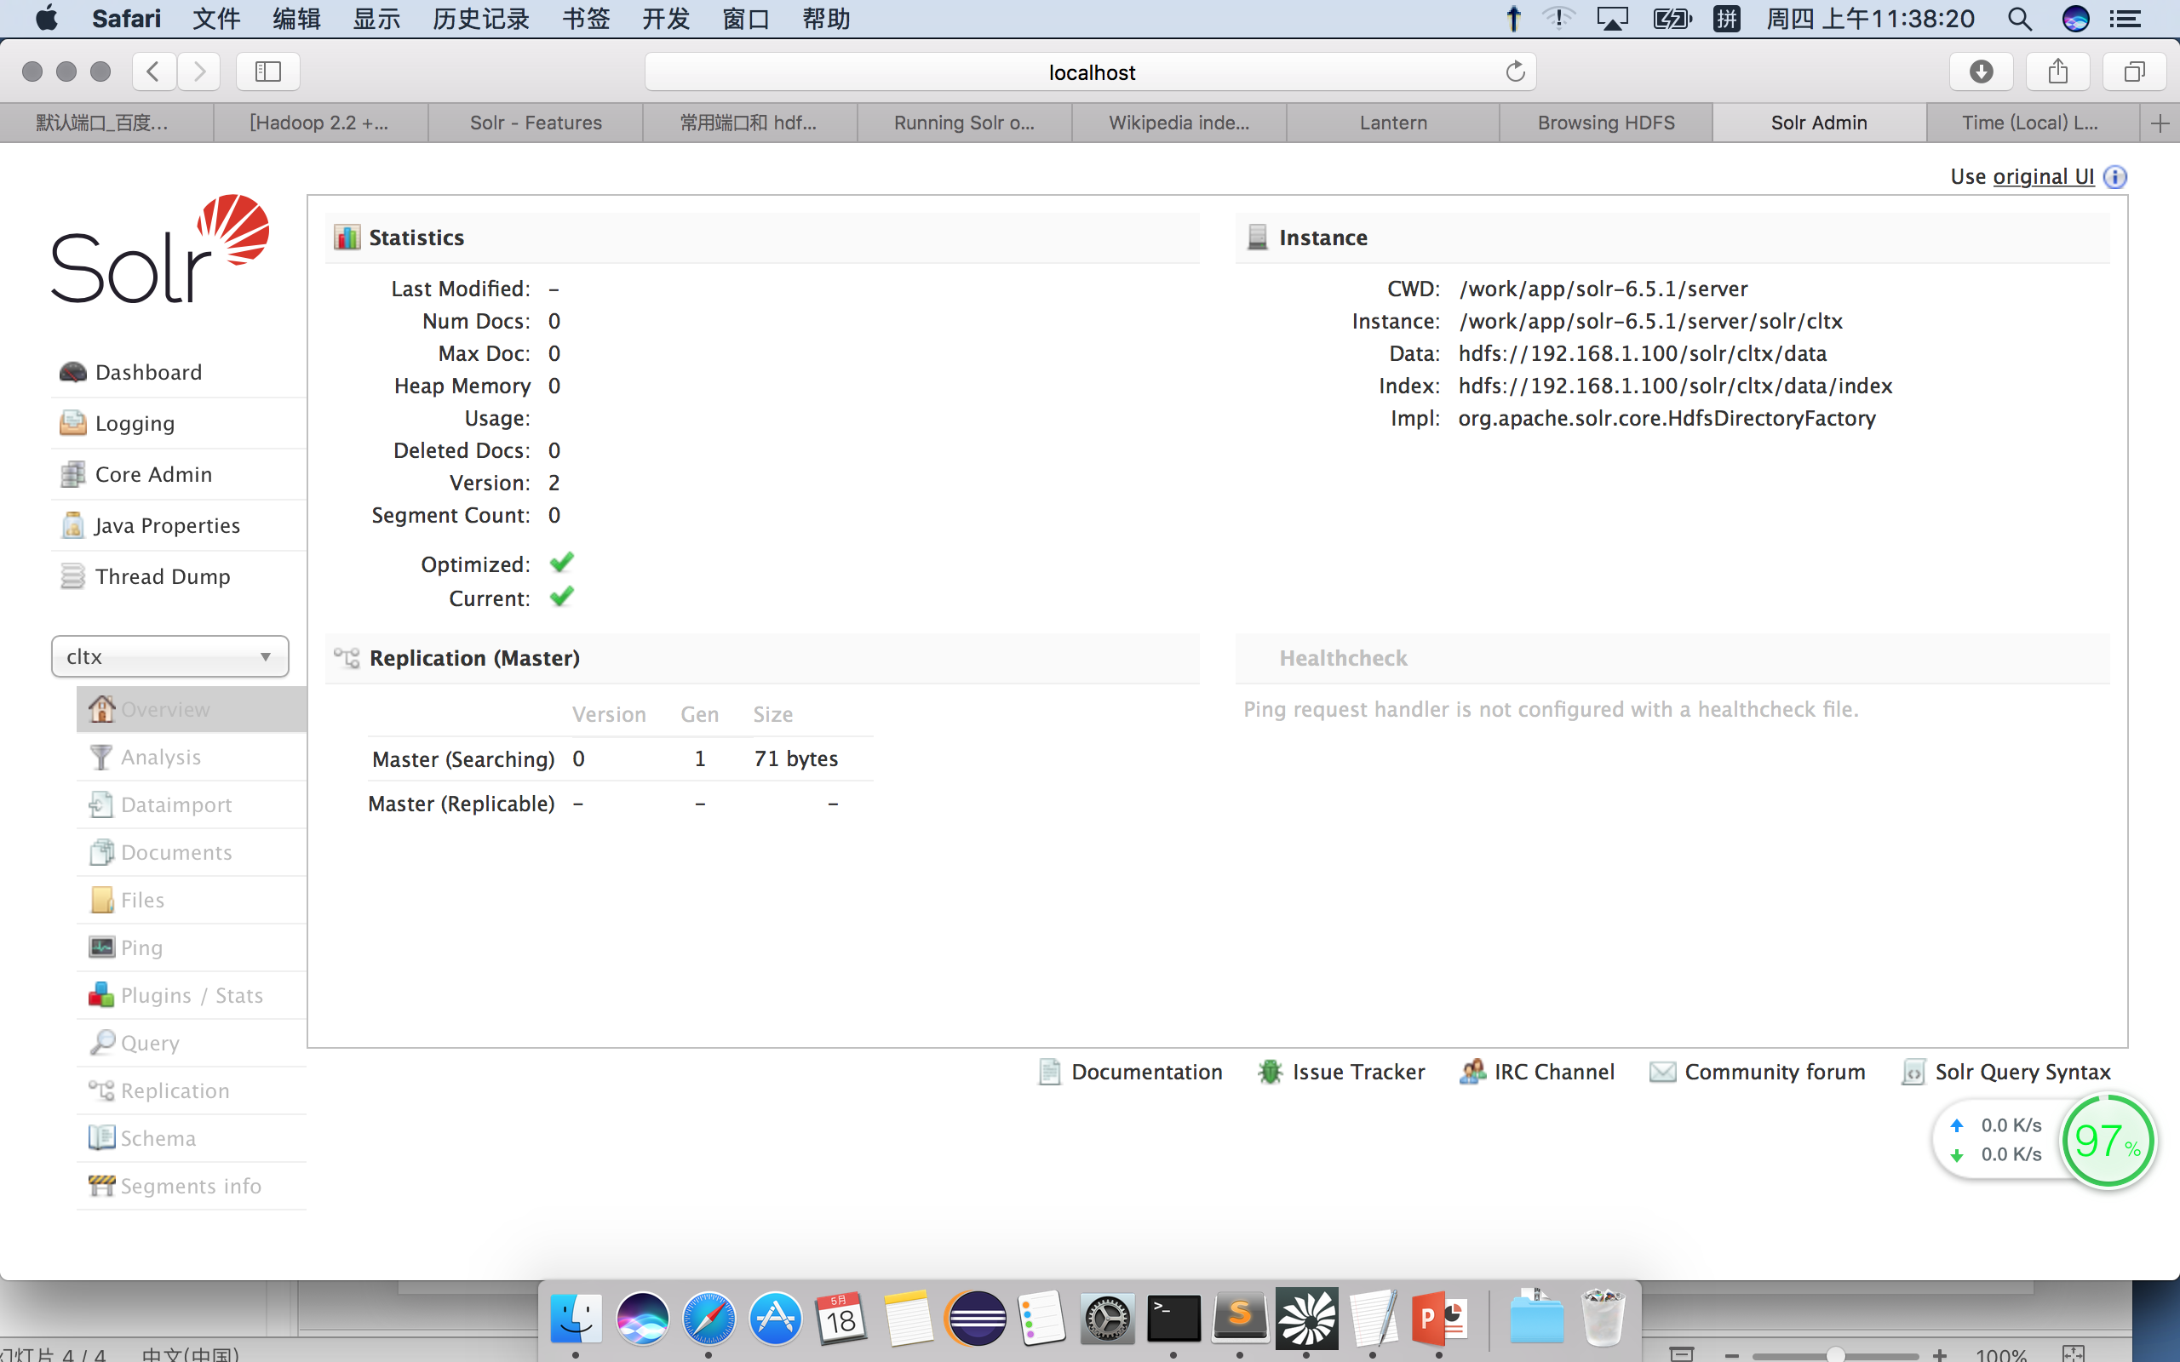
Solr 命令
1、启动
bin/solr start 启动
2、bin/solr create -c cltx
3、bin/solr stop 停止

Slide 5
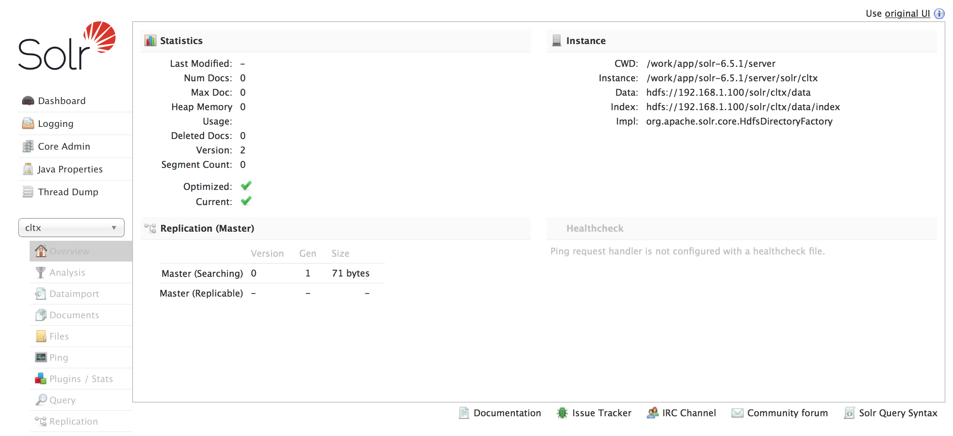
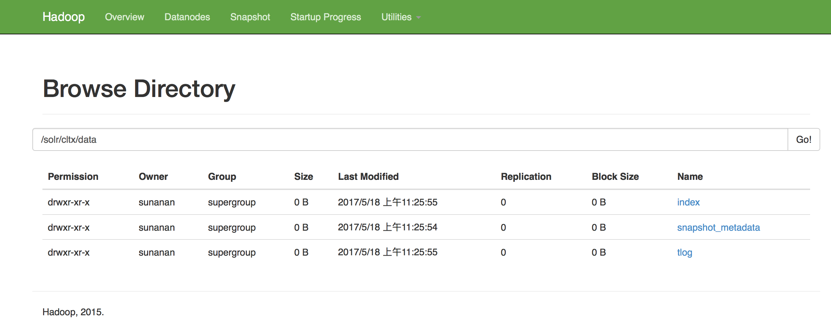
Solr 命令
1、启动
bin/solr start 启动
2、bin/solr create/delete -c cltx
创建／删除主题
3、bin/solr stop 停止

Slide 6
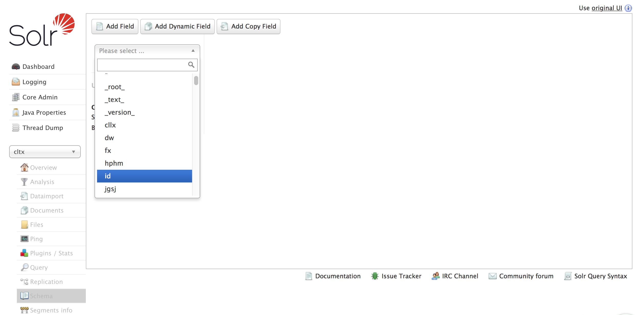
Solr建立索引字段

Slide 7
Solr开发
Maven依赖
<dependency>
<groupId>org.slf4j</groupId>
<artifactId>slf4j-api</artifactId>
<version>1.7.16</version>
</dependency>
<!-- https://mvnrepository.com/artifact/org.apache.solr/solr-solrj -->
<dependency>
<groupId>org.apache.solr</groupId>
<artifactId>solr-solrj</artifactId>
<version>6.5.1</version>
</dependency>

Slide 8
Solr插入数据
package org.base.solr;
import java.io.IOException;
import java.util.ArrayList;
import java.util.Collection;
import org.apache.solr.client.solrj.SolrClient;
import org.apache.solr.client.solrj.SolrServerException;
import org.apache.solr.client.solrj.impl.ConcurrentUpdateSolrClient;
import org.apache.solr.client.solrj.impl.HttpSolrClient;
import org.apache.solr.client.solrj.impl.XMLResponseParser;
import org.apache.solr.client.solrj.response.UpdateResponse;
import org.apache.solr.common.SolrInputDocument;
public class SolrWriter {
public static void main(String[] args) {
String urlString = "http://localhost:8983/solr/cltx";
//SolrClient solr = new HttpSolrClient.Builder(urlString).build();
//((HttpSolrClient) solr).setParser(new XMLResponseParser());
ConcurrentUpdateSolrClient solr = new ConcurrentUpdateSolrClient.Builder(urlString).withQueueSize(100).withThreadCount(4).build();
solr.setParser(new XMLResponseParser());
Collection<SolrInputDocument> docs = new ArrayList<SolrInputDocument>();
for(int i = 0; i < 1000;i++)
{
SolrInputDocument input = new SolrInputDocument();
//String date = new java.text.SimpleDateFormat("yyyyMMddHHmmss").format(new java.util.Date());
input.addField("id", (long)i);
input.addField("jgsj", new java.util.Date());
input.addField("hphm", "浙A"+i);
input.addField("cllx", i);
input.addField("fx", "东向西"+i);
input.addField("dw", "测试点"+i);
docs.add(input);
}
try {
solr.add(docs);
UpdateResponse response= solr.commit();
System.out.println(response.getStatus());
solr.close();
} catch (SolrServerException e) {
try {
solr.rollback();
} catch (SolrServerException e1) {
// TODO Auto-generated catch block
e1.printStackTrace();
} catch (IOException e1) {
// TODO Auto-generated catch block
e1.printStackTrace();
}
// TODO Auto-generated catch block
e.printStackTrace();
} catch (IOException e) {
// TODO Auto-generated catch block
try {
solr.rollback();
} catch (SolrServerException e1) {
// TODO Auto-generated catch block
e1.printStackTrace();
} catch (IOException e1) {
// TODO Auto-generated catch block
e1.printStackTrace();
}
e.printStackTrace();
}
finally{
}
}
}

Slide 9
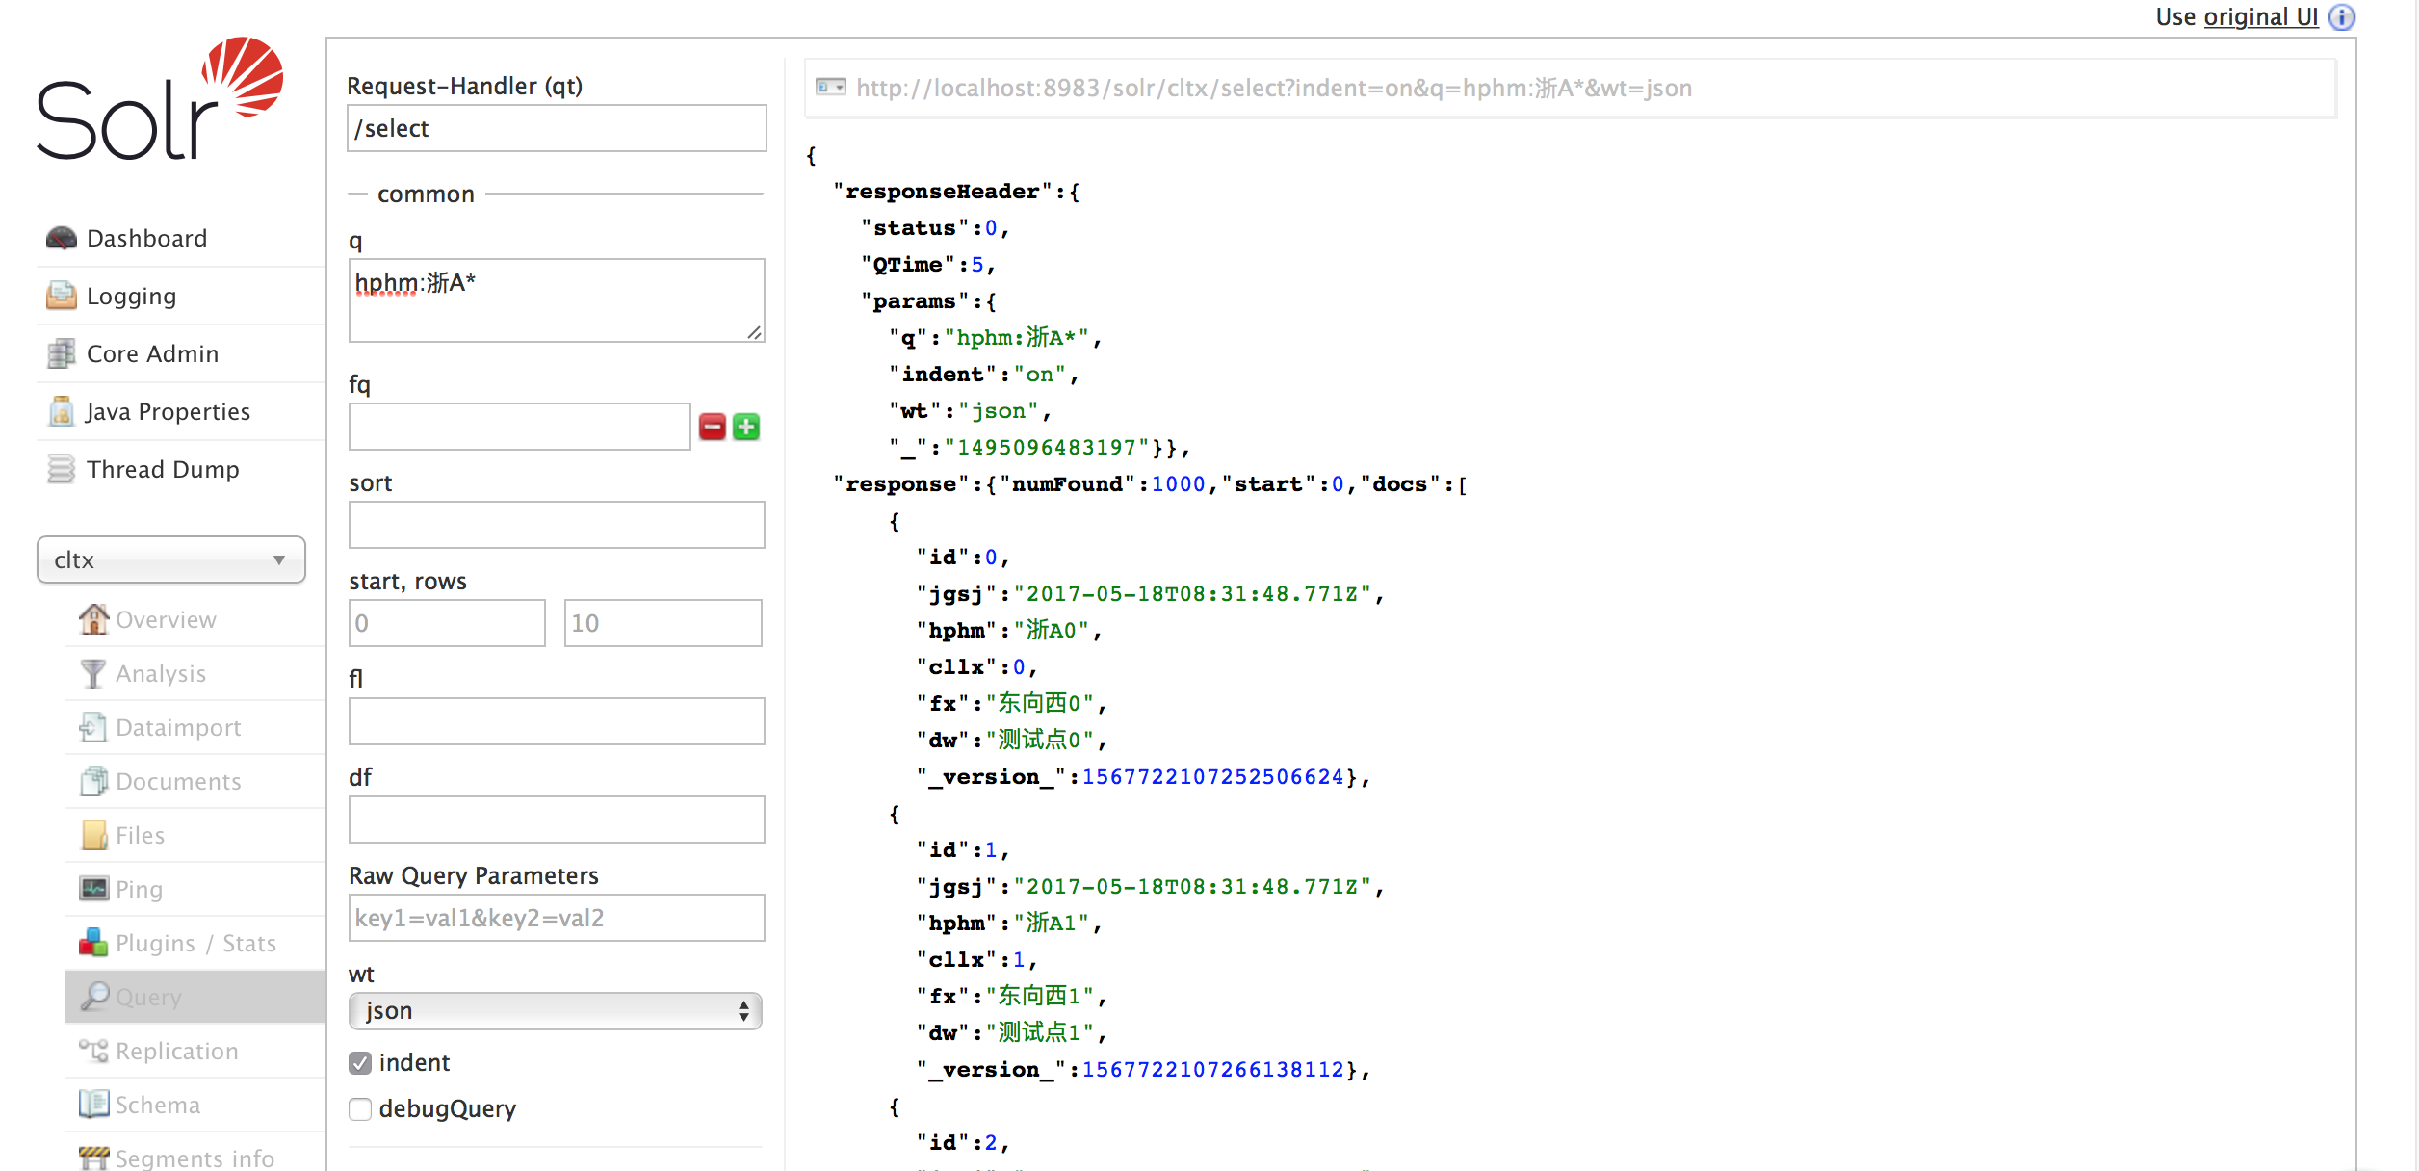
Solr界面查询结果

Slide 10
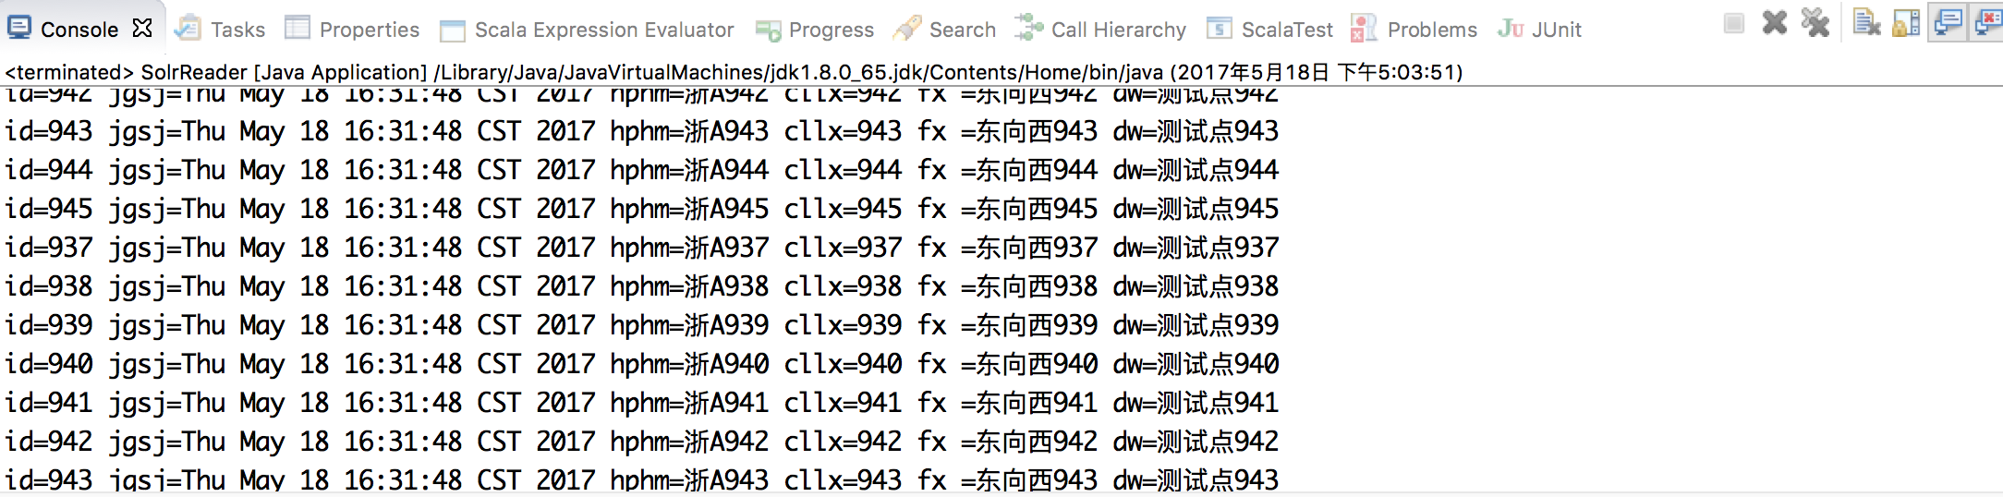
Solr代码查询
package org.base.solr;
import java.io.IOException;
import java.text.SimpleDateFormat;
import java.util.ArrayList;
import java.util.Collection;
import java.util.Date;
import java.util.ListIterator;
import org.apache.solr.client.solrj.SolrClient;
import org.apache.solr.client.solrj.SolrQuery;
import org.apache.solr.client.solrj.SolrServerException;
import org.apache.solr.client.solrj.impl.ConcurrentUpdateSolrClient;
import org.apache.solr.client.solrj.impl.HttpSolrClient;
import org.apache.solr.client.solrj.impl.XMLResponseParser;
import org.apache.solr.client.solrj.response.QueryResponse;
import org.apache.solr.common.SolrDocument;
import org.apache.solr.common.SolrDocumentList;
import org.apache.solr.common.SolrInputDocument;
import org.apache.solr.common.params.SolrParams;
public class SolrReader {
public static void main(String[] args) {
String urlString = "http://localhost:8983/solr/cltx";
SolrClient solr = new HttpSolrClient.Builder(urlString).build();
((HttpSolrClient) solr).setParser(new XMLResponseParser());
SolrQuery query = new SolrQuery();
// query.setQuery(mQueryString);
query.set("fl", "id,jgsj,hphm,cllx,fx,dw");
// query.setFields("id", "title", "price");
// query.set("q", "*:*");
// query.set("q", "hphm:浙A?2*");//?或者*
// query.set("q", "hphm:浙A?2* AND id:12");//?或者*
//query.set("q", "hphm:浙A?2* AND id:[2 TO 120]");//?或者* 整数不能模糊查询, AND
// OR
//SimpleDateFormat sdf = new SimpleDateFormat("yyyy-MM-dd'T'HH:mm:ss'Z'");
//String time = "jgsj:["+sdf.format(new Date())+" TO "+sdf.format(new Date())+"]";
query.set("q", "jgsj:[2013-01-01T00:00:00Z TO 2018-01-01T00:00:00Z]");//
/*
* []表示查询一个日期范围，包括边界即createtime>=a and createtime
* <=b。{}表示查询一个日期范围不包括边界即createtime>a and createtime <b。
*
* A TO * 表示没有上界即>=A或是>A ,视使用的是[]还是{}而定
*
* TO A 表示没有下界即<=A或是<A ,视使用的是[]还是{}而定
*
* NOW表示当前时间,NOW/DAY表示当前日期.
*/
QueryResponse response;
try {
int index = 0;
int pagesize = 10;
int gets = 0;
while (true) {
query.setStart(index);
index++;
query.setRows(pagesize);
response = solr.query(query);
SolrDocumentList list = response.getResults();
ListIterator<SolrDocument> itr = list.listIterator();
gets = 0;
while (itr.hasNext()) {
SolrDocument doc = itr.next();
System.out.println("id=" + doc.getFieldValue("id")
+ " jgsj=" + doc.getFieldValue("jgsj").toString()
+ " hphm=" + doc.getFieldValue("hphm") + " cllx="
+ doc.getFieldValue("cllx") + " fx ="
+ doc.getFieldValue("fx") + " dw="
+ doc.getFieldValue("dw"));
gets++;
}
if (gets < pagesize) {
break;
}
}
} catch (SolrServerException e) {
// TODO Auto-generated catch block
e.printStackTrace();
} catch (IOException e) {
// TODO Auto-generated catch block
e.printStackTrace();
}
}
}

Slide 11
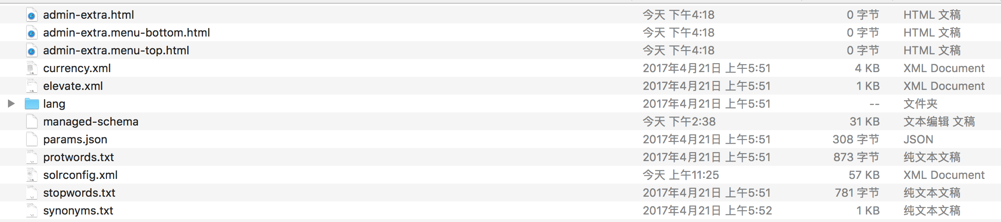
Solr注意
1、
Can not find: admin-extra.html [/work/app/solr-6.5.1/server/solr/cltx/conf/admin-extra.html]
日志出现上述异常，在目录cltx/conf 下添加空文件，实现如下目录：
2、不支持count查询，分页可参考上述查询代码
3、各种条件查询，参数类型参考查询代码，支持模糊查询?,*,AND,OR，区间条件[],{},日期条件查询

