Slide 1
Blockchain Solution for MOOG
By:
E-Numismatists
Bhumika Khatwani
Sunita Pattanayak

Slide 2
The Use Case( Maintaining Moog’s Medical Enteral Feeding Protocol)
Moog’s medical enteral feeding pump records patient’s feeding history, talks securely to Bluetooth enabled weight scale to record patient weight over time to verify effectiveness of treatment.
Data records tracked as part of secure Blockchain based medical records where patient ‘owns’ and controls access to her secure medical records.
Patient grants granular access to data based on need to know.
Treating doctor receives patient records and compliance history.
Home health care provider receives records of consumed product and replenishes when needed.
Pump and scale manufacturer receive data on the reliability and compliance of their products

Slide 3
Why Blockchain?
Here are the reasons we think blockchain can solve this scenario:
There are three types of peer to peer transactions with no intermediaries
Patient and Doctor
Patient and Health care provider
Patient and Pump and scale manufacturer
Here, transactions can be the following :
Weight Change Update from patient to doctor
Information about replenishment of consumed product
Feedback for effectiveness of pump
Blockchain can take care of all the above requirements by a decentralized infrastructure.
All transactions will be recorded in a distributed ledger of blocks.
A consensus protocol will take care of agreement on validity of blocks.
The chain of blocks created will be immutable or tamper free due to the chain links.
Thus, blockchain can provide trust and security through the consensus and non tamperable recording.

Slide 4

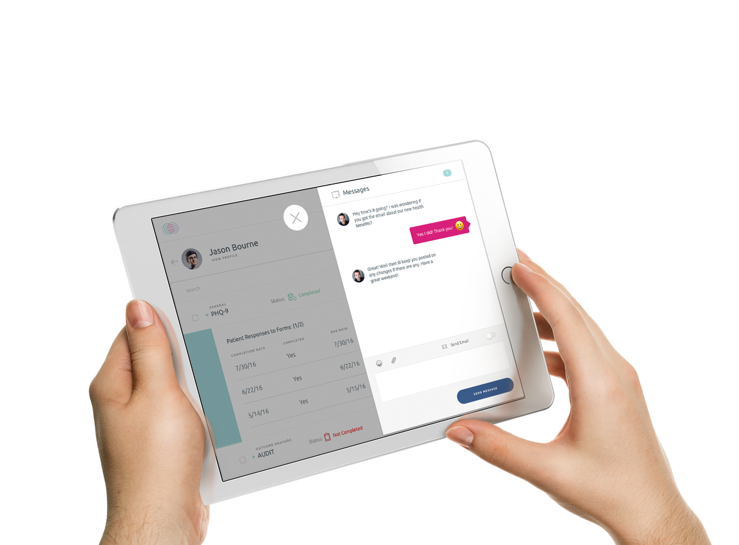


Model
Send Patient Information
Check patient weight
Doctor
Send Dosage information
Send Feedback
Formulary info
Patient with the pump
Manufacturer

Slide 5
Remix-solidity program
3 individuals involved in the transactions :
Patient
Doctor
Formulary
Functions created :
Create Patient info : patient id, weight and dosage
Create Doctor info : id should be less than 10000, patient id, weight and dosage initialized to 0
Create Formulary info : id should be more than 10000, patient id, dosage initialized to 0
Send Require info : Patient to doctor, update about weight
Send latest info and check patient weight : This function will compare previous weight stored with doctor with latest patient weight and show alert if patient weight decreased
Send dosage info : Update the formulary if there is an increase or decrease in dosage of the patient.

Slide 6
Dapp using smart contracts, truffle VM
We use truffle to code Dapp, test it
The Dapp ( Decentralised Application Stack) :
End
user Web
Interface
Peer to peer network(Bluetooth Stack)
Hardware- Pumps
Smart contracts created using solidity
Blockchain VM- truffle IDE

Slide 7
Dapp development using truffle VM
Use basic truffle IDE given
Folder structure :
Enteral : Main folder containing:
Contracts : Contains all smart contracts created using solidity.
Migrations : Created automatically when we do truffle migrate –reset.
Node_modules : Created automatically using npm init.
Src : Contains index.html, js and css files for creating web interface.
Test : Contains files to test the Dapp
Bs-config.json : Contains info for using npm run dev.
Package.json : Contains folder structure to be accessed for development of the app i.e src folder.

Slide 8
Conclusion
Factors considered in the created project:
Patient decides the info to be shared with doctor and health care proivder
Weight update to the doctor
Dosage update to the doctor
Only the doctor can create his own info, access info shared by the patient and share previous weight to compare with latest weight to create alert.
Only the formulary can create its own info, access dosage info shared by the patient and change the nutrient supply accordingly.
Feasible enhancement of the project :
An anonymous feedback loop for the Manufacturer to monitor its pumps effectiveness
Checking doctor’s prescription if its in accordance with FDA, HIPPA compliance
Keeping track of the nutrients dosage and insurance information.

Slide 9


