Slide 1


Capestone Project – WestFloridaahec
By,
Kondapalli Vyshnavi

Slide 2
Introduction
Combination Of Manual and Automation testing.
Manual Testing:
Excel documentation of test cases .
Test Management Tool – Jira.
Automation Testing:
Selenium Web Driver
TestNg
BDD Cucumber
CI/CD:
Jenkins
Version Control:
Git/GitHub

Slide 3
Application Under Test: West Florida AHEC Website (https://westfloridaahec.org/)
Purpose: The website serves as the primary online platform for the organization, providing information on health programs, events, and contact details. It is a critical tool for community outreach and engagement.
Key sections:
Programs: AHEC Scholars, Tobacco Free Florida, Healthy Aging, etc.
Forms: Enrolment forms, resource requests, applications.
Navigation: Multi-page dynamic website with user-interactive elements.

Slide 4
Objectives
Automate testing of critical workflows.
Validate forms (e.g., scholar applications, navigator requests).
Generate automated reports (TestNG + Cucumber reports).
Jira reports.
Jenkins builds.

Slide 5
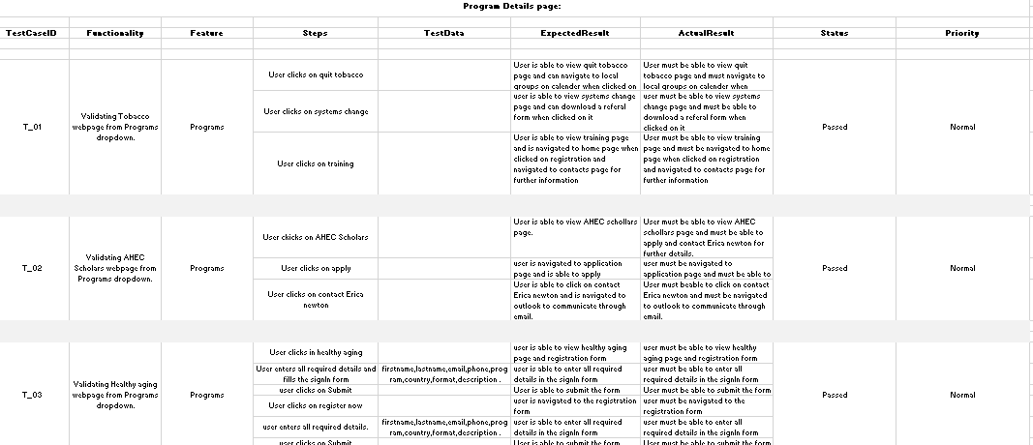
Manual Testing

Slide 6
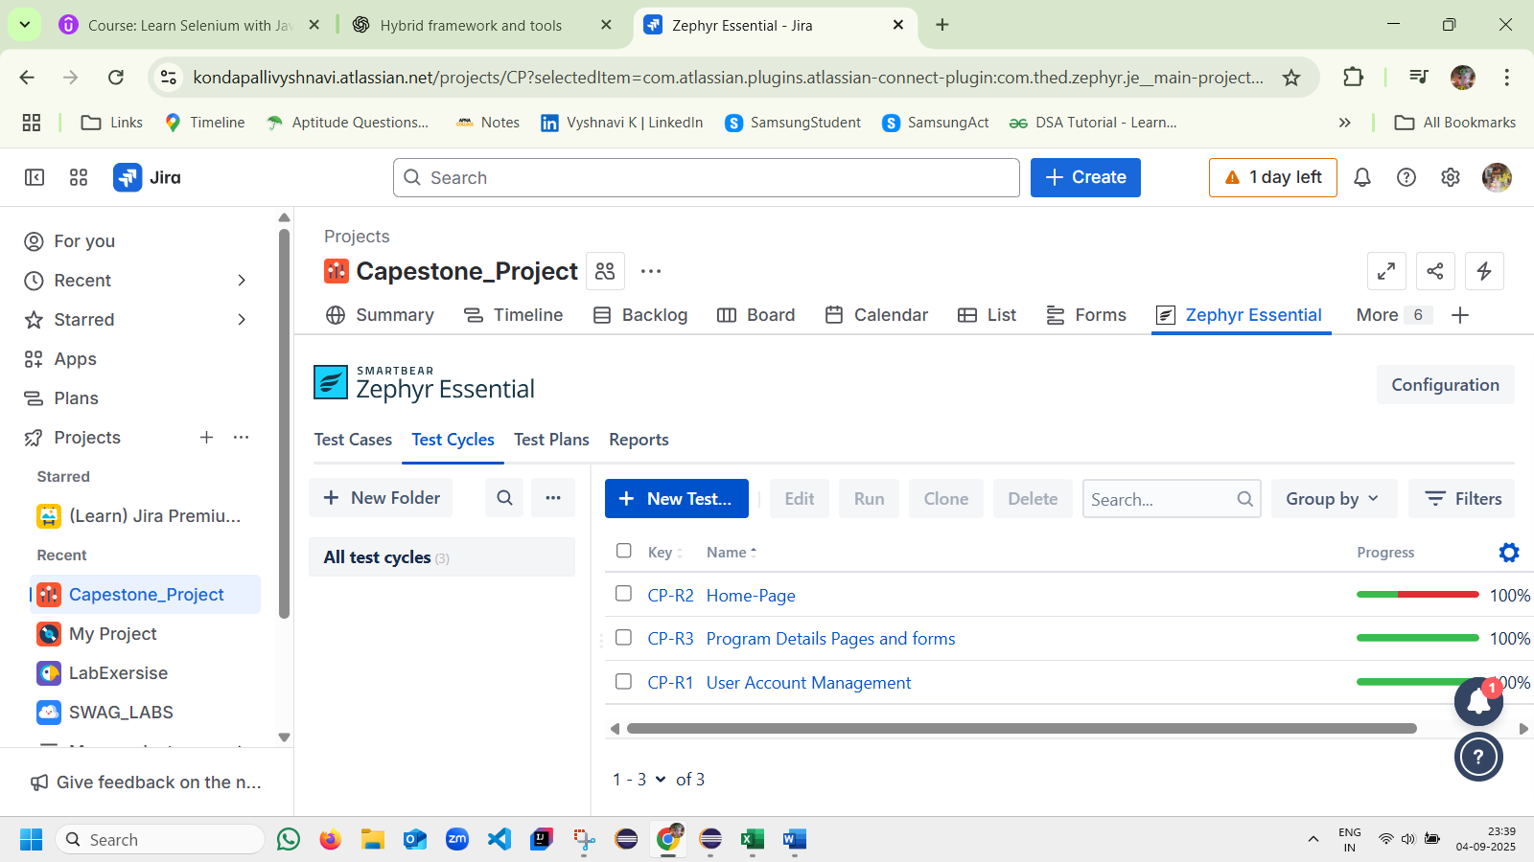

Slide 7
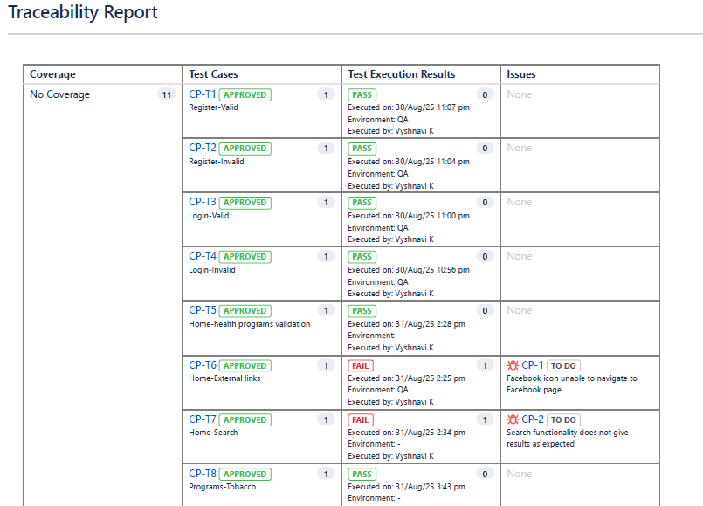

Slide 8
In - Scope
Functional testing of links, windows and forms.
Manual Test Cases documentation.
Test execution via TestNG & Selenium WebDriver.
Test execution via cucumber BDD
Automated reporting (Extent/Emailable report).
Features Automated :
User login and Register
Home page and search
Health Programs

Slide 9
Out Of Scope
Backend database testing.
API testing.
Security and performance testing.
UI Testing

Slide 10
Testing Process
Requirement analysis of healthcare workflows.
Test case design (manual → automation).
Framework development (Page Object Model with TestNG).
Execution of test suites.
Report generation and analysis.

Slide 11
Frameworks
Technology Stack: Selenium WebDriver, TestNG, Java, Maven, GitHub, Jenkins, Jira
Design Pattern: Page Object Model (POM) and Regular TestNg pattern.
Reports: Jira Reports, TestNG emailable reports, Html reports

Slide 12
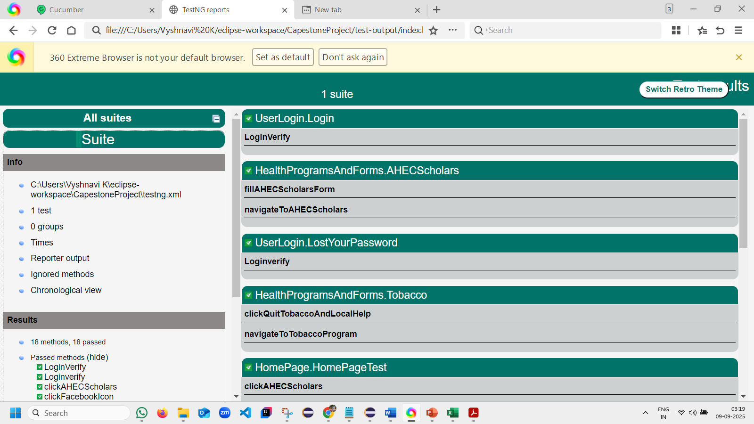

Slide 13
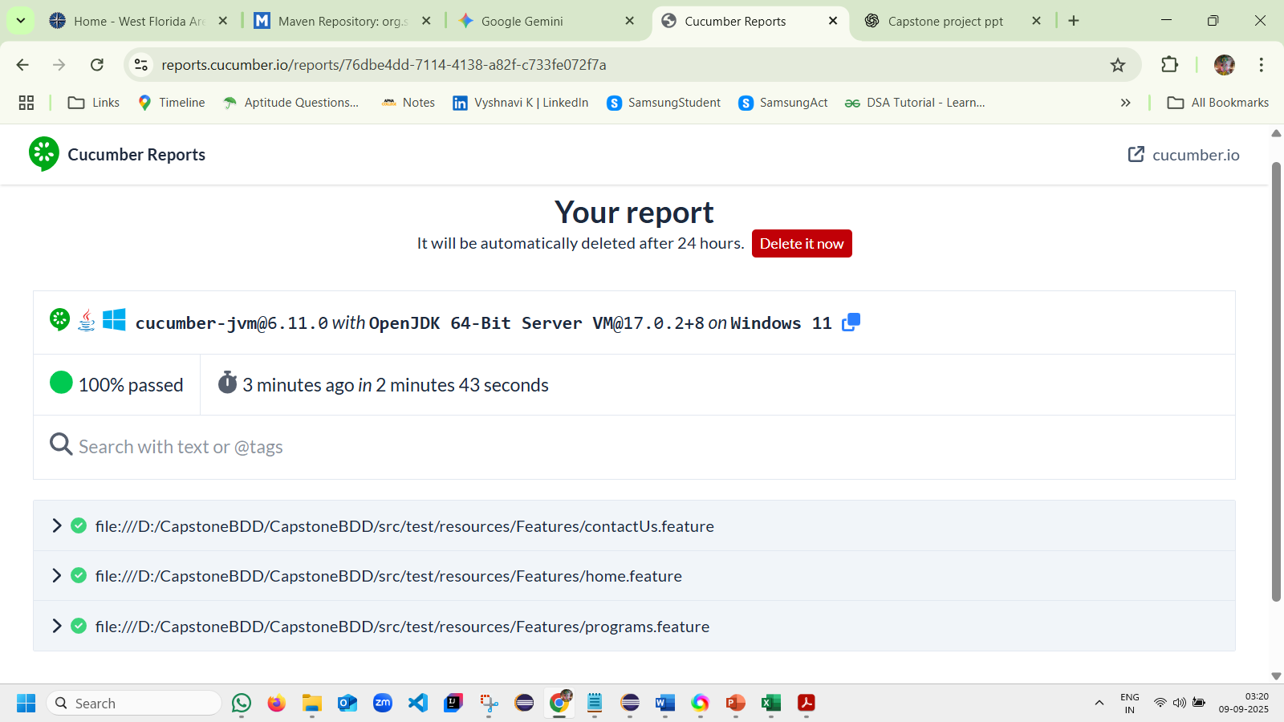

Slide 14
Challenges
Challenge: Dynamic elements & iframes in forms.
Challenge: Maintaining test scripts. Solution: POM structure for reusability.
Syntaxes and annotations used.

Slide 15
THANK YOU.

