Slide 1

Have you ever said…
'I'll do it in 5 minutes'?
5 minutes → 30 minutes → 2 hours → Tomorrow.
What really happened?
Was it laziness?
Or was your brain trying to avoid something?
THE PSYCHOLOGY OF PROCRASTINATION
Why We Delay — And How to Beat It

Slide 2
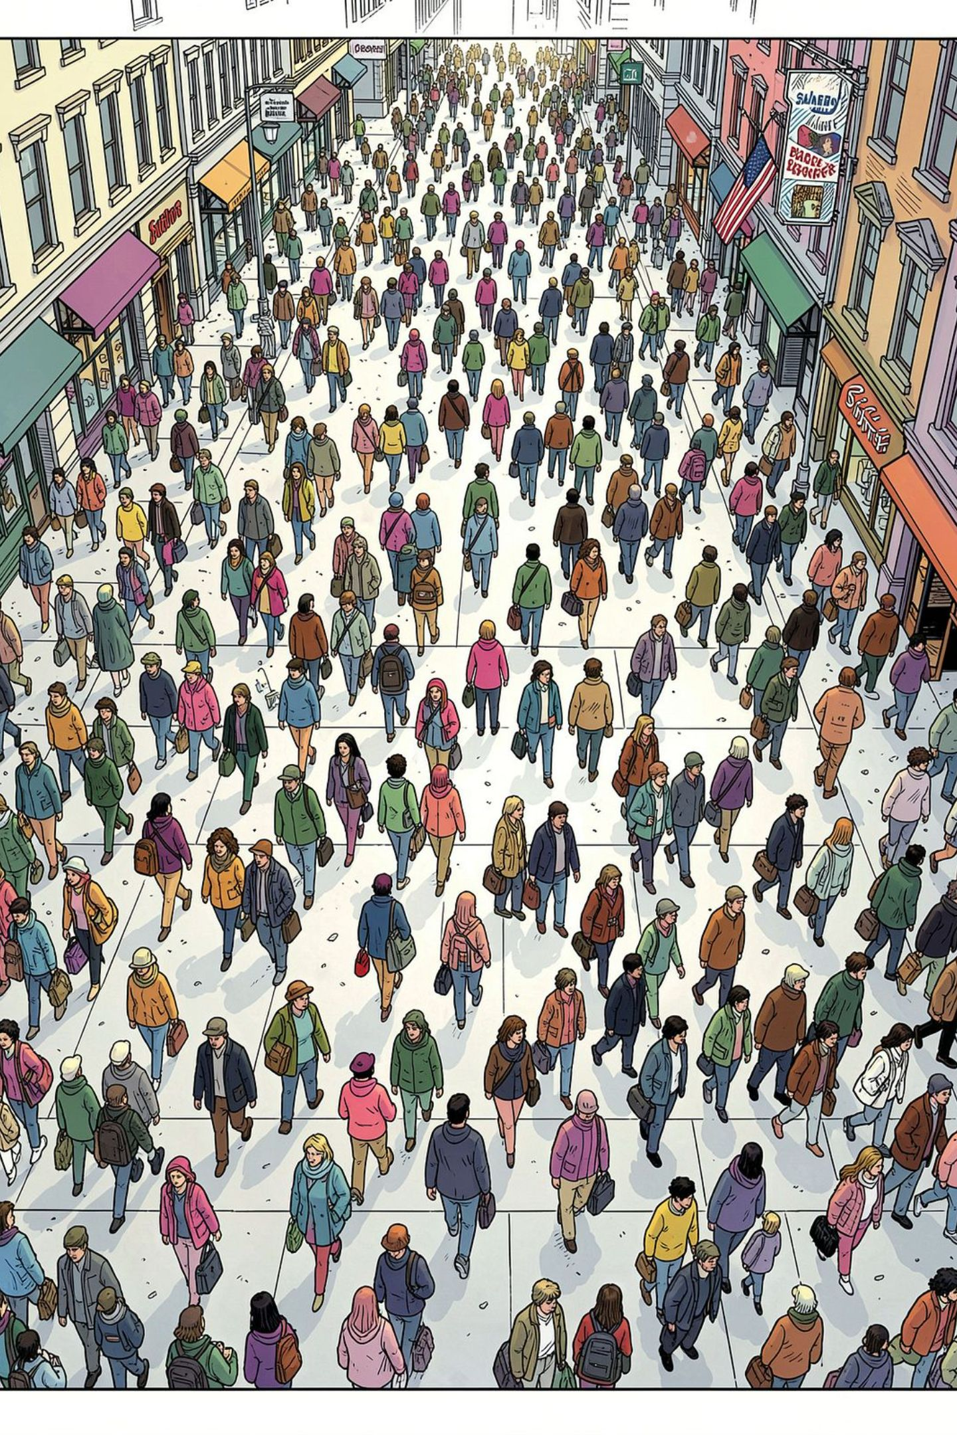
PROCRASTINATION
The Procrastination Paradox
95%
It’s not laziness
Procrastination is usually not a time problem. It’s a mood-management strategy — a way to escape discomfort fast.
When a task feels uncertain, boring, overwhelming, or risky, the brain reaches for relief. That’s why we know what to do and still avoid it.
The fight isn’t with the work — it’s with the feeling it brings up.
of people procrastinate

Slide 3
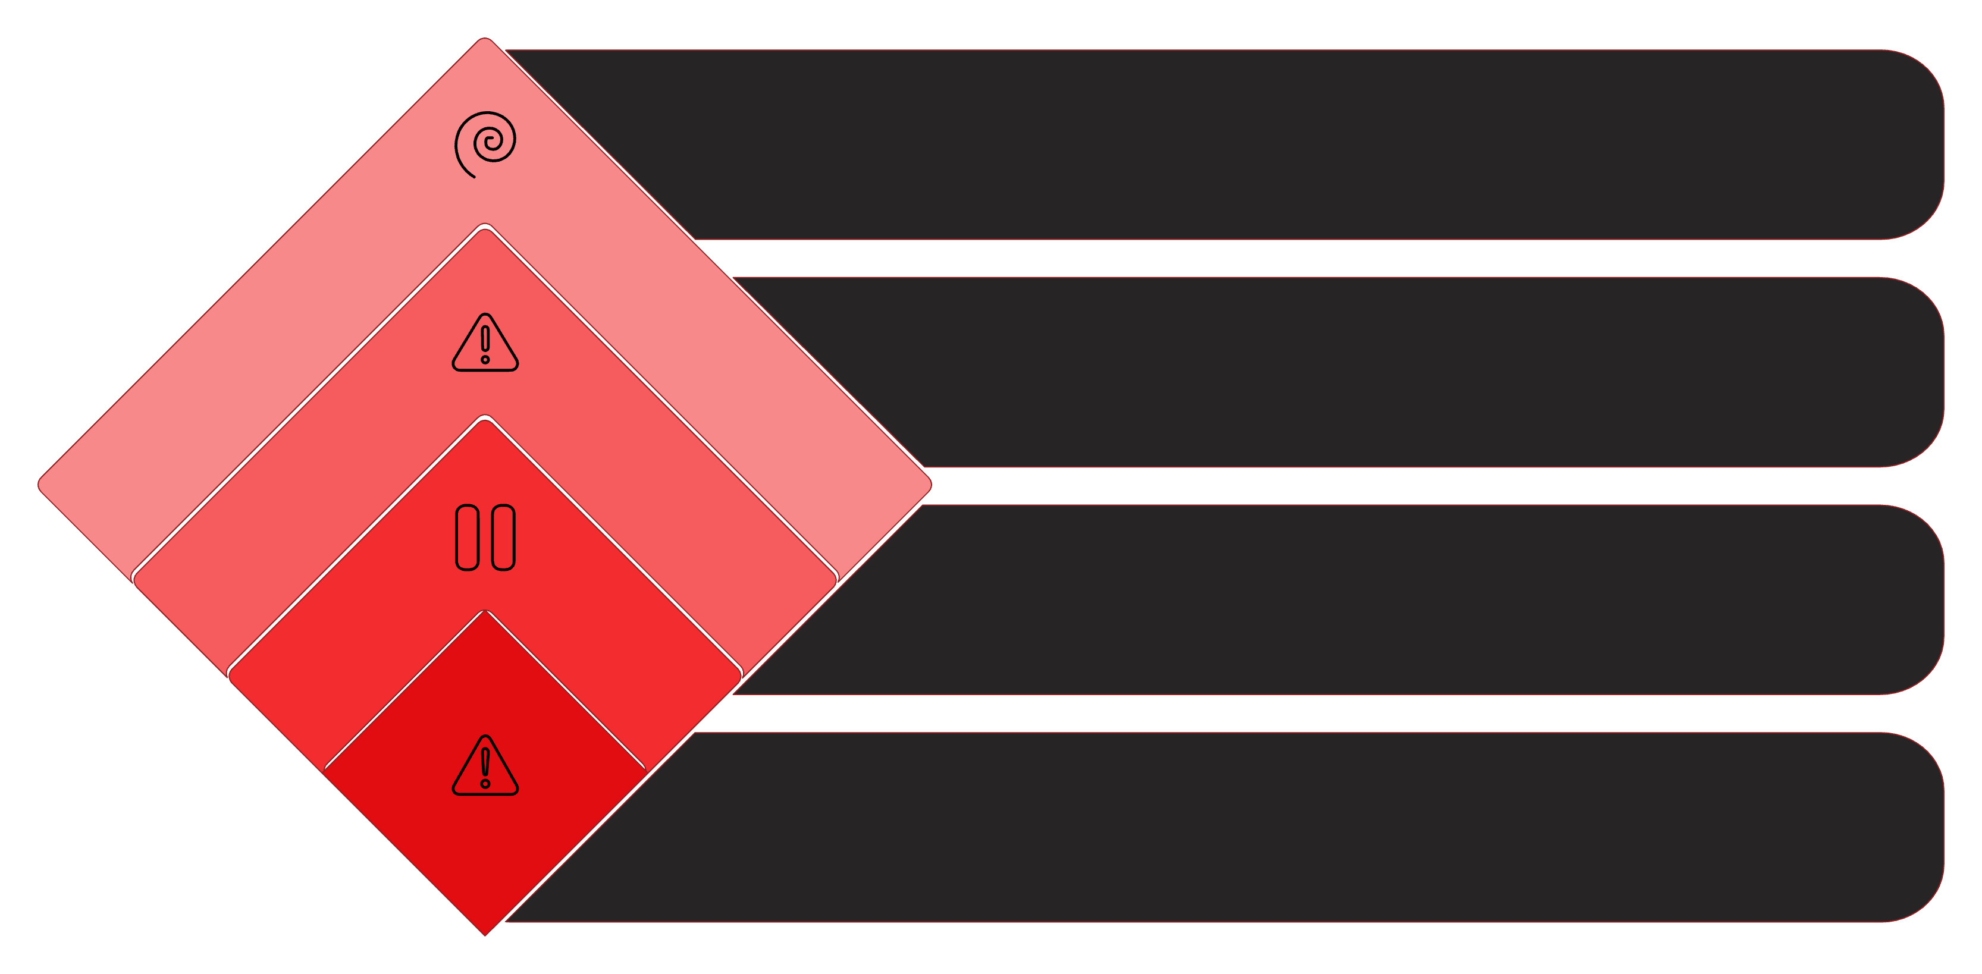
The Real Culprit: Emotional Discomfort
Task Feels Harder
The longer you wait, the heavier it gets
Emotional Debt
Guilt, stress, and pressure build up
Avoidance
You delay it for quick relief
Initial Trigger
A task sparks anxiety, boredom, or uncertainty
Your brain chases comfort — and procrastination offers a quick escape. But that relief is costly: what you avoid today usually returns with more urgency, more stress, and less time. It’s not a time management problem. It’s emotional regulation.
The Trap
The Cost
The Root
Avoidance brings short relief, then reinforces the habit
Delays turn into guilt, stress, and panic
When discomfort shows up, the brain picks relief now

Slide 4
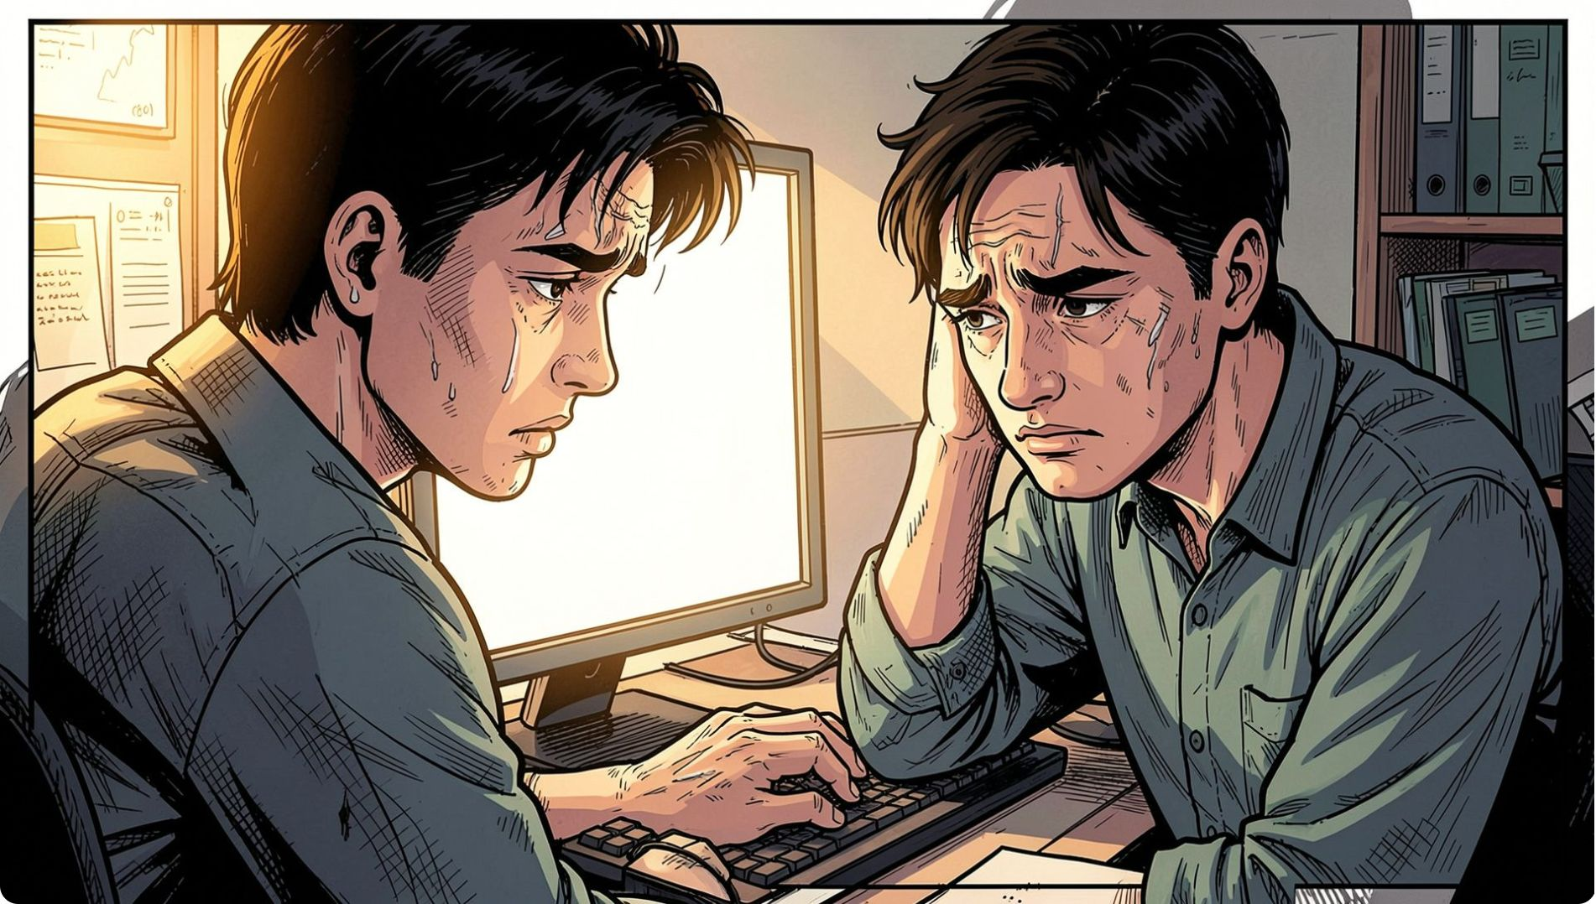

PRODUCTIVITY
Why Willpower Fails
"Just do it" sounds good — but it often backfires. Willpower is limited, and by day’s end your brain is on low battery. That’s why a task can feel easy in the morning and impossible at 6 p.m.
Decision Fatigue
Motivation Follows Action
More choices drain mental energy, making distractions harder to resist. By evening, even small tasks feel heavy.
Don’t wait to feel ready. Start small, build momentum, and let action create motivation.

Slide 5


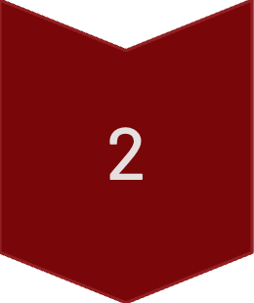
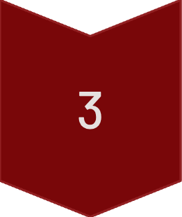

QUICK WIN
PRODUCTIVITY
The 2-Minute Rule That Actually Works
Stop negotiating with the task. Commit to 2 minutes. That tiny start lowers resistance and gets you moving fast.
Start Small
Do just 2 minutes, not the whole task.
Bypass the Barrier
Starting is the hardest part. Once you begin, resistance usually drops.
Momentum Takes Over
Action creates motivation. Minute two often feels easier than minute zero.
This works by sidestepping the emotional barrier: “I should” becomes “I’m already doing it.”

Slide 6
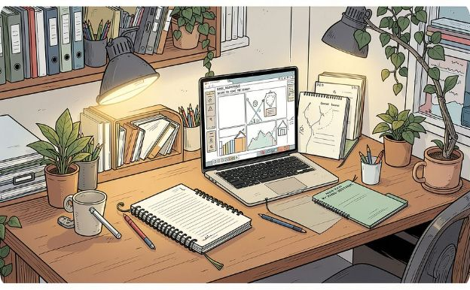
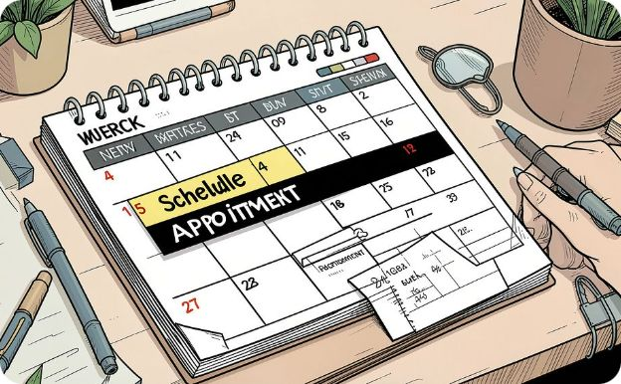
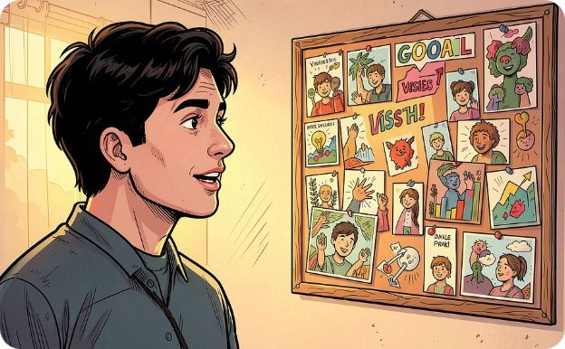
Your Anti-Procrastination Toolkit
Remove Friction
Schedule It
Find Your Why
Prep your workspace the night before. When starting is obvious, there's less room to stall.
Treat deadlines like appointments: non-negotiable. Time-block it and protect the slot.
Link the task to a goal that matters. Purpose beats pressure when motivation fades.

