Slide 1
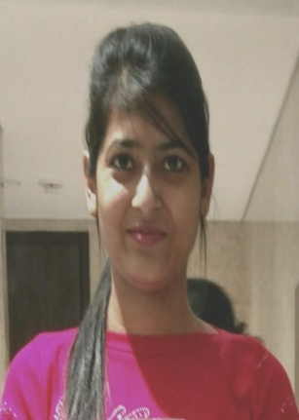
Sunidhi DevOps Engineer- Cloud Infrastructure Service
Sunidhi
Profile Summary
Technical Skills:
Infrastructure tools – Chef (Chef Client, Chef Compliance, Chef Automation, Chef Solo),VMware (vCenter, vRA/vRO, vSphere)
CI/CD Tools – Jenkins, Git
Programming languages – Java, PLSQL
Scripting languages: JavaScript, PowerShell, Ruby, Python
Database – MySQL, Oracle 11g
Operating System – Windows server 2012 and Linux.
DevOps Engineer
Cloud Automation and Operations - Cloud Practice
Profile Summary
Sunidhi has around 1.5 years of experience and has worked on Installation, Configuration and Trouble shooting of Chef products such as Chef Compliance, Chef Automation, Chef Solo.
She also has a knowledge of VMware vRealize Orchestration, VMware vRealize Automation, VMware vSphere client Setup of vRealize Automation infrastructure (vRA, vRO, IAAS).
Worked on other DevOps tools like Jenkins, Git.
Also trained in JEE and Amazon web services.
Skilled at development of enterprise applications using core java, advance java and databases with flexibility . Scripting knowledge for cloud tools (Power shell and java script ).
Sunidhi holds Bachelor of Technology degree in Computer Science and Technology from Kurukshetra University, India. She has done projects on open source software and tools.
Experience
Sunidhi has worked on Installation, Configuration and Trouble shooting of Chef products such as Chef Compliance, Chef Automation, Chef Solo, and also worked on VMware vRealize Orchestration, VMware vRealize Automation, vSphere client and other DevOps tools like Jenkins, Git. Also trained in JEE and Amazon web services.
Her main specialties and expertise area includes:
Writing chef recipes for windows and linux nodes to install various software.
Writing Chef Compliance profiles for various cookbooks.
Setting up and managing Chef Infrastructure(workstation, server, client, compliance, automate).
Integrating Chef server with Chef Compliance.
Creating and Managing Virtual Machines and Templates.
Integration of Chef Server and Workstation with Jenkins.
Migrating of Virtual Machines using V Motion.
Provision VMware Datastores and configures storage for Virtual Machines.

