Slide 1
18CS503:Operating Systems
Course Instructor: Vijaya Murari T.
Sections: 5C and 5D
L-T-P:4:0:2

Slide 2
TEXT BOOK:
Operating System Concepts, Abraham Silberschatz, Greg Gagne, Peter B. Galvin, 10th Edition, John Wiley & Sons, 2018, ISBN: 9781119320913.
Syllabus:
Unit-1
OS structure
Process Management
Threads and Concurrency
Unit-2
CPU Scheduling
Process Synchronization
Deadlocks

Slide 3
Unit-3
Main Memory
Virtual Memory
Unit-4
Mass storage structure
Implementing File System
Security
Security problem, threats, implementing security defences
Protection

Slide 4
What is an Operating System?
A program that acts as an intermediary between a user of a computer and the computer hardware
Operating system goals:
Execute user programs and make solving user problems easier
Make the computer system convenient to use
Use the computer hardware in an efficient manner

Slide 5
Computer System Structure
Computer system can be divided into four components:
Hardware – provides basic computing resources
CPU, memory, I/O devices
Operating system
Controls and coordinates use of hardware among various applications and users

Slide 6
Application programs – define the ways in which the system resources are used to solve the computing problems of the users
Word processors, compilers, web browsers, database systems, video games
Users
People, machines, other computers

Slide 7
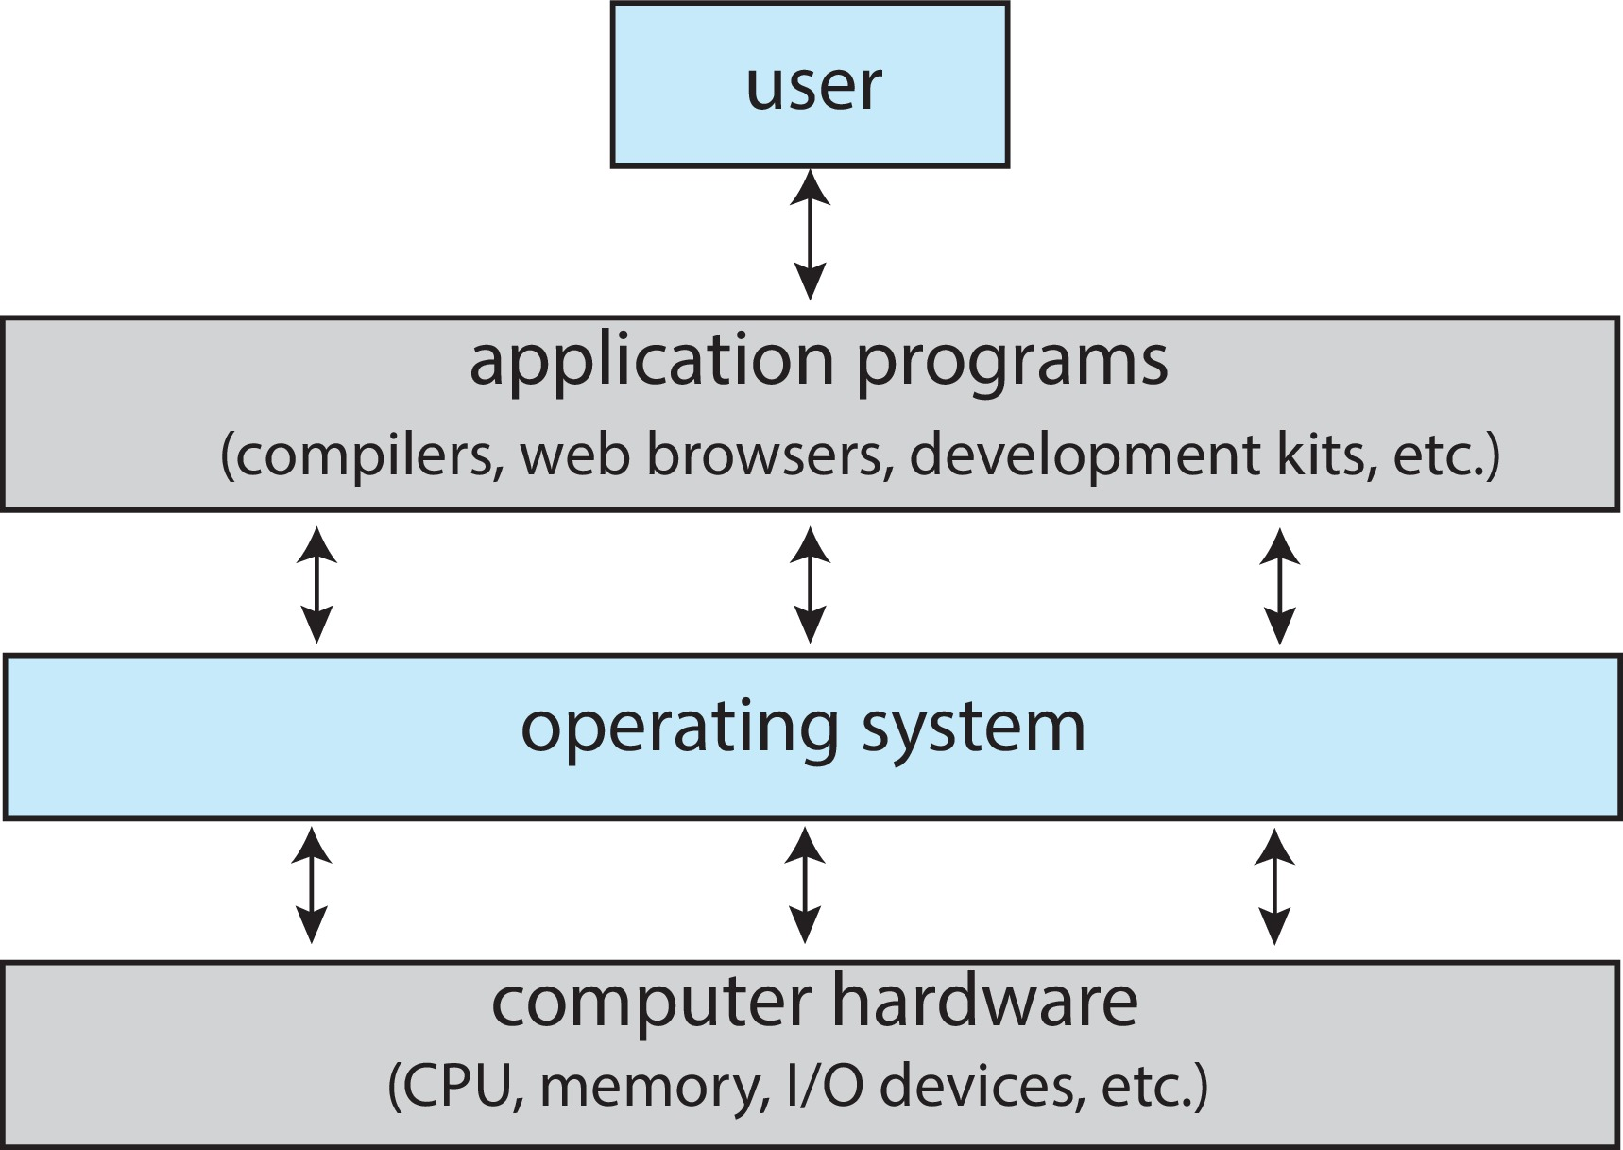
Abstract View of Components of Computer

Slide 8
OS: viewpoints
User View
Convenience
Ease of use
No attention to resource utilization
Compromise between individual usability and resource utilization when computer are connected to the servers over the network
Touch screen interfaces for mobile devices.

Slide 9
Some computers have little or no user interface, such as embedded computers in devices and automobiles
Run primarily without user intervention
System View
Resource allocator: OS manages CPU time, memory space, file-storage space, I/O devices etc
A Control program: manages the execution of user programs to prevent errors and improper use of the computer.

Slide 10
Operating System Services
Operating systems provide an environment for execution of programs and services to programs and users
One set of operating-system services provides functions that are helpful to the user:
User interface - Almost all operating systems have a user interface (UI).
Command-Line (CLI), Graphics User Interface (GUI), touch-screen, Batch

Slide 11
Program execution - The system must be able to load a program into memory and to run that program, end execution, either normally or abnormally (indicating error)
I/O operations - A running program may require I/O, which may involve a file or an I/O device
File-system manipulation - The file system is of particular interest. Programs need to read and write files and directories, create and delete them, search them, list file Information, permission management.

Slide 12
Communications – Processes may exchange information, on the same computer or between computers over a network
Communications may be via shared memory or through message passing (packets moved by the OS)
Error detection – OS needs to be constantly aware of possible errors
May occur in the CPU and memory hardware, in I/O devices, in user program
For each type of error, OS should take the appropriate action to ensure correct and consistent computing

Slide 13
Debugging facilities can greatly enhance the user’s and programmer’s abilities to efficiently use the system
Another set of OS functions exists for ensuring the efficient operation of the system itself via resource sharing
Resource allocation - When multiple users or multiple jobs running concurrently, resources must be allocated to each of them
Many types of resources - CPU cycles, main memory, file storage, I/O devices.

Slide 14
Accounting - To keep track of which users use how much and what kinds of computer resources
Protection and security - The owners of information stored in a multiuser or networked computer system may want to control use of that information, concurrent processes should not interfere with each other
Protection involves ensuring that all access to system resources is controlled
Security of the system from outsiders requires user authentication, extends to defending external I/O devices from invalid access attempts

Slide 15
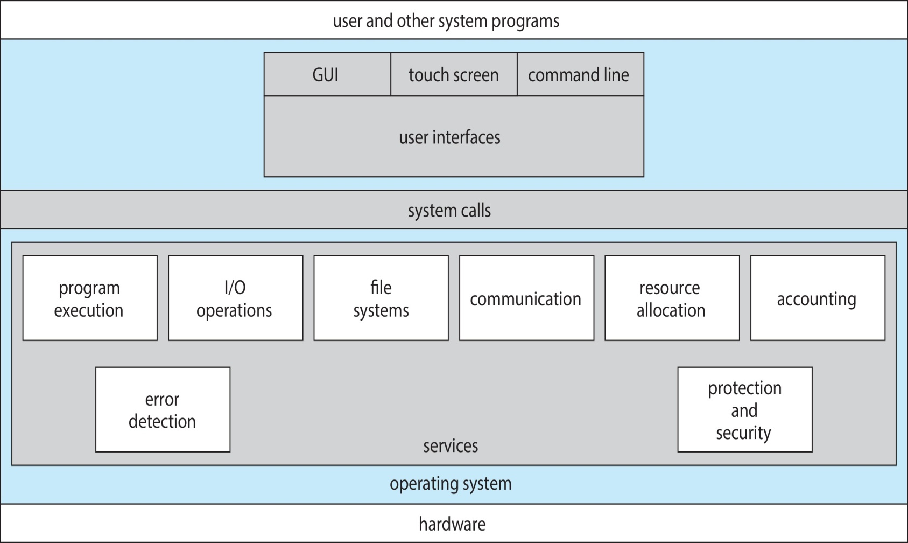
A view of OS services

Slide 16
Approaches for user interaction with OS
Command Interpreters
Command Line Interface (CLI) allows direct command entry
Sometimes implemented in kernel, sometimes by systems program
Sometimes multiple flavors implemented – shells
Primarily fetches a command from user and executes it
Sometimes commands built-in, sometimes just names of programs

Slide 17
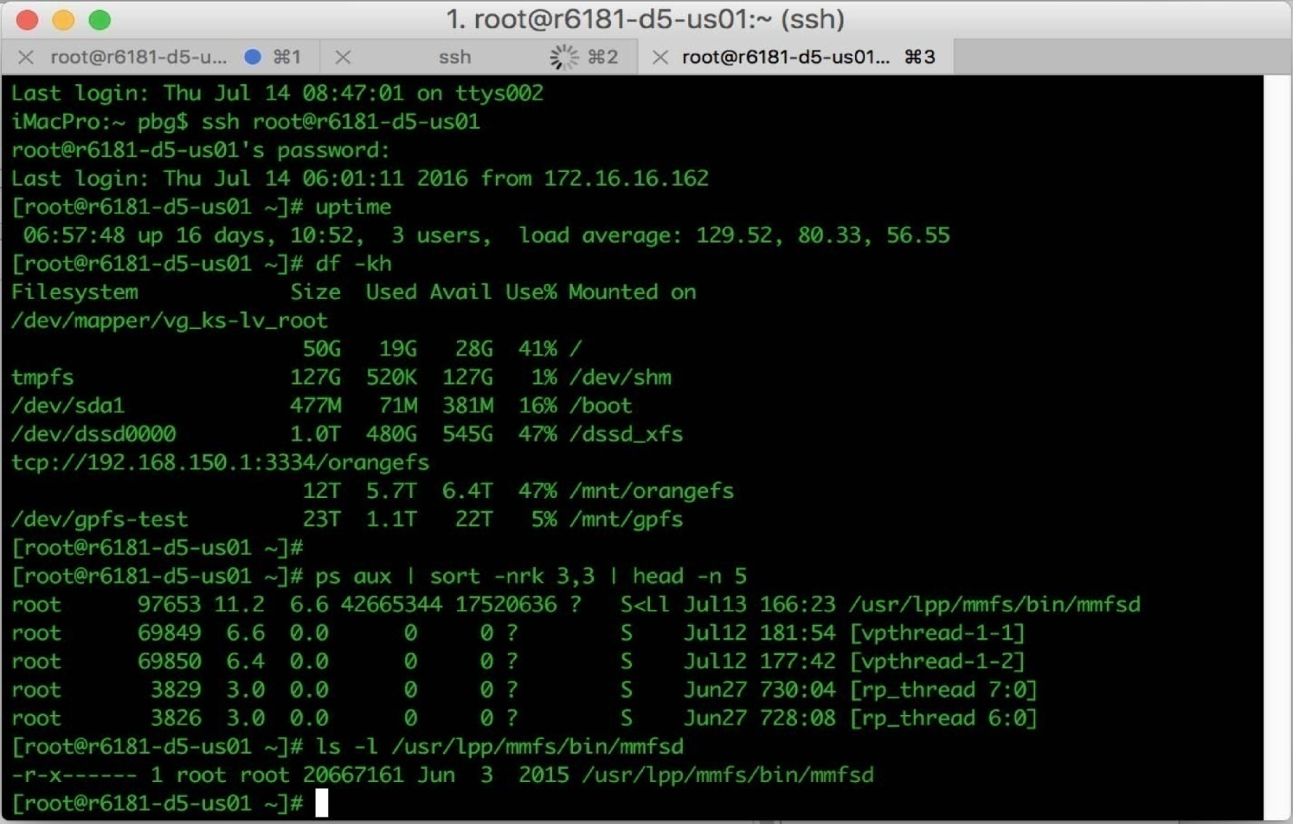
Bourne Shell Command Interpreter

Slide 18
Graphical User Interface(GUI)
User-friendly desktop metaphor interface
Usually mouse, keyboard, and monitor
Icons represent files, programs, actions, etc
Various mouse buttons over objects in the interface cause various actions (provide information, options, execute function, open directory (known as a folder)
Invented at Xerox PARC

Slide 19
Many systems now include both CLI and GUI interfaces
Microsoft Windows is GUI with CLI “command” shell
Apple Mac OS X is “Aqua” GUI interface with UNIX kernel underneath and shells available
Unix and Linux have CLI with optional GUI interfaces (CDE, KDE, GNOME)

Slide 20
System Calls
Programming interface to the services provided by the OS
Typically written in a high-level language (C or C++)
Mostly accessed by programs via a high-level Application Programming Interface (API) rather than direct system call use

Slide 21
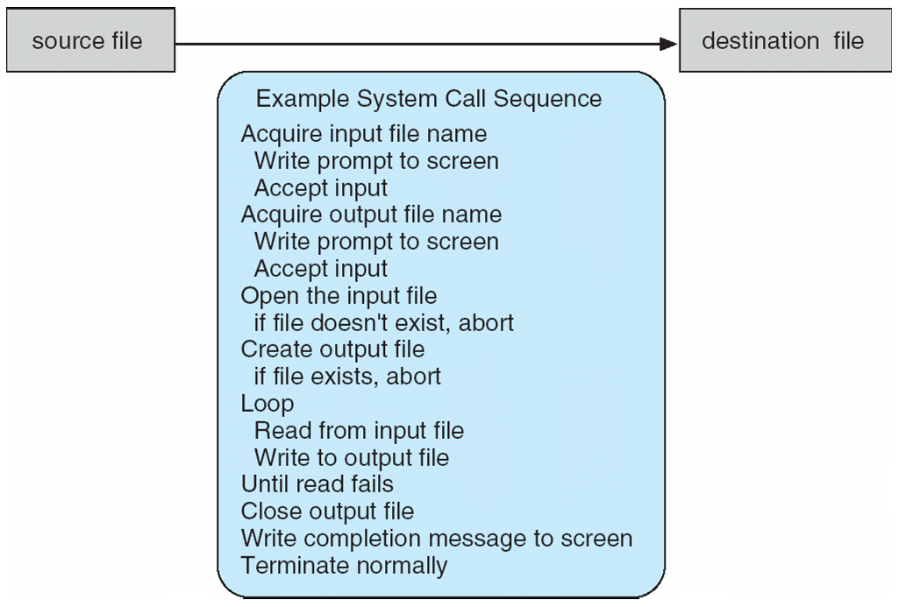
Example of System Calls
System call sequence to copy the contents of one file to another file
Command: cp in.txt out.txt

Slide 22
Application Programming Interface(API)
Application developers design programs according to an application programming interface(API).
The API specifies a set of functions that are available to an application programmer, including the parameters that are passed to each function and the return values the programmer can expect.

Slide 23
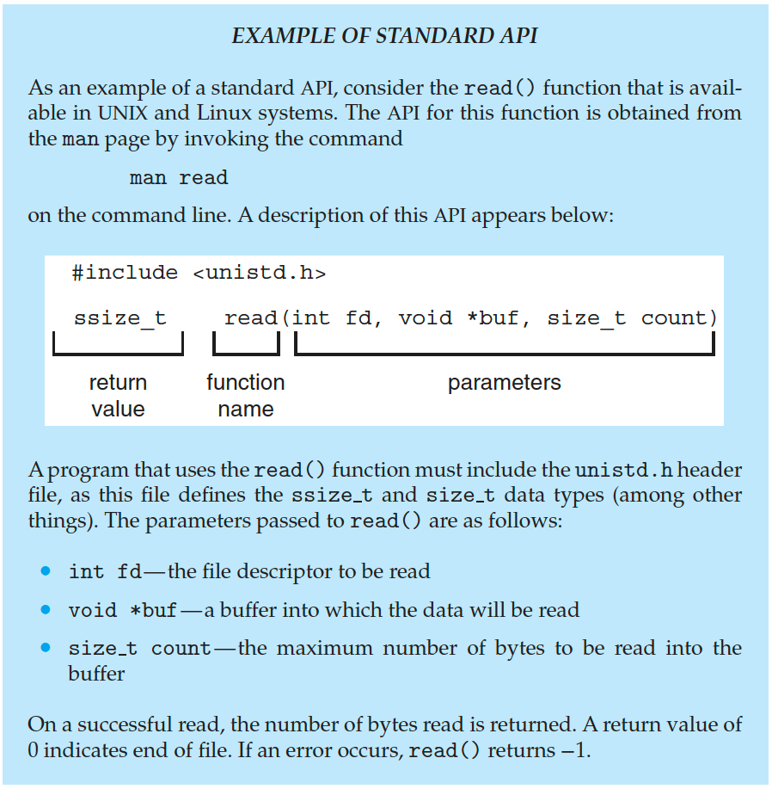
Example of standard API

Slide 24
Three most common APIs are
Win32 API for Windows,
POSIX API for POSIX-based systems (including virtually all versions of UNIX, Linux, and Mac OS X),
Java API for the Java virtual machine (JVM)

Slide 25
Why programmer prefer programming according to API rather then invoking actual system calls?
Program portability: An application programmer designing a program using an API can expect her program to compile and run on any system that supports the same API
Actual system calls can often be more detailed and difficult to work with than the API available to an application programmer

Slide 26
Correlation
Nevertheless, there often exists a strong correlation between a function in the API and its associated system call within the kernel.
In fact, many of the POSIX and Windows APIs are similar to the native system calls provided by the UNIX, Linux, and Windows operating systems.

Slide 27
System call implementation
The Run Time Environment (RTE) provides a system call interface that serves as the link to system calls made available by the operating system.
RTE- is the full suite of software needed to execute applications written in a given programming language, including its compilers or interpreters as well as other software, such as libraries and loaders.

Slide 28
The system-call interface intercepts function calls in the API and invokes the necessary system calls within the operating system.
Typically, a number is associated with each system call
System-call interface maintains a table indexed according to these numbers
The system call interface invokes the intended system call in OS kernel and returns status of the system call and any return values

Slide 29
The caller need know nothing about how the system call is implemented
Just needs to obey API and understand what OS will do as a result call
Most details of OS interface hidden from programmer by API
Managed by run-time support library (set of functions built into libraries included with compiler)

Slide 30
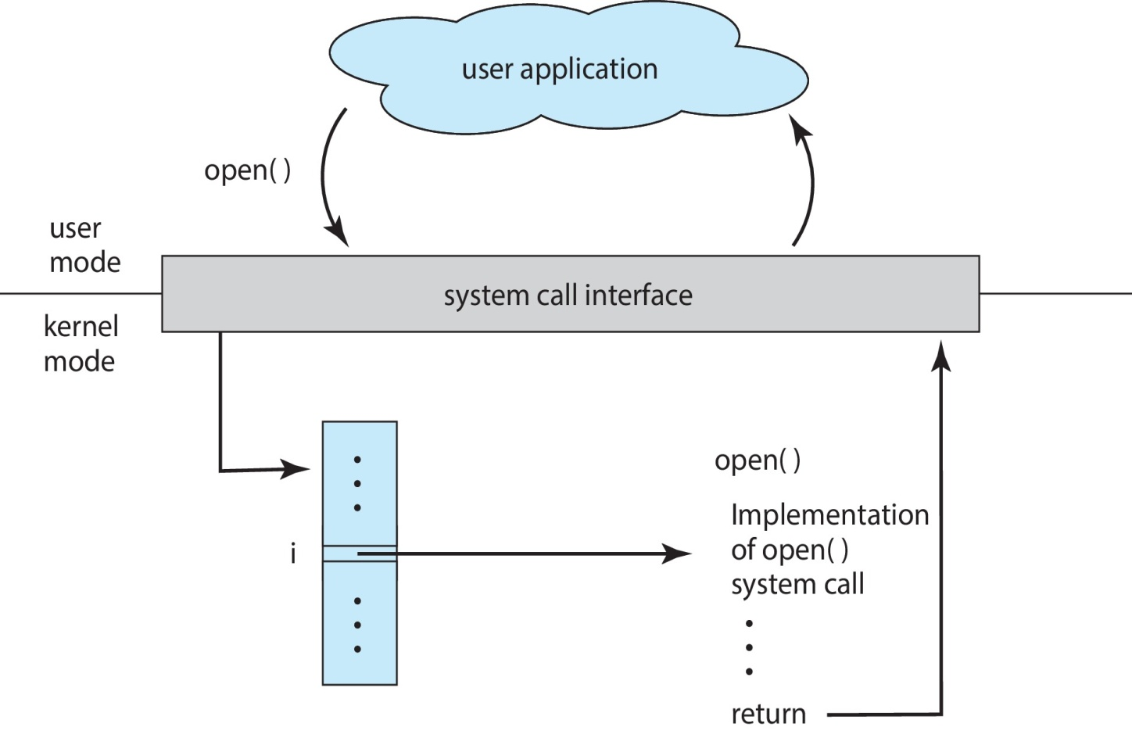
The handling of a user application invoking the open() system call

Slide 31
System call parameter passing
Often, more information is required than simply identity of desired system call
Exact type and amount of information vary according to OS and call
Three general methods used to pass parameters to the OS
Simplest: pass the parameters in registers
In some cases, there may be more parameters than registers

Slide 32
Parameters stored in a block, or table, in memory, and address of block passed as a parameter in a register
This approach taken by Linux and Solaris
Parameters placed, or pushed, onto the stack by the program and popped off the stack by the operating system
Block and stack methods do not limit the number or length of parameters being passed

Slide 33
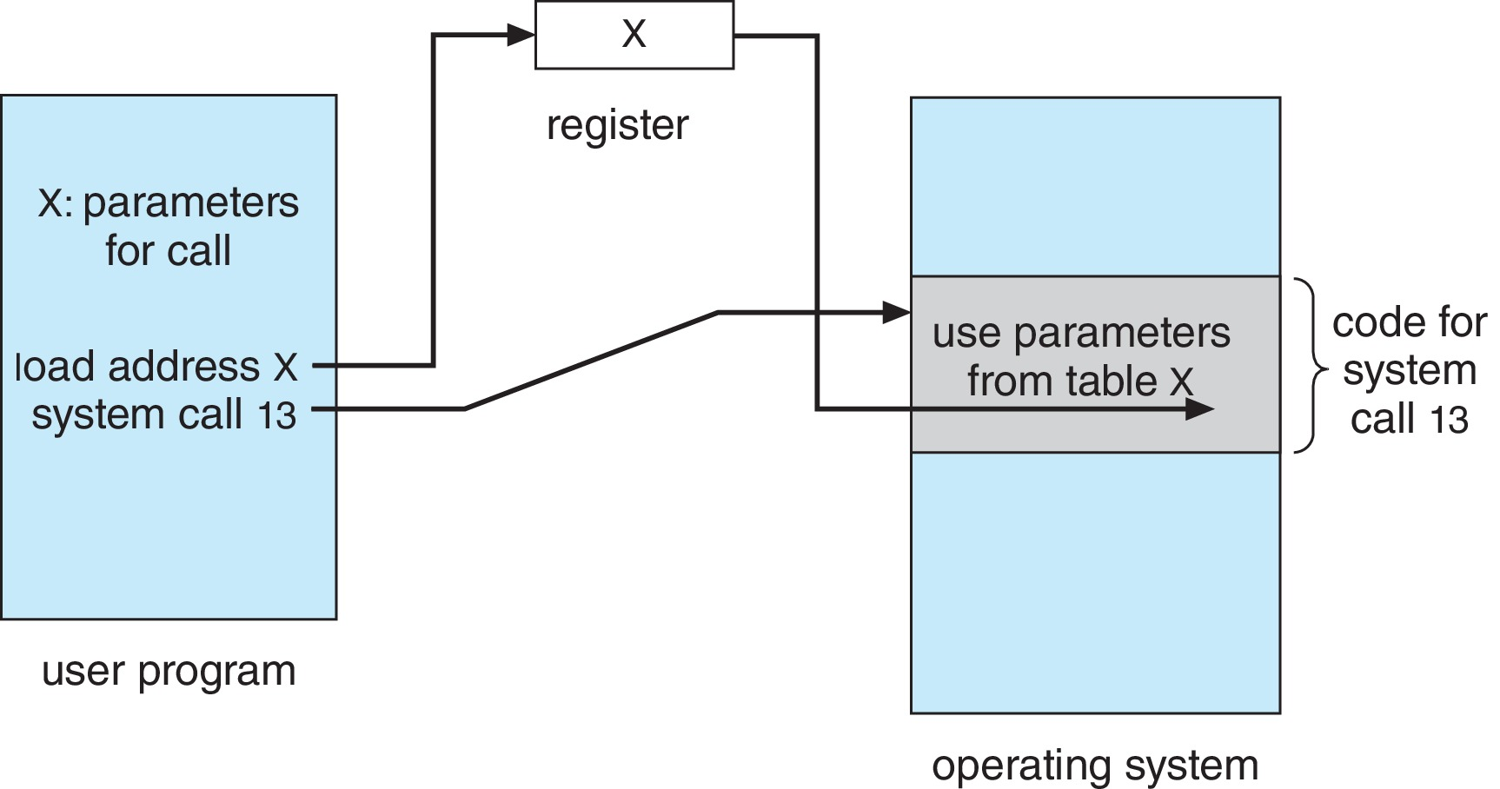
Parameter Passing via table

Slide 34
Types of system calls
Process control
create process, terminate process
end, abort
load, execute
get process attributes, set process attributes
wait for time
wait event, signal event
allocate and free memory
Dump memory if error
Debugger for determining bugs, single step execution
Locks for managing access to shared data between processes

Slide 35
File management
create file, delete file
open, close file
read, write, reposition
get and set file attributes
Device management
request device, release device
read, write, reposition
get device attributes, set device attributes
logically attach or detach devices

Slide 36
Information maintenance
get time or date, set time or date
get system data, set system data
get and set process, file, or device attributes
Communications
create, delete communication connection
send, receive messages if message passing model to host name or process name
From client to server
Shared-memory model create and gain access to memory regions
transfer status information
attach and detach remote devices

Slide 37
Protection
Control access to resources
Get and set permissions
Allow and deny user access

Slide 38
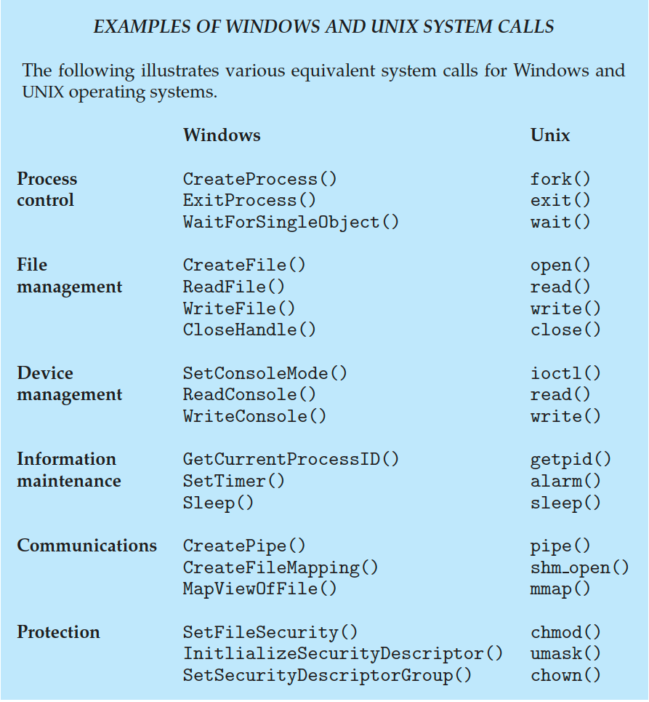
Examples of Windows and Unix System Calls

Slide 39
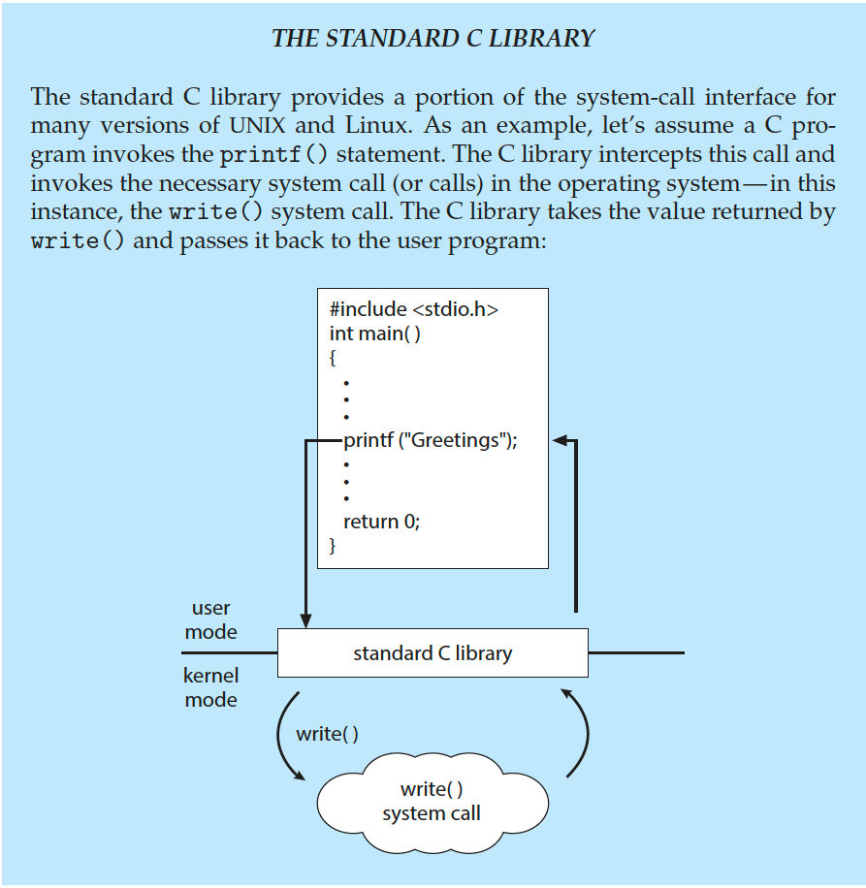
Standard C Library Example
C program invoking printf() library call, which calls write() system call

Slide 40
System services
System programs provide a convenient environment for program development and execution. They can be divided into:
File manipulation
Status information sometimes stored in a file
Programming language support
Program loading and execution
Communications
Background services

Slide 41
File management - Create, delete, copy, rename, print, dump, list, and generally manipulate files and directories
Status information
Some ask the system for info - date, time, amount of available memory, disk space, number of users
Others provide detailed performance, logging, and debugging information
Typically, these programs format and print the output to the terminal or other output devices

Slide 42
Some systems implement a registry - used to store and retrieve configuration information
File modification
Text editors to create and modify files
Special commands to search contents of files or perform transformations of the text
Programming-language support
Compilers, assemblers, debuggers and interpreters sometimes provided

Slide 43
Program loading and execution- Absolute loaders, relocatable loaders, linkage editors, and overlay-loaders, debugging systems for higher-level and machine language
Communications - Provide the mechanism for creating virtual connections among processes, users, and computer systems
Allow users to send messages to one another’s screens, browse web pages, send electronic-mail messages, log in remotely, transfer files from one machine to another

Slide 44
Background Services
Launch at boot time
Some for system startup, then terminate
Some from system boot to shutdown
Provide facilities like disk checking, process scheduling, error logging, printing
Run in user context not kernel context
Known as services, subsystems, daemons

Slide 45
Linkers and Loaders
Usually, a program resides on disk as a binary executable file—for example, a.out or prog.exe.
To run on a CPU, the program must be brought into memory and placed in the context of a process.
Steps
Source files are compiled into object files that are designed to be loaded into any physical memory location, a format known as an relocatable object file

Slide 46
Next, the linker combines these relocatable object files into a single binary executable file.
During the linking phase, other object files or libraries may be included as well, such as the standard C or math library (specified with the flag -lm).
A loader is used to load the binary executable file into memory, where it is eligible to run on a CPU core.
Relocation assigns final addresses to program parts and adjusts code and data in program to match those addresses

Slide 47
Modern general purpose systems don’t link libraries into executables
Rather, dynamically linked libraries (in Windows, DLLs) are loaded as needed, shared by all that use the same version of that same library (loaded once)
Object, executable files have standard formats, so operating system knows how to load and start them

Slide 48
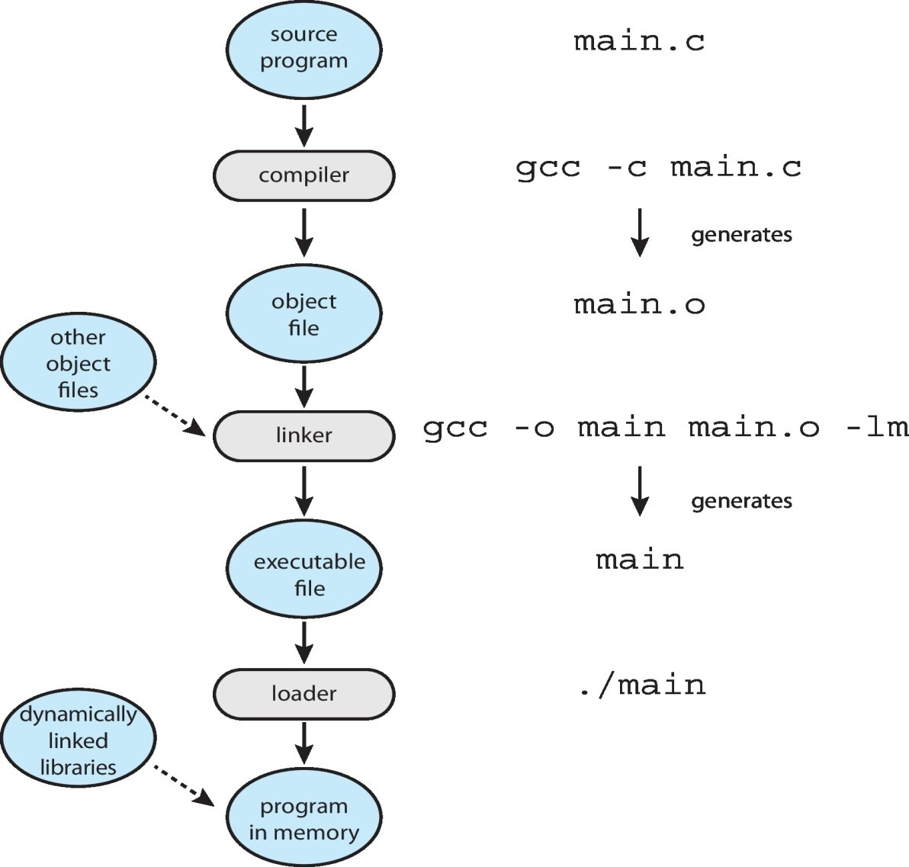
The Role of the linker and loader

Slide 49
Design and Implementation
Design and Implementation of OS is not “solvable”, but some approaches have proven successful
Internal structure of different Operating Systems can vary widely
Start the design by defining goals and specifications
Affected by choice of hardware, type of system

Slide 50
User goals and System goals
User goals – operating system should be convenient to use, easy to learn, reliable, safe, and fast
System goals – operating system should be easy to design, implement, and maintain, as well as flexible, reliable, error-free, and efficient
Specifying and designing an OS is highly creative task of software engineering

Slide 51
Policy and Mechanism
Policy: What will be done?
Timer construct for ensuring the CPU protection
Example: Interrupt after every 100 seconds
Mechanism: How to do something?
Example: timer
Important principle: separate policy from mechanism

Slide 52
The separation of policy from mechanism is a very important principle, it allows maximum flexibility if policy decisions are to be changed later.
Example: change 100 to 200

Slide 53
Implementation
Early operating systems were written in assembly language
Now, most are written in higher-level languages such as C or C++, with small amounts of the system written in assembly language.
Actually usually a mix of languages
Lowest levels in assembly
Main body in C

Slide 54
Systems programs in C, C++, scripting languages like PERL, Python, shell scripts
Example: Android OS
Its kernel is written mostly in C with some assembly language
Most Android system libraries are written in C or C++
Its application frameworks—which provide the developer interface to the system—are written mostly in Java.

Slide 55
More high-level language easier to port to other hardware
But slower
Requires increased storage.

Slide 56
Operating System Structure
General-purpose OS is very large program
Various ways to structure ones
Monolithic structure
Layered Approach
Microkernels
Modules
Hybrid systems

Slide 57
Monolithic structure
UNIX – limited by hardware functionality, the original UNIX operating system had limited structuring.
The UNIX OS consists of two separable parts
Systems programs
The kernel
Consists of everything below the system-call interface and above the physical hardware

Slide 58
Provides the file system, CPU scheduling, memory management, and other operating-system functions
A large number of functions for one level
Traditional UNIX system architecture is shown in the next slide
The Linux operating system is based on UNIX and is structured similarly, as shown in the slide 60.
Monolithic structure is difficult to implement and extend
But there is very little overhead in the system call interface
Communications within the kernel is fast.
Still used in UNIX, Linux and Windows OS

Slide 59
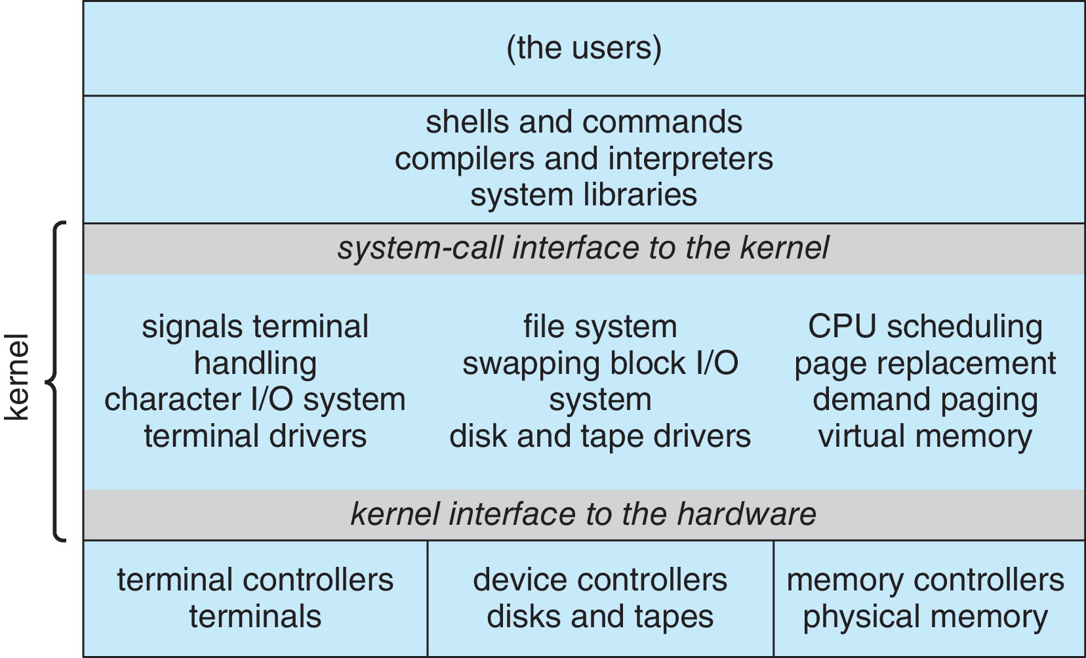

Slide 60
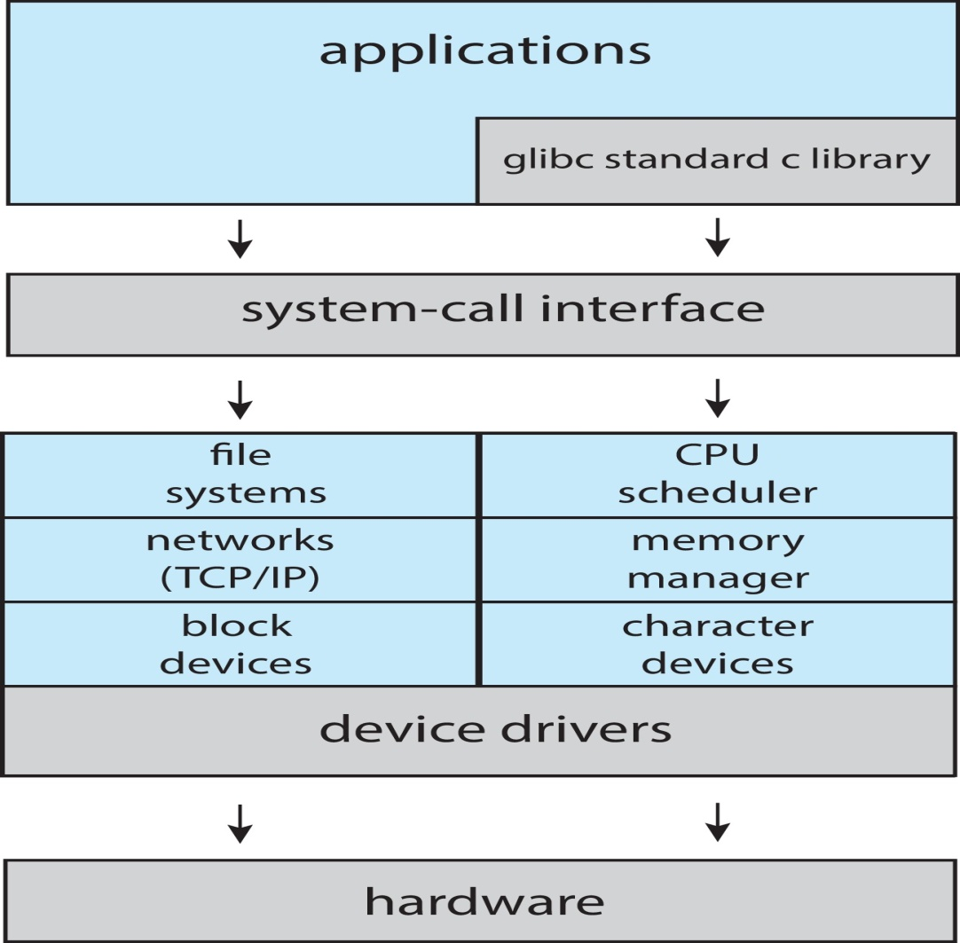
Linux System Structure
Monolithic plus modular design

Slide 61
Layered Approach
The operating system is divided into a number of layers (levels), each built on top of lower layers.
The bottom layer (layer 0), is the hardware; the highest (layer N) is the user interface.
With modularity, layers are selected such that each uses functions (operations) and services of only lower-level layers
A layer does not need to know how these operations are implemented; it needs to know only what these operations do

Slide 62
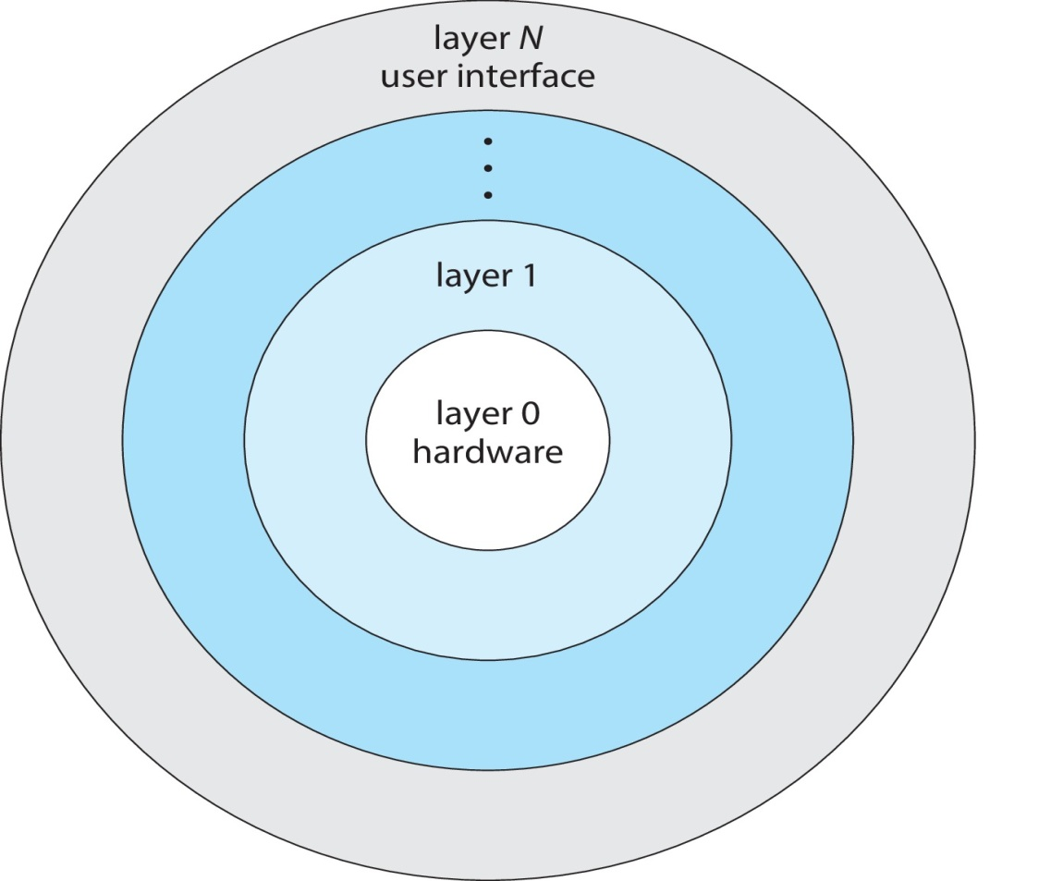
Layered system structure

Slide 63
The main advantage of the layered approach is simplicity of construction and debugging
The layers are selected so that each uses functions(operations) and services of only lower-level layers
This approach simplifies debugging and system verification.
The first layer can be debugged without any concern for the rest of the system, because by definition, it uses only the basic hardware (which is assumed correct) to implement its functions.
Once the first layer is debugged, its correct functioning can be assumed while the second layer is debugged, and so on.

Slide 64
If an error is found during the debugging of a particular layer, the error must be on that layer, because the layers below it are already debugged
Relatively few operating systems use a pure layered approach.
One reason involves the challenges of appropriately defining the functionality of each layer.
the overall performance of such systems is poor due to the overhead of requiring a user program to traverse through multiple layers to obtain an operating-system service.

Slide 65
Microkernels
Mach OS is an example of microkernel
Developed by researchers at Carnegie Mellon University in mid 1980’s
All nonessential components are moved from the kernel space to the user space
There is little consensus regarding which services should remain in the kernel and which should be implemented in user space.

Slide 66
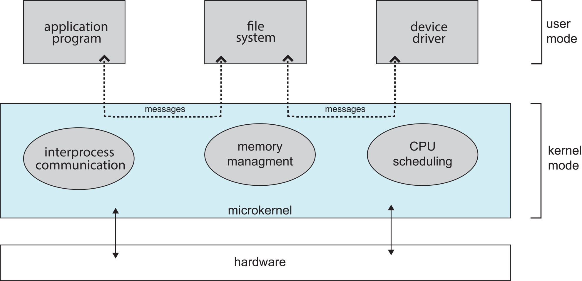
Microkernel System Structure

Slide 67
Typically, however, microkernels provide minimal process and memory management, in addition to a communication facility.
Communication takes place between user modules using message passing
Benefits:
Easier to extend a microkernel
Easier to port the operating system to new architectures
More reliable (less code is running in kernel mode)
More secure

Slide 68
Disadvantage
Performance overhead of user space to kernel space communication
Best illustration
Darwin, the kernel component of the macOS and iOS operating systems
Another example is QNX, a real-time operating system for embedded systems.

Slide 69
Modules
Many modern operating systems implement loadable kernel modules (LKMs)
E.g: Linux, MacOS, Solaris, Windows
Here, the kernel has a set of core components and can link in additional services via modules, either at boot time or during runtime
Avoids recompiling the kernel every time a change was made

Slide 70
Resembles a layered system in that each kernel section has defined, protected interfaces
But it is more flexible than a layered system, because any module can call any other module
Similar to the microkernel approach in that the primary module has only core functions and knowledge of how to load and communicate with other modules
But it is more efficient, because modules do not need to invoke message passing in order to communicate.

Slide 71
Linux uses loadable kernel modules, primarily for supporting device drivers and file systems.
LKMs can be “inserted” into the kernel as the system is started (or booted) or during run time, such as when a USB device is plugged into a running machine.
If the Linux kernel does not have the necessary driver, it can be dynamically loaded.
LKMs can be removed from the kernel during run time as well.

Slide 72
Hybrid systems
Most modern operating systems are not one pure model
Hybrid combines multiple approaches to address performance, security, usability needs
Linux and Solaris kernels in kernel address space, so monolithic, plus modular for dynamic loading of functionality
Windows mostly monolithic, plus microkernel for different subsystem personalities

Slide 73
macOS and iOS
Apple’s macOS operating system is designed to run primarily on desktop and laptop computer systems
iOS is a mobile operating system designed for the iPhone smartphone and iPad tablet computer.
Highlights of various layers are as follows
User experience layer
macOS uses Aqua user interface designed for mouse or track pad
iOS uses the Springboard user interface, which is designed for touch devices.

Slide 74
Application frameworks layer
macOS uses Cocoa framework for developing macOS applications
iOS uses Cocoa Touch framework to provide support for hardware features unique to mobile devices, such as touch screens.
Cocoa and Cocoa Touch frameworks provide API’s for objective-C and Swift programming languages.
Core frameworks
This layer defines frameworks that support graphics and media including, Quicktime and OpenGL.

Slide 75
Kernel environment
This environment, also known as Darwin, includes the Mach microkernel and the BSD UNIX kernel.

Slide 76
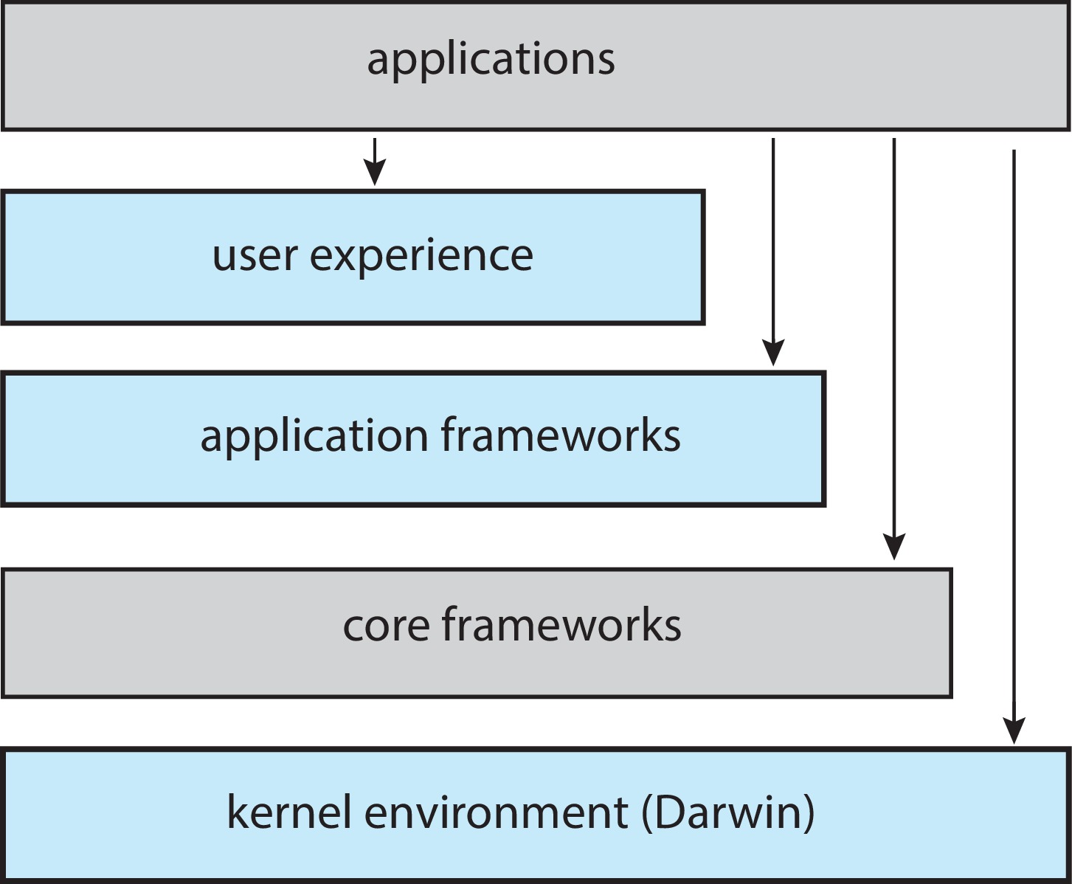
macOS and iOS structure

Slide 77
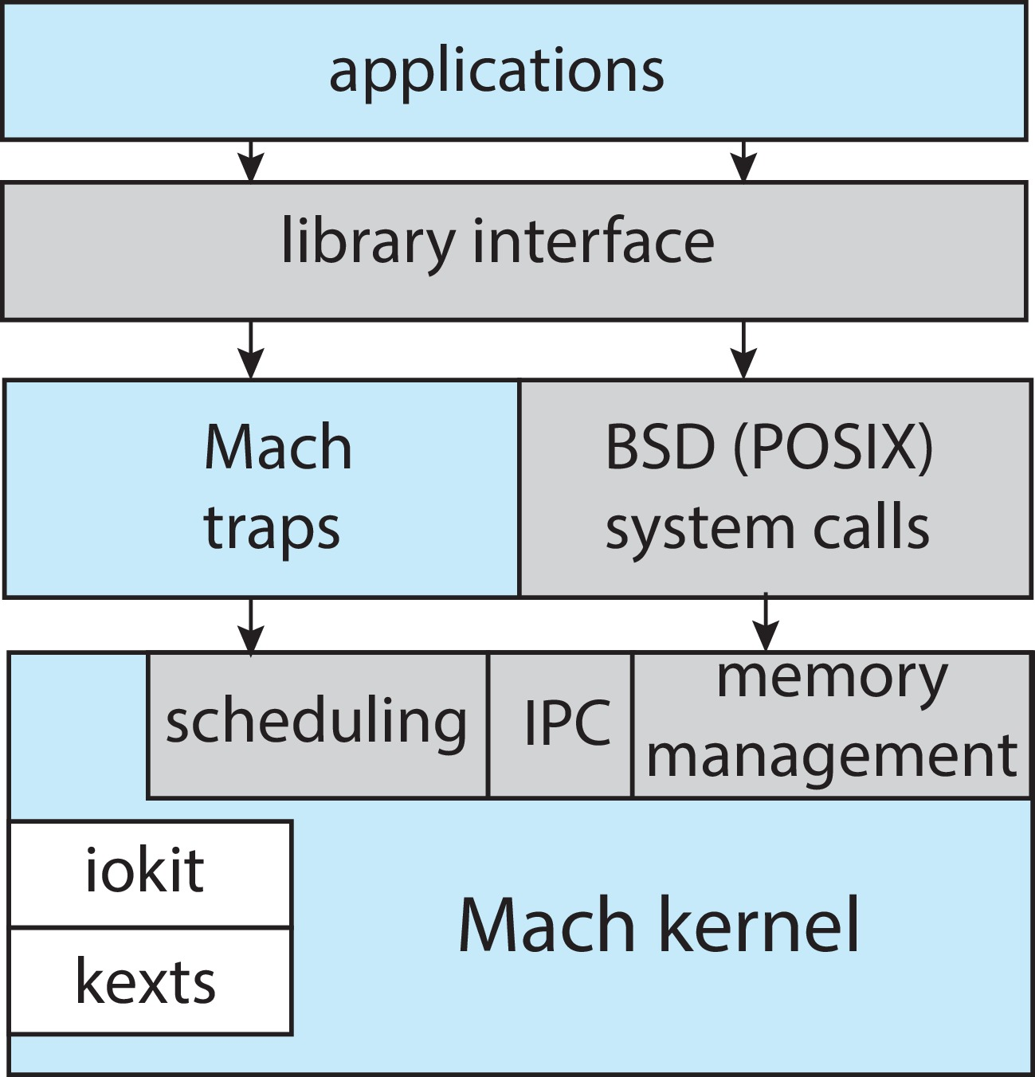
Structure of Darwin

Slide 78
Darwin provides two system-call interfaces:
Mach system calls (known as Traps)
BSD system calls (which provide POSIX functionality).
The interface to these system calls is a rich set of libraries that includes
The standard C library
libraries that provide networking, security, and progamming language support
Mach provides fundamental OS services like
Memory management

Slide 79
CPU Scheduling
Inter process communication facilities like message passing and Remote Procedure Calls
Mach provides functionality through kernel abstractions
The kernel environment provides an I/O kit for development of device drivers and dynamically loadable modules

Slide 80
Android
Developed by Open Handset Alliance (mostly Google)
Open Source
Similar stack to iOS
Based on Linux kernel but modified
Provides process, memory, device-driver management
Adds power management

Slide 81
Runtime environment includes core set of libraries and Dalvik virtual machine
Apps developed in Java plus Android API
Java class files compiled to Java bytecode then translated to executable than runs in Dalvik VM
Libraries include frameworks for web browser (webkit), database (SQLite), multimedia, smaller libc

Slide 82
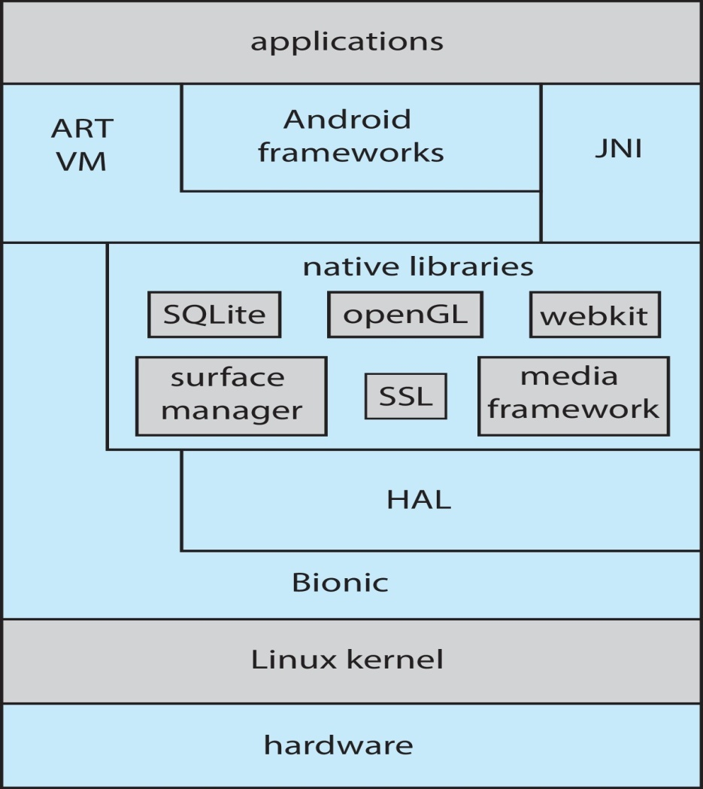
Android Architecture

