Slide 1
Threads and Concurrency

Slide 2
Overview
A thread is a basic unit of CPU utilization
It comprises a thread ID, a program counter (PC), a register set, and a stack.
It shares with other threads belonging to the same process its code section, data section, and other operating-system resources, such as open files and signals
A traditional process has a single thread of control.
If a process has multiple threads of control, it can perform more than one task at a time

Slide 3
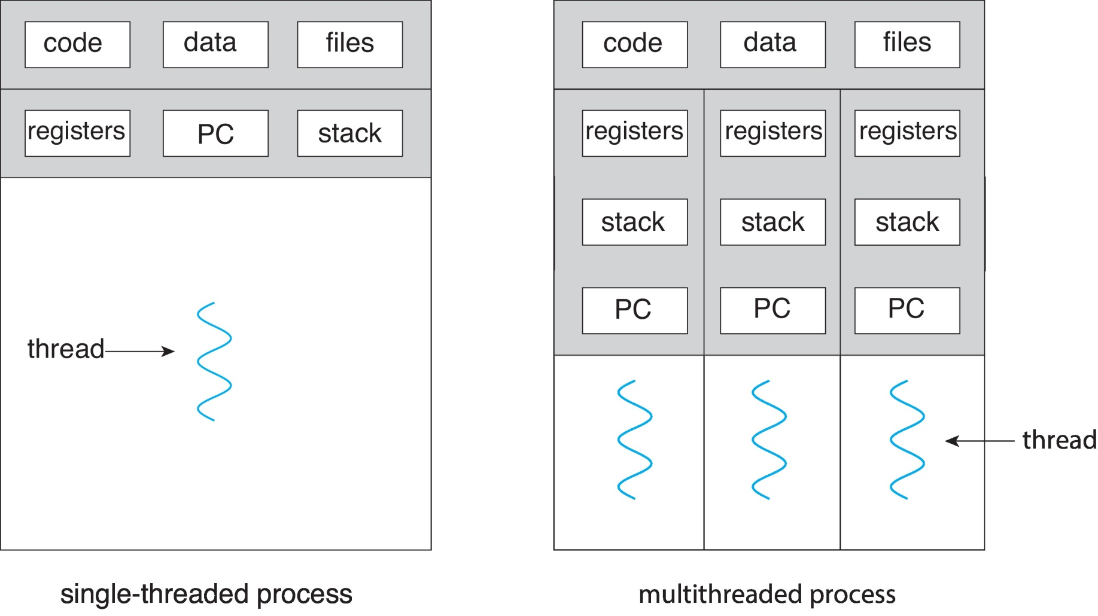
Single and Multithreaded Processes

Slide 4
Motivation
Most software applications that run on modern computers and mobile devices are multithreaded
An application typically is implemented as a separate process with several threads of control
Examples
An application that creates photo thumbnails from a collection of images may use a separate thread to generate a thumbnail from each separate image

Slide 5
A web browser might have one thread display images or text while another thread retrieves data from the network.
A word processor may have a thread for displaying graphics, another thread for responding to keystrokes from the user, and a third thread for performing spelling and grammar checking in the background.
In certain situations, a single application may be required to perform several similar tasks.
For example, a web server accepts client requests for web pages, images, sound, and so forth
A busy web server may have several(perhaps thousands of) clients concurrently accessing it

Slide 6
If the web server ran as a traditional single-threaded process, it would be able to service only one client at a time, and a client might have to wait a very long time for its request to be serviced.
One solution is to have the server run as a single process that accepts requests.
When the server receives a request, it creates a separate process to service that request
In fact, this process-creation method was in common use before threads became popular

Slide 7
Disadvantages
Time consuming
Resource intensive
It is generally more efficient to use one process that contains multiple threads.
If the web-server process is multithreaded, the server will create a separate thread that listens for client requests.
When a request is made, rather than creating another process, the server creates a new thread to service the request and resumes listening for additional requests.

Slide 8
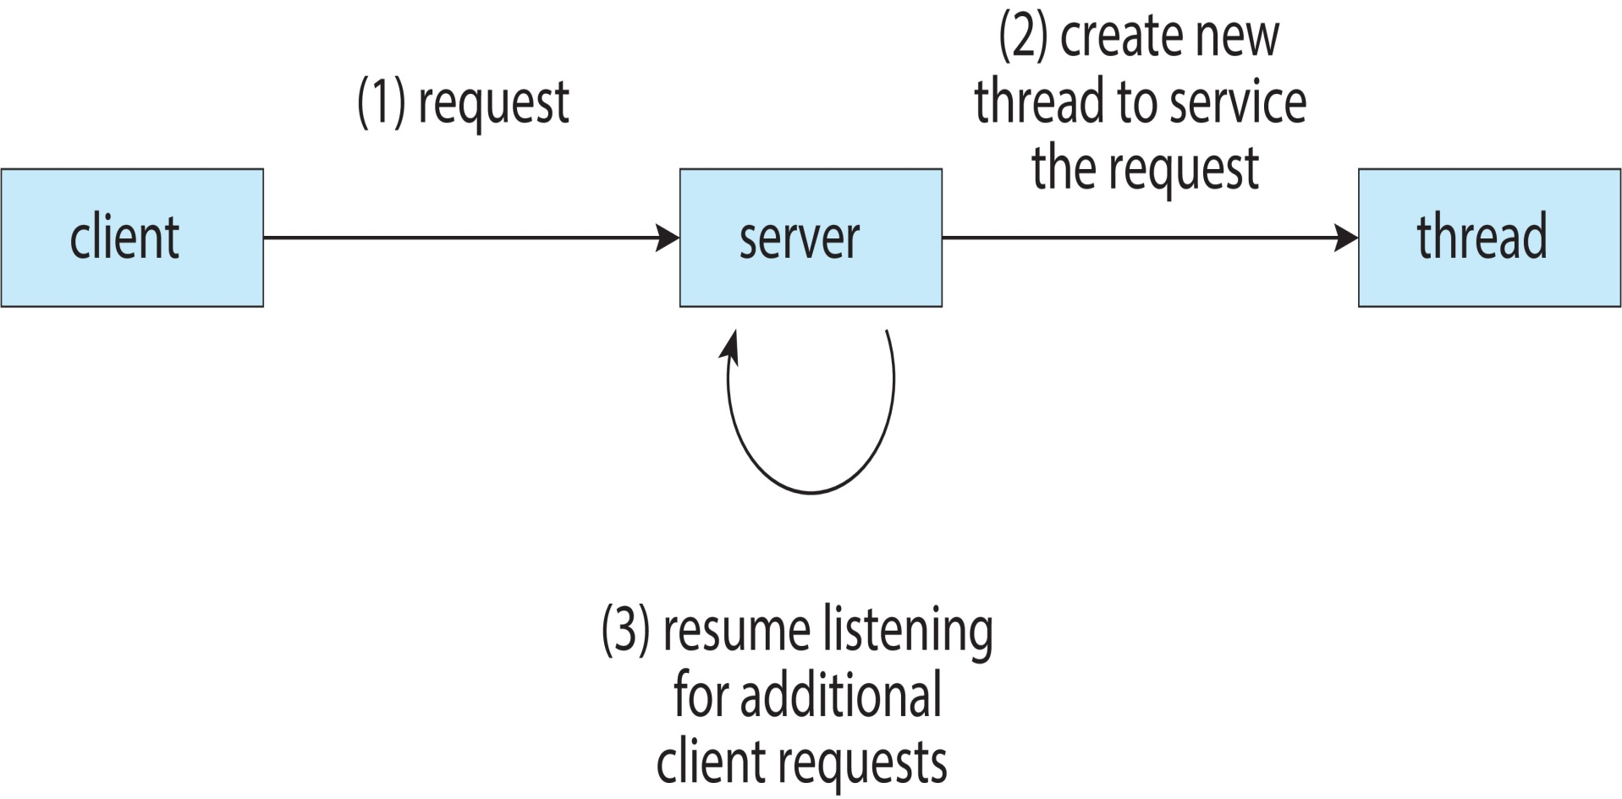
Multithreaded Server Architecture

Slide 9
Kernels are generally multithreaded
E.g: Linux systems
Many applications can also take advantage of multiple threads, including basic sorting, trees and graph algorithms
In addition, programmers who must solve contemporary CPU-intensive problems in data mining, graphics, and artificial intelligence can leverage the power of modern multicore systems by designing solutions that run in parallel.

Slide 10
Benefits
Responsiveness
may allow continued execution if part of process is blocked, especially important for user interfaces
Resource Sharing
threads share resources of process, easier than shared memory or message passing
Economy
cheaper than process creation, thread switching lower overhead than context switching
Scalability
process can take advantage of multicore architectures

Slide 11
Multicore Programming
Multicore systems
multiple computing cores are placed on a single processing chip where each core appears as a separate CPU to the operating system
Multithreaded programming provides a mechanism for more efficient use of these multiple computing cores and improved concurrency
Consider an application with four threads

Slide 12
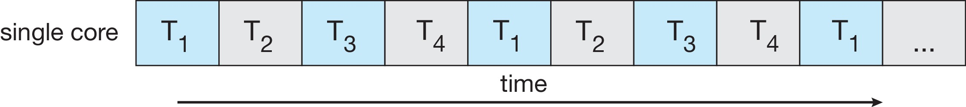
On a system with a single computing core, concurrency merely means that the execution of the threads will be interleaved over time because the processing core is capable of executing only one thread at a time
Concurrent execution on single-core system:

Slide 13
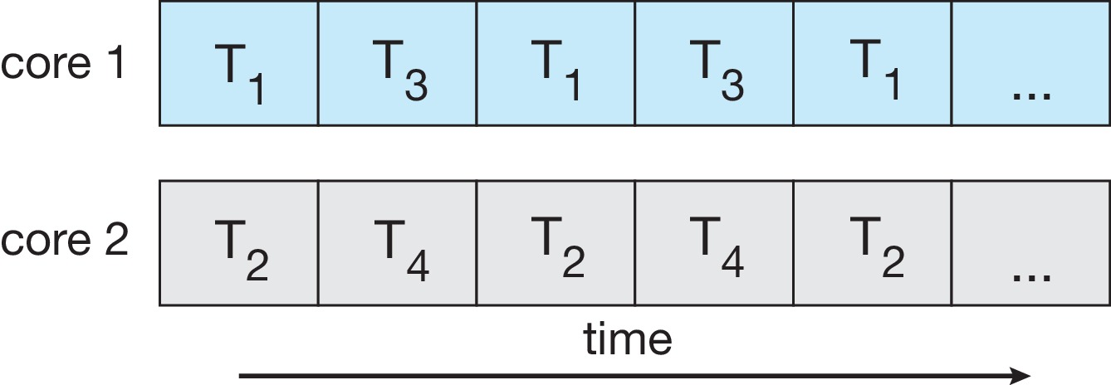
On a system with multiple cores, however, concurrency means that some threads can run in parallel, because the system can assign a separate thread to each core
Parallelism on a multi-core system:

Slide 14
Distinction between concurrency and parallelism in this discussion
A concurrent system supports more than one task by allowing all the tasks to make progress.
In contrast, a parallel system can perform more than one task simultaneously
Thus, it is possible to have concurrency without parallelism
Earlier, most computer systems had only a single processor, and CPU schedulers were designed to provide the illusion of parallelism by rapidly switching between processes, there by allowing each process to make progress

Slide 15
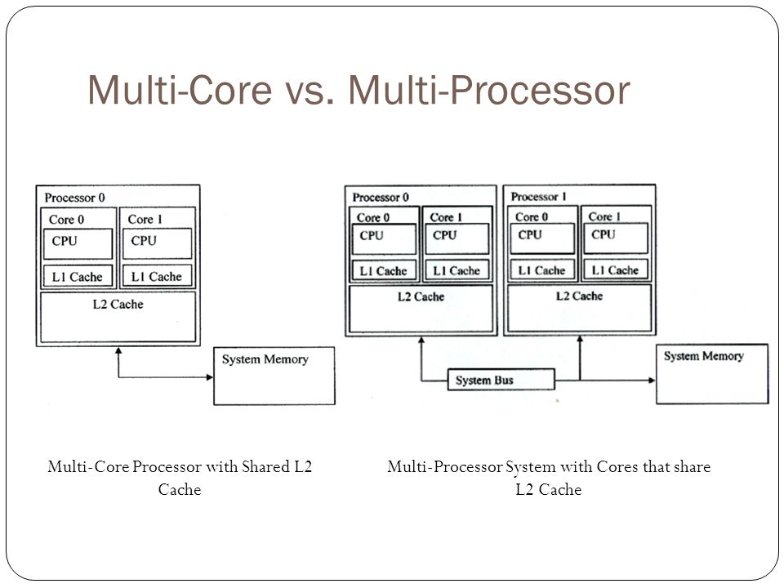

Slide 16
Programming Challenges
In general, five areas present challenges in programming for multicore systems:
Identifying tasks.
This involves examining applications to find areas that can be divided into separate, concurrent tasks.
Ideally, tasks are independent of one another and thus can run in parallel on individual cores.
Balance
While identifying tasks that can run in parallel, programmers must also ensure that the tasks perform equal work of equal value

Slide 17
In some instances, a certain task may not contribute as much value to the overall process as other tasks
Using a separate execution core to run that task may not be worth the cost
Data splitting
Just as applications are divided into separate tasks, the data accessed and manipulated by the tasks must be divided to run on separate cores
Data dependency
The data accessed by the tasks must be examined for dependencies between two or more tasks

Slide 18
When one task depends on data from another, programmers must ensure that the execution of the tasks is synchronized to accommodate the data dependency
Testing and debugging
When a program is running in parallel on multiple cores, many different execution paths are possible
Testing and debugging such concurrent programs is inherently more difficult than testing and debugging single-threaded applications

Slide 19
Types of parallelism
Data parallelism
focuses on distributing subsets of the same data across multiple computing cores and performing the same operation on each core
E.g.: Consider, for example, summing the contents of an array of size N. On a single-core system, one thread would simply sum the elements [0] ...[N −1].
On a dual-core system, however, thread A, running on core 0, could sum the elements[0]...[N∕2 − 1] while thread B, running on core 1, could sum the elements [N∕2]...[N − 1]

Slide 20
The two threads would be running in parallel on separate computing cores
Task parallelism involves distributing not data but tasks (threads) across multiple computing cores.
Each thread is performing a unique operation.
Different threads may be operating on the same data, or they may be operating on different data
Consider again our example above
In contrast to that situation, an example of task parallelism might involve two threads, each performing a unique statistical operation on the array of elements

Slide 21
The threads again are operating in parallel on separate computing cores, but each is performing a unique operation
Fundamentally, then
data parallelism involves the distribution of data across multiple cores
Task parallelism involves the distribution of tasks across multiple cores
However, data and task parallelism are not mutually exclusive, and an application may in fact use a hybrid of these two strategies

Slide 22
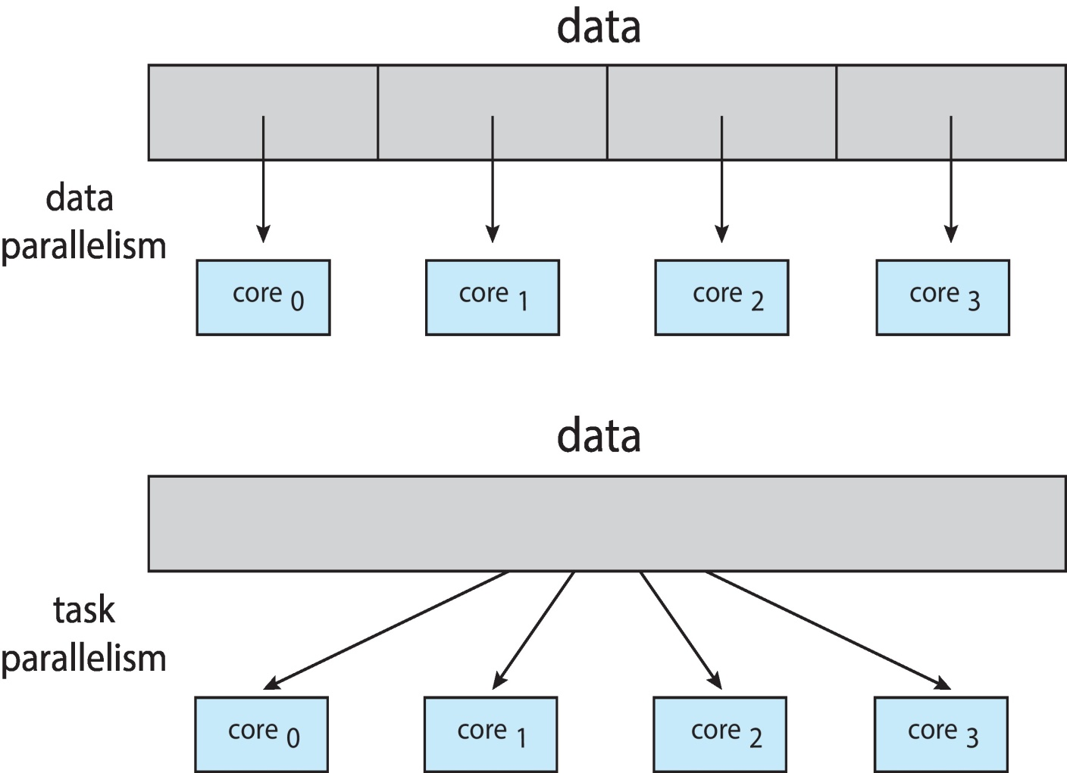
Data and Task Parallelism

Slide 23
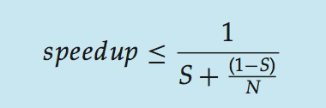
Amdahl’s Law
Amdahl’s Law is a formula that identifies potential performance gains from adding additional computing cores to an application that has both serial (nonparallel) and parallel components
If S is the portion of the application that must be performed serially on a system with N processing cores, the formula appears as follows:

Slide 24
As an example, assume we have an application that is 75 percent parallel and 25 percent serial.
If we run this application on a system with two processing cores, we can get a speedup of 1.6 times.
If we add two additional cores (for a total of four), the speedup is 2.28 times
One interesting fact about Amdahl’s Law is that as N approaches infinity, the speedup converges to 1∕S.

Slide 25
For example, if 50 percent of an application is performed serially, the maximum speedup is 2.0 times, regardless of the number of processing cores we add
This is the fundamental principle behind Amdahl’s Law:
the serial portion of an application can have a disproportionate effect on the performance we gain by adding additional computing cores

Slide 26
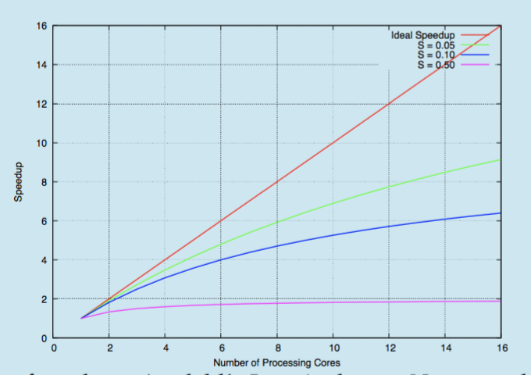
Amdahl’s Law

Slide 27
Multithreading Models
Support for threads may be provided either
At the user level for User Threads
Or by the kernel, for kernel threads
User threads are supported above the kernel and are managed without kernel support
Kernel threads are supported and managed directly by the operating system
Virtually all contemporary operating systems
Including Windows, Linux, and macOS— support kernel threads

Slide 28
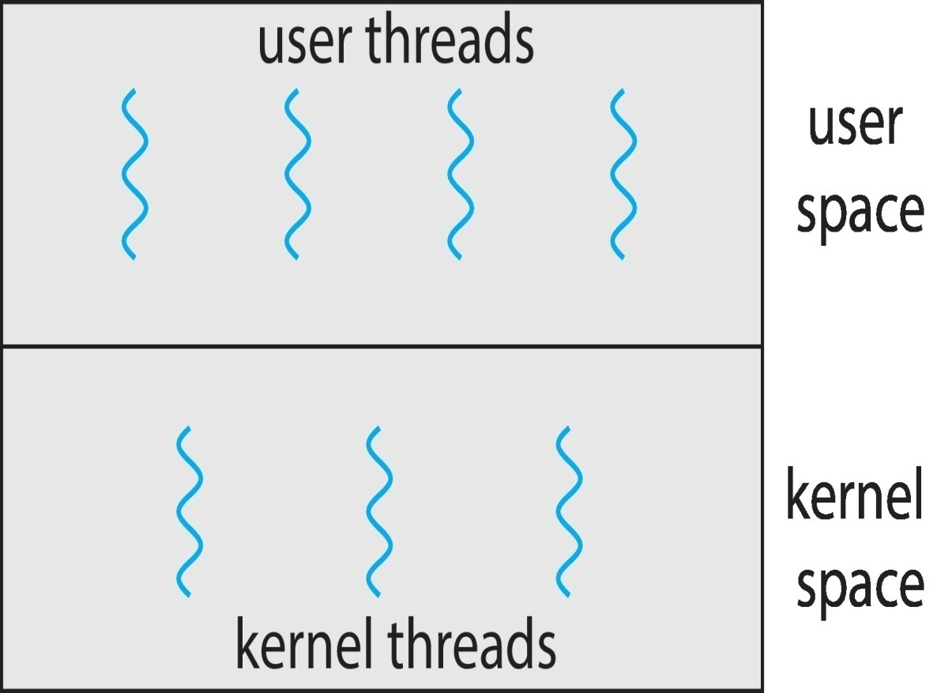
User and Kernel Threads

Slide 29
Multithreading Models
Many -to -One Model
One-to-One Model
Many –to-Many Model

Slide 30
Many-to-One Model
The many-to-one model maps many user-level threads to one kernel thread.
Thread management is done by the thread library in user space, so it is efficient
However, the entire process will block if a thread makes a blocking system call
Also, because only one thread can access the kernel at a time, multiple threads are unable to run in parallel on multicore systems

Slide 31
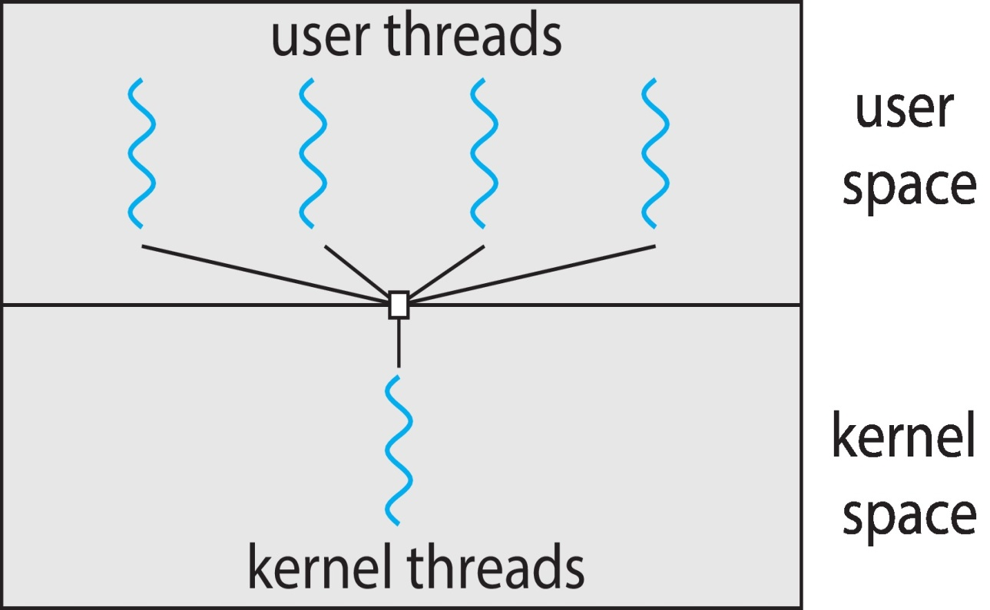

Slide 32
Green threads a thread library available for Solaris systems and adopted in early versions of Java used the many-to-one model.
However, very few systems continue to use the model because of its inability to take advantage of multiple processing cores, which have now become standard on most computer systems

Slide 33
One-to-One Model
The one-to-one model maps each user thread to a kernel thread
It provides more concurrency than the many-to-one model by allowing another thread to run when a thread makes a blocking system call
It also allows multiple threads to run in parallel on multiprocessors

Slide 34
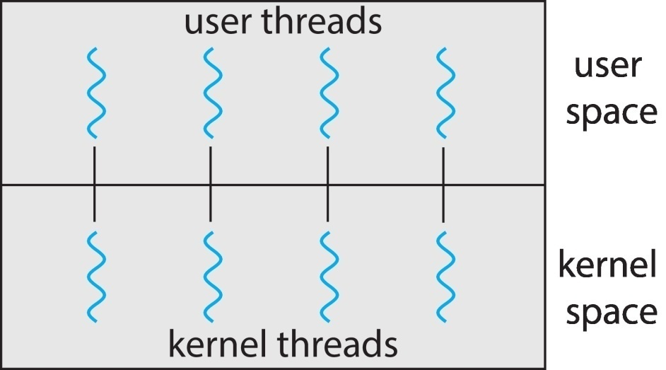
The only drawback to this model is that creating a user thread requires creating the corresponding kernel thread
a large number of kernel threads may burden the performance of a system
Linux, along with the family of Windows operating systems, implement the one-to-one model

Slide 35
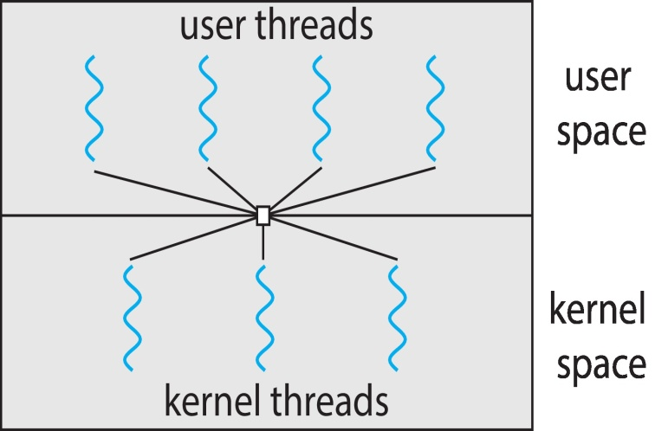
Many-to-Many Model
The many-to-many model multiplexes many user-level threads to a smaller or equal number of kernel threads.
The number of kernel threads may be specific to either a particular application or a particular machine
an application may be allocated more kernel threads on a system with eight processing cores than a system with four cores

Slide 36
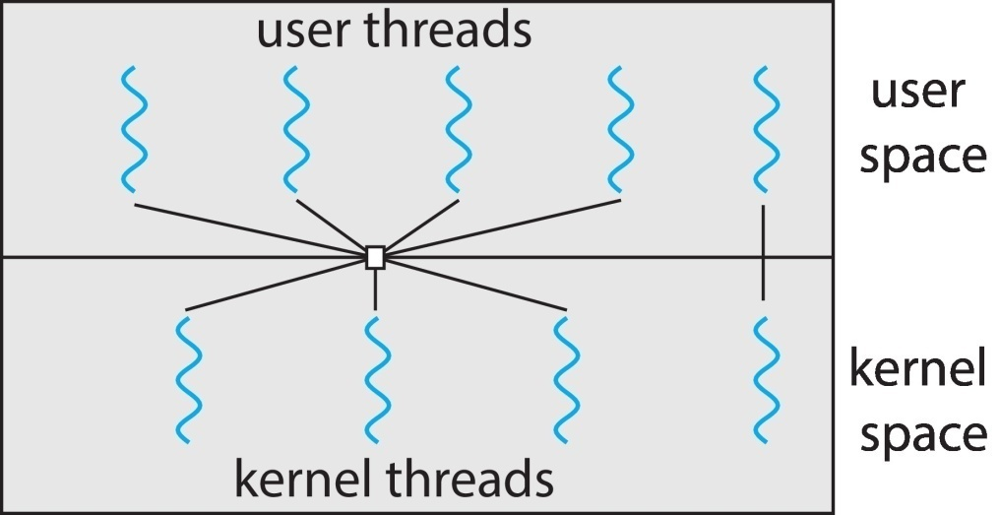
Two Level Threads
One variation on the many-to-many model still multiplexes many user-level threads to a smaller or equal number of kernel threads but also allows a user-level thread to be bound to a kernel thread.
This variation is sometimes referred to as the two-level model

Slide 37
Although the many-to-many model appears to be the most flexible of the models discussed, in practice it is difficult to implement.
In addition, with an increasing number of processing cores appearing on most systems, limiting the number of kernel threads has become less important

Slide 38
Effect of the models on concurrency
The many to-one model allows the developer to create as many user threads as she wishes, it does not result in parallelism, because the kernel can schedule only one kernel thread at a time
The one-to-one model allows greater concurrency, but the developer has to be careful not to create too many threads within an application.
The many-to-many model suffers from neither of these shortcomings:

Slide 39
Developers can create as many user threads as necessary, and the corresponding kernel threads can run in parallel on a multiprocessor
Also, when a thread performs a blocking system call, the kernel can schedule another thread for execution.

